Slide 1
The State of HDF
Summer ESIP 2023
Dana Robinson
Director of Software Engineering
NASA EED-3 / The HDF Group
derobins@hdfgroup.org
This work was supported by NASA/GSFC under Raytheon Technologies contract number 80GSFC21CA001.
This document does not contain technology or Technical Data controlled under either the U.S. International Traffic in Arms Regulations or the U.S. Export Administration Regulations.

Slide 2
Outline
About us
Software status
Current focus
How we can help each other

Slide 3
About us

Slide 4
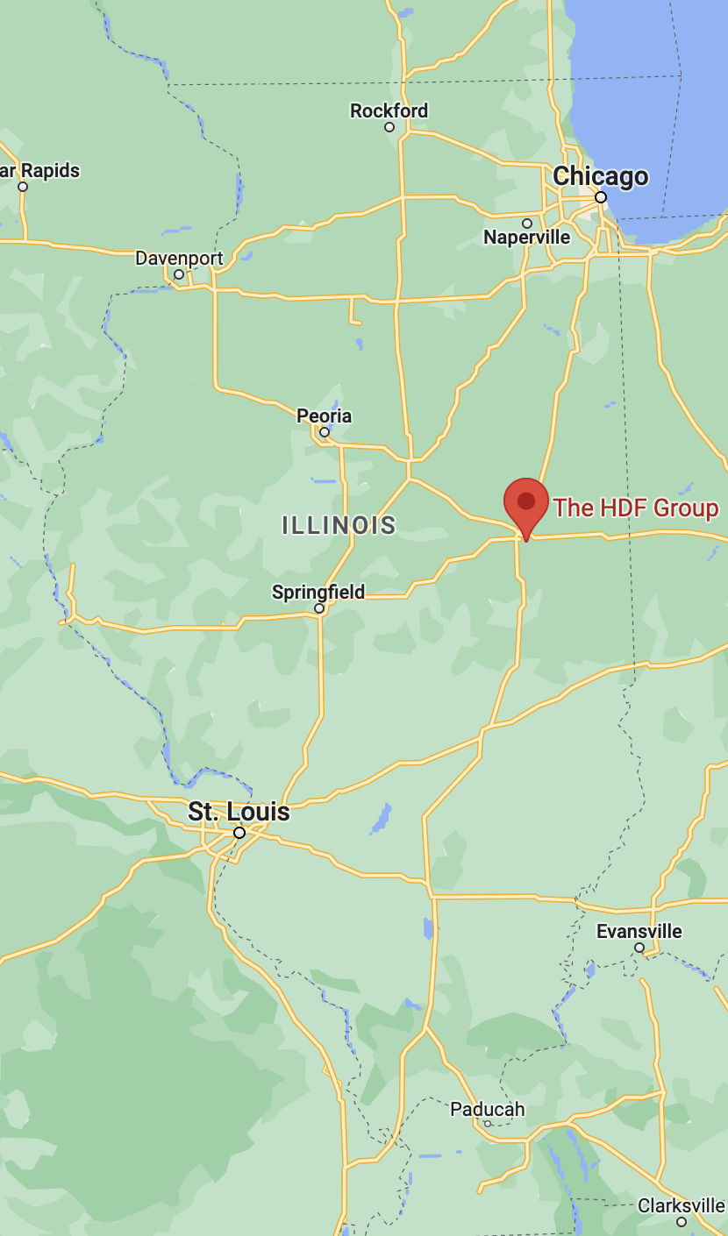
The HDF Group
Located in Champaign, IL
Spun off from NCSA in 2006
Non-profit 501(c)(3)
~25 employees

Slide 5
The HDF Group
Mission-driven
  Sustainable development of HDF technologies
  Guarantee continual accessibility of HDF data
Services
  Maintain and develop HDF products
  Consulting and support contracts
  Training

Slide 6
25 years of HDF5!
HDF5 1.0.0 was released in 1998
What will the next 25 years bring?
https://forum.hdfgroup.org/t/what-do-you-want-to-see-in-hdf5-2-0/10003
🎂 🎉

Slide 7
Software Status

Slide 8
Release schedules
HDF5
HDF4
HDFView

Slide 9
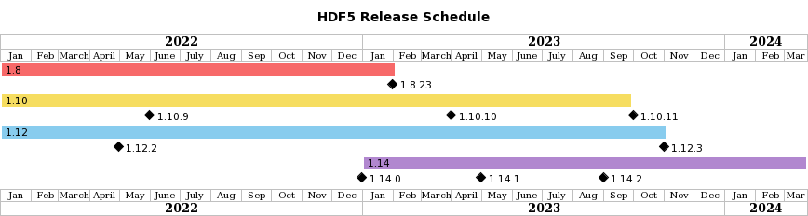
HDF5 Schedule
Latest: 1.14.1(May 2023)
1.8 branch retired early this year
1.10 and 1.12 retiring this year
Have not scheduled 2024 yet

Slide 10
HDF5 New Features
1.14.0
  Multi-dataset I/O
  Selection I/O
  Subfiling
  Onion VFD
1.14.1
  Maintenance release
  bugfixes, minor features
https://www.hdfgroup.org/2023/05/release-of-hdf5-1-14-1-newsletter-194/

Slide 11
HDF5 New Features
1.14.2
  Read-only S3 VFD improvements
    Better logging
    Temporary security credential support
  CVE-free

Slide 12
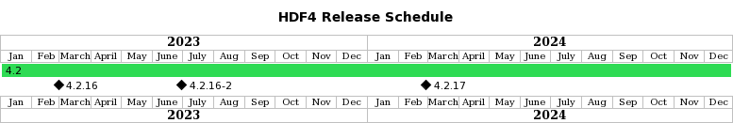
HDF4 Schedule
Latest: 4.2.16-2 (June 2023)
  Patch release (fixes a Java issue w/ HDFView)
  Bugfixes
  Build system improvements
https://www.hdfgroup.org/2023/07/release-of-hdf-4-2-16-2-a-patch-release-newsletter-195/

Slide 13
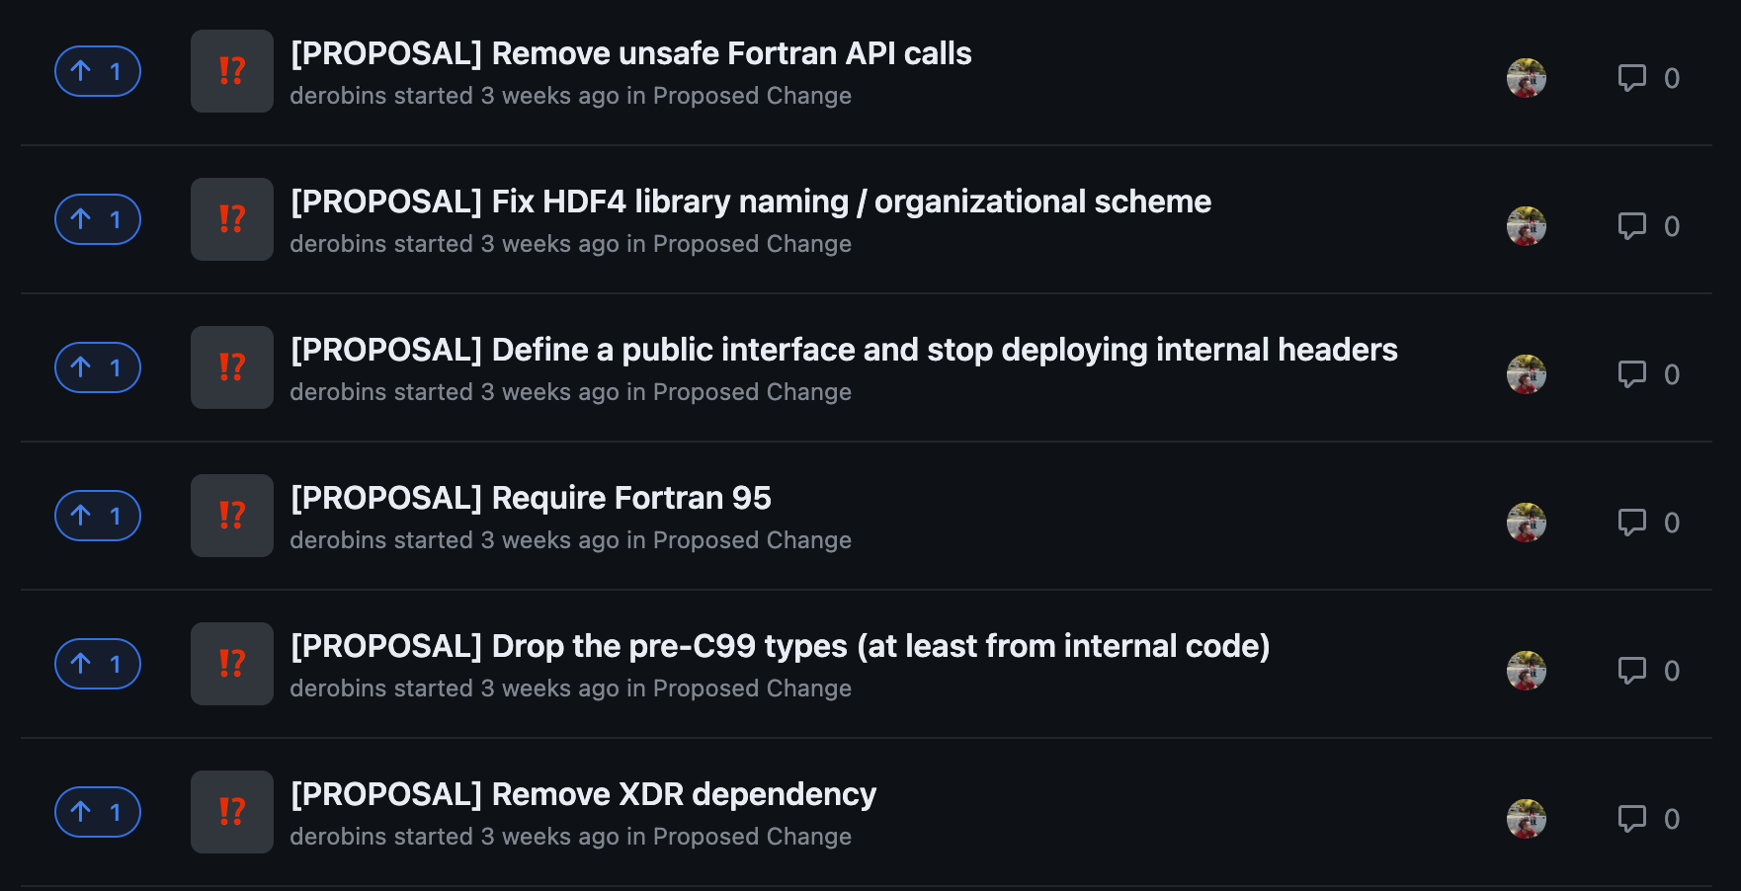
HDF4 Changes
https://github.com/HDFGroup/hdf4/discussions

Slide 14
HDF Product Change Policy
As always, we:
Strive to maintain API compatibility
  HDF5's compatibility macro scheme, etc.
Are committed to file format forward and backward compatibility
  Should always be able to create files in earlier formats
  Should always be able to read earlier file formats

Slide 15
HDF Product Change Policy
Before implementing a breaking change, we will:
Create a discussion post on GitHub
Create a post in the HDF Forum
Make an announcement in the newsletter
Attempt to contact people who we know might be affected
Allow at least 30 days for comments
https://forum.hdfgroup.org/t/hdf4-change-procedure/11240

Slide 16
HDFView
Latest: HDFView 3.3.0 (April 2023)
Based on:
  HDF5 1.14.1
  HDF4 4.2.16 (4.2.16-2 coming soon)
Releases based on older versions of HDF5 (e.g., 1.10) have been retired
Looking to modernize or replace this!
https://www.hdfgroup.org/2023/04/release-of-hdfview-3-3-0-newsletter-193/

Slide 17
Current Focus

Slide 18
What are we working on?
Improve software quality
Increase transparency
Strengthen our community
Modernize HDF Products

Slide 19
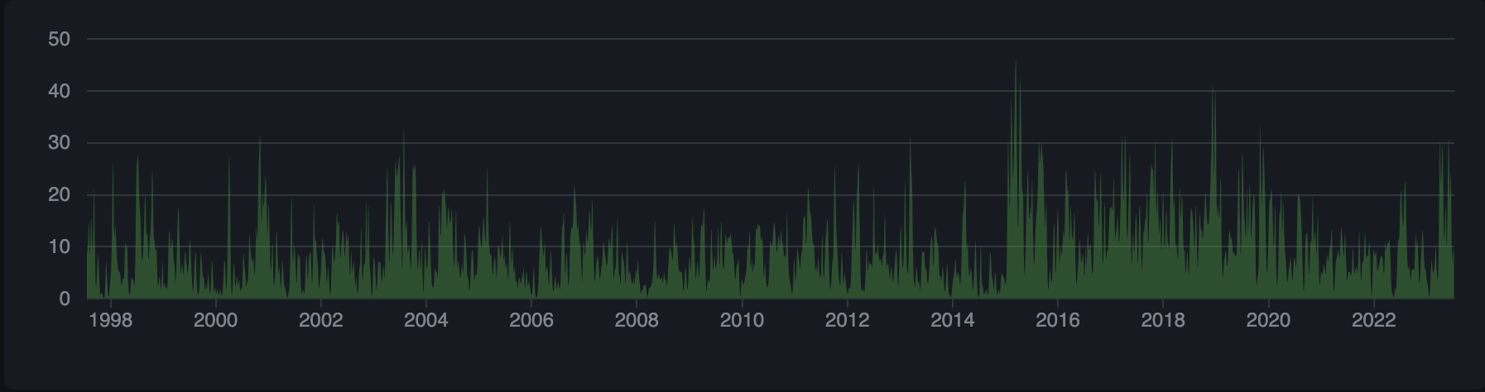
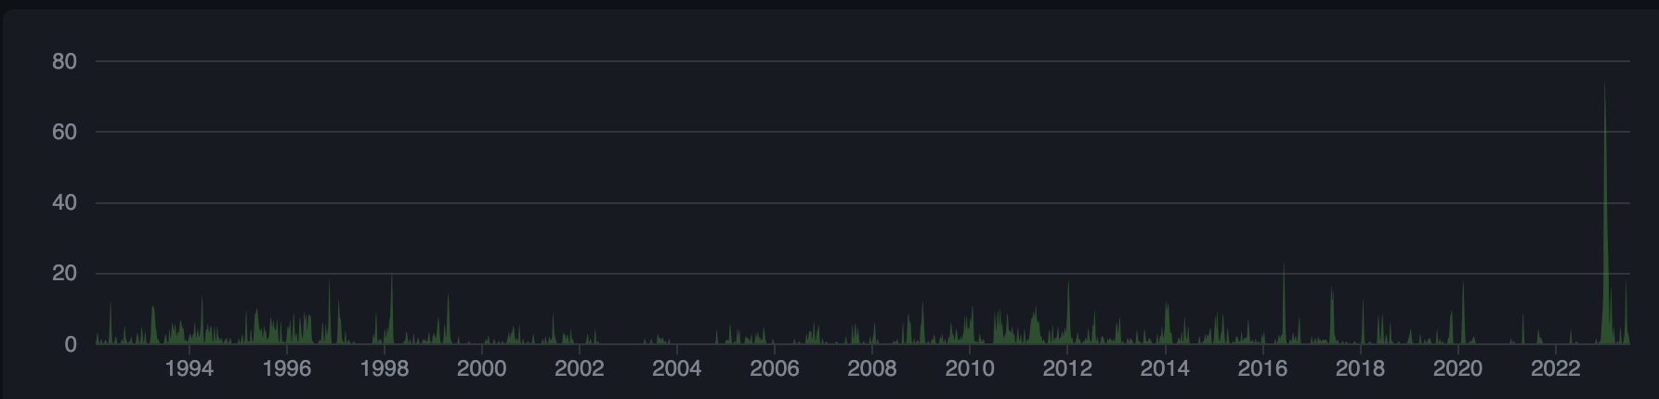
HDF Product Development
HDF5
HDF4

Slide 20
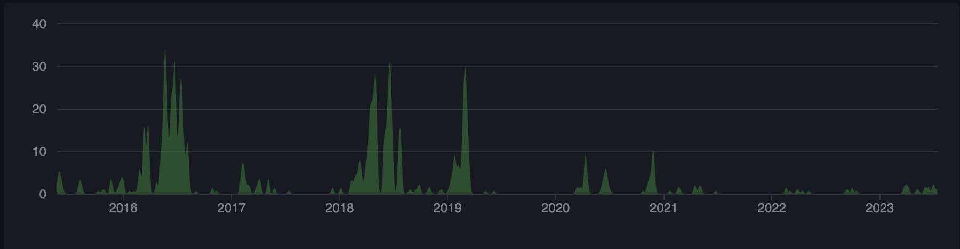
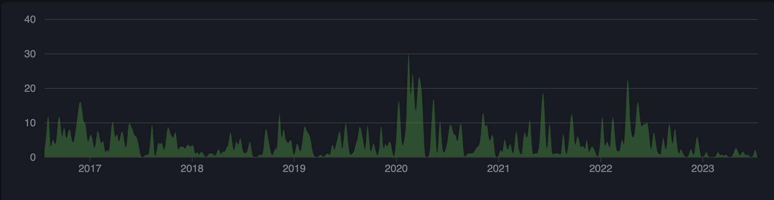
HDF Product Development
HDFView
HSDS

Slide 21
Software quality
All CVE issues fixed
  https://github.com/HDFGroup/cve_hdf5
  3 currently unfixed
Testing improvements
  Integration testing w/ key products (h5py, etc.)
  More transparency w/ CDash
Resolve unfixed GitHub issues
Code cleanup

Slide 22
Transparency
HDF5, although open source, grew up in a walled garden and this mindset persists
I'm working to fix this!
The goal is to do all product-specific (e.g., HDF5) work with the community

Slide 23
Transparency
HDF5 Working Group meeting
  Every Thursday at 10:05 central time
  Email me (derobins@hdfgroup.org) for an invite
  Covers pull requests, issues, tech discussion
Most project planning moving to GitHub
More testing via GitHub actions
  Will use public CDash for non-GitHub tests

Slide 24
Community
Aforementioned HDF5 WG meeting
Everything in the transparency slides, really
Adding external people as code owners
Spending more time connecting with our users, both new and old

Slide 25
Modernization
Some of our key software has been around for a long time!
  HDF(4): 35 years (1988)
  HDF5: 25 years (1998)
  HDFView: 16 years (2007)
Although we strive to keep our software up to date, the code is still old and could use an overhaul

Slide 26
Modernization
Better support for new compilers
  Especially Intel's oneAPI
Better support for AI/ML workflows
Better cloud integration
Better support for heterogeneous computing
Windows Unicode support

Slide 27
Modernization
Better variable-length support
Multithreading
Support for sparse data
Improve performance
Internal cleanup
  Easier to modify & debug
  Refactor code that made sense in 1998 but not so much now

Slide 28
How can we help each other?

Slide 29
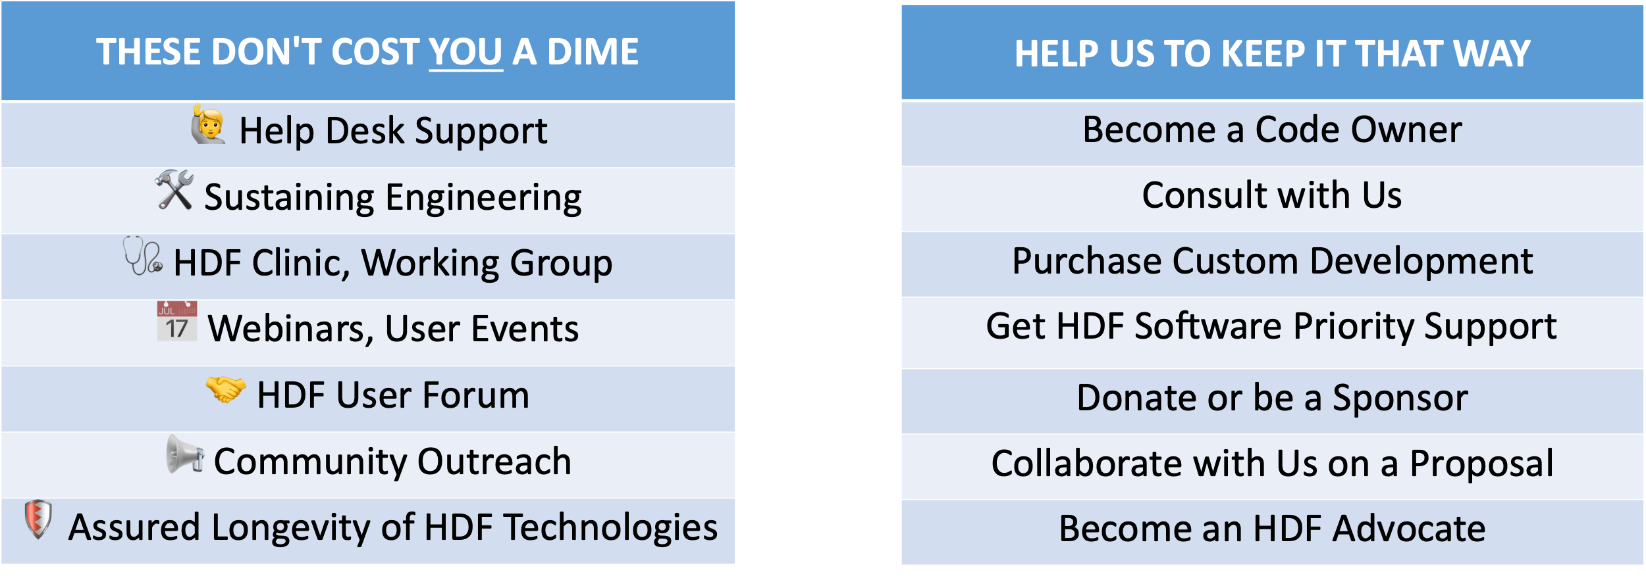
Support our non-profit mission
Contact: info@hdfgroup.org
https://www.hdfgroup.org/donate

Slide 30
HDF User Group Meetings
US HUG
  August 16-18, 2023
  The Ohio State University - Columbus, OH
  https://www.hdfgroup.org/hug/hug23/
European HUG (focus on compression)
  September 19-21, 2023
  DESY - Hamburg, Germany
  https://indico.desy.de/event/39343/

Slide 31
Thanks for your time!

Slide 32
This work was supported by NASA/GSFC under Raytheon Technologies contract number 80GSFC21CA001.

