Slide 1


HDF Town Hall 2022:
HSDS Performance Features
John Readey – jreadey@hdfgroup.org

Slide 2
Outline
Brief Overview of HSDS
Streaming support
Fancy indexing
Performance Comparison
Case Studies

Slide 3
What is HDF5?
Depends on your point of view:
a C-API
a File Format
a data model
The File format is just a container for
The data. Dropping this view of HDF
allows us to more flexibly create a cloud
version of HDF.
Notes:
Mention Andrew’s talk

Slide 4
HDF for the Cloud
Ideas
  Web based - provide a RESTful API that is feature compatible with HDF5 Lib API
  Utilize object storage – cost effective, scalable throughput, redundant
  Elastic compute – scale throughput by autoscaling compute clusters
  Compatibility - Provide client SDK so existing HDF applications can just work

Slide 5
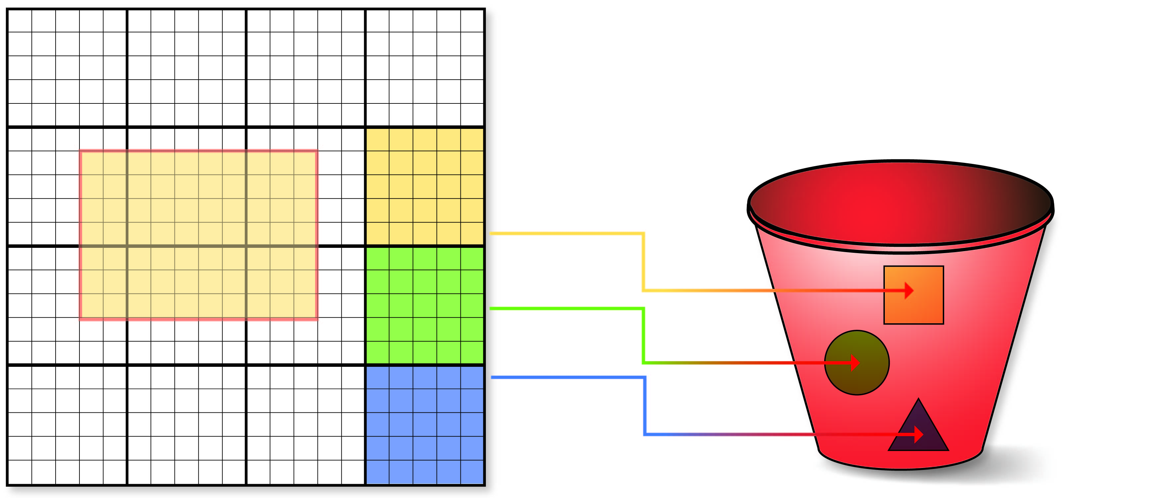



HDF Cloud Schema
Big Idea: Map individual HDF5 objects (datasets, groups, chunks) as Object Storage Objects
How to store HDF5 content in S3?
Limit maximum storage object size
Support parallelism for read/write
Only data that is modified needs to be updated
Multiple clients can be reading/updating the same “file”
Each chunk (heavy outlines) get persisted as a separate object
Legend:
Dataset is partitioned into chunks
Each chunk stored as an S3 object
Dataset meta data (type, shape, attributes, etc.) stored in a separate object (as JSON text)

Slide 6
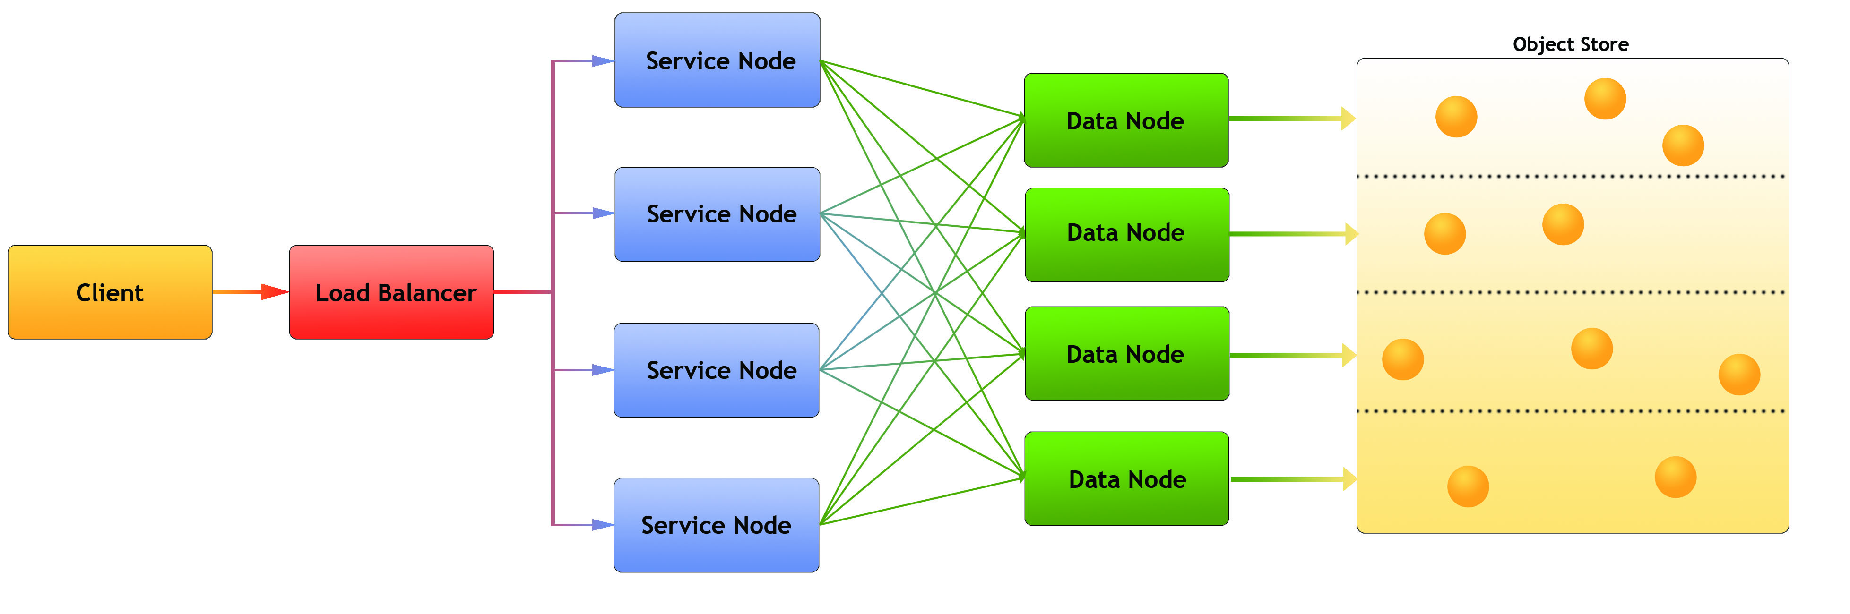
Architecture
Legend:
Client: Any user of the service
Load balancer – distributes requests to Service nodes
Service Nodes – processes requests from clients (with help from Data Nodes)
Data Nodes – responsible for partition of Object Store
Object Store: Base storage service (e.g. AWS S3)
Notes:
Each node is implemented as a docker container

Slide 7
Server Features
Simple + familiar API
  Clients can interact with service using REST API
  SDKs provide language specific interface (e.g. h5pyd for Python)
  Can read/write just the data they need (as opposed to transferring entire files)
  Support for compression
Scalable performance:
  Can cache recently accessed data in RAM
  Can parallelize requests across multiple nodes
  More nodes ➔ better performance
  Cluster based – any number of machines can be used to constitute the server
  Multiple clients can read/write to same data source
  No limit to the amount of data that can be stored by the service

Slide 8
H5pyd – Python client
H5py is a popular Python package that provide a Pythonic interface to the HDF5 library
H5pyd (for h5py distributed) provides a h5py compatible h5py for accessing the server
Pure Python – uses requests package to make http calls to server
Include several extensions to h5py:
  List content in folders
  Get/Set ACLs (access control list)
  Pytables-like query interface
H5netcdf and xarray packages will use h5pyd when http:// is prepended to the file path
Installable from PyPI: $ pip install h5pyd

Slide 9
HSDS Deployment Types
There’s quite a few ways to deploy HSDS:
  Docker -- +simple to setup, - Limited to one machine
  Kubernetes -- + dynamically scale, +run in cluster, +complicated to setup
  AWS Lambda -- + no server, +super elastic, -slow startup
  H5pyd direct – + no server, -no coordination between apps

Slide 10


HSDS on Docker
External Clients
DN1
dns hostname
SN
DN2
Typically # of DN set to number of cores
Can’t change # of DNs after startup
Only 1 SN, so can be a bottleneck
Not easy to have other containers talk to SN node
DN3
Local host
Internal Clients
DN4
EC2 Instance

Slide 11
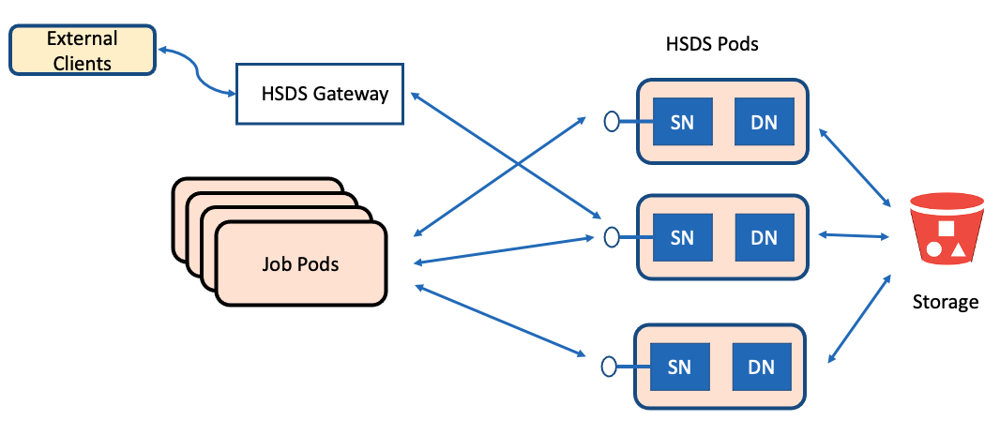
HSDS On Kubernetes
HSDS Pods – one SN, one DN container per pod
Number of HSDS Pods can be dynamically scaled
Kubernetes Job pods (user application) can be scaled to increase throughput
Ability to run more pods can be scaled by increasing number of servers in Kubernetes cluster
All pods agnostic as to which machine they are running on
Ability to scale up and down is improved in v0.7!

Slide 12
HSDS on Kubernetes Alternative Deployment
Configure each pod with containers for app, SN, DNs
App just uses localhost endpoint to talk to SN
SN just talks to DNs in its pod
No worries about scaling HSDS
But DN’s in different pods won’t coordinate (may overwrite each other – need to have app pods write to different chunks)
App
SN
DN1
Pod #1
DN1
DN1
DN4
App
SN
DN1
Pod #2
DN1
DN1
DN4
Etc…

Slide 13


HSDS on Lambda
External Clients
The Good
HSDS Lambda Function
Storage
Lambda function provides completes HSDS API
Pay just for time function spends executing
Up to 1000 simultaneous invocations
H5pyd can invoke lambda directly
API Gateway can be used to provide REST endpoint
h5pyd Clients
The Bad
Startup cost per invocation (up to 2 sec)
Limitations on size of req/response
Maximum run time
Only JSON supported (no binary req/response)

Slide 14
H5pyd Direct
H5pyd App
SN
In direct mode, h5pyd instantiates SN/DN nodes as sub-processes on File open
Number of DN nodes can be specified (will default to # of cores)
On file close, subprocesses or terminated
Some overhead setting up subprocesses, not a good choice if app will be doing lots of file opens
DN1
DN1
DN1
DN4
Storage
App Subprocesses

Slide 15
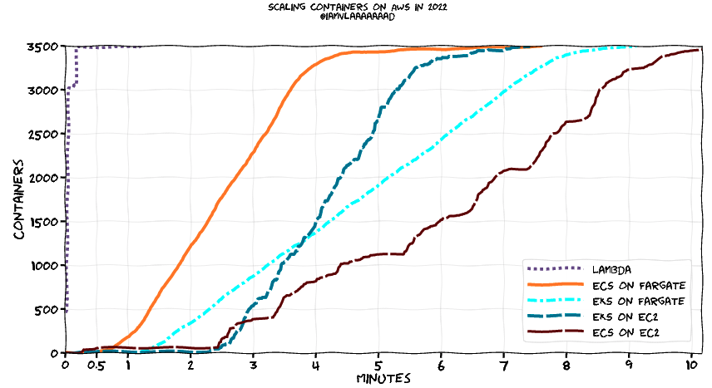
When to use Lambda?
Use Lambda when handling quickly changing workloads or sporadic usage.
(otherwise you’ll be better off with EC2 or Kubernetes)

Slide 16
Streaming Support
Previously HSDS had limits on the number of chunks that could be accessed in one request and the number of bytes that could be read or written (server would send a 413 – Payload too large response)
Problem was the HSDS would need to allocate memory buffer to store the response (or request)
Too large of request -> out of memory death!
In v0.7, HSDS now internally paginates larger request
So:
  No limit on the size of a binary request (+1GB/req is fine)
  Memory load on server is managed
  Client will start getting bytes back when the server is still processing latter chunks

Slide 17
Fancy Indexing
Fancy indexing enables dataset selections based on start+stop+stride or set of indexes
Example. N(0:100, (1,4,63,92))
In v0.7 fancy indexes can be done in one request vs (a series of hyperslab selections)
Some selections see 8x speed increase vs getting on index per request
Example: retrieving 4000 random columns from a 17520 by 2018392 dataset demonstrating good scaling as the number of HSDS nodes was increased:
  4 nodes: 65.4s
  8 nodes: 35.7s
  16 nodes: 23.4 s

Slide 18
Time Series Performance Comparison
How does HSDS do compared to other methods?
Test case: read 1 column from 17568 x 2018392 dataset
  80GB file, 40k chunks, 10GB read to return 4mb
Compare:
  HDF5Lib with file on spinning disk
  HDF5Lib with file on SSD
  HDF5Lib with ros3 VFD with file on S3
  HSDS with file on S3
    Test with 1,2,4,8 HSDS nodes

Slide 19
Time Series Results
Setup | Time (sec) | MiB/s
HDF5 HDD | 59 | 186
HDF5 SSD | 4 | 2750
HDF5 ros3 | 400 | 28
HSDS s3 1 node | 109 | 101
HSDS s3 2 node | 67 | 164
HSDS s3 4 node | 42 | 262
HSDS s3 8 node | 34 | 324
All tests were run on an AWS m5.2xlarge instance (4 core/32GB ram)
Storage cost comparison:
SDD: $0.10/GB/month
HDD: $0.045/GB/month
S3: $0.023/GB/month
Code for the test can be found here: https://github.com/HDFGroup/hsds/blob/master/tests/perf/nrel/nsrdb/nsrdb_test.py

Slide 20
HSDS Caching
The HSDS DN containers use chunk and metadata caches
Enables skipping storage read if content can be found in cache
Total cache size is dn_cache_size * dn_count
  Since each DN container’s cached items are disjoint from other DNs
Example test setup:
  4 m5.2xlarge instance in a Kubernetes cluster
  50 HSDS pods
  Each DN (one per pod) configured with 2GB chunk cache
  Total cache size: 100 GB

Slide 21
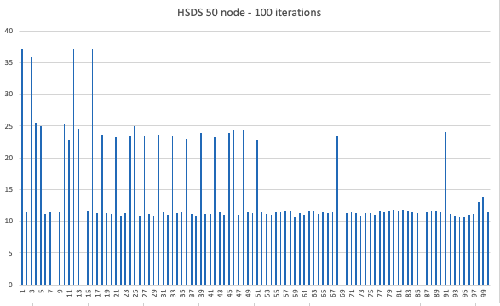
Effect of caching
Running the time series test case 100 times
Select random column (out of of 17568)
After each iteration, chance that chunks needed will be resident increases

Slide 22


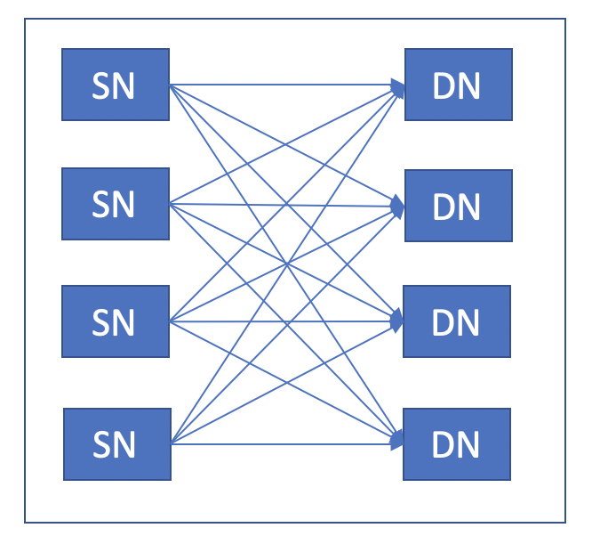

HDF Lab
HDF Lab is a JupyterLab and HDF server environment hosted by the HDF Group on AWS
HDF Lab users can create Python notebooks that use h5pyd to connect to HDF Server
Each user gets equivalent to 2-core Xeon Server and 10GB local storage
Users can use up to 100GB of data on HDF Server
User logs into Jupyter Hub
User
JupyterHub spawns new container at login
User’s container and EBS volume
S3 Bucket
HDF Server

Slide 23
Case Study - NREL
NREL (National Renewable Energy Laboratory) uses HDF Cloud to make PB’s of environmental data accessible to the public.
HSDS enables users to slice and dice just the data they need (say given time range, or geo range)
Use of HSDS has expanded over the last 5 years
NREL has started to use the HSDS Lambda functions (request load is highly variable driven mostly by external uses)

Slide 24
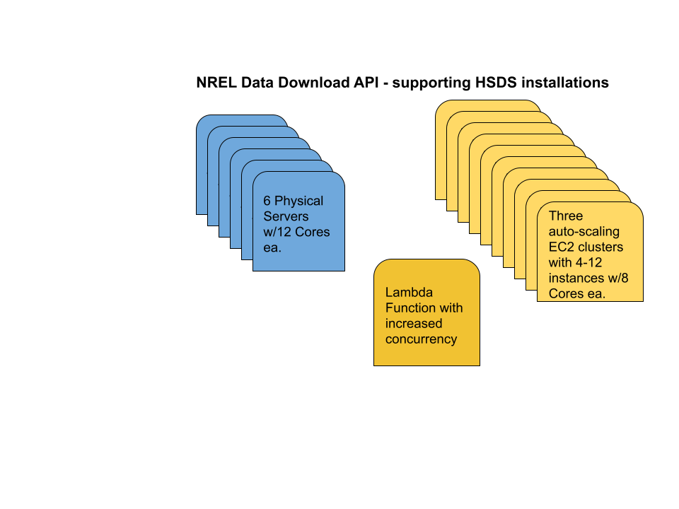
NREL Infrastructure

Slide 25
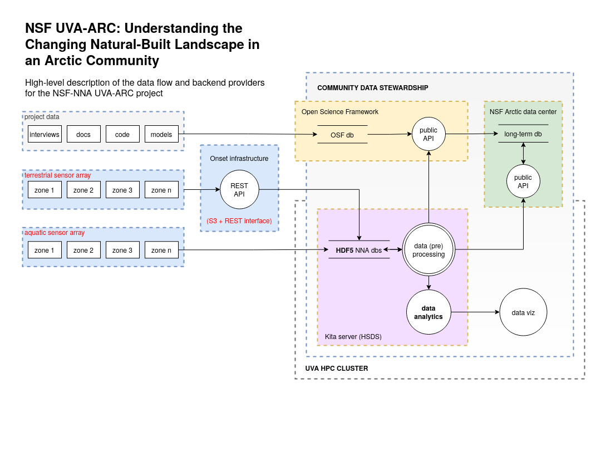
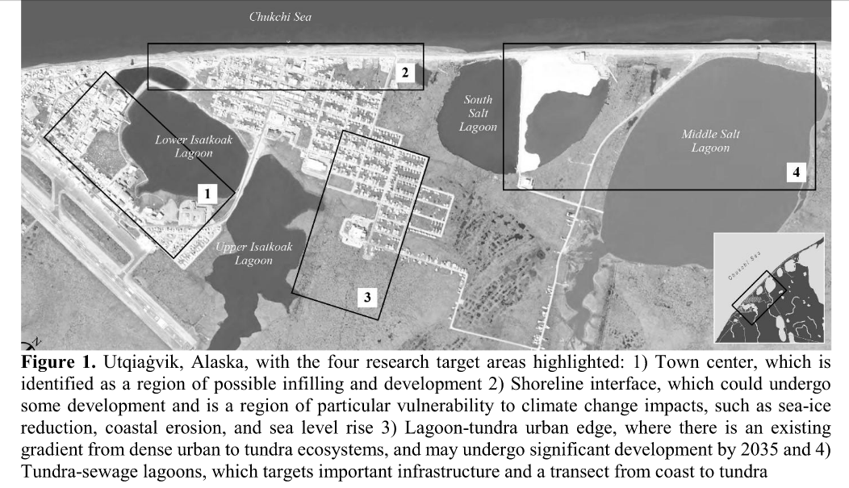
Case Study – NSF UVA-ARC
NSF Project to collect environmental data
Data is streamed from hundreds of sensors to HSDS
Have collected two years of data from testbed site at U. of Virginia
North Alaska data collection starts this week!

Slide 26
References
HSDS Design Doc: https://github.com/HDFGroup/hsds/blob/master/docs/design/hsds_arch/hsds_arch.md
HSDS Design Schema: https://github.com/HDFGroup/hsds/blob/master/docs/design/obj_store_schema/obj_store_schema_v2.md
SciPy2017 talk: https://s3.amazonaws.com/hdfgroup/docs/hdf_data_services_scipy2017.pdf
AWS Big Data Blog article: https://aws.amazon.com/blogs/big-data/power-from-wind-open-data-on-aws/

