Slide 1


HDF for the Cloud -
Serverless HDF
ESIP Summer 2021
John Readey

Slide 2
Overview
HDF as a Service – HSDS
HSDS Storage Model
HSDS Serverless with AWS Lambda
HSDS Serverless with Direct Access

Slide 3
HDF as a Service - HSDS
HSDS – Highly Scalable Data Service -- is a REST-based web service for HDF data
Design criteria:
Performant – good to great performance
Scalable – Run across multiple cores and/or clusters
Feature complete – Support (most) of the features provided by the HDF5 library
Utilize POSIX or object storage (e.g. AWS S3, Azure Blob Storage)
Note: HSDS was originally developed as a NASA ACCESS 2015 project: https://earthdata.nasa.gov/esds/competitive-programs/access/hsds

Slide 4
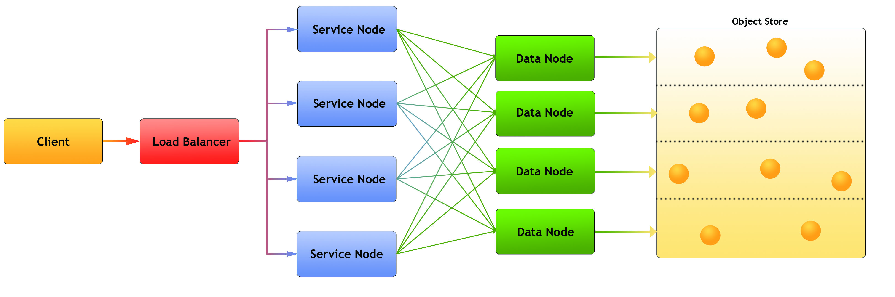
HSDS Architecture
Legend:
Client: Any user of the service
Load balancer – distributes requests to Service nodes
Service Nodes – processes requests from clients (with help from Data Nodes)
Data Nodes – responsible for partition of Object Store
Object Store: Base storage service (e.g. AWS S3)
Notes:
Each node is implemented as a docker container

Slide 5




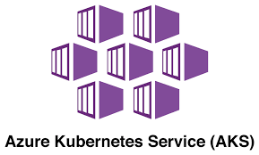

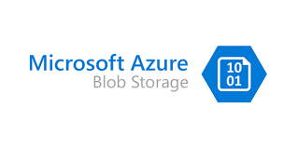


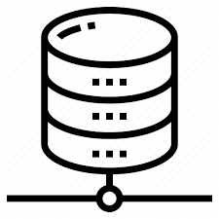
HSDS Platforms
HSDS is implemented as a set of containers and can be run on common container management systems:
Using different supported storage systems:
POSIX Filesystem

Slide 6
Why an HDF Service?
There are several benefits to enabling HDF as a Service…
Allow remote access to large datasets (the inertia of big data)
Coordinate actions of multiple reader/writer clients
Provide language-neutral interface to HDF
  Though h5pyd (Python) and REST VOL (C/C++) provide HDF5 API compatibility
Enable web-based applications
Facilitate container-based applications (Docker, Kubernetes, Mesos)

Slide 7
HSDS Storage Model
Instead of managing HDF5 objects (datasets, groups, chunks) within a POSIX file, HSDS stores each HDF object as a separate file (or object within an object storage system such as S3)
  For meta data (datasets and groups), content is saved in a self-descriptive manner using JSON
  For chunks, data is stored as a binary object for efficiency
Storing larger datasets in this manner will lead to a large number of objects to store one “file”, but HDF API and tools abstract user from needing to deal with the underlying storage system
The HSDS Storage model is ”cloud compatible” since it allows efficient updates when object storage systems (e.g. S3, Azure Blob Storage, Ceph) are used

Slide 8
HSDS sharded schema example
root_obj_id/
group.json
obj1_id/
group.json
obj2_id/
dataset.json
0_0
0_1
obj3_id/
dataset.json
0_0_2
0_0_3
Observations:
Metadata is stored as JSON
Chunk data stored as binary blobs
Self-explanatory
One HDF5 file can translate to lots of objects
Flat hierarchy – supports HDF5 multilinking
Can limit maximum size of an object
Can be used with Posix or object storage
Schema is documented here: https://github.com/HDFGroup/hsds/blob/master/docs/design/obj_store_schema/obj_store_schema_v2.md

Slide 9
HSDS sans Service
The next HSDS release will provide two new (though related) capabilities:
  AWS Lambda support - HSDS implemented as a Lambda Function
  Direct Access Model – HSDS implemented entirely on the client
Both of these enable developers to take advantage of HSDS capabilities without the need to run a server

Slide 10
Pros and cons of running a service
Accessing a sharded data store via a service (HSDS) is great:
  Server mediates access to the storage system
  Server can speed things up by caching recently accessed data
  Minimizes data I/O between client & server (e.g. remote clients)
  HSDS serves as a synchronization point for multi-writer/multi-reader algorithms
Unless it’s not:
  Don’t want to bother setting up, running service
  Challenge to scale capacity of service to clients
  Cloud charges for running server 24/7

Slide 11

AWS Lambda
AWS Lambda is an AWS service that enables function to be executed on demand without the need to provision any infrastructure
Price (with 1GB memory) is: $0.0000000167/ms
Beyond potential cost savings, Lambda enables “infinite elasticity”
  Can support widely varying workloads without need to spin up/down servers
  By default, 1000 instances of a function can be run simultaneously
No infrastructure management required
  i.e. os patches, server backup, monitoring, etc.
Invoked from AWS Management Console, Programmatically, or AWS API Gateway

Slide 12
AWS Lambda Challenges
Adapting existing container-based server to run on Lambda is not trivial…
  Software needs to initialize as quickly as possible (to minimize latency)
  Unable to take advantage of caching
  Limited to max 6 VCPUs per function
  Lambda runtime environment is restricted:
    No equivalent to docker to manage multiple containers
    TCP not allowed (which is how HSDS containers talk to each other)
    Shared memory not allowed

Slide 13
HSDS Lambda Design
HSDS is implemented on Lambda as follows:
  On startup SN node and DN nodes are run as sub-processes (vs containers)
    Number of DN nodes based on available VCPUs
    Nodes communicate via Unix Domain sockets (vs TCP)
  Payload is unpacked to a HTTP request and sent to the SN node
  SN node distributes work over DN nodes
  DN nodes read/write to S3, return result to SN node
  Response is returned as the Lambda result
Benefits:
  Same code base as HSDS service
  Full HDF REST API supported

Slide 14

Payload unpacked
Result returned
Payload
Lambda entry point
Result
HTTP/socket request
Container image load
SN subprocess
1. Image loaded
HTTP/socket requests
2. Subprocesses run
3. Payload unpacked
4. HTTP/socket request sent to SN
DN1 subprocess
DN2 subprocess
DN3 subprocess
5. SN multiplex req to DN nodes
6. DN reads/write to/from S3 bucket
S3 requests
7. DN returns response to SN
AWS Container Registry Service (ACR)
8. SN returns response to parent process
9. Result packed to Lambda result
10. Lambda exits

Slide 15
HSDS Lambda Performance Constraints
Compared with HSDS running on a dedicated server, the response time will be 2-100x slower
Performance challenges:
    2-4 seconds for a ”cold” function to startup
    ~0.5 seconds for HSDS code to initialize
    All data must be fetched from S3 (no cache to utilize)
    Limited number of cores (number of DN nodes) available
  But…
    Cost-effective ($0.0000000167/ms!)
    No setup needed
    Workload can be parallelized over as many as 1000 Lambda functions

Slide 16
HSDS Lambda Performance Results
Simple performance test:
  (10000, 1602, 2976) dimension data, hyperslab selection of [:, x, y]
  400 chunks access (~1GB data)
  10,000 elements returned (~39KB)
Results
  Server HSDS w/ 4 nodes: 5.04s, 204 MB/s
  Lambda HSDS w/ 1GB mem: 25.6s (cold), 40 MB/s
  Lambda HSDS w/ 1GB mem: 18.1s (warm), 56 MB/s
  Lambda HSDS w/ 10GB mem: 10.2s (warm), 102 MB/s

Slide 17
HSDS Direct Access
HSDS Direct Access enables client code to incorporate HSDS functionality without the need of a server
As with HSDS Lambda, enables “serverless” operation
Direct Access is best used for applications that run “close” to the storage and don’t require close multi-client synchronization
Supports POSIX, S3, or Azure Blob storage

Slide 18
HSDS Direct Access Architecture
As with HSDS Lambda:
SN code runs as a sub-process
DN code runs in one or more sub-processes (e.g. based on number of cores)
Communication between parent processes and sub-processes via Unix Domain sockets
Sub-processes shutdown when last file is closed
All code executes on local system
The Python H5PYD package initiates direct access when endpoint is specified as ‘local’.
Otherwise the application functions in the same manner as with server

Slide 19
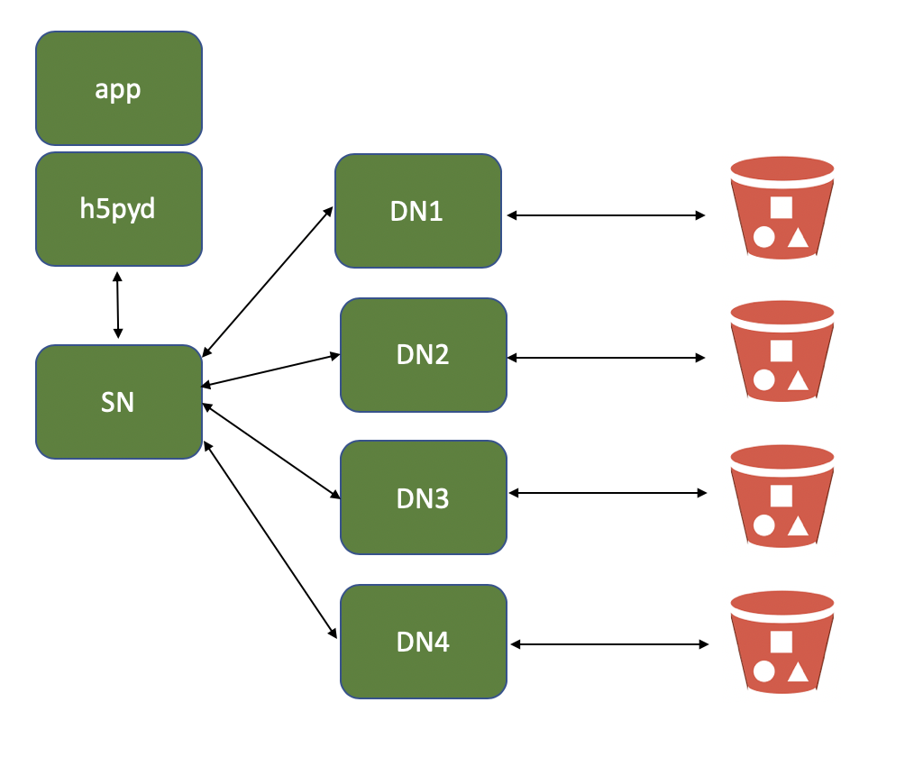
Direct Access Architecture
Number of DN nodes set to number of cores
All green boxes run as processes on client system
S3, Azure Blob, or Posix storage

Slide 20
Direct Access Performance/Functional Constraints
Limited to available network/CPU on host computer
  No clustering as with HSDS for Kubernetes
Best if host is “close” to data
  E.g. running on EC2 instance in same region as S3 Bucket
Client needs authorization to read/write from storage system
  No per-user access control as with HSDS service
Multiple clients writing to same store may overwrite each other
  But no risk of storage becoming unreadable

Slide 21
Futures: Direct Access VOL plugin
For C/C++ apps, the direct access model could be implemented as a VOL connector
Other than launching the sub-processes the VOL would work in the same way as the REST VOL, so it probably makes sense to include this functionality in the REST VOL rather than create a new VOL
With direct access HDF5 lib + REST VOL enables sharded data as an alternative to the HDF5 file format
  Enables multi-threading (& parallelization support for even single threaded apps)
  Enables async API
  Cloud optimized storage (or Posix)
  Crash-proof

Slide 22
Release Target
AWS Lambda support is available now in the HSDS 0.7.0 beta release
  Available on github
  Of course, requires AWS account and use of S3 storage
Official release of HSDS 0.7.0 should be available this summer
HSDS Direct access support will be available in h5pyd v0.8.0
  Available as beta now
  (also planned for summer 2021)
Feedback (github issues, PRs, email) is encouraged

Slide 23
Try it out!
Get the software here:
HSDS: https://github.com/HDFGroup/hsds
H5pyd: https://github.com/HDFGroup/h5pyd
REST VOL: https://github.com/HDFGroup/vol-rest
REST API documentation: https://github.com/HDFGroup/hdf-rest-api
Example programs: https://github.com/HDFGroup/hdflab_examples
HSDS Lambda how to: https://github.com/HDFGroup/hsds/blob/master/docs/aws_lambda_setup.md

Slide 24
Questions?

