Slide 1
HDF – Current Status and Future Directions
2021 ESIP Summer Meeting
Elena Pourmal
The HDF Group Technical Manager, EED2 Contractor
epourmal@hdfgroup.org
This work was supported by NASA/GSFC under Raytheon Technologies contract number NNG15HZ39C.
This document does not contain technology or Technical Data controlled under either the U.S. International Traffic in Arms Regulations or the U.S. Export Administration Regulations.

Slide 2
Outline
Update on Hierarchical Data Format (HDF) software
  Releases
  Development efforts
  Outreach
What is on your HDF wish list?
https://docs.google.com/document/d/1S6N1z-dQUqNsk5zvUmkQGwOuTa-OjBOzeqEDPlCINvE/edit?usp=sharing

Slide 3
HDF Releases

Slide 4
HDF5, HDF4 and HDFView
Release information, source code and Linux, macOS, Windows binaries, and compression plugins are available from The HDF Group (THG) Portal
HDF5
  We support HDF5 1.8.*, 1.10.* and 1.12.* maintenance releases
    The latest releases are 1.8.22, 1.10.7, 1.12.1
    Upcoming releases are 1.10.8 and 1.8.23 in Fall 2021
  Starting with HDF5 1.10.7 szip compression was replaced with aec (Open Source, BSD license)

Slide 5
HDF5, HDF4 and HDFView (cont’d)
We strongly encourage to migrate HDF5-based software from HDF5 1.8.* to the latest maintenance release of 1.10 or 1.12
We address HDF5 Common Vulnerabilities and Exposures (CVE) issues in our maintenance releases
  CVEs are found by intentionally corrupting HDF5 files
  To avoid the issues, create files using 1.10 or later File Format that has checksums for HDF5 metadata and the latest maintenance releases

Slide 6
HDF5, HDF4 and HDFView (cont’d)
HDF 4.2.15
  On macOS systems software must be built with the shipped XDR¹ library
  Support for macOS BigSur will be added in HDF 4.2.16 later this year
HDFView 3.1.2
  Built with HDF 4.2.15, HDF5 1.10.7, and OpenJDK² 15
  Known issue: HDFView doesn’t handle loading of large files gracefully (size is system dependent)
¹ Sun Microsystems Remote Procedure Call package
² Open Java Development Kit

Slide 7
Development Efforts

Slide 8
HDF5 Compression Tuning
HDF5 is build and tested with a diverse set of compression methods
  GNU zip and Szip extended-Rice lossless compression
  Multiple lossless and lossy compression plugins registered with The HDF Group
    Popular compressions used by HDF5 for Python (h5py) and PyTables, bit shuffle compression, and JPEG
    ZFP - lossy and lossless floating-point and integer high-speed compression
    SZ - lossy floating-point and integers high-speed compression
  Plugins source is available from https://github.com/HDFGroup/hdf5_plugins
  Binaries are available from HDF Portal with each maintenance release
Parallel HDF5 library can write/read compressed data using any of registered compressors
The HDF Group developers are looking into scalability for parallel applications that use compression

Slide 9
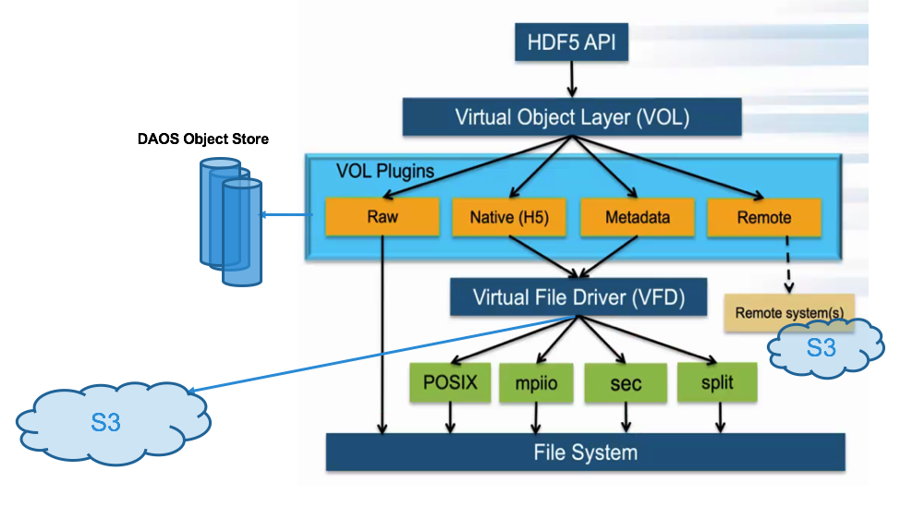
New Ways of Accessing HDF5 Data
HDF5 connectors allow access data in Object Store, Cloud (e.g., Amazon S3), on node-local storage, etc., or reorganize data for optimal I/O, or use different file format
  HDF5 1.13.0 release will support multiple HDF5 connectors developed for High Performance Computing applications
  Connector could be multi-threaded to speed-up data access
HDF5 drivers (VFD) allow different access modes
  The Splitter VFD maintains separate Read/Write and Write/Only channels for ”concurrent” file writes to two files using a single HDF5 file handle.
  The Mirror VFD uses TCP/IP¹ sockets to perform write-only file input/output operations on a remote machine.
  Single Writer/Multiple Reader VFD allows reader processes to access a file modified by writer process
  “Onion” VFD stores multiple versions of HDF5 file
¹ Transmission Control Protocol/Internet Protocol

Slide 10
Outreach

Slide 11
Getting Help
Contact
  help@hdfgroup.org and HDF-FORUM HDF software questions
  eoshelp@hdfgroup.org with questions about HDF-EOS products and software
Visit
  HDF portal
    HDF documentation, FAQs, Tutorials, etc.
  HDF – EOS Tools and Information Center
    Great collection of information related to HDF-EOS.
Attend and present at
  HDF Clinic every Tuesday at 1:00 pm Central
  HDF User’s Group meeting, October 12-15, 2021

Slide 12
Contribute
HDF software is on GitHub
HDF5 documentation is in Doxygen starting with HDF5 1.12.1 release
  https://docs.hdfgroup.org/hdf5/v1_12/
  https://docs.hdfgroup.org/hdf5/develop/
  Searchable, indexed by Google
  Help us to improve HDF5 documentation!

Slide 13
Let’s check the wish list now
Thank you!

Slide 14
This work was supported by NASA/GSFC under Raytheon Technologies contract number NNG15HZ39C.

