Slide 1
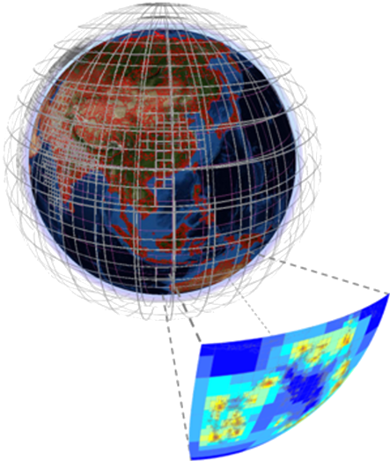



MATLAB Modernization on HDF5 1.10
Support for SWMR and VDS and Cloud Data Access
wasbs://
s3://
Ellen Johnson
Senior Software Engineer, MathWorks
ESIP Summer 2021/HDF Workshop
July 23, 2021

Slide 2

Agenda
Scientific data overview
HDF5 interface
What we’ve been doing
What’s new in 21b
Demo
Performance and compatibility
What’s in the future
Wrap-up and Q&A
21b topics covered are available now to MATLAB users in
R2021b prerelease
Full R2021b release planned for September

Slide 3
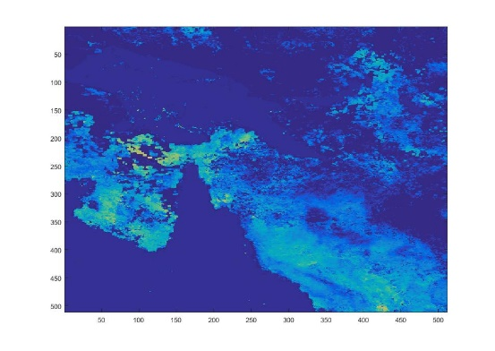
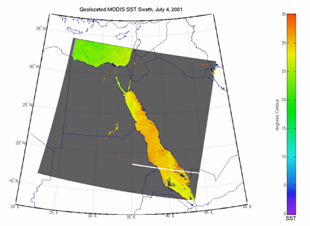
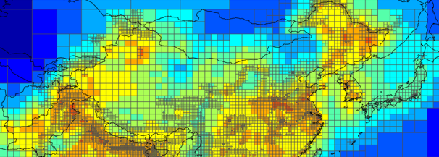
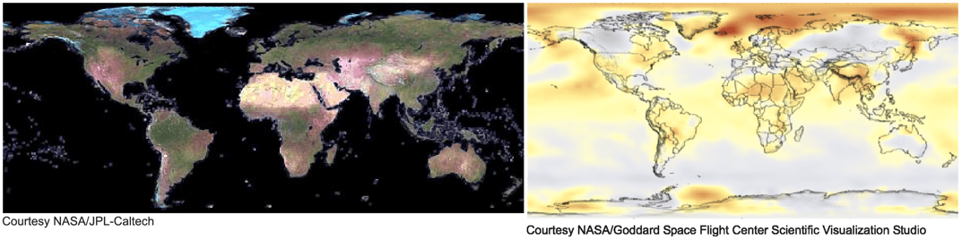
Scientific Data in MATLAB
Scientific data formats
  HDF5, HDF4, HDF-EOS2
  NetCDF (with OPeNDAP)
  FITS, CDF, BIL, BIP, BSQ
Image file formats
  TIFF, JPEG, PNG, JPEG2000, HDR,
  and more
Vector data file formats
  ESRI Shapefiles, KML, GPS
  and more
Raster data file formats
  GeoTIFF, NITF, USGS and SDTS DEM, NIMA DTED, and more
Web Map Service (WMS)

Slide 4
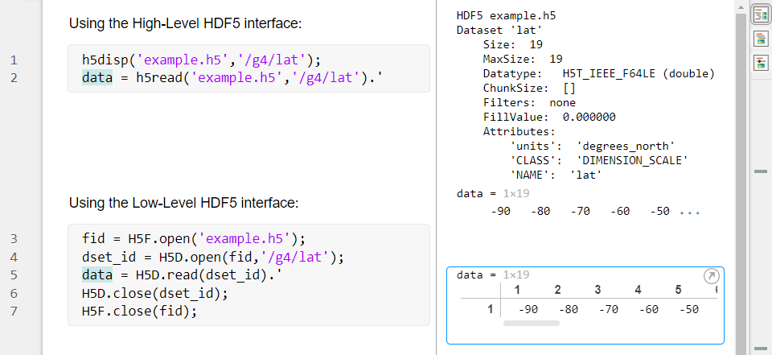
Working with HDF5 in MATLAB
MATLAB has two HDF5 interfaces
High-level (HL) : Ease-of-use, less control
Low-level (LL) : Wraps HDF5 C library, more control
Interface | Function
High-level | h5create, h5read, h5write, h5disp, etc.
Low-level | H5F.open H5F.start_swmr_write H5D.read H5G.create H5P.select_hyperslab H5P.set_layout H5P.set_virtual H5S.create_simple H5T.refresh and over 300 more
Notes:
h5disp maps to h5dump
try, catch
don’t have to recompile your code to play with the lower level interfaces
Run code as you type it

Slide 5




What We’ve Been Up To
Upgraded to HDF5 1.8.12
Support for reading datasets with Dynamically Loaded Filters
attempted upgrade to 1.10.2…performance regressions
Support for HDF5 remote data access
Wrote in-house Virtual File Driver
  S3 and Azure: Read/Write
  Hadoop: Read-only
  Enabled for all HL and LL functions
Support for MAT-file v7.3 remote save/load
more work on upgrading to 1.10.7…still regressions, but devised a solution

Slide 6

What’s New in R2021b
MATLAB customer-facing HDF5 interface now uses HDF5 1.10.7
New functions in low-level interface for:
  Single-Writer/Multiple-Reader
  Virtual Dataset
  Fine Tuning the Metadata Cache
  Partial Edge Chunk
Modified existing functions for 1.10.7
Shipping binaries for both 1.10.7 and 1.8.12 (Interim solution)
  1.10.7 for MATLAB HDF5 interface
  1.8.12 for MAT-file v.7.3 to avoid 1.10 regressions
  Consulting with THG and MathWorks teams on solution
Goal: Ship one version and stay current with HDF5 releases

Slide 7
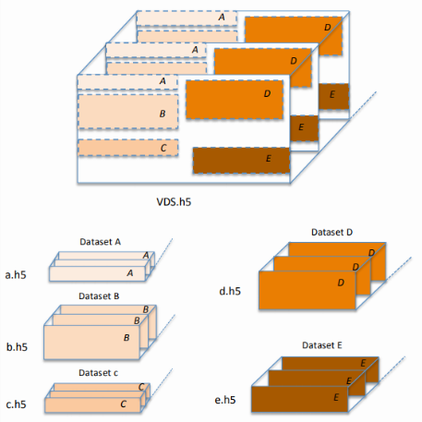
Functional Details in R2021b
New functions added to LL interface
  Added ~30 new functions across the 16 APIs
  Provides fine-grained control of SWMR, VDS, Partial Edge Chunk, Metadata Cache
Modified existing functions to work with 1.10.7
  H5F.open (for SWMR)
  H5P.set_layout (for VDS)
  H5R.dereference (for 1.10 signature)
  H5P.set_libver_bounds (for new high/low values)
h5read, h5disp, h5info can access Virtual Datasets
whether stored locally or cloud
  S3, Azure, Hadoop

Slide 8
New Functions Mapped to HDF5 Features
HDF5 Feature | MATLAB Function
SWMR | H5F.start_swmr_write H5O.disable_mdc_flushes H5O.enable_mdc_flushes H5O.are_mdc_flushes_disabled
VDS | H5P.set_virtual H5P.get_virtual_dsetname H5P.set_virtual_view H5P.get_virtual_count H5P.get_virtual_filename H5P.get_virtual_view H5P.get_virtual_vspace H5P.set_virtual_printf_gap H5S.is_regular_hyperslab H5P.get_virtual_srcspace H5P.gset_virtual_printf_gap H5S.get_regular_hyperslab
Fine Tuning the MDC | H5F.get_metadata_read_retry_info H5D.flush H5O.flush H5P.get_metadata_read_attempts H5D.refresh H5O.refresh H5P.set_metadata_read_attempts H5G.flush H5T.flush H5F.get_intent H5G.refresh H5T.refresh
Partial Edge Chunk | H5P.get_chunk_opts H5P.set_chunk_opts

Slide 9
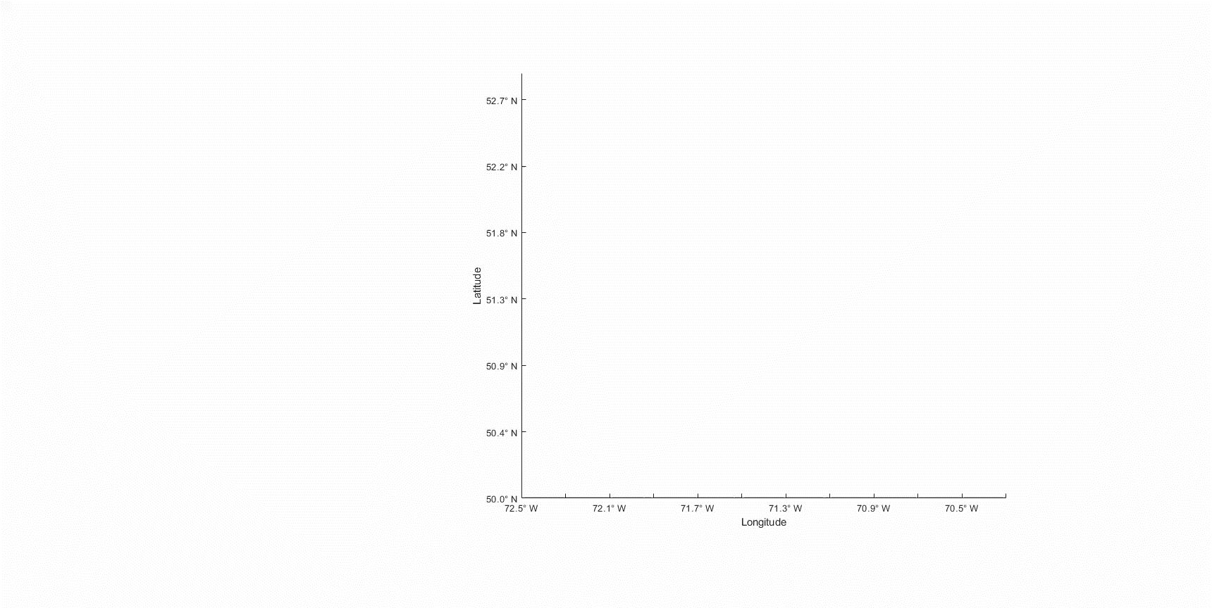
Demo: Using SWMR with VDS in MATLAB with parpool
Mix of local and remote data access

Slide 10
Performance
Performance benchmarks with 1.10.7 vs 1.8.12
Improvements
  h5write, h5create, many low-level functions: minimal/moderate improvements
Regressions
  h5info: Substantial regressions with highly-nested groups with small datasets
  Working with THG to determine if same issue as MAT-file v7.3
Future performance work
  Optimize our HDF5 codebase (have identified target areas)
  Adding more workflow-based performance tests

Slide 11
Compatibility
Linux-only: Filter plugins with calls to core HDF5 library need to be rebuilt
with our shipping symbol-versioned HDF5 1.10.7 binary
  To avoid issues due to symbol collisions
  Option 1: Rebuild plugin with /matlab/bin/glnxa64/libhdf5.so.103.3.0
  Option 2: Build 1.10.7 using our GNU export map, then rebuild plugin with this binary.
  Will provide instructions in documentation and File Exchange
  Interim solution until we ship one version again
H5P.set_libver_bounds
  low/high = latest/latest will create incompatible files with earlier MATLAB versions

Slide 12

Future Work Under Consideration
Highest priority
Ship one HDF5 version (Linux plugin workaround no longer required)
Support for writing datasets using Dynamically Loaded Filters
Better experience for working with filter plugins
Upgrade to HDF5 1.14 when available, evaluate new features to support
Watch-and-wait
High-level support for creating VDS, controlling SWMR settings
Support for other 1.10 features (Page Buffering, File Space Management)
Looking for community feedback

Slide 13
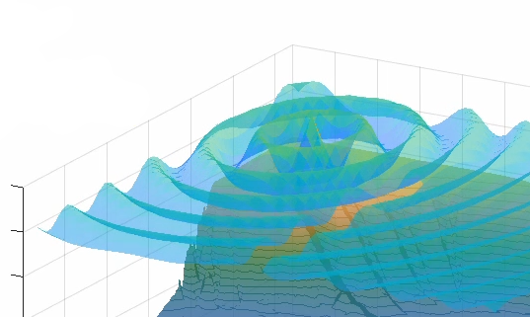
Wrap-up and Q&A
MATLAB now current with latest HDF5 version on 1.10 branch
New SWMR and VDS capabilities
Linux Filter Plugin compatibility
Please try out our new functions in R2021b prerelease
We love hearing feedback – it helps us improve our products!
Reach out to us with any questions or wish-lists!
- ellenj@mathworks.com

Slide 14
Acknowledgements
GEBCO Gridded Bathymetry Data: https://www.gebco.net/data_and_products/gridded_bathymetry_data/ ​
GEBCO Compilation Group (2020) GEBCO 2020 Grid (doi:10.5285/a29c5465-b138-234d-e053-6c86abc040b9)​
The HDF Group: www.hdfgroup.com​
HDF5 VDS RFC: https://portal.hdfgroup.org/display/HDF5/RFC+HDF5+Virtual+Dataset
Thank You!

