Slide 1
STARE-PODS: A Versatile data store leveraging the hdf virtual object layer for compatibility
SpatioTemporal Adaptive Resolution Encoding (STARE)
Michael L Rilee^{1,2} Kwo-Sen Kuo^{1,3}, James Gallagher⁴, James Frew⁵, Niklas Griessbaum⁵,
Edward Hartnett⁶, Robert Wolfe¹, Gerd Heber⁷, Siri Jodha Khalsa⁸
¹NASA Goddard Space Flight Center, Greenbelt, Maryland, USA
²Rilee Systems Technologies LLC, Derwood, Maryland, USA
³Bayesics LLC, Bowie, Maryland, USA
⁴OPeNDAP, Inc., Narragansett, Rhode Island, USA
⁵University of California, Santa Barbara, California, USA
⁶Ed Hartnett Consulting, Boulder, CO, USA
⁷The HDF Group, Champaign, IL, USA
⁸Coloradio Associates for Science and Technology LLC, Boulder, CO, USA
2020 ESIP Summer Meeting
2020 July 22
STARE
Proposal No. 17-ACCESS17-0039
Federal Award ID No. 80NSSC18M0118

Slide 2
STARE-PODS for scalable Analysis Ready Data (ARD)
Diverse low-level Earth Science data (ESD) requires special treatment to co-align and combine for integrative analysis
The SpatioTemporal Adaptive Resolution Encoding (STARE) provides a unifying indexing scheme to combine geo-located ESD
STARE partitioned ESD enables Parallel Optimized Data Store (PODS)
HDF’s Virtual Object Layer (VOL) and Virtual Data Set (VDS) technologies can provide familiar front-ends to data in STARE-PODS
STARE-PODS unifies accessing diverse data with minimum duplication
STARE-PODS is a proposal to NASA/ACCESS-19 currently under review.

Slide 3
STARE Basics

Slide 4
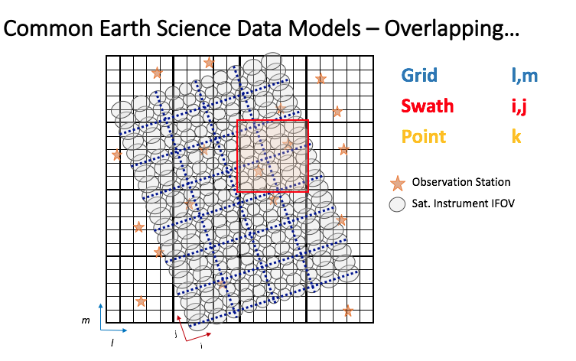
STARE Basics
Existing native array & memory indexing impedes integration and processing.
Notes:
PROJECT OVERVIEW
What we see in analysis is the native array indexing, the l,m, I,j, k and the actual geometry is hidden. IFOV too. The above still not reality.

Slide 5
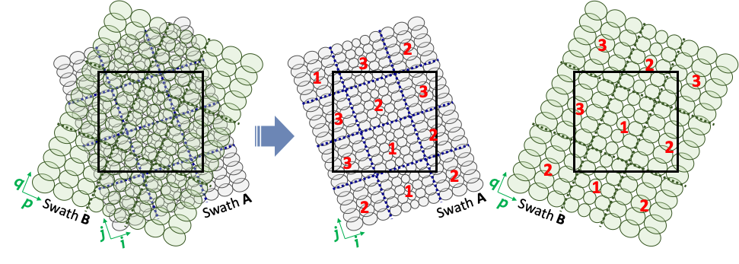
Parallel & distributed indexing based on native array partitioning leads to extra data movement, breaking SCALABILITY.
Higher-res nadir
Lower-res wing
Region of interest
Two swath sections, A and B, overlap with the region of interest (ROI) outlined in black, with data on separate computational nodes (numbered).
Notes:
L1+L2: If your scientific analysis requires combining level 1 and 2 data, one has to arrange all of this themselves.

Slide 6
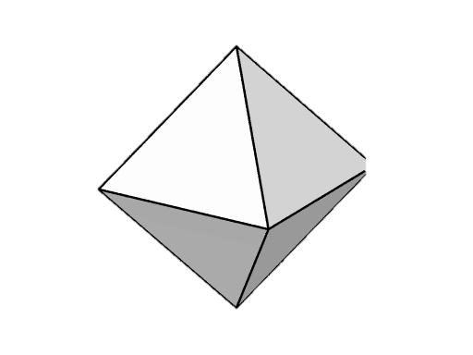
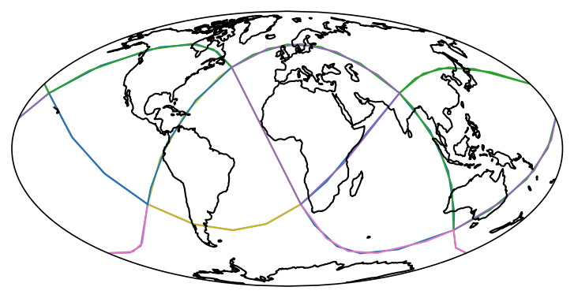
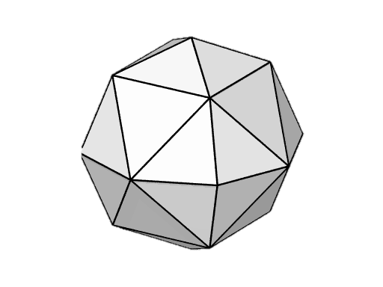
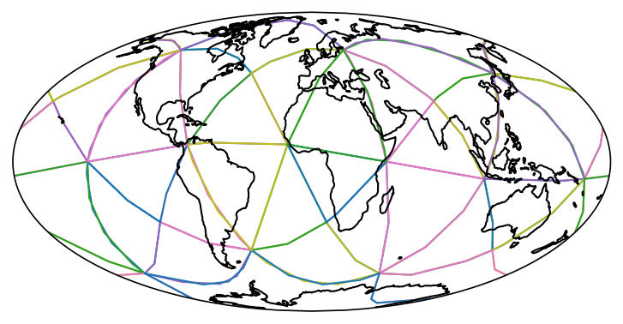
STARE Encoding a locations in a recursive spatial quad-tree
A tilted root polyhedron
0th level
STARE Spatial ‘Trixels’
Encoded as 64-bit integers
First refinement level
1st level
STARE Temporal indexing is similar but based on calendrical periods.

Slide 7
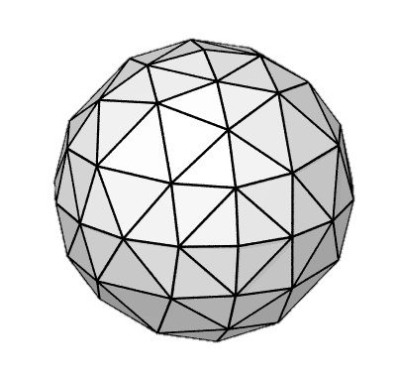
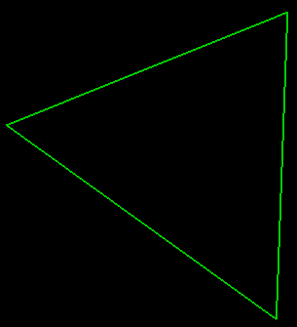
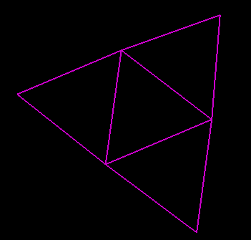

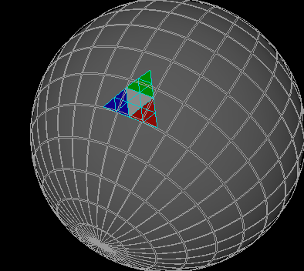
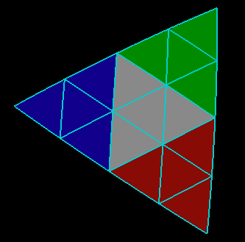
STARE Spatial Hierarchical Triangular Mesh (HTM) Indexing: spherical triangles to integers via quadtree recursion
aids comparison of different data sets, integer operations are much faster than geometric calculations
bit pattern keeps co-located data together when “chunked”
STARE Temporal Hierarchical Calendrical Partitioning (HCP): similar but with branching based on calendar partitions
level
Levels
N3333
Bit 1 1 11 11 11 11 -> 0xffc (right justified)
N3333 ffc0000000000000 @level 3 (left justified)
1
2
3
00
3
01
10
N33330-N33333
N33330 ffc0000000000000 @level 4
l
N33333 fff0000000000000 @level 4
11
01
0000
10
11
4
00
0011
1100
N333300-N333333
N333300 ffc0000000000000 @level 5
l
N333333 fffc0000000000000 @level 5
5
1111
Chunk 1
ffc0-ffcc
Chunk 2
ffd0-ffdc
Chunk 3
ffe0-ffec
Chunk 4
fff0-fffc
@level 5
Parallel Store, SciDB…
Worker
Node
1
Worker
Node
2
Worker
Node
3
Worker
Node
4
Worker
Node
1
Worker
Node
2
Worker
Node
3
Worker
Node
4
“Chunks”

Slide 8
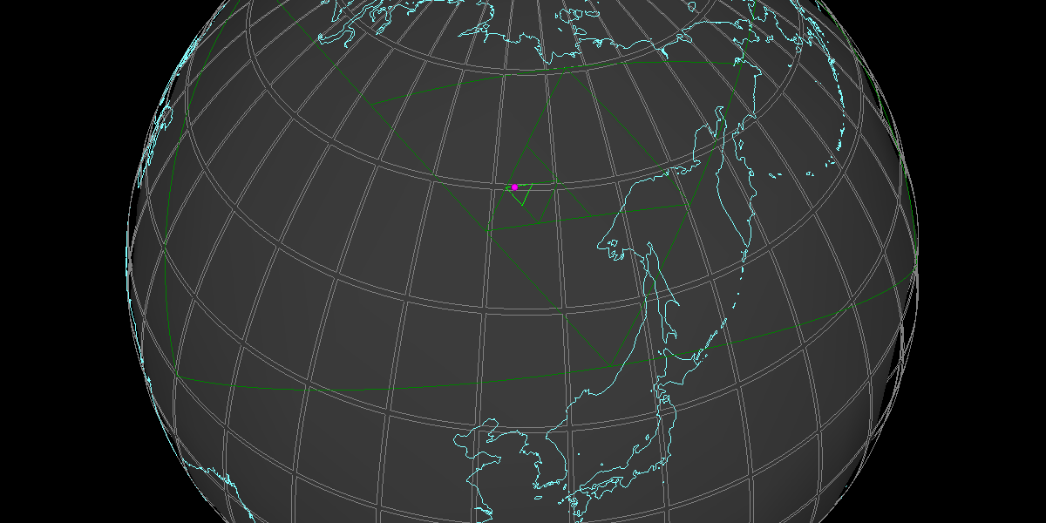
STARE vs Floating-Point Encoding
 | Longitude | Latitude
Human readable | +123.4° | 60°
Single-precision floating-point | 0x42f6cccd | 0x42700000
STARE id* | 0x36ee9398f7210f34
*STARE id also includes resolution information. In this case, it points to quadfurcation level 20, i.e. ≲ 10m
The smallest triangle in the figure is at quadfurcation level 6.

Slide 9
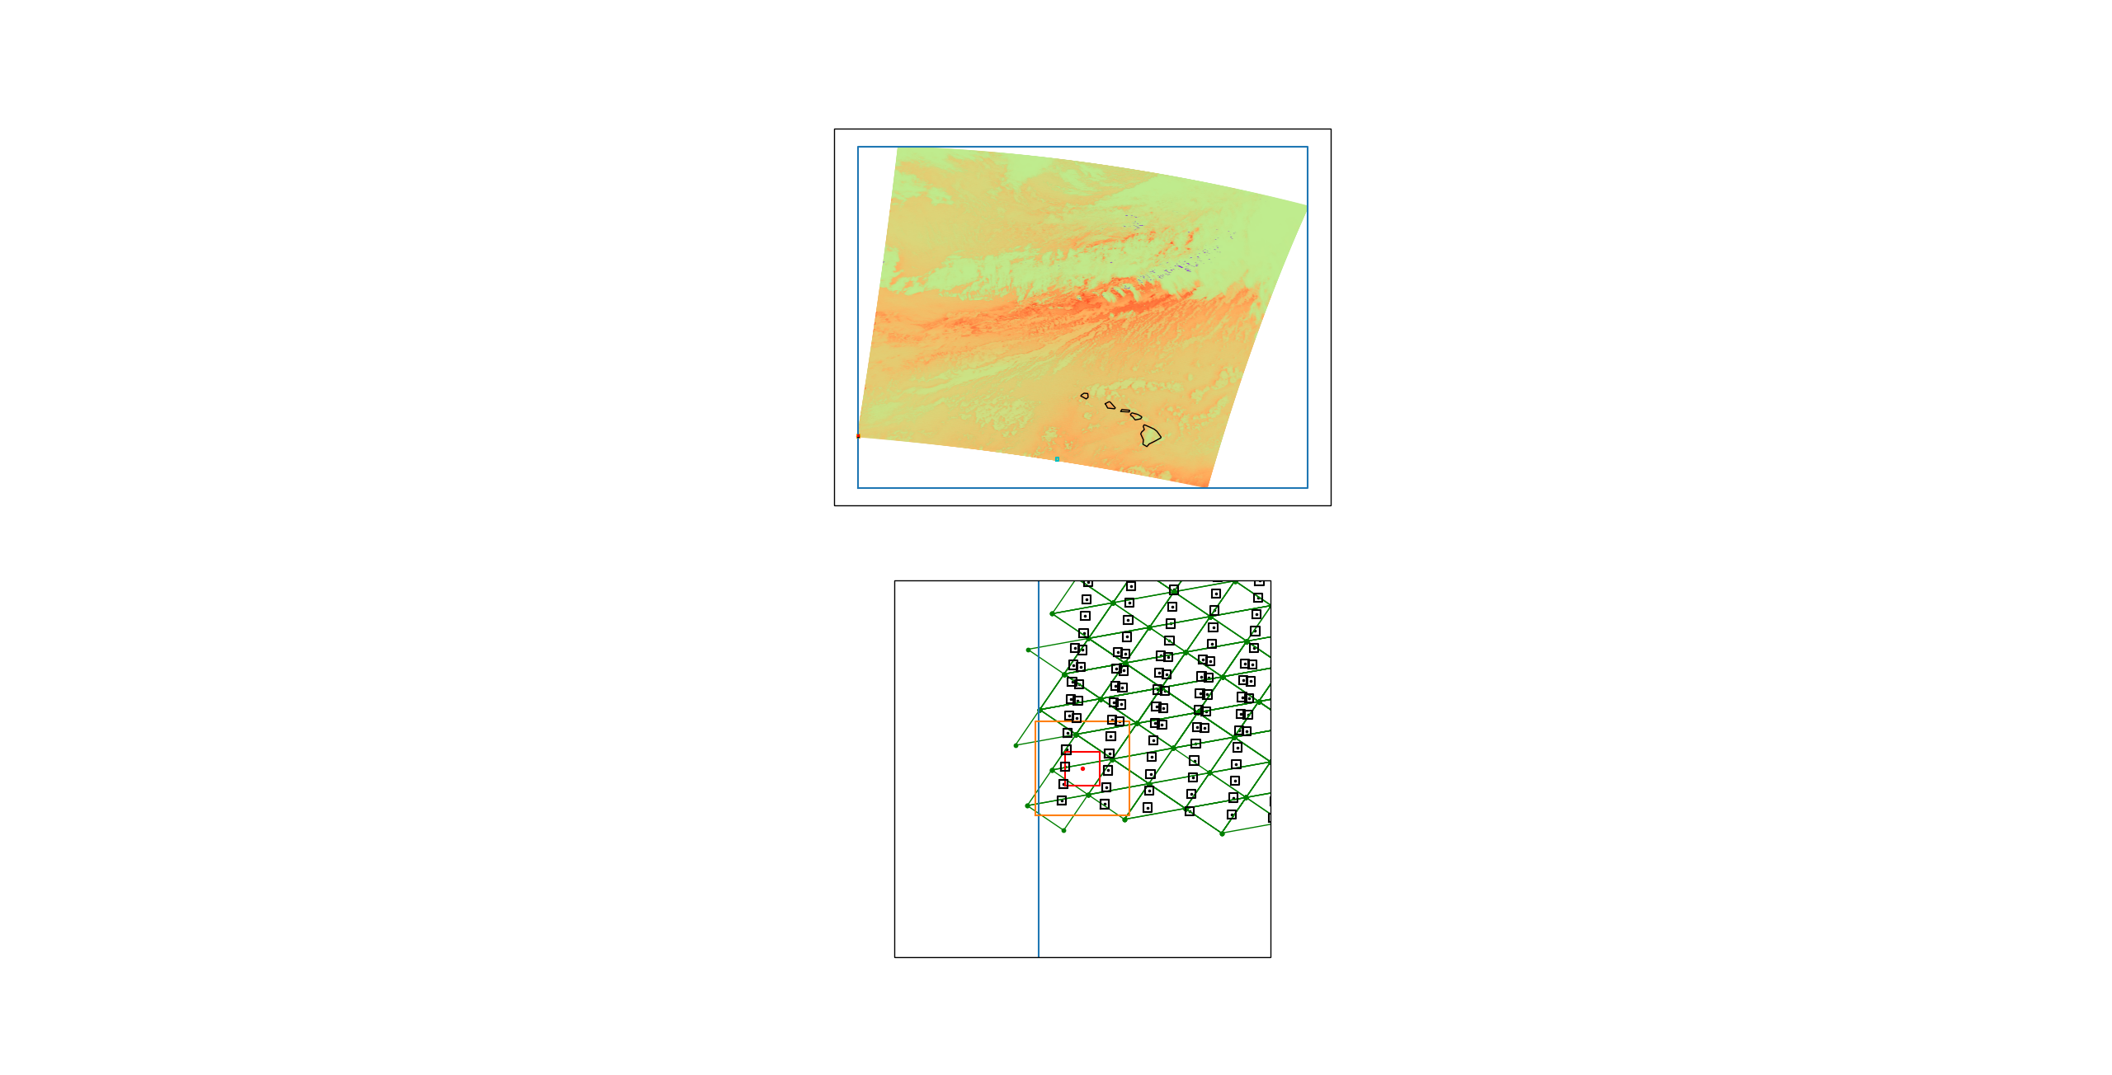
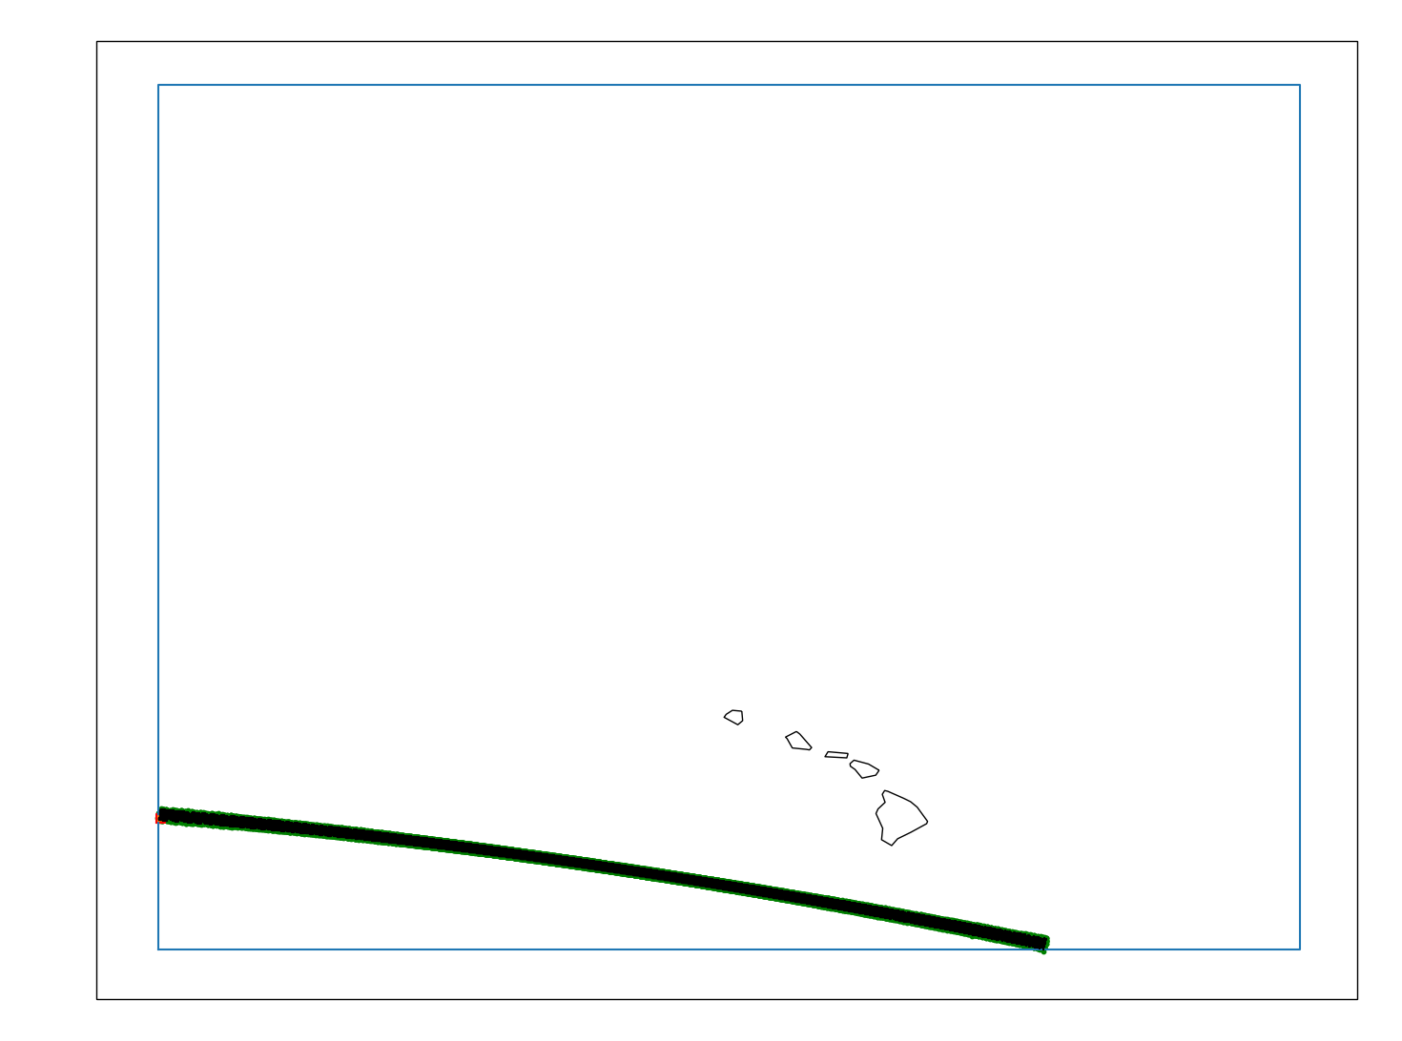
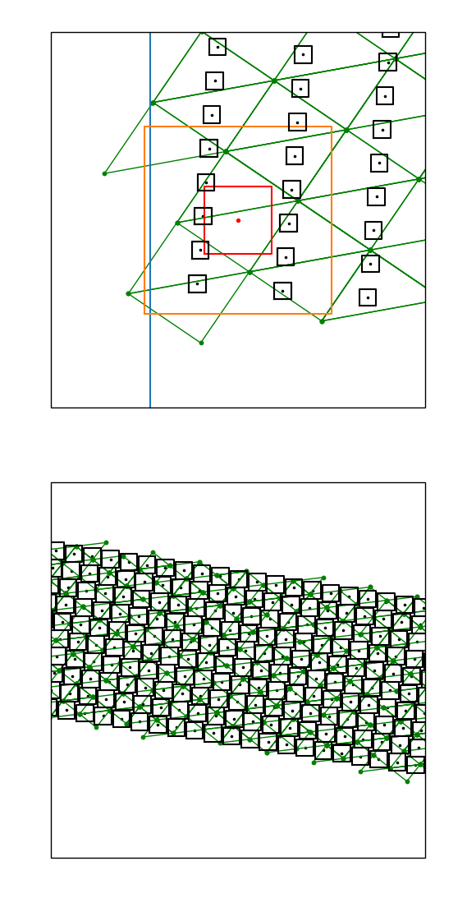
Supporting conventional lon-lat vs. STARE-based integration
MODIS
STARE indexing adapts to the resolution of the data, which often varies.
One “scan” with
ten sensors.
MODIS pixel
(nadir resolution)
Lon-lat
search area for combining data
GOES pixel
WING
NADIR
Notes:
Bottom part of MODIS granule, zoom in to scan line, explain boxes on WING, go to nadir.
Show difference between conventional and STARE ways
Why? Square-based vs. triangle-based integration – infusion people they understand conventional lon-lat grid integration/comparison (L3)
We hope the comparison will help show people/convince people STARE-way is better

Slide 10
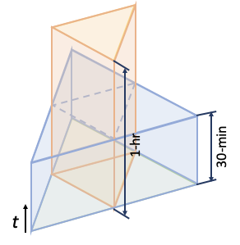
2+1 Dimensions indexed with two integers
STARE SpatioTemporal Search/Index Volumes
Hurricane IRMA
Key West
“Sensor trajectory”
Cuba
STARE Volumes
(not to scale)

Slide 11
Parallelization for Volume & Variety Scaling

Slide 12
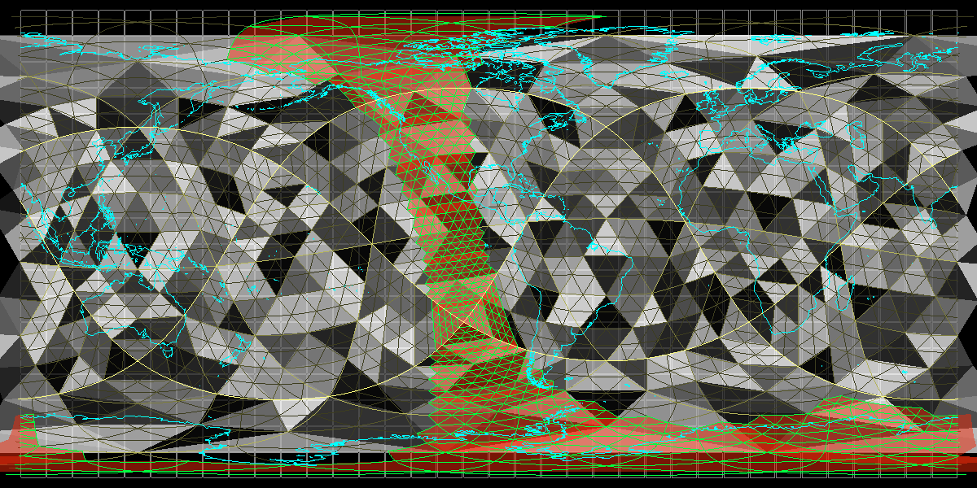
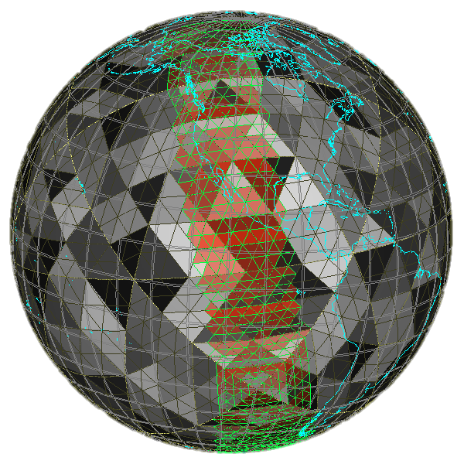
STARE supporting a 16-way partitioning co-locating diverse data
Notes:
chunkLevel=3 (nodes). TrixelGrid=0,1,2,3,4 (yellows getting darker). Swath, resolution level=5 (green).
*** HTM not new, NEIGHBORHOOD part is new

Slide 13
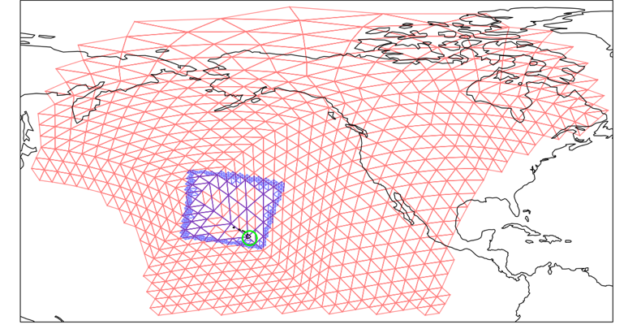
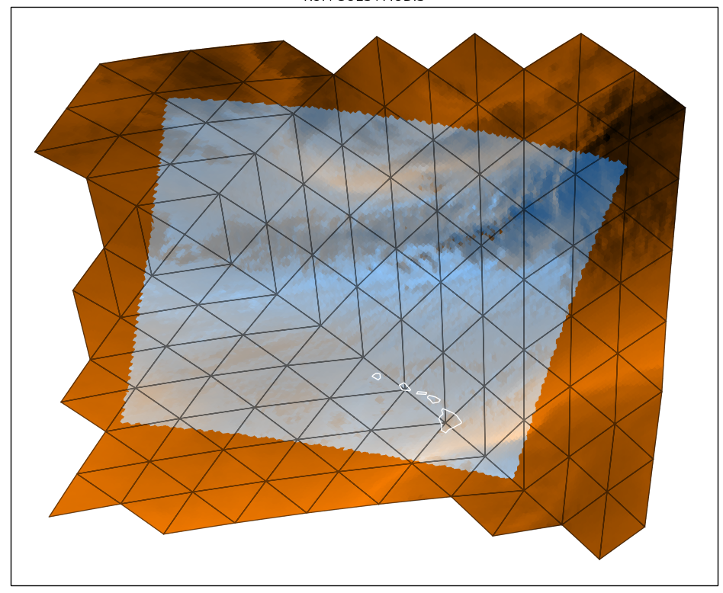
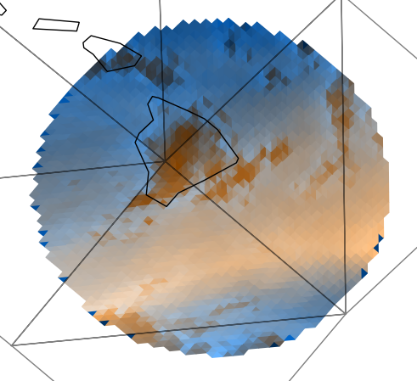
Using STARE to combine GOES and MODIS data
Can use key-value store to integrate
GOES (red/brown) and MODIS (blue) granules integrated using STARE (visualized in equirectangular projection)
Notes:
Want to do this at scale, spatial and temporal
NOAA help desk, don’t us this

Slide 14
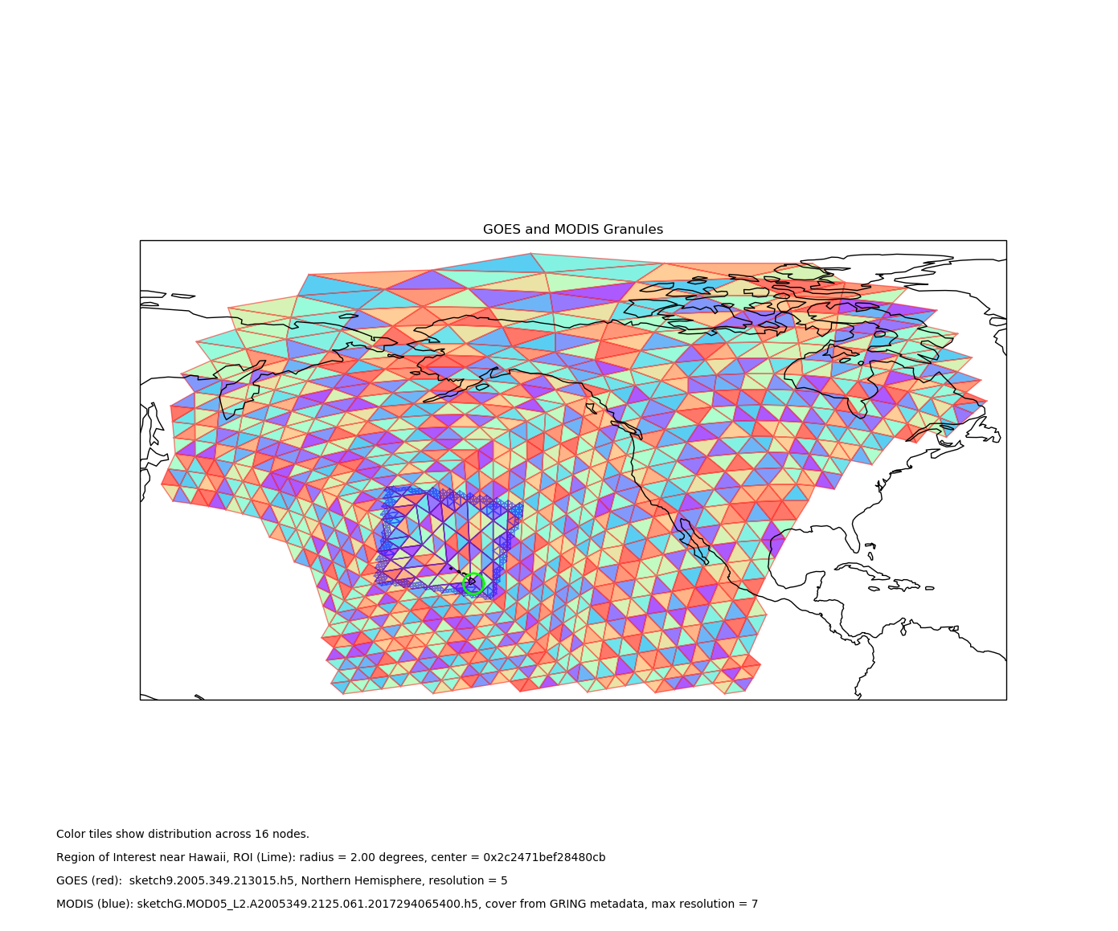
Using STARE to combine GOES and MODIS data
Can use key-value store to integrate
GOES (red/brown) and MODIS (blue) granules integrated using STARE (visualized in equirectangular projection)
Notes:
Want to do this at scale, spatial and temporal
NOAA help desk, don’t us this

Slide 15
HDF
Virtual Object Layer and
Virtual Data Sets

Slide 16
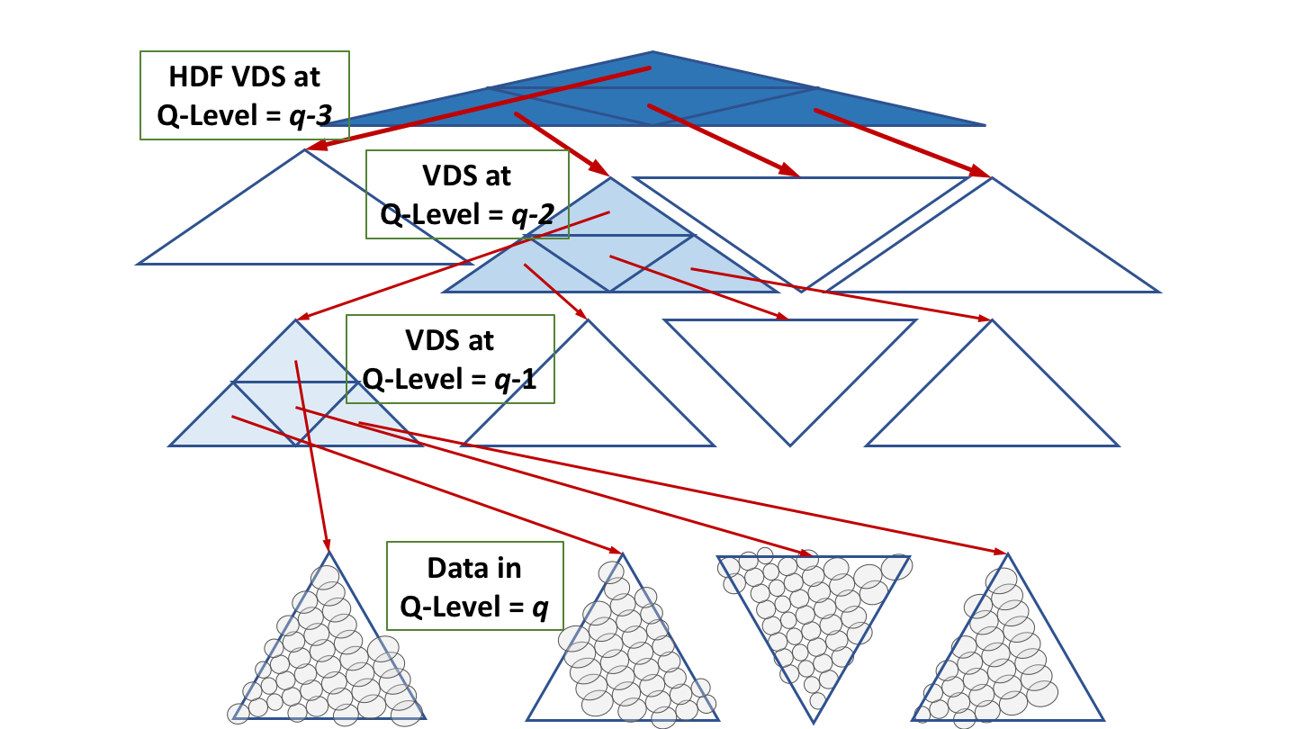
Scalable Homogenized Analysis Ready Data Store (STARE-SHARDS)
HDF Virtual Data Set API
Usability
HDF Virtual Data Set for tailoring views into the data
Actual data partitioned into chunks for parallelism with unified search and co-alignment.
Individual instrument field of views
Volume & variety scalability

Slide 17
Scalable Homogenized Analysis Ready Data Store (STARE-SHARDS)
HDF Virtual Data Set API
Usability
HDF Virtual Data Set for tailoring views into the data
STARE-SHARDS Storage Layer
Actual data partitioned into chunks for parallelism with unified search and co-alignment.
Individual instrument field of views
Volume & variety scalability

Slide 18
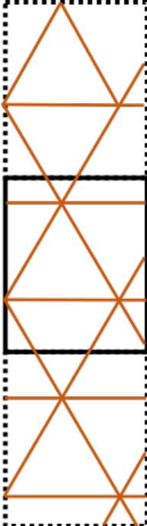
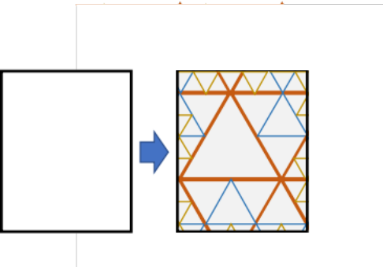
Using familiar HDF methods to access STARE-SHARDS
End users and legacy applications interact with STARE-SHARDS transparently.
STARE partitioned swath data looks like familiar HDF files
HDF
Virtual
Granule
Use a STARE ‘cover’ to partition a granule
Different sources and varieties of data with different coverage, resolutions…
Data Source 2
Data Source A
Data Source 3
Data Source B
Data Source 1

Slide 19
Using familiar HDF methods to access STARE-SHARDS
End users and legacy applications interact with STARE-SHARDS transparently.
STARE partitioned swath data looks like familiar HDF files
HDF
Virtual
Granule
Use a STARE ‘cover’ to partition a granule
Different sources and varieties of data with different coverage, resolutions…
Data Source 2
Data Source A
Data Source B
Data Source 3
Data Source 1

Slide 20
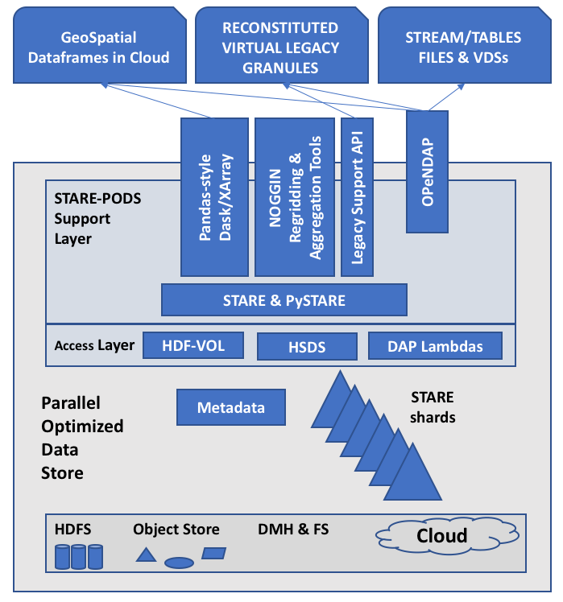
The Proposed Architecture
STARE SHARDS to PODS to Integrative Analysis
Use & Tooling
Query, Marshalling, “Transport”
Index & Organization
Computing & Storage

Slide 21
The Architecture
STARE SHARDS to PODS to Integrative Analysis
STARE Location Service (SLS)
A ‘DNS’ for geolocated data

Slide 22
Conclusion: STARE-PODS for scalable integrative analysis
STARE lays the foundation for scaling both variety and volume
  Supports lower-level (L1 & L2) data accessibility, combination, and scalability
  Features C++ and Python APIs, including a Pandas-like interface
  STARE Sidecar files limit costs of translation into STARE indices
OPeNDAP integration is in progress
Libraries, examples, tests, and cookbooks at https://github.com/SpatioTemporal
STARE-PODS and STARE-SHARDS
  Organize diverse data for co-alignment and parallel/distributed storage and processing
  HDF Virtual Object Layer and Data Set support transparent legacy access
Acknowledgments
STARE-PODS is a proposal to NASA/ACCESS-19 currently under review.
This work is supported by NASA/ACCESS-17. Federal Award ID No. 80NSSC18M0118.
NASA/LaRC for interest and support.

Slide 23
Supplemental

Slide 24
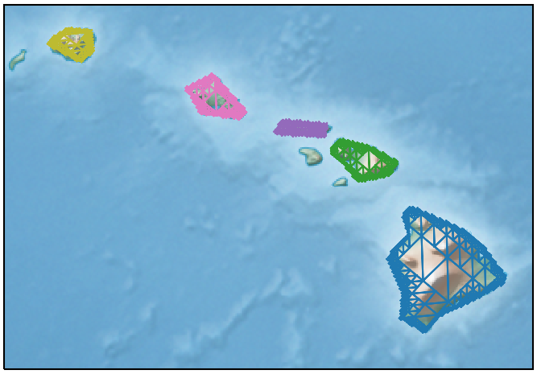

Slide 25
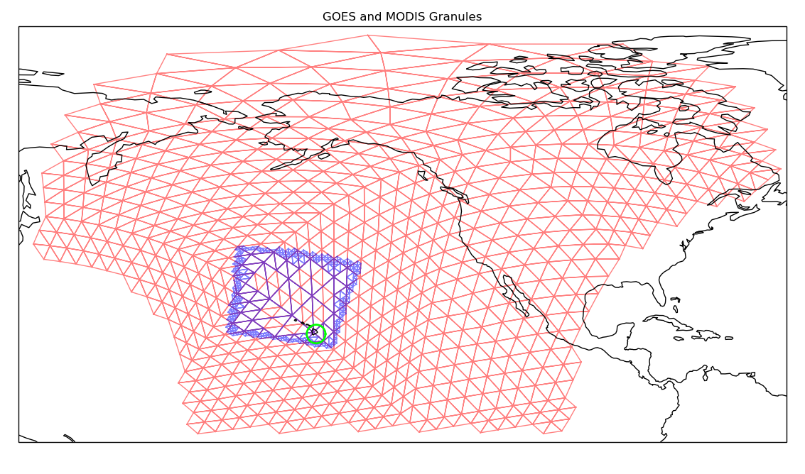
NASA/ACCESS-17-39 STARE
80NSSC18M0118
M. Rilee
mike@rilee.net
Rilee Systems Technologies LLC
2019 October 21

Slide 26
NASA/ACCESS-17-39 STARE
80NSSC18M0118
M. Rilee
mike@rilee.net
Rilee Systems Technologies LLC
2019 October 21
Notes:
16 nodes. GOES northern hemisphere, MODIS, Hawaii – 2deg circle

Slide 27
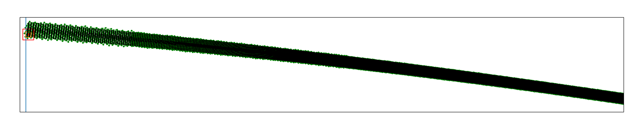
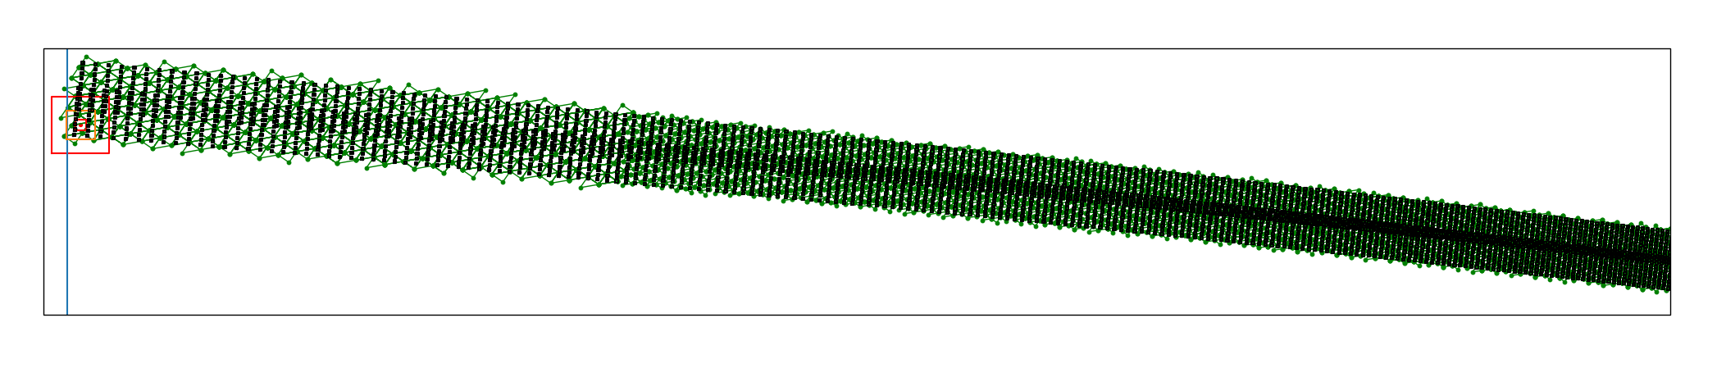
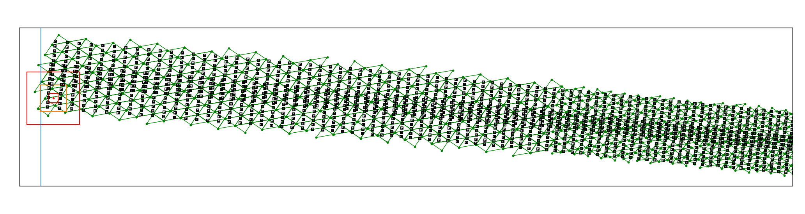
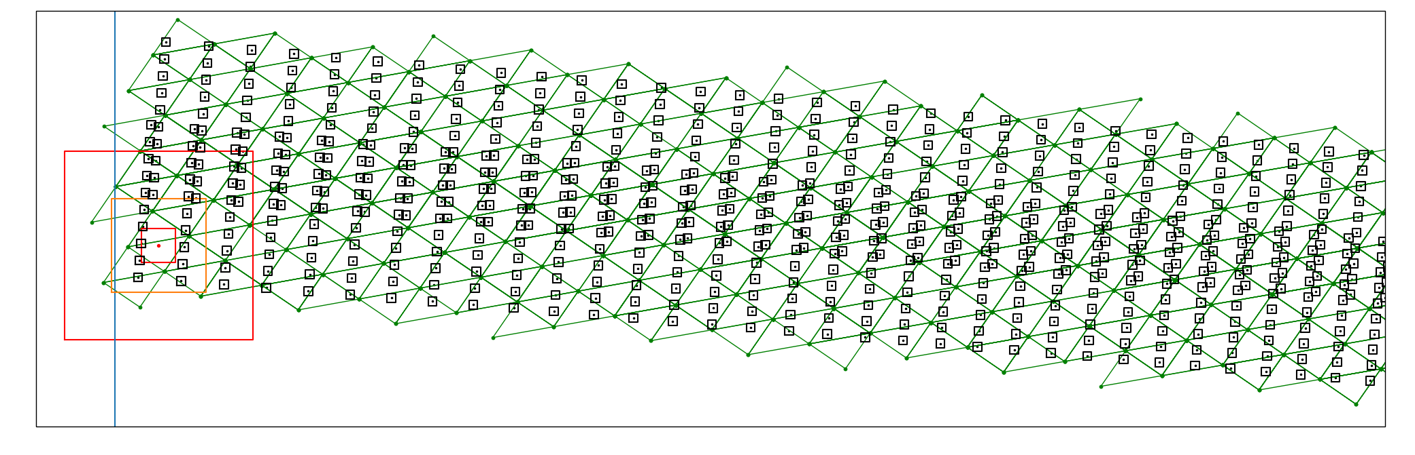
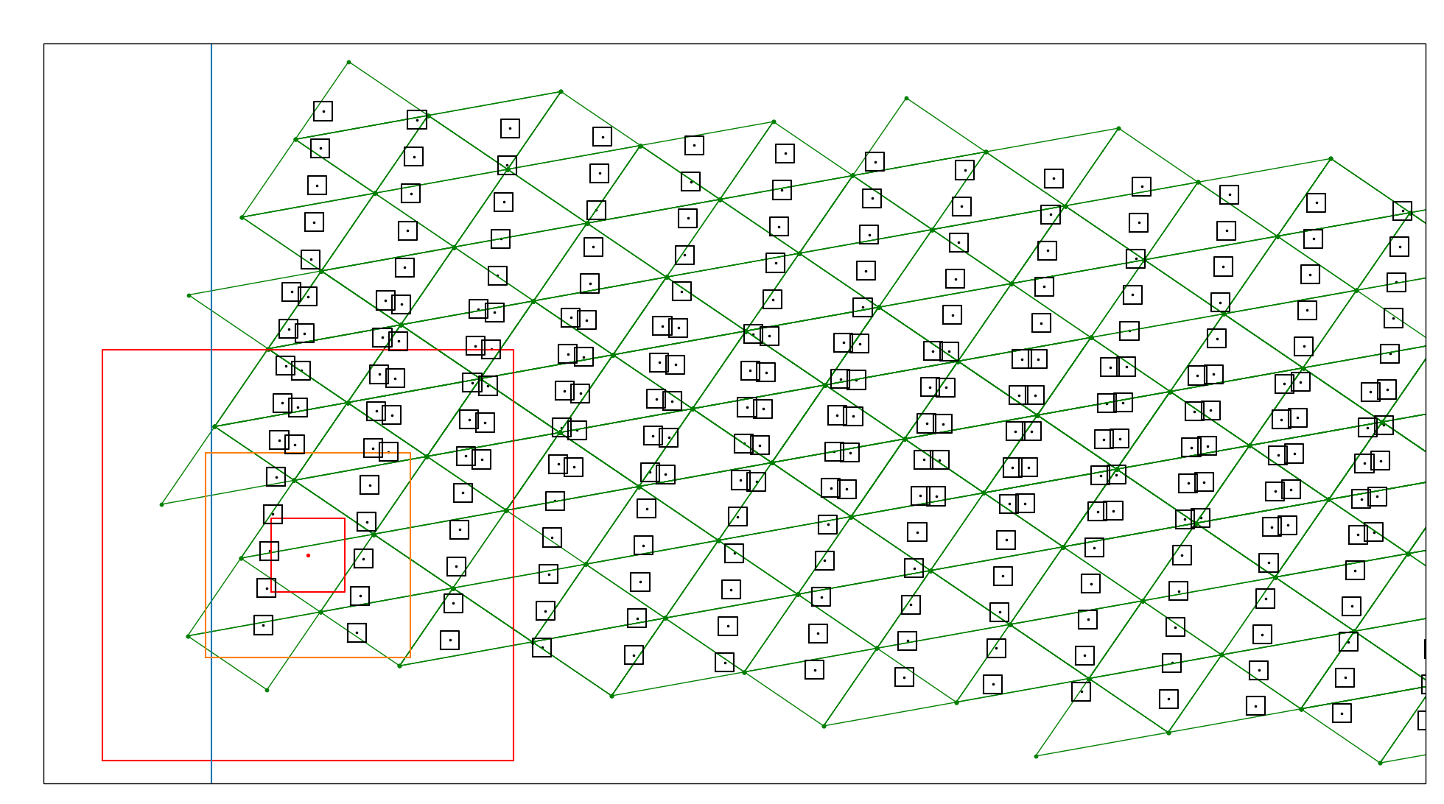
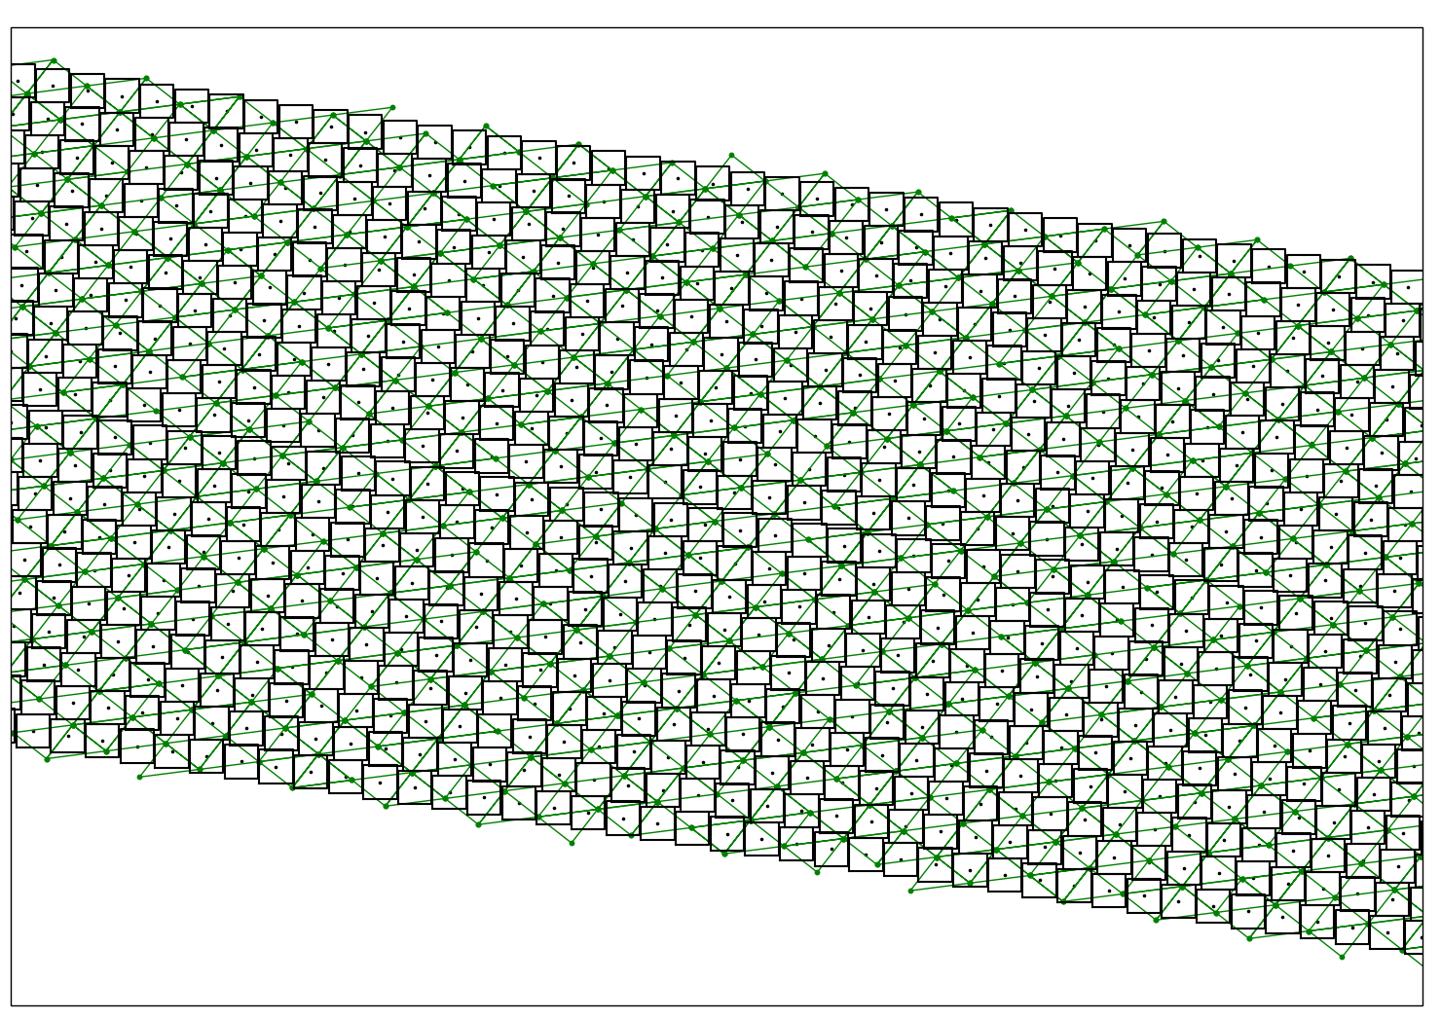
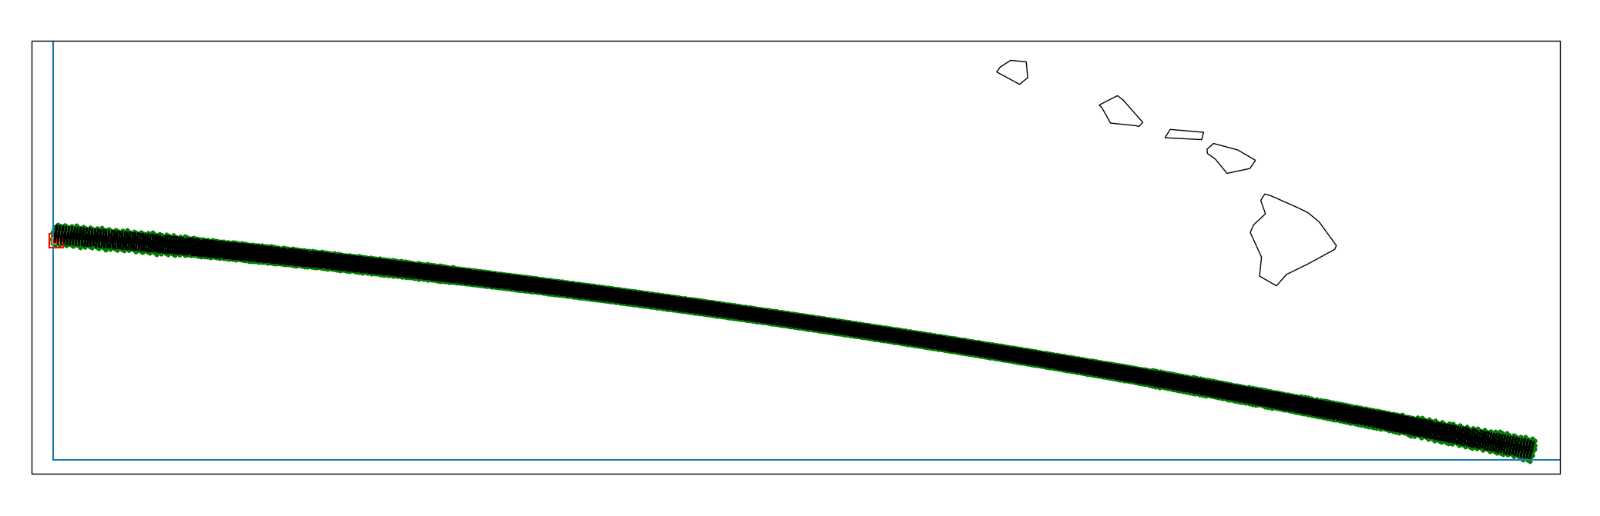
Zooming in to the MODIS swath “bow-tie”
Two “scans”
overlapping
WING
NADIR
STARE Indexing adapts to the data
Notes:
20 detectors, adjacent scans, overlapping at the wings
No overlap at center

Slide 28
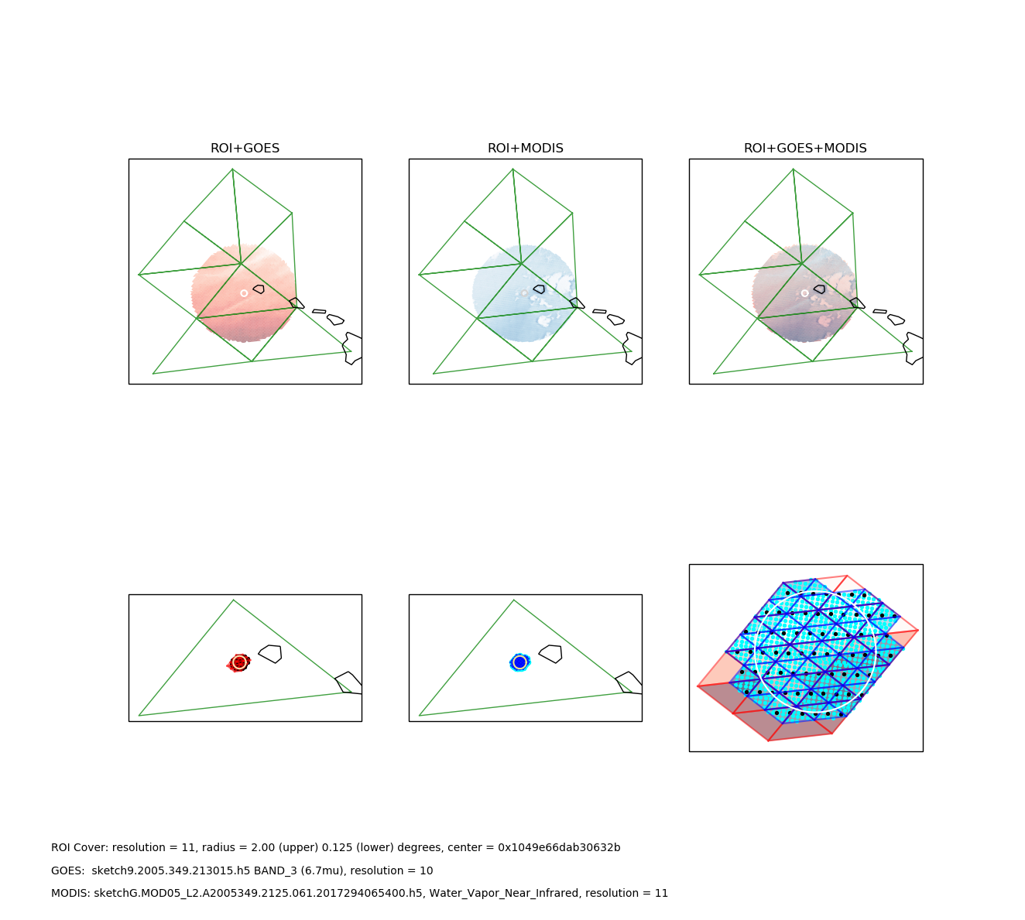
ROI+GOES
ROI+MODIS
ROI+GOES+MODIS
A
D
C
B
STARE Spatial IDs
Level 5, green trixels
A 0x1048000000000005
B 0x104a000000000005
C 0x104c000000000005
D 0x104e000000000005
0x1049e66dab30632b
0x1048000000000005
NASA/ACCESS-17-39 STARE
80NSSC18M0118
M. Rilee
mike@rilee.net
Rilee Systems Technologies LLC
2019 October 24
Notes:
cover: 0x1049e66dab30632b
0 0x1010000000000005
0 0x1048000000000005
0 0x104a000000000005
0 0x104c000000000005
0 0x104e000000000005
0 0x1068000000000005
0 0x2c08000000000005
0 0x2c30000000000005
0 0x2c70000000000005

Slide 29
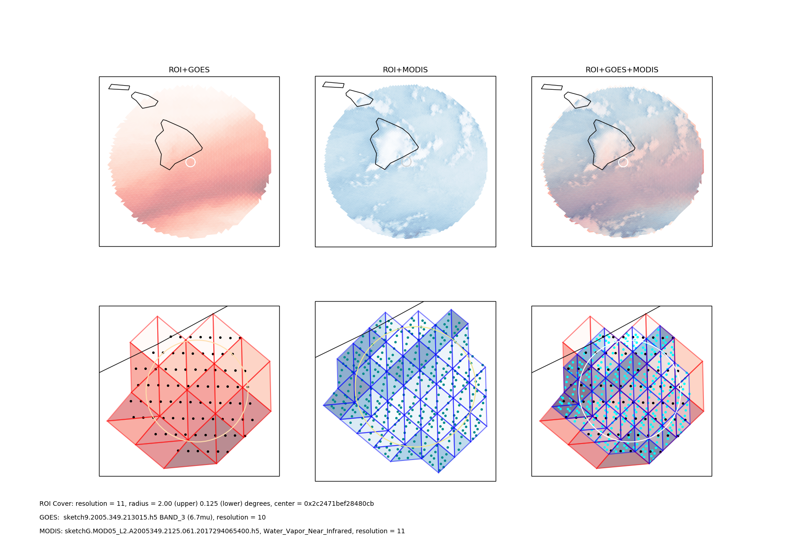
NASA/ACCESS-17-39 STARE
80NSSC18M0118
M. Rilee
mike@rilee.net
Rilee Systems Technologies LLC
2019 October 21

Slide 30
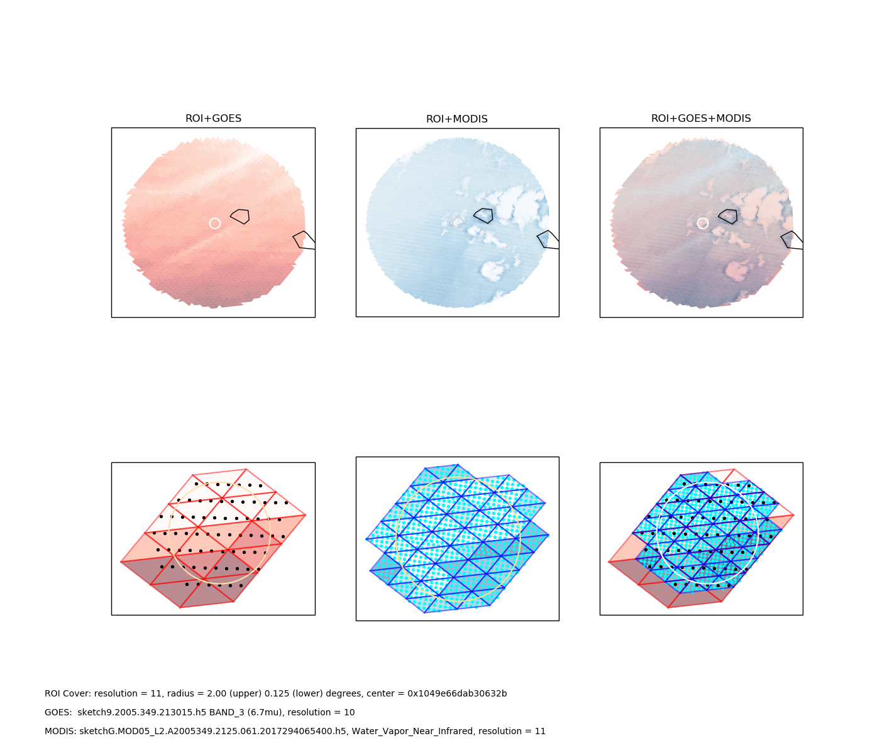
ROI+GOES
ROI+MODIS
ROI
+GOES
+MODIS
A: 0x1049e6000000000a
B: 0x1049e6600000000b
C: 0x1049e66dab30632b
NASA/ACCESS-17-39 STARE
80NSSC18M0118
M. Rilee
mike@rilee.net
Rilee Systems Technologies LLC
2019 October 24

Slide 31


Instrument Field of View and Point Spread Function Modeling
Integration at the finest level via IFOV and PSF modeling
k
j
“brown psf”
“blue psf”
$${{\tilde{s}}_{i}≈S}_{j}W_{ji}⊕S_{k}W_{ki}$$
i
$$\tilde{s}=\underline{W} S$$
“combined”
Signal
(target)
Observation
Vectors
(source)
PSF
weights
Finer trixels not shown for clarity.

Slide 32
