Slide 1


HDF for the Cloud:
New HDF Server Features
John Readey

Slide 2
Overview
HDF storage schema for the cloud
HDF Server features
What’s new
What’s next
Demo

Slide 3
What is HDF5?
Depends on your point of view:
a C-API
a data model
a file format
Let’s imagine keeping the API and
Data model, but with a different (cloud friendly)
Storage format

Slide 4
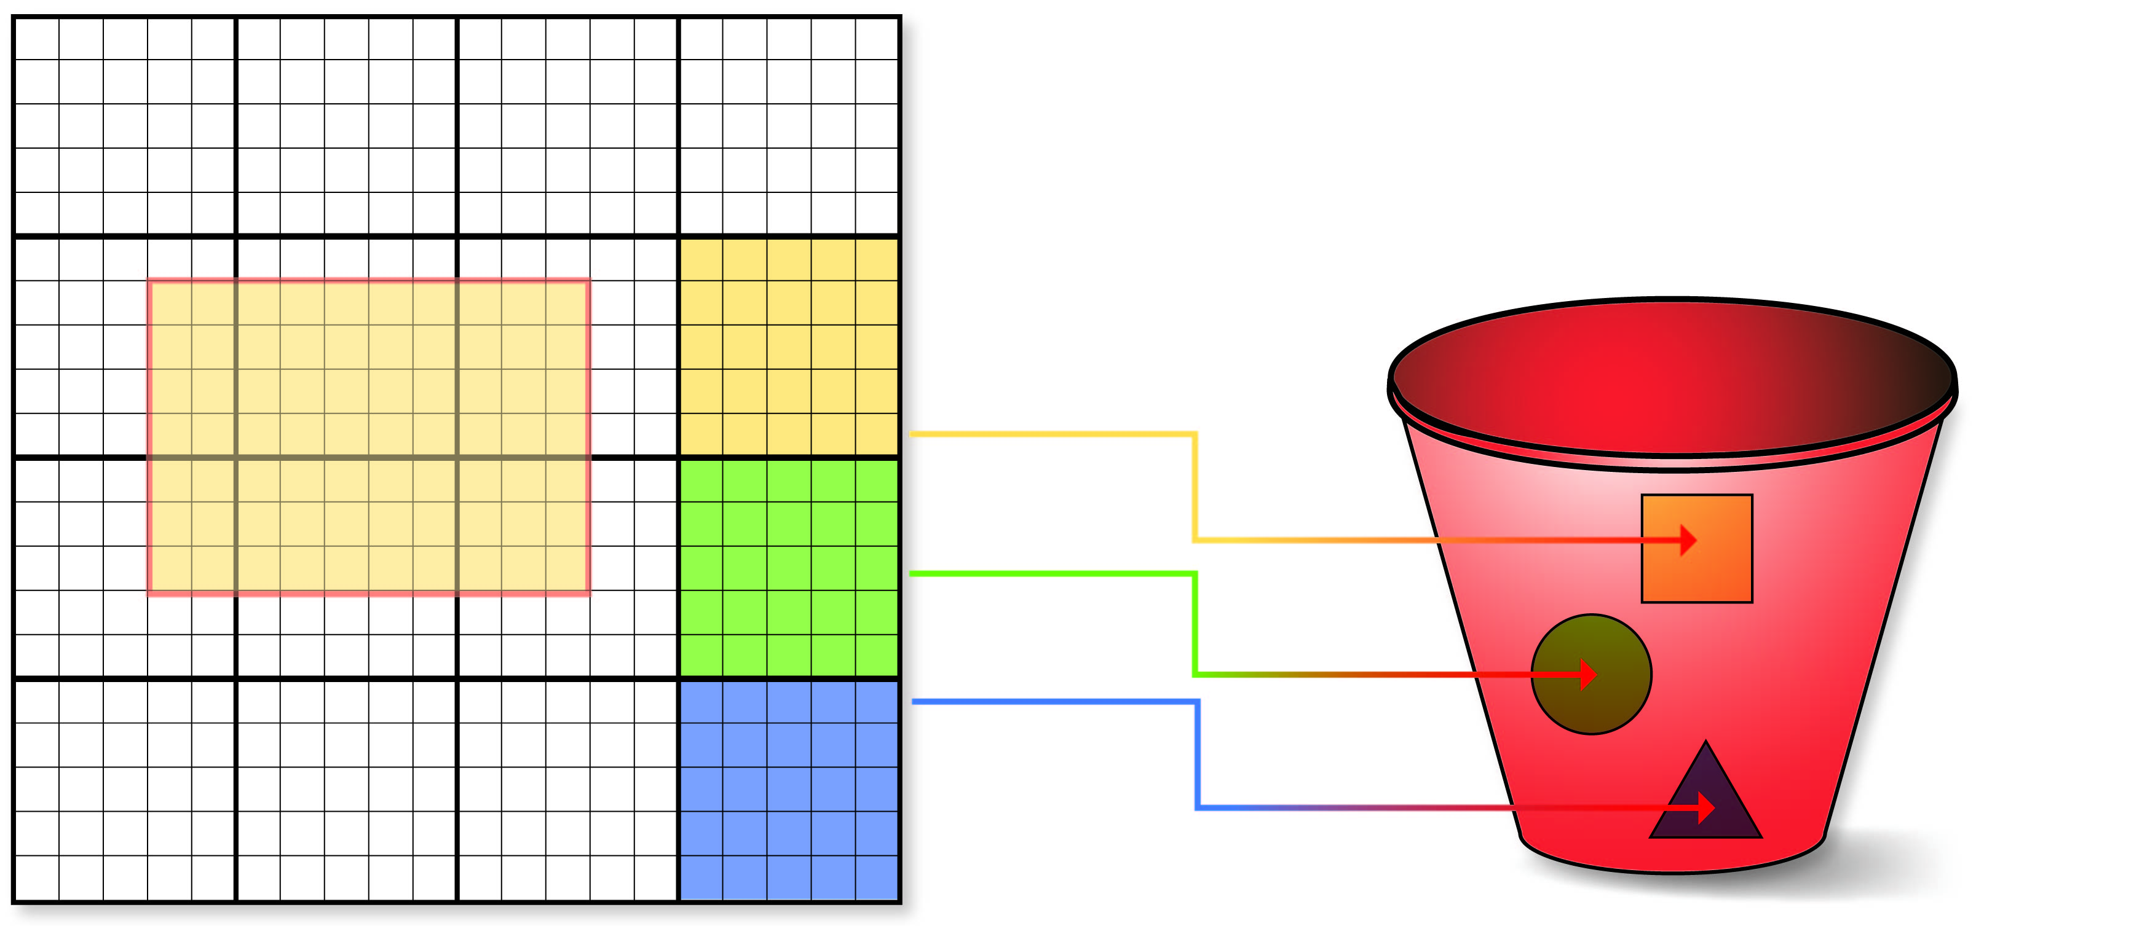



HDF Sharded Schema
Big Idea: Map individual HDF5 objects (datasets, groups, chunks) as Object Storage Objects
Why a sharded data format?
Limit maximum size of any object
Support parallelism for read/write
Only data that is modified needs to be updated
Multiple clients can be reading/updating the same “file”
Don’t need to manage free space
Each chunk (heavy outlines) get persisted as a separate object
Legend:
Dataset is partitioned into chunks
Each chunk stored as an object (file)
Dataset meta data (type, shape, attributes, etc.) stored in a separate object (as JSON text)

Slide 5
Sharded format example
root_obj_id/
group.json
obj1_id/
group.json
obj2_id/
dataset.json
0_0
0_1
obj3_id/
dataset.json
0_0_2
0_0_3
Observations:
Metadata is stored as JSON
Chunk data stored as binary blobs
Self-explanatory
One HDF5 file can translate to lots of objects
Flat hierarchy – supports HDF5 multilinking
Can limit maximum size of an object
Can be used with Posix or object storage
Schema is documented here: https://github.com/HDFGroup/hsds/blob/master/docs/design/obj_store_schema/obj_store_schema_v2.md

Slide 6
Implementations of the sharded schema
A storage format specification is nice, but it would be useful to have some software that can actually write and read to the format…
As it happens, we’ve created a software service that uses the schema: HSDS (Highly Scalable Data Service)
Note: HSDS was originally developed as a NASA ACCESS 2015 project: https://earthdata.nasa.gov/esds/competitive-programs/access/hsds
Software is available at: https://github.com/HDFGroup/hsds

Slide 7
Server Features
Simple + familiar API
  Clients can interact with service using REST API
  SDKs provide language specific interface (e.g. h5pyd for Python)
  Can read/write just the data they need (as opposed to transferring entire files)
  Support for compression
Container based
  Run in Docker or Kubernetes or DC/OS
Scalable performance:
  Can cache recently accessed data in RAM
  Can parallelize requests across multiple nodes
  More nodes ➔ better performance
  Cluster based – any number of machines can be used to constitute the server
  Multiple clients can read/write to same data source
  No limit to the amount of data that can be stored by the service

Slide 8
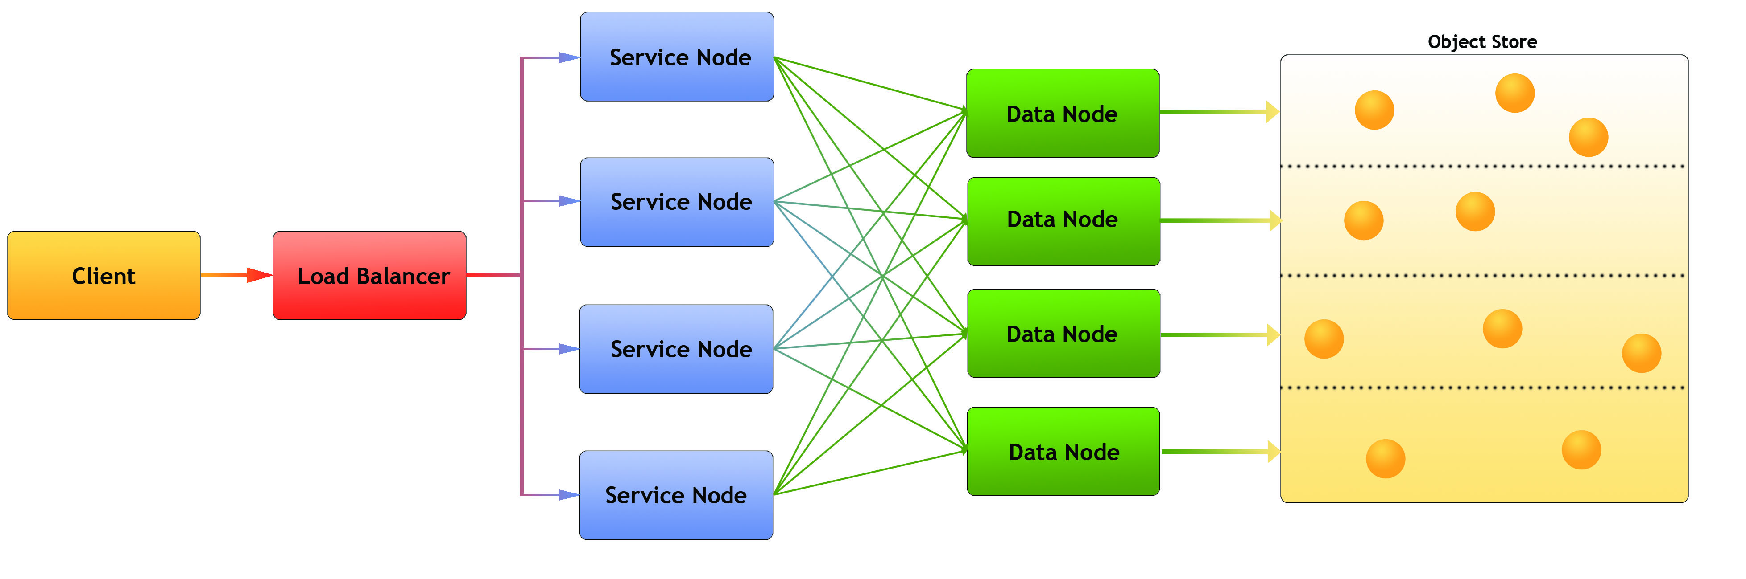
Architecture
Legend:
Client: Any user of the service
Load balancer – distributes requests to Service nodes
Service Nodes – processes requests from clients (with help from Data Nodes)
Data Nodes – responsible for partition of Object Store
Object Store: Base storage service (e.g. AWS S3)
Notes:
Each node is implemented as a docker container

Slide 9
HDF API Compatibility
The sharded storage schema captures the HDF data model, and REST service interface is nice, but it would be great if the existing HDF based applications and libraries could use the new storage format without requiring a bunch of code changes…
Two related projects provide a solution:
H5pyd – h5py compatible package for Python
REST VOL – HDF5 library plugin for C/C++

Slide 10
H5pyd – Python client
H5py is a popular Python package that provide a Pythonic interface to the HDF5 library
H5pyd (for h5py distributed) provides a h5py compatible h5py for accessing the server
Pure Python – uses requests package to make http calls to server
Include several extensions to h5py:
  List content in folders
  Get/Set ACLs (access control list)
  Pytables-like query interface
H5netcdf and xarray packages will use h5pyd when http:// is prepended to the file path
Installable from PyPI: $ pip install h5pyd
Source code: https://github.com/HDFGroup/h5pyd

Slide 11

Supporting the Python Analytics Stack
Many Python users don’t use h5py, but tools higher up the stack: h5netcdf, xarray, pandas, etc.
Since h5pyd is compatible with h5py, we should be able to support the same stack for HDF Cloud
Applications can switch between local and cloud access just by changing file path.
Xarray
Xarray
H5NETCDF
H5NETCDF
H5PY
H5PY
H5PYD
HDF5Lib
HDF5Lib
HDFServer
Disk

Slide 12
REST VOL Plugin
The HDF5 VOL architecture is a plugin layer for HDF5
Public API stays the same, but different back ends can be implemented
REST VOL substitutes REST API requests for file i/o actions
C/Fortran applications should be able to run as is
Some features not implemented yet:
  VLEN support
  Large read/write support (selections >100mb)
Downloadable from: https://github.com/HDFGroup/vol-rest

Slide 13
Command Line Interface (CLI)
Accessing HDF via a service means one can’t utilize usual shell commands: ls, rm, chmod, etc.
Command line tools are a set of simple apps to use instead:
  hsinfo: display server version, connect info
  hsls: list content of folder or file
  hstouch: create folder or file
  hsdel: delete a file
  hsload: upload an HDF5 file
  hsget: download content from server to an HDF5 file
  hsacl: create/list/update ACLs (Access Control Lists)
  Hsdiff: compare HDF5 file with sharded representation
Implemented in Python & uses h5pyd
Note: data is round-tripable:
  HDF5 File ➔hsload ➔ HSDS store ➔ hsget ➔ HDF5 file

Slide 14
Supporting traditional HDF5 files
We’ve discussed three aspects of HDF: the data model, API, and file format. With HSDS we’ve kept the data model and API, but the file format is radically different. But maybe you have a PB or two of HDF5 files you’d like to use…
If you have HDF5 files already stored in the cloud, they can be accessed by HDF Server
Rather than converting the entire file to the HDF Schema, just the metadata needs to be imported (typically <1% of the file)
Dataset reads are converted to S3 Range Gets on the stored file
The hsload CLI tool has an option (--link ) for loading file metadata
It is also possible to construct a server file that aggregates multiple stored files (similar to how the HDF5 library VDS feature works)

Slide 15
New HSDS features
HSDS version 0.6 is coming soon…
What’s new:
POSIX Support – Store content on regular disk drives
Azure
  Azure Blob support – Support for Azure’s object storage format
  AKS (Azure Kubernetes) – Run in Azure’s managed Kubernetes
  Active Directory authentication – Authenticate via AD
AWS
  Added support for AWS Lambda
DC/OS – support for DC/OS (Apache Mesos) distributed system
Domain checksums – verify when any content changes
Role Based Access Control (RBAC) – manage ACLs for user groups
Complete list is here: https://github.com/HDFGroup/hsds/issues/47

Slide 16






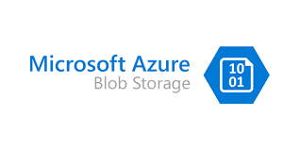



HSDS Platforms
HSDS can be run on most container management systems:
Using different supported storage systems:
POSIX Filesystem

Slide 17
AWS Lambda Functions
HSDS can parallelize requests across all the available backend (“DN”) nodes on the server
AWS Lambda is a new service that enables you to run requests ”serverless”
Pay for just cpu-seconds the function runs
By incorporating Lambda, some HDF Server requests can parallelize across a 1000 Lambda functions (equivalent to a 1000 container server)
Will dramatically speed up time-series selections

Slide 18


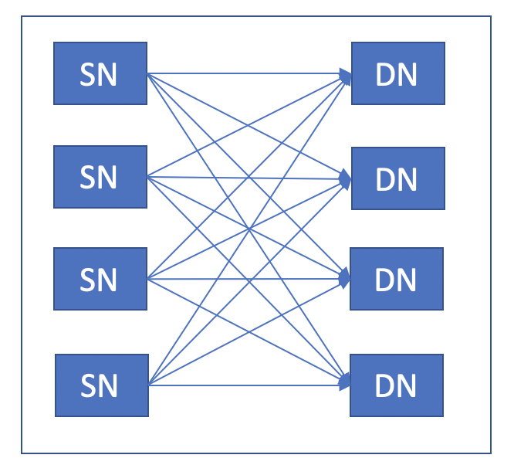

Kita Lab
Kita Lab is a JupyterLab and HDF server environment hosted by the HDF Group on AWS
Kita Lab users can create Python notebooks that use h5pyd to connect to HDF Server
Each user gets equivalent to 2-core Xeon Server and 10GB local storage
Users can use up to 100GB of data on HDF Server
Sign up here: https://www.hdfgroup.org/hdfkitalab/
User logs into Jupyter Hub
User
JupyterHub spawns new container at login
User’s container and EBS volume
S3 Bucket
HSDS on Kubernetes

Slide 19
Futures
Sometimes you’d rather do without a server and talk to the storage system directly:
  Don’t want to deal with setting up service
  Don’t want to worry about scaling service up and down with client load
  You don’t need the synchronization (e.g. managing multiple clients writing to the same dataset) that a service provides
HS Direct Access will be a new VOL connector that enables this for the HDF5 library
  Will take advantage of multiple cores
  Uses same schema as HSDS (and can be used in conjunction with HSDS)
Design doc is here: https://github.com/HDFGroup/hsds/blob/master/docs/design/direct_access/direct_access.md

Slide 20
Questions?

