Slide 1
HDF5 and Ecosystem: what is new?
ESIP
HDF Town Hall
June 22, 2020
Elena Pourmal epourmal@hdfgroup.org

Slide 2
Outline
HDF update
  Releases and new features
  Community engagement
    Github move
    Documentation work
    HDF5 User’s Group meeting
    The HDF Group Webinars
HDF5 ecosystem update
  HDFql
  H5CPP

Slide 3
HDF update
Releases and new features

Slide 4
HDF4
HDF 4.2.15 released in February 2020
  Added support for
    macOS 10.13 and 10.14
    VS2019
    MinGW (for C library only)
  Code cleanup: fixed memory leaks and refactored code.
HDF4 is deprecated in favor of HDF5
  Use h4toh5tools software to convert HDF4 files to HDF5
The HDF Group will provide HDF4 releases once a year to keep up with the new systems and compilers
  Known problems: Fortran library build fails with gcc 10
Migrate to HDF5 now!

Slide 5
HDF5
Current maintenance releases (1.8.*, 1.10.*, 1.12.*)
  In all releases we addressed vulnerability issues reported by HDF5 Community
  HDF5 1.8.21 June 2018
    Updated C++ APIs; bug fixes in tools
    The HDF Group will release HDF5 1.8.22 later in the year
    Consider migrating to HDF5 1.10.6 or HDF5 1.12.0 now unless you see performance degradation for your application
    Support for 1.8.* releases will be dropped as soon as we address performance issues in 1.10 and 1.12 releases.
  HDF5 1.10.6 December 2019
    Added S3 and HDFS read-only Virtual File Drivers (VFDs) (more info on the next slides)
    Improved performance when creating a large number of objects
    Addressed several backward compatibility issues when creating files to be read by HDF5 1.8.* versions
    HDF5 1.10.7 August 2020
      Performance improvements for handling selections and large number of objects

Slide 6
HDF5 (cont’d)
Current maintenance releases
  HDF5 1.12.0 in February 2020 – major release
    Virtual Object Layer (VOL)
    External references
    Performance improvements when working with selections
    Extensions to file format to support new features
    Files created by HDF5 1.12.* releases maybe not compatible with HDF5 1.10.* and earlier
      H5repack tool can be used to “downgrade” the version of file format to 1.10 or to 1.8
  Why to move to 1.12.*?
    Multiple ways to access data in Cloud and in Object Store using VOL and VFD capabilities
      Minimum or no modifications are required to applications
    External references along with existing Virtual Datasets provide a flexible way to aggregate data stored in HDF5 files
    Performance improvements for sequential and parallel HDF5

Slide 7
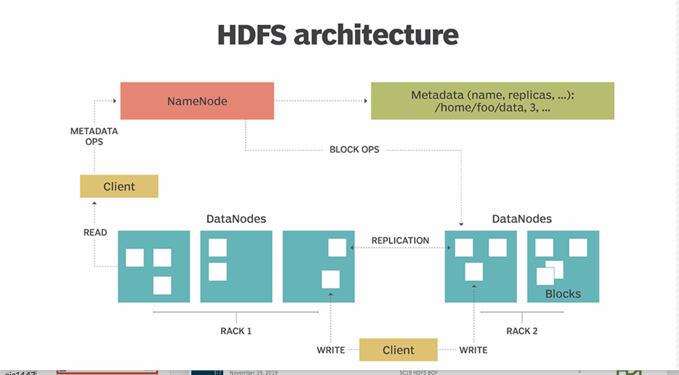
HDF5 Library Architecture (1.12.0)
HDF5 API and language bindings
Virtual Object Layer (VOL)
Pass-through VOL connectors
HDF5 Core Library
Native Connector
Data
Elevator
External connectors
DAOS
REST
Hermes
….
VFDs
POSIX
SWMR
S3
MPI I/O
….
HDFS
HDF5 applications can talk to Cloud using S3 VFD or REST VOL and HSDS server

Slide 8
HDF5 Cloud Solutions
S3 VFD
Part of the 1.10.6 and 1.12.0 releases
Read-only
Usage:
H5FD_ros3_fapl_t ros3_fa = { 1, 0, "", "", "" };
fapl_id = H5Pcreate(H5P_FILE_ACCESS);
status = H5Pset_fapl_ros3(fapl_id, &ros3_fa);
file = H5Fopen (FILE, H5F_ACC_RDONLY, fapl_id);
Future work:
  Improve scalability
  Make VFD dynamically loaded and file in S3 without application modification
  Provide write access to S3
REST VOL
External plugin for HDF5 1.1.2.0
  https://github.com/HDFGroup/vol-rest/blob/hdf5_1_12_update/docs/users_guide.pdf
Supports both reads and writes
Usage:
  RVinit();
  fapl = H5Pcreate(H5P_FILE_ACCESS); H5Pset_fapl_rest_vol(fapl);
  file = H5Fopen(filename,H5F_ACC_RDWR,fapl);
  or set environment variable to point to connector; no modification to application is needed
  HDF5_PLUGIN_PATH=/<path>/lib
  HDF5_VOL_CONNECTOR=REST
Future work:
  Provide direct access to S3
  Improve scalability

Slide 9


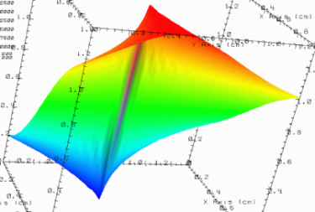

HDF5 External References
HDF5 dataset may now store references to objects or to dataset regions that are in another HDF5 file.
B.h5
Time step
36,000
V1 | V2 | temp
---- |----- |-----
12 | 23 | 3.1
15 | 24 | 4.2
17 | 21 | 3.6
Dataset in B.h5 stores references
to datasets stored in A.h5
A.h5

Slide 10
HDF5 Reference to Attribute
HDF5 1.12.0 allows to reference an attribute of a dataset or a group.
Time step
100,000
B.h5
Time step
36,000
V1 | V2 | temp
---- |----- |-----
12 | 23 | 3.1
15 | 24 | 4.2
17 | 21 | 3.6
Dataset in A.h5 stores references to the attributes on the objects in A.h5 and in B.h5.
A.h5

Slide 11
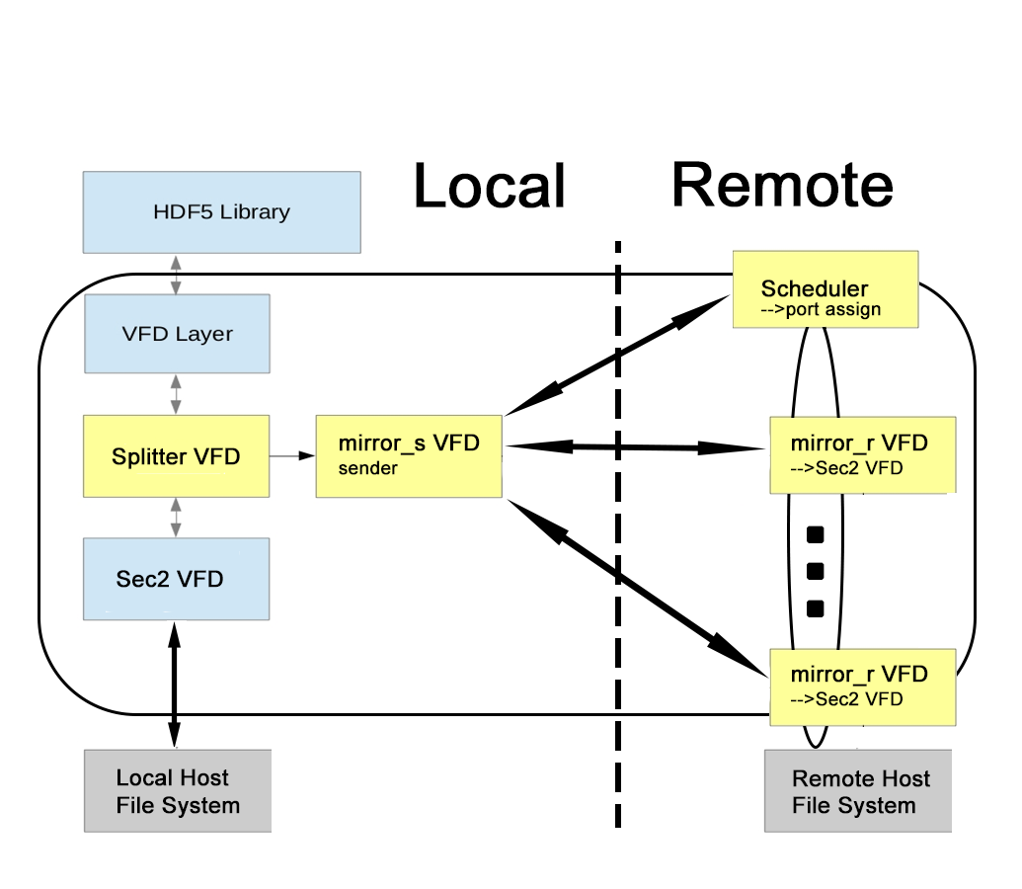
Splitter and Mirror VFDs
Coming in HDF5 1.12.1

Slide 12

HDF5 File Provenance
HDF5 offers no support for version control and provenance management
Data provenance is a major concern in cases where
  Original data must be preserved
  Changes are tracked and attributed
General HDF5 “undo” capability is technically challenging but tracking changes per file open/close cycle may be sufficient
  Changes are stored in the file itslef
Solution: new VFD (called provenance or “onion’)
  Coming in HDF5 1.12.2

Slide 13
HDF update
Community engagement

Slide 14
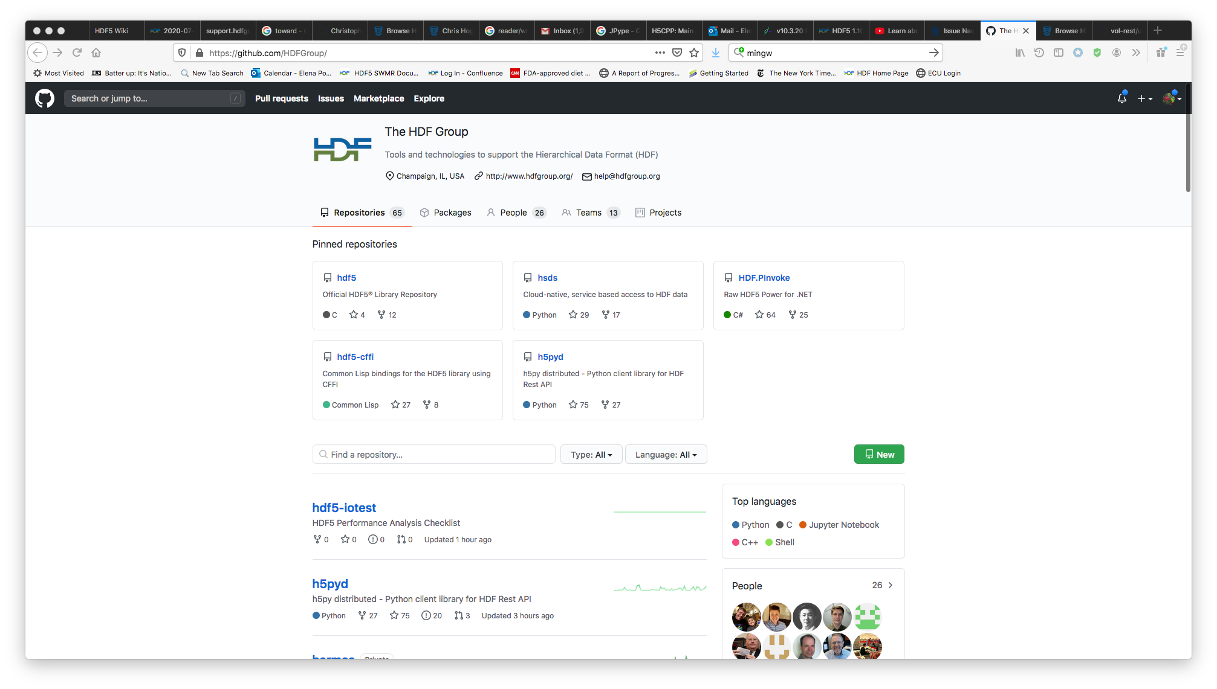
HDF5 is moving to Github
We plan to announce the move after HDF5 1.10.7 release

Slide 15
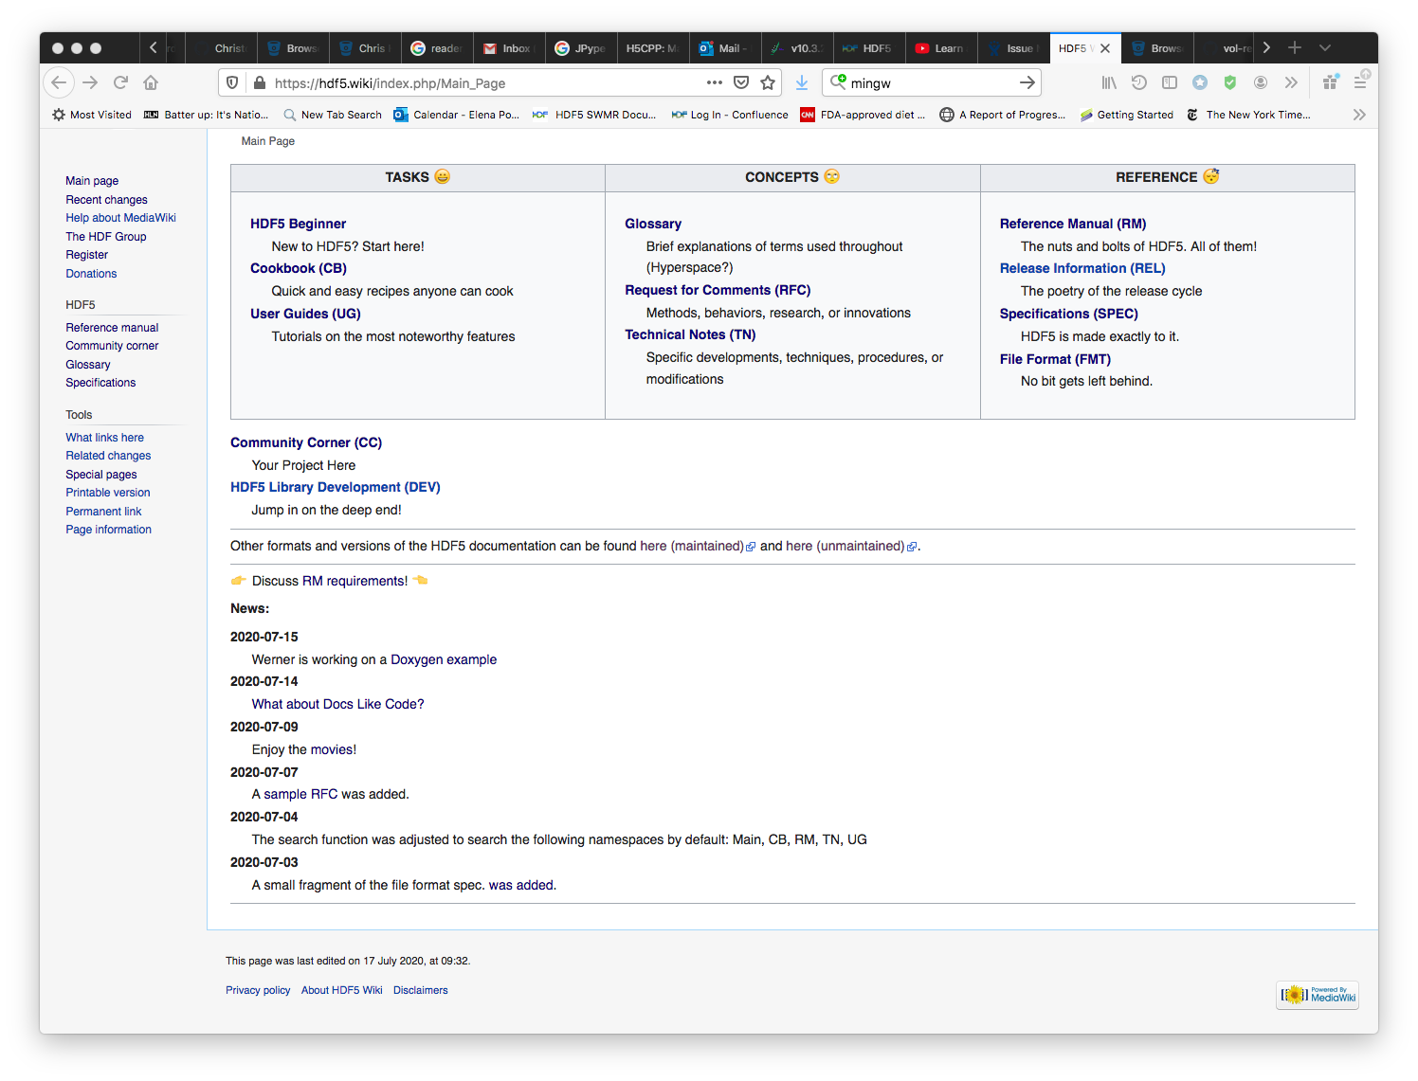
HDF5 Documentation
The HDF Group is working on addressing deficiencies of current HDF documentation (e.g., slow, hard to search, multiple locations)
Go to https://hdf5.wiki/ and help us with requirements gathering!

Slide 16
Want to learn more about HDF5?
HDF5 Webinars
  https://www.hdfgroup.org/category/webinar/
  Announced on HDF-FORUM and Website
HDF5 User’s Group Meeting
  October 2020 via ZOOM
  Interested to present your work? Please contact epourmal@hdfgroup.org
HDF-FORUM
  https://forum.hdfgroup.org/
HDF Helpdesk
  help@hdfgroup.org
  Service Desk (requires registration via https://hdfgroup.org )

Slide 17
HDF5 ecosystem update
HDFql and H5CPP – news kids on the block

Slide 18
HDF query language (HDFql)
HDFql (https://www.hdfql.com/) is a high-level language to manage HDF5 data
  Designed to be as simple and powerful as SQL
    Reads and writes HDF5 data; supports parallel I/O
    Has data and metadata querying capabilities
  Works on Linux, Windows and macOS and supports C, C++, Java, Python, C#, Fortran, and R
  Easy to learn; portable
create file my_file.h5
use file my_file.h5
create dataset my_group/my_dataset as int(3) enable zlib values(4, 8, 6)
HDFql
hid_t file, group, dataspace, property, dataset;
hsize_t dimension;
int value[3];
file = H5Fcreate(“my_file.h5”, H5F_ACC_EXCL, H5P_DEFAULT, H5P_DEFAULT);
group = H5Gcreate(file, “my_group”, H5P_DEFAULT, H5P_DEFAULT, H5P_DEFAULT);
dimension = 3;
dataspace = H5Screate_simple(1, &dimension, NULL);
property = H5Pcreate(H5P_DATASET_CREATE);
H5Pset_chunk(property, 1, &dimension);
H5Pset_deflate(property, 9);
dataset = H5Dcreate(group, “my_dataset”, H5T_NATIVE_INT, dataspace, H5P_DEFAULT, property, H5P_DEFAULT);
value[0] = 4;
value[1] = 8;
value[2] = 6;
H5Dwrite(dataset, H5T_NATIVE_INT, H5S_ALL, H5S_ALL, H5P_DEFAULT, &value);
HDF5 C
Courtesy Rick Noyer rick@hdfql.com

Slide 19
H5CPP
Website: http://h5cpp.org/
GitHub: https://github.com/steven-varga/h5cpp
Download: http://h5cpp.org/download/
Modern C++17 interface to HDF5
  Designed on principles of simplicity – uses four basic CRUD-like templates
  Supports popular Linear Algebra systems
  Has zero overhead over C APIs
  No knowledge of HDF5 is required
  Developed by Steven Varga, independent developer and researcher

Slide 20
H5CPP (cont’d)
h5py
temperature = np.random.random(1024)
wind = np.random.random(2048)
f = h5py.File('weather.hdf5')
f["/15/temperature"] = temperature f["/15/temperature"].attrs["dt"] = 10.0
f["/15/wind"] = wind
H5CPP
fvec temperature = arma::randu<fvec>(1024);
fvec wind = arma::randu<fvec>(2048);
auto fd = h5::create("weather.hdf5", H5F_ACC_TRUNC);
auto ds = h5::write(fd, "/15/temperature", temperature);
ds["dt"] = 10.0f;
h5::write(fd, "/15/wind", wind);

Slide 21

THANK YOU!
Questions & Comments?

