Slide 1

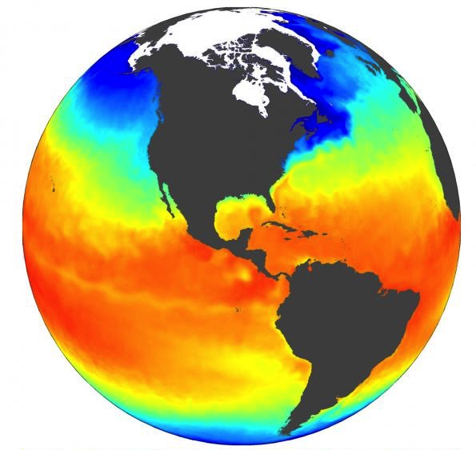

Parallel Computing with
HDF Server
John Readey
Notes:
Many users of HDF5 are now migrating data archives to public or private cloud systems. The access approaches and performance characteristics of cloud storage are fundamentally different than traditional data storage systems because 1) the data are accessed over http and 2) the data are stored in an object store and identified using unique keys. There are many different ways to organize and access data in the cloud. The HDF Group is currently exploring and developing approaches that will facilitate migration to the cloud and support many existing HDF5 data access use cases. Our goal is to protect data providers and users from disruption as their data and applications are migrated to the cloud.

Slide 2
The HDF5 data format
Established 20 years ago the HDF5 file format is the most commonly used format in Earth Science
Note: NetCDF4 files are actually HDF5 “under the hood”
HDF5 was designed with the (somewhat contradictory) goals of:
  Archival format – data that can stored for decades
  Analysis Ready -- data that can be directly utilized for analytics (no conversion needed)
There’s a rich set of tools and language SDKs:
  C/C++/Fortran
  Python
  Java, etc.

Slide 3
HDF5 File Format meets the Cloud
Storing large HDF5 collection on AWS is almost always about utilizing S3:
  Cost effective
  Redundant
  Sharable
It’s easy enough to store HDF5 files as S3 objects, but these files can’t be read using the HDF5 library (which is expecting a POSIX filesystem)
Experience using FUSE to read from S3 using HDF5Library has not tended to work so well
In practice users have been left with copying files to local disk first
This has led to interest in alternative formats such as Zarr, TileDB, and our own HSDS S3 Storage Schema (more on that later)
Our HSDS server provides a means of efficiently accessing HDF5 data on S3

Slide 4
HDF Server
HSDS is an open source REST based service for HDF data
  Think of it as HDF gone cloud native. ☺
HSDS Features:
  Runs as a set of containers on Kubernetes – so can scale beyond one machine
  Requests can be parallelized across multiple containers
  Feature compatible with the HDF library but is independent code base
  Supports multiple readers/writers
  Uses S3 as data store
  Existing HDF APIs (h5py, h5netcdf, xarray, etc.) work seamlessly with HSDS
Available now as part of HDF Kita Lab (our hosted Jupyter environment): https://hdflab.hdfgroup.org
Available on AWS Marketplace as “Kita Server”

Slide 5
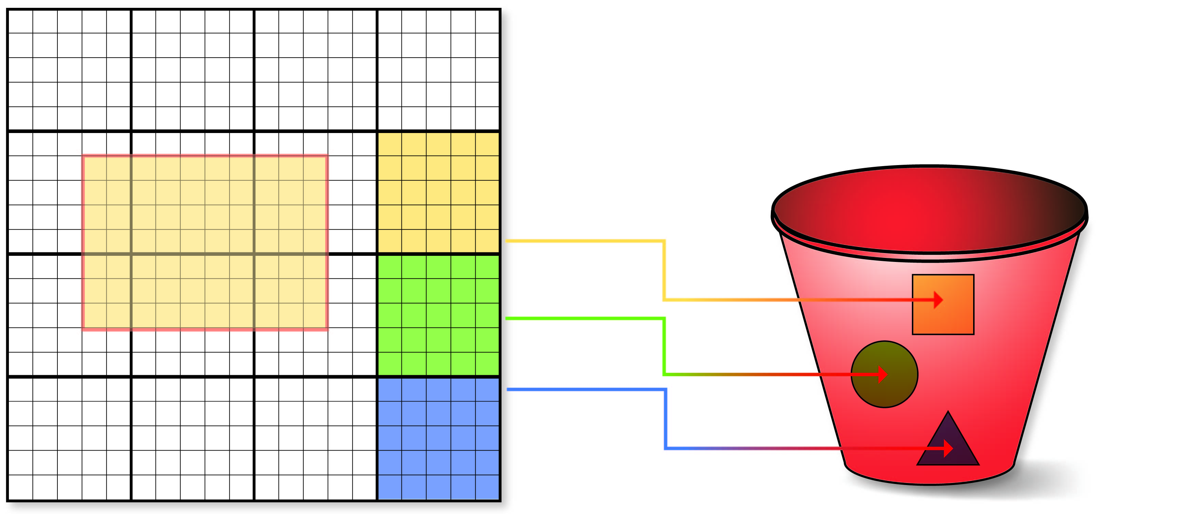



HDF Cloud Schema
Big Idea: Map individual HDF5 objects (datasets, groups, chunks) as Object Storage Objects
How to store HDF5 content in S3?
Limit maximum storage object size
Support parallelism for read/write
Only data that is modified needs to be updated
Multiple clients can be reading/updating the same “file”
Each chunk (heavy outlines) get persisted as a separate object
Legend:
Dataset is partitioned into chunks
Each chunk stored as an S3 object
Dataset meta data (type, shape, attributes, etc.) stored in a separate object (as JSON text)
Notes:
This idea has been kicking around for a while, but storing potentially millions of files on a Linux filesystem would be problematic.
Using S3 as the storage vehicle is a natural fit since there’s no limit to the number of objects in a bucket. With NREL we’ve validated this approach to 50 TB’s of data over 27MM objects (see aws-big-data blog article: https://aws.amazon.com/blogs/big-data/power-from-wind-open-data-on-aws/
)

Slide 6
Dataset JSON Example
{
"creationProperties": {},
"id": "d-9a097486-58dd-11e8-a964-0242ac110009",
"layout": {"dims": [10], "class": "H5D_CHUNKED"},
"root": "g-952b0bfa-58dd-11e8-a964-0242ac110009",
"created": 1526456944,
"lastModified": 1526456944,
"shape": {"dims": [10], "class": "H5S_SIMPLE"},
"type": {"base": "H5T_STD_I32LE", "class": "H5T_INTEGER"},
"attributes": {}
}
creationProperties contains HDF5 dataset creation property list settings.
Id is the objects UUID.
Layout represents HDF5 dataspace.
Root points back to the root group
Created & lastModified are timestamps
type represents HDF5 datatype.
attributes holds a list of HDF5 attribute JSON objects.

Slide 7
Schema Details
Key Organization
  Objects are stored root_id
  All non-root objects are stored as sub-keys of root_id
  “flat” organization to support non-cycle links
  Each storage node is limited to about 300 req/s 5,500 req/s
    Note: rate limit raised last year by Amazon
Chunks are stored in the same folder as dataset metadata
  Chunk key is determined based on chunk position in the data space
  E.g. c-<uuid>_0_0_0 Is the corner chunk of a 3-dimensional dataset
  Chunk objects get created as needed on first write
Schema is currently used just by HDF Server, but could just as easily be used directly by clients (assuming that writes don’t conflict)

Slide 8
New Features
Several improvements have been made over the last year
  Read access for traditional HDF5 Files stored in S3
    More on this in the next slide
  Shuffle filter support
    Along with deflate
  Fast metadata loading
    Optionally load all metadata in one request
  Support for multiple buckets
    HSDS can access data stored in different buckets
  H5netcdf & xarray support
    Support for the REST API is built into these packages
  Additional CLI tools (hsmv, hscp, hsdiff)
  Variable Length data support with compression
  Schema V2

Slide 9

Supporting traditional HDF5 files
Downside of the HDF S3 Schema is that data needs be transmogrified*
Since the bulk of the data is usually the chunk data it makes sense to just leave the data in place and save pointers to the original file(s):
  Convert just the metadata of the source HDF5 file to the S3 Schema
  Store the source file as a S3 object
  For data reads, metadata provides offset and length into the HDF5 file
  S3 Range GET returns needed data
This approach can be used either directly or with HDF Server
Compared with accessing S3 directly, you reduce the number of S3 requests needed
Performance is comparable to sharded data model
Only read access is supported

Slide 10

Hybrid Approach: Metadata + HDF5 Files
Imported Metadata (JSON)
HDF5 File stored as S3 object
Dset /dset1: chunk 0
Dset /dset1: chunk 1
S3 Range GET(
S3 Key
Offset
Num Bytes)
Dset /dset1: chunk n
S3://BIG_REPO/…/AN_HDF5_FILE.h5

Slide 11
Kita Lab – playground for HDF Server
HDF Kita Lab runs on AWS in a Kubernetes cluster
  Cluster can scale to handle different number of users
  Each user gets:
    1 CPU Core (2.5GHz Xeon)
    8 GB RAM
    10 GB Disk
    100 GB S3 Storage
Access to HDF Kita Server
  Ability to read/write HDF data stored on S3
User environment configured for commonly used Python Packages for HDF users:
  H5py(d), pandas, h5netcdf, xarray, bokeh, dask
HDF Kita Command Line tools:
  Hsinfo, hsls, hsget, hsload, etc.

Slide 12
Kubernetes Platform
JupyterLab and Kita Server both runs as a set of Docker containers
Kubernetes transparently manages running these containers across multiple machines
{
Containers
JupyterHub
HDF Kita Server (HSDS)
Kubernetes
AWS

Slide 13




Architecture
SN
DN
User
spawn
SN
DN
SN
DN
SN
DN
AWS S3
User Containers &
EBS Volumes
Kita Server (HSDS)

Slide 14
References
HSDS: https://github.com/HDFGroup/hsds
H5Pyd: https://github.com/HDFGroup/h5pyd
Kita Lab: https://www.hdfgroup.org/hdfkitalab/
SciPy2017 talk: https://s3.amazonaws.com/hdfgroup/docs/hdf_data_services_scipy2017.pdf
AWS Big Data Blog article: https://aws.amazon.com/blogs/big-data/power-from-wind-open-data-on-aws/
Spark and HDF Blog article: https://www.hdfgroup.org/2015/04/putting-some-spark-into-hdf-eos
Notebook from this talk: https://gist.github.com/jreadey/d1c67aee07451985397f48a50be2cdaa

