Slide 1
HDF5 Roadmap 2019-2020
Summer ESIP 2019
Elena Pourmal
The HDF Group EED2 Team Lead
epourmal@hdfgroup.org
This work was supported by NASA/GSFC under Raytheon Co. contract number NNG15HZ39C.
This document does not contain technology or Technical Data controlled under either the U.S. International Traffic in Arms Regulations or the U.S. Export Administration Regulations.

Slide 2
Outline
New features in Hierarchical Data Format 5 (HDF5) Release 1.12.0
Support for HDF5 versions 1.8 and 1.10
Summary of HDF5 Roadmap

Slide 3


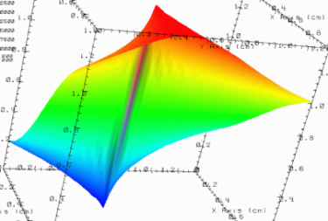

HDF5 References
HDF5 dataset may store references to other objects or references to selected elements of a dataset.
References to objects or dataset regions stored in other files are coming in HDF5 1.12.0.
B.h5
Time step
36,000
V1 | V2 | temp
---- |----- |-----
12 | 23 | 3.1
15 | 24 | 4.2
17 | 21 | 3.6
Dataset in B.h5 stores references
to datasets stored in A.h5
A.h5
Notes:
Arrows symbolize the links between objects.

Slide 4
HDF5 Reference to Attribute
HDF5 1.12.0 will allow to reference an attribute of a dataset or a group. Dataset in A.h5 stores references to the attributes in A.h5 and B.h5.
Time step
100,000
B.h5
Time step
36,000
V1 | V2 | temp
---- |----- |-----
12 | 23 | 3.1
15 | 24 | 4.2
17 | 21 | 3.6
A.h5
Notes:
Arrows symbolize the links between objects.

Slide 5
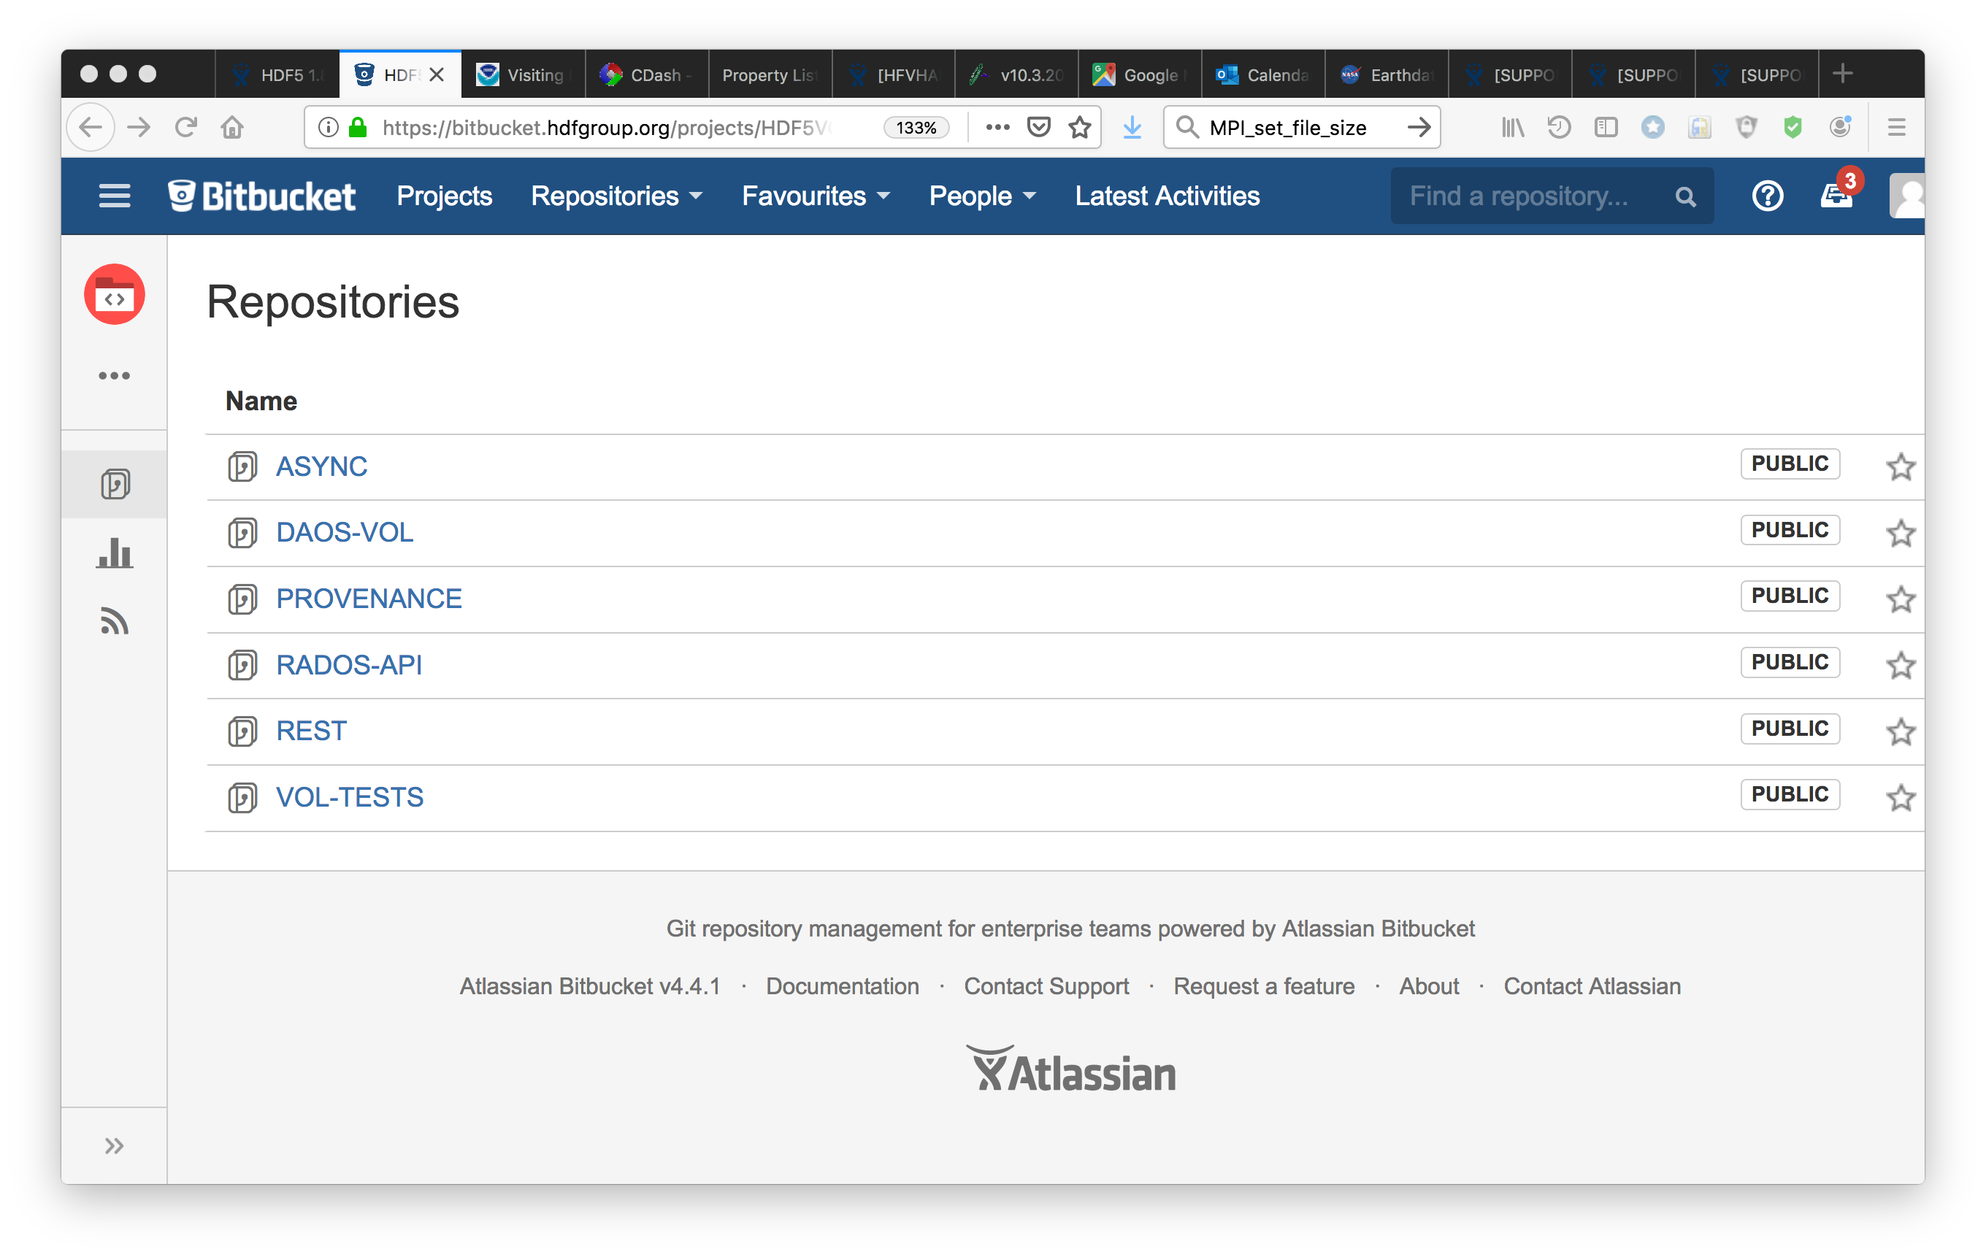
HDF5 New Architecture
HDF5 1.12.0 enables HDF5 to store data on new storage using Virtual Object Layer (VOL) connectors and Virtual File Drivers (VFDs).
VOL connectors developed by The HDF Group and its collaborators are available from public repository https://bitbucket.hdfgroup.org/projects/HDF5VOL

Slide 6
HDF5 New Architecture (cont’d)
1
DAOS Object Store
DAOS
AIO
REST
S3
S3
1 – HDF5 Application Programming Interface

Slide 7
S3 VFD
HDF5 1.12.0 will have a VFD to access HDF5 file via Amazon Simple Storage Service (Amazon S3)
Requires minimum changes to the application code
h5dump and h5ls tools have a flag to specify the driver to access HDF5 file on S3
h5ls --vfd=ros3
https://s3.us-east-2.amazonaws.com/file.h5

Slide 8
S3 VFD (cont’d)
Uses “range get” commands to get “bytes” from HDF5 file stored on S3
New API to set up S3 VFD
  herr_t H5Pset_fapl_ros3(hid_t fapl_id, H5FD_ros3_fapl_t *fa)
Credentials are passed via parameter to the function
Demo

Slide 9
HDFS VFD
HDF5 1.12.0 will have a VFD to access HDF5 file on Hadoop Distributed File System (HDFS).
  New API to access HDF5 file on HDFS
  herr_t H5Pset_fapl_hdfs(hid_t fapl_id);
HDF5 command line tools with enabled HDFS VFD allows to extract metadata and raw data from HDF5 and netCDF4 files on HDFS, and use Hadoop streaming to collect data from multiple HDF5 files.
Demo

Slide 10
New default for string encoding
UTF-8 will be default string encoding instead of ASCII starting with HDF5 1.12.0
  Names of groups, datasets, attributes
  Names of compound datatypes fields, enums, names of the files that are stored in HDF5 according to the File Format spec (VDS, VFDs family and split) have to be ASCII.

Slide 11
Support for HDF5 1.8 and 1.10
The HDF Group will continue support for HDF5 1.8.* and 1.10.* releases
  Security patches
  Critical bug fixes
  Performance improvements
  Thorough testing of HDF5 1.8.* for forward compatibility with HDF5 1.10.* and 1.12.0
    Files created by applications that are built with the HDF5 version later than 1.8.* and that do not use any new features of that version are readable by 1.8.*

Slide 12
260 days
HDF5 Roadmap
260 days
HDF5 1.8
2019
2020
2021
2022
Q1
260 days
Q2
Q3
Q4
Q1
Q2
Q3
Q4
Q1
Q2
Q3
Q4
Q1
5 days
Today
4 days
260 days
Fall 2019
1.8.22
Summer 2020
1.8.23
260 days
Security patches
Forward Compatibility with 1.12
Security patches
Forward Compatibility with 1.12
1 day
0 days
1 day
HDF5 1.10
0 days
0 days
Nov
1.10.8
May
1.10.9
0 days
Nov
1.10.6
May
1.10.7
Address degradation of performance between major HDF5 releases 1.6 – 1.10
VDS HDF5 performance
Public performance benchmark test suit
Dynamically loaded VFDs
S3, HDFS, Spark VFD connectors
Address degradation of performance between major HDF5 releases 1.6 – 1.10
Security updates
Bug fixes
0 days
0 days
259 days
HDF5 1.12
5 days
5 days
2020-2021
1.12.X
HDF5 2.0 instead of 1.12.0?
Storage beyond the current File Systems and HDF5 file format
3 days
July 2019
1.12.0
Nov 2019
1.12.1
5 days
Query and Indexing
Full SWMR
Mirror VFD
Provenance (Onion) VFD
VOL architecture
References
Parallel compression (enhanced)
VOL plugins (DAOS)
VFD plugins
Dynamically loaded VFDs
S3, HDFS, SPARK VFD connectors
1 day
2 days
2017

Slide 13













This work was supported by NASA/GSFC under Raytheon Co. contract number NNG15HZ39C.
in partnership with

