Slide 1
NASA Terra Data Fusion
Kent Yang
The HDF Group
HDF Town Hall
July 20, 2018

Slide 2
The Terra Data Fusion Project Team
Department of Atmospheric Sciences, University of Illinois
Larry Di Girolamo Guangyu Zhao Yizhe Zhan Landon Clipp Shashank Bansal
Yat Long Lo Dongwei Fu Brandon Chen
Department of Geography and GIS, University of Illinois
Shaowen Wang Yan Liu Yizhao Gao
The HDF Group
MuQun (Kent) Yang H Joe Lee
National Center for Supercomputing Applications, University of Illinois
John Towns Kandace Turner Michelle Butler Sean Stevens David Ralia
Jonathan Kim Donna Cox Stuart Levy Robert Patterson Andrew Christiensen
Department of Atmospheric Sciences, Texas A&M
Ping Yang Hioki Souichiro Yi Wang
NASA Langely/SSAI
Lusheng Liang
NASA Goddard Space Flight Center
Ralph Kahn Jim Limbacher

Slide 3
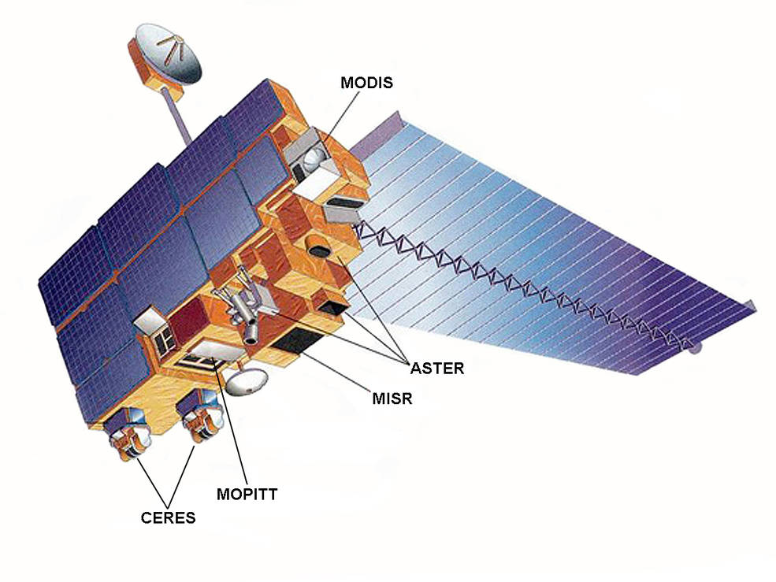
EOS Terra
Flagship mission
Launched in 1999
Projection ends in 2022
Longest single satellite climate record
One of the most popular Earth Science satellite data
Five instruments
  ASTER,CERES, MISR,MODIS,MOPITT
Credits: NASA

Slide 4
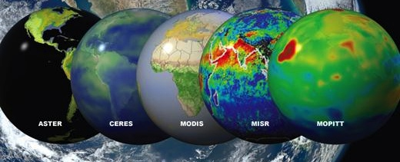
Terra, in 2015 alone…
More than 360 million files…
Totaling more than 3.4 PB data…
Delivered to more than 100,000 users around the world.
More than 1,800 peer-reviewed publications (over 15,000 to date)
Results from Terra cited more than 49,000 times (over 250K to date)
“The high publication rate includes an increasing number of papers capitalizing on fusion of data among Terra sensors”
– NASA Senior Review 2017: Terra

Slide 5
Terra Data Fusion Project
Fuse existing Level 1B Terra radiance products from all Terra 5 instruments into one product

Slide 6
Why Terra Data Fusion?
Scientific value added by data fusion of its five instruments.
A key recommendation from the 2007 NRC Decadal Survey on Earth Science and Application from Space:
“…experts should... focus on providing comprehensive data sets that combine measuremements from multiple sensors.”

Slide 7
Challenges for Terra Data Fusion
Huge data volumes
  1 PB input data from year 2000 to 2015
Need adequate cyberinfrastructure to tackle
Input data residing at different locations
Need to transfer huge data volumes

Slide 8
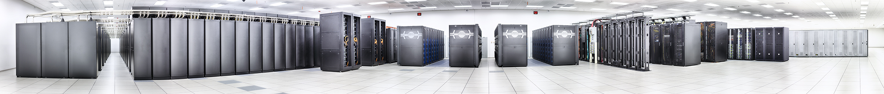
Solutions
NCSA supercomputer clusters
  Blue Waters and other clusters were used for Terra Data fusion
  NCSA nearline tape archive system is used to store the input and fusion data
NCSA experts helped transfer the huge input data to NCSA supercomputer facilities
NCSA Blue Waters

Slide 9
More Challenges
Input data
  Different granularities
  Different methods to store radiance and geo-location data
  Different file formats
Complicate fusion file organization
Metadata conventions need to catch up
Overcoming these challenges is what
The HDF Group contributed the most!

Slide 10
Different Instrument Granularities
Map granules from different instruments to a common granule that contains data for a single Terra orbit.
  Contain multiple MODIS and ASTER input granules
  Subset CERES and MOPITT input granules

Slide 11
Different Methods to Store Data
Unpacking MODIS, ASTER and MISR radiation data to physical units
  Need to unpack the data by following the specific packing schemes of individual instruments
Interpolating MODIS, ASTER and MISR geolocation data to native radiance resolution
  Need to handle each instrument differently

Slide 12
Different File Formats of Input Granules
All converted to HDF5 file format
  From HDF4, HDF-EOS2 and HDF-EOS5
Also netCDF-4 compatible
  Following netCDF-4 enhanced data model

Slide 13
Complicate Fusion file organization
Use HDF5 group structure to organize different instruments and different input granules
  Each instrument represented by one group
  Each input granule stored as the subgroup of the instrument group

Slide 14
Metadata Conventions Catch-up
Make the fusion HDF5 file follow CF conventions by adding key CF attributes
  Units
  Coordinates
  _FillValue
  Valid_min
  Valid_max

Slide 15
More usage of HDF5 features
HDF5 chunking and compression are used to reduce the total fusion file size.

Slide 16
Fusion File Statistics
About 1 million input files.
84,303 files – from Feb 25 2000 to Dec 31 2015
The total file size is 2.3 petabytes.
Typical file sizes 15GB – 40GB. The largest file size is 68.7GB. Average file size is 26GB.
HDF5 in-memory compression reduces the total file size by 60%.

Slide 17
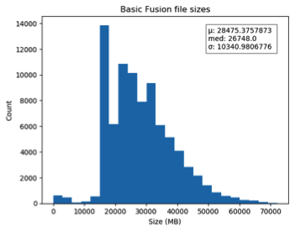
Fusion File Statistics

Slide 18
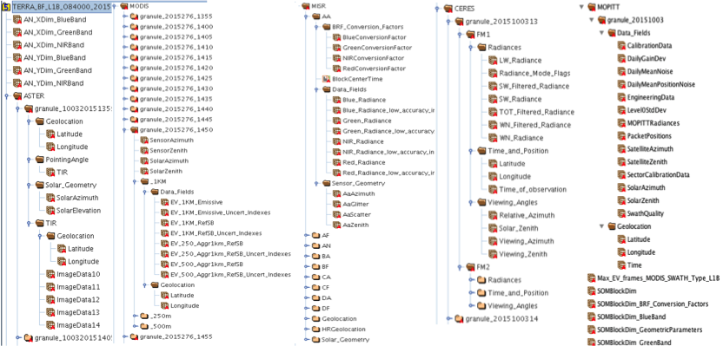
Fusion HDF5 File Layout in HDFView
Notes:
Note the file hierarchy according to individual instrument

Slide 19
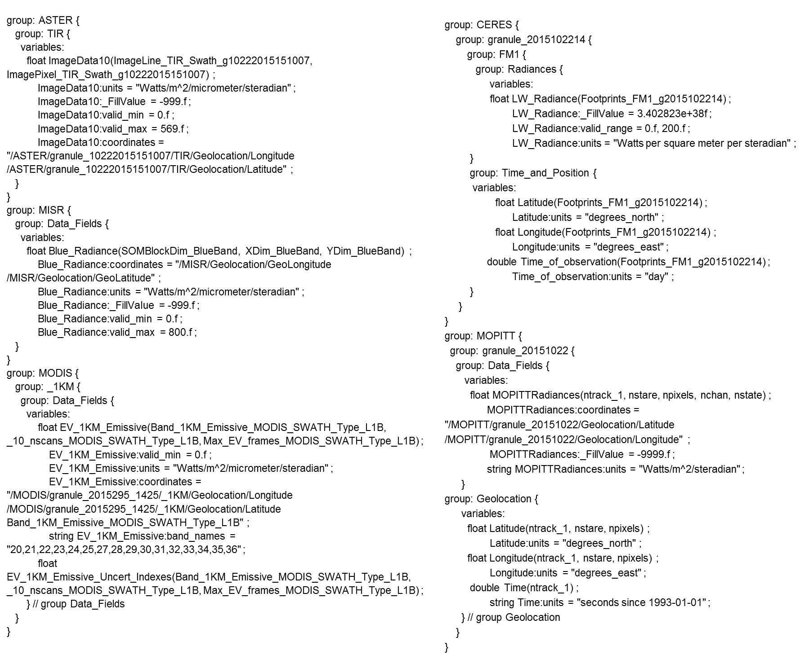
Fusion HDF5 File Layout in CDL
Notes:
Note the netCDF-CF information in the CDL. Dimension names and CF attributes.

Slide 20
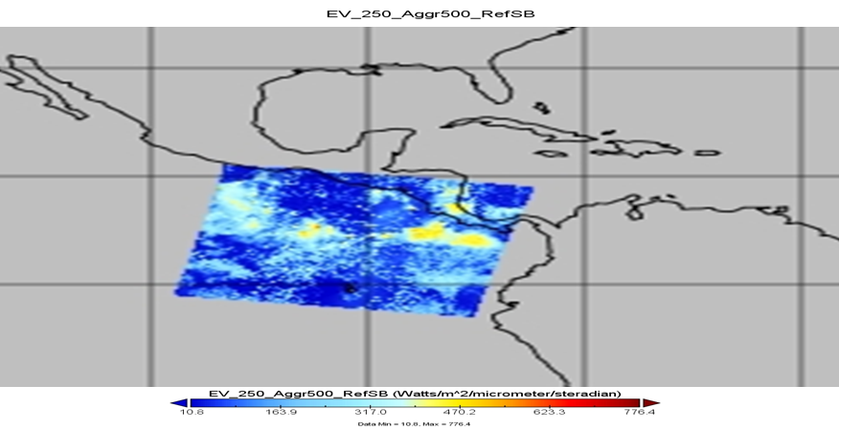
Fusion file visualized in Panoply

Slide 21
Other Work
Validate the generated data to ensure the high quality fusion product
Implemented the advanced fusion resampling and reprojection tool
  Resample / reproject the radiance fields for one Terra instrument onto the grids used by another Terra instrument
Generated the NASA CMR-compliant fusion Collection and granule metadata in ECHO 10 XML format
Notes:
May expand if more time is given. The metadata information can be added easily.

Slide 22
Fusion data visualization demo

Slide 23
Thank You!

Slide 24
Acknowledgements
This work was supported by NASA ACCESS Grant #NNX16AM07A.
Any opinions, findings, conclusions, or recommendations expressed in this material are those of the author[s] and do not necessarily reflect the views of NASA.

Slide 25
Questions/comments?

