Slide 1
Hierarchical Data Format for Earth Observing System
Data Product Developer’s Guide
HDF-EOS Workshop XXI /
The 2018 ESIP Summer Meeting
Hyo-Kyung (Joe) Lee
Software Engineer / The HDF Group
hyoklee@hdfgroup.org
This work was supported by NASA/GSFC under Raytheon Co. contract number NNG15HZ39C.
This document does not contain technology or Technical Data controlled under either the U.S. International Traffic in Arms Regulations or the U.S. Export Administration Regulations.

Slide 2
Motivation and Related work
The work presented in this talk is done in support of Data Product Developers Guide Working Group https://wiki.earthdata.nasa.gov/display/ESDSWG/Data+Product+Developers+Guide+Working+Group
WG Mission Statement: Help Data Product developers make data usable for End Users
WG chairs
  Hampapuram Ramapriyan (hampapuram.ramapriyan@ssaihq.com)
  Peter Leonard (pleonard@sesda3.com)
WG POCs
  Chris Lynnes (chris.lynnes@nasa.gov)
  Nathan James (nate.james@nasa.gov)
  John Moses (john.f.moses@nasa.gov)
The HDF Group members
  Joe Lee (hyoklee@hdfgroup.org) and Aleksandar Jelenak (ajelenak@hdfgroup.org)

Slide 3
Broader HDF-EOS Definition
Hierarchical Data Format for Earth Observing System
Any Earth data stored in HDF format
  HDF4, HDF5, and netCDF-4

Slide 4
HDF-EOS Data Product
Data is a consumer product like food, clothing, and house.
Design and package it well.
Users (=consumers) will appreciate it.

Slide 5
What Users Ask through Help Desk
Geolocation retrieval
Sampling over region & time
Creating plots (e.g., Journal publication)
GDAL* tools (e.g., ESRI ArcGIS)
netCDF tools (e.g., Panoply)
Programming in MATLAB
*Geospatial Data Abstraction Library

Slide 6
Better Products = Less Questions
Improve Earth data user experience
Self-describing = self-serviceable data
How to create better data products?

Slide 7
Guide I: Geo-location
Add latitude/longitude variables
  Regardless of projection parameters in metadata
For grids and points, use 1D dataset.
For swath, use 2D dataset.
  This will help visualization tools.
No 3D dataset / No fill value
Use units attribute (e.g., degrees_east
and degrees_north)
Notes:
Data with geo-location is like mail without address information.

Slide 8
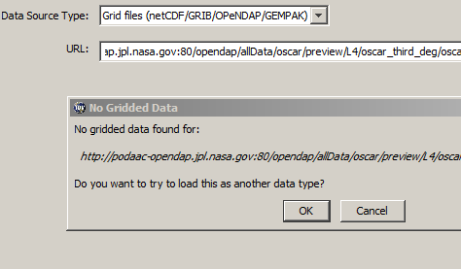
Why Geo-location?
Integrated Data Viewer throws “No Gridded data found” error message.
NCAR Command Line Language cannot plot data if lat / lon has fill values.

Slide 9
Guide II: Named Dimensions
Essential for netCDF interoperability
Have named dimensions.
1-d coordinate variable, use the same name as dataset name (COARDS*)
Use netCDF APIs but store as netCDF-4/HDF5 (easy).
Use HDF5 dimension scale APIs if you don’t want to use netCDF APIs (difficult).
Check with netCDF-Java tools.
* Cooperative Ocean/Atmosphere Research Data Service

Slide 10
Why named dimensions?
Strange phony_dim_0 will appear for netCDF tools.
Dimension names are heavily used by netCDF-Java tools to identify feature types.
If 1D variable name matches dimension name, it becomes a coordinate variable automatically.

Slide 11
Guide III: The CF Conventions
CF: Climate and Forecast Metadata
long_name attribute
units attribute
coordinates attribute
Use templates

Slide 12
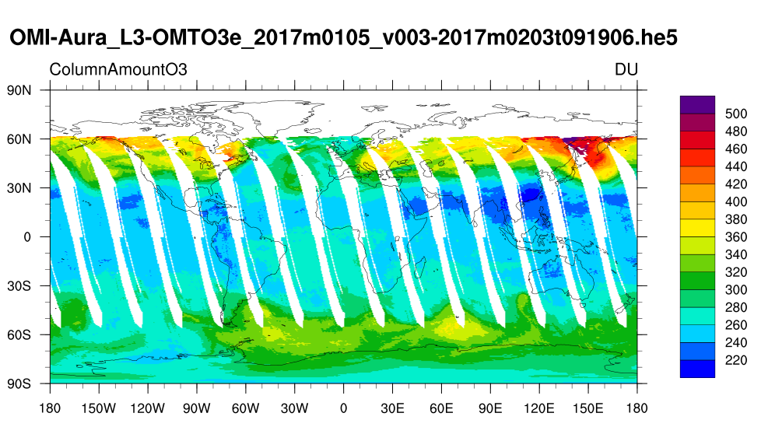
Why long_name and units?
Some tools utilize them automatically!
NCAR Command Line Language
Image from http://hdfeos.org/zoo

Slide 13
Guide IV: Test with tools.
MATLAB, Python
Geospatial Data Abstraction Library (GDAL) tools (e.g., gdal_translate)
NCAR Command Line Language (NCAR)
toolsUI and Panoply
Integrated Data Viewer (IDV)
Interactive Data Language (IDL)
OPeNDAP (e.g., Hyrax*, THREDDS**)
*Hyrax is the data server from OPeNDAP.
**Thematic Real-time Environmental Distributed Data Services

Slide 14
Question: any tool for guidelines?
Answer: HDF Product Designer (HPD) can help data producers!

Slide 15
HDF Product Designer (HPD)
Design is key.
Design twice, produce data once.
Testing and validation is a must.
  CF checker from JPL
  Testing with netCDF-C tool (e.g., ncdump)
  Testing with THREDDS / Hyrax

Slide 16
Why HDF Product Designer?
Design and test product quickly.
Graphical User Interface (GUI)
Design Templates
  CF feature types
  Existing NASA HDF4/HDF5 products
Testing and validation is built-in.
  CF convention checker
  Hyrax/THREDDS

Slide 17
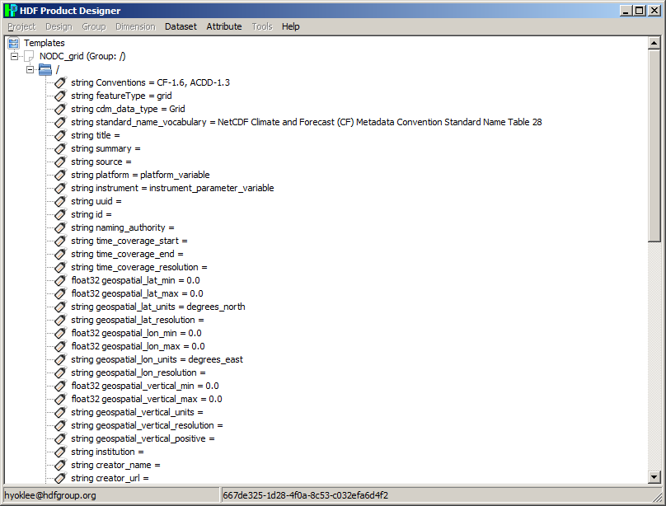
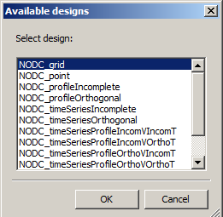
HPD GUI & Design Template

Slide 18
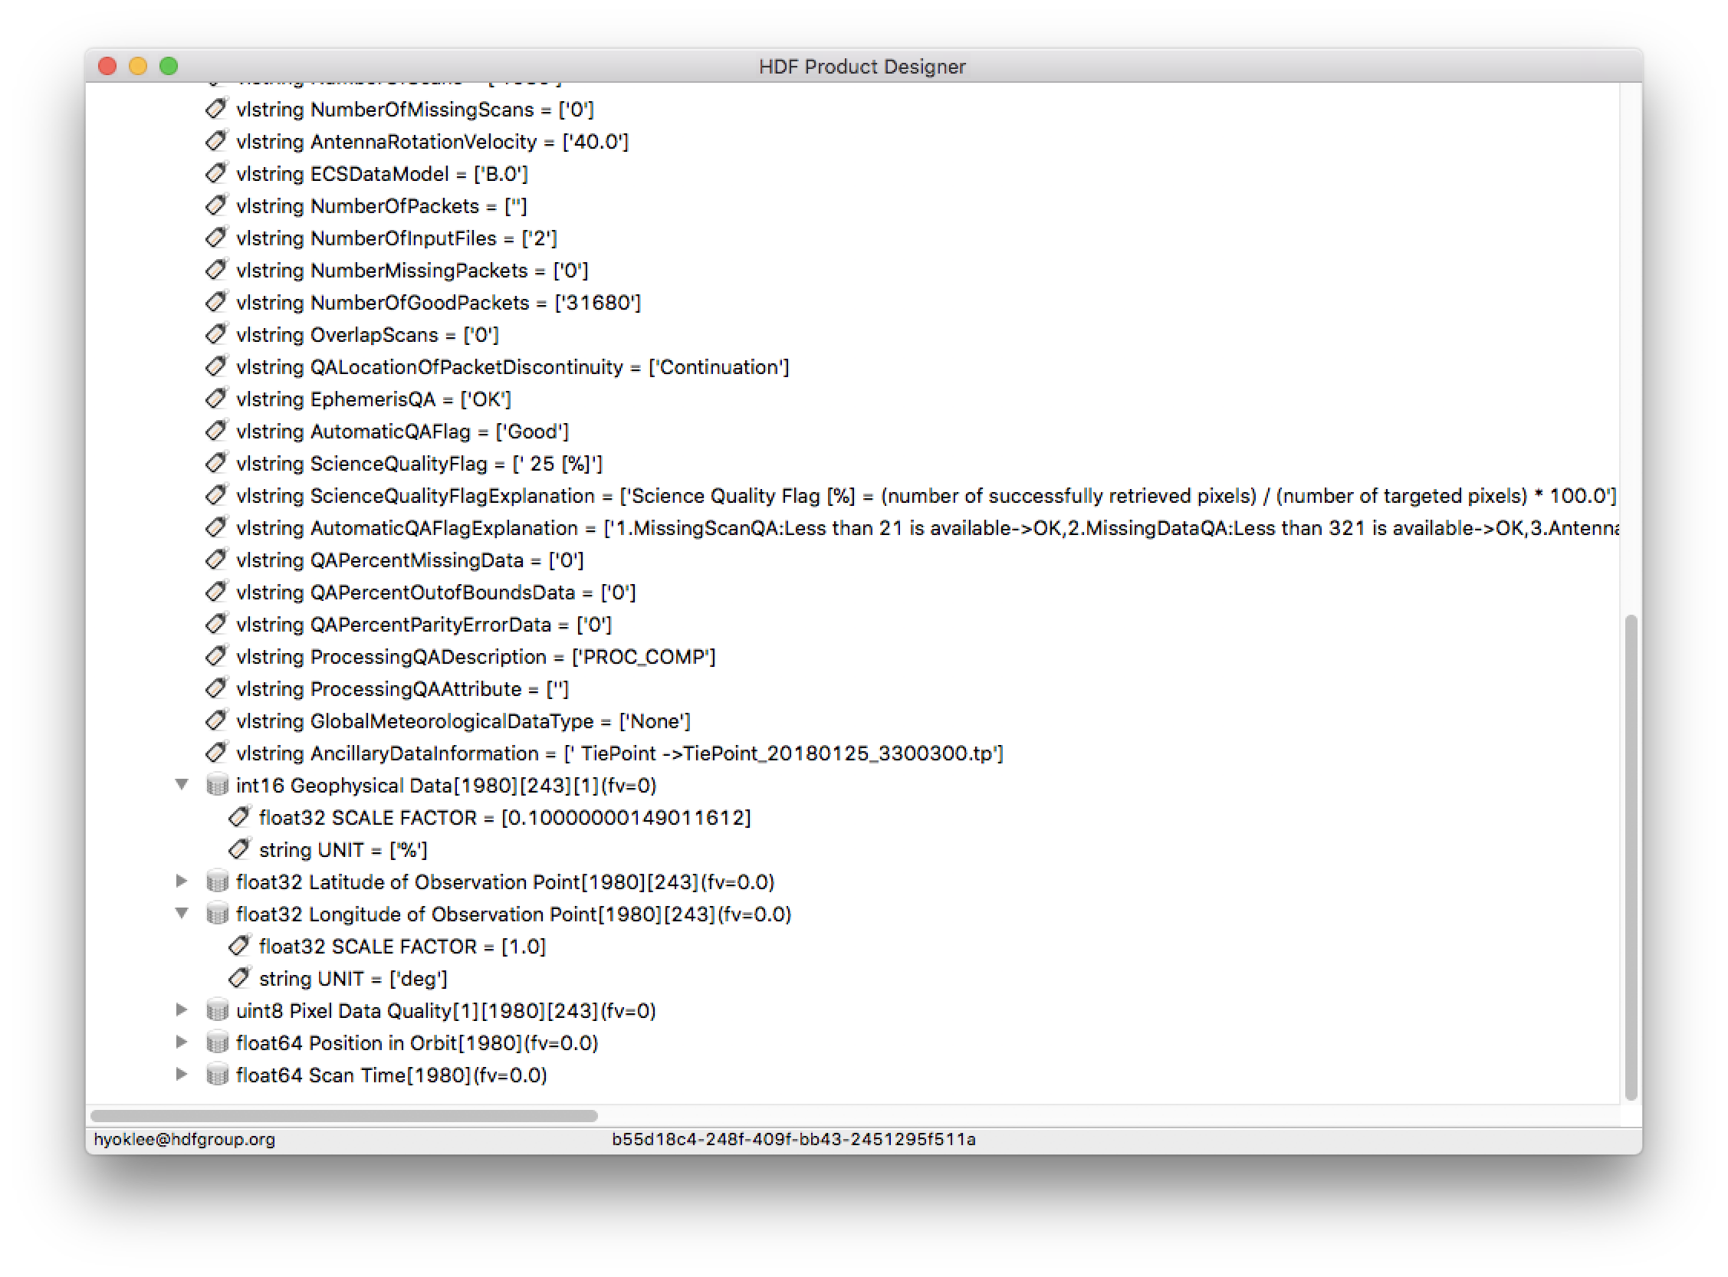
Case Study: JAXA* (Before)
*Japan Aerospace Exploration Agency

Slide 19
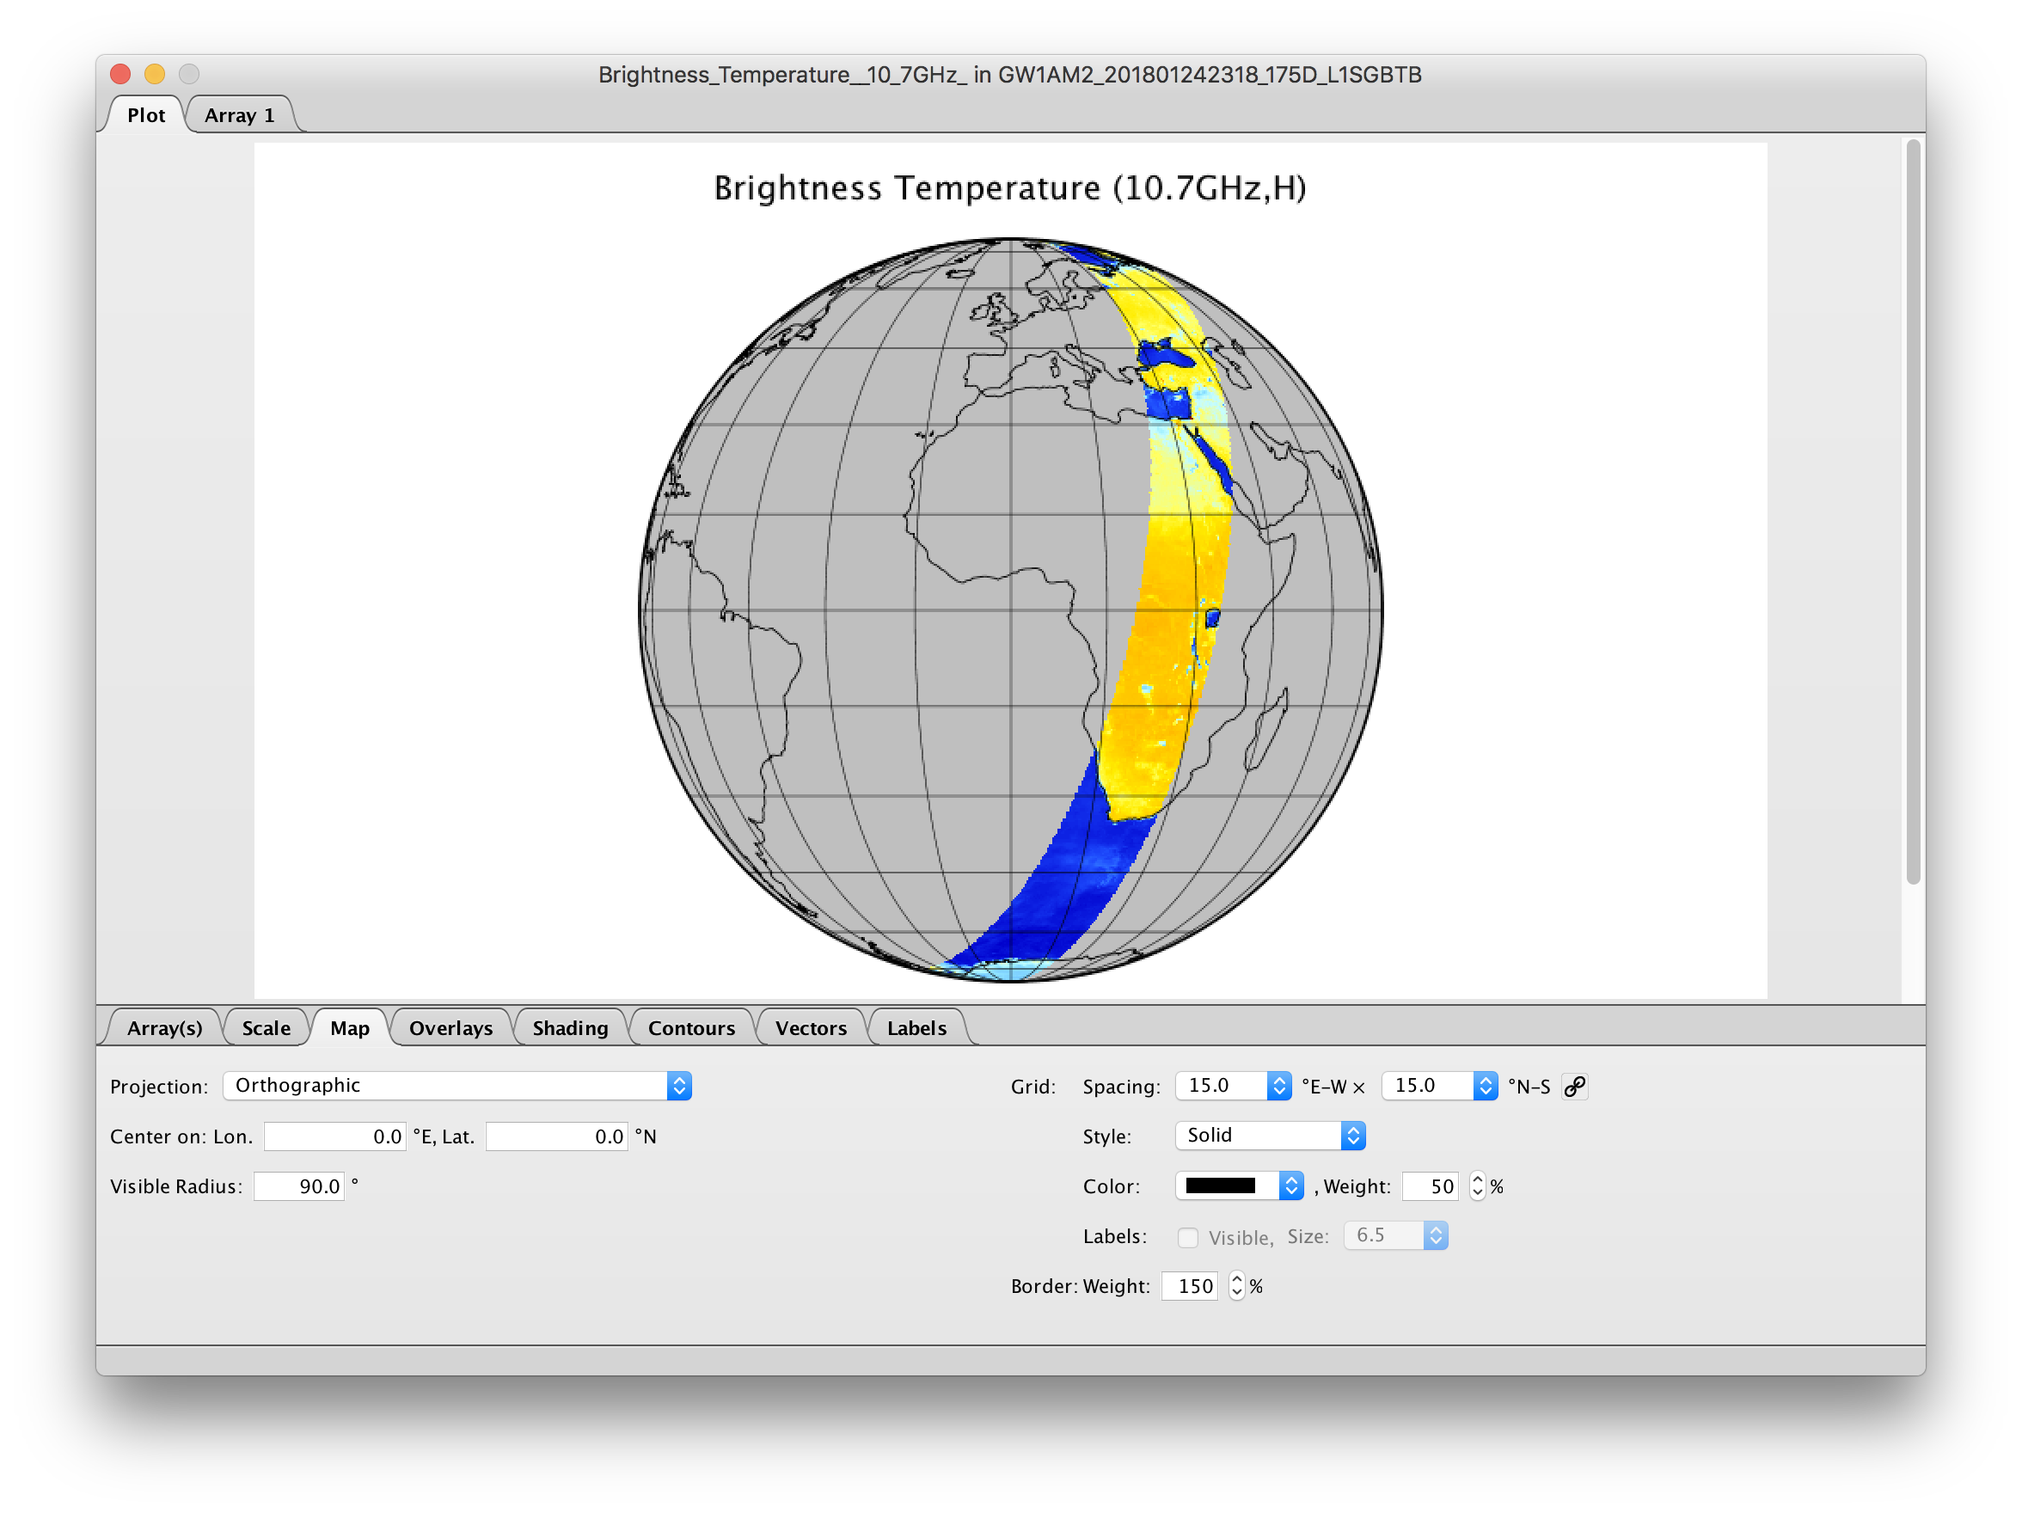
Case Study: JAXA (After 90 min.)
Notes:
!! It would be good to reflect in the title what was done in 90 minutes for people who will find presentation

Slide 20
HPD References
http://hpd.readthedocs.io
http://youtube.com/hdfeos
HPD Future Work?
Common Metadata Repository (CMR) integration
Web-based GUI

Slide 21












This work was supported by NASA/GSFC under Raytheon Co. contract number NNG15HZ39C.
in partnership with

