Slide 1
S3 VFD
Elena Pourmal
The HDF Group
HDF Workshop
July 17, 2018

Slide 2
S3 Virtual File Driver
Goal
  Serve HDF5 files from Object Store
Approach
  Use existing HDF5 library and new VFD drivers to access the HDF5 file (work in progress)
  S3 VFD uses range gets to read the desired data from the HDF5 file
  R/O case
    Optimization is performed to avoid small metadata accesses
    Ingestion tool is required to create object with metadata information
  R/W case takes advantage of paged allocation feature introduced in HDF5 1.10.1
    VFD tracks allocations for the pages containing metadata and raw data for an object.

Slide 3
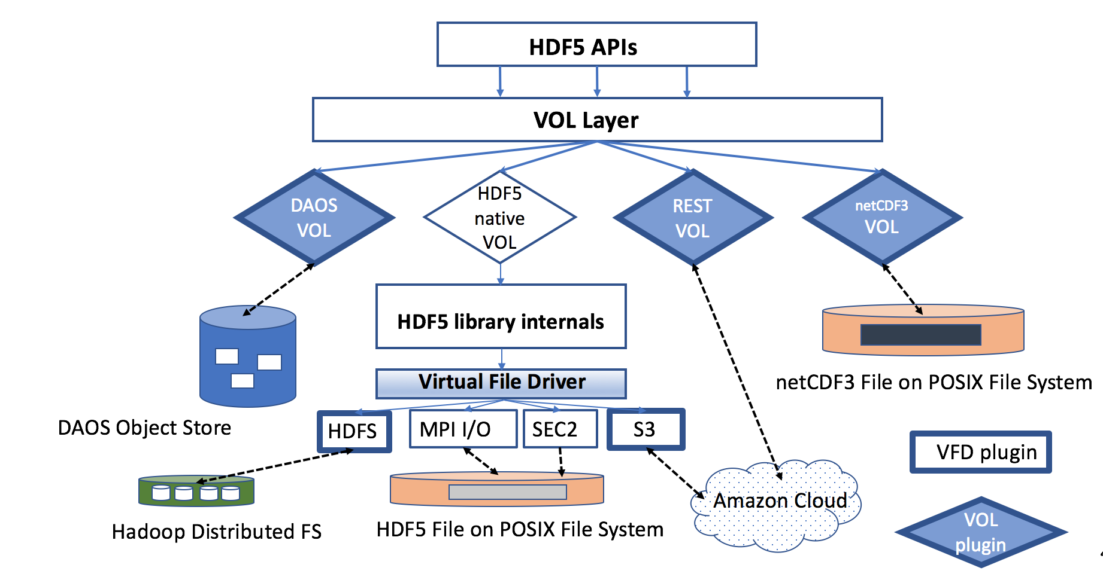
Virtual Object Layer and Virtual File Driver

Slide 4
Programming Model
New API to set up S3 VFD
  herr_t H5Pset_fapl_ros3(hid_t fapl_id, H5FD_ros3_fapl_t *fa)
Credentials are passed via the H5FD_ros3_fapl_t structure
  typedef struct H5FD_ros3_fapl_t {
  int32_t version;
  hbool_t authenticate;
  char aws_region[H5FD__ROS3_MAX_REGION_LEN + 1];
  char secret_id[H5FD__ROS3_MAX_SECRET_ID_LEN + 1];
  char secret_key[H5FD__ROS3_MAX_SECRET_KEY_LEN + 1];
  } H5FD_ros3_fapl_t;

Slide 5
Demo
Traversing HDF5 example (C program)
Working with tools (h5dump and h5ls)

Slide 6
Thank You!

