Slide 1
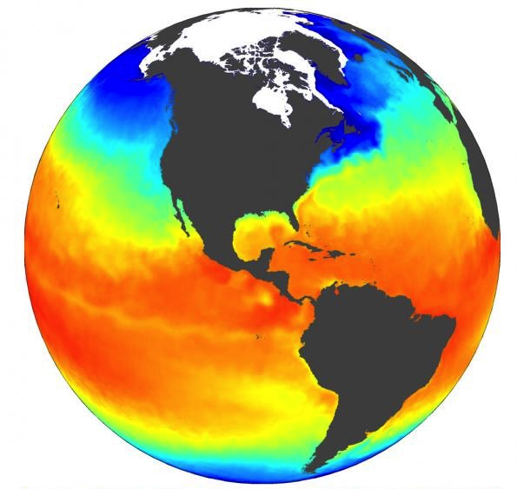

Product Designer Hub – Taking HPD to the Web
Ted Habermann
Director of Earth Science
thabermann@hdfgroup.org

Slide 2


HPD System Overview
Import Options
HDF online
(files, data)
HDF5
HDF5
JSON
HDF4
MAP
NcML
(Remote)
OPeNDAP
DMR
CDL
Excel
Text (CSV)
DB
Desktop Client
(Easy Install)
Restful Server
Data Store
(users, projects, file structures, metadata)
HDF
JSON
HDF5 Template
Description File (doc)
HDF
JSON
IDL
MATLAB
Python
Export
Options

Slide 3
HPD System Overview
Import Options
HDF online
(files, data)
HDF5
HDF5
JSON
HDF4
MAP
NcML
(Remote)
OPeNDAP
DMR
CDL
Excel
Text (CSV)
DB
Desktop Client
(Easy Install)
Restful Server
Data Store
(users, projects, file structures, metadata)
HDF
JSON
HDF5 Template
Description File (doc)
HDF
JSON
IDL
MATLAB
Python
Export
Options

Slide 4
Product Designer Hub - Overview
GeoNetwork
XML
ISO / NcML / WaterML / SensorML / EML
HDF
JSON
HDF online
(files, data)
Browser
WebService
Validators / Evaluators
Annotators
File Browser / Compass
HDF5 Template
Description File (doc)
HDF
JSON
IDL
MATLAB
Python

Slide 5
Community Metadata in HDF
1) Many communities use metadata dialects that include XML representations.
2) There is a straightforward correspondence between XML structures and HDF groups and attributes.
3) We can create a web service that
  ingests metadata in XML
  transforms that XML into HDF Groups and Attributes (either HDF-XML or NcML)
  creates an HDF file that includes the metadata
  use that file to create
    HDF-JSON
    code in IDL, matlab, or python
    A design document in Word

Slide 6
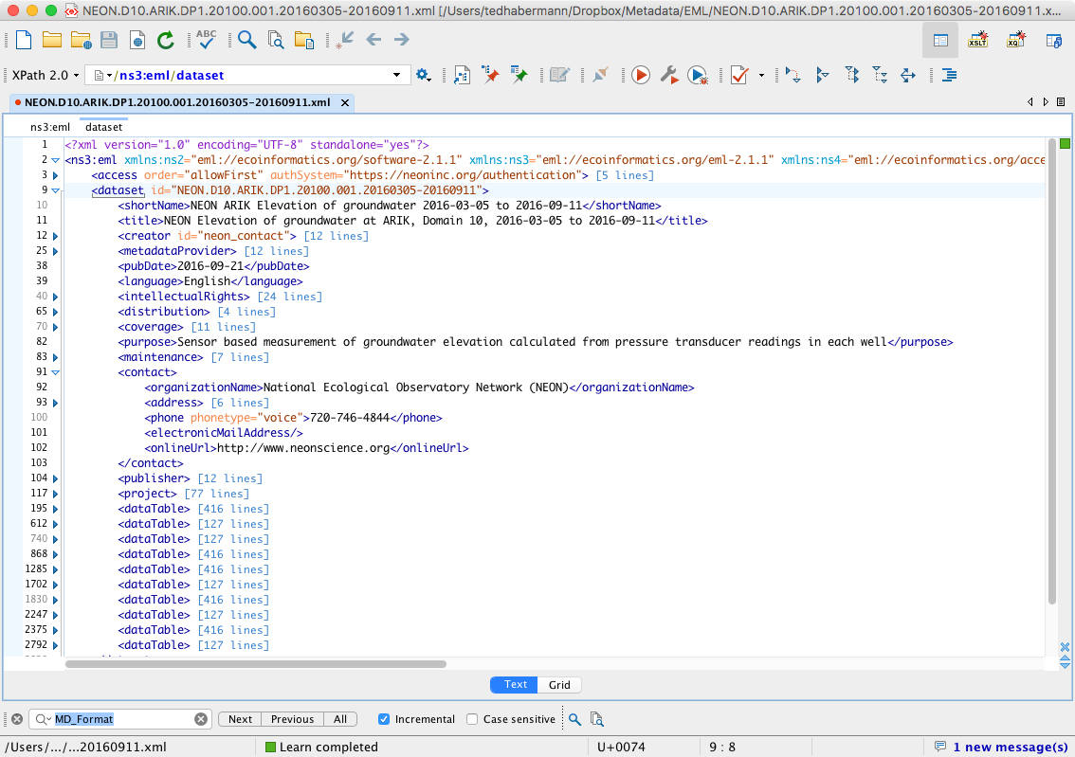
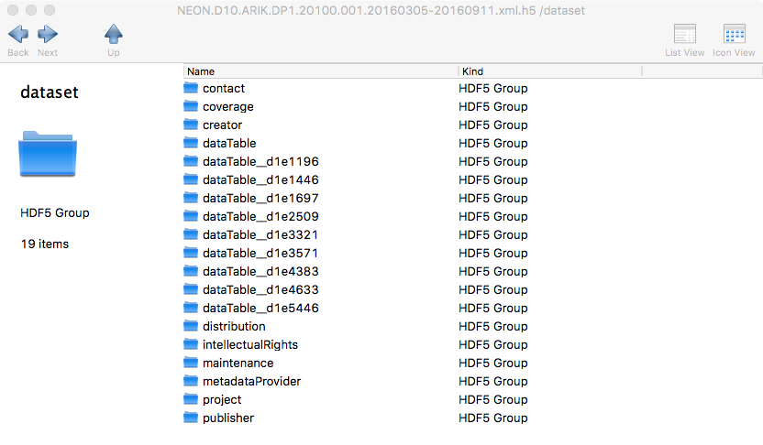
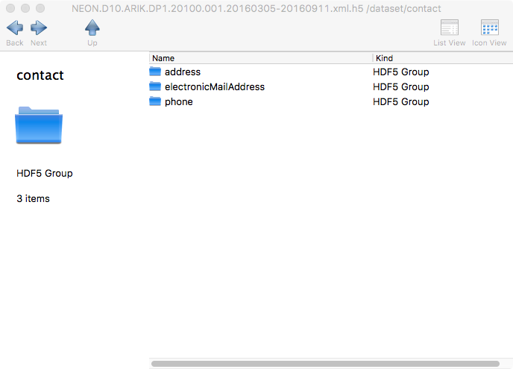
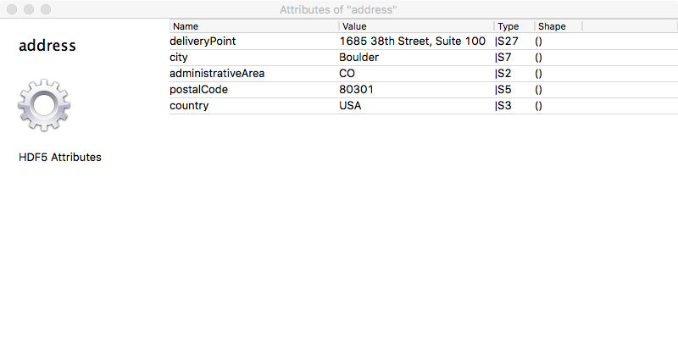
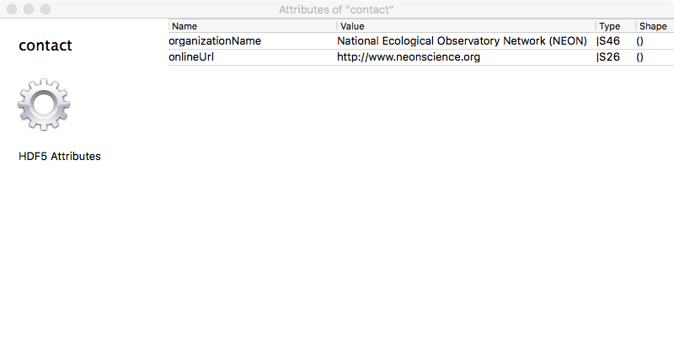
Community Metadata in HDF

Slide 7
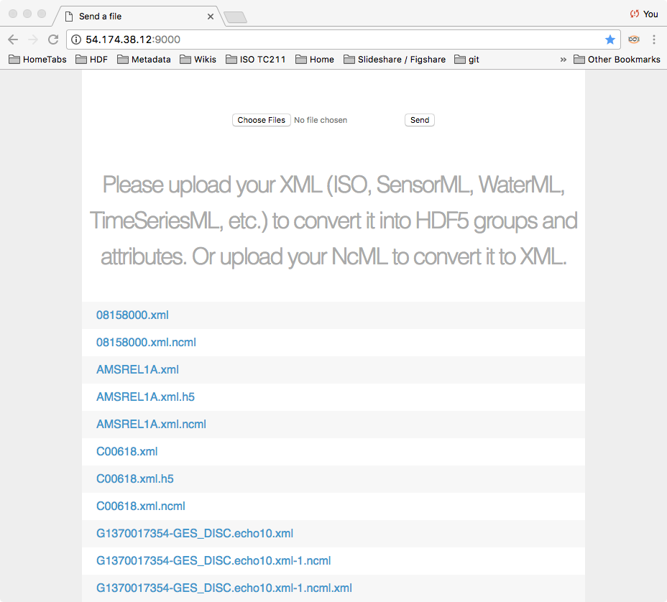
Product Designer Hub – V0
HDF online
(files, data)
Browser
HDF5 Template
Local Disk
The web service:
receives the uploaded file
checks the XML dialect
if is is one of the known dialects:
  translate the XML to NcML
  ingest the NcML into HDF
  return HDF file to user
XML
ISO / NcML / WaterML / SensorML / TSML
XML
EML

Slide 8

Client/Server Architecture
C/Fortran
Application
Web
Application
HDF REST API
(http)
NetCDF4 Lib
Browser
HDF5 Lib
REST VOL
S3 VFD
h5pyd
REST Backend
Note: Clients don’t need to know what’s going on inside this box!
Python
Applications
CMD Line Tools
Client Software Stack
HDF Service (h5serv or …)

Slide 9
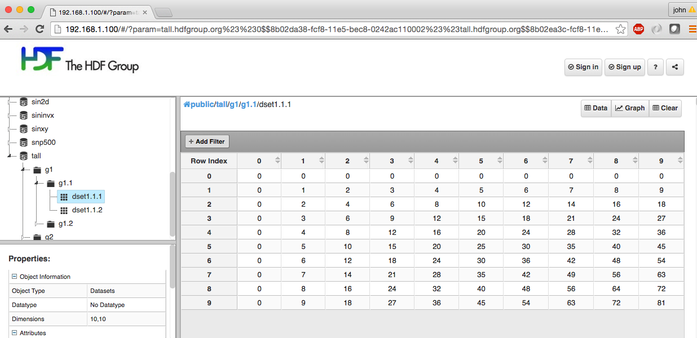
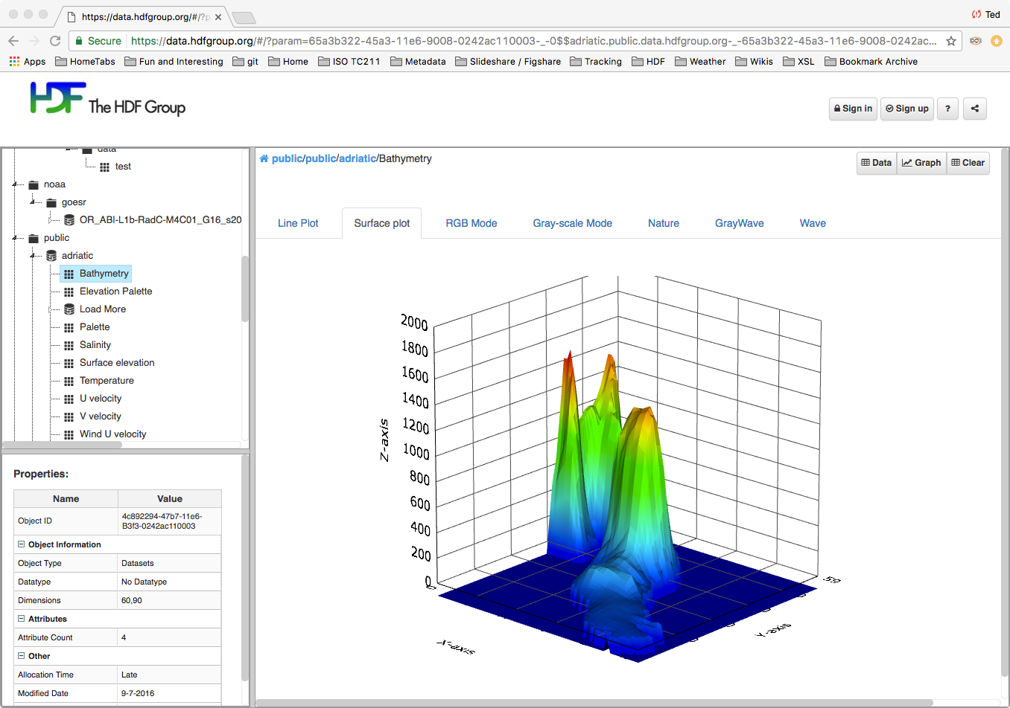
Web UI – Display HDF Content in a browser
https://data.hdfgroup.org

Slide 10

Thank You!
thabermann@hdfgroup.org
Questions?

