Slide 1
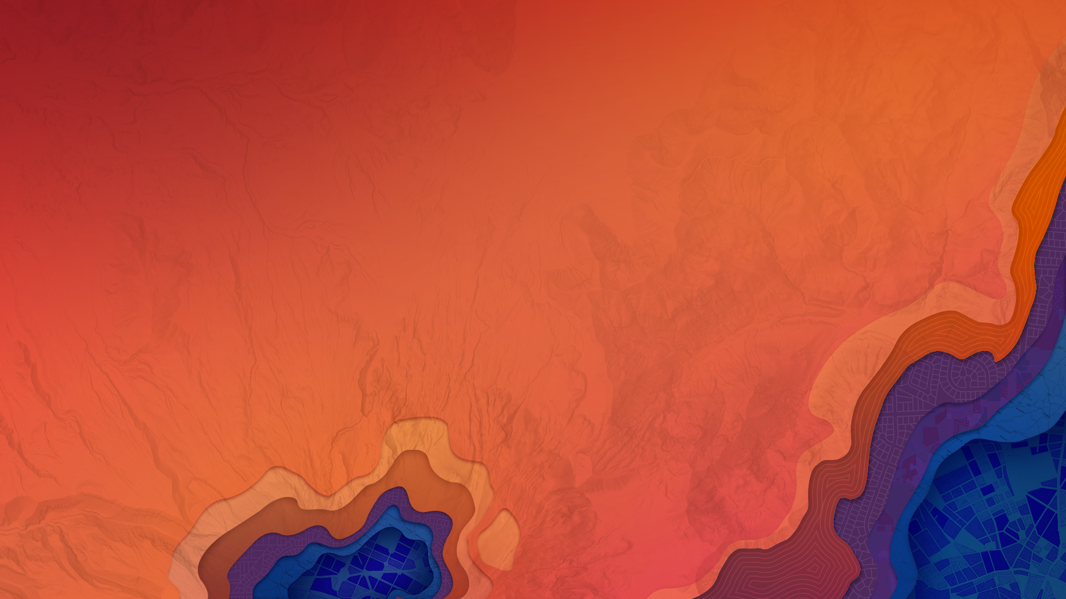

Multidimensional Scientific Data in ArcGIS
ESIP Summer Meeting 2017 | July 25-28, 2017
Nawajish Noman, Christine White

Slide 2

Outline
Part I
  ArcGIS Platform
  Scientific Multidimensional Data
  Ingest and Data Management
Part II
  Data Exploration and Visualization
  Analysis
  Extending Analytical Capabilities using Python
Part III
  Publishing and Sharing Services
  Consuming Services

Slide 3


ArcGIS Development
Trends in Capabilities
ArcGIS is Evolving as a Remote Sensing Software Platform
Sensor Support
  EO, RADAR, LiDAR, FMV,…
> 80 Formats
  HDF, NetCDF, GRIB, NITF
Image Processing
Distributed Data & Analytics
Management and Dissemination
Web Services and Standards
  WMS, WCS, KML,…
R&D Staff

Slide 4

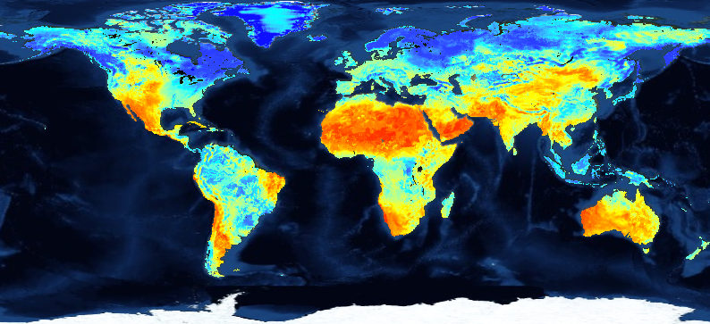
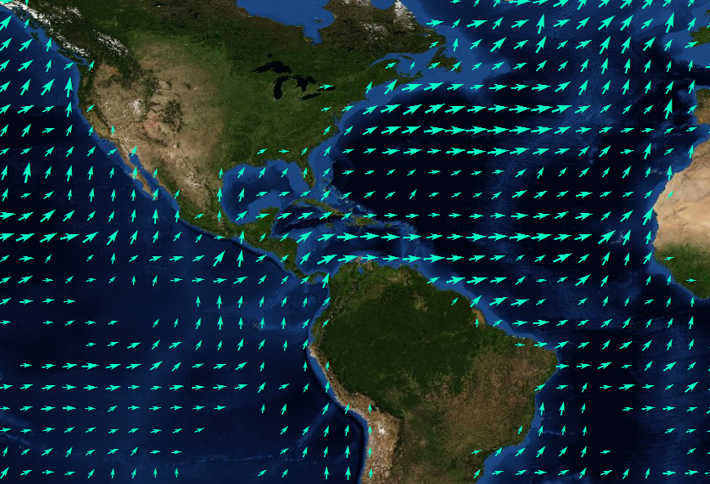
Scientific Multidimensional Data
Stored in netCDF, GRIB, and HDF formats
Multidimensional
Ocean data
  Sea temperature, salinity, ocean current
Weather data
  Temperature, humidity, wind
Land
  Soil moisture, NDVI, land cover
Temperature
longitude
time

Slide 5
Scientific Data in ArcGIS - Vision
ArcGIS
direct ingest
data management
visualization
share
analysis

Slide 6
Challenges
Manage
Analyze
Share
variety of formats
volume & velocity
redundancy
portability
scalability
reproducibility
integration
standards
accessibility

Slide 7
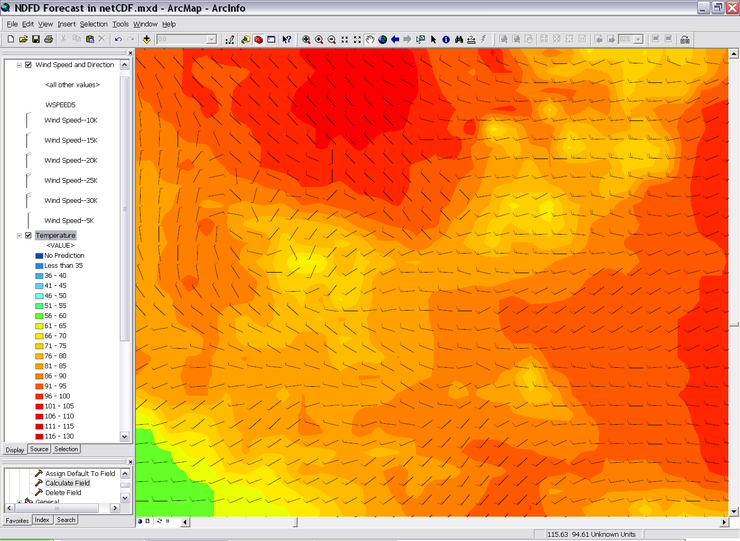
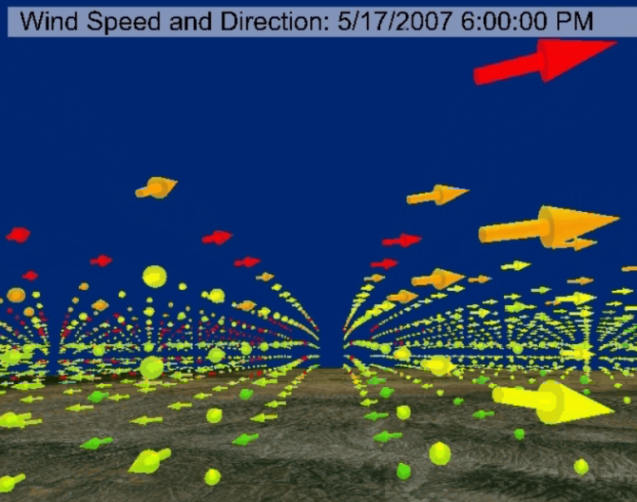
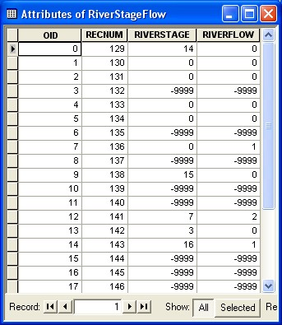
Representing Scientific Data in ArcGIS
Data is represented as
  Raster
  Feature
  Table
Direct read
Exports GIS data to netCDF

Slide 8
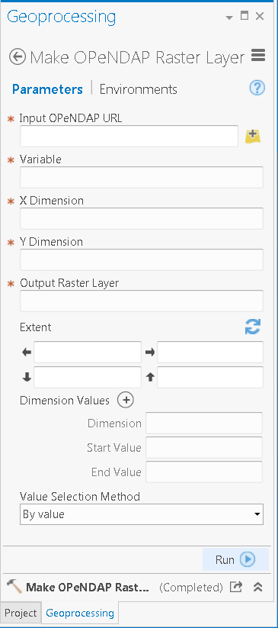
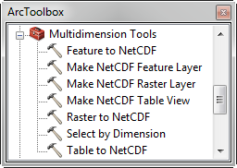
Ingesting Scientific data in ArcGIS
Directly reads netCDF file using
  Make NetCDF Raster Layer
  Make NetCDF Feature Layer
  Make NetCDF Table View
Ingest OPeNDAP Service
  Output dynamic multidimensional raster
  Support Sub-setting
Scientific data formats are supported in mosaic dataset
  netCDF
  HDF
  GRIB

Slide 9
CF Convention
Climate and Forecast (CF) Convention
http://cf-pcmdi.llnl.gov/
Initially developed for
Climate and forecast data
Atmosphere, surface and ocean model-generated data
Also for observational datasets
CF is now the most widely used conventions for geospatial netCDF data. It has the best coordinate system handling.
Current version 1.6
You can use Compliance checker utility to check a netCDF file.
http://cf-pcmdi.llnl.gov/conformance/compliance-checker/

Slide 10
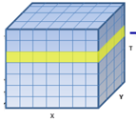
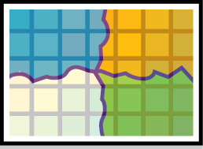






What about Aggregation?
Create a seamless multi-dimensional cube from
  files representing different regions
  files representing different time steps/slices
  Mosaic dataset supports multiple files and variables, normalize time and depth

Slide 11
Tabular View
Raster | Shape | Variable | StdTime | StdZ
… | … | Temperature | 3/22/2016 | -10
… | … | Temperature | 3/23/2016 | -10
… | … | Temperature | 3/24/2016 | -10
… | … | Salinity | 3/22/2016 | -10
… | … | Salinity | 3/23/2016 | -10
… | … | Salinity | 3/24/2016 | -10
… | … | Temperature | 3/22/2016 | -20
… | … | Temperature | 3/23/2016 | -20
… | … | … | … | …
Tabular view of items in a multivariate multidimensional mosaic dataset

Slide 12
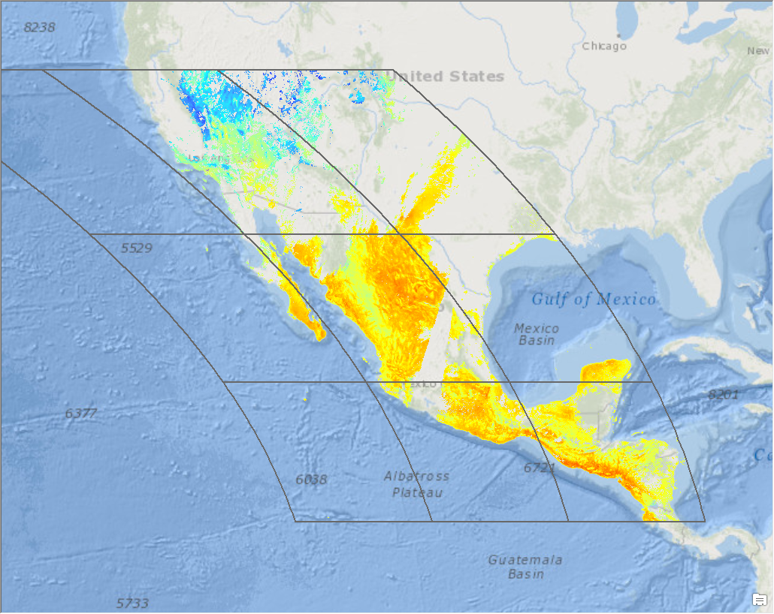
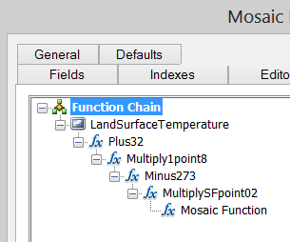
Scientific data support in Mosaic Dataset
Supports netCDF, HDF and GRIB
  Spatial Aggregation
  Temporal Aggregation
  On-the-fly analysis
Serve as Multidimensional
  Image Service
  Map Service
  WMS
Supports direct ingest
Eliminates data conversion
Eliminates data processing
Improves workflow performance
Integrates with service oriented architecture

Slide 13
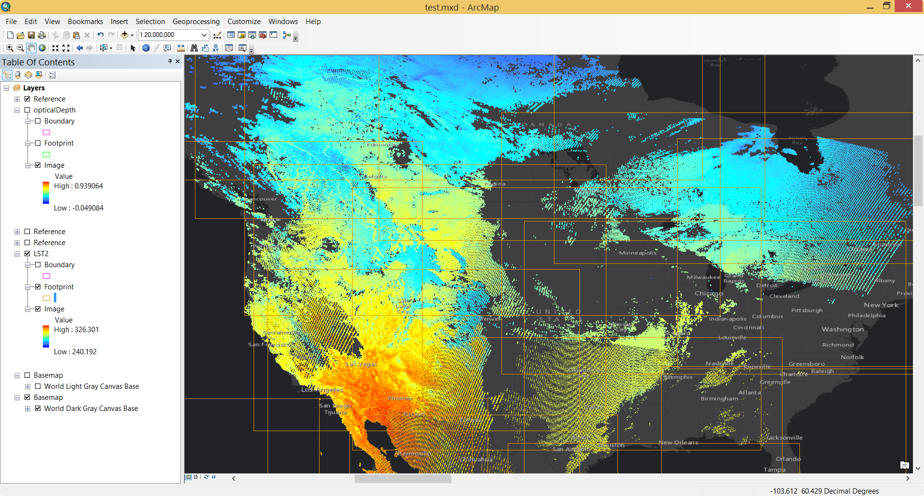
MODIS: Land Surface Temperature

Slide 14
Using Scientific Data in ArcGIS
Behaves the same as any layer or table
Display
  Same display tools for raster and feature layers will work on multi-dimensional raster and feature layers.
Graphing
  Driven by the table just like any other chart.
Animation
  Multi-dimensional data can be animated through time dimension.
Analysis Tools
  Will work just like any other raster layer, feature layer, or table. (e.g. create buffers around points, reproject rasters, query tables, etc.)

Slide 15
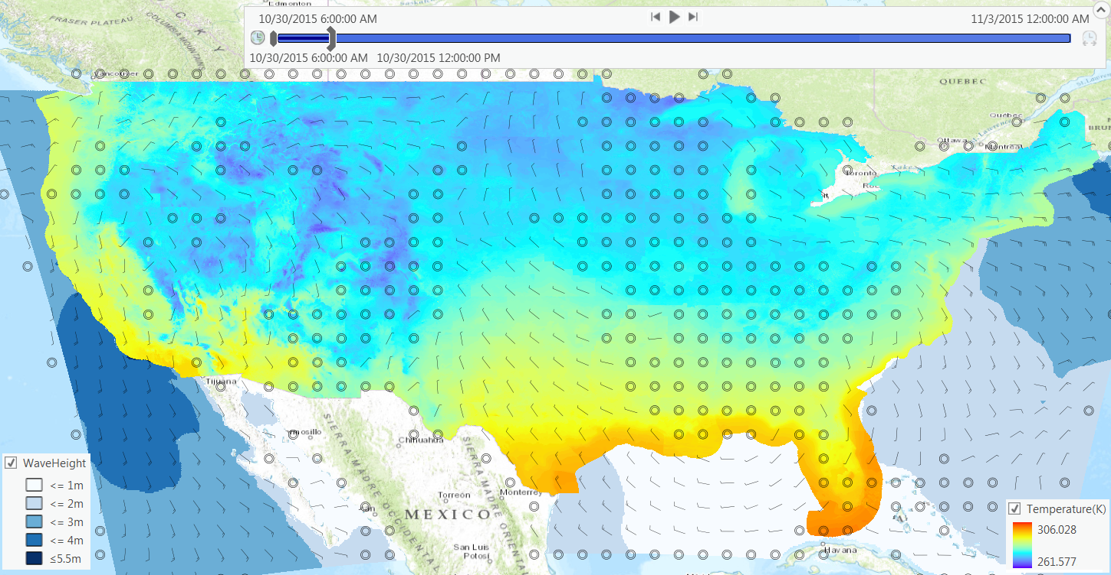
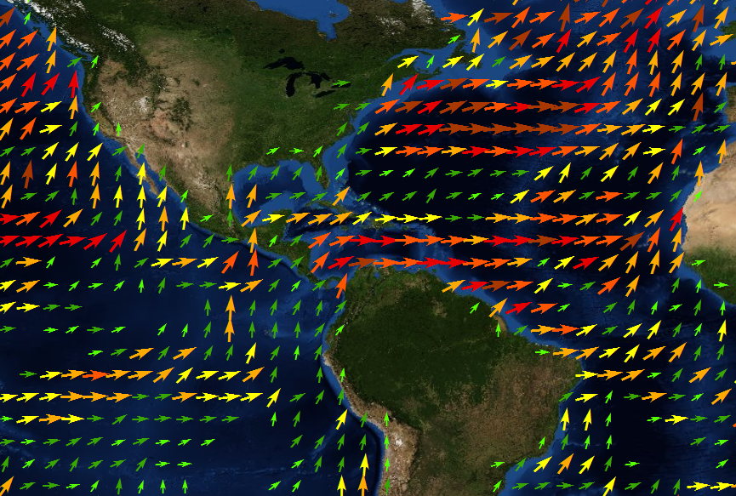
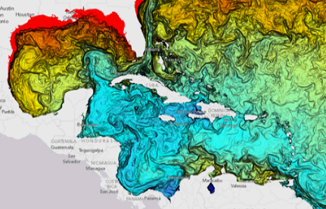

Visualization of Scientific Data
Slicing
Temporal animation using Time Slider
Dimensional animation using Range Slider
Predefined renderer
Notes:
Will be available in 10.3 or later.

Slide 16
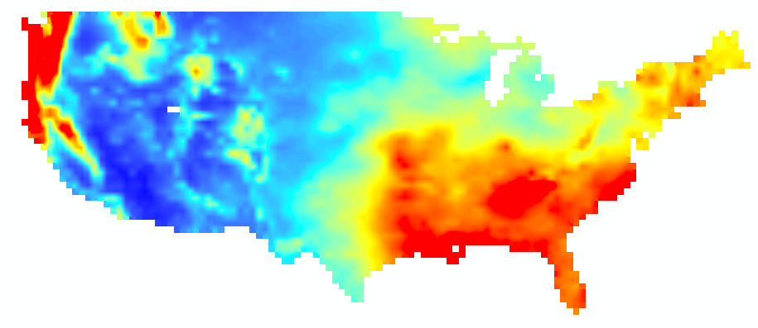
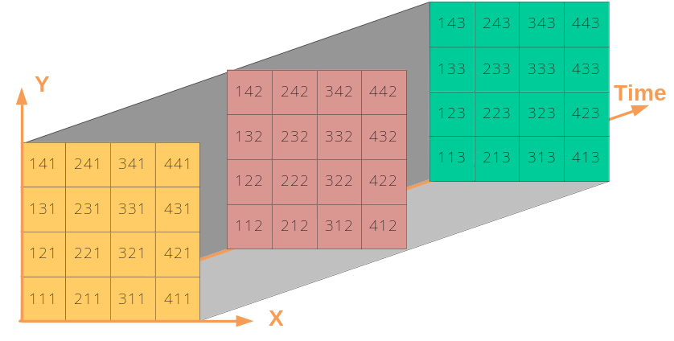
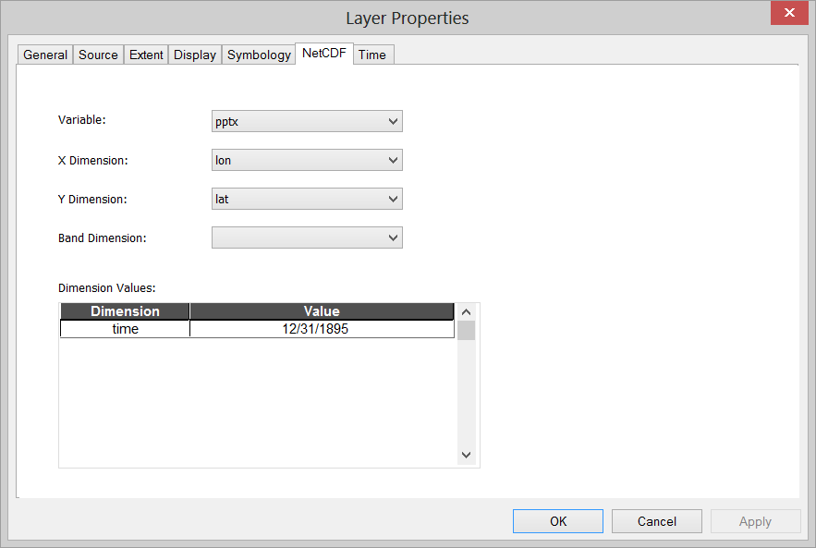
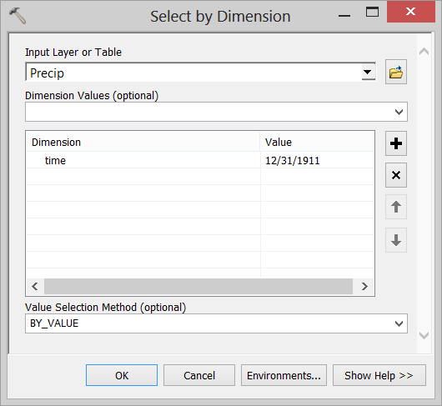
Changing Time Slice
Time = 1

Slide 17
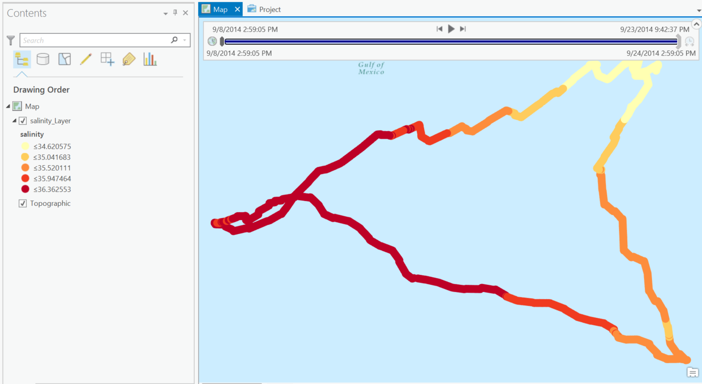
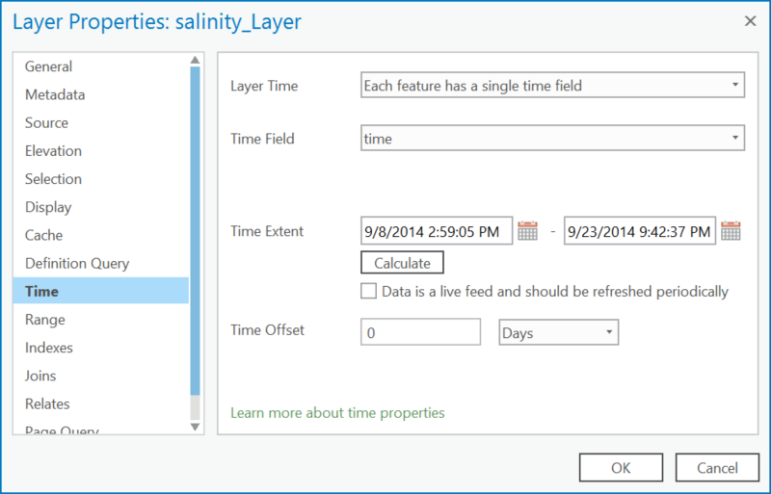
Animating through Time using Time Slider

Slide 18
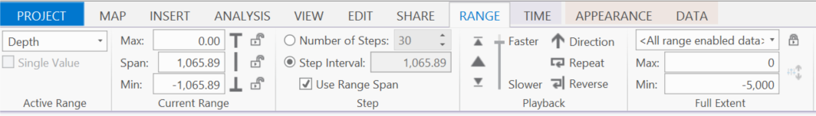
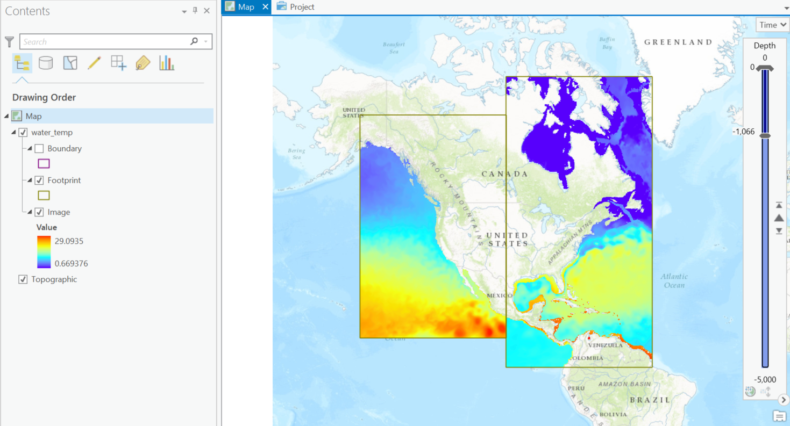
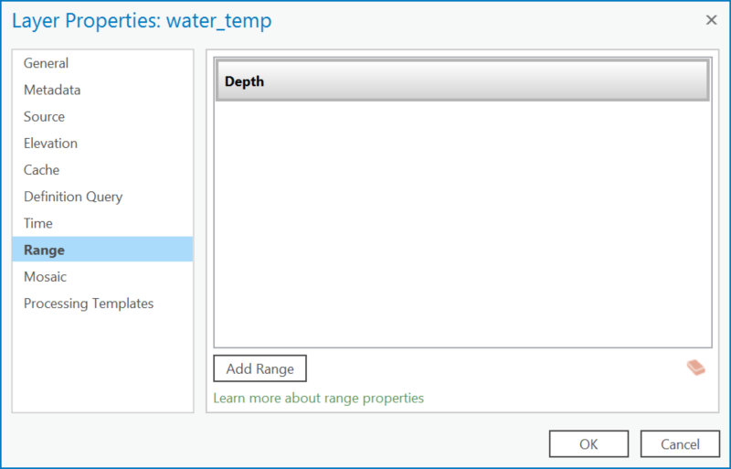
Animating through Depth using Range Slider

Slide 19
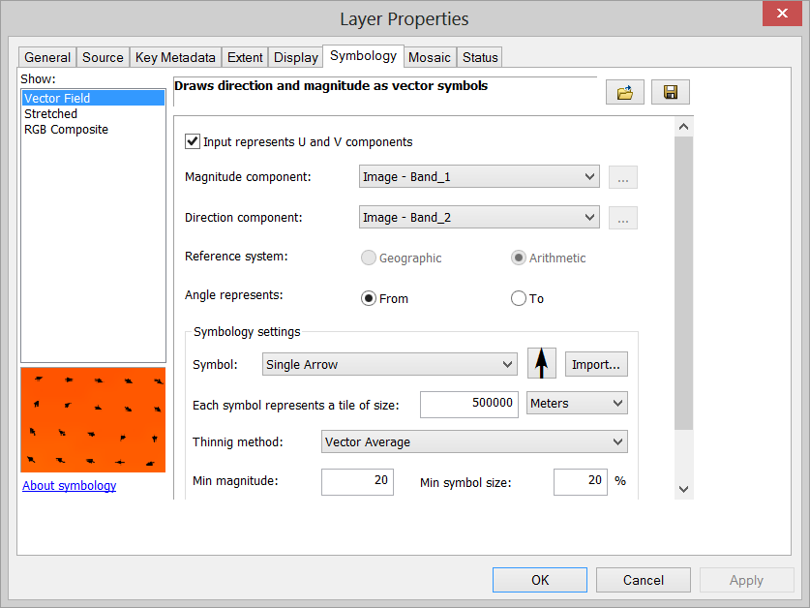
Visualization of Raster as Vectors
New Vector Field renderer for raster
  Supports U-V and Magnitude-direction
  Dynamic thinning
  On-the-fly vector calculation
Eliminates raster to feature conversion
Eliminates data processing
Improves workflow performance
Notes:
Will be available in 10.3 or later.

Slide 20
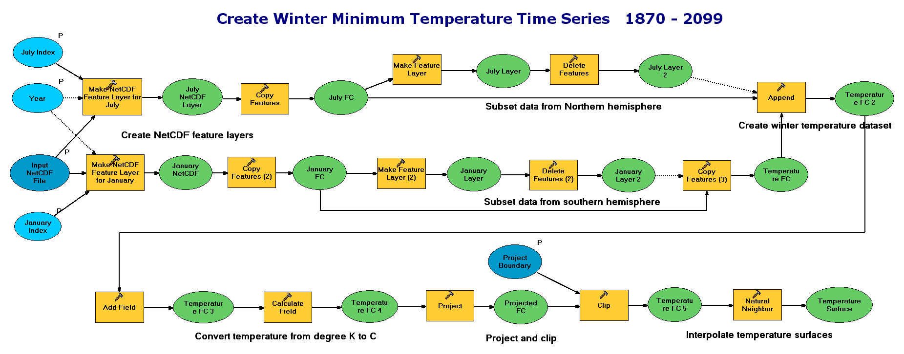
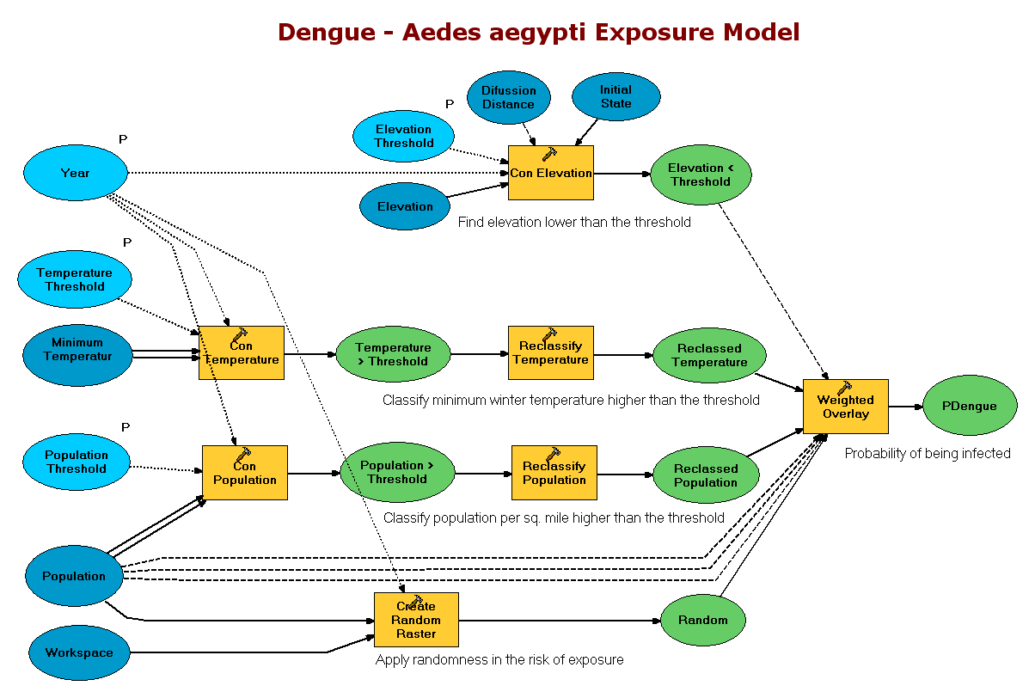
Spatial and Temporal Analysis
Hundreds of analytical tools available for raster, features, and table
Temporal Modeling
  Looping and iteration in ModelBuilder and Python

Slide 21
On-the-Fly Processing using Raster Functions
Several analytical functions are available out of the box
Functions are chained together to create complex model
Used to perform on-the-fly analysis
Extend analytical capability using Python Raster Function

Slide 22
Python Package: netCDF4-Python, SciPy
netCDF4-python is included in 10.3/Pro
  Read and write netCDF file
  Conversion time values to date
  Multi-file aggregasion
  Compression
SciPy
Python Raster Function
https://www.unidata.ucar.edu/software/netcdf/workshops/2012/netcdf_python/netcdf4python.pdf

Slide 23
Disseminating
Desktop
Web
Device
Apps
professional
geospatial analysts
Access / Identity
multivariate multidimensional mosaic dataset
Services
Server
Online Content and Services

Slide 24
Sharing / WMS Support (for multi-dimensions)
Map Service (supports WMS)
  Makes maps available to the web.
Image Service (supports WMS)
  Provides access to raster data through a web service.
Geoprocessing Service
  Exposes the analytic capability of ArcGIS to the web.

Slide 25
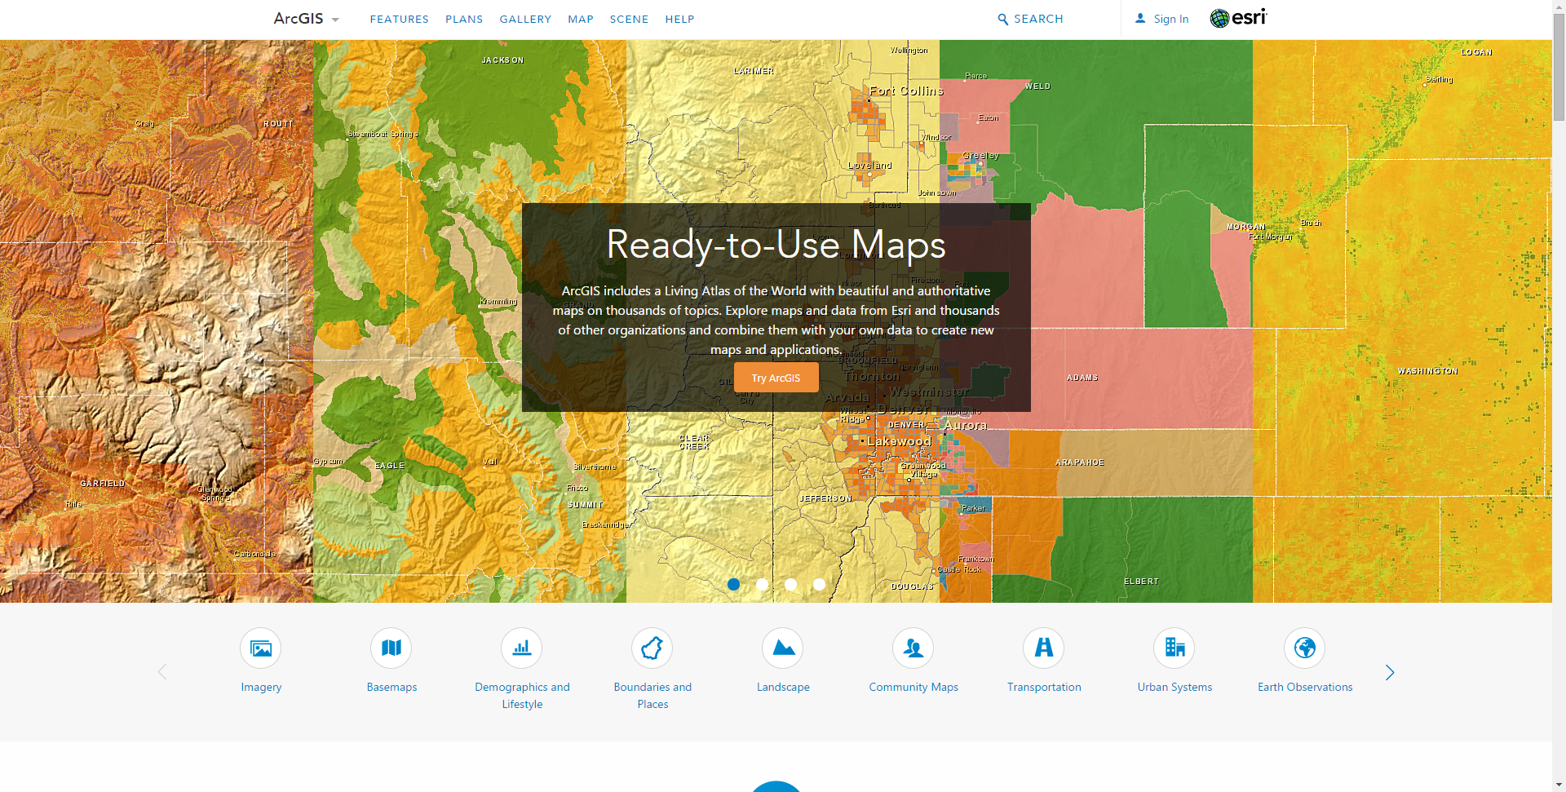
ArcGIS Online: The Living Atlas
www.arcgis.com

Slide 26
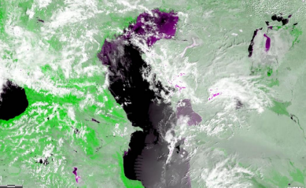
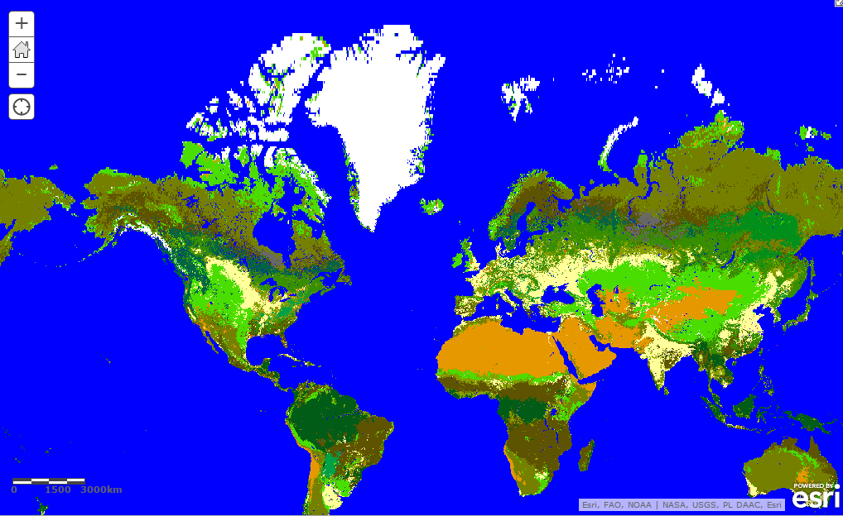
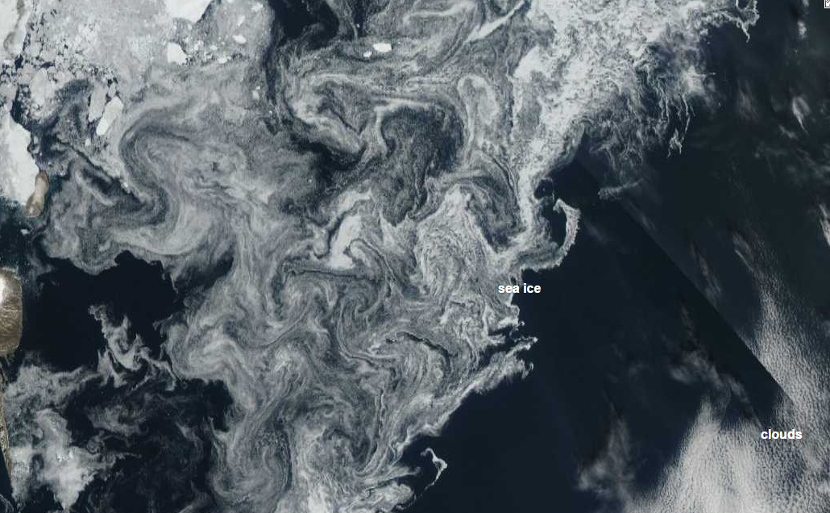
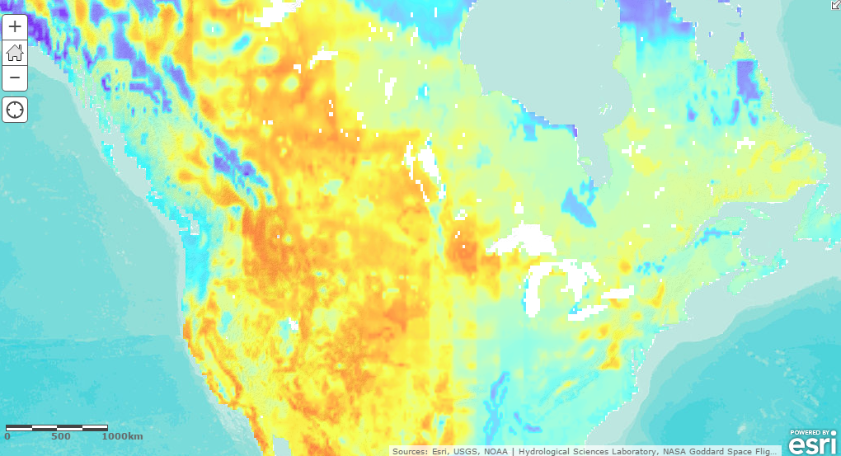
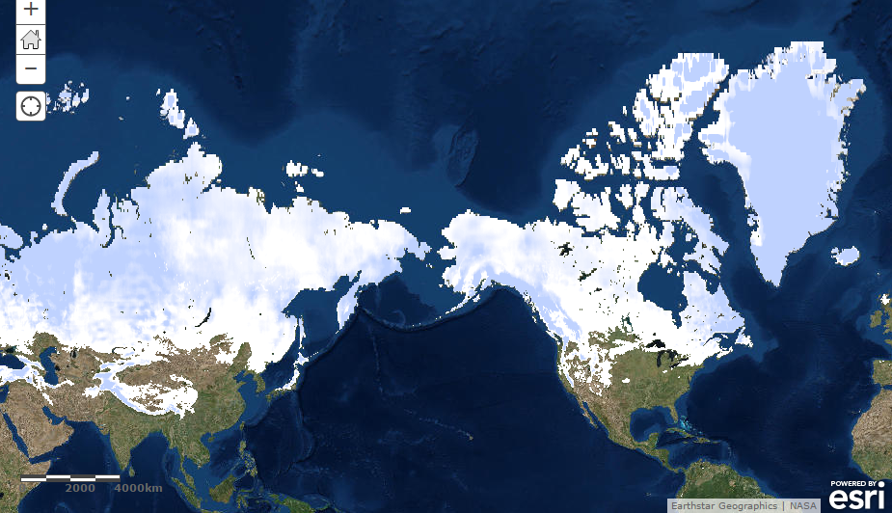
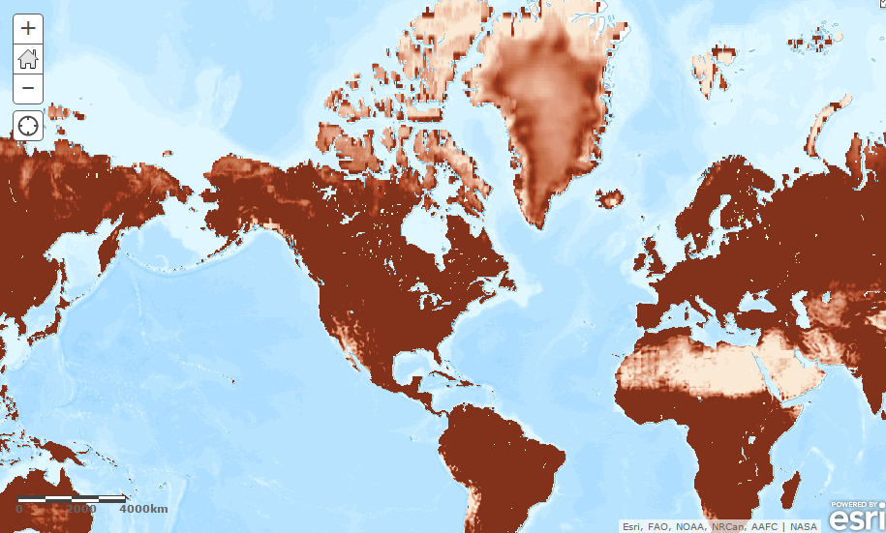
Services of Scientific Data
Online Imagery content that can be directly used:
MODIS data
  MODIS land cover 2000-2011
  MODIS Vegetation Analysis
  MODIS Greenland Sea Ice
Live NOAA wind service
NASA Global Land Data Assimilation (GLDS)
  Soil moisture
  Evapotranspiration
  Snow pack
More

Slide 27
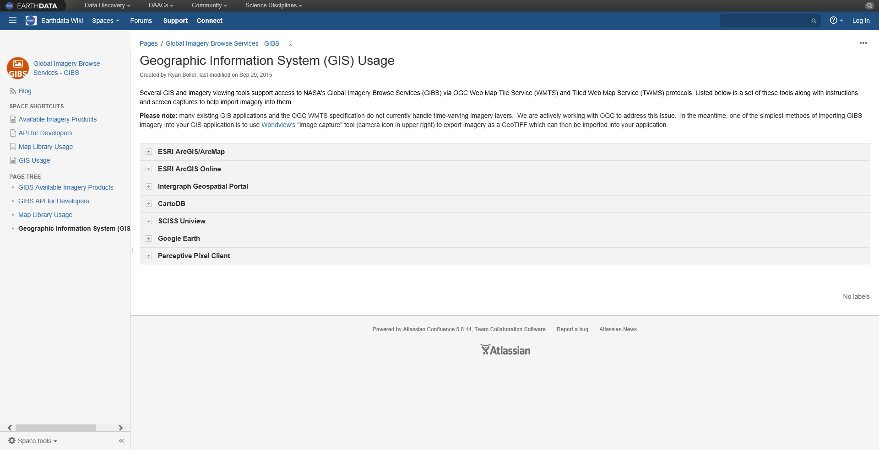
NASA Global Imagery Browse Services (GIBS)

Slide 28
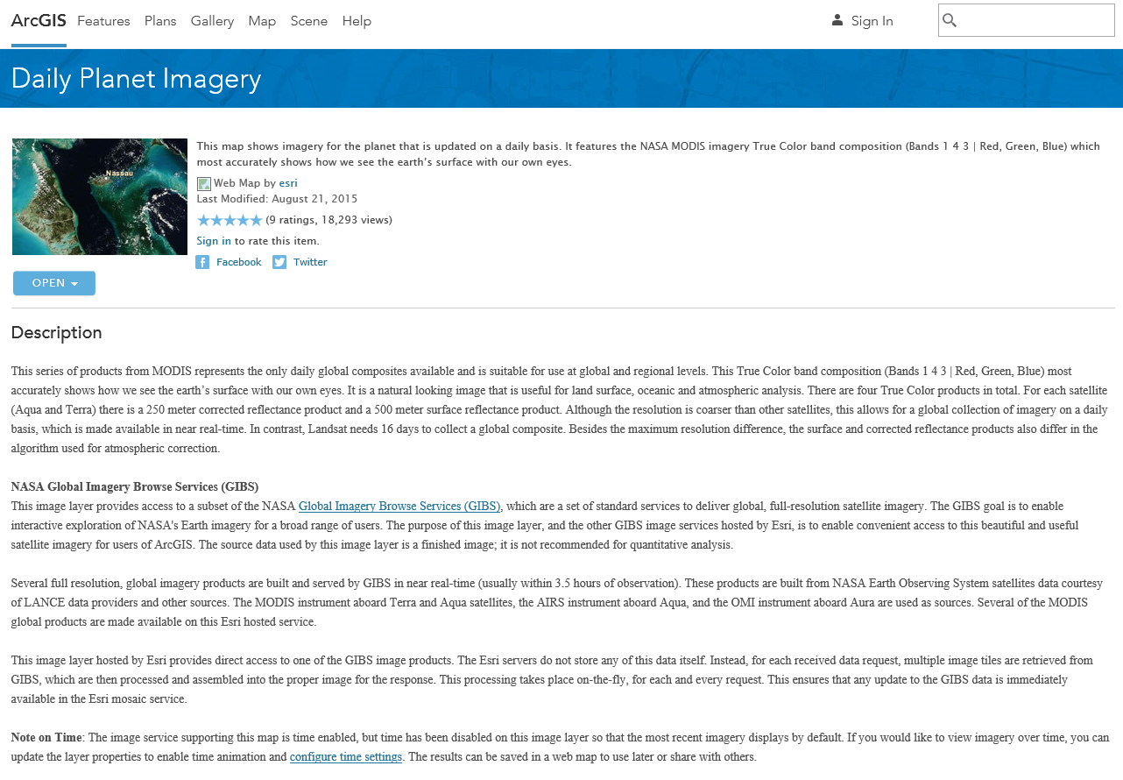
NASA Global Imagery Browse Services (GIBS)

Slide 29
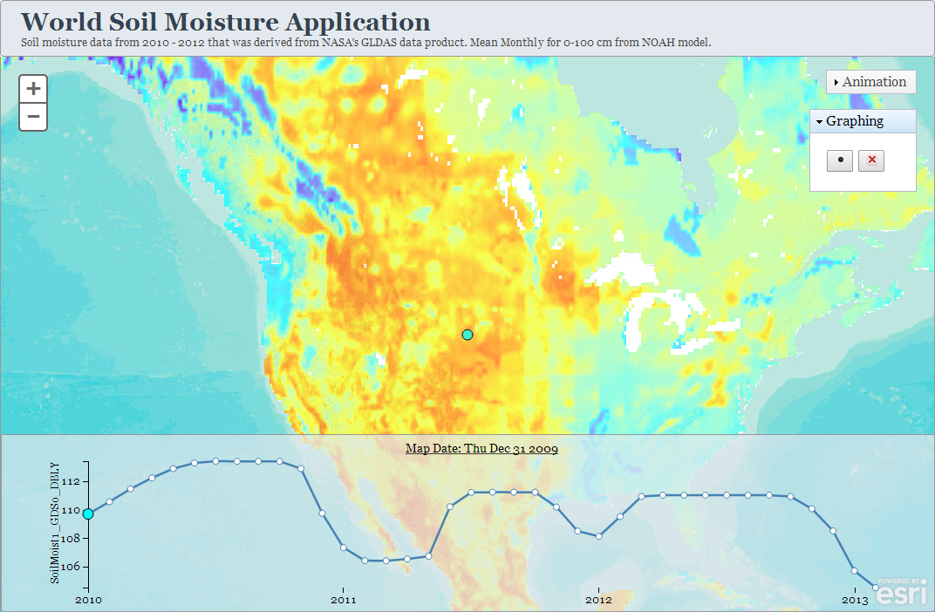
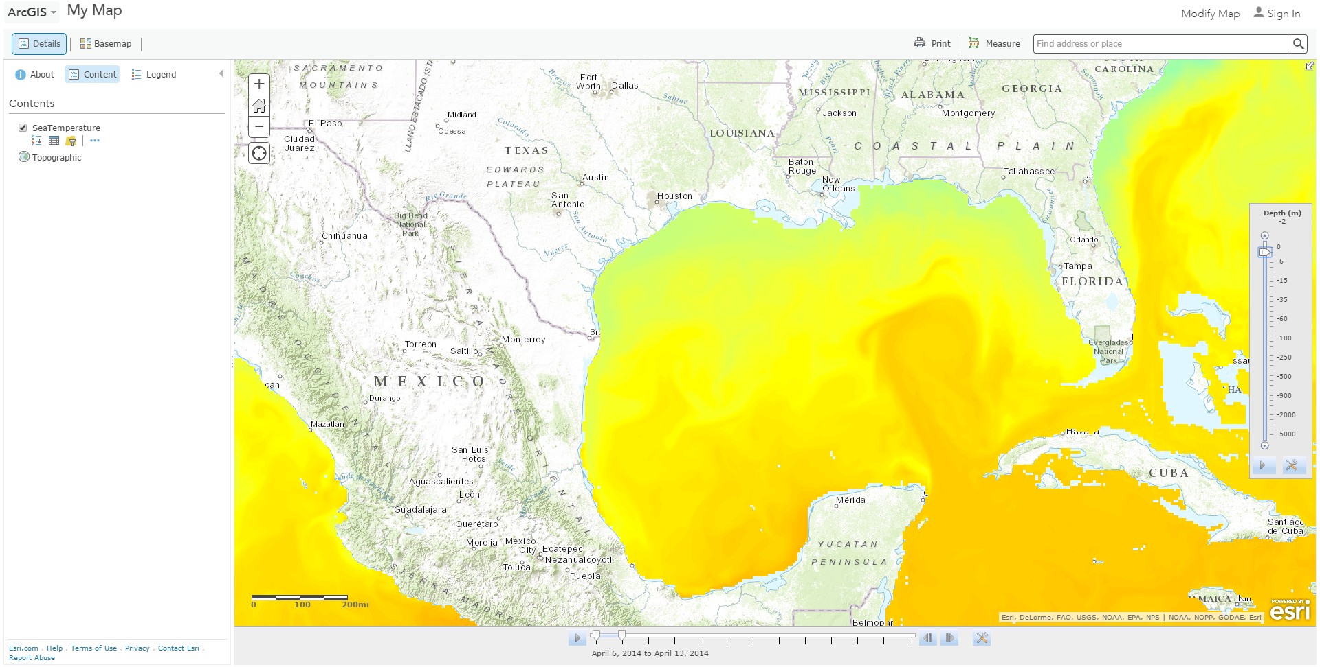
Consuming Scientific Data Services
ArcGIS Desktop/Pro/Server
Web Map Viewer
Web Applications
Story maps
Operational Dashboard

Slide 30
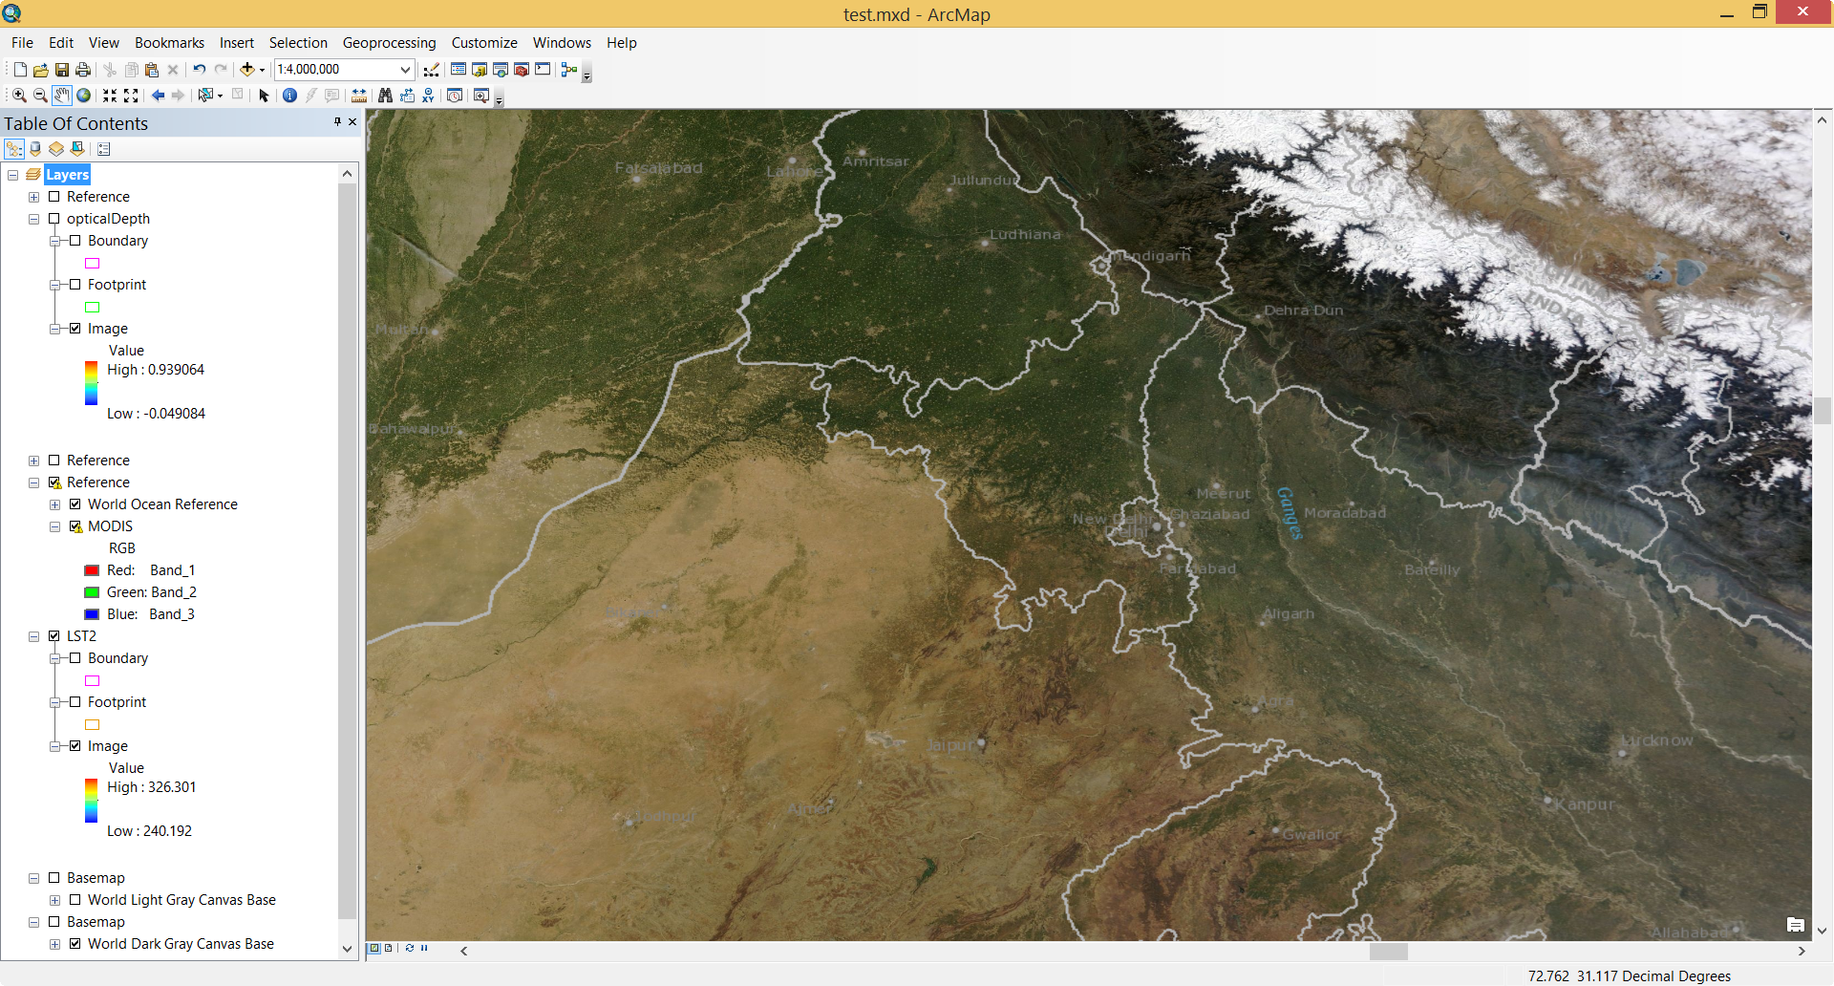
Corrected Reflectance – Consumed in ArcGIS Desktop

Slide 31
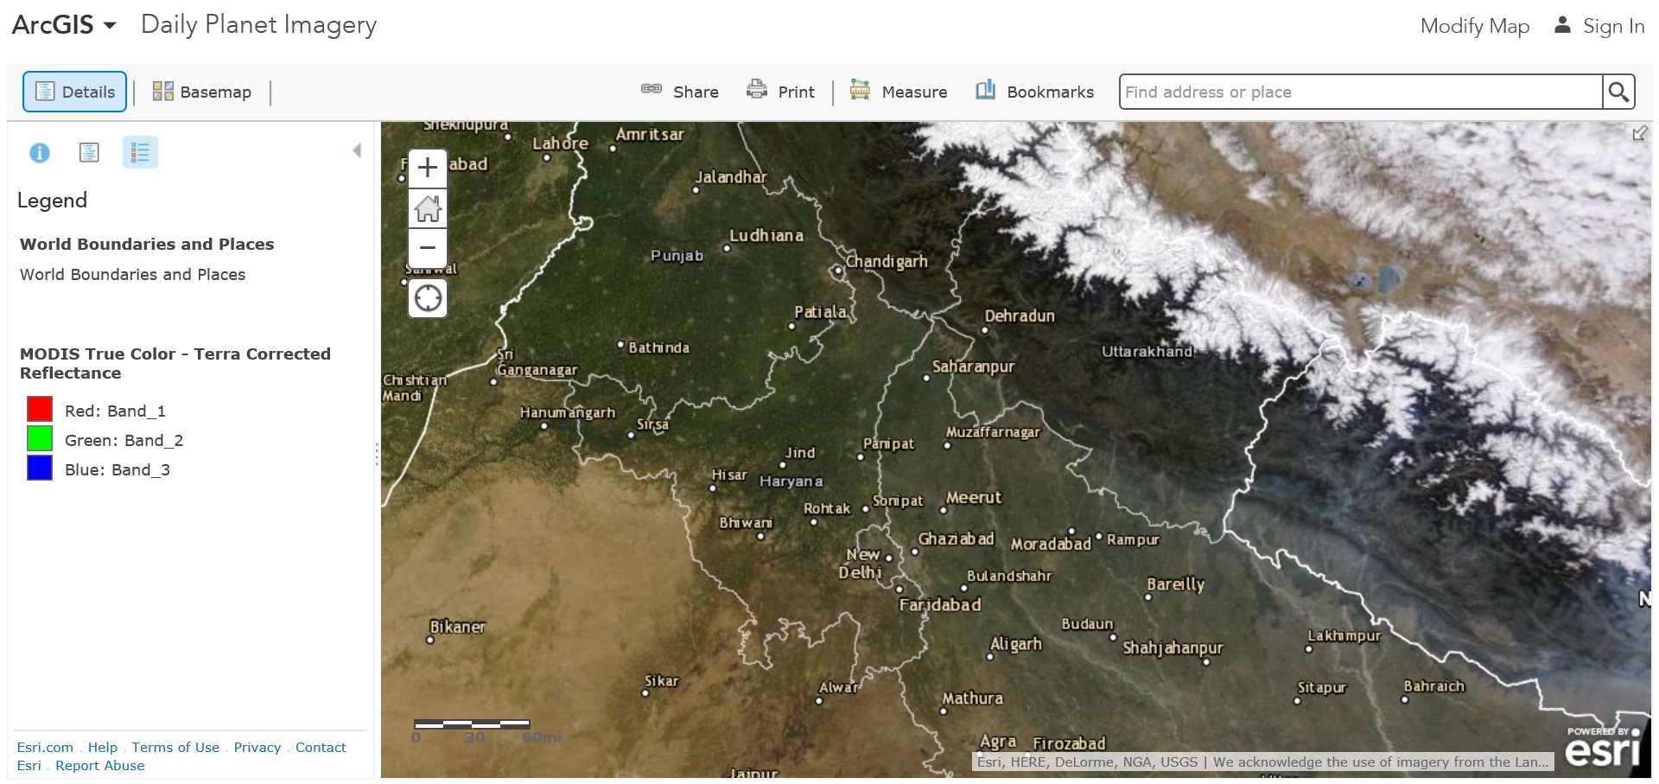
Corrected Reflectance in Map Viewer

Slide 32
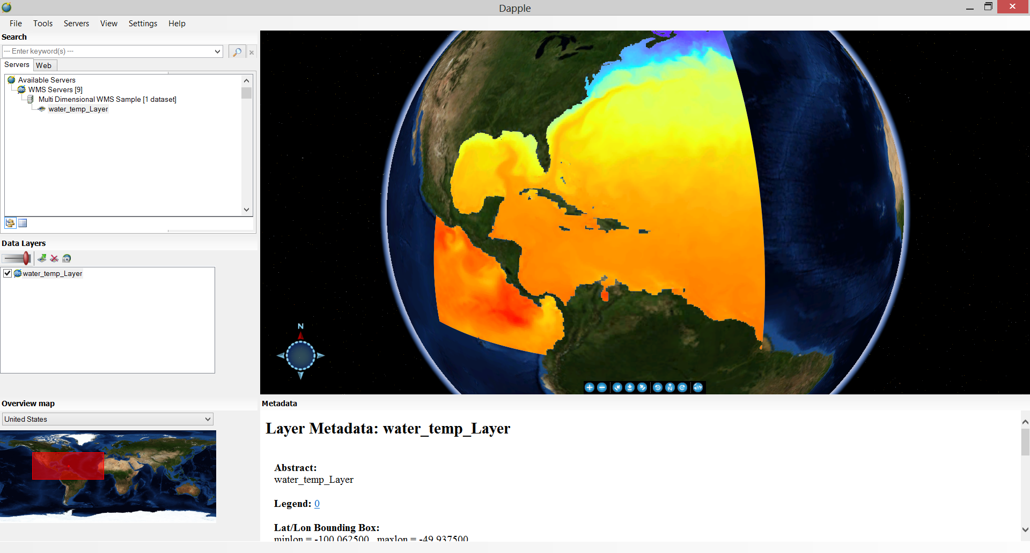
WMS in Dapple Earth Explorer

Slide 33
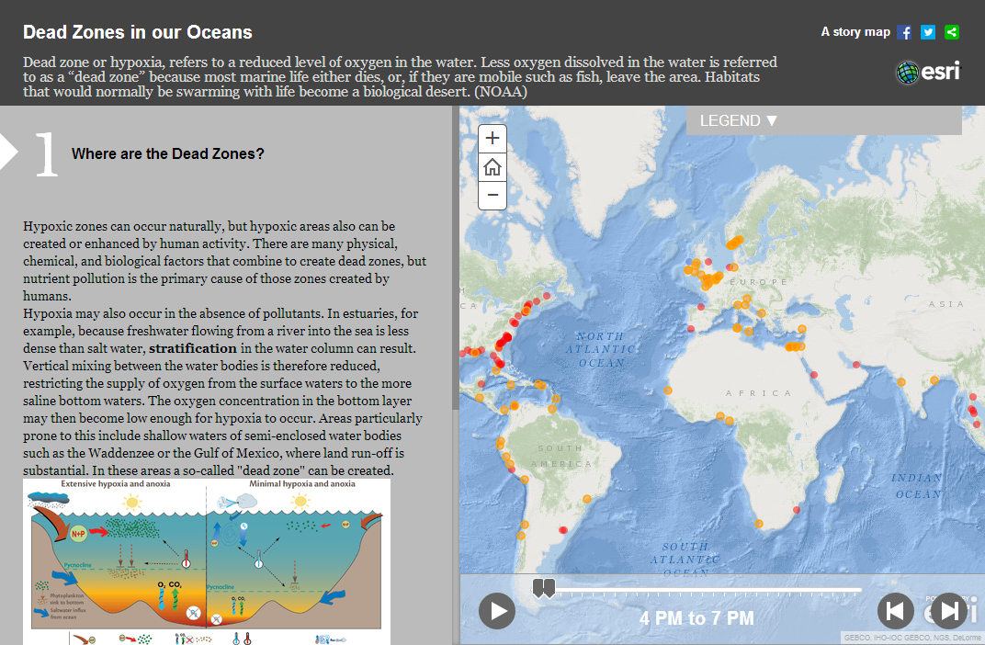
Tell the story of your scientific data – Create Story Maps
http://dtc-sci01.esri.com/DeadZoneStoryMap/

Slide 34

ArcGIS is a Scientific Collaboration Platform
Discover
Consume
Contribute
ArcGIS Online or on-premise Portal
Capability
Choices
Format
Choices
Services
Files
Dissemination with Choices
Rich Information Products
Analysis
Remote Sensing & Scientific Data
Notes:
Geography, the science that you work with, is an integrating science of our world. It brings together all the other sciences -- hydrology, geology, climatology, sociology, anthropology, and all of the ologies rest on the spatial dimension. This framework provides rich content and also a context for understanding everything. And understanding is the key. It's one of the keys that will help us address and take on the big challenges of our world today. It's clear to me that that is what this community is all about.

Slide 35



