Slide 1
Efficiently serving HDF5 via OPeNDAP
Kent Yang
The HDF Group
This work was supported by NASA/GSFC under Raytheon Co. contract number NNG15HZ39C

Slide 2
Why OPeNDAP¹?
Check metadata remotely (in various forms)
Obtain the subset of data easily and efficiently
Hide the original data sources
  Hierarchical Data Format(HDF) 4 and 5
  Network Common Data Form(NetCDF)
  Geospatial Tagged Image File Format(GeoTiFF)
OPeNDAP output(including subsets) can be downloaded as other formats
Many popular earth science tools can visualize and analyze the data via OPeNDAP

Slide 3
HDF5 Hyrax handler
To visualize the HDF5 data via Hyrax
  We have to follow the Climate and Forecast(CF) conventions to translate the data layout
CF-required metadata layout
NASA HDF5 metadata layouts
HDF5 CF Handler

Slide 4
How HDF5 Handler (CF Option) Works
HDF5 Library
CF-required layout
NASA HDF5 files
HDF5 Handler –CF option

Slide 5
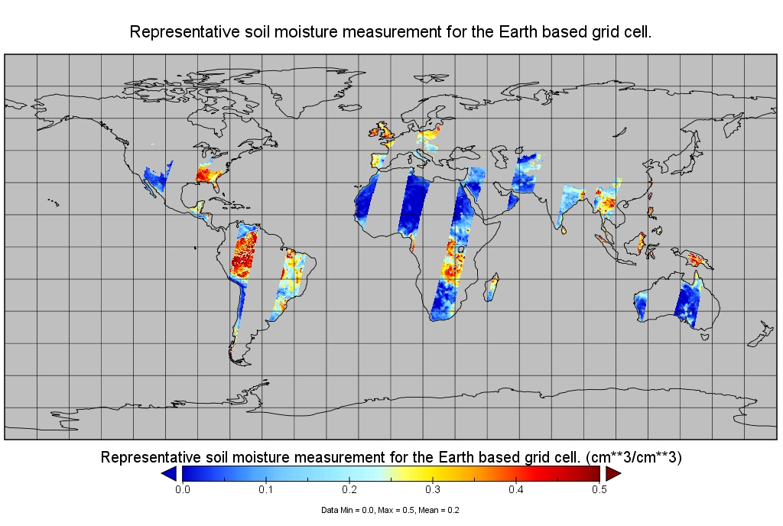
Visualize A Soil Moisture Active Passive(SMAP) HDF5 variable via Hyrax
Notes:
This is SMAP level 3 example. An HDF5 variable can be displayed by Panoply through Hyrax.

Slide 6
HDF5 handler and NcML¹
NcML module can be used with the HDF5 handler to provide the missing CF conventions information
<variable name="VNP_Grid_500m_2D_SurfReflect_I1_1">
<!-- Rename attribute Scale and Offset -->
<attribute name= "scale_factor" orgName= " Scale" /> <attribute name="add_offset" orgName="Offset" />
</variable>
"scale_factor"
"Scale"

Slide 7
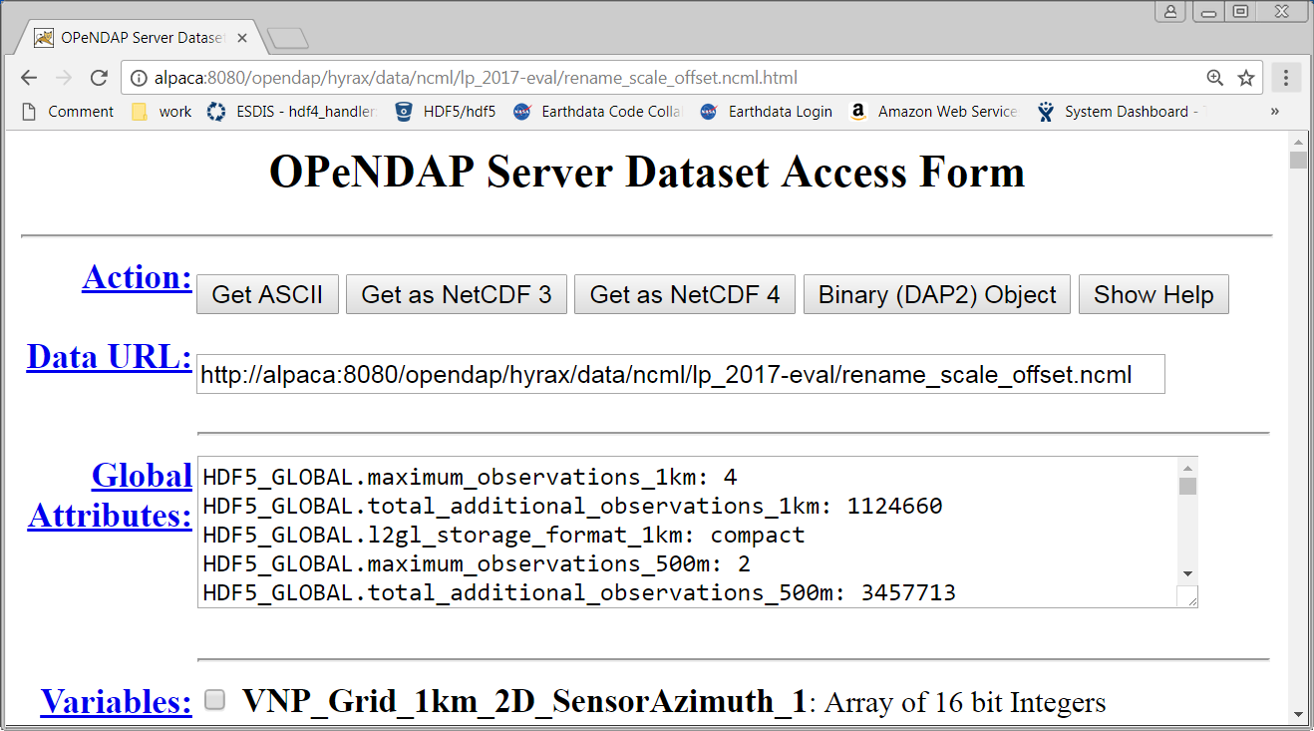
HDF5 handler and File NetCDF
File NetCDF module can work with the HDF5 handler to convert HDF5 files to NetCDF-3 or NetCDF-4 classic files

Slide 8
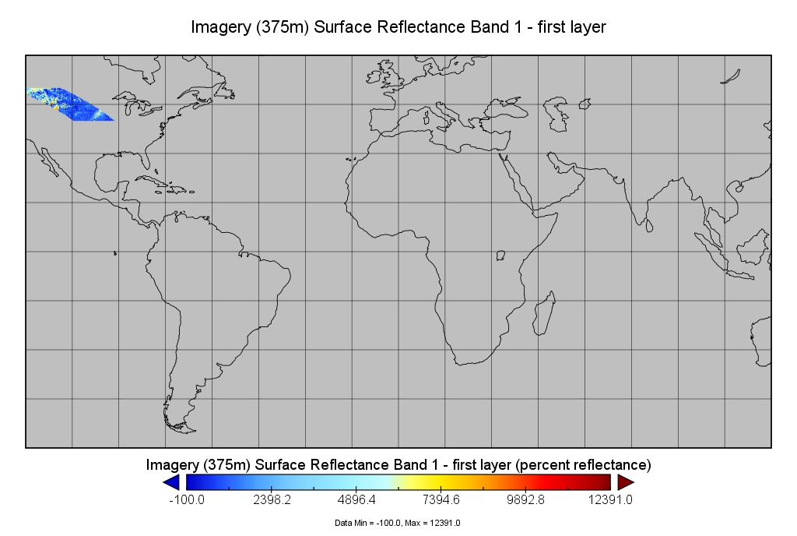
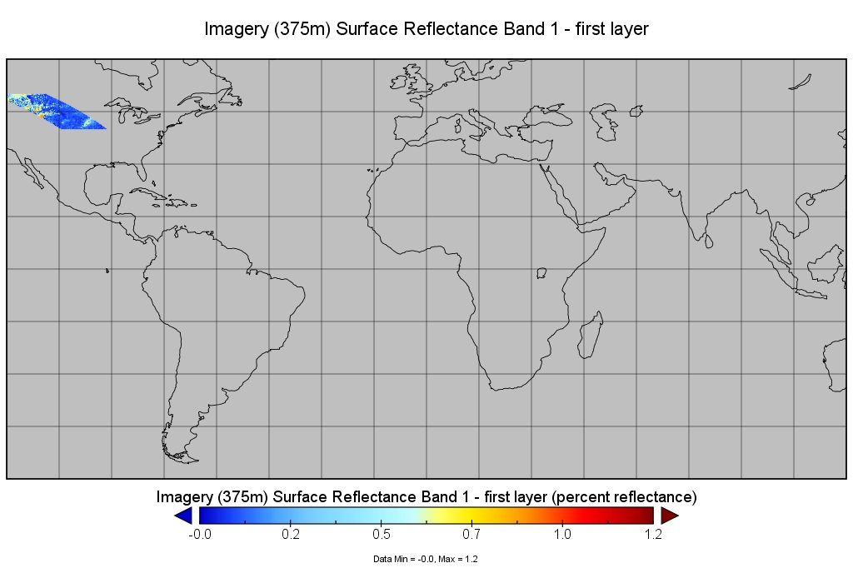
Use NcML and file NetCDF to work with HDF5 handler
<variable name="VNP_Grid_500m_2D_SurfReflect_I1_1">
<!-- Rename attribute Scale and Offset -->
<attribute name= "scale_factor" orgName= " Scale" />
<attribute name="add_offset" orgName="Offset" />
</variable>
Scale = 1e-4
1.2
12391.0
1.2
12391.0
VIIRS¹ via Hyrax directly
The NetCDF file of VIIRS¹
via Hyrax NcML and file NetCDF modules

Slide 9
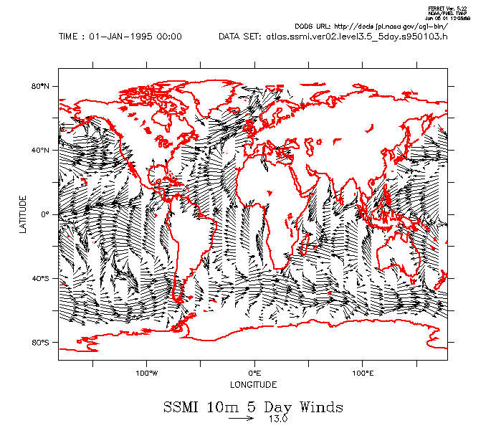
Service Chain to access HDF5 via Hyrax
HDF5
files
OPeNDAP clients
(netCDF, Ferret,
Panoply, …...)
Hyrax core
Main engine
HDF5 handler
Alternative output
File NetCDF
NetCDF
files
Supplement Info/Aggregate
NcML

Slide 10
DAP¹4 support in the HDF5 handler
CF option
  DAP4 strictly mapped from DAP2
  Dataset Metadata Response(DMR) replaces Dataset Descriptor Structure(DDS) and Dataset Attribute Structure(DAS)
No-CF(generic) option
  HDF5 group to DAP4 group
  HDF5 signed 8-bit and 64-bit integers to DAP4
  HDF5 dimensions following the NetCDF-4 to DAP4 mapping

Slide 11
Interoperability enhancement
CF option with DAP2
DAP2 and CF have restrictions
  not all HDF5 objects can map to DAP2 or CF
  An example: DAP2 doesn’t support 64-bit integer, HDF5 supports
Provide a way for service providers to check if there are any objects ignored when mapping from HDF5 to DAP2

Slide 12
Performance Improvement
Options that may help reduce the access time
Reducing data access time
  HDF5 is efficient to retrieve raw data
  Caching the raw data in the disk
    Best if the data is compressed
Reducing DAP2 DDS and DAS access time
  Caching DDS and DAS in memory
  Caching DAS in the disk

Slide 13
How HDF5 Handler(CF option) Memory Cache Works
HDF5 CF Handler
Memory Cache
HDF5 Library
CF-required layout
NASA HDF5 files

Slide 14
How HDF5 handler(CF Option) Memory Cache Works(continued)
HDF5 CF Handler
CF-required layout
Memory Cache
HDF5 Library
NASA HDF5 files
Notes:
[

Slide 15
How HDF5 Handler(CF Option) Disk Cache Works
CF-required layout
HDF5 CF Handler
DAS Disk Cache
HDF5 Library
NASA HDF5 files

Slide 16
How HDF5 Handler(CF Option) Disk Cache Works - Continued
CF-required layout
HDF5 CF Handler
DAS Disk Cache
HDF5 Library
NASA HDF5 files

Slide 17
Other New Features
Support the access of HDF-EOS5 sinusoidal projection in the HDF5 OPeNDAP handler

Slide 18
Future work
CF option
  Support the mapping of 64-bit integer to DAP4
  Support the access of other projections of HDF-EOS5-like products
  Add the DDS disk cache support(?)
Non-CF(generic) option
  Add the mapping of HDF5 variable length data to DAP4

Slide 19
ACCESS HDF5 via Hyrax in Cloud
Three architectures
HDF5 handler can be enhanced for the future work of Architectures 2 and 3

Slide 20
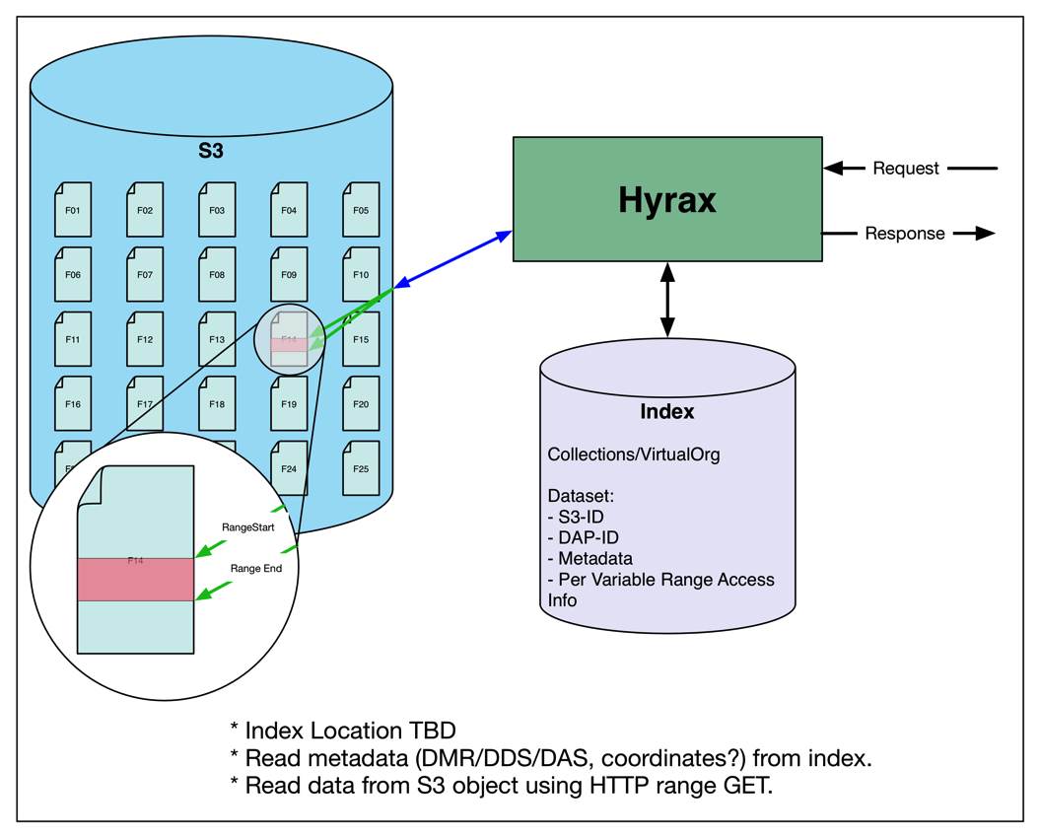
Archit. #2: Files With HTTP¹ Range-Gets
  Current implementation:
  Range-Gets index
  per HDF5 chunk
  Add an option to handler:
  Range-Gets index
  per HDF5 variable

Slide 21
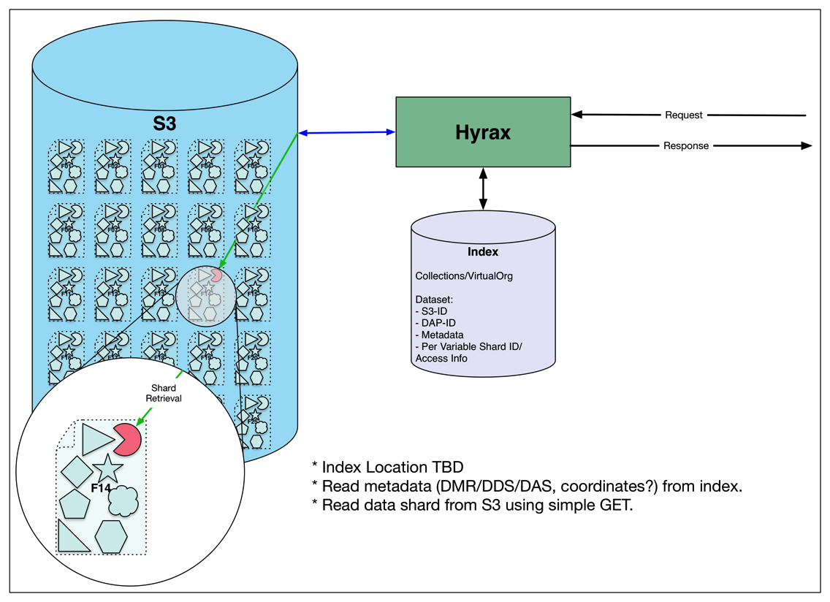
Archit. #3: HDF5 Datasets as S3¹ Objects
  Current implementation:
  An HDF5 chunk in
  a variable is an S3 object.
  Add an option to handler:
  An HDF5 variable is an
  S3 object.

Slide 22

This work was supported by NASA/GSFC under Raytheon Co. contract number NNG15HZ39C

