Slide 1
Hierarchical Data Formats (HDF)
Update
Latest HDF releases and more
The HDF Group
Elena Pourmal (epourmal@hdfgroup.org)
This work was supported by NASA/GSFC under Raytheon Co. contract number NNG15HZ39C
Notes:
HDF – Hierarchical Data Format (Version 4 and Version 5)
A free and open source (BSD license)
General purpose platform for storing,
managing, archiving, and exchanging data
Extensive facilities for data and metadata
association, hierarchies, and annotation
A self describing file format that is portable
across operating systems and architectures,
and that supports flexible user defined types
A software library for high I/O performance,
parallel I/O and out of core data access
(partial I/O), which supports compression
and other custom filters
High quality documentation
A responsive helpdesk and active users’
forum for community based support
The HDF Group
is a not for profit corporation
whose mission is to ensure the long term
accessibility to HDF data through the
sustainable development and support of HDF
technologies.
The HDF Group is dedicated to evolving HDF
technologies to serve the needs of users in ever
changing computational environments, while at
the same time maintaining its commitment to
ensure the accessibility of data stored in HDF
for the coming decades, even centuries.
The HDF project started at NCSA and the
University of Illinois in 1987. The HDF Group
completed its transition to an independent
corporation in mid 2006.

Slide 2
Outline
The HDF Group Website changes
Update on HDF5 1.8.19, 1.10.1 and HDF 4.2.13
Compatibility issues
Updates on HDF-Java, HDFView 3.0 and other tools
Supported compilers and systems
Compression library for interoperability with h5py and Pandas
Tell us about your needs!

Slide 3
Where to find us on the Web?
New Website (https://hdfgroup.org)
  Info about organization
  Latest 1.10 releases and HDFview 3.0
  New commercial tools by The HDF Group
    ODBC (Excel connector to HDF5)
  Registration
  Links to The HDF Group Support Website (https://support.hdfgroup.org)
    Documentation
    Old releases
    Misc. information about projects
  We are working on the new Support Portal (launch by the end of 2017)
Send us your feedback!

Slide 4
Latest HDF releases
Release cycle – once a year
HDF 4.2.13 (June 30, 2017)
  Memory leak fixes
  Support for Mac OS 10.12
  Support for the latest GNU, PGI an dIntel compilers
We do not plan any major work (i.e., performance improvements, new features, etc.) for HDF4
Encourage to move to HDF5

Slide 5
HDF5
Two versions
  HDF5 1.8.19 (May 16, 2017)
    Bug fixes, new APIs
  HDF5 1.10.1 (April 27, 2017)
    New features, extensions to HDF5 file format

Slide 6
Dropping Support for HDF5 1.8
Last release by June 30, 2019
  4 more HDF5 1.8 releases
We encourage you to move to HDF5 1.10 during the next year
  Recompile your application with the new version of HDF5
Contact help@hdfgroup.org if you encounter any problems

Slide 7
Issues you may encounter when moving applications to 1.10
C, Fortran, C++, Python application that worked with HDF5 1.8 may create HDF5 file incompatible with HDF5 1.8 file format
  When specifying latest file format while calling H5Pset_libver_bounds function
  The HDF Group will provide a fix before dropping support for HDF5 1.8
    Small update to the function call is required
HDF5 Java applications
  HDF5 JNI supports 64-bit objects identifiers; code based on the previous versions of HDF5 JNI need to be updated

Slide 8
Compatibility Issues
File is created by HDF5
 | 1.8 | 1.10
1.8 | Yes | No Use H5Pset_libver_bounds with appropriate parameters; don’t use features new in 1.10.0, 1.10.1
1.10 | Yes | Yes
File is read by HDF5

Slide 9
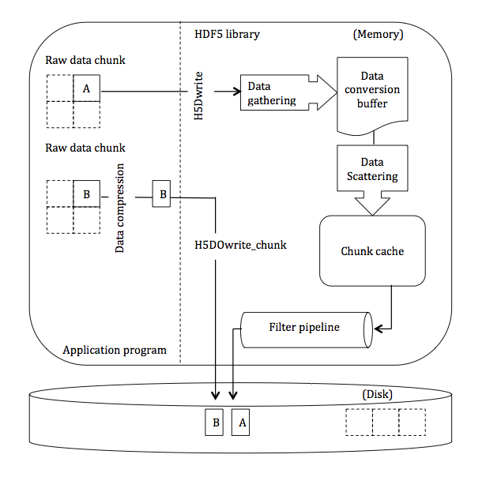
HDF5 1.8.19 New Features
H5DOread_chunk
  Function to read compressed data without uncompressing it (see H5DOwrite_chunk)
H5Dread
H5DOread_chunk
Notes:
Use when no decoding is necessary, for example, when rewriting the data from one file to another

Slide 10
HDF5 1.10.1 (Performance)
“Evict on close” feature
  Reduces memory footprint when iterating through many HDF5 objects (i.e, files, groups, datasets)
I/O improvements
  Paged Aggregation
  Page Buffering
https://support.hdfgroup.org/HDF5/docNewFeatures/
Notes:
The HDF5 library's metadata cache is fairly conservative about holding on to HDF5 object metadata (object headers, chunk index structures, etc.), which can cause the cache size to grow, resulting in memory pressure on an application or system. The "evict on close" property will cause all metadata for an object to be evicted from the cache as long as metadata is not referenced from any other open object. See the Fine Tuning the Metadata Cache documentation for information on the APIs.
The current HDF5 file space allocation accumulates small pieces of metadata and raw data in aggregator blocks which are not page aligned and vary widely in sizes. The paged aggregation feature was implemented to provide efficient paged access of these small pieces of metadata and raw data. See the RFC for details. Also, see the File Space Management documentation.
Small and random I/O accesses on parallel file systems result in poor performance for applications. Page buffering in conjunction with paged aggregation can improve performance by giving an application control of minimizing HDF5 I/O requests to a specific granularity and alignment. See the RFC for details. Also, see the Page Buffering documentation.

Slide 11
HDF-JAVA Update
HDF4 and HDF5 JNI are part of the HDF4 and HDF5 1.10 source distribution
  HDF5 JNI supports 64-bit objects identifiers; code based on the previous versions of HDF5 JNI need

Slide 12
HDFView 3.0 (beta)
HDFView 3.0-beta release (May 31, 2017)
  The Graphical User Interface (GUI) framework that HDFView uses was migrated from Swing (GUI widget toolkit for Java; part of Oracle’s Java Foundation Classes ) to Standard Widget Toolkit (http://www.eclipse.org/swt/ ), which provides a more native application look and feel and advanced support for tables.
  The data views have been separated from the main HDFView window. The main HDFView window still displays open files and their structures on the left side of the window, and it now displays any metadata on the right side.
  This release includes improved support for various datatypes (compound, array of compound, and opaque).
HDFView 3.0 planned for December 2017

Slide 13
HDF Tools
Command-line tools in HDF4 and HDF5
  Display content
  Copy data from one file to another
  Diff two files
Maintenance mode (bug fixing)
Which tools are missing?
  HDF4 and HDF5 diff
  ?

Slide 14
Supported Compilers
GNU
PGI
Intel
We test with two latest compiler versions available
Other?

Slide 15
Supported OSs
Linux 2.6, 2.7 and 3.10
Mac OS X 10.(8,9,10,11) and moving to 10.12
Windows 10 (32 and 64-bit)
  VS 2015 and Intel Fortran v.16
Windows 7 (32 and 64-bit)
  VS 2013 and Intel Fortran v.15
Cygwin 32-bit
SunOS 5.11 (32 and 64-bit)
PowerPC 64
Different Linux distributions (Fedora, Suse, Debian)
Anything missing?

Slide 16
Compression Library
HDF5 compression filters (plugins)
Dynamically loaded at run-time
  BZIP2 (PyTables, Pandas)
  MAFISC
  BLOSC (PyTables, Pandas)
  LZ4 (h5py)
  More filters are coming….
Contact help@hdfgroup.org if interested to try

Slide 17
Open Discussion
Tell us about your needs

Slide 18

This work was supported by NASA/GSFC under Raytheon Co. contract number NNG15HZ39C

