Slide 1
Data Analytics using MATLAB and HDF5
Ellen Johnson
Senior Team Lead, MATLAB Toolbox I/O
MathWorks

Slide 2
Overview
MATLAB support for Scientific Data
Big Data and Data Analytics Workflows
Functions and datatypes for Data Analytics
Example: FileDatastore for HDF5 data

Slide 3
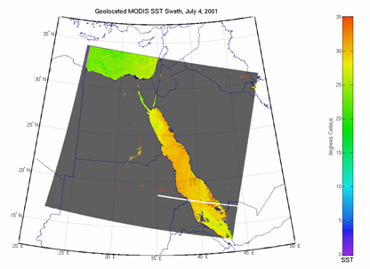
MATLAB Support for Scientific Data
Scientific data formats
  HDF5, HDF4, HDF-EOS2
  NetCDF (with OPeNDAP!)
  FITS, CDF, BIL, BIP, BSQ
Image file formats
  TIFF, JPEG, HDR, PNG, JPEG2000, and more
Vector data file formats
  ESRI Shapefiles, KML, GPS
  and more
Raster data file formats
  GeoTIFF, NITF, USGS and SDTS DEM, NIMA DTED, and more
Web Map Service (WMS)

Slide 4
MATLAB Support for HDF5
High Level Interface (h5read, h5write, h5disp, h5info)
  h5disp('example.h5','/g4/lat');
  data = h5read('example.h5','/g4/lat');
Low Level Interface (Wraps HDF5 C APIs)
  fid = H5F.open('example.h5');
  dset_id = H5D.open(fid,'/g4/lat');
  data = H5D.read(dset_id);
  H5D.close(dset_id);
  H5F.close(fid);
Notes:
h5disp maps to h5dump
try, catch
don’t have to recompile your code to play with the lower level interfaces
Run code as you type it

Slide 5
MATLAB Support for netCDF including OPeNDAP
High Level Interface (ncdisp, ncread, ncwrite, ncinfo)
  url = 'http://oceanwatch.pifsc.noaa.gov/thredds/ dodsC/goes-poes/2day';
  ncdisp(url);
  data = ncread(url,'sst');
Low Level Interface (Wraps netCDF C APIs)
  ncid = netcdf.open(url);
  varid = netcdf.inqVarID(ncid,'sst');
  netcdf.getVar(ncid,varid,'double');
  netcdf.close(ncid);
Notes:
ncdisp maps to ncdump

Slide 6


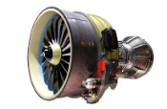

Big Data and Data Analytics: Why MATLAB?
2
MATLAB lets domain experts do Data Science themselves
1
Data
Analytics
MATLAB Analytics work with business, scientific, engineering data
DATA
Engineering, Scientific, and Field
Business and Transactional
3
4
MATLAB Analytics run in
embedded systems
developed with
Model-Based Design
MATLAB Analytics
deploy to
enterprise IT systems
Embedded Systems
Developed with Model-Based Design
Enterprise IT Systems

Slide 7
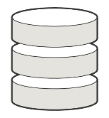




Big Data Workflows in MATLAB
ACCESS
Access data and collections of files
that do not fit in memory
Datastores
Images
Spreadsheets
Tabular Text
Custom Files
SQL
Hadoop (HDFS)
PROCESS AND ANALYZE
SCALE
Purpose-built capabilities for domain experts to work with big data locally
Scale to compute clusters and Hadoop/Spark for data stored in HDFS
Tall Arrays
Math
Statistics
GPU Arrays
Matrix Math
Deep Learning
Image Classification
Tall Arrays
Math, Stats, Machine Learning on Spark
Distributed Arrays
Matrix Math on Compute Clusters
MDCS for EC2
Cloud-based Compute Cluster
MapReduce
MATLAB API for Spark
Visualization
Machine Learning
Image Processing
Notes:
MapReduce/Spark API: Lower level control

Slide 8

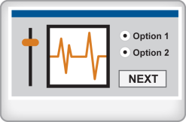
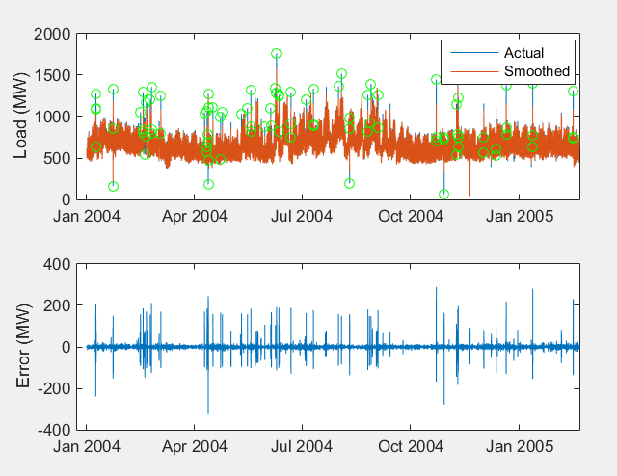
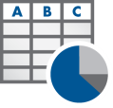



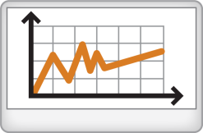
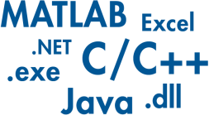












Data Analytics Workflows in MATLAB
Access and Explore Data
Preprocess Data
Develop Predictive Models
Integrate Analytics with Systems
Files
Working with
Messy Data
Model Creation e.g. Machine Learning
Desktop Apps
Databases
Data Reduction/
Transformation
Parameter Optimization
Enterprise Scale Systems
Sensors
Feature
Extraction
Model
Validation
Embedded Devices and Hardware

Slide 9
Today’s Focus: Accessing, Exploring, Preprocessing Data
Access and Explore Data
Preprocess Data
Files
Business and Transactional Data
Working with
Messy Data
Repositories – SQL, NoSQL, etc.
File I/O – Text, Spreadsheet, etc.
Web Sources – RESTful, JSON, etc.
Databases
Data Reduction/
Transformation
Engineering, Scientific and Field Data
Real-Time Sources – Sensors, GPS, etc.
File I/O – Image, Scientific Data Formats, Video, Audio, etc..
Communication Protocols – OPC (OLE for Process Control), CAN (Controller Area Network), etc.
Sensors
Feature
Extraction

Slide 10
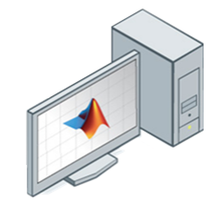
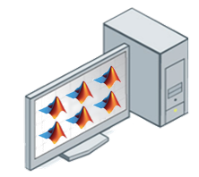






What is a datastore?
Serial
PCT
Local Workers
MDCS
MDCS
MATLAB Compiler
Notes:
An Object representing a collection of data

Slide 11
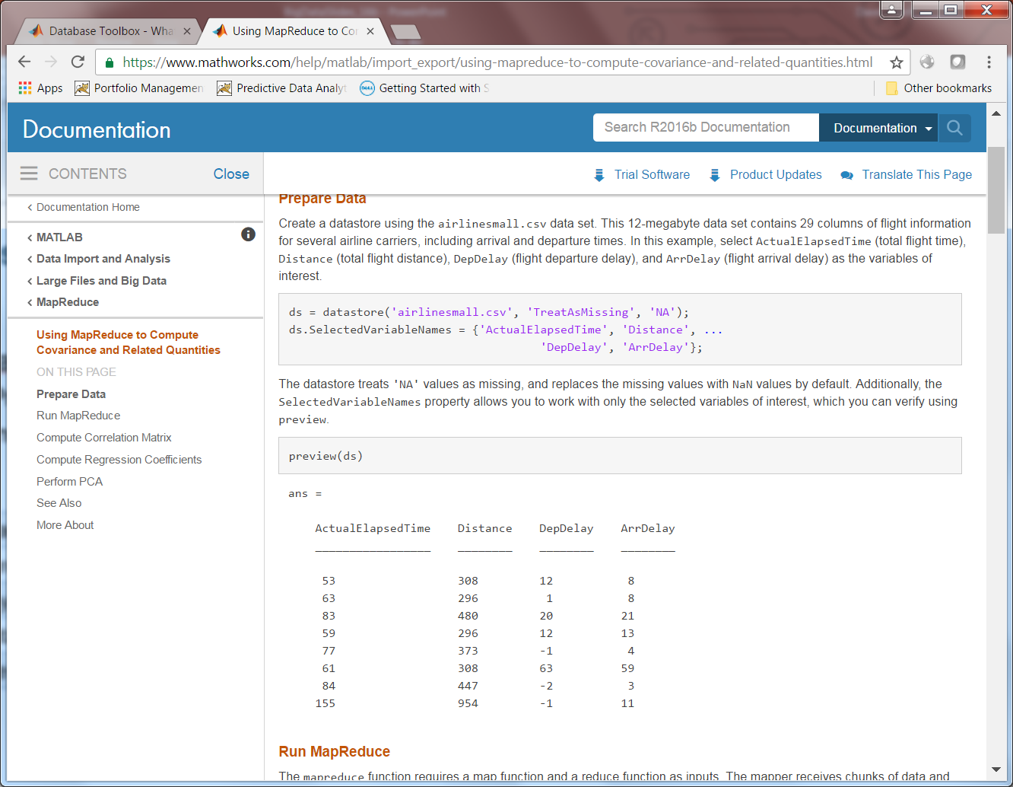
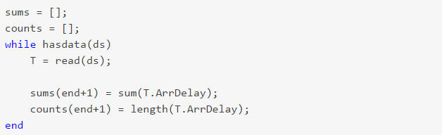
Access Big Data through datastore
Datastore: easily access large sets of data
  Object designed for accessing data
  Preview data structure and format
  Variety of types for different data sources:
    TabularText Datastore
    Spreadsheet Datastore
    Database Datastore
    KeyValue Datastore
    File Datastore
    Image Datastore
  Incrementally read portions of the data
  Use with Parallel Computing tools
Notes:
Datastore provides a straightforward way to access big data that consists of one text file or a collection of text files.
Step through files a chunk at a time
Use wildcards to specify
all the files in a given directory
Identify columns to import
using column names
Specify format for each
column of interest

Slide 12
When to Use datastore
Data Characteristics
  Data stored in files supported by datastore
Compute Platform
  Desktop or cluster
Analysis Characteristics
  Supports Load, Analyze, Discard workflows
  Incrementally read chunks of data,
  process within a while loop
Notes:
Datastore provides a straightforward way to access big data that consists of one text file or a collection of text files.
Step through files a chunk at a time
Use wildcards to specify
all the files in a given directory
Identify columns to import
using column names
Specify format for each
column of interest

Slide 13
Example datastore code
ds = tabularTextDatastore('c:\airlinedata\*.csv');
maxDelay = 0;
while hasdata(ds)
data = read(ds);
chunkmax = max(data.DepartureDelay);
maxDelay = max(maxDelay,chunkmax);
end
% or use tall!
ds = tabularTextDatastore('c:\airlinedata\*.csv');
t = tall(ds);
maxDelay = gather(max(t.DepartureDelay));

Slide 14





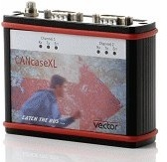




Datastores – the Key to Tall Arrays
Databases
ds = datastore(…)
T = tall(ds)
…
Images
Custom
ds = datastore('s3://…',…)

Slide 15
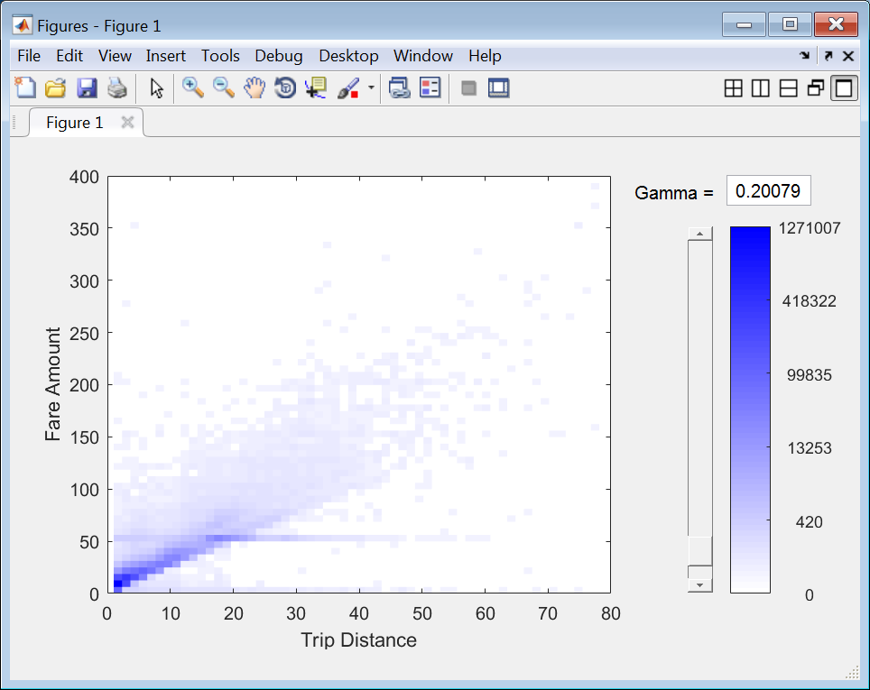

What are Tall Arrays?
tall data type introduced in
Ideal for tabular/columnar data
  One or more rows can fit into memory
  Overall data size is too big to fit into memory
Access Data
Tall Data Types
Preprocessing
Machine Learning
Text
Spreadsheet (Excel)
Database (SQL)
Images
Custom Reader
Simulink
Table
Timetable
Cell
Numeric
Dates & times
String
Categorical
Cellstr
Numeric functions
Summary statistics
String processing
Table wrangling
Missing data handling
Visualizations:
  Plot, scatter
  Histogram/histogram2
  Kernel density plot
  Bin-scatter
Linear Models
Logistic Regression
Discriminant analysis
Classification Trees
SVM
K-means
PCA
Random data sampling
“Tall” data types and functions for use with out-of-memory data

Slide 16


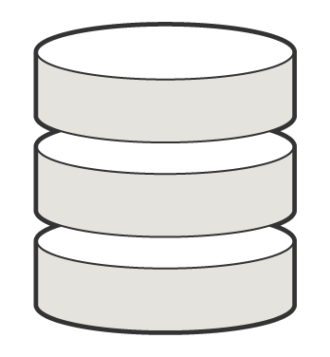

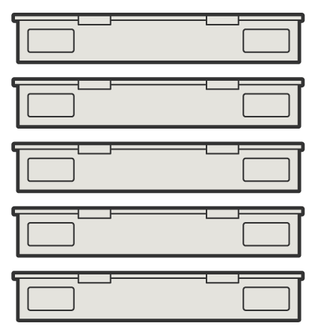


Execution Environments for Tall Arrays
Local disk,
Shared folders,
Databases
or Spark + Hadoop (HDFS), for large scale analysis
Run on Compute Clusters
Process out-of-memory data on your Desktop to explore, analyze, gain insights and to develop analytics
Use Parallel Computing Toolbox for increased performance
MATLAB Distributed Computing Server,
Spark+Hadoop

Slide 17
Example: Working with HDF5 data using FileDatastore
NASA’s Operation IceBridge Aircraft Missions
  Reference: https://nsidc.org/data/icebridge/campaign_data_summary.html
  Airborne Topographic Mapper LIDAR
  Measures changes in ice surface elevation
Let’s look at the Antarctica Larsen D Ice Sheet datasets
  Larsen D data collected on 10/18/14 and 11/18/2016
Create a FileDatastore with a custom file reader
  Read through the collections of files
  Gather information on the datasets

Slide 18
Example: Working with HDF5 data using FileDatastore
Create a FileDatastore
ds = fileDatastore(h5Folder, 'ReadFcn', @h5readall);
Scale to MapReduce
  Map function receives chunks of data and outputs intermediate results
  Reducefunction reads the intermediate results and produces a final result
mapreducer(0);
mrOutputFolder = fullfile(pwd, 'output');
outds = mapreduce(ds, @countMap, @countReduce, 'OutputFolder', 'output');

Slide 19
Example: Working with HDF5 data using FileDatastore
Read and view the computed data
tbl = readall(outds);
outTable = horzcat(tbl.Key, struct2table([tbl.Value{:}]));
outTable.Properties.VariableNames{1} = 'Filename‘
>> fileDatastoreDemo
********************************
* MAPREDUCE PROGRESS *
********************************
Map 0% Reduce 0%
Map 10% Reduce 0%
Map 21% Reduce 0%
Map 31% Reduce 0%
Map 42% Reduce 0%
Map 53% Reduce 0%
Map 63% Reduce 0%
Filename NumberOfDatasets FileSize ErrorDatasets
_____________________________________________________________________________________________________________________________________ ________________ __________ _____________
'\\mathworks\home\ellenj\iceSheet\n5eil01u.ecs.nsidc.org\ICEBRIDGE\ILATM1B.002\2016.11.18\h5Files\ILATM1B_20161118_162307.ATM6AT6.h5' 19 1.3913e+07 0
'\\mathworks\home\ellenj\iceSheet\n5eil01u.ecs.nsidc.org\ICEBRIDGE\ILATM1B.002\2016.11.18\h5Files\ILATM1B_20161118_162801.ATM6AT6.h5' 19 1.5699e+07 0
'\\mathworks\home\ellenj\iceSheet\n5eil01u.ecs.nsidc.org\ICEBRIDGE\ILATM1B.002\2016.11.18\h5Files\ILATM1B_20161118_163343.ATM6AT6.h5' 19 1.6593e+07 0
'\\mathworks\home\ellenj\iceSheet\n5eil01u.ecs.nsidc.org\ICEBRIDGE\ILATM1B.002\2016.11.18\h5Files\ILATM1B_20161118_163935.ATM6AT6.h5' 19 1.4693e+07 0
'\\mathworks\home\ellenj\iceSheet\n5eil01u.ecs.nsidc.org\ICEBRIDGE\ILATM1B.002\2016.11.18\h5Files\ILATM1B_20161118_164516.ATM6AT6.h5' 19 1.5862e+07 0
'\\mathworks\home\ellenj\iceSheet\n5eil01u.ecs.nsidc.org\ICEBRIDGE\ILATM1B.002\2016.11.18\h5Files\ILATM1B_20161118_165055.ATM6AT6.h5' 19 1.6317e+07 0
'\\mathworks\home\ellenj\iceSheet\n5eil01u.ecs.nsidc.org\ICEBRIDGE\ILATM1B.002\2016.11.18\h5Files\ILATM1B_20161118_165637.ATM6AT6.h5' 19 1.6681e+07 0
'\\mathworks\home\ellenj\iceSheet\n5eil01u.ecs.nsidc.org\ICEBRIDGE\ILATM1B.002\2016.11.18\h5Files\ILATM1B_20161118_170223.ATM6AT6.h5' 19 1.6438e+07 0
'\\mathworks\home\ellenj\iceSheet\n5eil01u.ecs.nsidc.org\ICEBRIDGE\ILATM1B.002\2016.11.18\h5Files\ILATM1B_20161118_170810.ATM6AT6.h5' 19 1.6231e+07 0 ‘ \\mathworks\home\ellenj\iceSheet\n5eil01u.ecs.nsidc.org\ICEBRIDGE\ILATM1B.002\2016.11.18\h5Files\ILATM1B_20161118_171357.ATM6AT6.h5' 19 1.6502e+07 0

Slide 20
Saving Preprocessed/Intermediate Data – MAT-Files
Saving preprocessed or intermediate results
In MATLAB, many people use .mat files for this
Binary MATLAB files that store workspace variables
MAT-File version 7.3 are based on the HDF5 file format!

Slide 21
Thank you!
Questions?

