Slide 1
Improved Methods for Accessing Scientific Data for the Masses
Amanda O’Connor
Professional Services Business Development Manager

Slide 2


Amanda O’Connor
Amanda O’Connor
Business Development Manager
Harris Corporation
Email: aoconn05@harris.com
303-544-4419

Slide 3
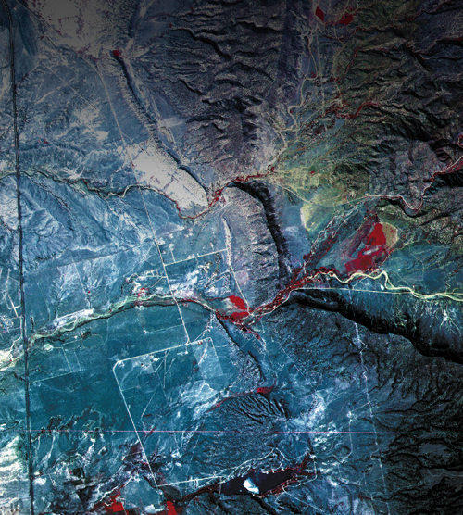
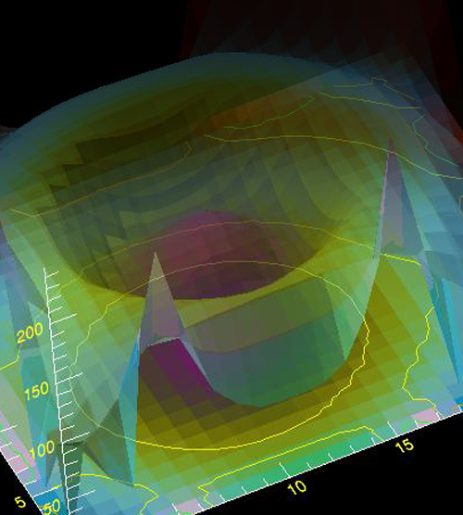

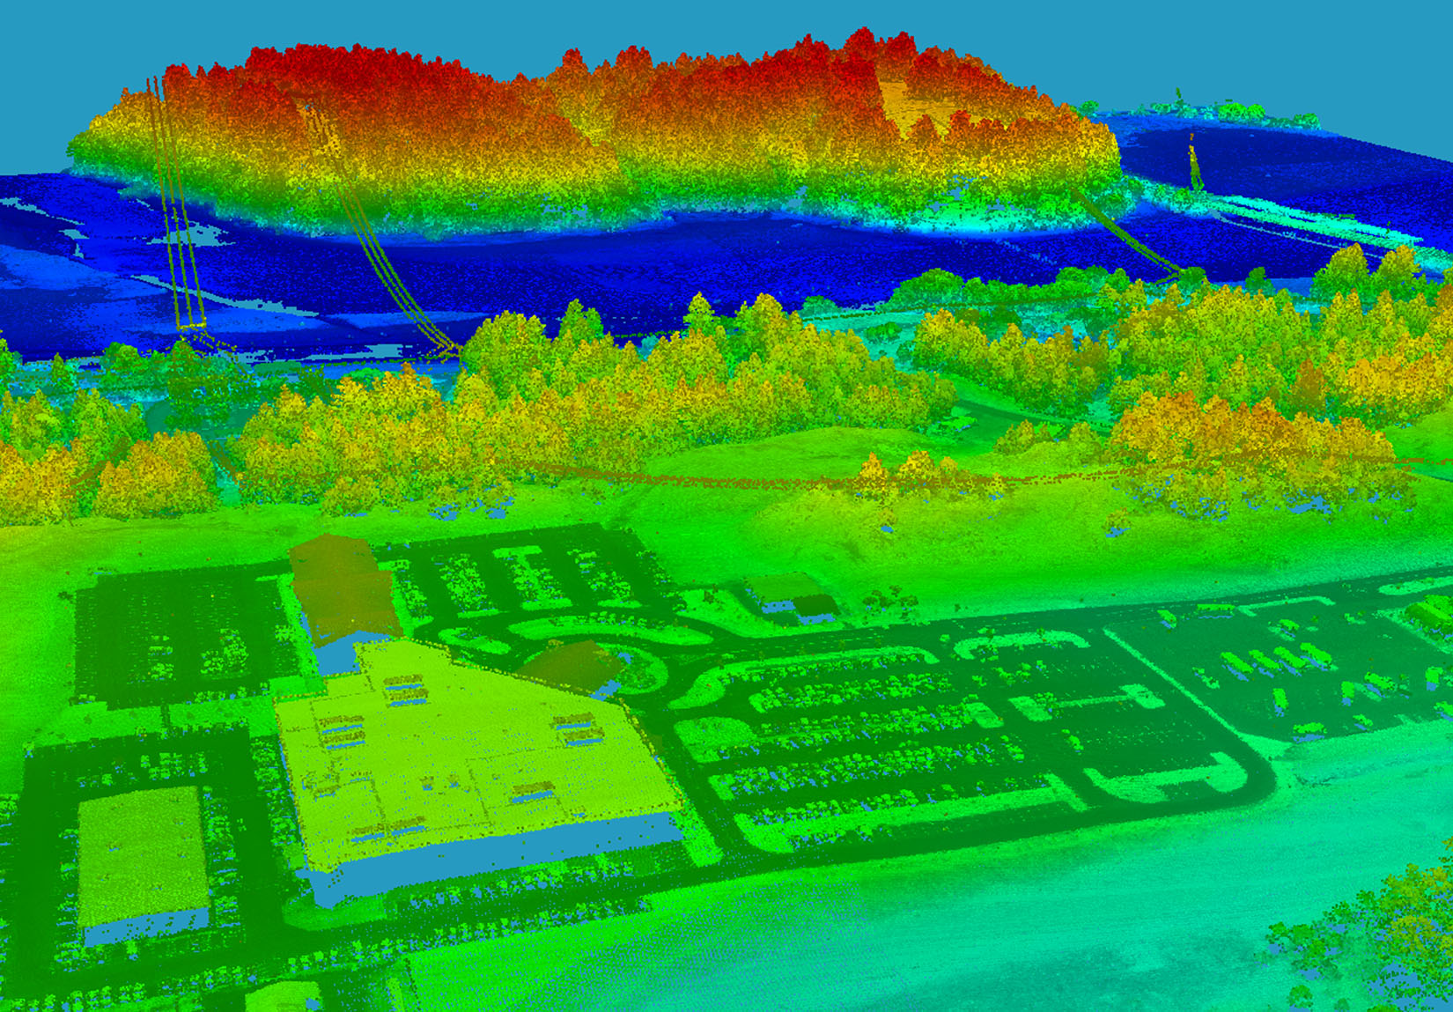
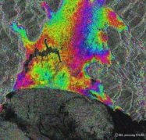
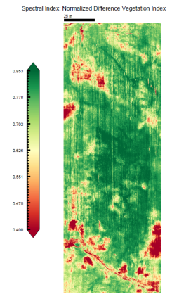
HARRIS GEOSPATIAL
Capabilities
WHO WE ARE
Broad portfolio, key experts, and proven track record of remote sensing science and data innovation technology
21,000 employees, 9000 scientists & engineers, worldwide presence representing > 100 countries
ENVI, IDL, Jagwire, Geiger Mode LiDAR, Sarscape, Custom Solutions, Geospatial Marketplace. Former RSI
KEY CUSTOMERS & PARTNERS
NASA | USDA | NGA | AEROVIRONMENT | USGS/DOI | FEMA | HALIFAX WATER | CARESTREAM HEALTH | MONSANTO | NATIONAL LABS | CYTOVIVA | HIGHLAND PRECISION AGRICULTURE | RIT | ASD | EDGE DATA | CLOUDEO | HYSPEED COMPUTING | OGC | AMAZON | AIRBUS | NVIDIA | ESRI | DIGITAL GLOBE | PLANET | NOAA|NCAR|CIRES|CU|U Wisconsin| AER |Harris Corp Internal| Raytheon |EUMETSAT |ESA |AUSBOM |UK MET Office| AFWA| NRL |NAVO|NREL |FNMOC|NPS| National Met Offices WW
ENVI
IDL
JAGWIRE
LiDAR
Sarscape
USE CASEs
Technology OVERVIEW
Precision Agriculture
Utility Inspections
Infrastructure Reconnaissance
Damage Assessment
Insurance Verification and Reports
Research & Development
Weather and Climate
MORE…
Best in Class Image Analytics
LiDAR Feature Extraction
SAR Analytics
Leader in Spectral Processing
GPU Acceleration
Cloud Analytics
Medical Imaging and Microscopy
Commercialization
Esri Integration
Automation
Precision Agriculture SMEs
Numeric Modeling
Photogrammetry SME
Deep Learning/Machine Learning
Meteorology SME

Slide 4
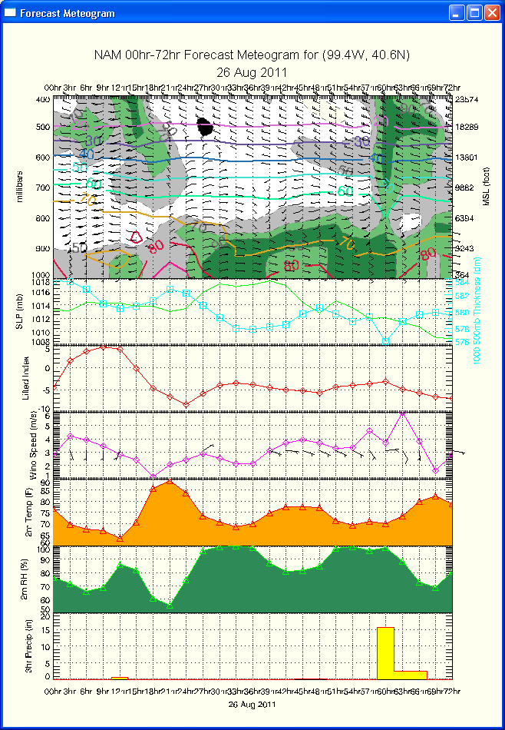
HARRIS GEOSPATIAL
Wx Capabilities
Key Geospatial Tools For Wx and Oceans
HDF/NetCDF template support in ENVI
Support GLT and full disk data projections with GOES-16
Animations of very large data
Scalable, source code agnostic enterprise infrastructure
Data provisioning: Harris Geospatial Market Place
ExactAIS global ship tracking service
USE CASEs
Weather Workbench 3-D and 4-D Visualization
NOAA Hazard Mapping System Interface
NOAA Study on cloud deployment of radiometric correction
Helios Traffic Camera Network for hyperlocal Wx
Plots, Charts, Graphics for NOAA NESDIS, STAR, OAR
USAGE OVERVIEW
NOAA has a site license for IDL—NASA has BPA
Virtual machine for sharable IDL Execution
ENVI/IDL task engine for scaling data production
Capable of large volume data production, highly optimized code, parallelizable and GPUs
Deep learning capabilities, robust and operational— Wet road/dry road detection, Wx Trends

Slide 5
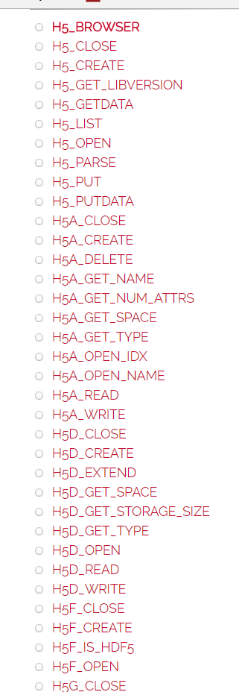
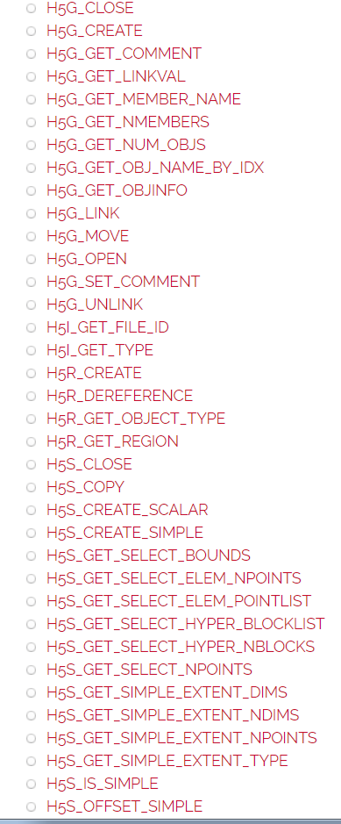
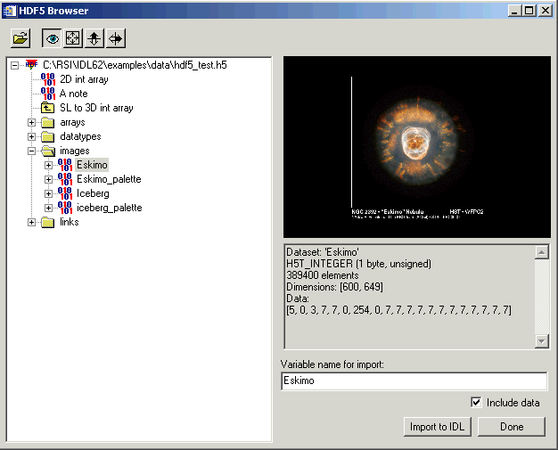
Scientific Data Support
IDL has long supported NetCDF/HDF 5
Legacy NASA, NOAA support
Typically needed to understand the format to read and write files
Required users not only to be scientists, but also experts in a file format

Slide 6
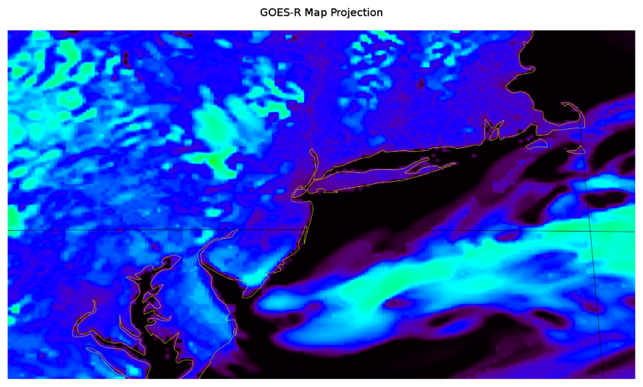
IDL GOES16 Map Projection
ENVI users ArcGIS Projection Engine and doesn’t handle full disk data as accuratly as possible
In IDL 8.6.1 Added specific GOES16 projection for more accuratly overlaying rasters on full disk data

Slide 7
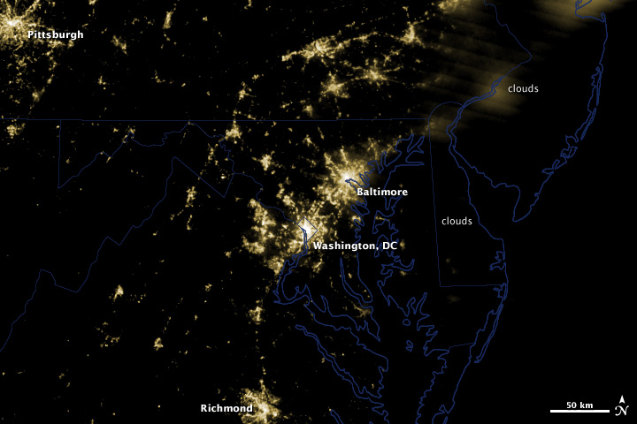
VIIRS Support in ENVI
ENVI and HDF/NETCDF
ENVI had supported Landsat HDF
Added improved HDF support for Suomi NPP VIIRS data
Including
  Bowtie correction
  Calibration
  SDR and EDR support
  Reprojection
  Visualiations

Slide 8
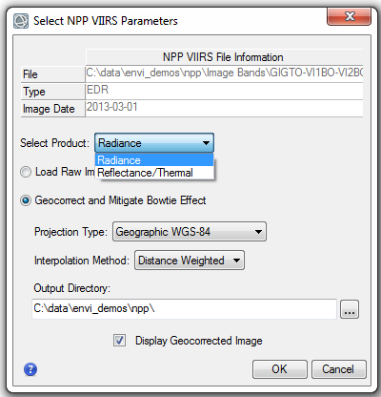
Calibration
Calibration applied upon opening
Calibration options are context dependant
Depending on image opened, Images are processed to radiance, reflectance, brightness temperature, or albedo
Calibration parameters are applied to each granule (if they are different)
Images are then displayed with the granules together as full image without granule separation lines
Notes:
Radiance is w/m2/sr/micrometer. --swap graphic—try an I band
Calibration options are context dependent, so if you are opening a thermal band you have radiance and brightness temp (K)

Slide 9
Bowtie Correction
Step 1: Determine Pixel size, Tie Points, and extents of image
Step 2: Map the GLT data values to a regular geographic grid
Step 3: Interpolation—Weighted Distance or NN
Notes:
--Call out weighted distance vs nn interpolation. 3x3 kernel is used for weighted distance. NN is best for classifications bc you don’t don’t want to change classes. Weighted dist averages the kenerl, nn picks the pixel closest.

Slide 10
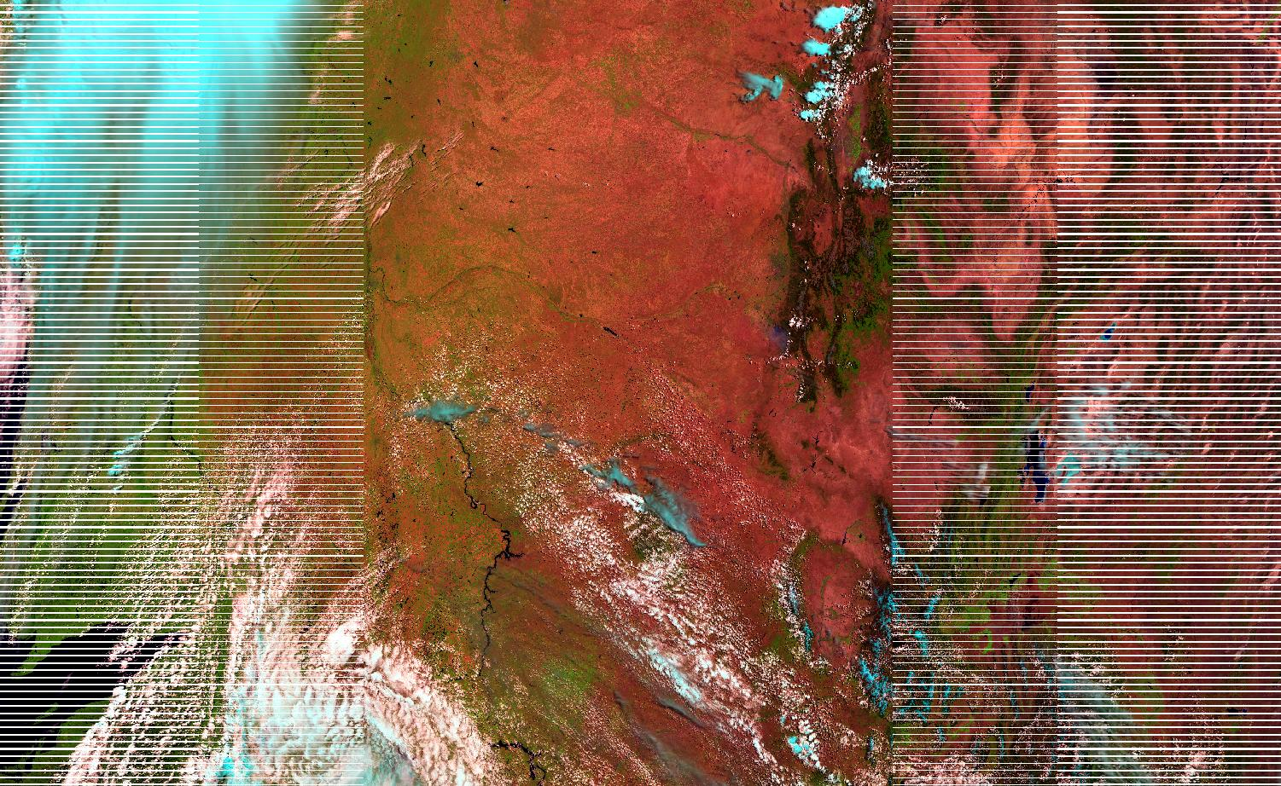
Bowtie Correction

Slide 11
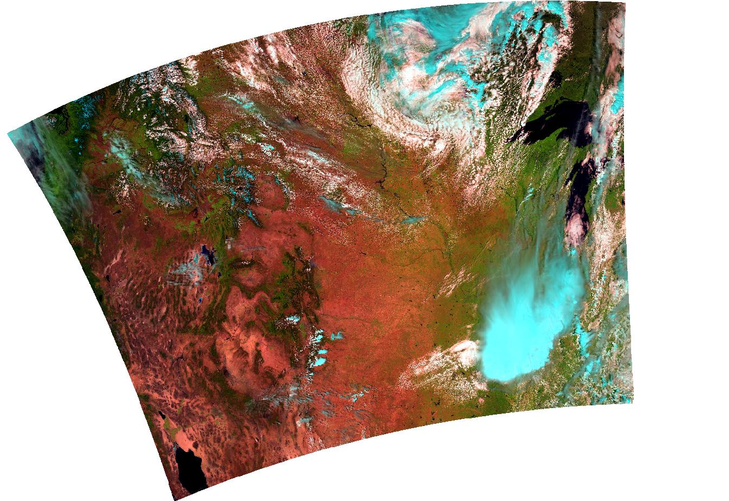
Bowtie Correction
Notes:
The center of the image is located at the following coordinates:
* Lat,Lon DMS: 41°23'57.81"N, 104°47'47.89"W
* Lat,Lon DD: 41.39939168N, 104.79663536W
* Map: -104.7966, 41.3994
* Proj: Geographic Lat/Lon, WGS-84
* MGRS: 13TEF1700083115

Slide 12
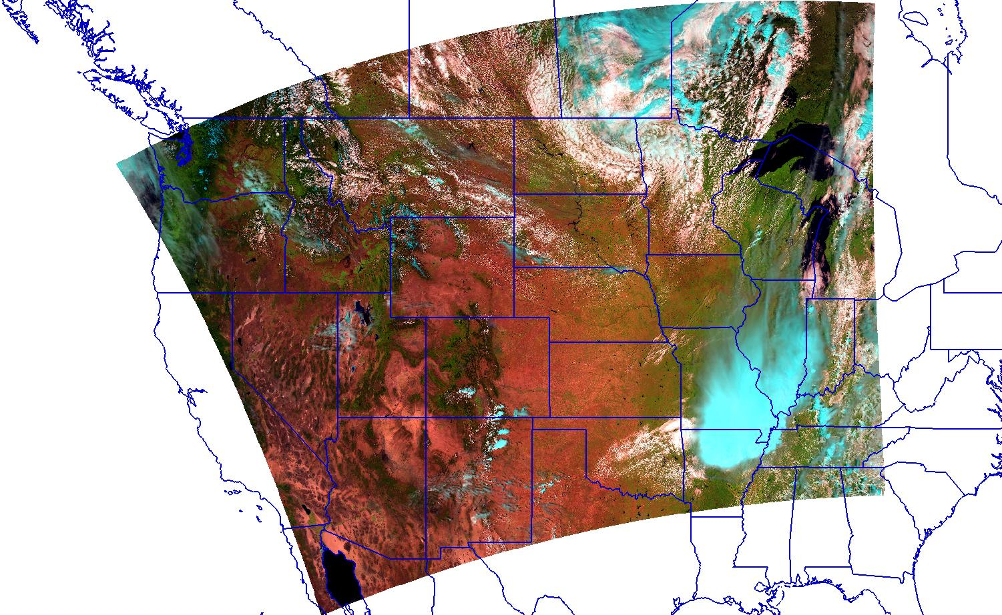
Bowtie Correction
Notes:
The center of the image is located at the following coordinates:
* Lat,Lon DMS: 41°23'57.81"N, 104°47'47.89"W
* Lat,Lon DD: 41.39939168N, 104.79663536W
* Map: -104.7966, 41.3994
* Proj: Geographic Lat/Lon, WGS-84
* MGRS: 13TEF1700083115

Slide 13
ENVI 5.4: Dataset Browser
Easily build new ENVI rasters that contain a combination of scientific data, attributes, and latitude/longitude information from HDF and NetCDF files.
Map attributes from the source dataset to standard ENVI header fields.
Add standard ENVI header fields to the new raster with known metadata values.
Select latitude and longitude datasets from the source file and add them to a Geographic Information folder in the Raster Builder.
Create XML templates for reading data in HDF4, HDF5 and NetCDF-3 datasets. Using a template prevents you from having to use the Dataset Browser to re-define the raster and metadata for every file.

Slide 14
ENVI 5.4: Dataset Browser
Easily build new ENVI rasters that contain a combination of scientific data, attributes, and latitude/longitude information from HDF and NetCDF files.
Map attributes from the source dataset to standard ENVI header fields.
Select latitude and longitude datasets from the source file and add them to a Geographic Information folder in the Raster Builder.
Create XML templates for reading data in HDF4, HDF5 and NetCDF-3 datasets. Using a template prevents you from having to use the Dataset Browser to re-define the raster and metadata for every file.
Use GLT and other information to reproject data

Slide 15
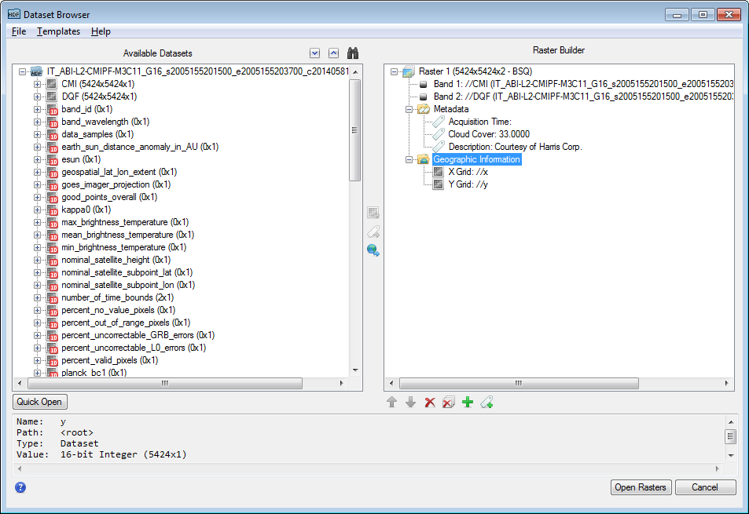
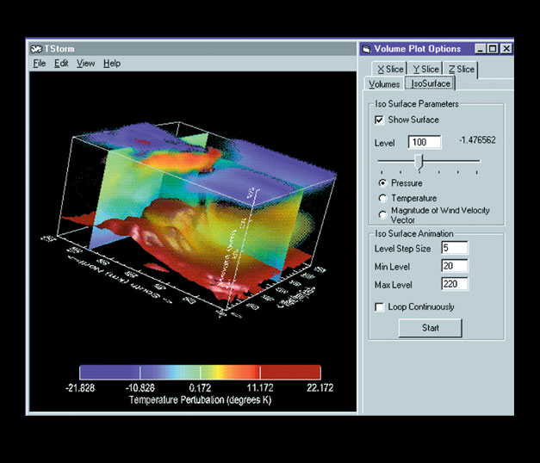
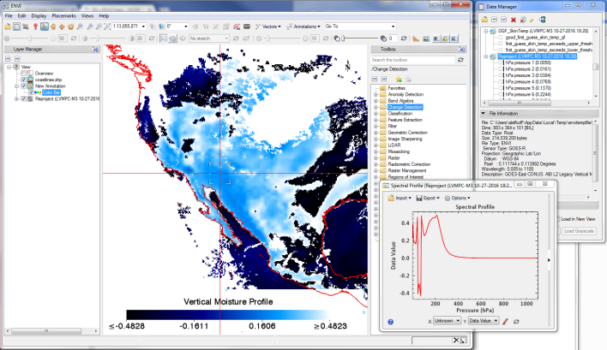
NetCDF/HDF5 Browser

Slide 16
What Does ENVI Get You?
Verticle Profiles into Layers like Atmospheric Pressure
Color tables
Export to other formats
Export to ArcGIS for Map Authoring

Slide 17
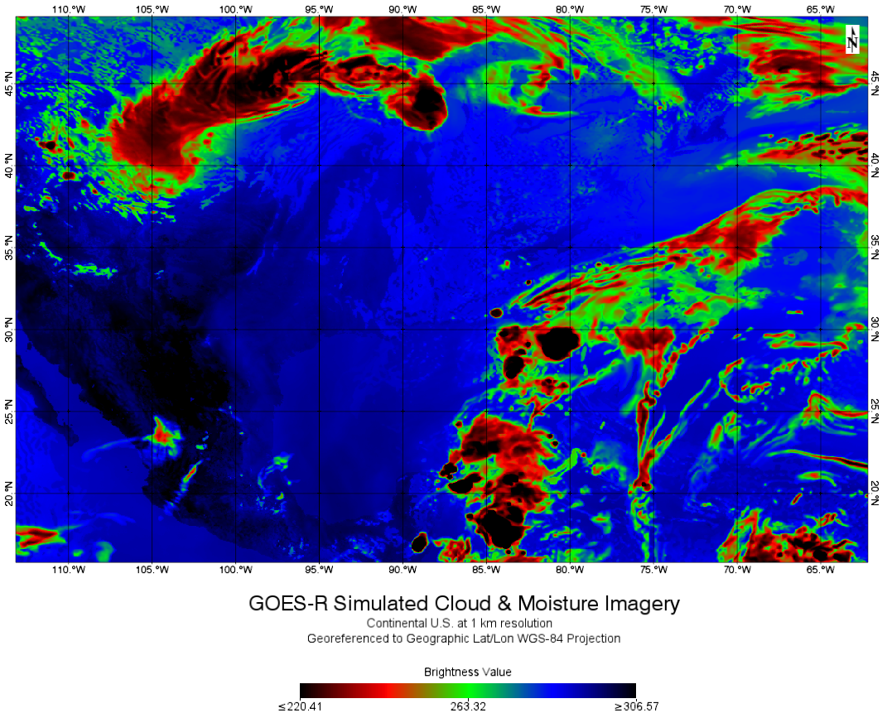

What does ENVI get you?
Mapping, Animation, Change Detection, Time Series, Annotation, Etc
All Push button and available through the ENVI API

Slide 18
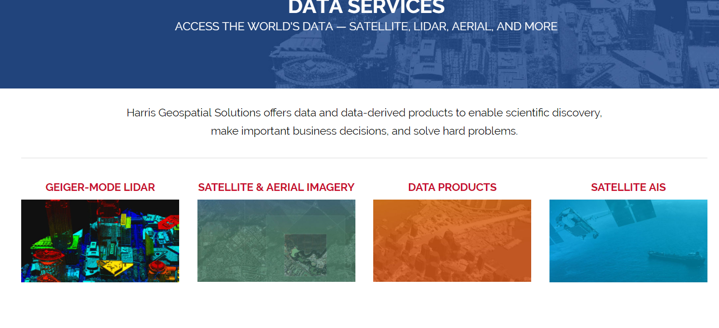
What is the value?
Enterprise
With massive increase of data from GOES16, rapid product creation
Wx Data services served from the cloud
Chances of single image analysis low, need a way to share info as well as extract/combine data quickly
Georeference quickly, atmospherically correct
Rapid ingest of space wx data
Harris working to create a data portal through MapMart

Slide 19
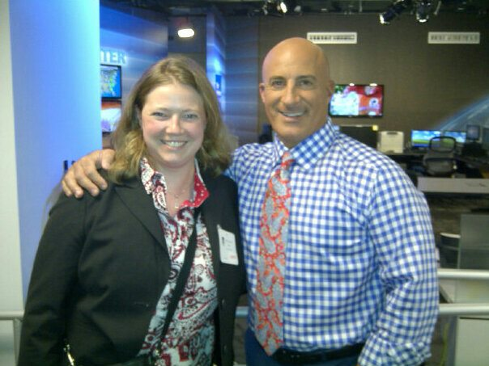

Questions?
Amanda O’Connor
Business Development Manager
Harris Corporation
Email: aoconn05@harris.com
303-544-4419
Joey Griebel
Federal Account Manager
Harris Corporation
Email: joey.griebel@harris.com
303-413-3974

