Slide 1
HDF Product Designer:
Using Templates to Achieve Interoperability
Aleksandar Jelenak, Joe Lee, Ted Habermann
The HDF Group
This work was supported by NASA/GSFC under Raytheon Co. contract number NNG15HZ39C

Slide 2
HDF Product Designer (HPD)
Application for consistently developing interoperable data content in HDF5 files
Client-server (Twelve-Factor) architecture
Has a desktop app
File content import from many formats
Content export as HDF5 file, source code, documentation in Word
Seamless integration with third-party validation tools

Slide 3
HPD Terms
Design: Contents to be stored in one HDF5 file.
Project: Main organizational and collaborative unit. Holds designs. Can have more than one user.
Template Design: A design that users copy to start their design.
Template File: A design as HDF5 file. Its HDF5 datasets have no data.

Slide 4
HPD System Overview

Slide 5
Templates in HPD
New feature available since June 1
Special project: Templates
All HPD users are members with read-only privileges
Templates are examples of file content that incorporates best practices, or are comprehensive and high-quality
HPD dev team curates the templates

Slide 6
Available Templates
NCEI template collection
  CF Point, Grid, Discrete Sampling Geometries
CF Swath templates will be added pending the community review (~later this year)
Suggestions to add more are welcome

Slide 7
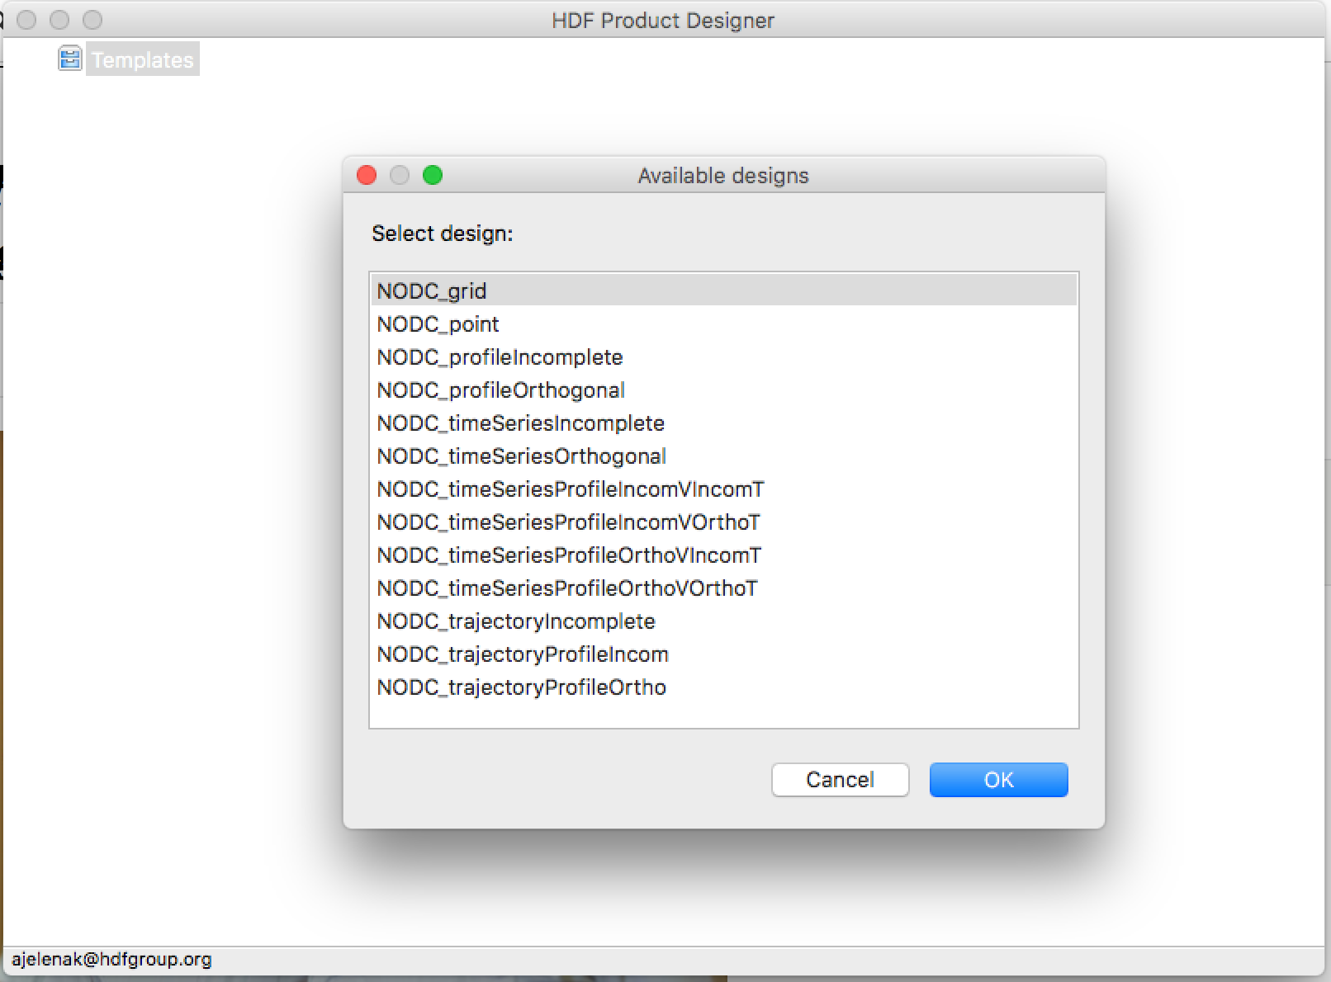
Select a template…

Slide 8
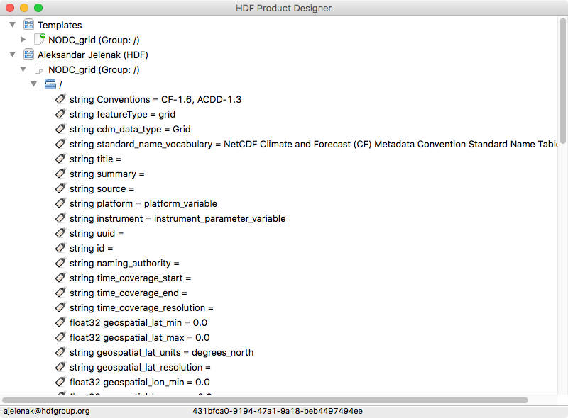
Copy template design…

Slide 9
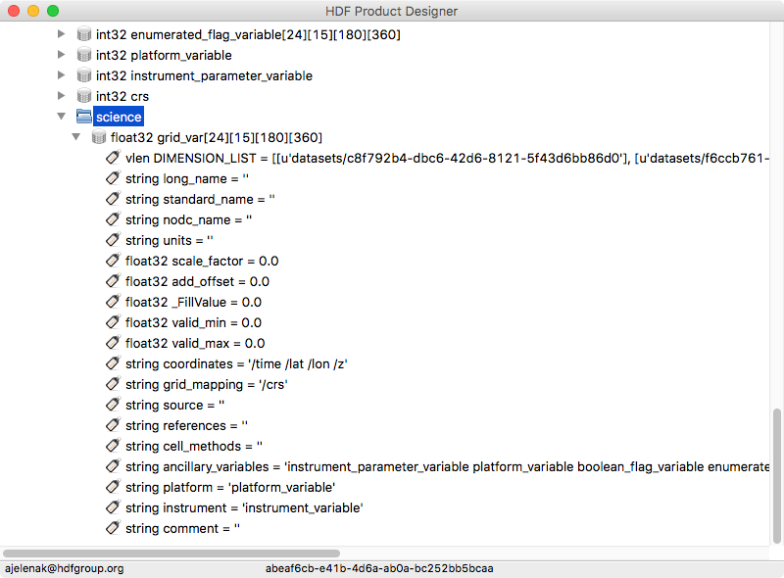
Add new content…

Slide 10
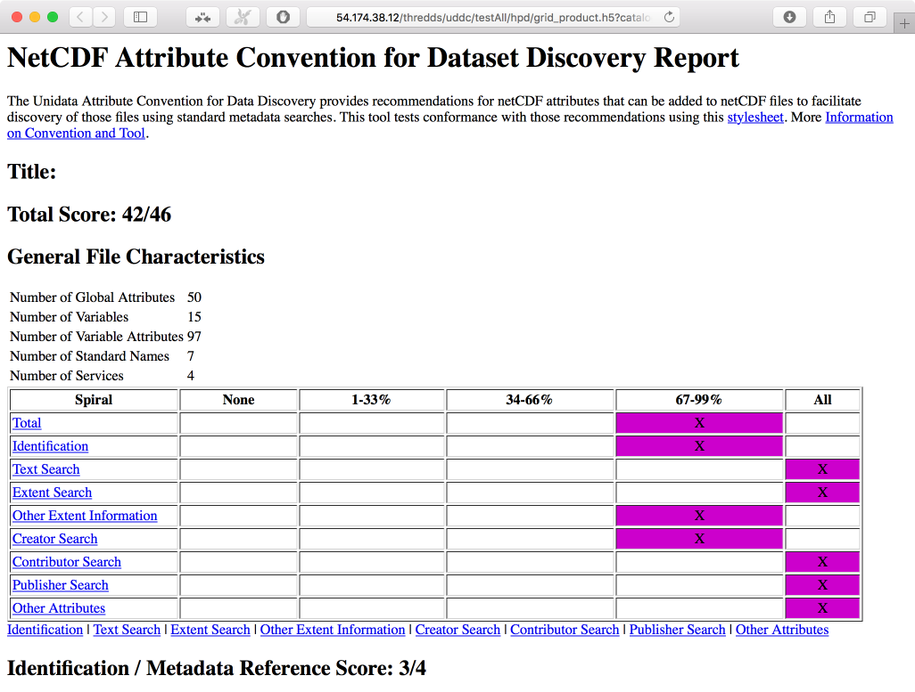
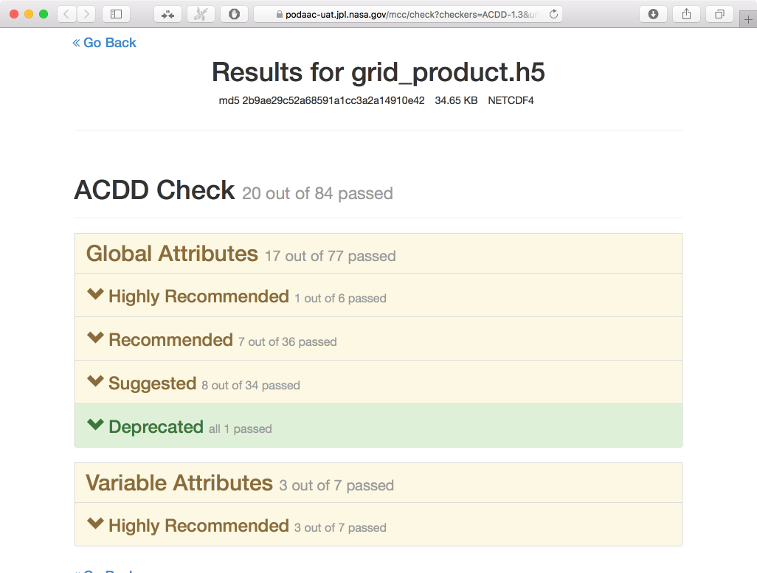
Validate the new design…

Slide 11
Conclusion
Templates allow yet another option for initializing new designs
Mix and match content from different templates
The collection can grow as organizations publish their templates, user feedback, or conventions add support for new types of data

Slide 12

This work was supported by NASA/GSFC under Raytheon Co. contract number NNG15HZ39C

