Slide 1
SPD and KEA:
HDF5 based file formats for Earth Observation
Pete Bunting¹, John Armston², Sam Gillingham³, Neil Flood⁴
1. Aberystwyth University, UK (pfb@aber.ac.uk)
2. University of Maryland, USA (armston@umd.edu)
3. Landcare Research, NZ (gillingham.sam@gmail.com)
4. Science Division, Queensland Government, Australia (neil.flood@dsiti.qld.gov.au)

Slide 2
Contents
Sorted Pulse Data (SPD) Format
  For storing laser scanning data
KEA Image File Format
  Implementation of the GDAL raster data model.

Slide 3
SPD: Little History…
The first version of ‘SPDLib’ was written in 2008
  ‘Sorted Point Data’, simply stored a 2D grid based index alongside the points file.
2009 I was using a ENVI image file to store the header information (as a 2 band image). Having multiple files per datasets wasn’t ideal also LAS missing fields (e.g., height) I wanted for processing.
  Colleague suggested looking at HDF5
2011 John Armston visited Aberystwyth with a set of full waveform acquisitions for use in his PhD.
  ‘Sorted Pulse Data’ was born.

Slide 4
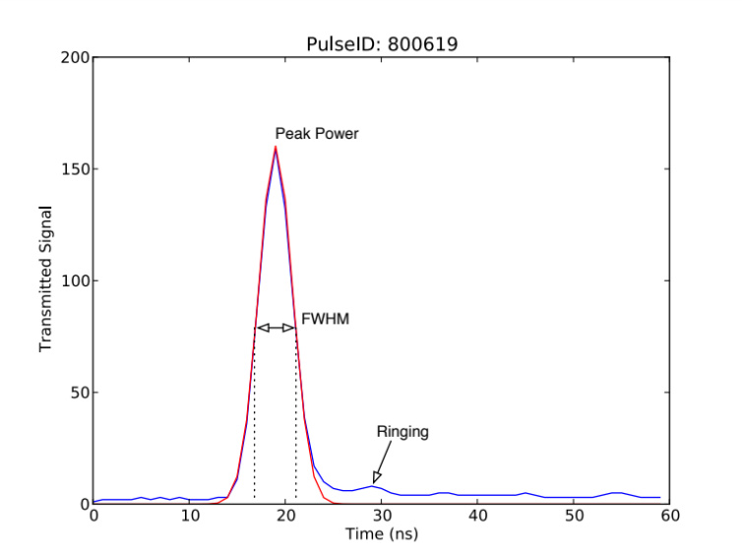
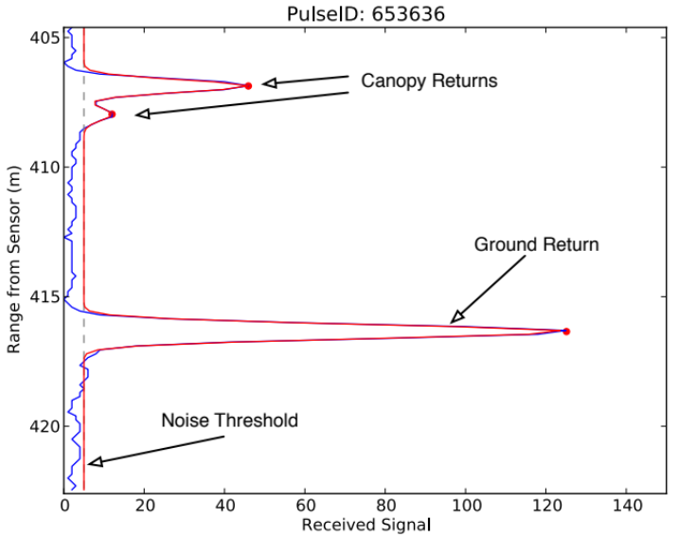
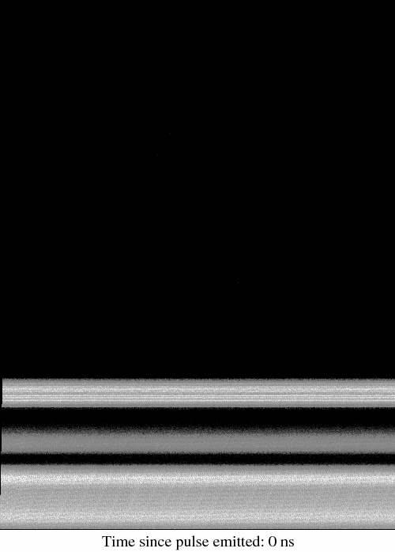
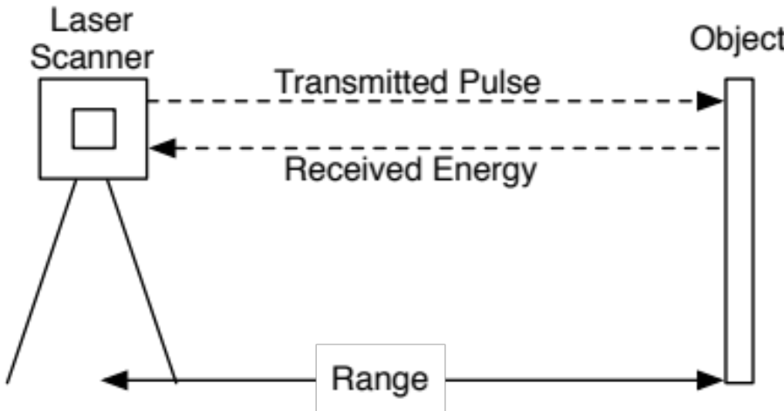


Why a Pulse?
Transmitted
Received
Video created by John Armston using SPDLib Python binding.

Slide 5
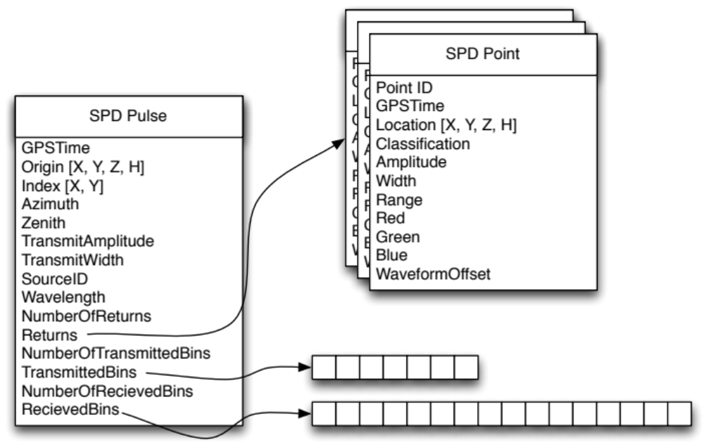
SPD File Format

Slide 6
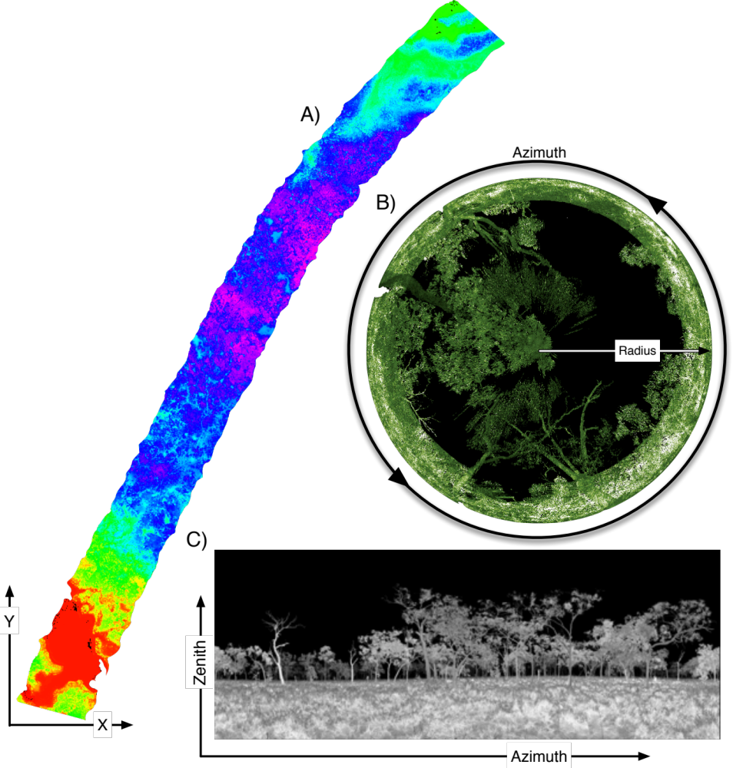
Sorted…
Indexing makes processing faster
  Cartesian
  Spherical
  Polar

Slide 7
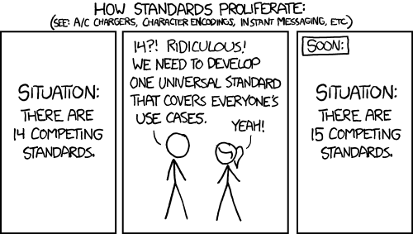
SPD & HDF5

Slide 8
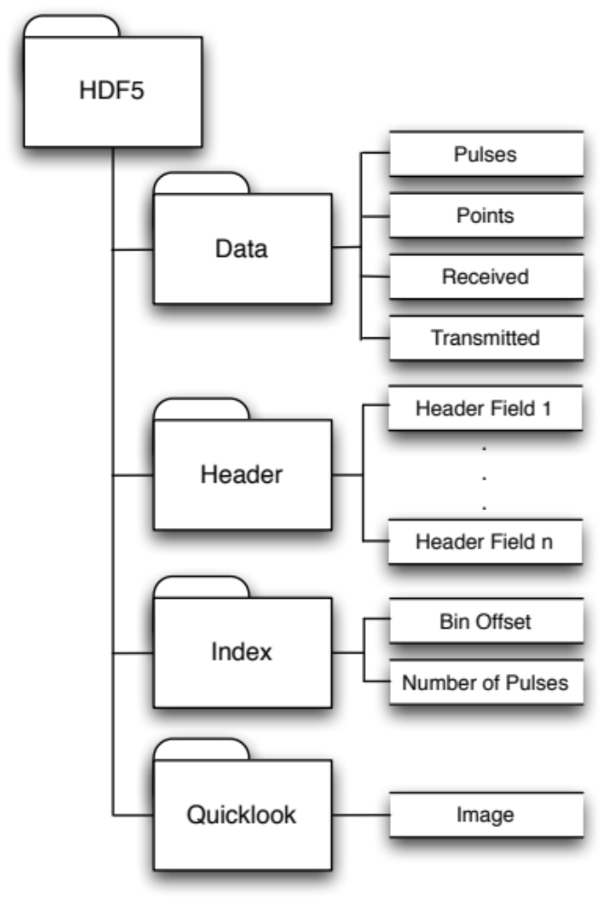
Why HDF5?
Another file format…
  Not just another block of binary you cannot do anything with unless you have a format definition.
Fields can be logically named and data types defined and read from the file.
  Self describing.

Slide 9
Compression
zlib compression is used by default
  Provided by HDF5 library
  Compression block size can be varied using SPD header parameters
File sizes are on average slight smaller than an uncompressed LAS file but larger than LAZ.
  More complex data structures
  Two pieces of information pulse and point(s)

Slide 10
KEA: Little History…
Created in 2012 and funded by Landcare Research, NZ.
The problem:
“How to have large attribute tables of data alongside raster data?”
Erdas Imagine format (HFA, *.img) supports attribute tables but compression is only supported for 32bit file sizes (i.e., < 2Gb).
  Attribute tables are also uncompressed.
BigTiff supports large raster imagery but not attribute tables.
Initial implementation with a hdf5 file for attribute table with a separate image file (e.g., tiff).
  This was untidy and having to keep track of multiple files is not desirable.
“Why not just put the image in the HDF5 file with a gdal driver?”
  Result the KEA HDF5 schema.

Slide 11

Raster Storage: KEA file format
HDF5 based image file format
GDAL driver
  Therefore the format can be used in any GDAL compatibly software (e.g., ArcMap)
Support for large raster attribute tables
zlib based compression
  Small file sizes
  10 m SPOT mosaic of New Zealand ~5GB per island (Each approx. 65000, 84000 pixels)
Bunting and Gillingham 2013

Slide 12
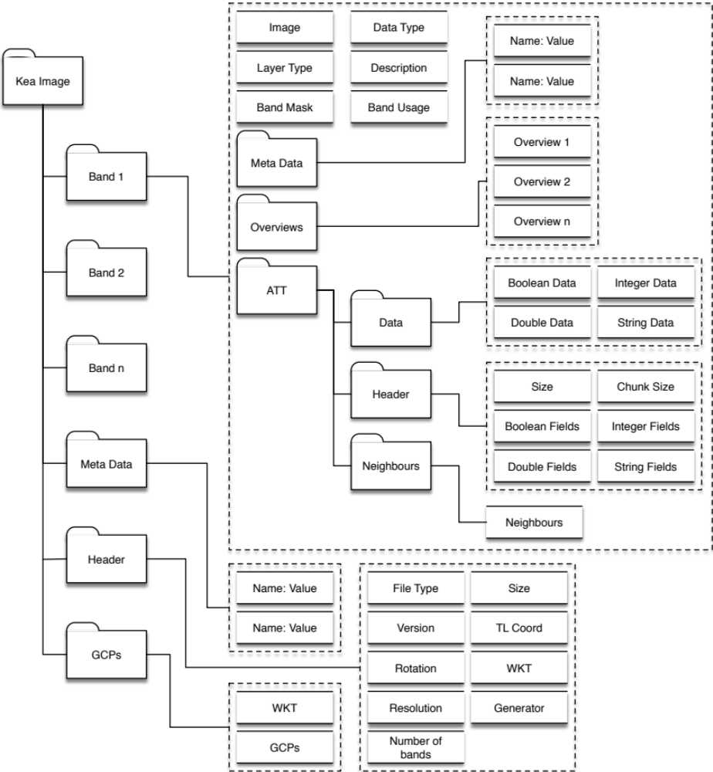
KEA File Structure
This structure is essentially the GDAL raster data model.
GDAL is defacto standard for EO raster data I/O.
  Used in open source and commercial software (e.g., ESRI).
We added a few addition for our own needs.
  Attribute table has concept of ‘neighbours’ to allow transversal of a set of clumps (e.g., object oriented image classification).

Slide 13
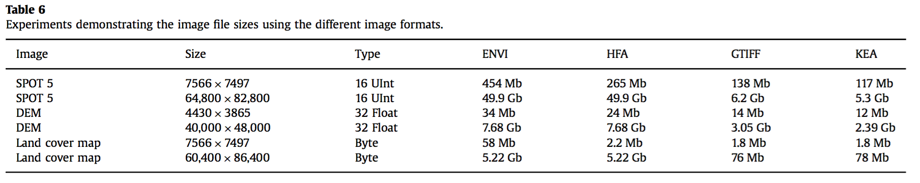
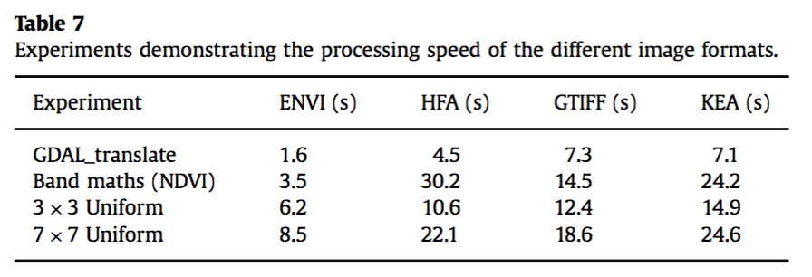
KEA Size and Speed

Slide 14
Is HDF5 a good base?
Yes. - We’ve found it excellent.
  Coding is quick and relatively easy
  No worrying about Endian etc.
    Originally SPD was developed on PowerPC Mac.
  If used correctly compression is good, with little overhead of the HDF5 structures
  Possible to make complex and flexible data structures.
However, it is the data structures in the file rather the ‘file format’ that is important thing.

Slide 15
However,
Compound data types can reduce flexibility
  Not possible to dynamically add new fields (c struct)
Use tables instead (as implemented in KEA attribute tables)
  i.e., Single data type per table
No boolean data type (C data types)
  Store as int8, wasted space?
No compression on ‘ragged’ data structure
HDF5 file can get defragmented
  Many changes (i.e., data added) happening within the file.
Cannot remove data from the file
  Deleting does not reduce file size.
Split data into suitable compression blocks and use / process data in those blocks.

Slide 16
SPD v4
Updated version of SPD (v3 has been the version widely used)
Learning lessons from SPD and KEA
  Remove compound data types
  Uses tables of single data type rather than compound data types.
  Made as much optional as possible.
  Multiple waveforms per pulse.
Implemented in pyLiDAR
  http://pylidar.org/en/latest/spdv4format.html
Pulses are very useful
  But some times points are all you need
Multiple methods of spatially indexing the data is useful
  2D grid useful for many but not all applications.

Slide 17

Questions

