Slide 1
Scientific Computing and Visualization using HDF
July 19th 2016
Durham, NC
Aashish Chaudhary
aashish.chaudhary@kitware.com
Technical Leader
with
Patrick O’Leary, Petr Votava (NASA),
Dr. Rama Nemani (NASA), Chris Harris,
Chris Kotfila, Doruk Aztek, Andrew Michaelis (NASA)

Slide 2
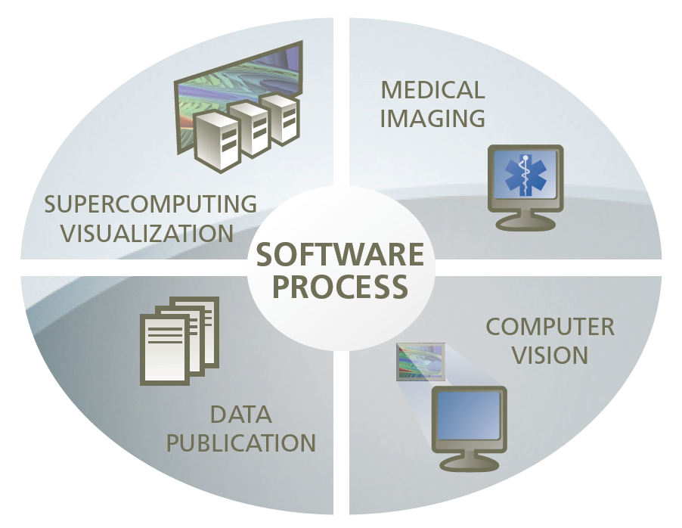
What We Do at Kitware?
0pen Source and Open Data is strongly encouraged and practised
at Kitware

Slide 3
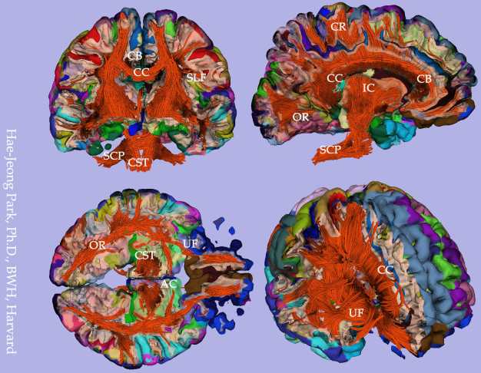
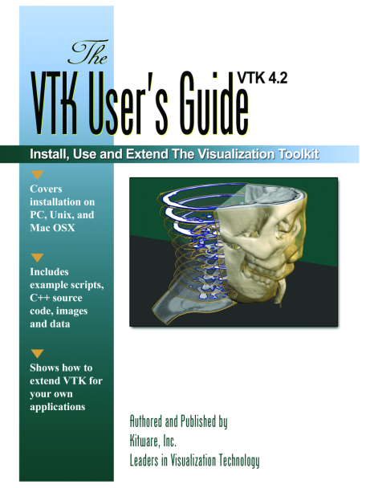
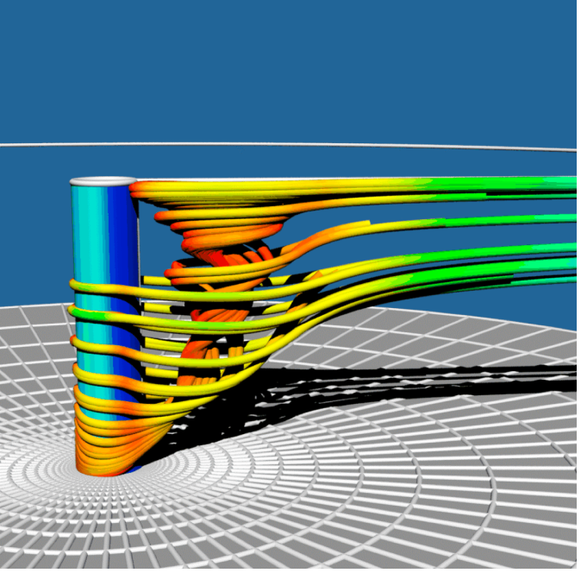
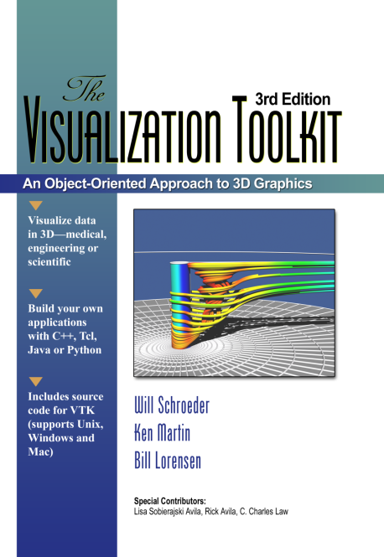
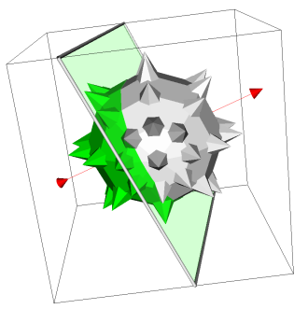
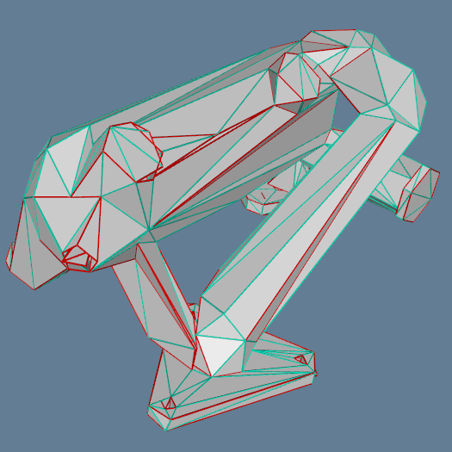
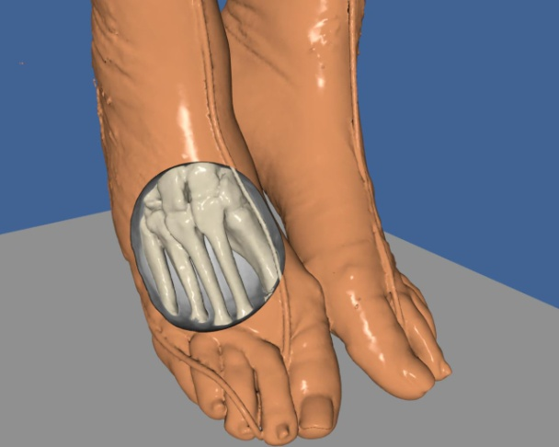
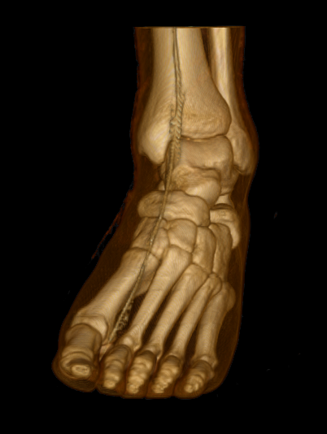
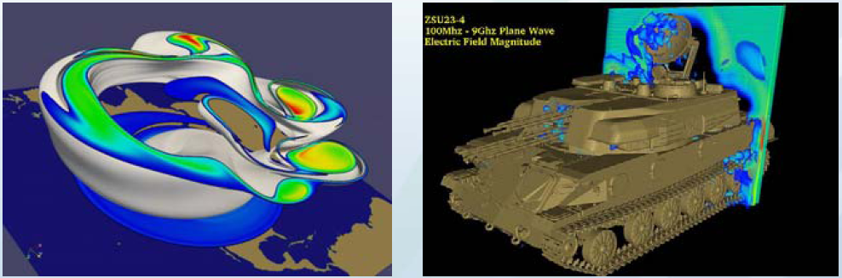
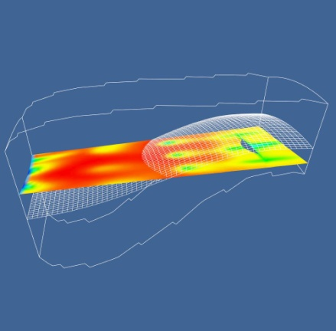
It started with VTK

Slide 4
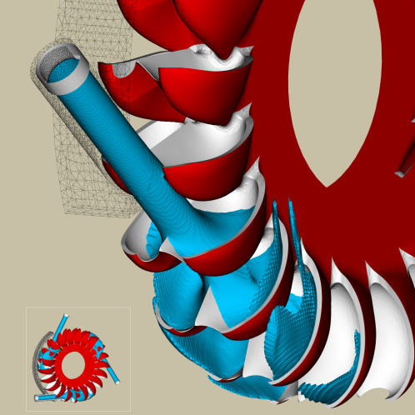
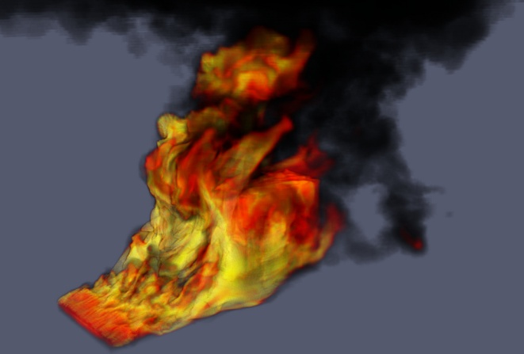
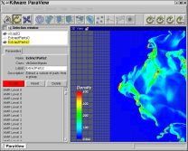
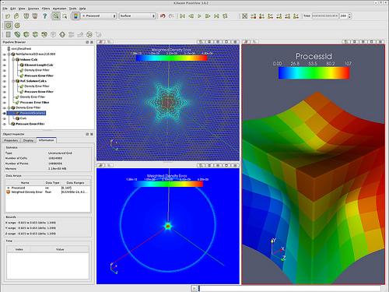
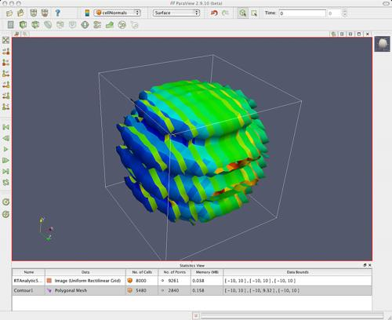
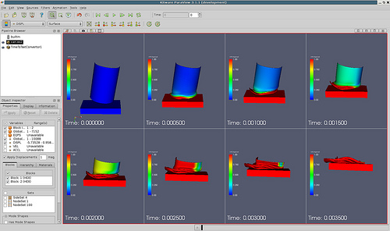
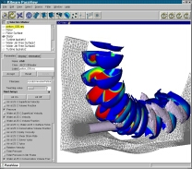
Parallel Processing and Rendering - Paraview

Slide 5
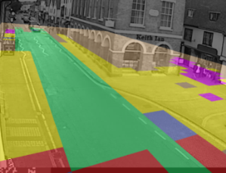
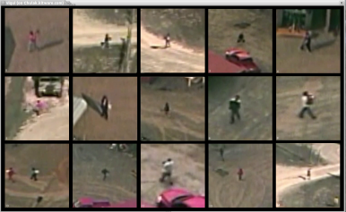
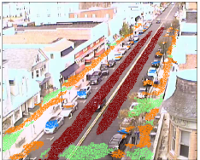
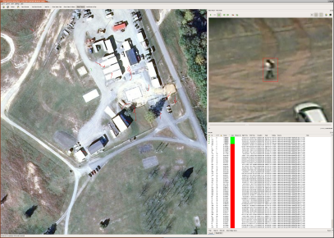
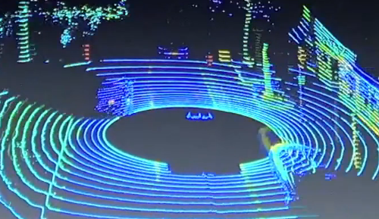
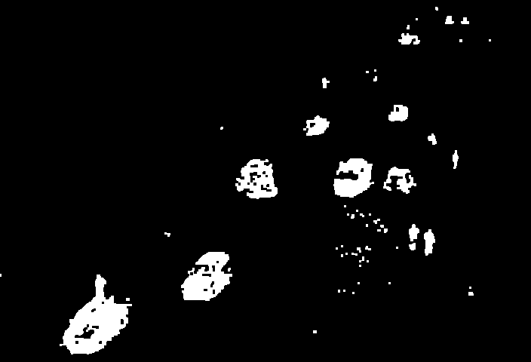
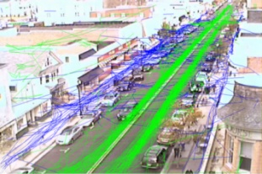
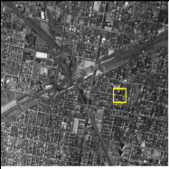
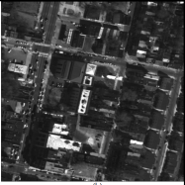
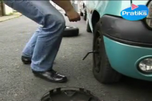
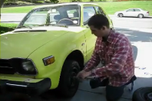
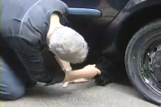
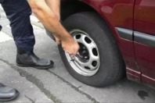
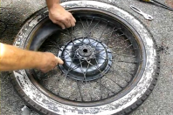
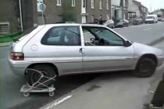
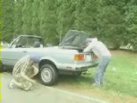
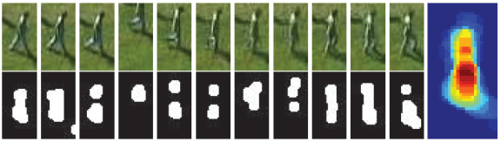
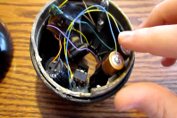

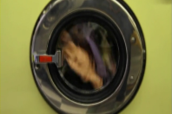
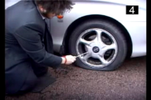
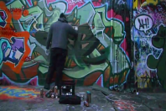
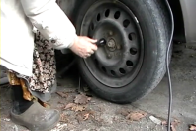

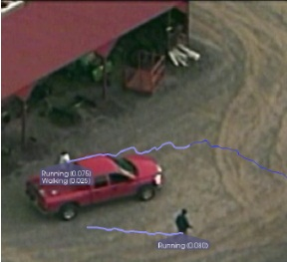
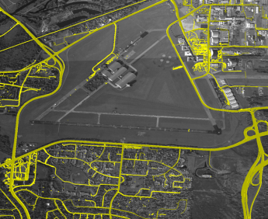
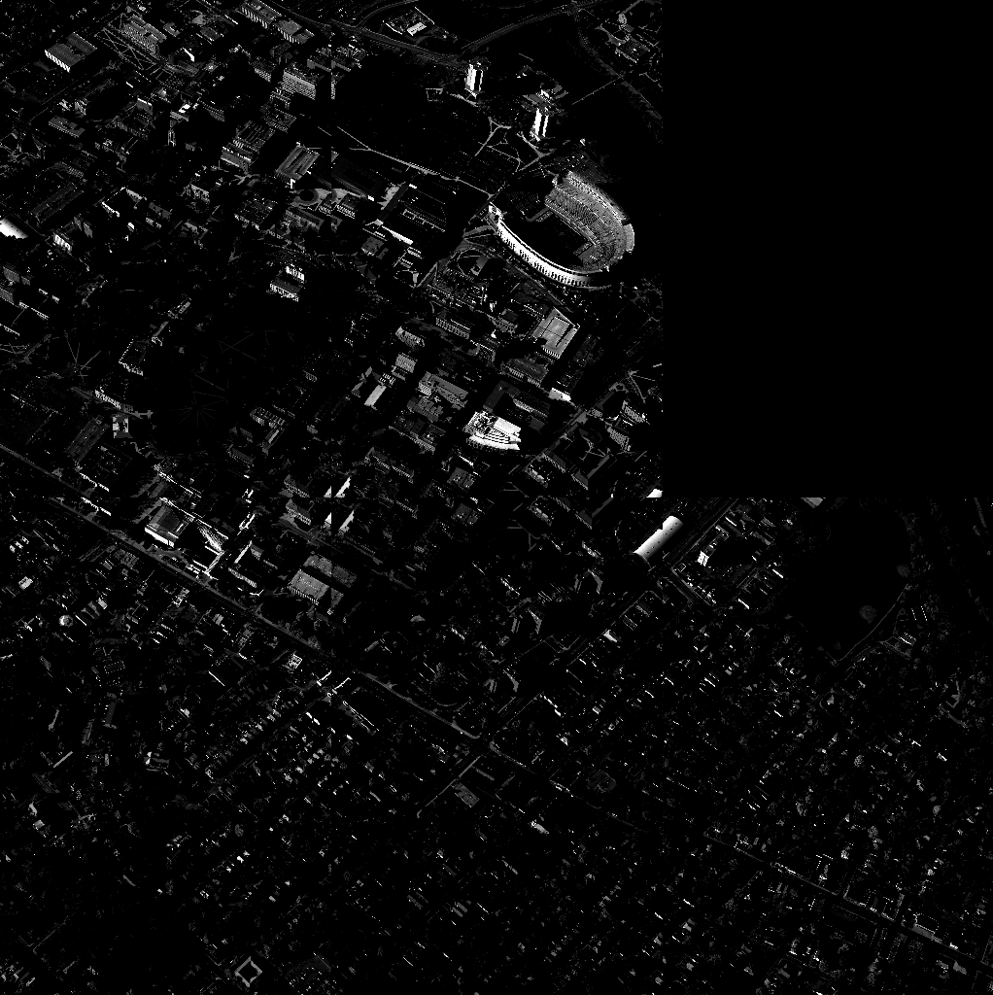
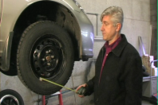
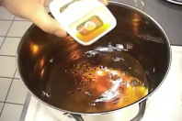

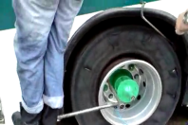
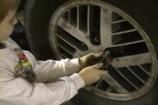
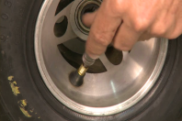

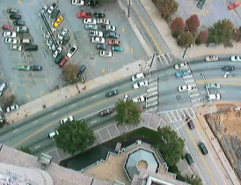
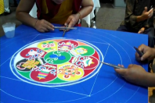


















Computer Vision
Object and Building Recognition by Function (DARPA)
Human Activity Detection (Army RRTO, CTTSO) and Tracking in Wide-Area Video (AFRL)
Content-based Video Retrieval by Actions (DARPA VIRAT)
Recognition by Function
Detection & Tracking
Content-based Retrieval
Images, Video, Point Clouds
Complex Event Recognition in Internet Videos (IARPA Aladdin)
3D Extraction and Compression
Event & Activity Recognition
Anomaly Detection
Wide-area Motion Imagery Threat Detection and Nodal Analysis (DARPA PerSEAS)
Normalcy Modeling and Anomaly Detection (DARPA PANDA and PerSEAS)
Football Play Recognition (DARPA CARVE)
3D model-based video compression (DARPA GRID) and super-resolved 3D reconstruction (DARPA Super 3D)

Slide 6


















Medical Computing
Longitudinal and population shape analysis
Surgical guidance
And simulation
Vascular analysis
Interactive medical applications and visualizations
Digital pathology
Orthopedic analysis
Quantitative imaging
Electronic health records

Slide 7









Community Adaptation

Slide 8




HDF at Kitware
Climate Community
High Performance Computing
Network Common Data Form (NetCDF)
Most projects use NetCDF4
Extensible Data Model and Format
Developed to exchange scientific data between HPC codes and tools
Heavy data is stored using HDF5
Medical Community
Vision Community
Leading-edge algorithms for registering and segmenting multidimensional data

Slide 9





ACME
The Accelerated Climate Modeling for Energy (ACME) project is sponsored by the Earth System Modeling (ESM) program (Biological and Environmental Research) with eight national laboratories and six partner institutions to develop and apply the most complete, leading-edge climate and Earth system models to challenging and demanding climate-change research imperatives.
Most commonly used data format - NetCDF4
Data streaming using OpenDAP
Python Interface for most of the tools

Slide 10


OpenNEX
NEX is a platform for scientific collaboration, knowledge sharing and research for the Earth science com
Global Daily Downscaled Projections (NEX-GDDP, NetCDF4)
MODIS-Land and Atmosphere (HDF)

Slide 11





Data processing
Web Visualization
Gaia
Gaia

Slide 12













Data processing
Web Visualization
Pure JS?
Notes:
We are using hdf to drive Web-based big data analysis. As excpected we are using ParaView to read and write files for ParaViewWeb processing, and we are using hdf5.node for more D3 like investigation tools. It would be wonderful if you could help the hdf5.node project along and maybe create a Pure JS implimentation.

Slide 13

HDF5 File Organization
Notes:
HDF5 layout for big data. Derived statistical data is saved in groups so that it doesn’t have to be recomputed for value adding visualizations.

Slide 14









Preprocessing
Simulation
Postprocessing
Notes:
HDF5 is commonly utilized by simulators leveraging our HPCCloud infrastructure. Performance is faily well studied on the traditional HPC resources interface, but writing files on AWS-based HPC clusters that HPCCloud creates on the fly is probably not optimal.
The first graph shows speed up from 4 to 64 processors in the cloud. The second graph shows that writing the output to cloud storage (in red) dominates performance bottlenecks.

Slide 15

Notes:
Layered architecture of HPCCloud providing access to traditional and virtual cloud HPC resources.

Slide 16
Possible Improvements
Streaming and Big Data analytics
Any useful ingestion of HDF data into cluster requires ETL pipeline
For some tools, computation cannot move close to the data, streaming support is necessary in such cases
Optimal read/write on cloud storage
Web-Support
More tools and projects are moving to support web-enabled data analysis and visualization
Pure JS implementation if possible

Slide 17
Summary
HDF is widely data format for scientific computing, climate/geospatial visualization, and in other domains at Kitware
Recently we have started using HDF for information visualization
We are looking forward to HDF usage on cloud and web-environment
Kitware is always looking for strong open source collaborations and is committed to push open-source scientific computing to its next level

Slide 18
Information
Aashish Chaudhary: aashish.chaudhary@kitware.com
LinkedIn: www.linkedin.com/in/aachaudhary
Kitware: http://www.kitware.com
NASA-NEX: https://nex.nasa.gov/nex
Kitware-AIST: https://github.com/OpenGeoscience/nex
HPC Cloud : http://www.kitware.com/publications/item/view/1784
HPCloud Github: https://github.com/Kitware/HPCCloud

