Slide 1

HDF Cloud Services
Moving HDF5 to the Cloud
John Readey
The HDF Group
jreadey@hdfgroup.org

Slide 2
Outline
Brief review of HDF5
Motivation for HDF Cloud Services
The HDF REST API
H5serv – REST API reference implementation
Storage for data in the cloud
HDF Scalable Data Service (HSDS) – HDF at Cloud Scale

Slide 3
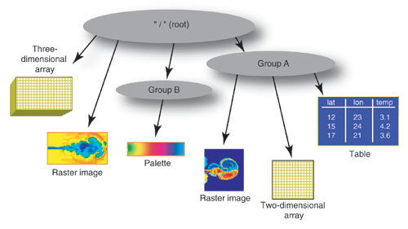
What is HDF5?
Depends on your point of view:
a C-API
a File Format
a data model
Think of HDF5 as a file system
within a file.
With chunking and compression.
Add NumPy style data selection.
Note: NetCDF4 Is based on HDF5
Notes:
Mention Andrew’s talk

Slide 4
HDF5 Features
Some nice things about HDF5:
Sophisticated type system
Highly portable binary format
Hierarchal objects (directed graph)
Compression
Fast data slicing/reduction
Attributes
Bindings for C, Fortran, Java, Python
Things HDF5 doesn’t do (out of the box):
Scalable analytics (other than MPI)
Distributed
Multiple writer/multiple reader
Fine level access control
Query/search
Web accessible

Slide 5
Why HDF in the Cloud
It can provide a cost-effective infrastructure
  Pay for what you use vs pay for what you may need
  Lower overhead: no hard ware setup/network configuration, etc.
Potentially can benefit from cloud-based technologies:
  Elastic compute – scale compute resources dynamically
  Object based storage – low cost/built in redundancy
Community platform (potentially)
  Enables interested users to bring their applications to the data

Slide 6
What do we need to bring HDF to the cloud?
Define a Web API for HDF
  REST based API vs C API of HDF5
Determine storage medium
  Disk? Object Storage? NoSQL?
Create Web Service that implements REST API
  Preferably high performance and scalable
REST API and Reference Service are available now (h5serv).
Work on a scalable service used Object Based Storage has just started.

Slide 7
Why an HDF5 Web API?
Motivation to create a web API:
Anywhere reference-able data – ie URI
Network Transparency
Clients can be lighter weight
Support Multiple Writer/Multiple Reader
Enable Web UIs
Increased scope for features/performance boosters
  E.g. in memory cache of recently used data
  Transparently support parallelism (e.g. processing requests in a cluster)
  Support alternative storage technologies (e.g. Object Storage)

Slide 8
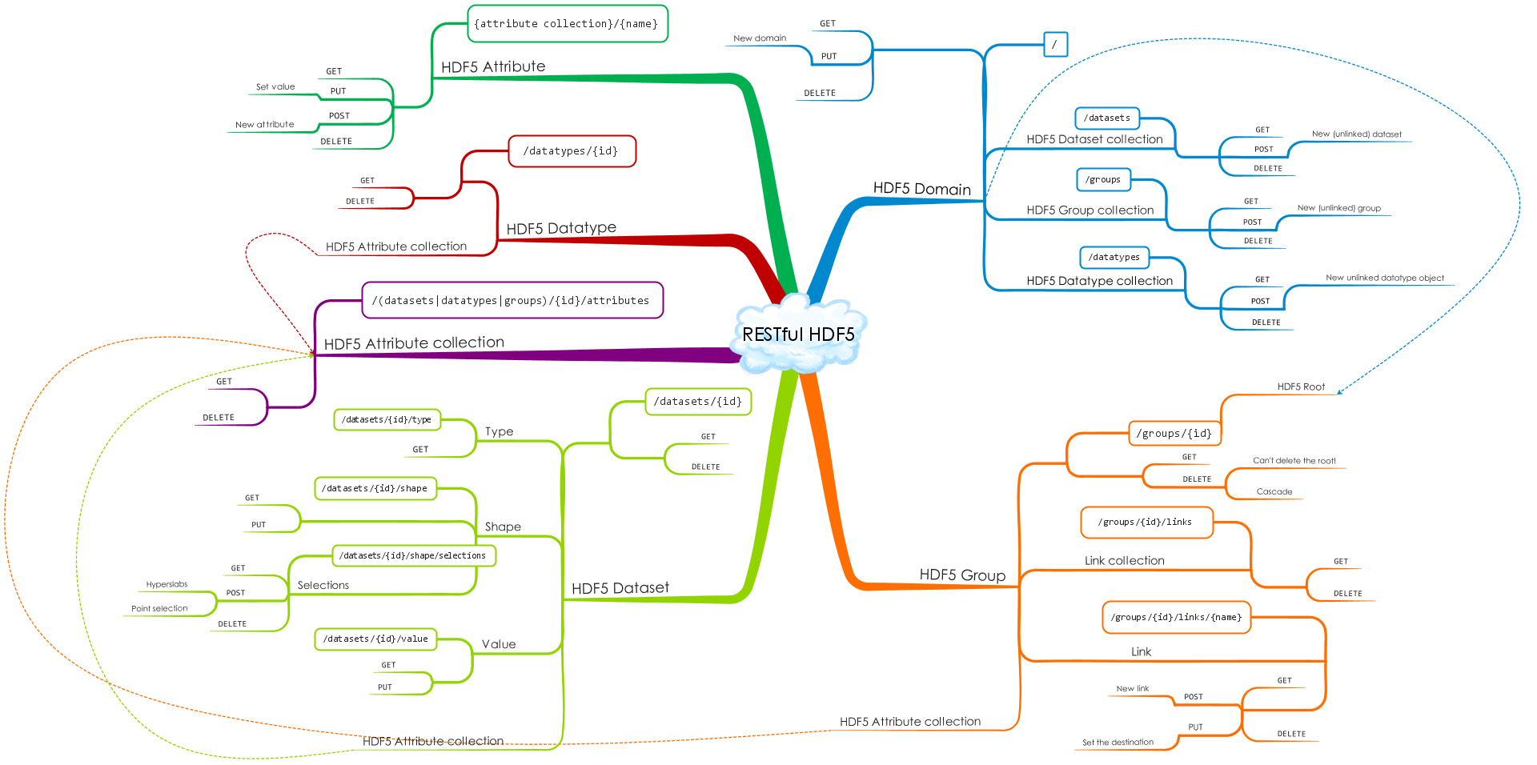
A simple diagram of the REST API

Slide 9
What makes it RESTful?
Client-server model
Stateless – (no client context stored on server)
Cacheable – clients can cache responses
Resources identified by URIs (datasets, groups, attributes, etc)
Standard HTTP methods and behaviors:
Method | Safe | Idempotent | Description
GET | Y | Y | Get a description of a resource
POST | N | N | Create a new resource
PUT | N | Y | Create a new named resource
DELETE | N | Y | Delete a resource

Slide 10
Example URI
http://tall.data.hdfgroup.org:7253/datasets/feef70e8-16a6-11e5-994e-06fc179afd5e/value?select=[0:4,0:4]
http://tall.data.hdfgroup.org:7253/datasets/34…d5e/value?select=[0:4,0:4]
scheme
domain
port
resource
Query param
Scheme: the connection protocol
Domain: HDF5 files on the server can be viewed as domains
Port: the port the server is running on
Resource: identifier for the resource (dataset values in this case)
Query param: Modify how the data will be returned
  (e.g. hyperslab selection)
Note: no run time context!

Slide 11
Example POST Request – Create Dataset
POST /datasets HTTP/1.1
Content-Length: 39
User-Agent: python-requests/2.3.0 CPython/2.7.8 Darwin/14.0.0
Authorization: Basic QWxhZGRpbjpvcGVuIHNlc2FtZQ==
host: newdset.datasettest.test.hdfgroup.org
Accept: */*
Accept-Encoding: gzip, deflate
{ "shape": 10, "type": "H5T_IEEE_F32LE" }
HTTP/1.1 201 Created
Date: Thu, 29 Jan 2015 06:14:02 GMT
Content-Length: 651
Content-Type: application/json
Server: TornadoServer/3.2.2
{ "id": "0568d8c5-a77e-11e4-9f7a-3c15c2da029e", "attributeCount": 0, "created": "2015-01-29T06:14:02Z", "lastModified": "2015-01-29T06:14:02Z", … ] }

Slide 12

Client/Server Architecture
C/Fortran
Applications
Web
Applications
HDF REST API
NetCDF4 Lib
Browser
(http)
HDF5 Lib
REST VOL
h5pyd
REST Backend
Note: Clients don’t need to know what’s going on inside this box!
Python
Applications
CMD Line Tools
Client Software Stack
HDF Service (h5serv or …)

Slide 13
Reference Implementation – h5serv
Open Source implementation of the HDF REST API
  Get it at: https://github.com/HDFGroup/h5serv
  First release in 2015 – many features added since then
Easy to setup and configure
Runs on Windows/Linux/Mac
Not intended for heavy production use
  Implementation is single threaded
  Each request is completed before the next one is processed

Slide 14
H5serv Highlights
Written in Python using Tornado Framework (uses h5py & hdf5lib)
REST-based API
HTTP request/responses in JSON or binary
Full CRUD (create/read/update/delete) support
Most HDF5 features (Compound types, Compression, chunking, links)
Content directory
Self-contained web server
Open Source (except web ui)
UUID identifiers for Groups/Datasets/Datatypes
Authentication and/or public access
Object-level access control (read/write control per object)
Query support

Slide 15
H5serv Architecture
REQ
Request Handler
HDF5Db
RSP
h5py
hdf5lib
File Storage

Slide 16
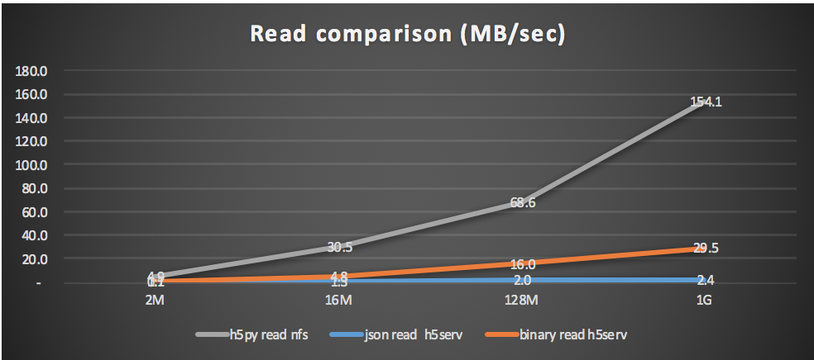
H5serv Performance
IO Intensive benchmark results – read n:n:n data cube as n:n:1 slices
Binary is 10x faster than JSON
Still 5x slower than NFS access of HDF5 file!
Haven’t spent too much effort on performance so far
Write results are comparable to read

Slide 17
Sample Applications
Even though h5serv has limited scalability, there have been some interesting applications built using it…
A couple of examples…
  The HDF Group is developing a AJAX-based HDF Viewer for the web
  Anika Cartas at NASA Goddard developed a ”Global Fire Emissions Database”
    This is a Web-based app as well
  Ellen Johnson has created sample MATLAB scripts using the REST API
    (stay tuned for her talk)
  H5pyd – A h5py compatible Python SDK
    See: https://github.com/HDFGroup/h5pyd
  CMD Line tools – coming soon

Slide 18
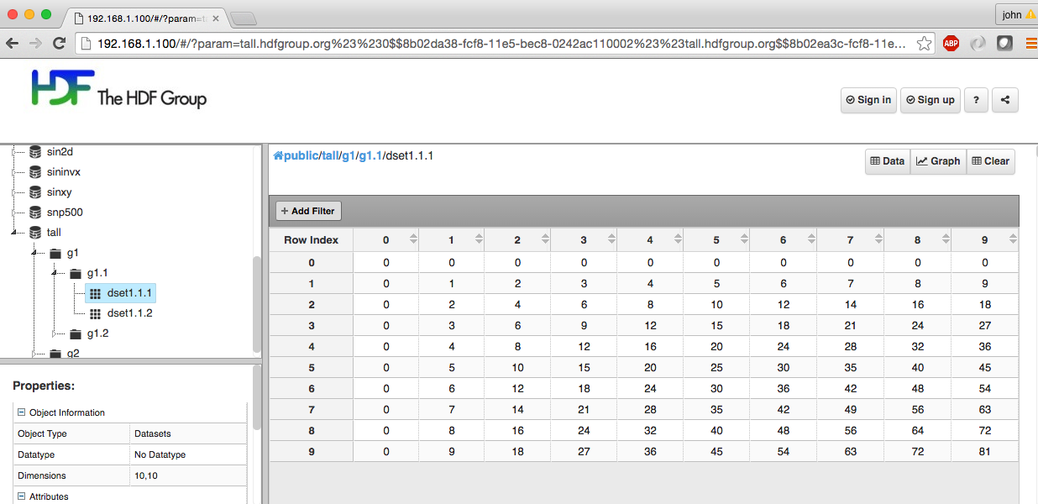
Web UI – Display HDF Content in a browser

Slide 19
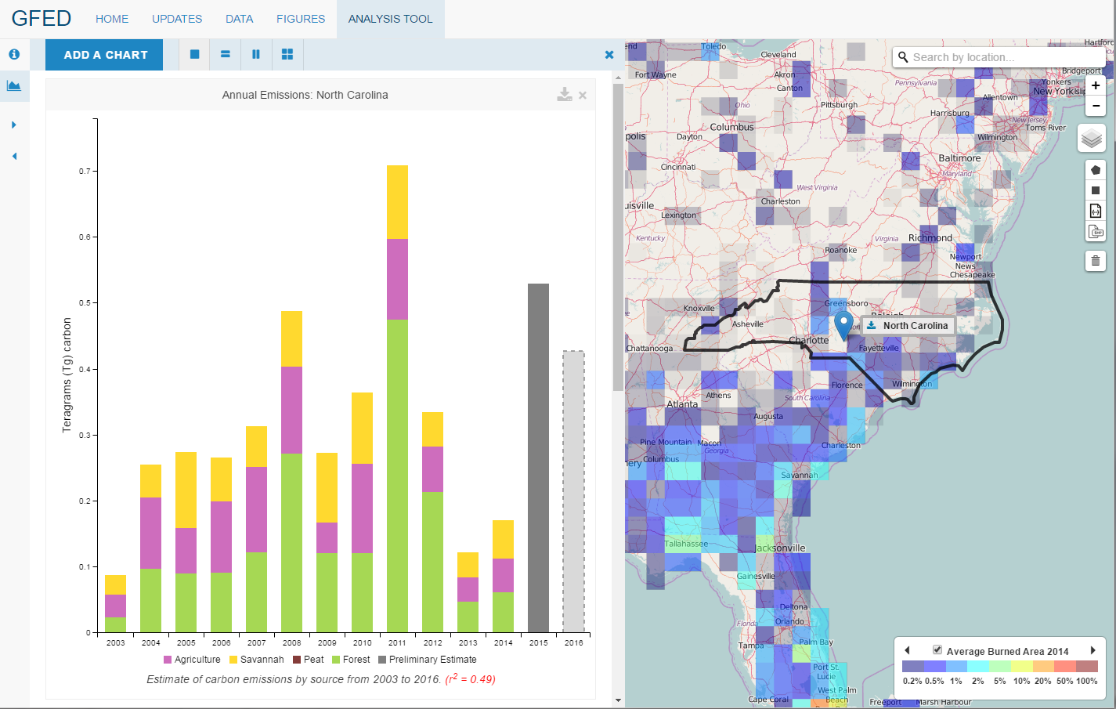
Global Fire Emissions Database

Slide 20
H5pyd – Python Client for REST API
H5py-like client library for Python apps
HDF5 library not needed on client
Calls to HDF5 in h5py replaced by http requests to h5serv
Provide most of the functionality of h5py high-level library
Same code can work with local h5py (to files) or h5pyd (to REST API)
Extensions for HDF REST API-specific features
  E.g.: query support
Future Work: HDF5 Rest VOL
Library for C/Fortran clients that provides HDF5 API with REST backend.

Slide 21

CMD Line Tools
Tools for common admin tasks:
List files (‘domains’ in HDF REST API parlance) hosted by service
Update permissions
Download content as local HDF5 files
Upload local HDF5 files
Output content of HDF5 domain (similar to h5dump or h5ls cmd tools)

Slide 22



Object Storage
Any string
Most common storage technology used in the cloud
Manage data as objects
Keys (a string) map to data blobs
Data sizes from 1 byte to 5 TB (AWS)
Cost effective compared with other cloud storage technologies
Built in redundancy
Potentially high throughput
Different Implementations:
  Public: AWS S3, Google Cloud Storage…
  Private: Ceph, openstack/Swift,…
  Mostly compatible…
a_key
Data blob
1 byte to 5 TB

Slide 23
Storage Costs
How much will it costs to store 1PB for one year on AWS?
Answer depends on the technology and tradeoffs you are willing to accept…
Technology | What it is | Cost for 1PB/1yr | Fine Print
Glacier | Offline (tape) Storage | $125K | 4 hour latency for first read Additional costs for restore
S3 Infrequent Access | Nearline Object Storage | $157K | $0.01/GB data retrieval charge $10K to read entire PB!
S3 | Online Object Storage | $358K | Request pricing $0.01 per 10K req Transfer out charge $0.01/GB
EBS | Attachable Disk Storage | $629K | Extra charges for guaranteed IOPS Need backups
EFS | Shared Network (NFS) | $3,774K | Not all NFSv4.1 features supported E.g. File Locking
DynamoDB | NoSQL Database | $3,145K | Extra charge for IOPS

Slide 24
Object Storage Challenges for HDF
Not POSIX!
High latency (0.25s) per request
Not write/read consistent
High throughput needs some tricks
  (use many async requests)
Request charges can add up (public cloud)
For HDF5, using the HDF5 library directly on an object storage system is a non-starter. Will need an alternative solution…

Slide 25
How to store HDF5 data in an object store?
Store each HDF5 file as an object store object?
Idea:
  Store each HDF5 file as an object
  Read on demand
  Update locally – write back entire file to store
But..
  Slow – need to read entire file for each read
  Consistency issues for updates
  Limit to max file size (AWS = 5TB)

Slide 26


Objects as Objects!
Big Idea: Map individual HDF5 objects (datasets, groups, chunks) as Object Storage Objects
Maximum storage object size is limited
Data can be accessed efficiently
Only data that is modified needs to be updated
(Potentially) Multiple clients can be reading/updating the same “file”
Each chunk (heavy outlines) get persisted as a separate object
Example:
Dataset is partitioned into chunks
Each chunk stored as an object
Dataset meta data (type, shape, attributes, etc.) stored in a separate object

Slide 27
HDF Scalable Data Service (HSDS)
A highly scalable implementation of the HDF REST API
Goals:
Support any sized repository
Any number of users/clients
Any request volume
Provide data as fast as the client can pull it in
Targeted for AWS
  but portable to other public/private clouds
Cost effective
  Use AWS S3 as primary storage
  Decouple storage and compute costs
  Elastically scale compute with usage

Slide 28
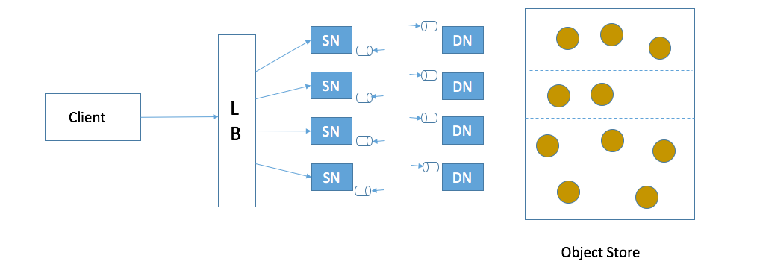
Architecture for HSDS
Legend:
Client: Any user of the service
LB: Load balancer – distributes requests to Service nodes
SN: Service Nodes – processes requests from clients (with help from Data Nodes)
DN: Data Nodes – responsible for partition of Object Store
Object Store: Base storage service (e.g. AWS S3)

Slide 29
HSDS Architecture Highlights
DN’s provide read/write consistent layer on top of AWS S3
DN’s also serve as data cache (improve performance and lower S3 request cost)
SN’s deterministically know which DN’s are needed to server a given request
Number of DN’s/SN’s can grow or shrink depending on demand
Minimal operational costs would be 1 SN, 1 DN and data storage costs for S3
Query operations can run across all data nodes in parallel

Slide 30
HSDS Timeline and next steps
Work just started July 1, 2016
This work is being supported by NASA Cooperative Agreement NNX16AL91A
Working with NASA OpenNEX team
Also included client components:
  HDF REST VOL
  H5pyd
  CMD line tools
Scope of project is for the next two years, but hoping to have prototype available sooner
Would love feedback on design, use cases, or additional features you’d like to see

Slide 31
To Find out More:
H5serv: https://github.com/HDFGroup/h5serv
Documentation: http://h5serv.readthedocs.io/
H5pyd: https://github.com/HDFGroup/h5pyd
RESTful HDF5 White Paper: https://www.hdfgroup.org/pubs/papers/RESTful_HDF5.pdf
OpenNex: https://nex.nasa.gov/nex/static/htdocs/site/extra/opennex/
Blog articles:
  https://hdfgroup.org/wp/2015/04/hdf5-for-the-web-hdf-server/
  https://hdfgroup.org/wp/2015/12/serve-protect-web-security-hdf5/

