Slide 1
HDF Update
Elena Pourmal
The HDF Group
epourmal@hdfgroup.org
This work was supported by NASA/GSFC under Raytheon Co. contract number NNG15HZ39C

Slide 2
Outline
What’s new in HDF?
HDF tools
  HDFView
  nagg
  ODBC
Q & A: Tell us about your needs

Slide 3
HDF5
HDF5 Compression
  Faster way to write compressed data to HDF5
  Community supported compression filters
  https://github.com/nexusformat/HDF5-External-Filter-Plugins/tree/master/
Single writer/multiple reader file access
Virtual Data Set
HDF5 JNI is part of the HDF5 source code

Slide 4
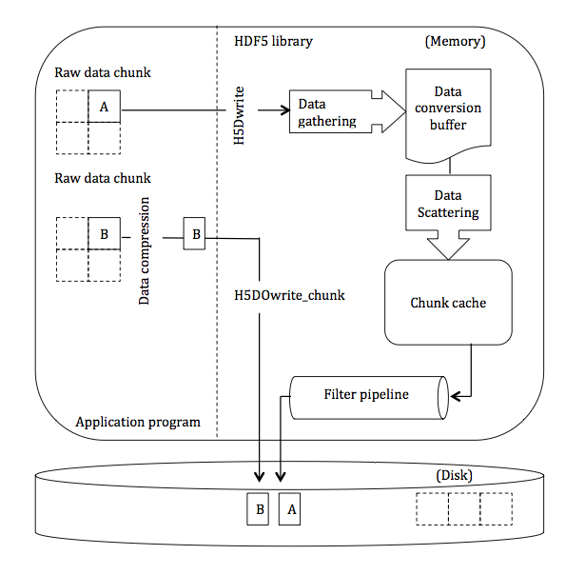
Direct chunk write: H5DOwrite_chunk
Notes:
Complexity of data flow when chunk is written by H5Dwrite call vs. simplified patch with the optimized function

Slide 5
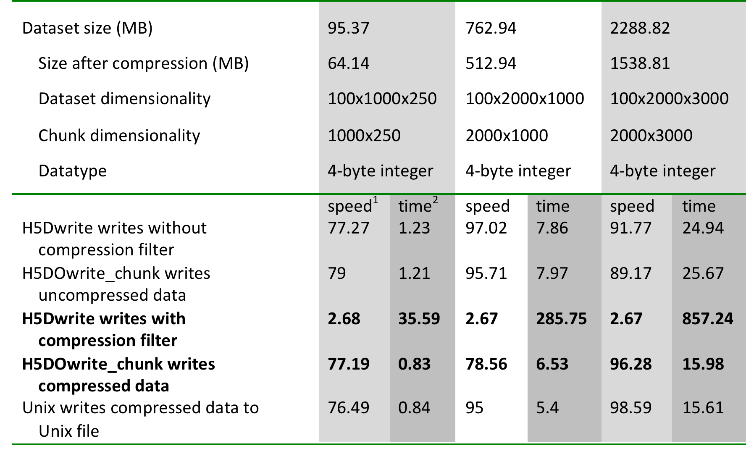
Performance results for H5DOwrite_chunk
Test result on Linux 2.6, x86_64
Each dataset contained 100 chunks,
written by chunks
1 Speed in MB/s
2 Time in seconds

Slide 6
Dynamically loaded filters
Problems with using custom filters
  “Off the shelf” tools do not work with the third-party filters
Solution
  Use 1.8.11 and later and dynamically loaded HDF5 compression filters
  Maintained library of HDF5 compression filters
    https://github.com/nexusformat/HDF5-External-Filter-Plugins

Slide 7
Example: Choose compression that works for your data
Compression ratio = uncompressed size/compressed size
h5repack command was used to apply compression
Time was reported with Linux time command
SCRIS_npp_d20140522_t0754579_e0802557_b13293_c20140522142425734814_noaa_pop.h5
Original size in bytes | Compression ratio with GZIP level 6 (time) | Compression ratio with SZIP NN encoding 32 (time)
256,828,584 | 1.3 (32.2 sec) | 1.27 (4.3 sec)
Notes:
H5repack tools was used to apply compression to every dataset in the file
-rw-r--r-- 1 epourmal hdf 196611611 Jul 17 17:33 gzip.h5
-rw-r--r-- 1 epourmal hdf 256828584 Jul 17 11:35 orig.h5
-rw-r--r-- 1 epourmal hdf 201924661 Jul 17 17:33 szip.h5

Slide 8
Example (cont): Choose compression that works for your data
Compression ratio = uncompressed size/compressed size
Dataset name (examples) | Dataset size in bytes | Compression ratio with GZIP level 6 | Compression ratio with SZIP NN encoding 32
ICT_TemperatureConsistency | 240 | 0.667 | Cannot be compressed
DS_WindowSize | 6,480 | 28.000 | 54.000
ES_ImaginaryLW | 46,461,600 | 1.076 | 1.000
ES_NEdNLW | 46,461,600 | 1.169 | 1.590
ES_NEdNMW | 28,317,600 | 14.970 | 1.549
ES_NEdNSW | 10,562,400 | 15.584 | 1.460
ES_RDRImpulseNoise | 48,600 | 124.615 | 405.000
ES_RealLW | 46,461,600 | 1.158 | 1.492
SDRFringeCount | 97,200 | 223.448 | 720.00
Notes:
GZIP compression alone made the difference only for 2 datasets; modified with shuffle – 3 datasets showed great compression ratios.

Slide 9
SWMR: Data access to file being written
New data elements…
Writer
Reader
HDF5 File
…that can be read by a reader…
with no IPC necessary.
… are added to a dataset in the file…
Notes:
No communications between the processes and no file locking are required. The processes can run on the same or on different platforms, as long as they share a common file system that is POSIX compliant.
The orderly operation of the metadata cache is crucial to SWMR functioning. A number of APIs have been developed to handle the requests from writer and reader processes and to give applications the control of the metadata cache they might need.

Slide 10
SWMR
Released in HDF5 1.10.0
Restricted to append-data only scenario
SWMR doesn’t work on NFS
Files are not compatible with HDF5 1.8.* libraries
Use h5format_convert tool
  Converts HDF5 metadata in place
  No raw data is rewritten

Slide 11
VDS
Data stored in multiple files and datasets can be accessed via one dataset (VDS) using standard HDF5 read/write

Slide 12
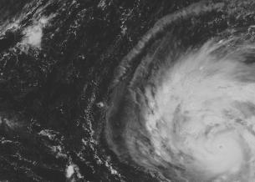
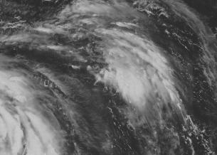

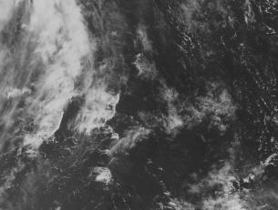
Collect data one way ….
File: a.h5
Dataset /A
File: b.h5
Dataset /B
File: c.h5
Dataset /C
File: d.h5
Dataset /D
Notes:
Images are stored in four different datasets. They represent a part of the bigger image.

Slide 13
Present it in a different way…
Whole image
File: F.h5
Dataset /D
Notes:
Virtual dataset stores a mapping for each quadrant to data stored in the source HDF5 files and datasets a-d.h5. Application can read the whole image from dataset /D using regular H5Dread call. It doesn’t need to know the mapping in order to read data.

Slide 14
VDS
VDS works with SWMR
File with VDS cannot be accessed by HDF5 1.8.* libraries
Use h5repack tool to rewrite data (1.10.0-patch1)

Slide 15
HDF5 Roadmap for 2016 -2017
May 31 -HDF5 1.10.0-patch1
  h5repack, Windows builds, Fortran issues on HPC systems
Late summer HDF5 1.10.1 (?)
  Address issues found in 1.10.0
December
  HPC features that didn’t make it into 1.10.0 release
Maintenance releases of HDF5 1.8 and 1.10 versions (May and November)

Slide 16
HDF4
HDF 4.2.12 (June 2016)
Support for latest Intel, PGI and GNU compilers
HDF4 JNI included with the HDF4 source code

Slide 17
HDF5 Roadmap for 2016 -2017
December 2016
  Minor bug fixes (if required)
  Performance improvements
Summer 2017
  Keep up with computing environments
  Performance improvements

Slide 18
HDFView
HDFView 2.13 (July 2016)
  Bug fixes
  Last release based on the HDF5 1.8.* releases
HDFView 3.0-alpha
  New GUI
  Better internal architecture
  Based on HDF5 1.10 release
Notes:
Java API wrappers (JNI)
API: HDF4, HDF5, version 1.10.1
JNI libraries packaged with appropriate HDF release (like C++, Fortran)
HDFView – HDF4/HDF5 file display, creation, editing
Better support for complex data types
Limited “compound compound”, variable length
Beta (alpha?) version with SWT GUI (Look and feel, better memory handling)
Will support v1.10.0
To be done:
Support for 1.10 features (creating VDS, etc.)
Various bug fixes and minor new features
Memory model redesign for large datasets / large # of objects

Slide 19
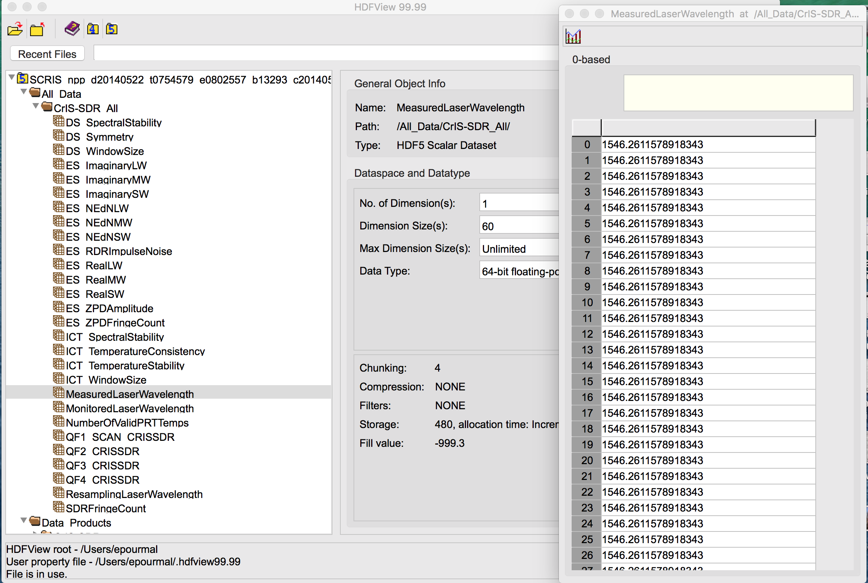
HDFView 3.0 Screenshot

Slide 20
Nagg tool
Nagg is a tool for rearranging NPP data granules from existing files to create new files with a different aggregation number or a different packaging arrangement.
Release 1.6.2 before July 21, 2016

Slide 21
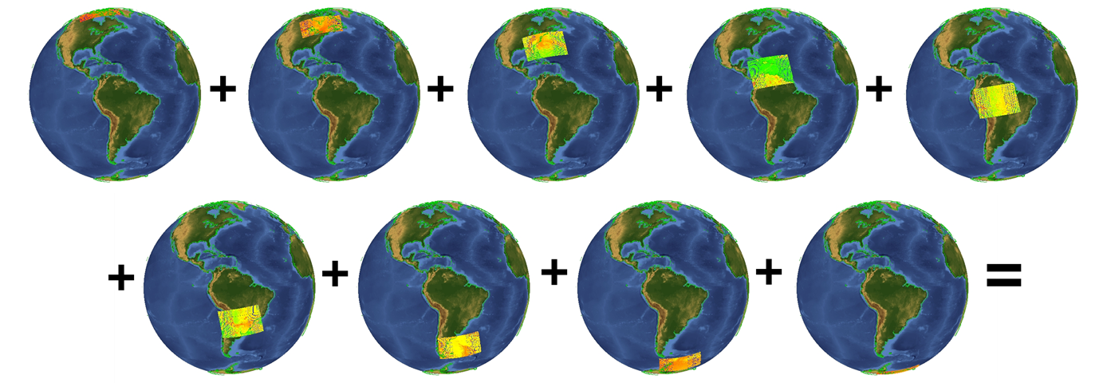
Nagg Illustration - IDV visualization
9 input files – 4 granules each in GMODO-SVM07… files

Slide 22
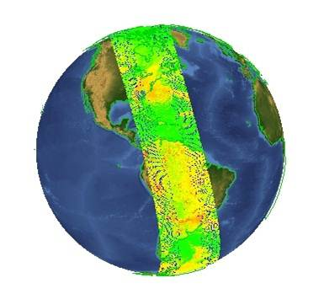
Nagg Illustration - IDV visualization
1 output file –36 granules in GMODO-SVM07… file

Slide 23
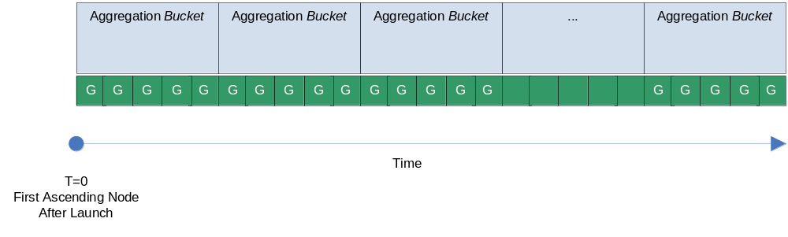
nagg: Aggregation Example
User Request Interval
T0 = IDPS Epoch Time
January 1, 1958 00:00:00 GMT
HDF5 File 1
………………………………………
HDF5 File M
Each file contains one granule
User requests data from the IDPS system for a specific time interval
Granules and products are packaged in the HDF5 files according to the request
This example shows one granule per file for one product
Notes:
This and the following slide address one of the simplest scenarios to
explain nagg’s functionality. User requested a product data for a
particular time interval with one granule per file.
The user gets HDF5 files with product data with one granule per file
and HDF5 files with the corresponding geolocation data.
He/she would like to re-aggregate data to have 5 granules per file.
(next slide)

Slide 24
nagg: Aggregation Example
Example: nagg –n 5 –t SATMS SATMS_npp_d2012040*.h5
Nagg copies data to the newly generated file(s).
User Request Interval
T0 = IDPS Epoch Time
January 1, 1958 00:00:00 GMT
HDF5 File 1
………………………………………………
HDF5 File N
First file contains 4 granules, the last one contains 3 granules
Other files contain 5 granules
Produced files co-align with the aggregation bucket start
HDF5 files are ‘full’ aggregations (full, relative to the aggregation period)
Geolocation granules are aggregated and packaged; see –g option for more control
Notes:
Here is a command that will do it. –n flag indicates number of granules per file,
-t indicates the type or product to be re-aggregated.
User has to specify the list of files with the granules to aggregate.
For convenience one can use wild cards to specify files names.
The result of nagg operation will be regarregated files as they
would be received by the user from the IDPS system.
New product files will co-align with the aggregation bucket start.
Therefore sometime the first and the last files in aggregation will not
have five granules. On this slide we show that the first HDF5 files will
contain 4 granules and the last one only three granules.
Geolocation product will be aggregated and packaged with the
product data. the tool has –g option to control geolocation data
packaging and aggregation.

Slide 25
Possible enhancement
Example: nagg –n 5 –v –t SATMS SATMS_npp_d2012040*.h5
Nagg with –v option doesn’t copy data to the newly generated file(s).
User Request Interval
HDF5 File 1
………………………………………………
HDF5 File N
Each file contains a virtual dataset. First file contains a dataset mapped to 4 granules,
the last one contains a virtual dataset mapped to 3 granules
Other files contain virtual datasets; each dataset is mapped to 5 granules
NO RAW DATA IS REWRITTEN
Space savings
No I/O performed on raw data

Slide 26
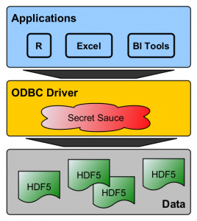




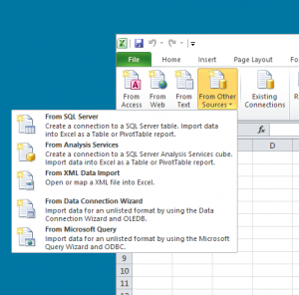

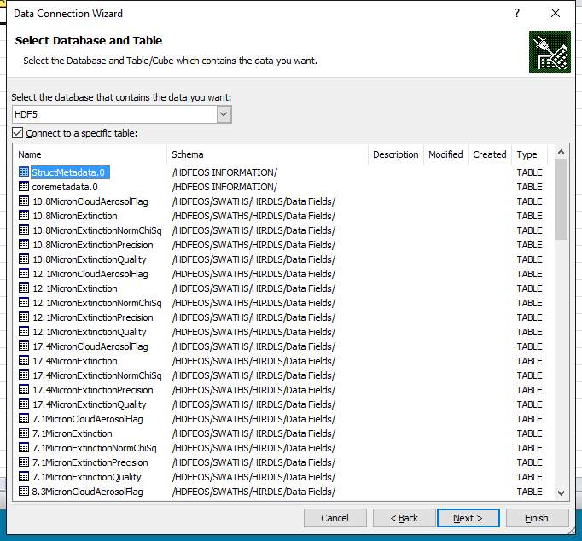



HDF5 ODBC Driver
Tap into the USB bus of data (ODBC)
Direct access to your HDF5 data from your favorite BI application(s)
odbc@hdfgroup.org
Join the Beta
Tell your friends
Send feedback
Beta test now
Q3 2016 Release
Desktop version
Certified-for-Tableau
Client/server version this Fall

Slide 27
New requirements and features?
Tell us your needs (here are some ideas):
  Multi-threaded compression filters
  H5DOread_chunk function
  Full SWMR implementation
  Performance
  Backward/forward compatibility
Other requests?

Slide 28

This work was supported by NASA/GSFC under Raytheon Co. contract number NNG15HZ39C

