Slide 1
NEON HDF5
eddy4R-Docker-HDF5 team (IPT-EC): David Durden, Stefan Metzger, Andy Fox, Greg Holling, Hongyan Luo, Natchaya Pingintha-Durden, Cove Sturtevant, David Weinstein
Date: 7/19/2016

Slide 2
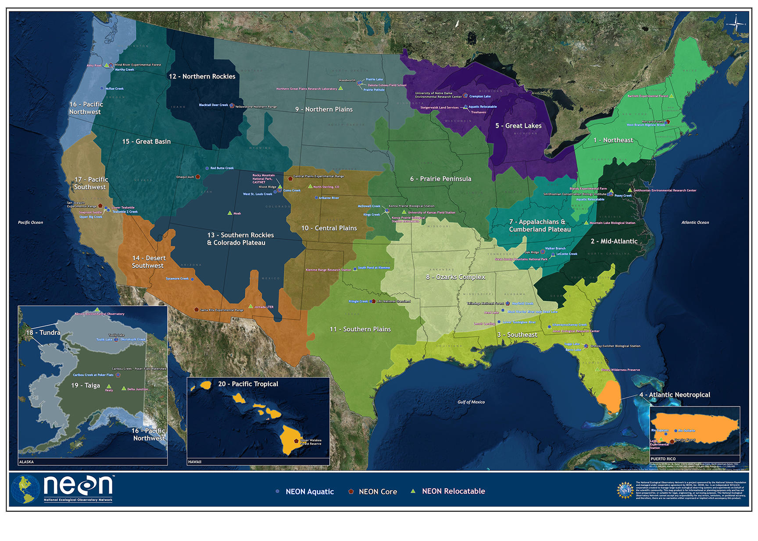
The National Ecological Observatory Network

Slide 3
Goals
To implement a fast and efficient file format for NEON data
  HDF5 file format provides high compressibility and fast efficient reading and writing of large amounts of data
Develop a standardized delivery structure for NEON data
  Structured files centered around the NEON data product numbering makes it an intuitive way to explore larger data files with interdependent data sets
Provide metadata with NEON data
  HDF5 attributes are a concise way to package metadata with our NEON data

Slide 4
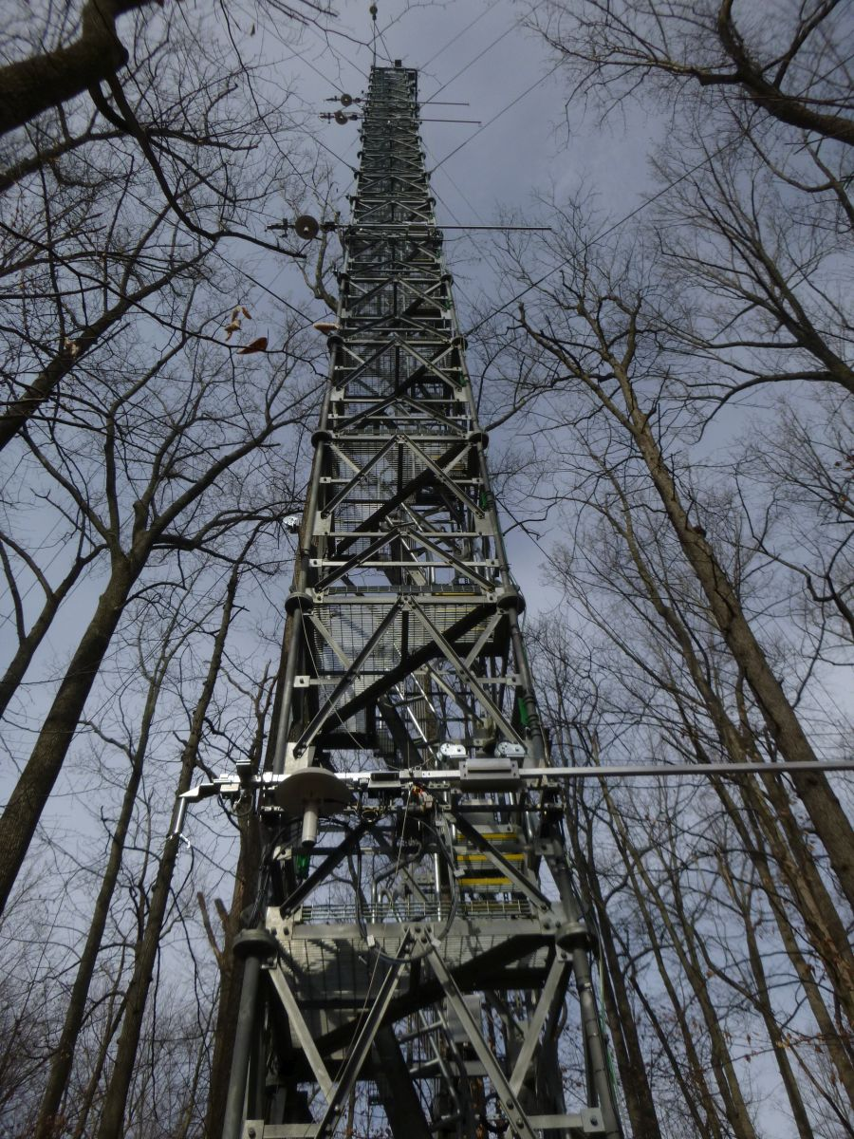
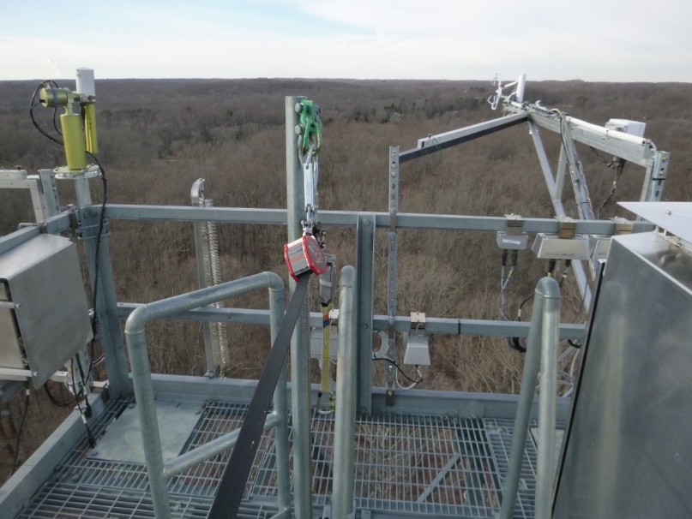
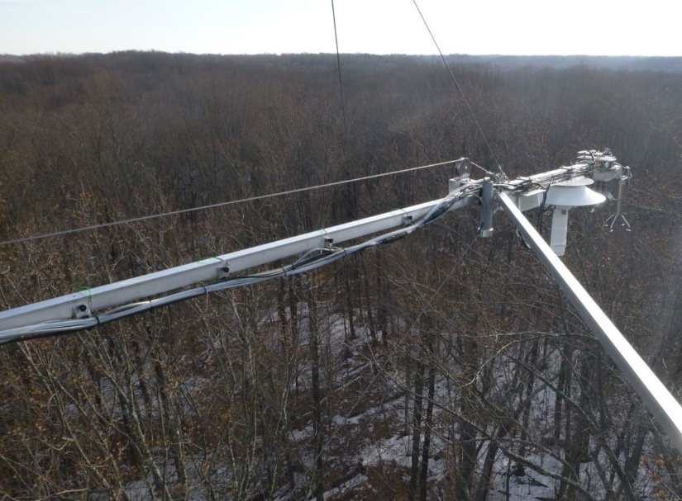
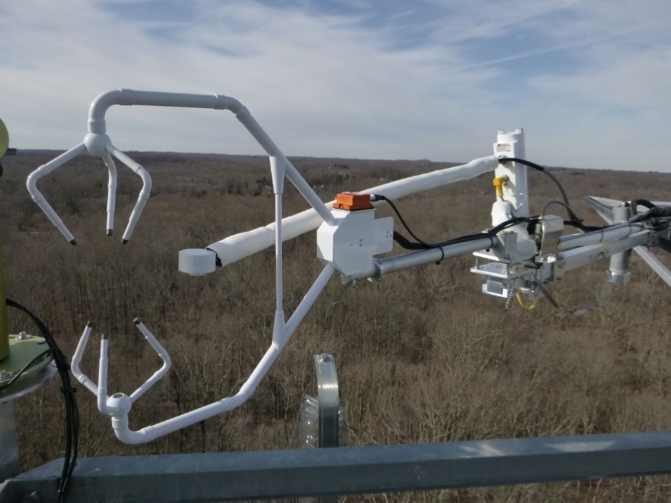
TIS example (Large datasets)
storage exchange assembly
turbulent exchange assembly

Slide 5
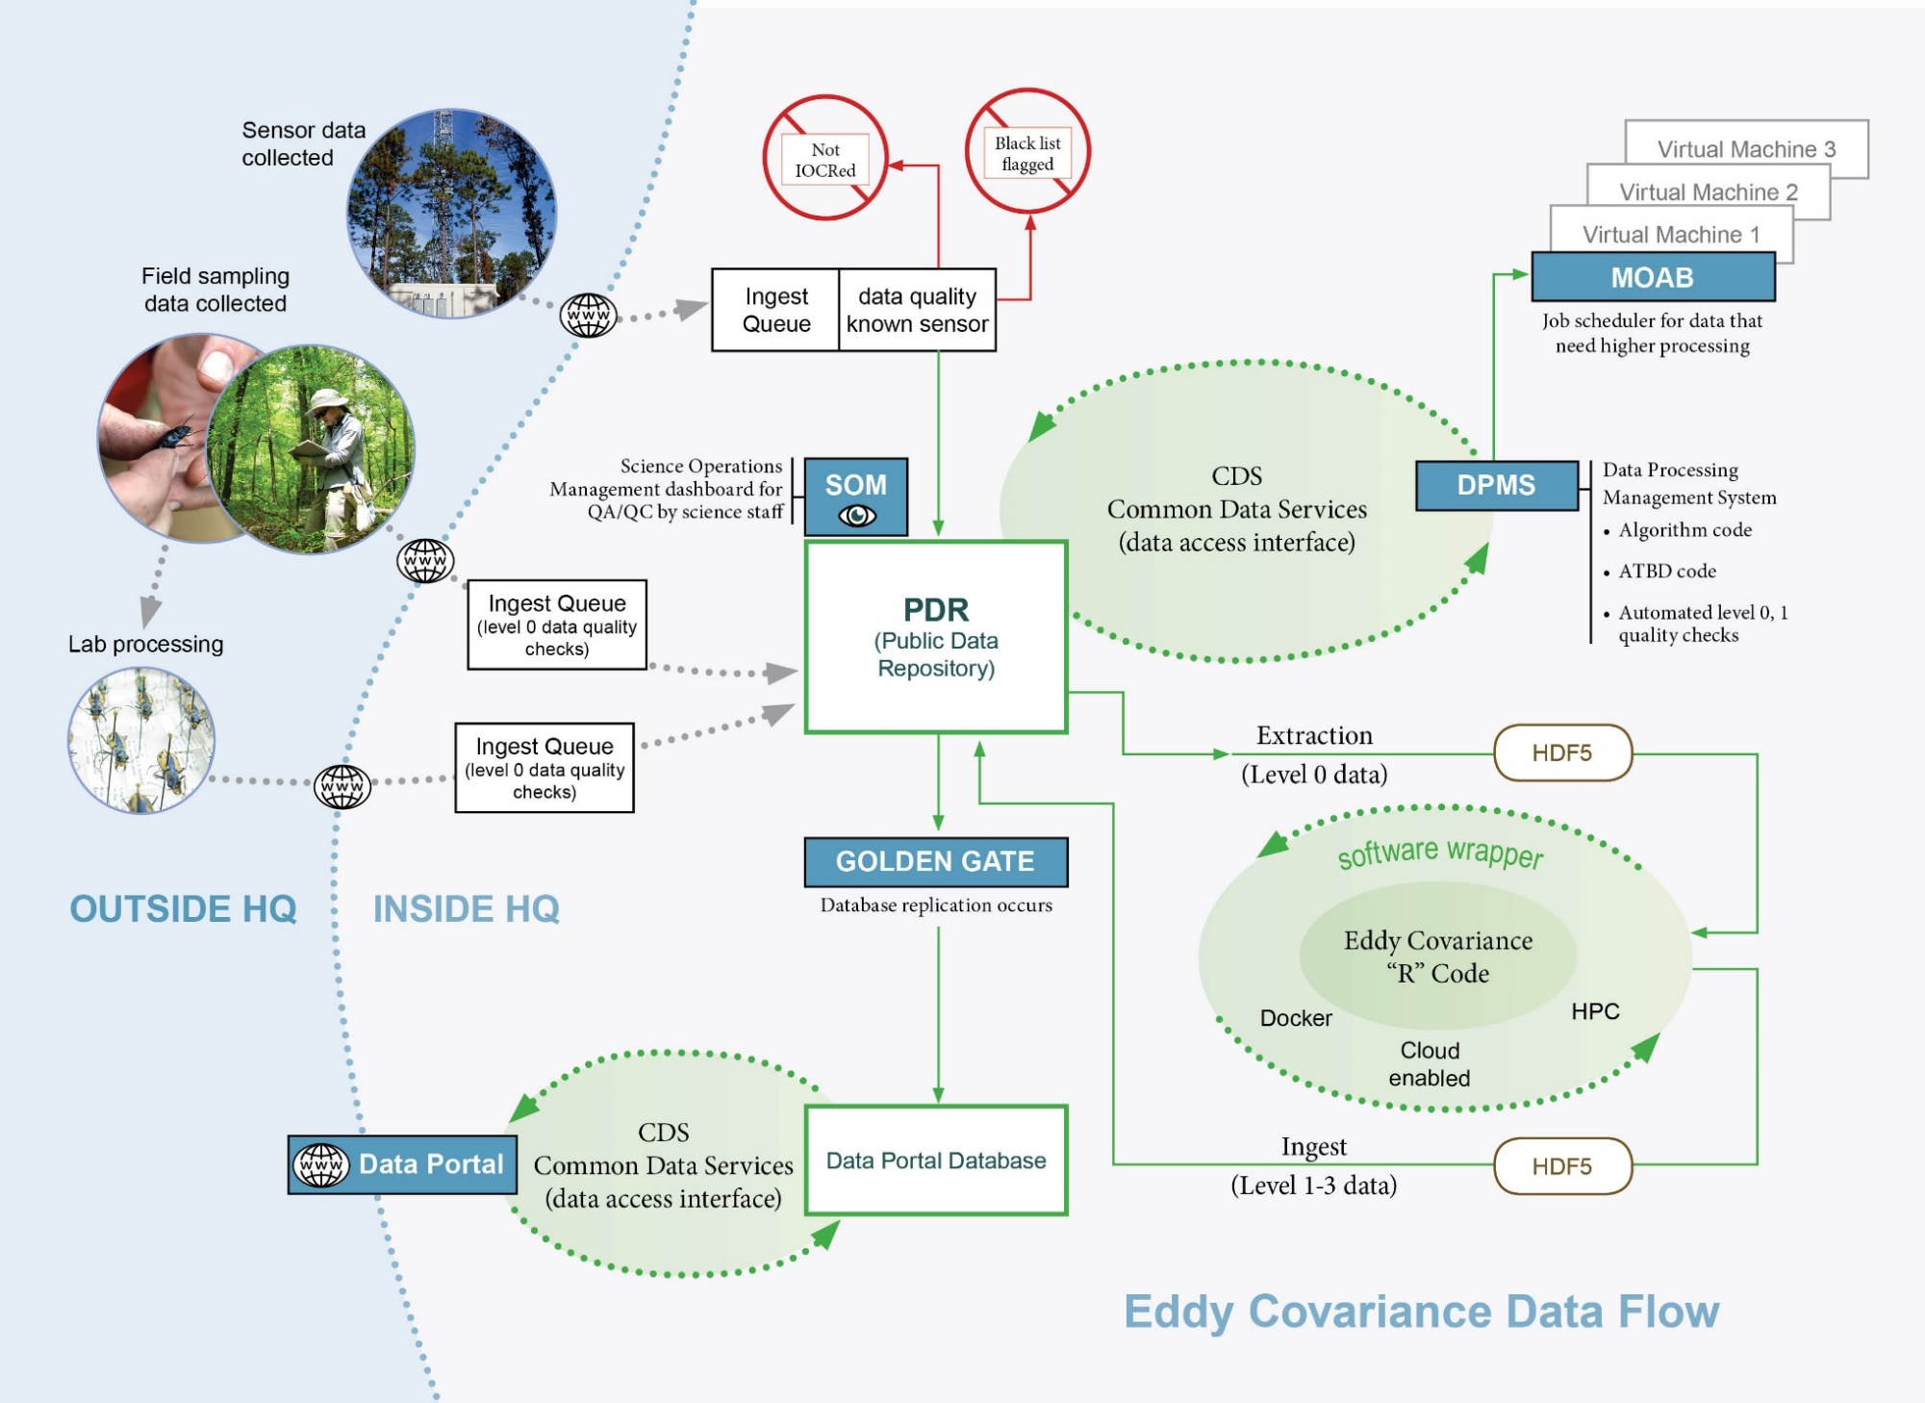
eddy-covariance in the CI workflow

Slide 6
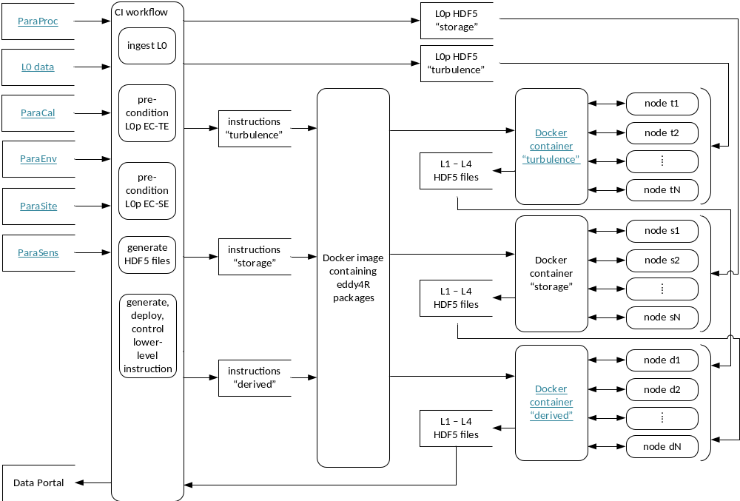
eddy4R-Docker-HDF5 workflow

Slide 7
NEON Data Product Naming Convention
NEON.DOM.SITE.DPL.PRNUM.REV.TERMS.HOR.VER.TMI
WHERE:
NEON=NEON
DOM=DOMAIN, e.g. D10
SITE=SITE, e.g. STER
DPL=DATA PRODUCT LEVEL, e.g. DP1
PRNUM = PRODUCT NUMBER =>5 digit number. Set in data products catalog.
TIS = 00000-09999
REV = REVISION, e.g 001.
TERMS=From NEON’s controlled list of terms. Index is unique across products.
HOR = HORIZONTAL INDEX. Semi-controlled; AIS and TIS use different rules. Examples: Tower=000, Hut = 700, DFIR=900.
VER = VERTICAL INDEX. Semi-controlled; AIS and TIS use different rules. Examples: Ground level=000, second tower level=020.
TMI=TEMPORAL INDEX. Examples: 001=1 minute, 030=30 minute, 999=irregular intervals.

Slide 8
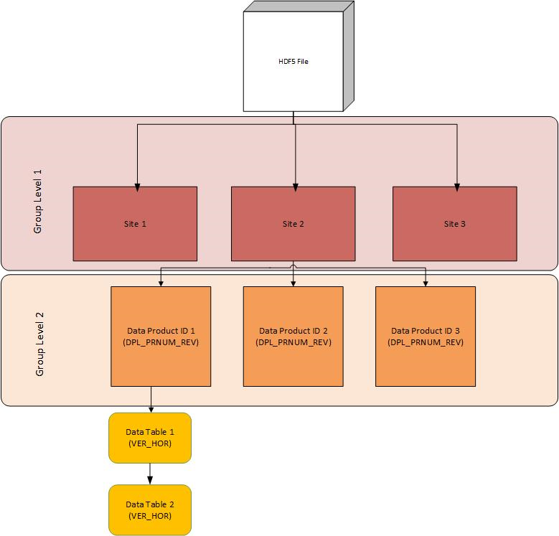
NEON HDF5 file structure

Slide 9
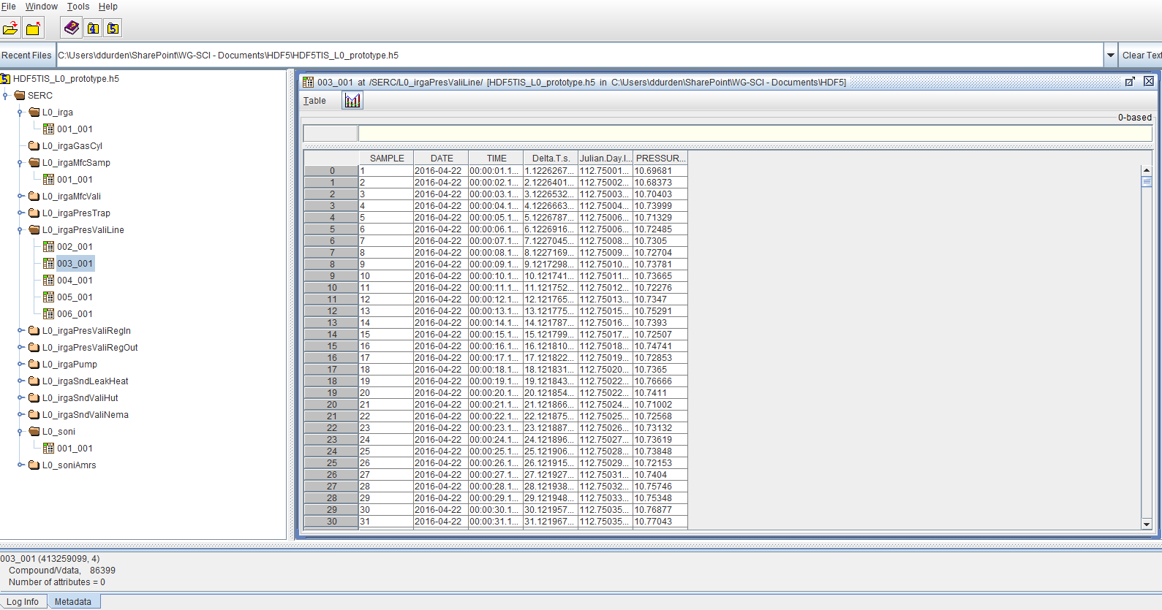
Example File

Slide 10
Metadata in HDF5

Slide 11
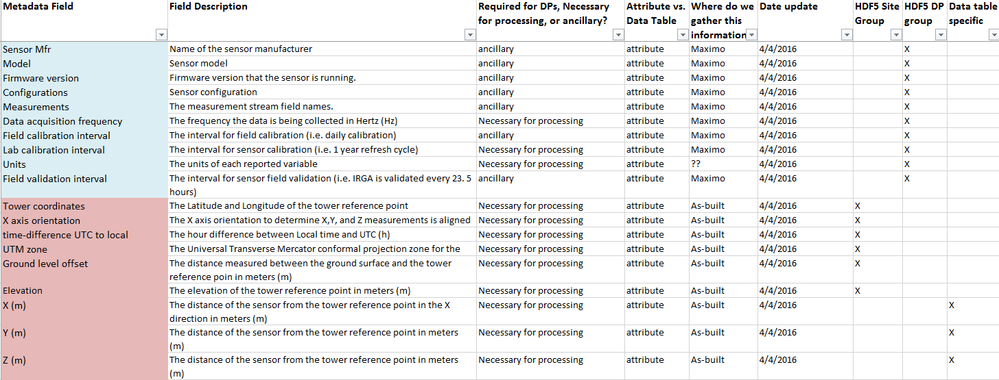
Metadata

Slide 12
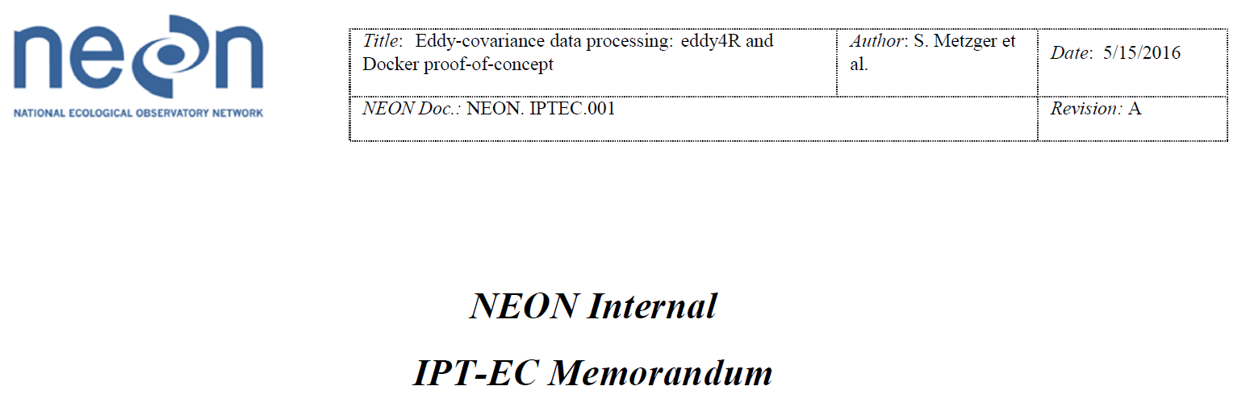
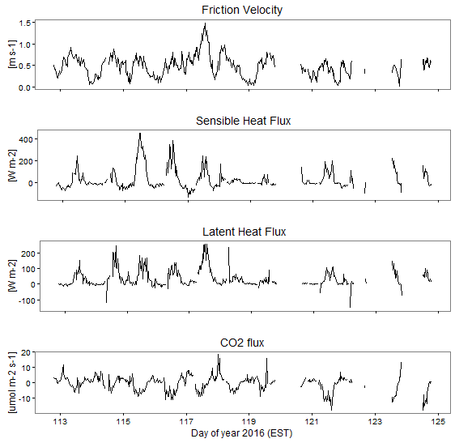
NEON’s first fluxes from SERC!
Timeframe:
  4/22/2016 -5/03/2016
File size for 1 day (4/22/2016):
  Compressed = 398 MB
  Uncompressed = 1.84 GB
  Data Compression Ratio ~ 4.5:1
Metadata: Units and variable names

Slide 13
Performance testing
test datasets approximated 1 day of L0p IRGA data
  “compound”: single dataset with each row having many numeric float values and a single string value
  “simple”: one dataset with each row having many numeric float values, second dataset with each row having a single string value
Results for COMPOUND dataset are:
Results for SIMPLE dataset are:
 | Compressed | Non-compressed
Read | 45 secs | 4.25 secs
Write | 621 secs | 11.25 secs
Size | 78 MB | 266 MB
 | Compressed | Non-compressed
Read | 1.45 secs | 0.75 secs
Write | 21.45 secs | 4 secs
Size | 21 MB | 266 MB

Slide 14
Future work
Implement R code into the eddy4R package to produce NEON formatted HDF5 files
  Development is currently on Github, if interested you can join our development efforts by signing up for one of our working groups
Easy way to imbed EML (Ecological Metadata Language) tags into HDF5?
  There is an ISO tag solution, but not anything for EML

