Slide 1
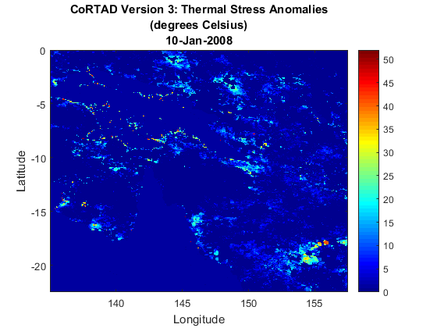
MATLAB, Big Data, and HDF Server
Ellen Johnson
MathWorks

Slide 2
Overview
MATLAB capabilities and domain areas
Scientific data in MATLAB
HDF5 interface
NetCDF interface
Big Data in MATLAB
MATLAB data analytics workflows
RESTful web service access
Demo: Programmatically access HDF5 data served on HDF Server

Slide 3


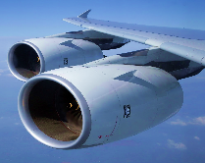

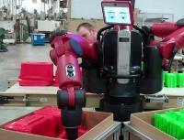


DESIGNED FOR
Embedded system
development
Engineering Education
Aircraft and missile
guidance systems
Control system design
Communications
system design
Earth Sciences
Engineering research
Robotics
Online trading systems
System optimization
Computational Biology
CUSTOMERS IN
Aerospace and defense
Automotive
Biotech and pharmaceutical
Communications
Education
Electronics and semiconductors
Energy production
Financial services
Industrial automation
and machinery
Medical devices
Software
Internet

Slide 4
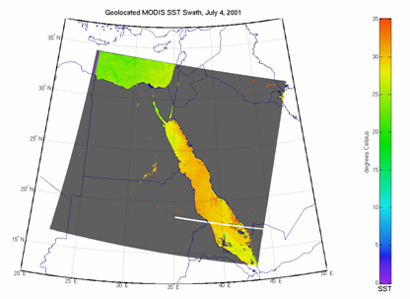
Scientific Data in MATLAB
Scientific data formats
  HDF5, HDF4, HDF-EOS2
  NetCDF (with OPeNDAP!)
  FITS, CDF, BIL, BIP, BSQ
Image file formats
  TIFF, JPEG, HDR, PNG, JPEG2000, and more
Vector data file formats
  ESRI Shapefiles, KML, GPS
  and more
Raster data file formats
  GeoTIFF, NITF, USGS and SDTS DEM, NIMA DTED, and more
Web Map Service (WMS)

Slide 5
HDF5 in MATLAB
High Level Interface (h5read, h5write, h5disp, h5info)
  h5disp('example.h5','/g4/lat');
  data = h5read('example.h5','/g4/lat');
Low Level Interface (Wraps HDF5 C APIs)
  fid = H5F.open('example.h5');
  dset_id = H5D.open(fid,'/g4/lat');
  data = H5D.read(dset_id);
  H5D.close(dset_id);
  H5F.close(fid);
Notes:
h5disp maps to h5dump
try, catch
don’t have to recompile your code to play with the lower level interfaces
Run code as you type it

Slide 6
NetCDF in MATLAB
High Level Interface (ncdisp, ncread, ncwrite, ncinfo)
  url = 'http://oceanwatch.pifsc.noaa.gov/thredds/ dodsC/goes-poes/2day';
  ncdisp(url);
  data = ncread(url,'sst');
Low Level Interface (Wraps netCDF C APIs)
  ncid = netcdf.open(url);
  varid = netcdf.inqVarID(ncid,'sst');
  netcdf.getVar(ncid,varid,'double');
  netcdf.close(ncid);
Notes:
ncdisp maps to ncdump

Slide 7


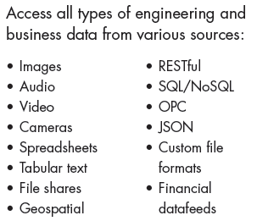
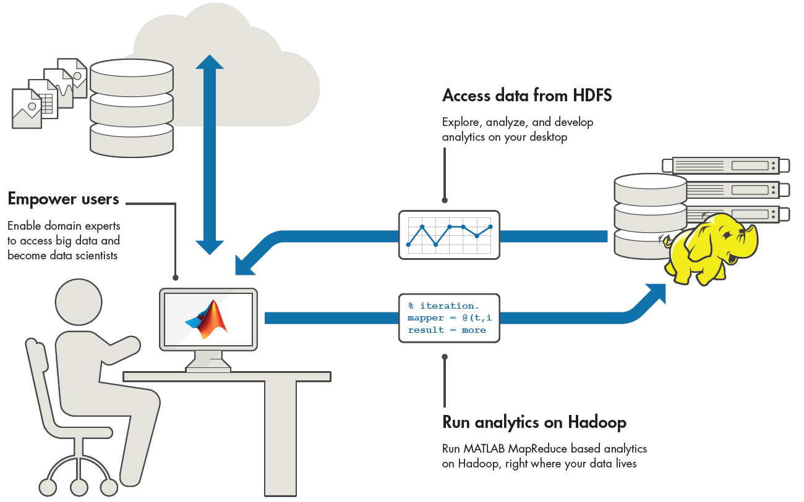
Big Data in MATLAB

Slide 8
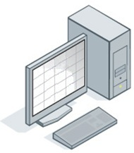
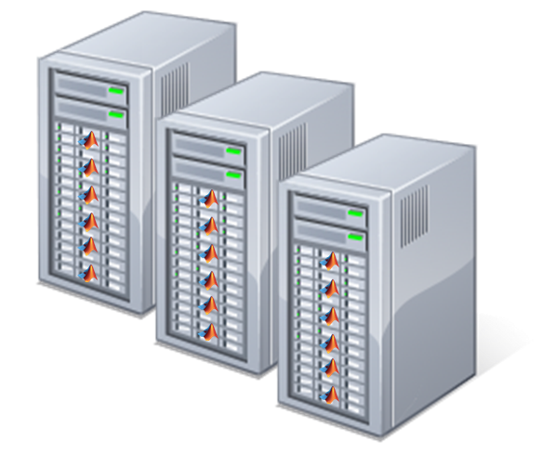

Scale Data
Memory and Data Access
64-bit processors
Memory Mapped Variables
Disk Variables
Databases
Datastores
Programming Constructs
Streaming
Block Processing
Parallel-for loops
GPU Arrays
SPMD and Distributed Arrays
MapReduce
Platforms
Desktop (Multicore, GPU)
Clusters
Cloud Computing (MDCS for EC2)
Hadoop
Notes:
Big data means many different things to different users. MATLAB provides numerous capabilities for processing data that is too cumbersome for the desktop, as well for supporting big data systems such as Hadoop:
64 bit processors along with memory mapped and disk variables optimize processing on the desktop, while databases and our new datastore functionality allow for analyzing your data in segments.
MATLAB also provides for various programming constructs to address the wide variety of data characteristics. Use system objects for stream processing, process images using block processing techniques, process your data in parallel or on GPUs using distributed arrays or the new Mapreduce framework in MATLAB to further enhance the speed of analysis and the volume of data which can be analyzed.
Theses capabilities will let you analyze big data on your desktop, and if more processing power or workspace is needed scale to a cluster. If your data happens to reside in the big data platform Hadoop, we have some new features to allow MATLAB to interoperate with this big data platform.

Slide 9
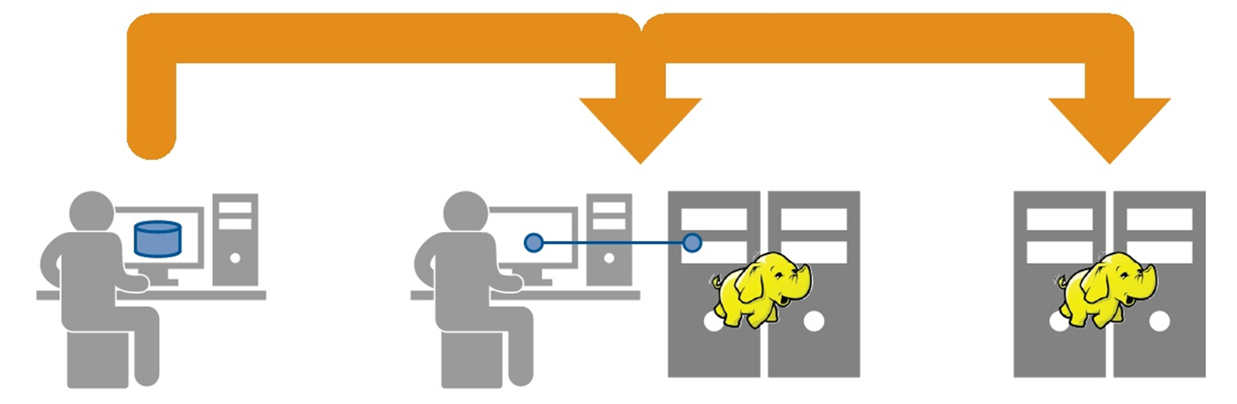
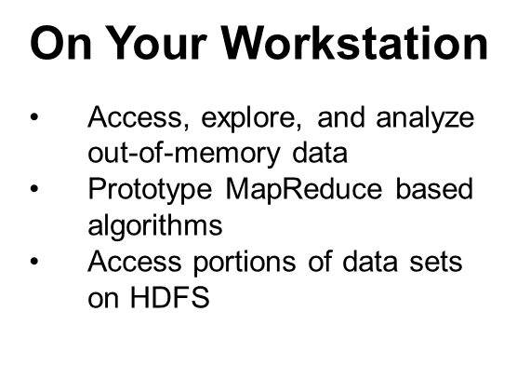
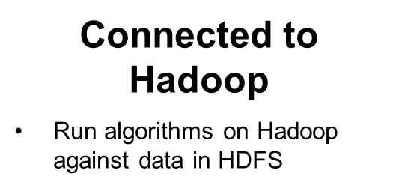


Hadoop with MATLAB
Production Hadoop
Create applications or components that execute on Hadoop

Slide 10
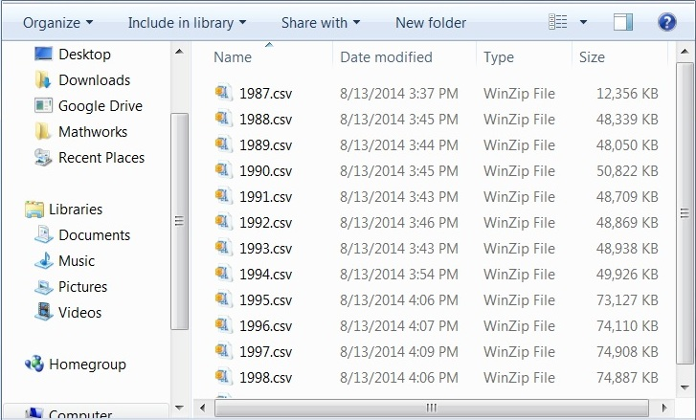
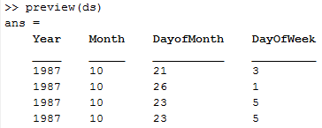
Access Big Data datastore
datastore for accessing large data sets
  Text or image files
  Single file or collection of files
Preview data structure and format
Select data to import using column names
Incrementally read subsets of the data
Access data stored in HDFS
airdata = datastore('*.csv');
airdata.SelectedVariables = {'Distance', 'ArrDelay‘};
data = read(airdata);
Notes:
Datastore provides a straightforward way to access big data that consists of a single text or image file or a large collection of such files.
Point the datastore to a folder or use wildcards to specify all the files in a given directory
Preview a subset of the data for easy exploration
Identify columns to import using column names, and specify the format for each column of interest
Step through files a chunk at a time

Slide 11
Analyze Big Data mapreduce
********************************
* MAPREDUCE PROGRESS *
********************************
Map 0% Reduce 0%
Map 20% Reduce 0%
Map 40% Reduce 0%
Map 60% Reduce 0%
Map 80% Reduce 0%
Map 100% Reduce 25%
Map 100% Reduce 50%
Map 100% Reduce 75%
Map 100% Reduce 100%
mapreduce uses datastore to process data in chunks
  Intermediate analysis results do not fit in memory
  Processing multiple keys
  Data resides in Hadoop
Work on the desktop
  Local data exploration, analysis, and algorithm development
Scale to Hadoop
  Interactive use with MATLAB Distributed Computing Server
  Deploy to production Hadoop instances using MATLAB Compiler
Notes:
MapReduce is a powerful programming technique for applying filtering, statistics and other general analysis methods to big data.
You can use mapreduce on your desktop machine for applications where the intermediate results of your analysis will not fit into memory, when the analysis is being done on many keys, or to develop algorithms for later use on data stored in HDFS, Hadoop Distributed File System.
You can execute MATLAB MapReduce based algorithms within Hadoop MapReduce, using MATLAB Distributed Computing Server
You can package MapReduce based algorithms for deploying to production Hadoop systems, using MATLAB Compiler™

Slide 12
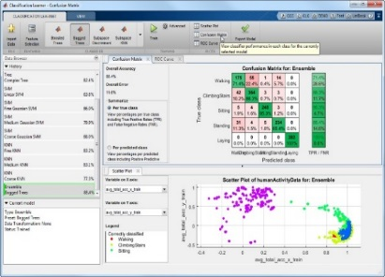
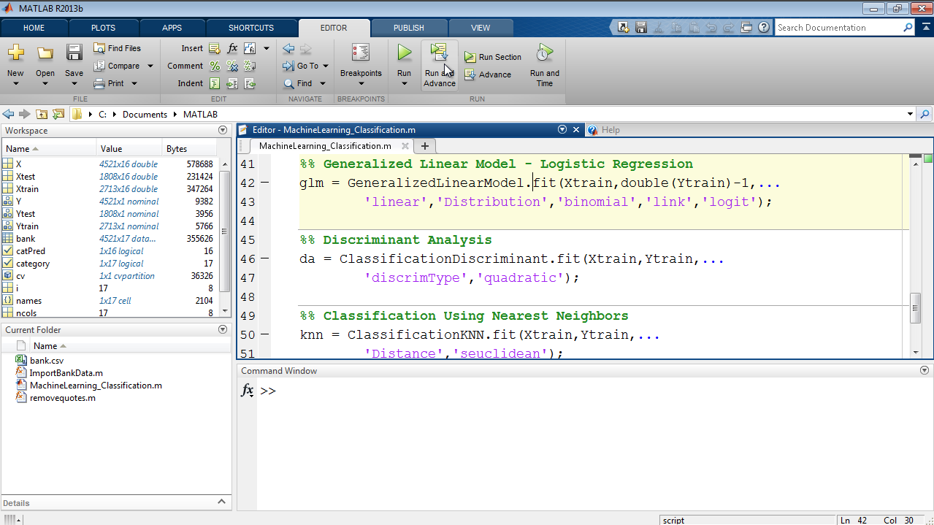

Data Analytics with MATLAB
Machine Learning
Statistics
Image Processing
Neural Networks
Apps
Language
Signal Processing
Optimization
Control Systems
Symbolic Computing
Financial Modeling

Slide 13
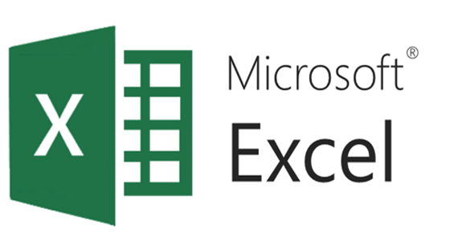
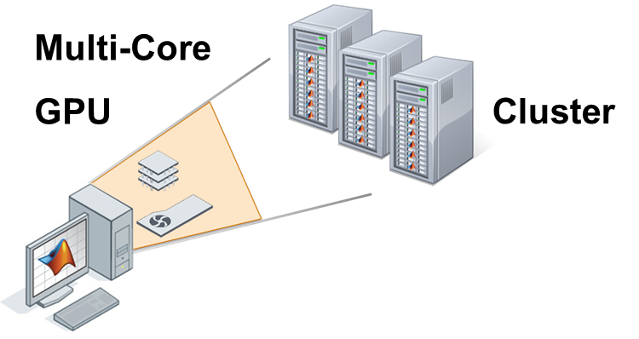




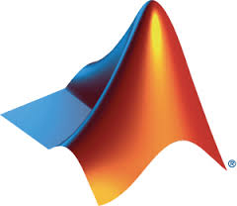
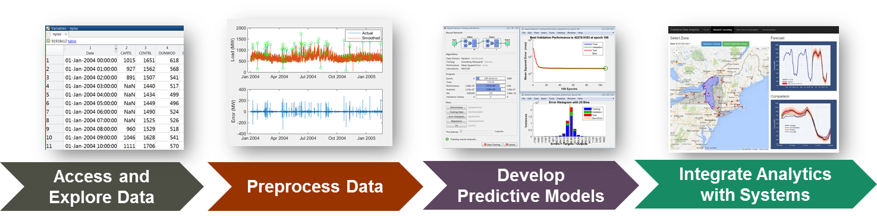
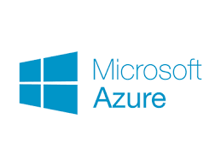


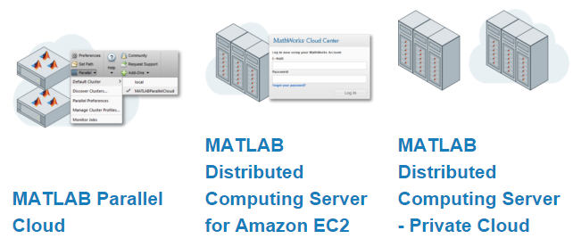











Enterprise-Scale Data Analytics
Computation
Layer
Data Visualization
Presentation
Layer
Cloud
Analytics
Layer
MathWorks Cloud
Data Warehouses
Databases
Data
Layer
Notes:
Customer’s point of view, especially if talking to IT/Enterprise Archiect
The key thing to take away from this slide is that there are many other companies in this space, but most of them should be considered complimentary to what we offer.
Only a few are competitive: R, Python, SAS
In the data layer, have the big data vendors, data warehouse vendors, …
Story here is that we can work with customers to help them integrate with these
Similar for the presentation layer…

Slide 14
Combining Big Data, RESTful Web Services, and MATLAB
Big Data
  mapreduce and datastore functions
  table, categorical, and datetime data types are powerful in conjunction with big data analysis
RESTful web service access
  webread, webwrite, and weboptions
  JSON objects represented as struct arrays
  struct2table converts data into table as a collection of heterogeneous data
Combine to support MATLAB data analytics workflow
Data import into appropriate data types
Data Exploration
Data Visualization
Data Analysis

Slide 15
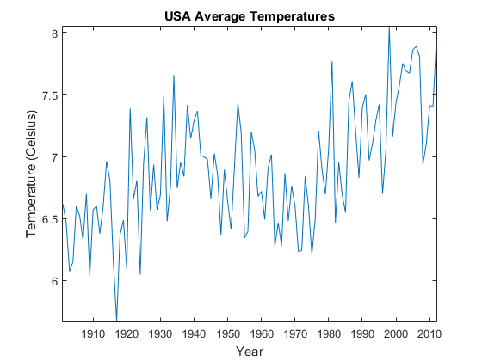
webread Example: Read historical temperature data
Read historical temperature data from the World Bank Climate Data API
>> api = 'http://climatedataapi.worldbank.org/climateweb/rest/v1/';
>> url = [api 'country/cru/tas/year/USA'];
>> S = webread(url)
S =
112x1 struct array with fields:
year
data
>> S(1)
ans =
year: 1901
data: 6.6187

Slide 16
Demo: Using MATLAB to programmatically access and analyze data hosted on HDF Server
HDF Server: A RESTful API providing remote access to HDF5 data
Responses are JSON formatted text
webread with weboptions provide data access
table and datetime data types enable data analysis
Example: Coral Reef Temperature Anomaly Database (CoRTAD)
Version 3 CoRTAD products in HDF5 format
1.8G dataset hosted on h5serv running on Amazon AWS
thermStress = sortrows(thermStress,'ThermalStressAnomaly','descend');
thermStress(1:10,:)
ans =
Latitude Longitude ThermalStressAnomaly
________ _________ ____________________
-8.2839 137.53 52
-2.0874 146.67 51
-8.2399 137.49 50
-8.2399 137.53 50
-15.447 145.22 50
-15.491 145.22 50
-10.13 148.34 50
-4.5924 135.99 49

Slide 17
Questions?
www.mathworks.com
www.mathworks.com/matlabcentral
Examples:
    Using the high-level HDF5 Functions to Import Data
    Tackling Big Data with MATLAB
Performing Numerical Simulation of an Oil Spill
Reading Content from RESTful Web Service
Thank you!

Slide 18
References
www.hdfgroup.org
https://hdfgroup.org/wp/2015/04/hdf5-for-the-web-hdf-server/
http://data.worldbank.org/developers/climate-data-api
https://data.nasa.gov/data
http://visibleearth.nasa.gov/
http://www.nodc.noaa.gov/sog/cortad/
http://data.nodc.noaa.gov/cgi-bin/iso?id=gov.noaa.nodc:0068999

