Slide 1
Utilizing HDF4 File Content Maps for the Cloud Computing
Hyokyung Joe Lee
The HDF Group
This work was supported by NASA/GSFC under Raytheon Co. contract number NNG15HZ39C
Notes:
Good morning, everyone! My name is Joe Lee and I’m a software engineer at The HDF Group. Although I attended the past ESIP meetings regularly, I could not travel this summer. ESIP meeting is a great place to learn and share new ideas and technologies through face-to-face conversation so I apologize for presenting my new idea over telecon.

Slide 2
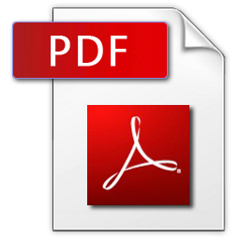
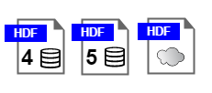
HDF File Format is for Data.
PDF for Document, HDF for Data
Why PDF over MS Word DOC?
  Free, Portable, Sharing & Archiving
Why HDF over MS Excel XLS(X)?
  Free, Portable, Sharing & Archiving
HDF: HDF4 & HDF5
Notes:
Although you may have heard about Hierarchical Data Format, let me start my presentation by giving a very short introduction to HDF.
HDF is similar to PDF in many ways as a free & portable binary format although the brand power of HDF is much weaker than the brand power of PDF.
Everybody knows that PDF is for publishing document. HDF is for publishing data of any size – big or small.
For example, NASA has used HDF for several decades to archive big data as large as Earth observation because it is good for sharing and archiving.
HDF has two incompatible formats called HDF4 and HDF5.
As the number indicates, HDF4 is old format and HDF5 is relatively new format.

Slide 3
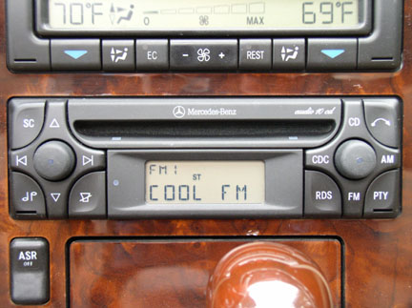

HDF4 is “old” format.
Old = Large volume over long time
Old = Limitation (32-bit)
Old = More difficult to sustain
Notes:
The idea that I am going to present today is mainly about HDF4 because HDF4 is old.
I cannot tell exactly how old HDF4 is because I don’t want to discriminate any file format based on its age. ☺
Old can mean many different things – both good and bad.
For example, old means a large volume of earth data has been archived in HDF4.
Old also means that HDF4 has some limits that are already overcome by today’s technology.
As the technology advances very fast, you’ll see fewer tools that support HDF4.
I put an image of CD-player because HDF4 reminds me the CD player in my 20 years old car.
In 1995, I had to pay extra money for it as a premium car audio option.

Slide 4
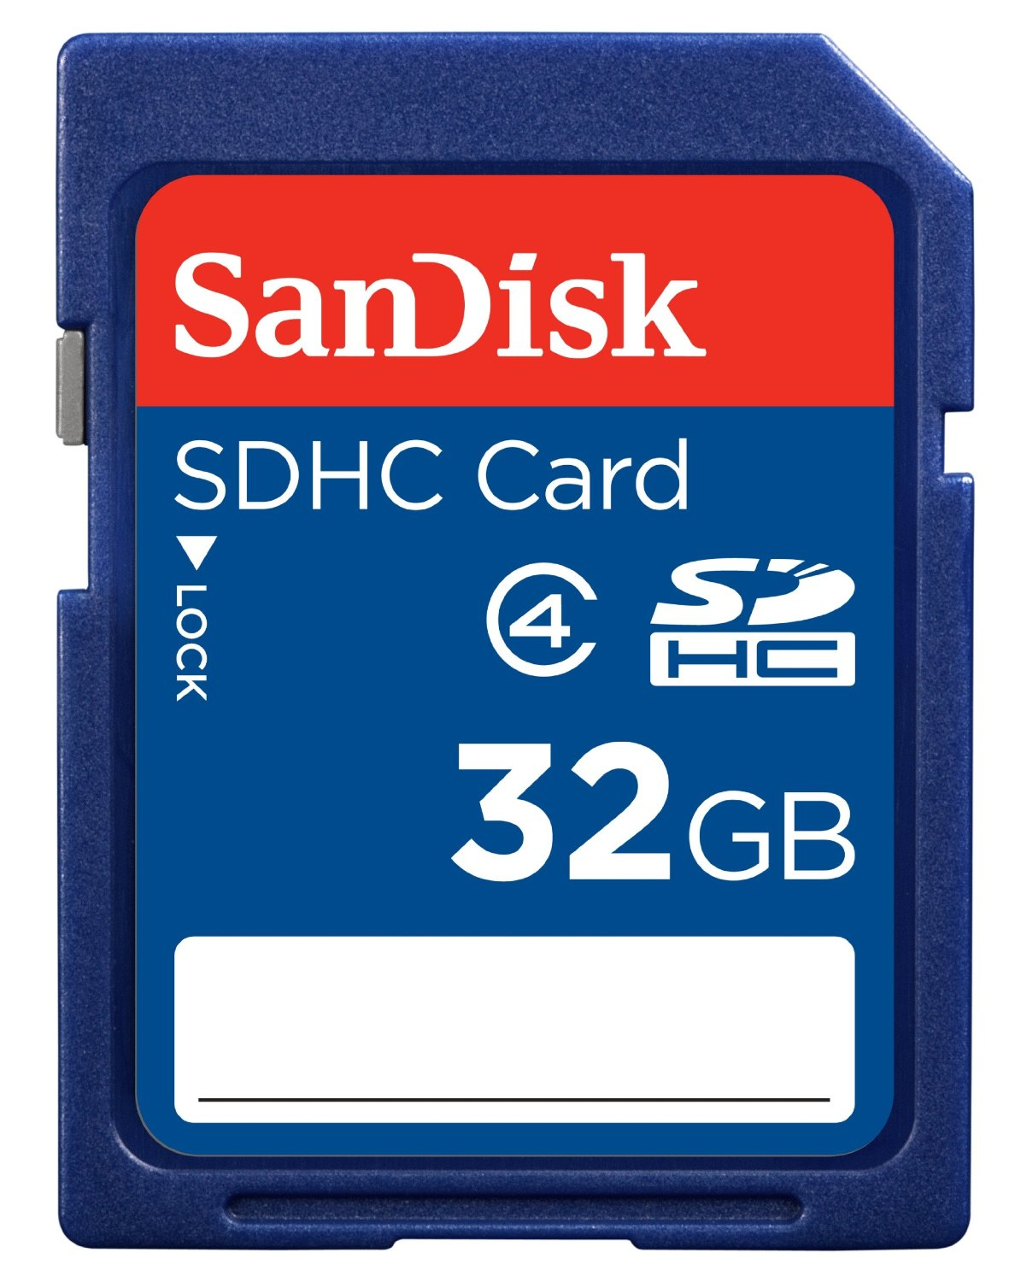
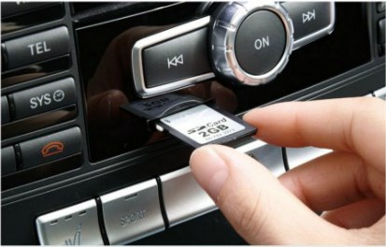
HDF4 is old. So What?
Convert it to HDF5.
Notes:
Last November, my 20 year old car was finally broken after racking up 250 thousand miles so I went shopping for a new car.
I was surprised to know that new cars do not have CD players any more.
Instead, they have USB or SD memory card slots and they accept MP3 formats.
I’m telling this story because the modernization of HDF4 data is necessary before it gets too old to sustain.
Since HDF4 is not backward-compatible with HDF5, HDF5 users need to convert HDF4 to HDF5 if their tools do not support HDF4.
The HDF Group already provides h4toh5 conversion tool.
This is a good solution as long as you are willing to convert millions of HDF4 files into HDF5 files.

Slide 5

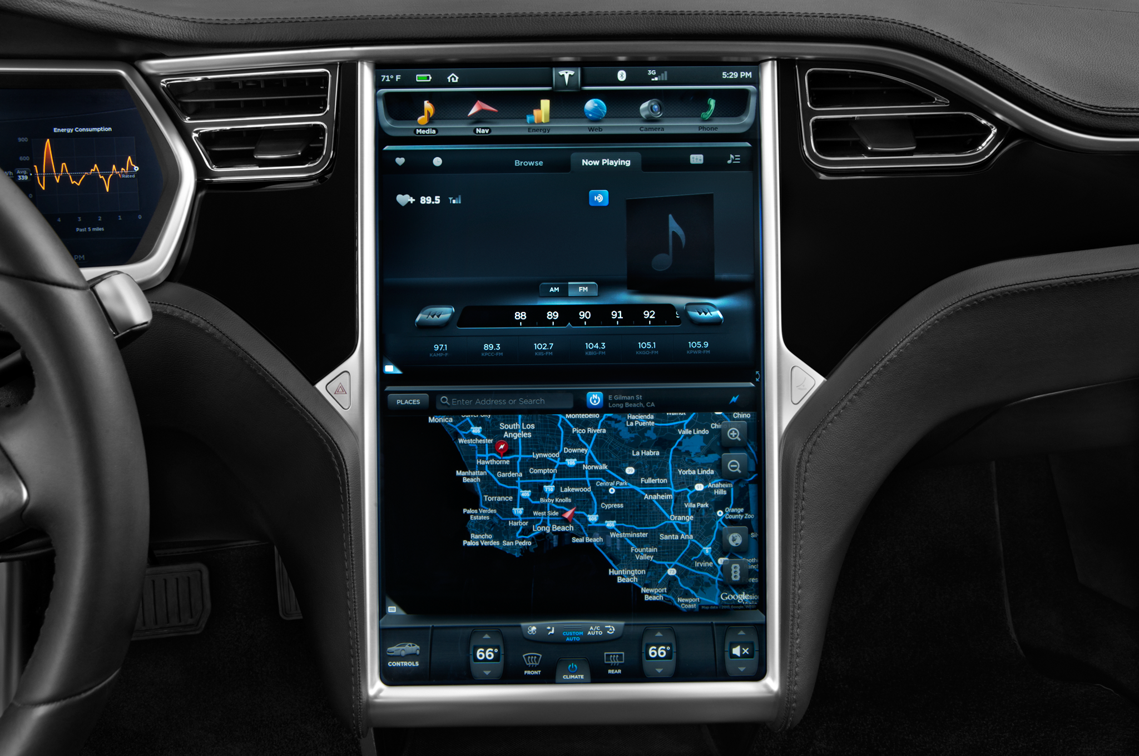
Any alternative?
Cloudification!
Notes:
Thinking about the future alternative, like Tesla car that can stream music from cloud, I think Earth data streaming from cloud is the way to go.
So, converting HDF4 to HDF5 is an OK solution but I think there should be an alternative if we’d like to modernize old HDF4 data in cloud age.

Slide 6
Cloudificaiton - Wiktionary
The conversion and/or
migration of data and
application programs in order to make use of
cloud computing
Notes:
I found the word “Cloudification” and I like it a lot. Wiktionary defines it as “The conversion ….”

Slide 7
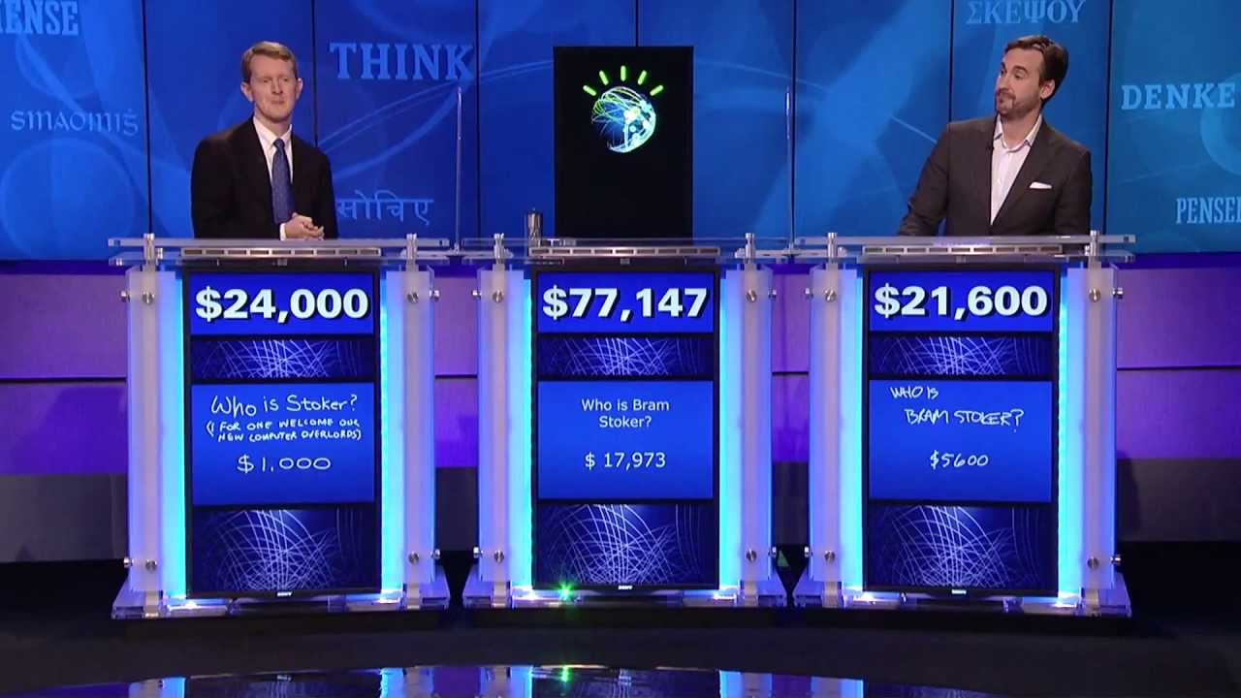

Why Cloud? AI+Bigdata+Cloud =
Notes:
Why does cloud computing matter? I think I don’t have to explain it any more thanks to IBM Watson and Google AlphaGo. When combined with AI and big data, cloud computing can do amazing things like beating human experts.

Slide 8
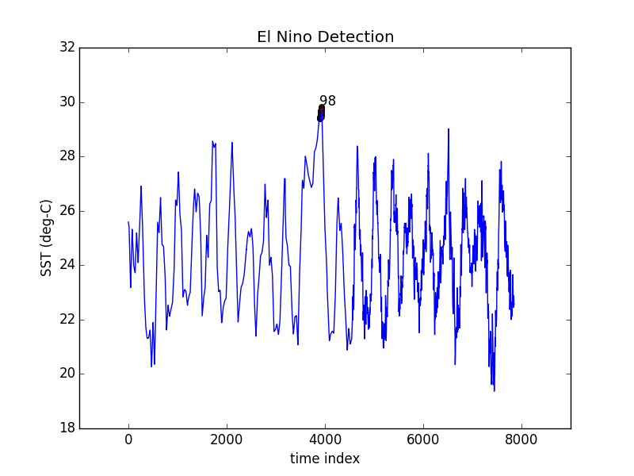

ABC Example: El Nino Detection
Notes:
For another example, last winter, I was involved in a project called data container study. I ran a machine learning experiment with 20 years of NASA sea surface temperature data near Peru from 1987 and 2008 using Open Science Data Cloud and I could detect an anomaly quickly in a few seconds. The result matched nicely with El Nino in 1998. Open Science Data Cloud was very convenient and fast.

Slide 9
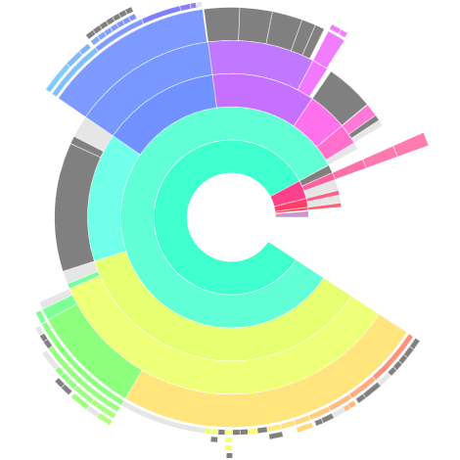
Cloudificaiton is cool but how?
Use
HDF4 File Content Map.
Table
Palette
Attribute
Group
Array
Notes:
What I also learned from data container study is that efficient I/O is the key.
OSDC provides 200 terra bytes of public data in HDF4 format.
However, they are not directly usable for me because OSDC does not provide any search interface to the collection that is similar to NASA Earthdata search.
OSDC only provides a list of HDF4 file names available and all I can do is to transfer a collection of HDF4 files “as is” from cloud storage to the computing nodes.
This is horribly inefficient because I need a way to search & filter the only relevant data to speed up my data analytics at collection level.
Thus, I came up with an idea to use HDF4 file content map to maximize the utilization of cloud computing. A single binary HDF4 file can have multiple data objects represented as array, group, table, attributes and so on. Each object can be precisely located using the offset from the beginning of file and the number of bytes to read using HDF4 file content map. The rationale is that if the only relevant object can be searched and loaded into data analytics engine, you can reduce the amount of I/O and thus get the result much faster. Without shredding thousands of HDF4 files into objects with HDF4 maps, you must load 200 TB of data into computing nodes, process them, and throw away. You must repeat this for different analytics jobs. You need to wait days for I/O operation while the actual data analytics takes only a few seconds.

Slide 10
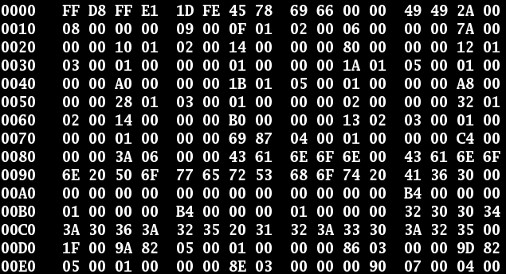
What is HDF4 Map?
XML (ASCII) file that maps the content of binary file.
<h4:Array name="c" path="/a/b/" nDimensions="4">
<h4:dataDimensionSizes>180 8 32 4</h4:dataDimensionSizes>
<h4:chunks>
<h4:chunkDimensionSizes>1 8 32 4</h4:chunkDimensionSizes>
<h4:fillValues value="-9999.000000" chunkPositionInArray="[0,0,0,0]"/>
<h4:byteStream offset="70798703" nBytes="2468" chunkPositionInArray="[114,0,0,0]"/>
<h4:byteStream offset="89101024" nBytes="32" chunkPositionInArray="[172,0,0,0]"/>
<h4:byteStream offset="89127527" nBytes="32" chunkPositionInArray="[173,0,0,0]"/>
</h4:chunks>
</h4:Array>
Notes:
So what is HDF4 file content map that I’m talking about? It is an XML file that maps the content of the HDF4 binary file.
Unless you’re a hacker working for NSA, it’s hard to know what’s inside the HDF4 binary file as shown in the slide.
HDF4 binary file is a long stream of bytes and HDF4 map file can tell you how to decrypt the stream correctly.

Slide 11
It is a map with addresses.
<h4:Array name="c" path="/a/b/" nDimensions="4">
<h4:dataDimensionSizes>180 8 32 4</h4:dataDimensionSizes>
<h4:chunks>
<h4:chunkDimensionSizes>1 8 32 4</h4:chunkDimensionSizes>
<h4:fillValues value="-9999.000000" chunkPositionInArray="[0,0,0,0]"/>
…
<h4:byteStream offset="70798703" nBytes="2468" chunkPositionInArray="[114,0,0,0]"/>
<h4:byteStream offset="89101024" nBytes="32" chunkPositionInArray="[172,0,0,0]"/>
<h4:byteStream offset="89127527" nBytes="32" chunkPositionInArray="[173,0,0,0]"/>
</h4:chunks>
</h4:Array>
Addresses in the file
Addresses in the data
Notes:
Interpreting binary data is possible because the file content map has full of addresses.
In HDF, a dataset can be organized into chunks for efficient I/O and the HDF4 map can tell where you can find a chunk of data.
The chunk position in array is a good indication of where data is located on on Earth if dataset is grid.
By fully disclosing offset and number of bytes to read from the binary file, you don’t need HDF4 libraries to access a chunk of data.

Slide 12
Byte size in map is quite useful.
Bigger chunks may have more information.
Nothing interesting
<h4:Array name="c" path="/a/b/" nDimensions="4">
<h4:dataDimensionSizes>180 8 32 4</h4:dataDimensionSizes>
<h4:chunks>
<h4:chunkDimensionSizes>1 8 32 4</h4:chunkDimensionSizes>
<h4:fillValues value="-9999.000000" chunkPositionInArray="[0,0,0,0]"/>
…
<h4:byteStream offset="70798703" nBytes="2468" chunkPositionInArray="[114,0,0,0]"/>
<h4:byteStream offset="89101024" nBytes="32" chunkPositionInArray="[172,0,0,0]"/>
<h4:byteStream offset="89127527" nBytes="32" chunkPositionInArray="[173,0,0,0]"/>
</h4:chunks>
</h4:Array>
These chunks may have same information.
This chunk may have useful information.
Notes:
If you read the file content map carefully, you can find some interesting patterns from byte size of each chunk.
The fillValues XML tag indicates that there’s nothing to be analyzed in the chunk.
Small size of chunk indicates that the chunk contains a lot of repeated information so it can be compressed.
Big size of chunk indicates that the chunk has more information than other compressed chunks.

Slide 13
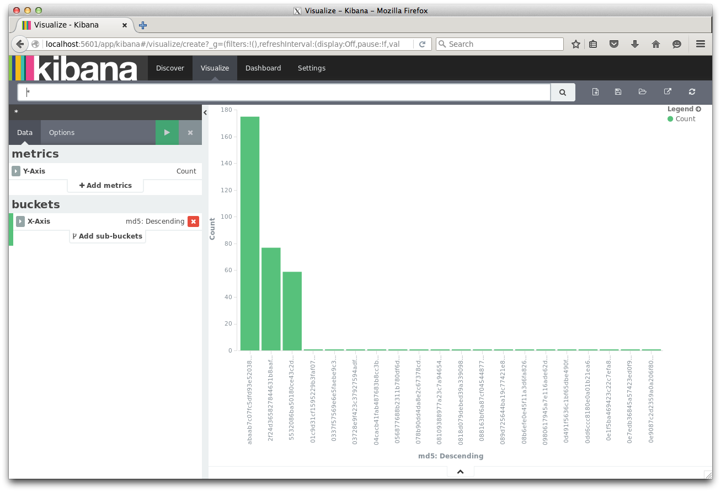

Run data analytics on maps.
Compute checksum and use Elastic Search & Kibana.
Frequency distribution
of checksums
Notes:
To find useful data from a huge collection of HDF4 in OSDC, I ran an elastic search on chunks and visually inspected the frequency distribution of checksums with Kibana after computing MD5 checksum of each chunk.
MD5 checksum on individual chunk is not provided by h4mapwriter yet, so I created a separate script in Python.

Slide 14
Some chunks are repeated.
A single HDF4 file has 160+ chunks of same data.
Chunks with the same checksum have the same data
Notes:
Running some analytics on HDF4 file using the HDF4 map was very fun.
It revealed that the same chunk of data is repeated within a HDF4 file.

Slide 15
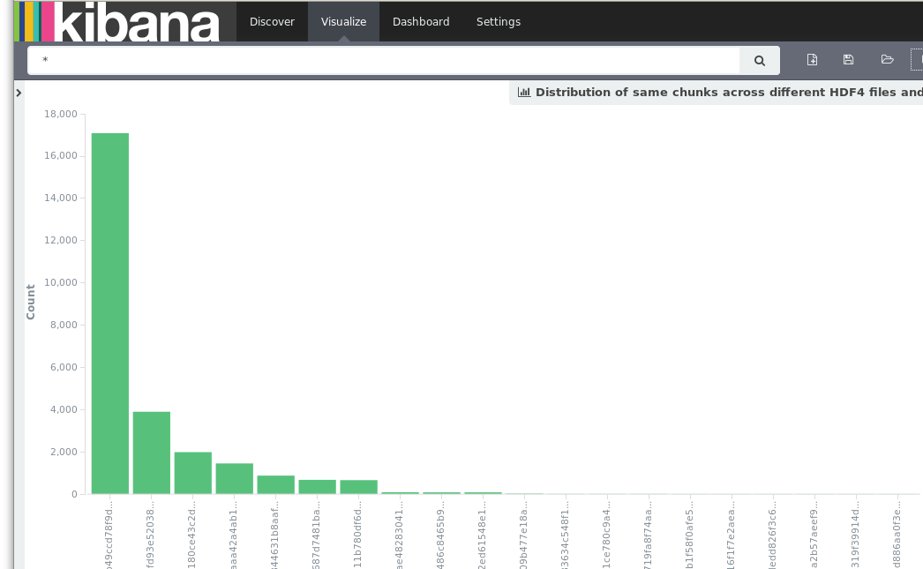
At collection level, it scales up.
Hundreds of HDF4 files have the 16K chunks of same data.
Notes:
At collection level, it scales up nicely.
Hundreds of HDF4 files have the 16K chunk of same data.
This makes sense because some observations from the Earth will be same for a long period of time.

Slide 16
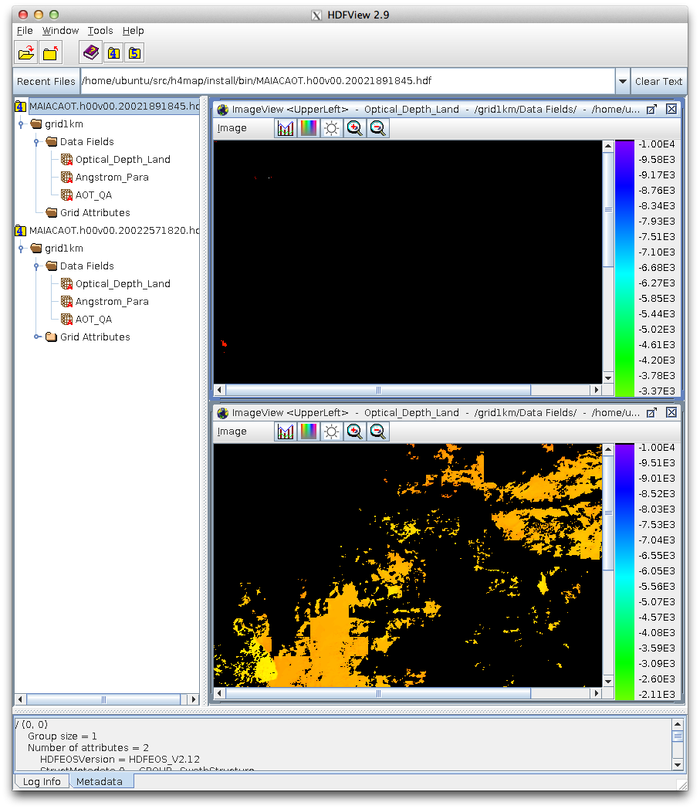
Elastic search with maps
.. can help users locate the HDF4 file of interest.
Nothing interesting
Most interesting
Notes:
Once index is built with Elastic Search, I can easily run query to find a dataset that I’m interested in using the byte size information.
For example, I could sort the dataset size from the smallest to the largest over hundreds of HDF4 files.
As expected, the smallest byte size dataset showed almost nothing when it is visualized with HDFView.
The largest byte size dataset returned a colorful image.

Slide 17
Store chunks as cloud objects
Reduce storage cost (e.g., S3) by avoiding redundancy.
Make each chunk searchable through search engine.
Run cloud computing on chunks of interest.
Notes:
Based on the HDF4 map information, I learned that it is possible to re-organize the entire collection of HDF4 data to optimize the use of cloud storage.
If you optimize data organization, ETL time for cloud computing will be shortened and the cost of storage will be also reduced.
If you can build search engine on top of those objects, advanced HDF4 users can run cloud computing directly on HDF chunks of their interest after filtering out irrelevant data based on the search result.
Users can always transform HDF chunks into other format such as Apache Parquet or JSON to meet their cloud computing needs.

Slide 18
Shallow Web is not Enough
NASA Earthdata search is too shallow.
Index HDF4 data using maps and make deep web.
Provide search interface for the deep web.
Frequently searched data can be cached as cloud objects.
Users can run cloud computing on cached objects in RT.
Verify results with HDF4 archives from NASA data centers.
Notes:
From the Elastic Search experiment with HDF4 map, now I have a new wish list for NASA Earthdata search.
Although I like the new and improved NASA Earthdata search, I still think it’s too shallow because it does not index what’s inside from granules.
If Earthdata search can index HDF4 maps and provide search interface, collection at the chunk level can be returned to a user’s query.
I’d like to call such search service as deep web search.
For a chunk collection that deep web search returns, user can stream chunks to user’s cloud storage.
Here, the key is to deliver chunk collection to user’s cloud service provider.
Downloading the entire HDF4 data does not make sense in this workflow.
Then, user can run his analytics job using cloud computing on the streamed chunks.
If necessary, users can go back to the original HDF4 archives and run the same analytics if necessary using the traditional off-cloud method.

Slide 19
HDF: Antifragile Solution for BACC
(BACC= Bigdata Analytics in Cloud Computing)
Use HDF archive as is. Create maps for HDF.
Maps can be indexed and searched.
ELT (Extract Load Transform) only relevant data into cloud from HDF.
Offset/length based file IO is universal - all existing BACC solutions will work. No dependency on HDF APIs.
Notes:
In summary, data archived in HDF is ready for big data analytics for certain access patterns that data producers prescribed.
The prescribed pattern may not match exactly what users need. For such use case scenario, HDF maps can be indexed and searched to identify relevant pieces from HDF.
I call it anti-fragile solution because any big data analytics solution in any computer language in any cloud computing environment will work. For example, I could read data over network in PHP language using Apache web server that supports byte-range and it worked pretty nicely. I picked PHP because PHP binding doesn’t exist for HDF. Relying on a single monolithic library to access data is too fragile.

Slide 20
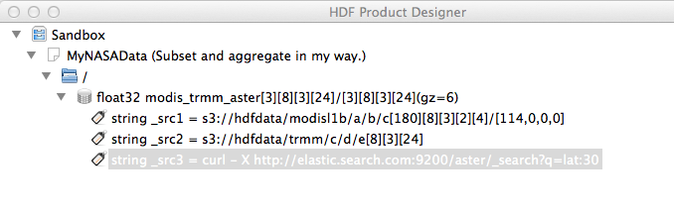
Future Work
HDF5 Mapping Project?
Use HDF Product Designer for archiving cloud objects and analytics results in HDF5.
Re-map: To metadata is human, to data is divine: For the same binary object, user can easily re-define meaning of data, re-index it, search, and analyze it. (e.g., serve the same binary data in Chinese, Spanish, Russian, etc.)
Notes:
You may wonder if the same solution can be applied to HDF5 or netCDF4.
Unfortunately, there is no HDF5 mapper tool yet.
How can a user save a collection of chunks in HDF5 easily for future use? I think HDF Product Designer is a good candidate for creating a new HDF5 from chunk objects in cloud. It can play a role of h4toh5 conversion tool with on-demand collection level subset/aggregation capability.
Finally, the HDF4 map idea has a great potential as flexible metadata solution. While binary is forever, metadata doesn’t have to be. If you re-map the same binary data with a different dialect, you can serve wider community that understands the dialect. One example is rewriting HDF4 file content map in different languages. Then, international users can discover and access Earthdata more easily.
Thank you for listening and I hope that you can use HDF4 map wisely in your next cloud computing project.
Do you have any question?

Slide 21

This work was supported by NASA/GSFC under Raytheon Co. contract number NNG15HZ39C

