Slide 1
Incorporating ISO Metadata Using HDF Product Designer
Aleksandar Jelenak, John Kozimor, Ted Habermann
The HDF Group
This work was supported by NASA/GSFC under Raytheon Co. contract number NNG15HZ39C

Slide 2
The Problem
The need for more contextual data (metadata) in HDF5 files is growing.

Slide 3
The Solution
Use the current conventions to the their fullest extent.
Store the rest of metadata using the ISO 19115 standards.

Slide 4
HDF Product Designer Can Help
Support for the most widely used Earth science metadata conventions.
The latest release (v1.4) allows import of ISO metadata objects into user designs.

Slide 5
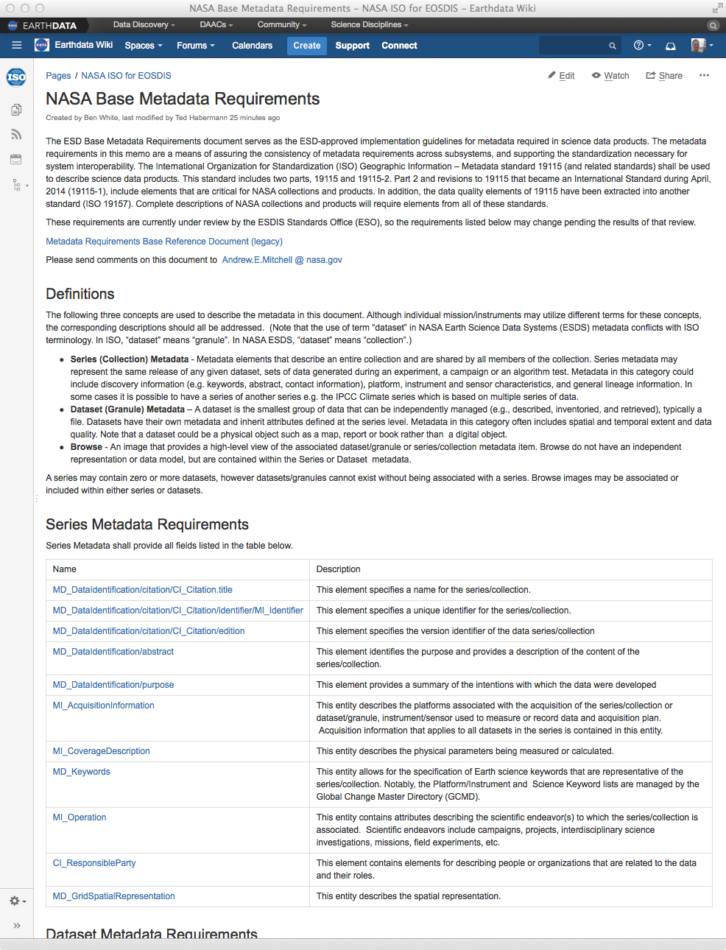
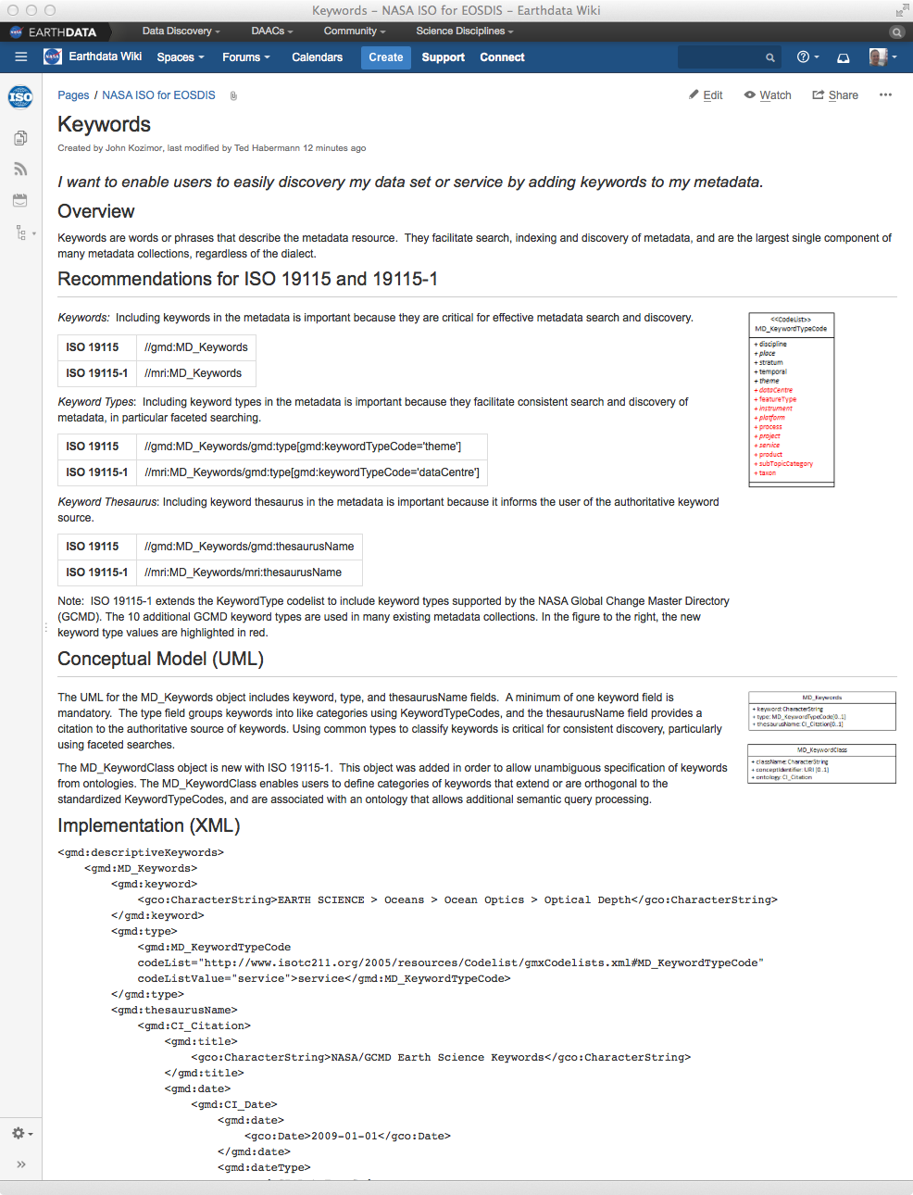

https://wiki.earthdata.nasa.gov/x/qorT
Use Case
Overview
Recommendations
Conceptual Model (UML)
Implementation (XML)
Implementation (NcML)
  HPD Design Name
Usage (UMM)
Crosswalks

Slide 6
Convention Support

Slide 7
Convention Support

Slide 8
Importing ISO Objects
Separate project with pre-built
ISO metadata components.

Slide 9
Importing ISO Objects
All groups in the ISO design have default role and type attributes. Do not change these!
Repeating roles have "_<uniqueID>" added to their names

Slide 10
Export As…
JSON
Export
Python,
MATLAB,
IDL
code
HDF5
Template
File

Slide 11
Sample of Python Code
# Group: /gmi:acquisitionInformation
grp_1 = f.create_group('gmi:acquisitionInformation')
# Creating attributes for /gmi:acquisitionInformation
grp_1.attrs['role'] = "gmi:acquisitionInformation"
grp_1.attrs['type'] = "gmi:MI_AcquisitionInformation"
# Group: /gmi:acquisitionInformation/gmi:instrument
grp_2 = grp_1.create_group('gmi:instrument')
# Creating attributes for /gmi:acquisitionInformation/gmi:instrument
grp_2.attrs['role'] = "gmi:instrument"
grp_2.attrs['type'] = "gmi:MI_Instrument"
grp_2.attrs['id'] = "instrument_1"
# Group: /gmi:acquisitionInformation/gmi:instrument/gmi:citation
grp_3 = grp_2.create_group('gmi:citation')
# Creating attributes for /gmi:acquisitionInformation/gmi:instrument/gmi:citation
grp_3.attrs['role'] = "gmi:citation"
grp_3.attrs['type'] = "gmd:CI_Citation"
grp_3.attrs['id'] = "fgdccitation_26722.114902.35002"
# Group: /gmi:acquisitionInformation/gmi:instrument/gmi:citation/gmd:date
grp_4 = grp_3.create_group('gmd:date')
# Creating attributes for /gmi:acquisitionInformation/gmi:instrument/gmi:citation/gmd:date
grp_4.attrs['role'] = "gmd:date"
grp_4.attrs['type'] = "gmd:CI_Date"

Slide 12
HDF5 Template File
Keyword values in HDF5

Slide 13

This work was supported by NASA/GSFC under Raytheon Co. contract number NNG15HZ39C

