Slide 1
HDF Project Update
The HDF Earth Science Project Team
The HDF Group
Champaign Illinois USA

Slide 2
HDF Group Mission
To provide high quality software for managing large complex data,
to provide outstanding services for users of these technologies,
and
to insure effective management of data throughout the data life cycle.

Slide 3
The HDF Group Services
Core software maintenance and distribution
Helpdesk and Mailing Lists
Priority Support
Enterprise Support
Consulting
Training
Special Projects
Notes:
Helpdesk and Mailing Lists
Available to all users as a first level of support
Standard Support
Rapid issue resolution and advice
Consulting
Needs assessment, troubleshooting, design reviews, etc.
Training
Tutorials and hands-on practical experience
Enterprise Support
Supporting many HDF activities across organizations
Special Projects
Adapting customer applications to HDF
New features and tools
Research and Development

Slide 4
Funding
Earth Science
High Performance Computing
High Speed Detectors
Various

Slide 5
























Funding
Earth Science
High Performance Computing
High Speed Detectors
Various
Notes:
NASA – EOS
NOAA/NASA/Riverside Tech – NPOESS/JPSS
A leading U.S. aerospace company
DOE projects
Sandia National Laboratory
Lawrence Berkeley National Lab
Argonne
ITER – international project to build an experimental fusion reactor based on the tokamak concept
Paul Scherrer Institute – variety of projects
Projects in oil and gas industry, finance, others
“In kind” support

Slide 6
Revenues by source

Slide 7
Technical activities
Technical operations
Support
Core software
Library and tools
Applications
QA
Maintenance
HPC
Projects
Connectors
Earth Science
ESDIS
JPSS
Others (ISO, GeoTIFF, etc.)
HDF Server

Slide 8
Earth Science activities
Notes:
For other work in earth science area, see later talk, “HDF Group Support for NPP/NPOESS/JPSS”

Slide 9
ESDIS
Notes:
HDF development work
OPeNDAP handler development
Code maintenance
HDF4, HDF5, HDFView, OPeNDAP handlers, etc.
H4H5 conversion library and utilities
Special tools, such as the HDF-EOS5 augmentation tool, the HDF-EOS2 dumper tool, the HDF-EOS5 to netCDF-4 converter tool and the HDF4/HDF-EOS2 to CF conversion library
HDF Support
Support to programmers and analysts and other EOS science software teams, tool vendors and other tool builders
Help EOS stakeholders (DAACs, SIPs, vendors, etc.)
Site visits to NASA data centers, SIPS and others
Communicating with the NASA User Service Working Group (USWG) and NASA ESDIS outreach managers
Helping NASA scientific applications to access and manage EOS data.
Participation in Earth Science conferences such as AGU, AMS, ESDSWG and ESIP Federation meetings
Helpdesk and newsletter
Tutorials and workshops
HDF and HDF-EOS websites
Studies, analyses, etc.
Investigate data catalog servers and integration with web service technologies
HDF4 content maps for archiving

Slide 10
HDF-EOS website: http://hdfeos.org
HDF-EOS support
  Daily forum
  eoshelp@hdfeos.org
  StackOverflow
Demos and examples
HDF-EOS tools
Steady Traffic: 3,500 visitors/month

Slide 11
Examples
Updated tool examples
  PyHDF
  H4CF
github.com/hdfeos:
  a collection of forked repositories related to HDF technology
Comprehensive examples
  Python
  OCO-2
  MATLAB/IDL/NCL examples requested by users
Send us your tools and examples.
What tools/examples would you like to see?

Slide 12
Web services
Demo servers
  OPeNDAP – HDF handlers with CF option
  THREDDS – catalog / h4map / h5json / cf checker
What kinds of web services would you like to see at HDF-EOS.org?
Send us your new NASA products for demo.
Notes:
New products TRMM 7, GPM,

Slide 13
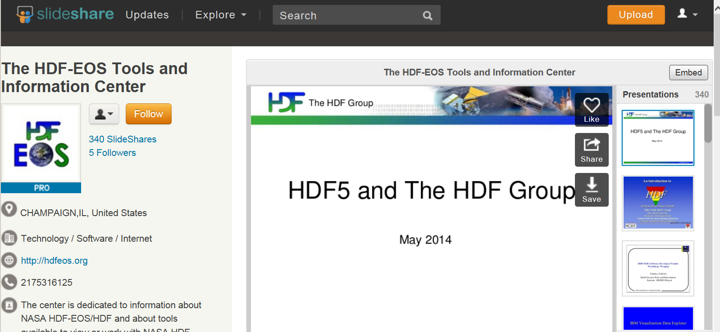
Slideshare
All workshop slides available through SlideShare
49,000 views in 2015

Slide 14
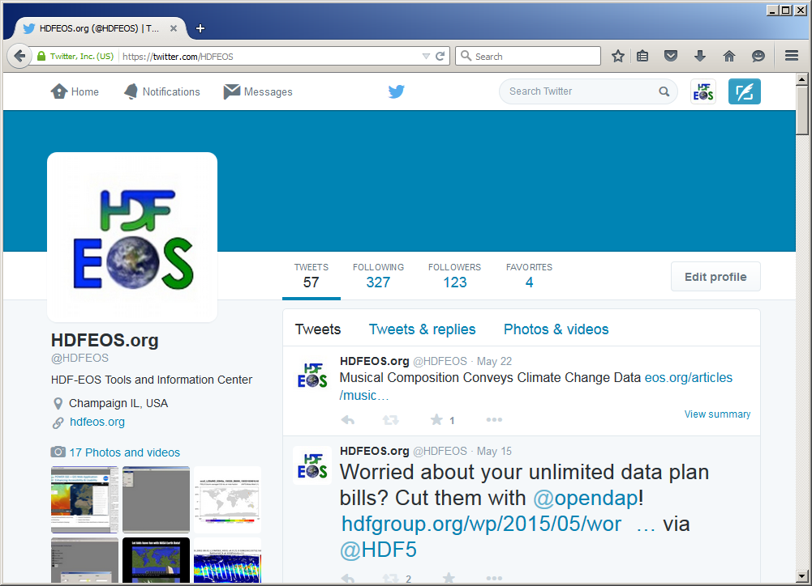
Follow us on twitter: @HDFEOS

Slide 15
EOS-related Tools Maintained
H4CF Conversion Toolkit
H4toh5 Conversion Library and Tools
HDF-EOS2 dumper
HDF-EOS5 augmentation
OPeNDAP Hdf4_handler
OPeNDAP Hdf5_handler
HDF-Java/HDFView
Notes:
HDF4 to HDF5 migration is a key recurring theme for us.

Slide 16
Other ESDIS
HDF5 Product Designer
CERES HDF4 to HDF5 migration
HDF4-to-CF conventions spec
ESDSWG Dataset Interoperability (DIWG)
Maintenance, QA, user support
Assist with HDF-EOS software maintenance

Slide 17

JPSS

Slide 18
JPSS Tool Development
nagg (aggregation)
h5augjpss (augmentation)
h5edit (attribute editor)
Compression/chunking performance tool
Notes:
Compression/chunking performance tool to help assess how compression and chunking parameters impact file access performance,

Slide 19
JPSS Studies
Compression for NPP products
Web services for NPP (THREDDS, OPeNDAP)
Assessing NPP metadata conventions, standards

Slide 20
JPSS other
Tutorial on how to use the HDF5 tools to examine JPSS/S-NPP files: hdfgroup.org/HDF5/Tutor/tools-jpss.html
Maintenance on NASA AIX system
Regression testing for S-NPP files
User support
Notes:
Regression testing for S-NPP files. We automatically pull down new S-NPP files and test against various HDF5 tools to make sure there are no issues with our tools and library.

Slide 21



Other earth science

Slide 22
Other
GeoTIFF - standardization
ISO TC 211 – Geographic metadata standardization
CH2MHill Polar Services - metadata
DIBBs
  Develop and promote tools to help communities improve their metadata
  Help enable broader use of their data

Slide 23
Support, Maintenance,
Quality Assurance, etc.

Slide 24
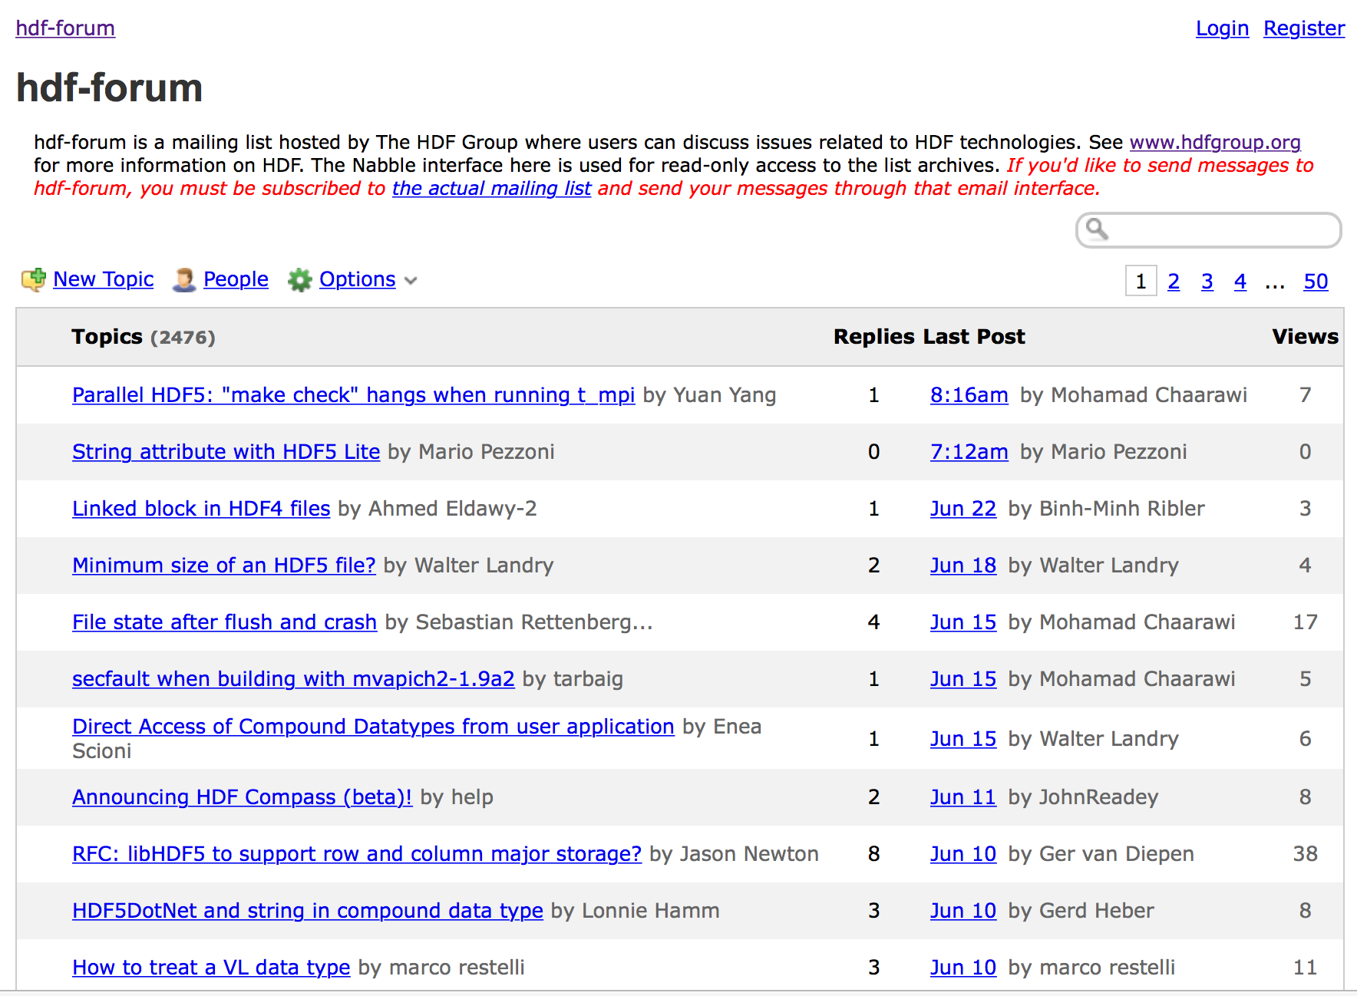
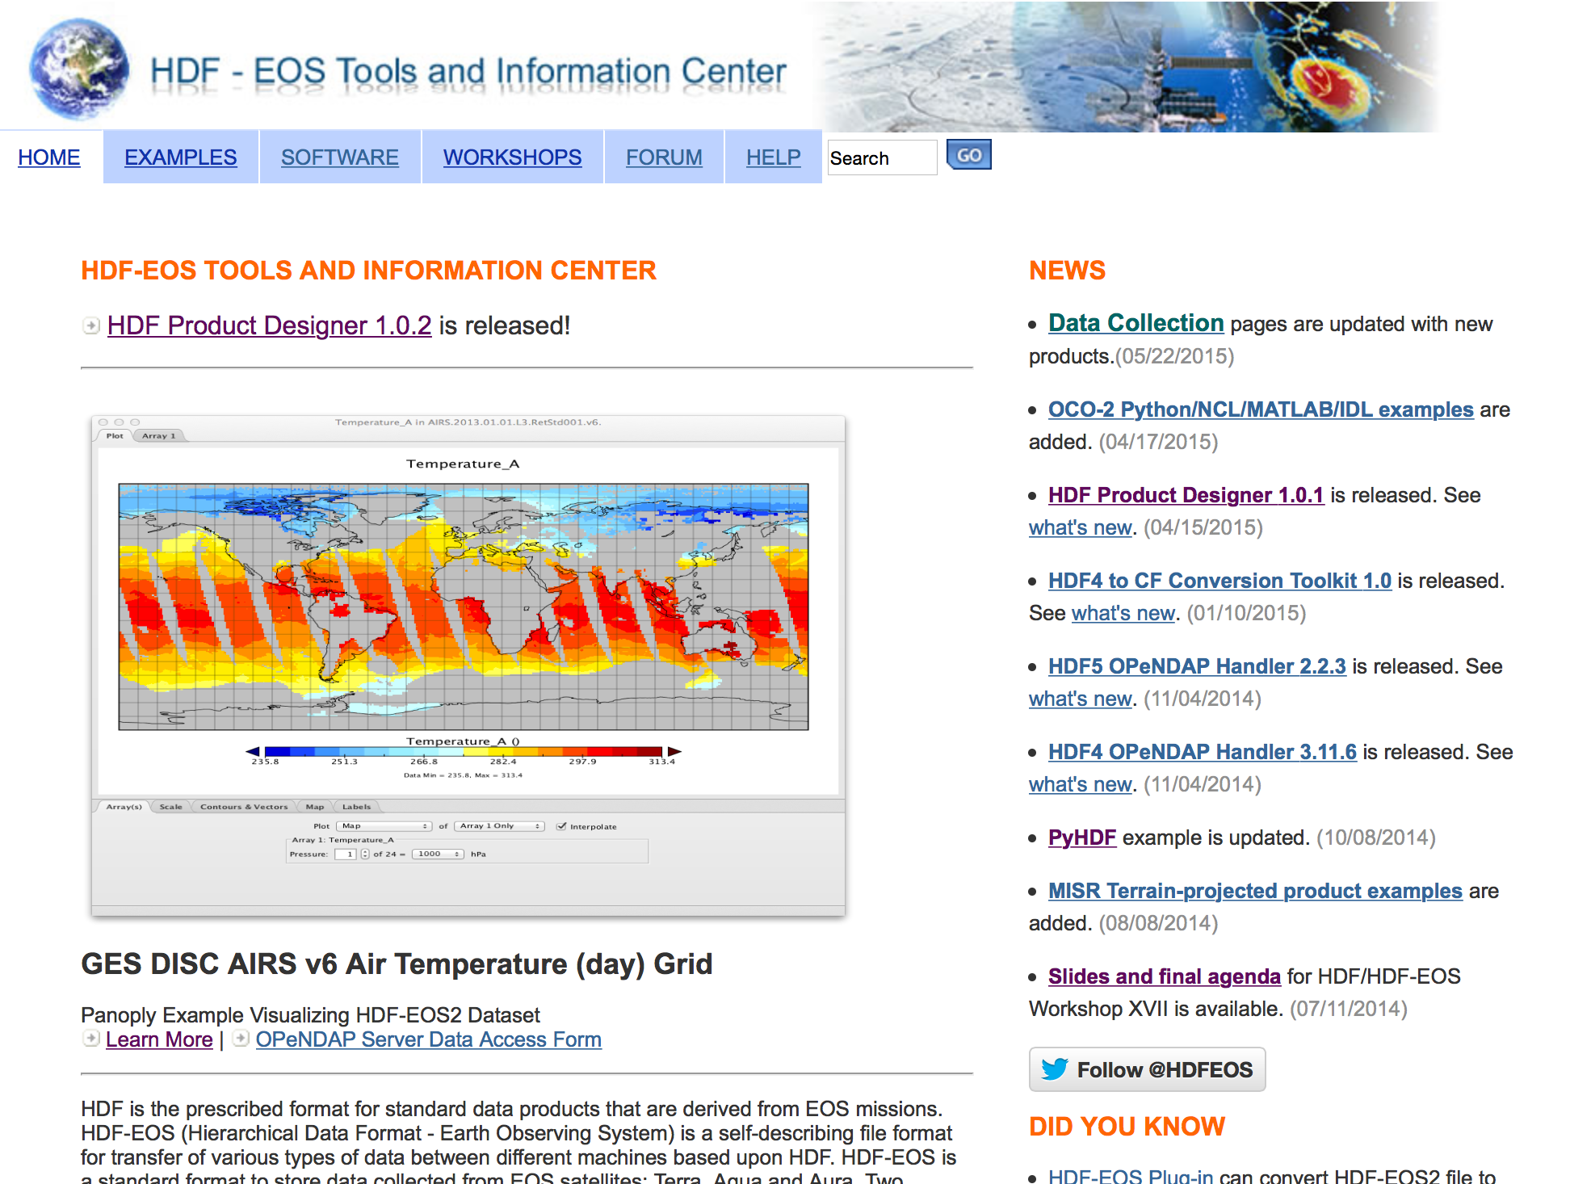
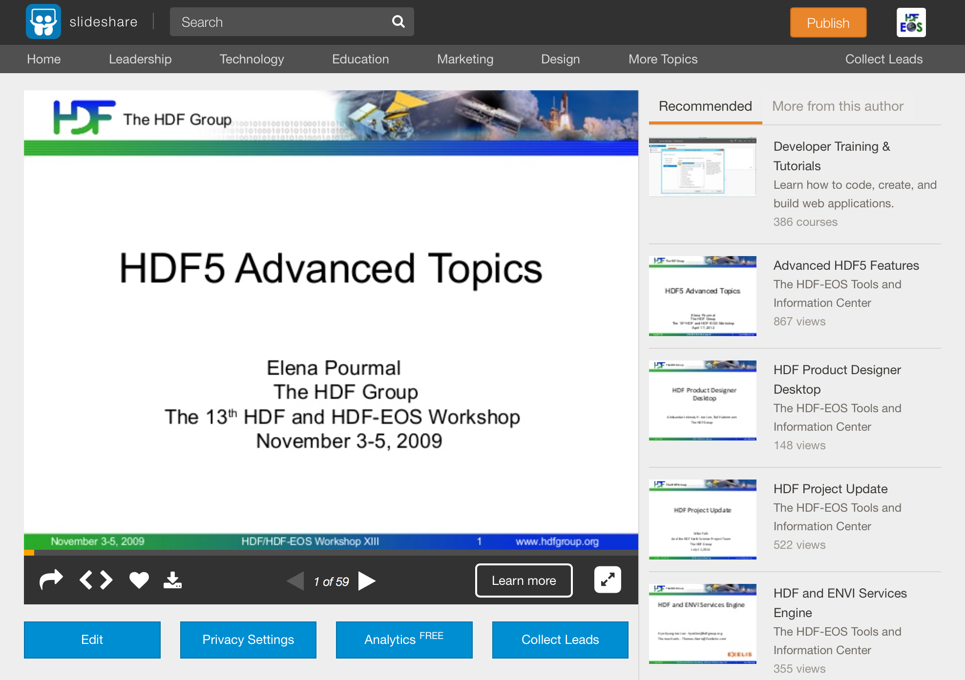
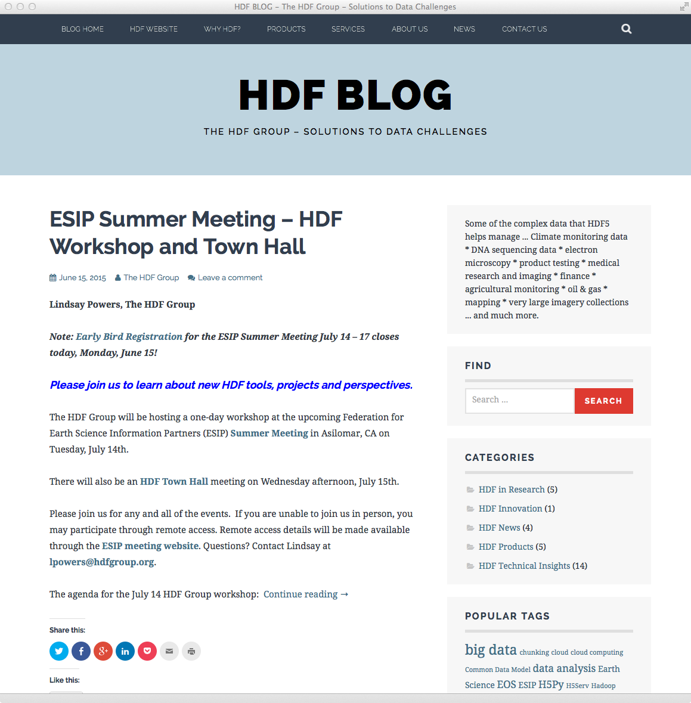
User Support

Slide 25
Tools
HDF4 and HDF5 command-line tools
HDFView
(Compass is separate)

Slide 26
What are your favorite tools?
Enhancements?
What’s missing?
Pain points?

Slide 27
What about languages?
Whither Java?
Python?
Favorite languages?
Concerns?
Enhancements, pain points?

Slide 28
HDF release activities

Slide 29
Library and tool releases
New features
Performance enhancements
OS and compiler support added and deprecated
Configuration management improvements
Bug fixes
We need your input on priorities!

Slide 30
Release schedules
At regular intervals, with occasional extra releases as needed.
HDF4
  Every February
HDF5
  Every May and November
Java
  Usually every November or December

Slide 31
Platform support

Slide 32
HDF4 Platforms Supported
OS | Compilers
Linux 2.6 PPC64 | GNU C and Fortran 4.4.7, IBM XL Fortran V15.1
Linux 2.6 x86_64 CentOS-6.5 32 and 64-bit modes | GNU C and Fortran 4.4.7 Intel C and Fortran v. 15.0.1 PGI C and Fortran v. 14.10
Linux 3.10.0 x86_64 CentOS-7 | GNU C and Fortran 4.8.2
Linux Debian 7.5, Fedora20, SUSE13.1, Ubuntu 14.04 | GNU C and Fortran (system defaults)
SunOS 5.11 | Sun C 5.12 and Fortran 8.6
Windows 7 32 and 64-bit, Windows 8, Cygwin_ NT-6.1.1.7.25 | VS 2008, 2010, 2012, 2013 Intel 14, GNU C and Fortran 4.8.3
Mac OS X Intel 10.7.5, 10.8.5, 10.9.5 32/64-bit | Apple clang v 6.0 and gfortran 4.8.2; Intel C and Fortran 15.0.1
http://www.hdfgroup.org/release4/platforms.html
Notes:
The slide outlines OSs and versions of the compilers used to test the latest public release HDF 4.2.11 in February 2015

Slide 33
HDF5 Platforms Supported
OS | Compilers
Same as for HDF4 | Same as for HDF4
AIX 6.1 | IBM XL C 10.1.0.5 and Fortran 12.1.0.6, gmake v3.82
Mac OS X Yosemite 10.10.2 | Apple clang/clang++ version 6.0 gfortran GNU Fortran (GCC) 4.9.2 Intel icc/icpc/ifort version 15.0.1
Cray Linux Environment | GNU C, C++ and Fortran v.4.9.2
FreeBSD 8.2-STABLE | GNU C, C++, Fortran 4.6.1
http://www.hdfgroup.org/HDF5/release/platforms5.html
Notes:
The slide outlines OSs and versions of the compilers used to test the latest public release HDF5 1.8.13 in May 2014. We support VS2008 on Windows for H5Py. Windows and Mac OS X have slightly updated versions of compilers

Slide 34
Platforms to be dropped
OS | Last release
Mac OS X 10.8 | HDF 4.2.12 Feb 2016 HDF5 1.8.16 Nov 2015

Slide 35
Platforms/compilers to be added
OS | Comment
Mac OS X 10.11 | For HDF4 and HDF5 releases in 2016
Compilers | Comment
GNU C/C++ 5.* | For HDF4 and HDF5 releases in 2015 and 2016
We use virtualization.
Can add any Linux or Windows flavors.
Just let us know!

Slide 36
HDF5 1.10

Slide 37
New capabilities in HDF5 1.10

Slide 38
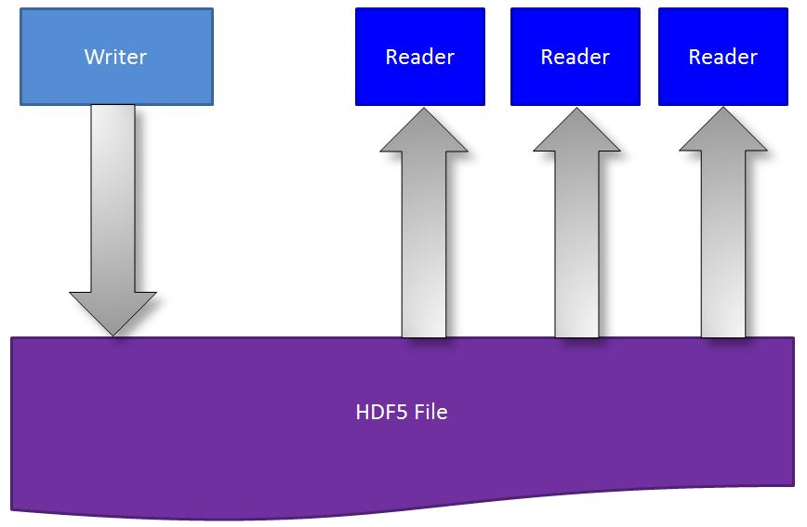
Concurrent Read/Write File Access
  Single Writer/Multiple Readers (SWMR)
  Simultaneous reading from the file while the file is being modified by another process

Slide 39
H5watch tool
Allows users to monitor when new records are appended to a dataset.
Uses SWMR

Slide 40
Virtual Dataset

Slide 41
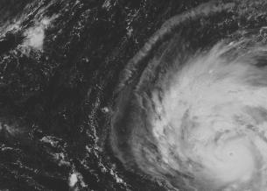
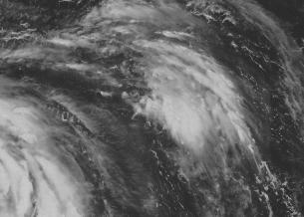


Collect data one way ….
File: a.h5
Dataset /A
File: b.h5
Dataset /B
File: c.h5
Dataset /C
File: d.h5
Dataset /D

Slide 42
Want your users to see the it all together…
File: F.h5
Dataset /D
Notes:
Virtual dataset stores a mapping for each quadrant to data stored in the source HDF5 files and datasets a-d.h5. Application can read the whole image from dataset /D using regular H5Dread call. It doesn’t need to know the mapping in order to read data.

Slide 43
Virtual Dataset
Allows you to describe and access data stored across many HDF5 files as if it all consists of a single dataset.
Notes:
43

Slide 44
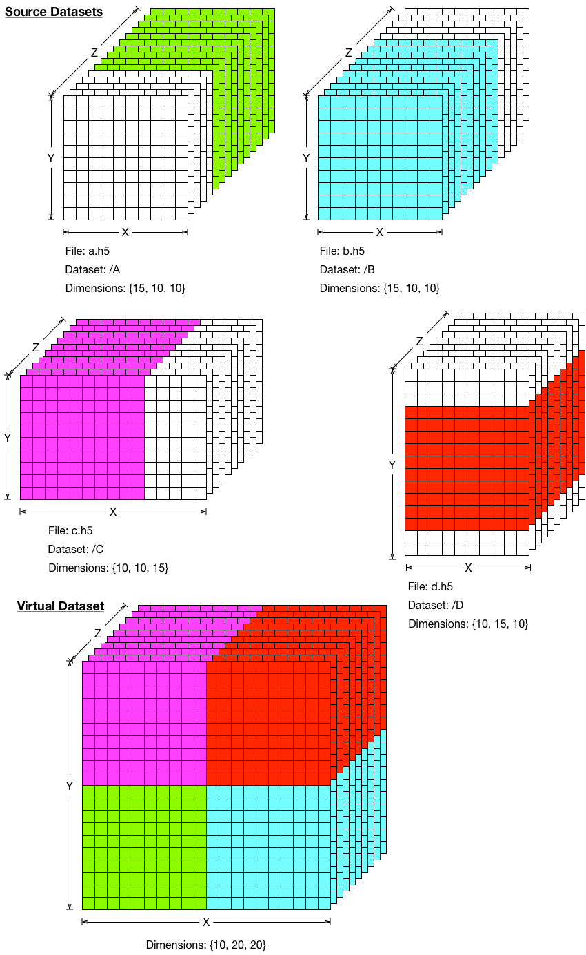
VDS Example

Slide 45
Other 1.10 capabilities
https://blog.hdfgroup.org/
hdf-forum@hdfgroup.org
Scalable chunk indexing
Improvements to parallel HDF5
Read our blog and join HDF FORUM for more info

Slide 46
HDF5 1.10.0 Release Timeline
First alpha on October 31, 2015
Full release on March 31, 2016

Slide 47
The HDF business

Slide 48
Business is booming…
$

Slide 49
Business is booming… and busting
$

Slide 50
Strategic Options

Slide 51
Some strategic options
Run faster, in the same direction
Increase community involvement
Rethink the HDF value proposition

Slide 52
Some strategic options
Run faster, in the same direction
Increase community involvement
  Research Coordination Network
  Compass
  GitHub
  Outreach (Social media, etc.)
  Etc.
Rethink the value proposition

Slide 53
Some strategic options
Run faster, in the same direction
Increase community involvement
Rethink the HDF value proposition

Slide 54
HDF Strategic Plan
April, 2014

Slide 55
Industry and customer themes support HDF growth opportunities
Industry says:
Data is expanding
Data is becoming more complex
Data is only useful if it can be easily accessed
Customers say:
HDF is the right solution
Especially for complex structured data
  …….but, it is too hard to use for most

Slide 56
Industry and customer themes support HDF growth opportunities
Industry says:
Data is expanding
Data is becoming more complex
Data is only useful if it can be easily accessed
Customers say:
HDF is the right solution
Especially for complex structured data
  …….but, it is too hard to use for most

Slide 57
The core opportunity is to simply ‘make HDF easier’
HDF Made Easy
Training
End to end Services
Customer Support
Enterprise Services

Slide 58
Specific Strategic Option Themes
Enhanced Services
  HDF University
  Premium Customer Support
  HDF Vertical Solutions
End-to-End Data Services
  HDF Cloud
  HDF Data Collector/On-boarding Services
  Connectors to Analytical Tools
  HDF Viewer
Skunk Works
  Crowdfund New Features
  HDF Marketplace

Slide 59
Specific Strategic Option Themes
Enhanced Services
  HDF University
  Premium Customer Support
  HDF Vertical Solutions
End-to-End Data Services
  HDF Cloud
  HDF Data Collector/On-boarding Services
  Connectors to Analytical Tools
  HDF Viewer
Skunk Works
  Crowdfund New Features
  HDF Marketplace

Slide 60
Things in the pipeline – baby steps
Excel add-in
ODBC driver
Spark and related
HDF server
  Basic capabilities
  NOAA Big Data Initiative
  Data provenance and multi-level security
  Financial archive
Notes:
:

Slide 61
Then someday..

Slide 62


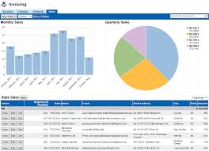
Fully managed data services solutions
Data/Meta Data schema to H5 services and tools
Connectors/
Plug-ins
Other files systems
Streaming Data Collector
HDF Cloud
.H5 + advanced features
Fully managed service
Flat monthly fee
Delivered with cloud partners
Internet of Things, sensor data
Value Proposition
Make it extremely easy and cost effective to get on-board with HDF, load data into HDF smart containers share data with scientists and get data out of HDF into other databases and tools.
BI/Visualization Tools
Bulk Data Import

Slide 63
Recommendation:
Create start-up entity to commercialize HDF technologies
HDF Group: Not for Profit
NewCo: For Profit Start-up Company
License start-up commercial rights
Royalty revenue, equity ownership

Slide 64

This work was supported by NASA/GSFC under Raytheon Co. contract number NNG10HP02C

Slide 65
Questions for you
HDF-EOS website demos and examples
  Send us your tools and examples.
  What tools/examples would you like to see?
  What kinds of web services would you like to see?
  Send us your NASA products for demo.
HDF tools
  Your favorite tools?
  Enhancements?
  What’s missing?
What about languages
  Whither Java?
  Favorite languages?
  Concerns?
  Enhancements?
OS’s and compilers
  What’s important to drop? To keep?

