Slide 1
The HDF Group: Community models and outreach
Lindsay Powers
The HDF Group
ESIP Summer 2015 HDF Workshop

Slide 2
HDF: A great sharing platform
Traditionally HDF has been thought of as an excellent platform for complex, large data in High Performance Computing environments.
However…
The HDF platform is also ideal for sharing intra and cross-disciplinary scientific data because it is self-describing, flexible, and allows incorporation of extensive metadata to improve the usability and understanding of the data by non-expert users.

Slide 3
HDF Engagement Goals
Helping communities and facilities improve metadata to facilitate data sharing, use, understanding and preservation.
Creating tools that remove barriers to sharing and using data.
Bringing together communities that share information, experience, and expertise
Provide education and training opportunities in HDF technologies
Establish sustainability for HDF technologies

Slide 4
HDF Community Building
Tool development in response to community needs
HDF (hdfgroup.org) and HDF-EOS (hdfeos.org) websites
NASA EOS Missions, DAACs and Users
HDF Forum
HDF Blog – community members encouraged to contribute
HDF workshops
Potential NSF Research Coordination Network
  Workshops
  Webinars
  Training modules
NSF DIBBs Project “Beyond Data Discovery: Shared Services for Community Metadata Improvement”

Slide 5
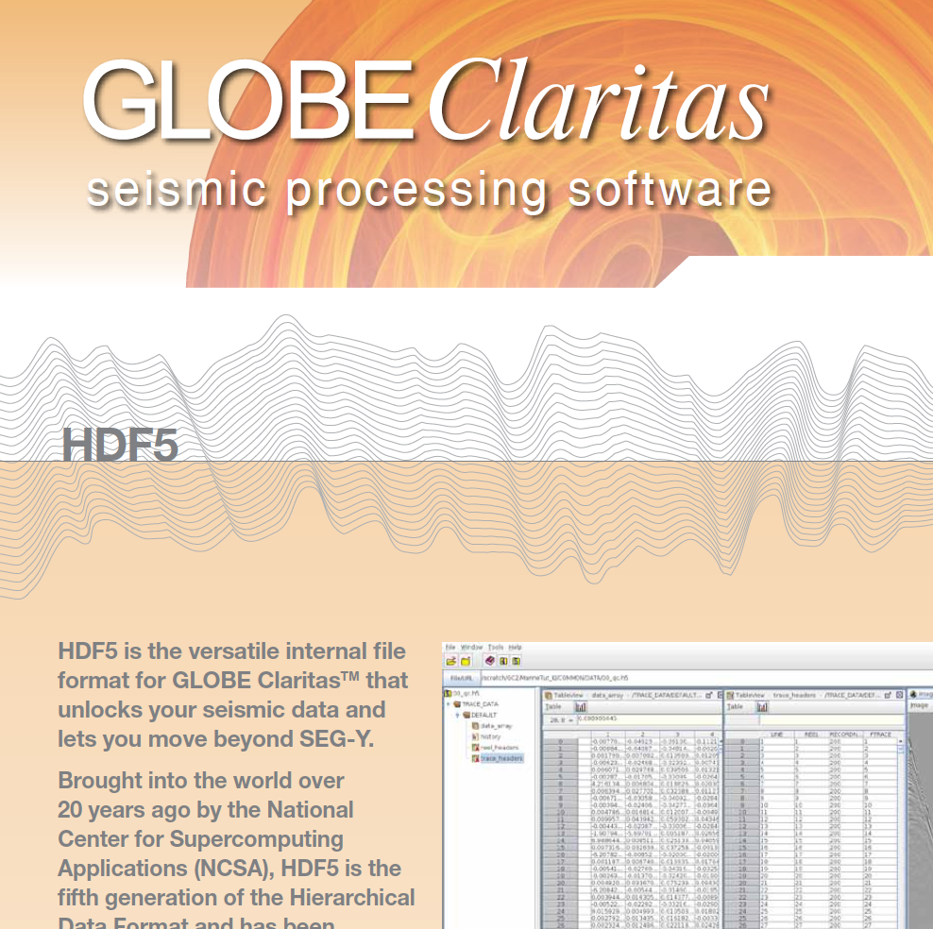
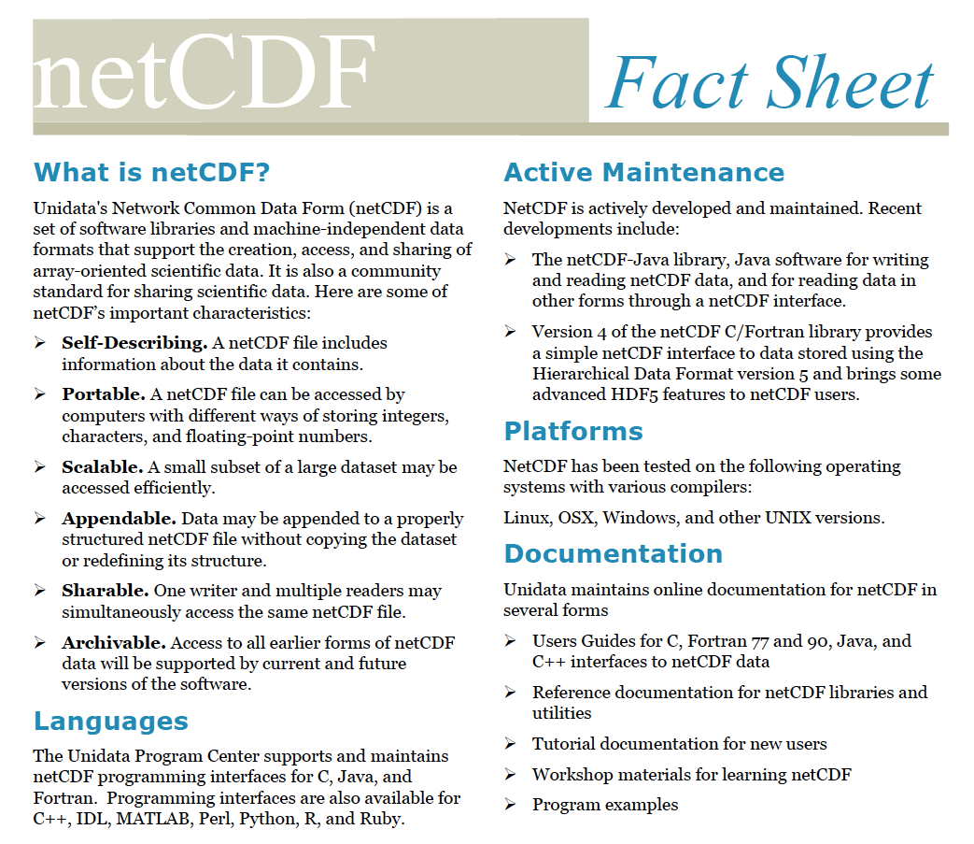
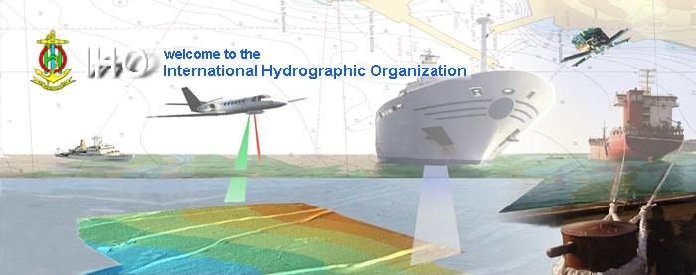
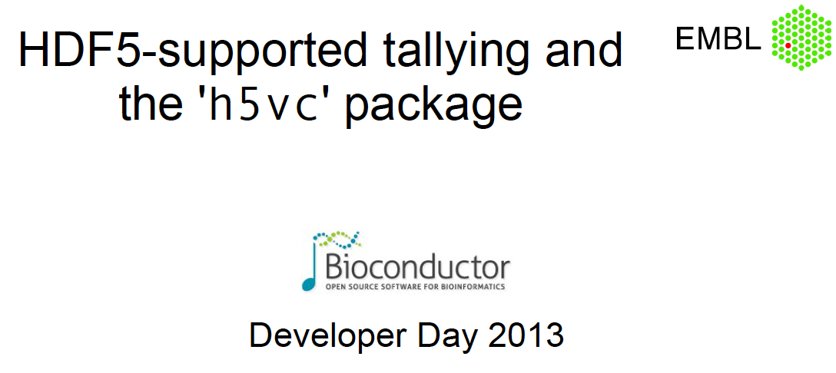
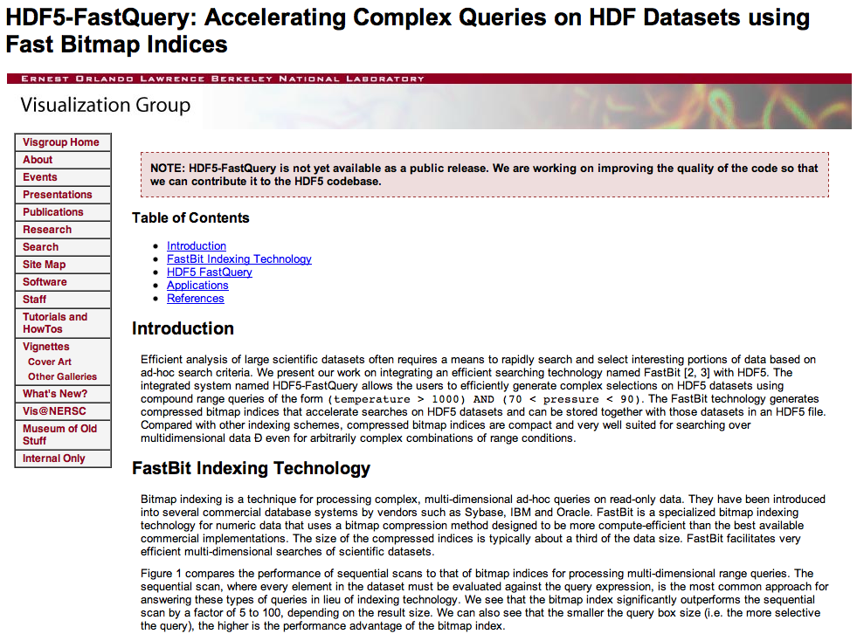
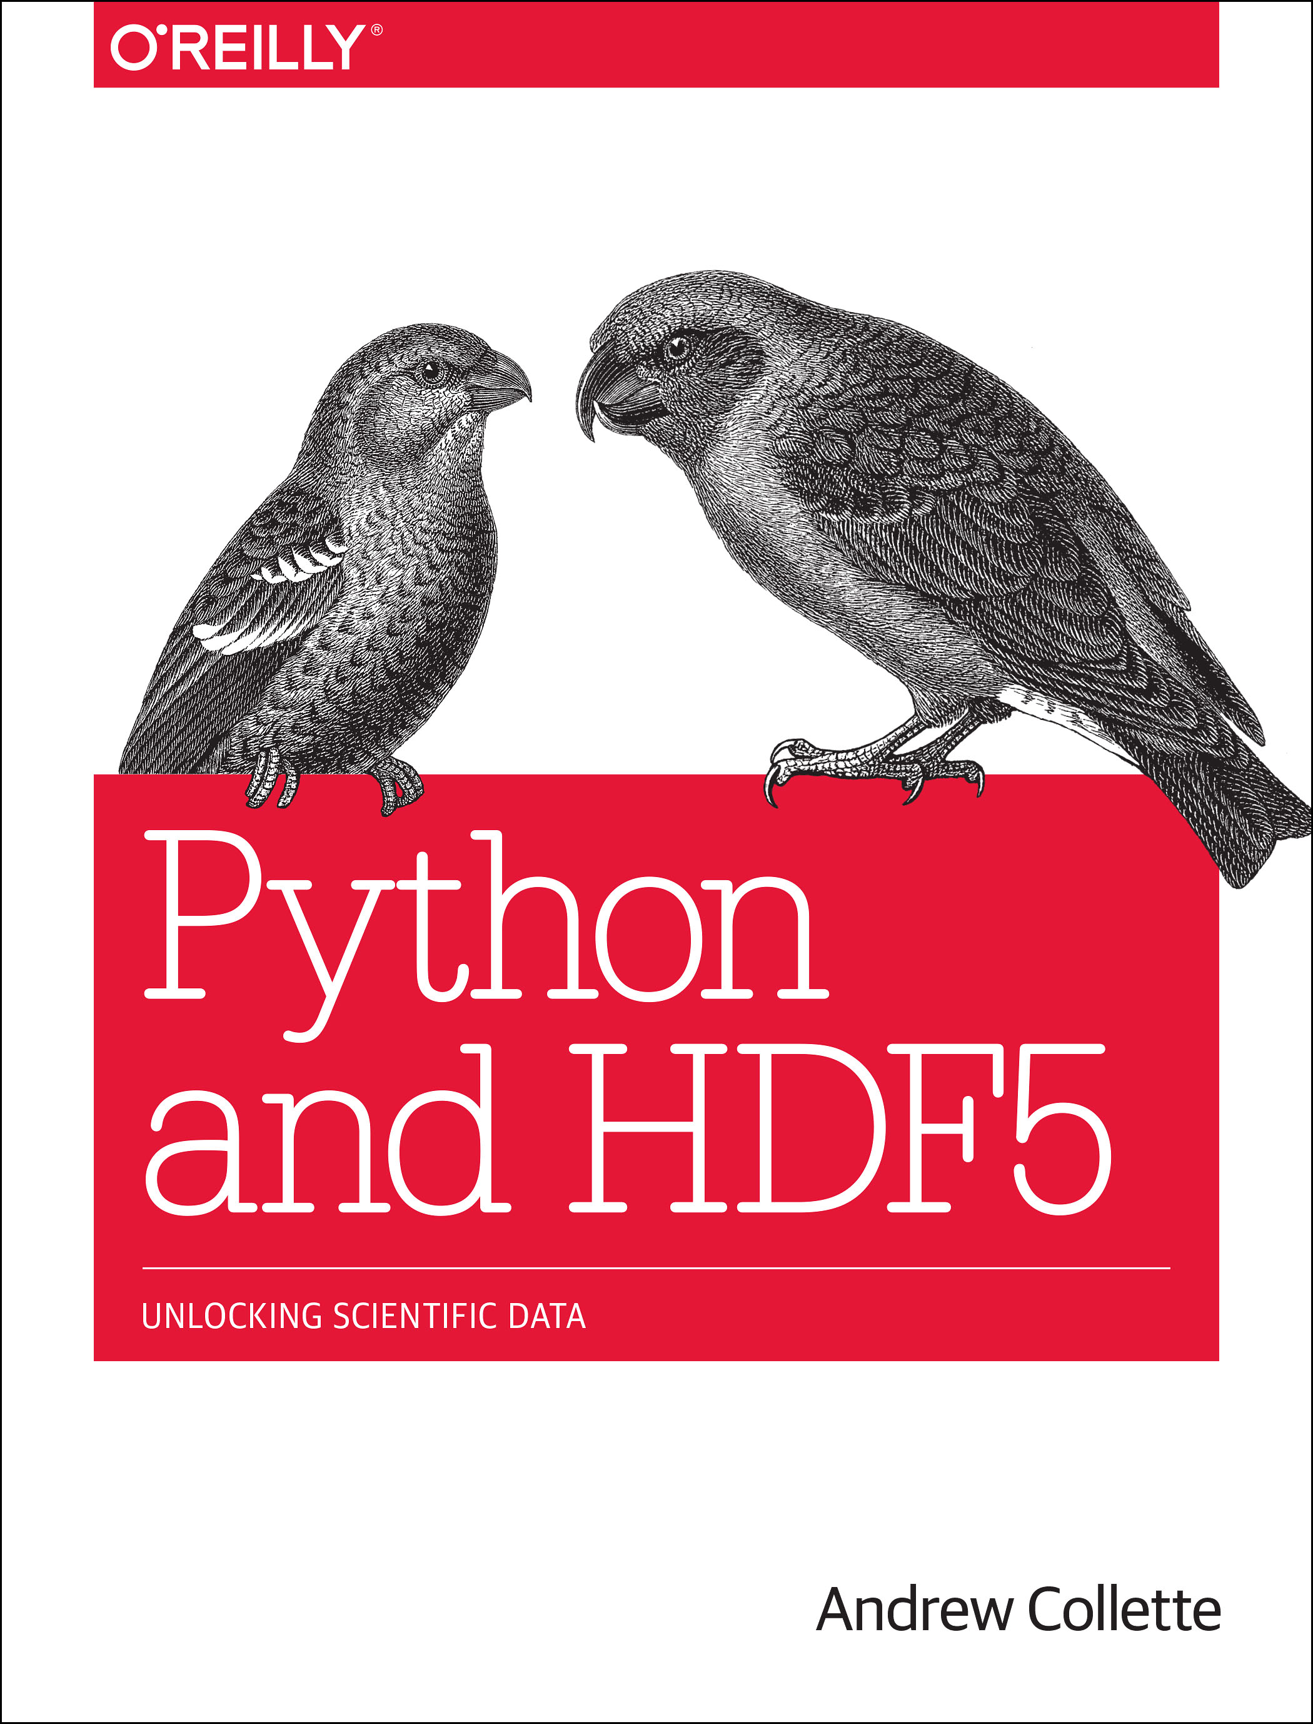
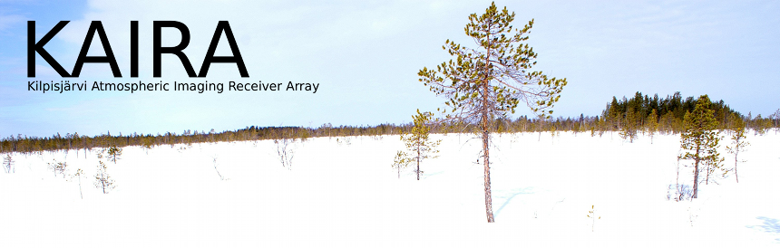
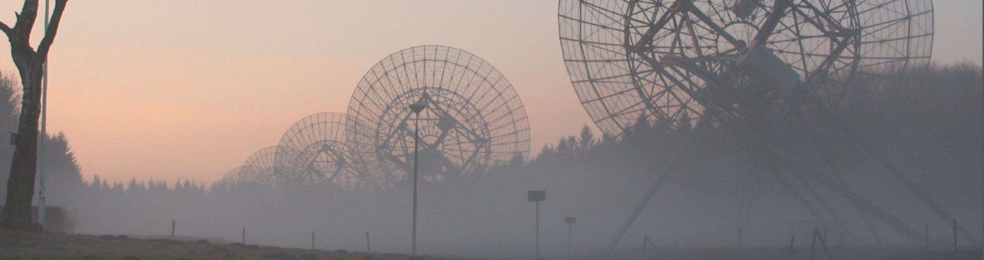
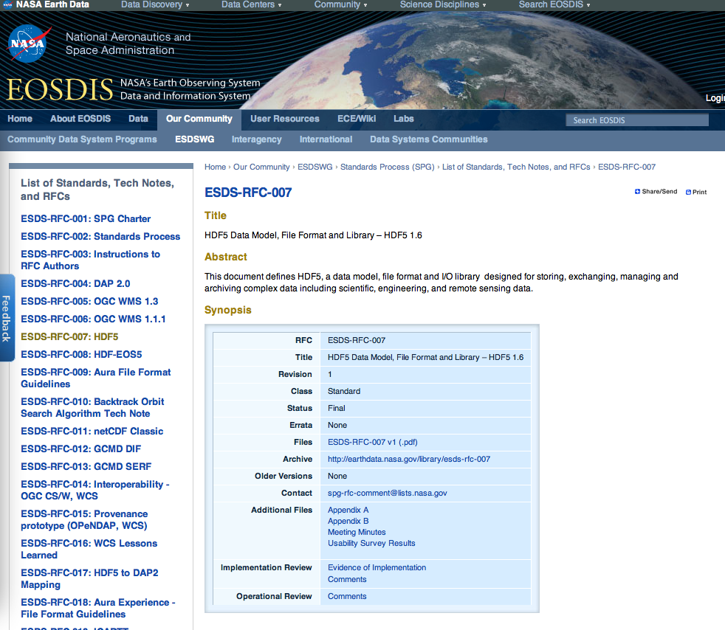
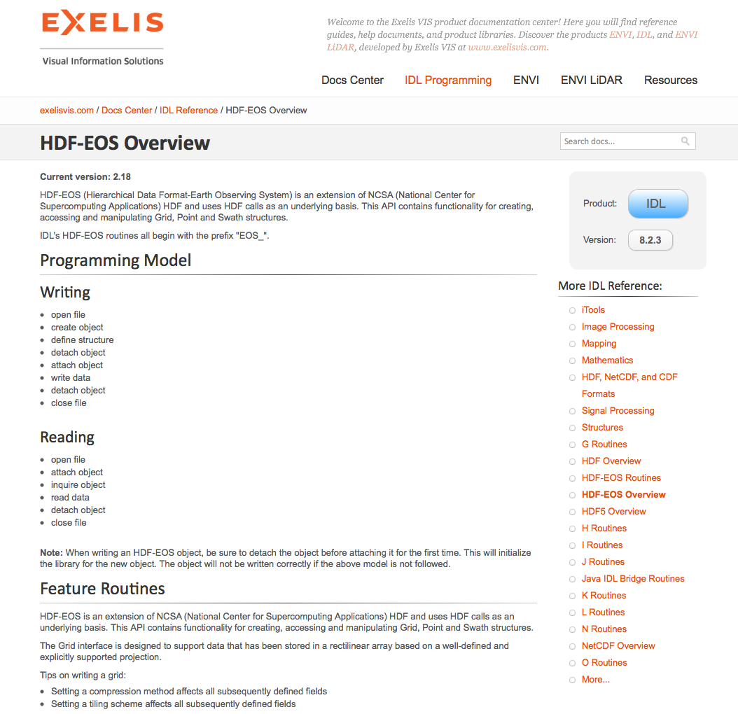
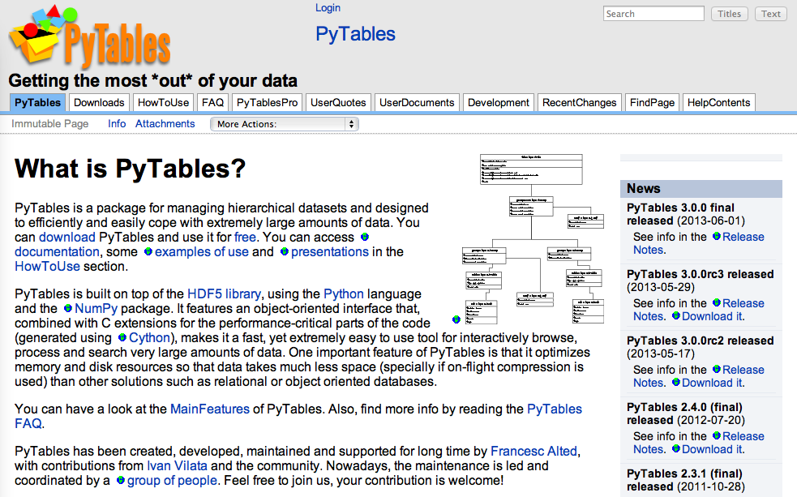

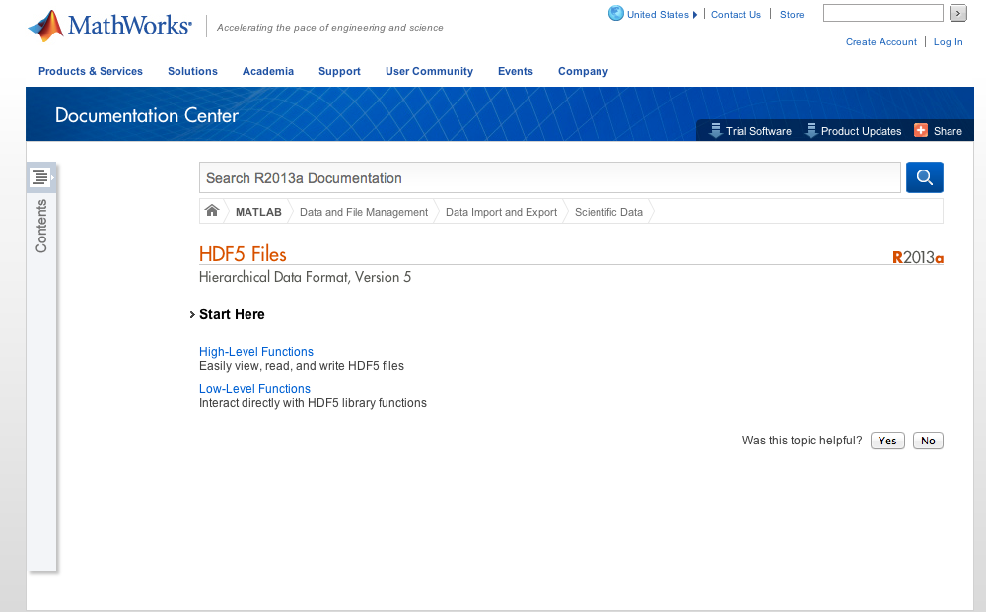
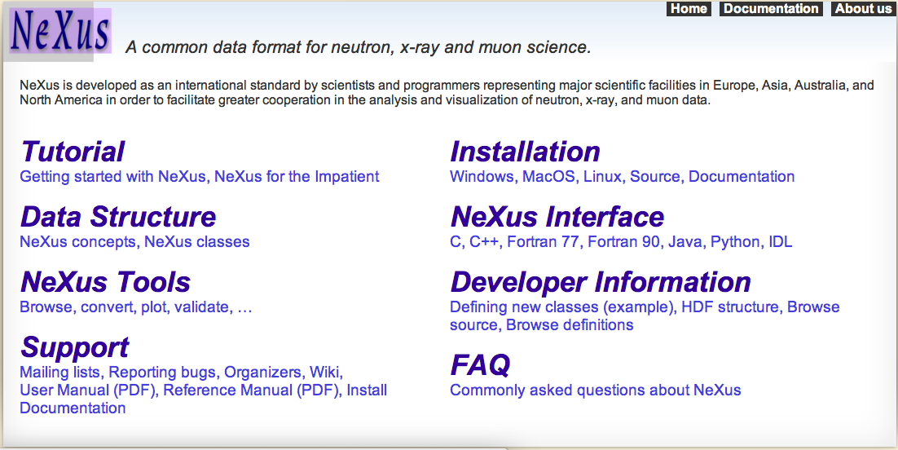
Formats with HDF Inside
HDF5
Notes:
Many diverse HDF users who have novel solutions to what may be universal or shared challenges. Establishing a stronger user community allows users to leverage others efforts and resources to avoid reinventing the wheel.

Slide 6





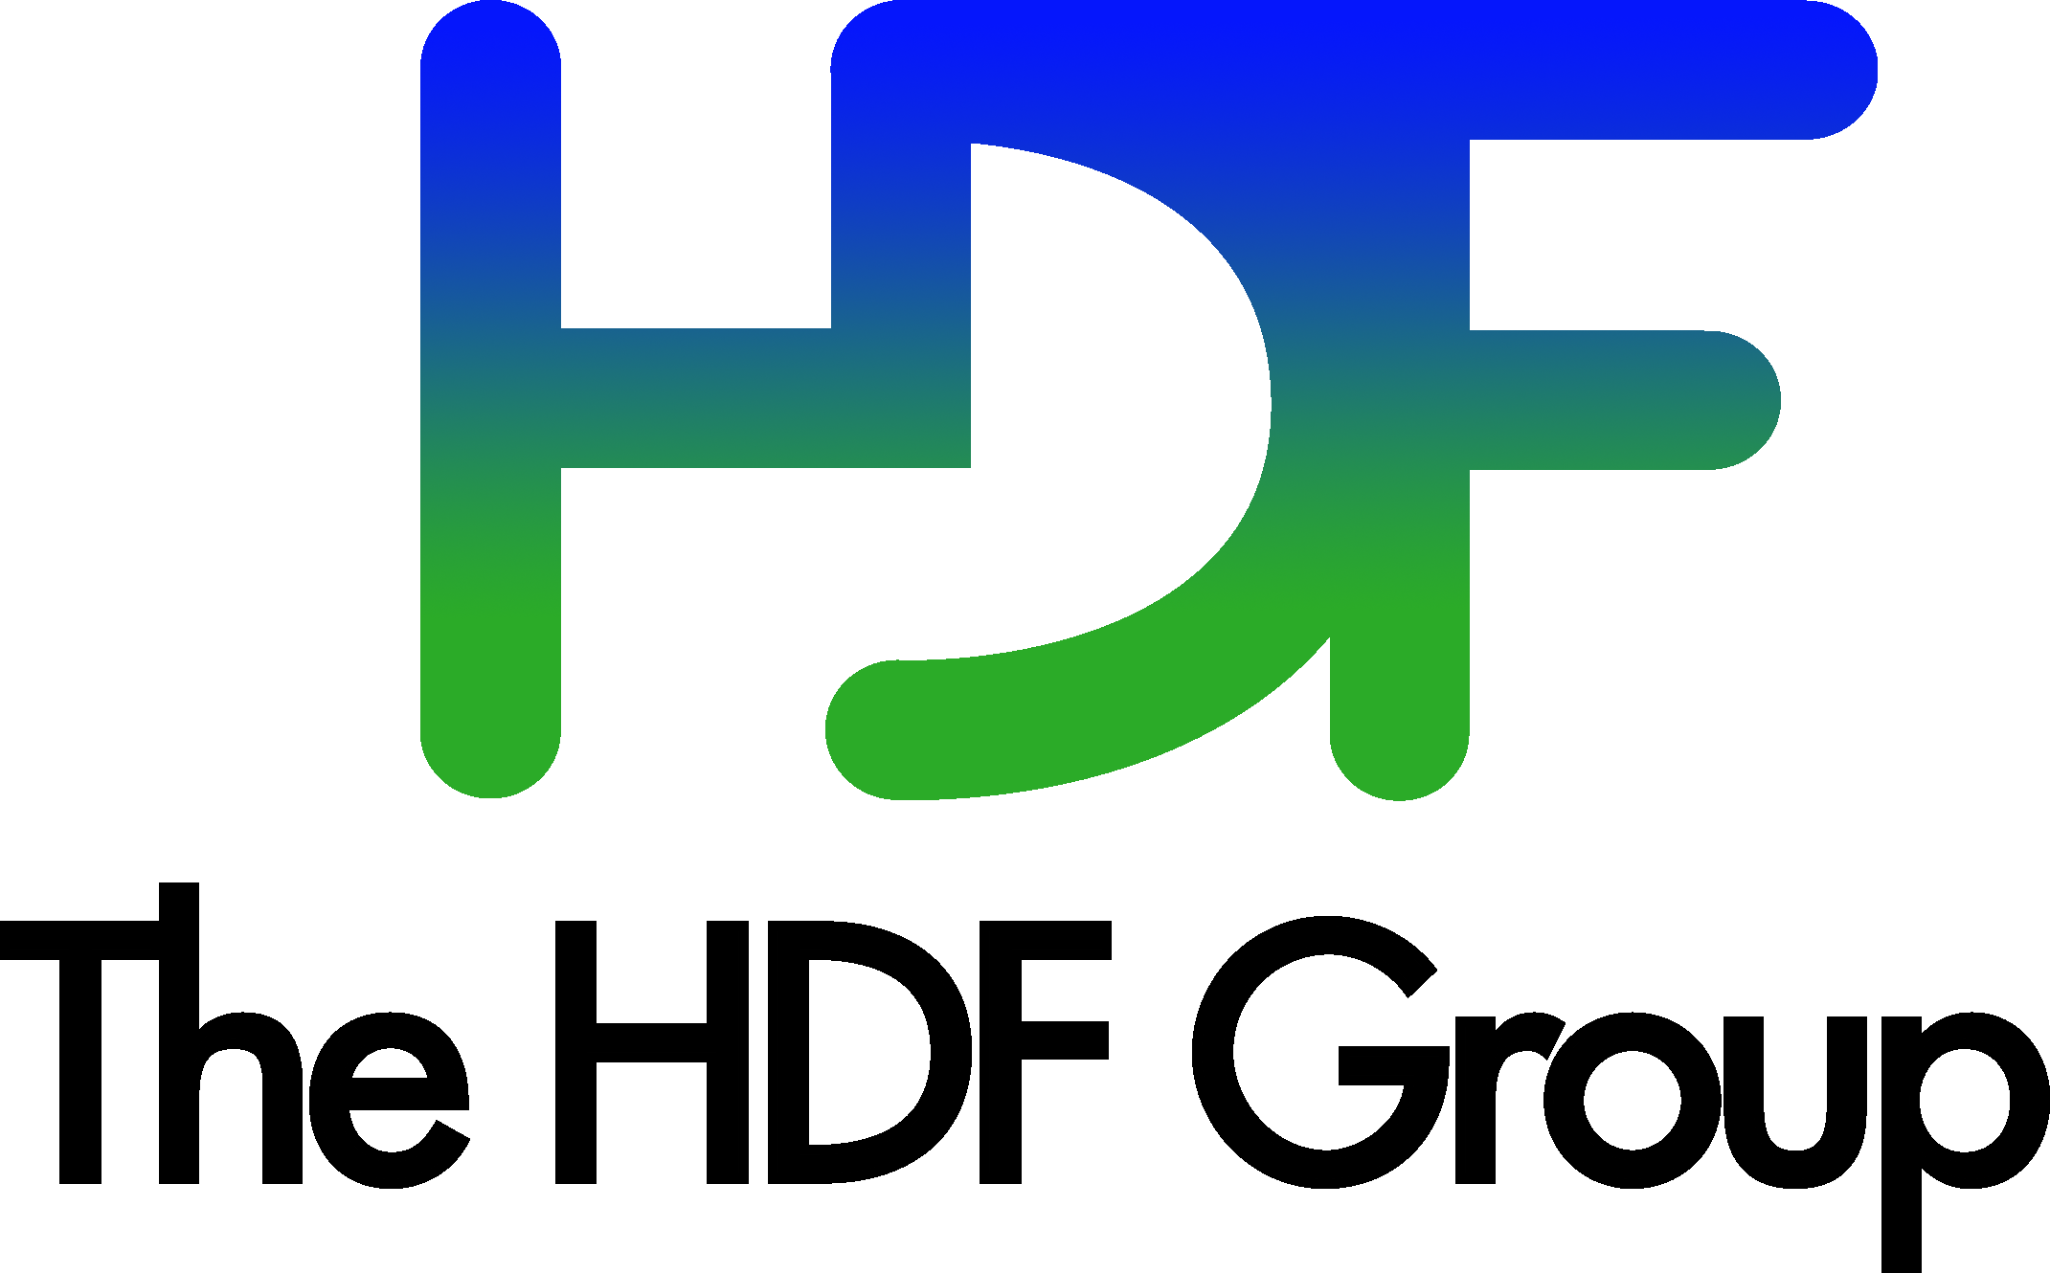

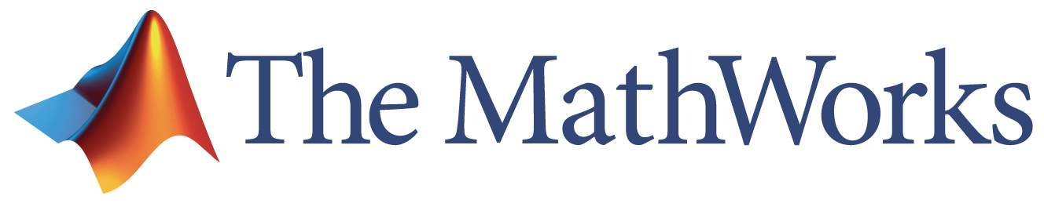



Extended Community
Notes:
Existing community organizations can provide insight and experience to help other entities share their data more efficiently and broadly. Communication about existing and developing tools and technologies, conventions and dialects can facilitate broader use and understanding of data, especially across domains.

Slide 7






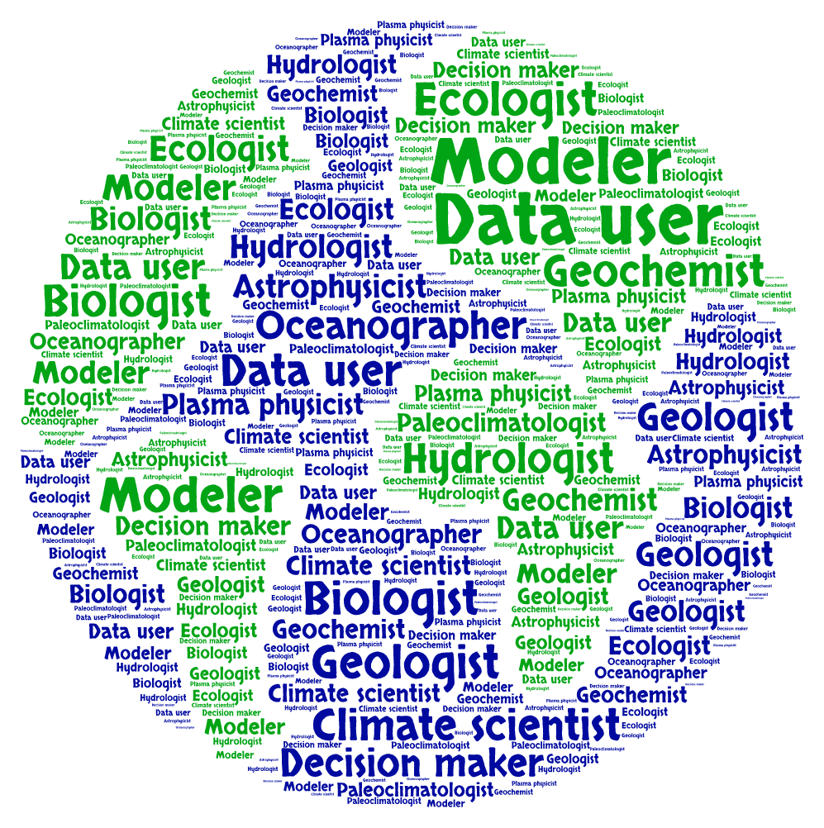
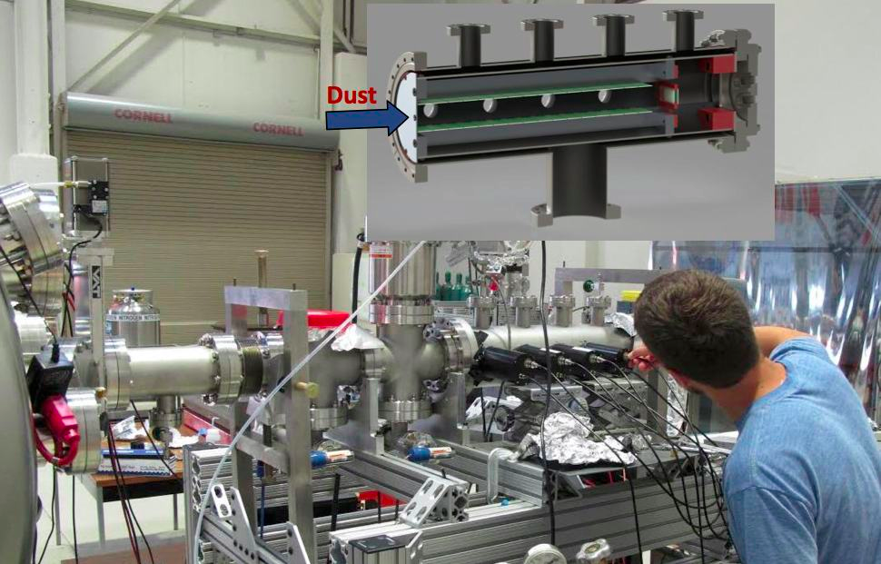
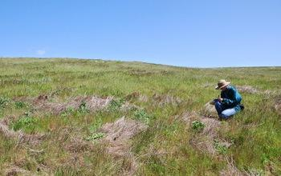
Models of community interaction with data providers
NASA/NOAA
IMPACT
Research Facilities
NEON
“Rules / Conventions”
DAAC
DAAC
DAAC
Notes:
Agencies provide data in a prescribed format netCDF, HDF-EOS, HDF4/5 through the distribution and archive facilities. User interaction through data distribution, forums and Science working groups
Research Facilities provide data but also allow scientists to collect their own data in the facilities. Scientists take their data away in the format provided and then do with it what they want. They may return it to the facility for further distribution to the community. There may or may not be requirements for standards on re-submission. Understanding the implications of choices about metadata dialects and requirements can help users improve their data for shared and future use (preservation).

Slide 8



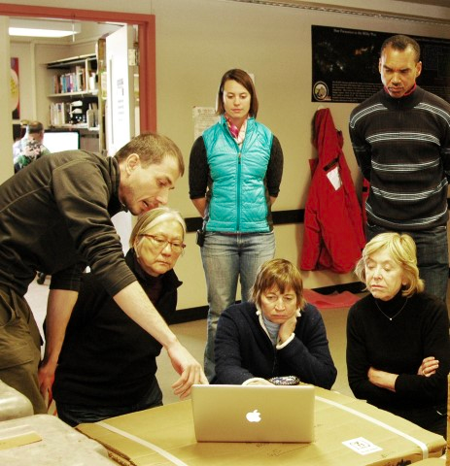


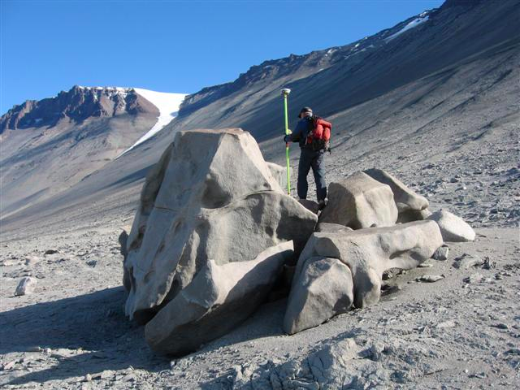
The data facility model
Data Facilities
IRI/LDEO

Slide 9
Benefits of community engagement
Efficiently use limited resources to solve communal problems
Improve interoperability across and within domains through communication and sharing expertise/tools
HDF sustainability
Improve metadata resulting in increased data use and understanding, and preservation

Slide 10
Get Involved
Join the HDF Research Coordination Network effort (email lpowers@hdfgroup.org)
Check out the latest HDF technologies @ https://www.hdfgroup.org/products/
Read the HDF Blog https://blog.hdfgroup.org/
Join the HDF Forum https://www.hdfgroup.org/services/support.html

Slide 11
Thank You!

Slide 12
Acknowledgements
This work was supported by NSF grant
number 1443062.
Photo credits: Elaine Hood, Nate Biletnikoff, IMPACT, Gregory Gilbert

Slide 13
Questions/comments?

