Slide 1
HDF Server
HDF for the Web
John Readey
The HDF Group
Champaign Illinois USA

Slide 2
HDF5 Background
HDF5 is…
A hierarchical file format
An API
A data model
HDF5 has not (until now)
Provided a service that exposes the full extent of the API:
Read/write
Full data type support
Compression/Chunking
Hyperslab/point selection

Slide 3
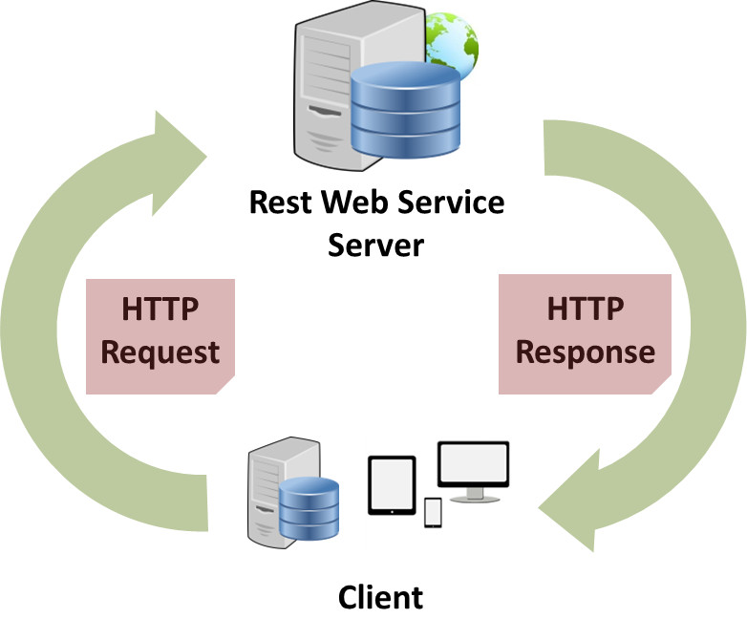
HDF Server (h5serv)

Slide 4
HDF Server Highpoints
Written in Python using Tornado Framework
REST-based API
HTTP request/responses in JSON
Full CRUD (create/read/update/delete) support
Self-contained web server
Open Source
UUID identifiers for Groups/Datasets/Datatypes
Very easy to install/run

Slide 5
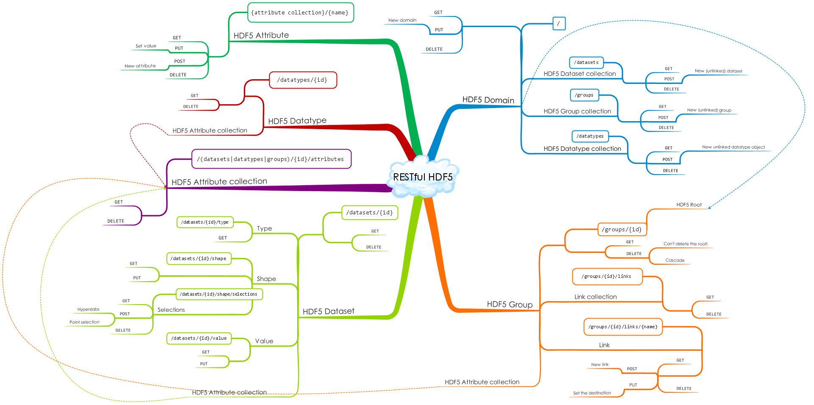
Simple Diagram of REST API

Slide 6
What makes it RESTful?
Client-server model
Stateless – (no client context stored on server)
Cacheable – clients can cache responses
Resources identified by URIs
Standard HTTP methods:
  GET – get a description of a resource
  POST – create a new resource
  PUT – create a named resource
  DELETE – delete a resource

Slide 7
Example Request
http://tall.data.hdfgroup.org:7253/datasets/feef70e8-16a6-11e5-994e-06fc179afd5e/value?select=[0:4,0:4]
http://tall.data.hdfgroup.org:7253/datasets/34…d5e/value?select=[0:4,0:4]
scheme
domain
port
resource
Query param
Scheme: the connection protocol
Domain: HDF5 files on the server can be viewed as domains
Port: this is the port the server is running on
Resource: identifier for the resource (dataset values in this case)
Query param: Modify how the data will be returned
  (e.g. hyperslab selection)

Slide 8
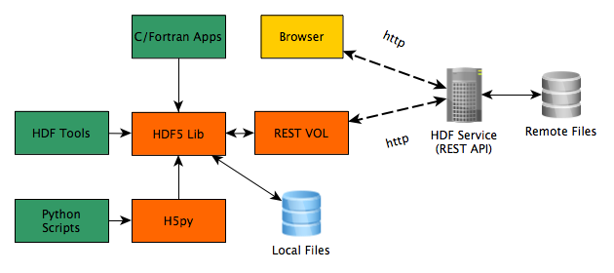
What’s next – client libraries
The REST api can be accessed directly, but it can be tedious
An HDF5 VOL library would provide the familiar HDF5 API
Current tools (e.g. h5dump) would work transparently

Slide 9
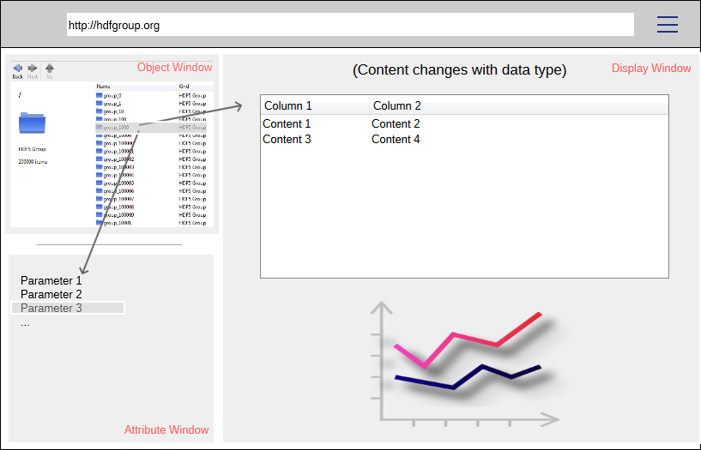
What’s next – Web UI
Provide a web interface using AJAX

Slide 10
What’s next – access control
I’d like to trust you, but…
Authentication (you are who you say you are)
HTTPS (cut out the man in the middle)
Authorization (who can do what)
  Per resource ACL’s

Slide 11
What’s next – search/query
Support query language to filter results
FastBit/PyTables indexes
Find the objects you are interested in
Search over entire repository

Slide 12
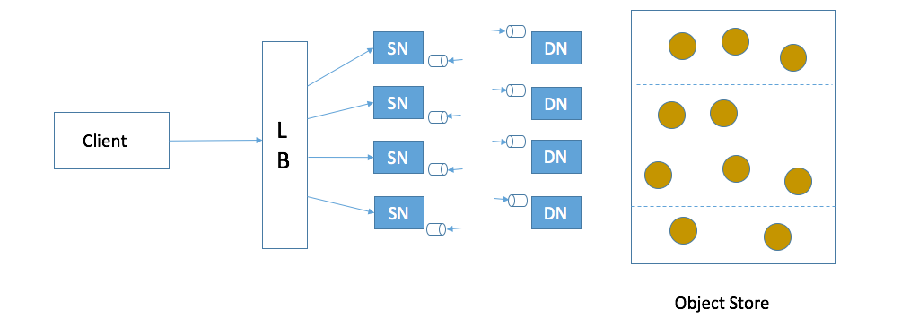
What’s next – Scalable Server
Support any sized repository
Any number of users
Any request volume
Provide data as fast as the client can pull it in

Slide 13
References & Sources
Source code: https://github.com/HDFGroup/h5serv
Project page: https://www.hdfgroup.org/projects/hdfserver/
Documentation: http://h5serv.readthedocs.org/en/latest/
White paper: https://www.hdfgroup.org/pubs/papers/RESTful_HDF5.pdf

Slide 14
The End
Thank You

Slide 15

This work was supported by NASA/GSFC under Raytheon Co. contract number NNG10HP02C

