Slide 1


America runs on
Excel and HDF5
... Glued together by Python
Gerd Heber
The HDF Group
Champaign Illinois USA
This work was supported by NASA/GSFC under Raytheon Co. contract number NNG10HP02C

Slide 2
Outline
A Problem
A Prototype
A Chance to make Yourself heard
An Invitation

Slide 3
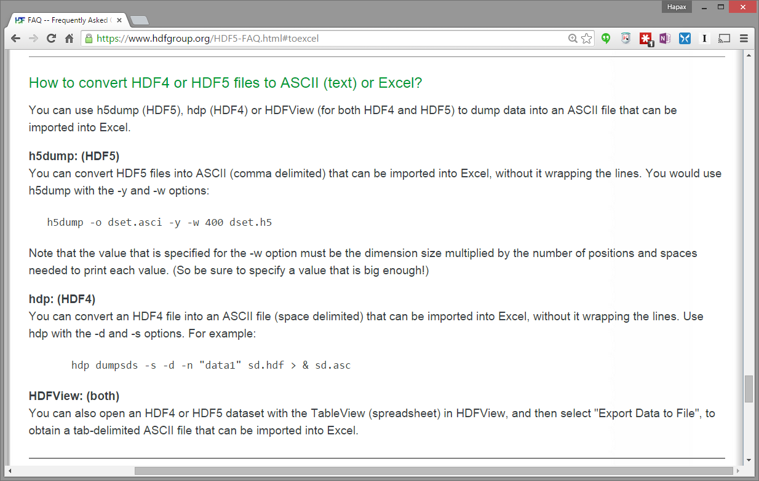
The (A) Problem
Are you kidding?
Notes:
Have you tried Copy&Paste between Excel and HDFView?

Slide 4

What People (Don’t) Want
Learn HDF just to get some data
Learn HDF
Install software
Data conversion orgies
Do everything in Excel
Keep it simple
Text files
Keep things in one place
Tell stories
Get on with life...

Slide 5





Who is the Customer?
Which dimensions are really
important and missing?
Pro
Dangerous position
Version 0.1
Distribution?
Where do we meet
and engage them?
Intermediate
How big?
Path to Version 1.0
Target Audience
Novice
Novice
Intermediate
Pro

Slide 6
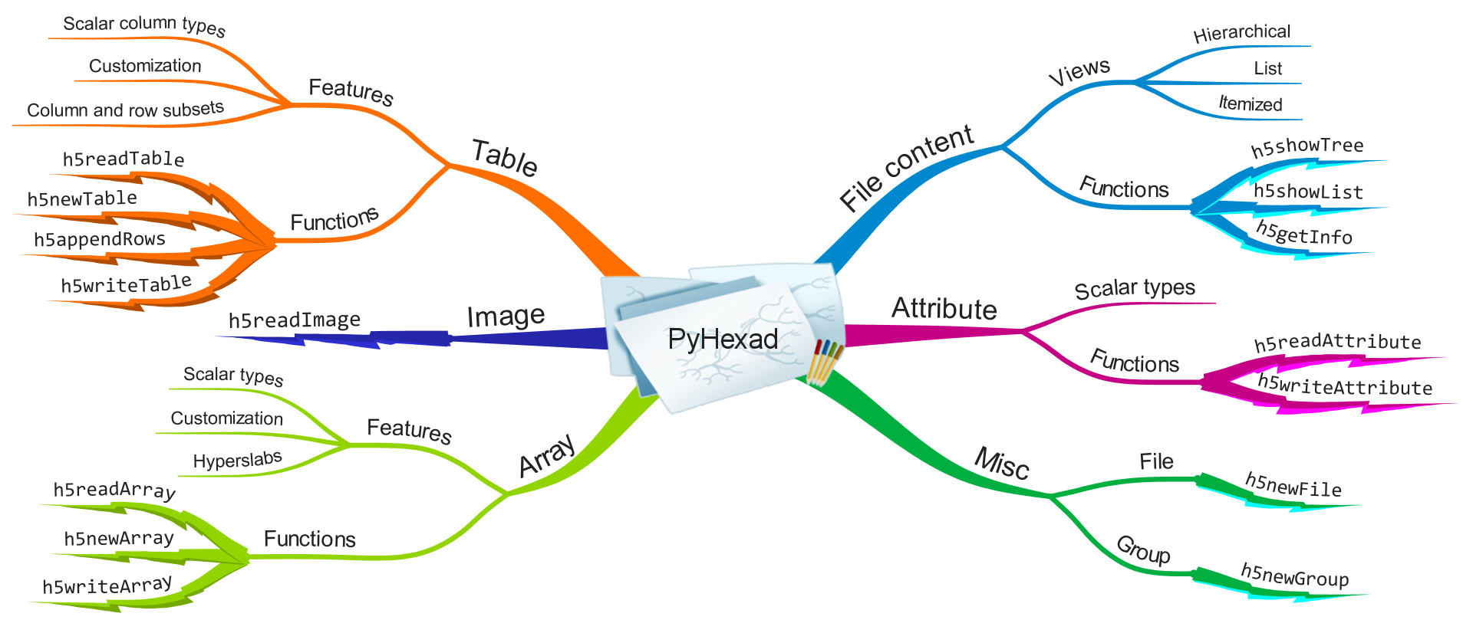
Brainstorm
PyHexad shall facilitate the delivery of decision-oriented information in Excel that is based on the analysis of data stored in HDF5 files.
PyHexad shall not get in the way!

Slide 7
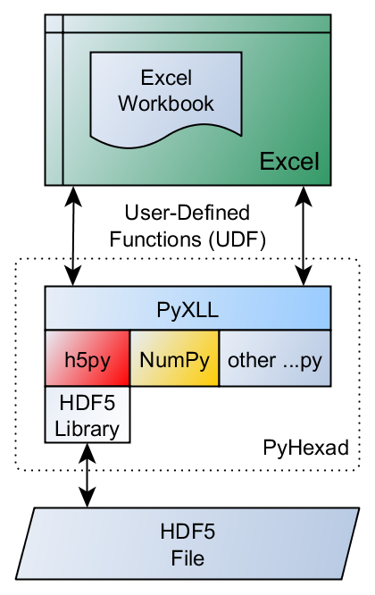

Python-based HDF5 Excel Add-in
Based on the PyXLL add-in distributed by Enthought,Inc.
PyHexad 0.1 = “just a bunch of user-defined functions”
Released in May 2015
Demo:
  Displaying the Contents of an HDF5 File in Excel
  Reading HDF5 Arrays and Tables into Excel
  Reading an HDF5 Image into Excel
Notes:
Show three short movies ~ 7 minutes

Slide 8

Questions / Concerns
Do you use any spreadsheet tools at all?
How important is Excel in your community?
Is the Python dependence a showstopper?
  Would a native add-in be a definite BUY?
Windows only (COM)
“More UI candy!” or “Don’t mess w/ the UI!”
Where in the “customer landscape” do you see yourself?
Have you tried it? Would you try it?
Would you work with us toward version 1.0?

Slide 9
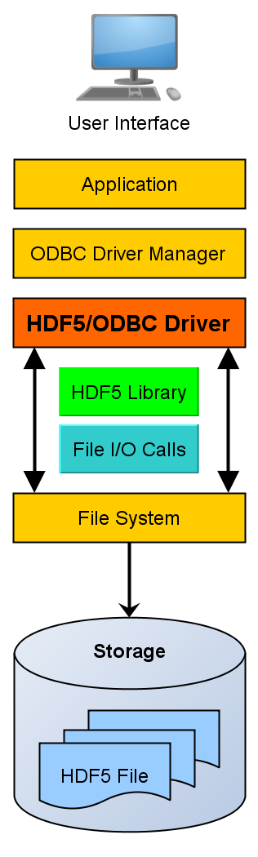
Work in Progress
Installation
PyTables
H5serv endpoint
Alternatives
HDF5/ODBC driver project
  Kicks off July 22 (2015)
  One “mythical man-month”
  Prototype in early August
  Interested?
    => Email to gheber@hdfgroup.org

Slide 10
References
[Blog] | https://hdfgroup.org/wp/2015/06/america-runs-on-excel-and-hdf5/
[GitHub] | https://github.com/HDFGroup/PyHexad
[PyXLL] | https://www.pyxll.com/
[PyHexad] | https://pypi.python.org/pypi/pyhexad
[Read the Docs] | http://pyhexad.readthedocs.org/en/latest/index.html
[YouTube] | https://www.youtube.com/channel/UCl1eZgmPsVVrK-IktaSrQRg

Slide 11
Thank You

Slide 12

This work was supported by NASA/GSFC under Raytheon Co. contract number NNG10HP02C

