Slide 1


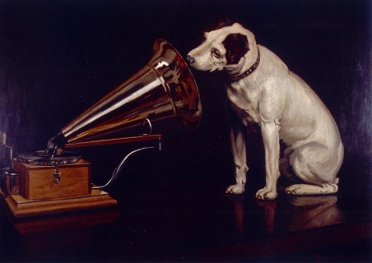
His Expert’s Voice
Community Conventions and Expert Systems
Gerd Heber
The HDF Group
Champaign Illinois USA
This work was supported by NASA/GSFC under Raytheon Co. contract number NNG10HP02C

Slide 2
Outline
Expert Systems Recap
Typical Example
An Expert System-centric View of the HDF Product Designer (HPD)
Status
Work in Progress

Slide 3
Conventions (Idealized)
A data model convention defines the structure and intended meaning of data. However, it should also be noted that a data model convention is restrictive rather than permissive.
Let me illustrate this with an old joke (well I’ve been telling it for a long time) about the differences between different European cultures. It goes like this:
“What is the difference between the British, the Germans, and the Italians?”
“I don’t know, what is the difference?”
“Well, for the British it is allowed unless it is forbidden, for the Germans it is forbidden unless it is allowed, and for the Italians it is allowed especially if it is forbidden.”
Well data models conventions are like the Germans. It is forbidden unless it is allowed. So if you have not provided the necessary entity types, relationship types, and attributes, then the data cannot be held.
Source: Developing High Quality Data Models by Matthew West, Elsevier 2011.

Slide 4

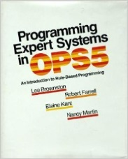
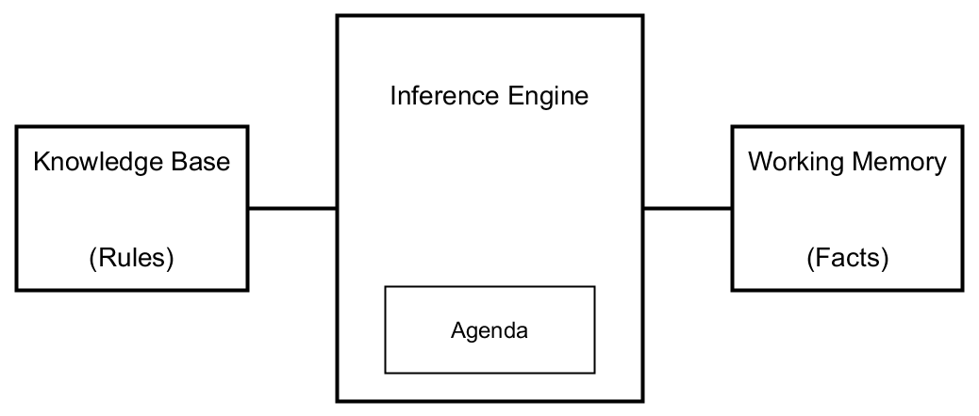


Expert Systems
“Smokey, this is not ‘Nam. This is bowling. There are RULES.” (W. Sobchak)
Rule: Red_light
IF
the light is red
THEN
stop
Rule: Green_light
IF
the light is green
THEN
go
(IF <LHS>
=>
THEN <RHS>)
(<pattern>*
=>
<action>*)

Slide 5
Conway’s Game of Life
A cell adjacent to exactly 2 or 3 other living cells continues to live.
Any living cell adjacent to less than 2 or greater than 3 other living cells will die.
Any dead cell adjacent to 3 other living cells comes to life.
 | X |  |  | X
 | X | X | X | X
 | X |  |  | X
 |  |  | X
 | X |  |  | X
X | X |  |  | X
 | X |  |  | X
Gen. N
Gen. N+1

Slide 6

Example (CLIPS Syntax)
(deffacts control-information
(phase assessment)
(phase-after assessment death)
(phase-after death birth)
(phase-after birth relaxation)
(phase-after relaxation assessment))
Ordered Facts ->
(deftemplate cell
“A live cell”
(slot row (type INTEGER) (range 0 4))
(slot col (type INTEGER) (range 0 4)))
<- Fact Template
(defrule deaths
“Living cells with live neighbor count <2 or >3 die”
(phase death)
?cell <- (cell (row ?row) (col ?col))
?count <- (live-neighbor-count (row ?row) (col ?col)
(val ?val&~2&~3))
=>
(printout t “Deleting cell [” ?row “,” ?col “]” crlf)
(retract ?cell))
Rule ->

Slide 7
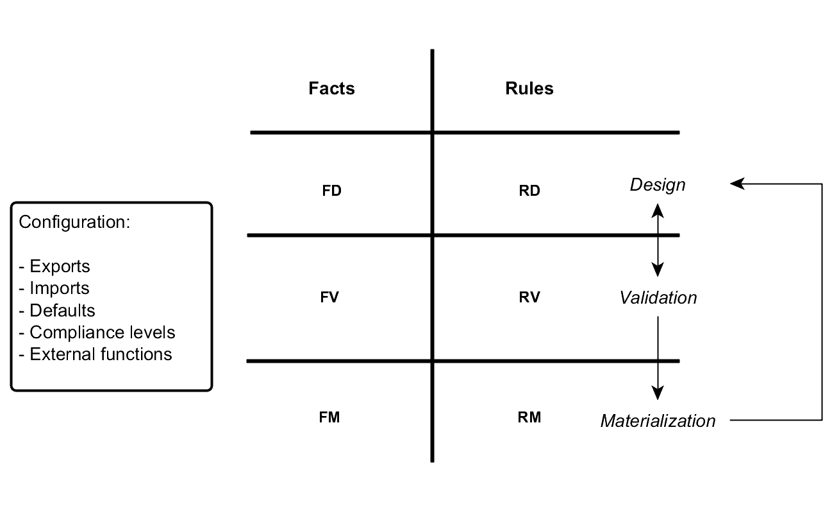
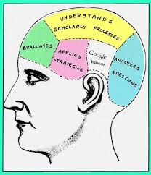
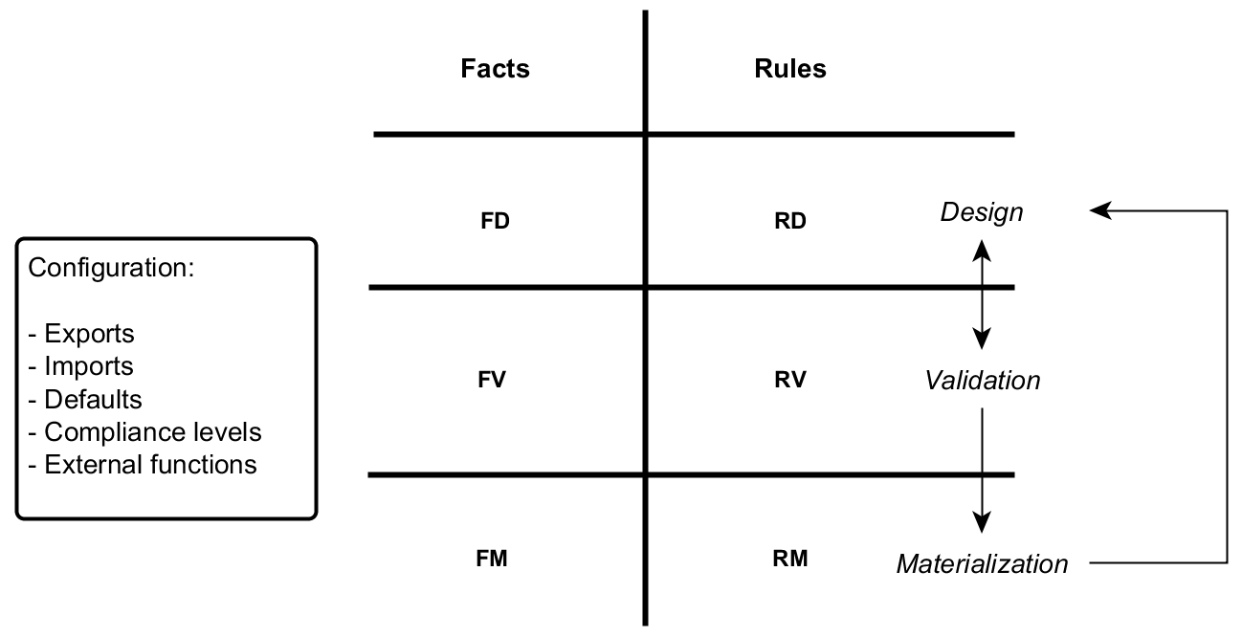
Convention Knowledge Organization
Interop
Convention 2
HPD
Design
Cycle
Convention 1

Slide 8
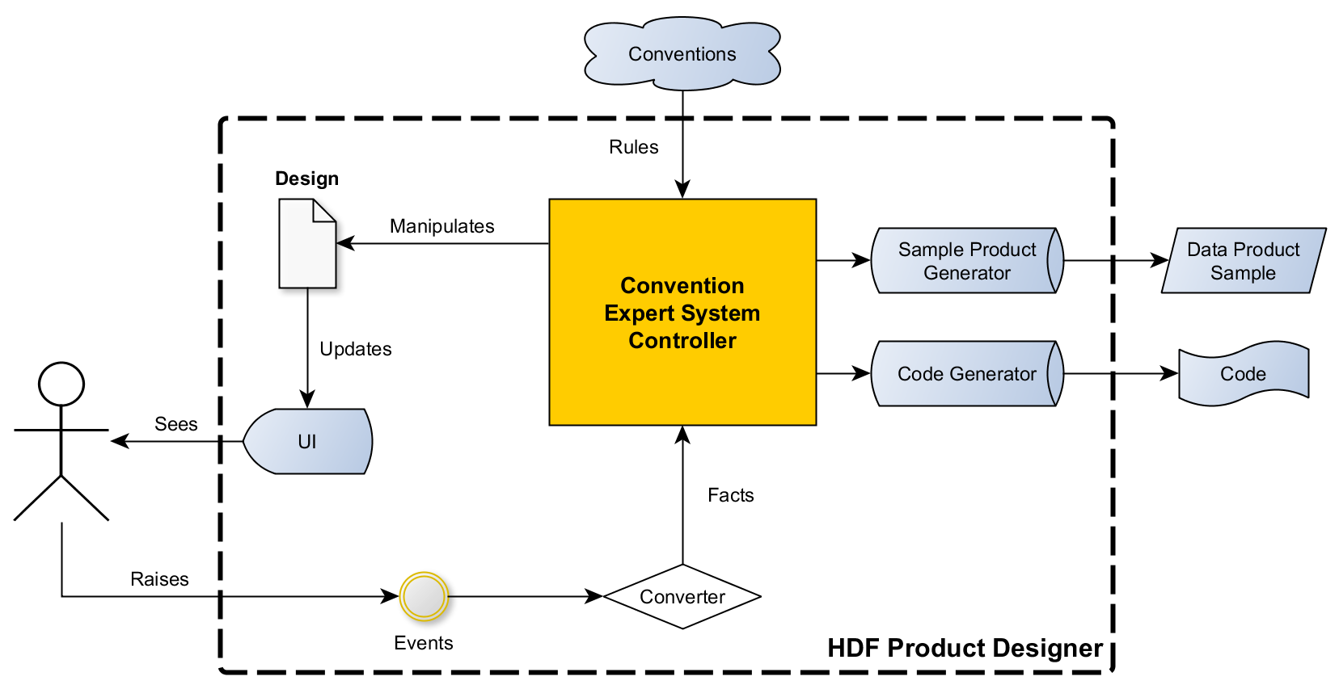

HPD: Expert System-Centric View
CLIPS rules and fact templates
provided by domain expert(s)
MVC
(MVC: Model-View-Controller pattern)

Slide 9
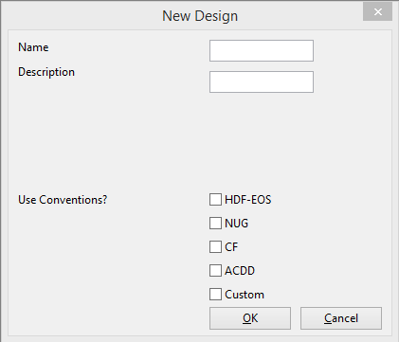

Status and Challenges
Conventions in HPD:
  HDF-EOS w/ ACCD
  NUG w/ ACCD
  CF w/ ACDD
  Custom (experimental)
CLIPS integration with a Python-based HPD client via PyCLIPS (unmaintained!)
State management (UI, design, facts)
The Expert System development process is different from traditional SW development

Slide 10
Work in Progress
Documentation
  HPD Convention Author’s Guide
  HPD Conventions Cookbook
Exploring new conventions
Improving the development process
Weighing technology options

Slide 11
References
[Book1] | J.C. Giarratano and G.D. Riley: Expert Systems: Principles and Programming, Fourth Edition, Course Technology, 2004.
[Book2] | C. Nikolopoulos: Expert Systems, Marcel Dekker, 1997.
[CLIPS] | http://clipsrules.sourceforge.net/
[Forgy1982] | Charles Forgy (1982). "Rete: A Fast Algorithm for the Many Pattern/Many Object Pattern Match Problem". Artificial Intelligence 19: 17–37. doi:10.1016/0004-3702(82)90020-0
[Jess] | http://herzberg.ca.sandia.gov/
[Lisa] | http://lisa.sourceforge.net/
[LispWorks] | http://www.lispworks.com/
[PyCLIPS] | http://pyclips.sourceforge.net/web/

Slide 12
Thank You

Slide 13

This work was supported by NASA/GSFC under Raytheon Co. contract number NNG10HP02C

