Slide 1

Putting some into HDF5
Gerd Heber & Joe Lee
The HDF Group
Champaign Illinois USA
This work was supported by NASA/GSFC under Raytheon Co. contract number NNG10HP02C

Slide 2

The Return of

Slide 3
Outline
“The Big Schism”
A Shiny New Engine
Getting off the Ground
Future Work

Slide 4
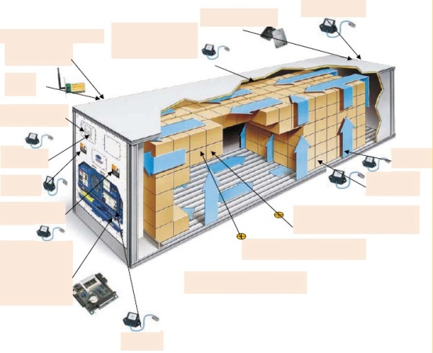
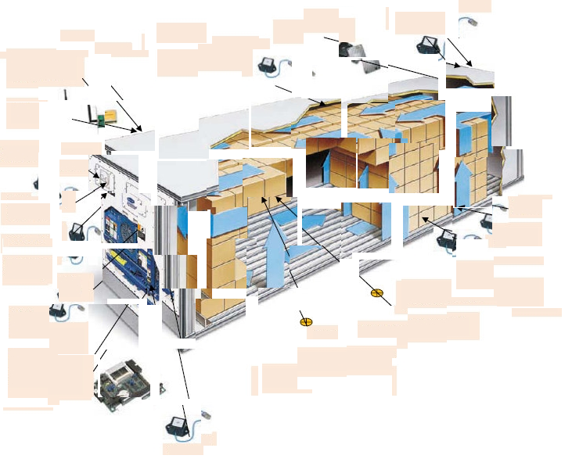


“The Big Schism”
An HDF5 file is a Smart Data Container
“This is what happens, Larry, when you copy an HDF5 file into HDFS!” (Walter Sobchak)
Ouch!
Don’t mess with HDF5!
Natural Habitat: Traditional File System
Block Store: Hadoop “File System” (HDFS)

Slide 5
Now What?
Ask questions:
  Who want’s HDF5 files in Hadoop? (volatile)
    Who wants to program MapReduce? (nobody)
  How big are your HDF5 files? (long tailed distrib.)
    No size (solution) fits all...
Do experiments:
  Reverse-engineer the format (students, weirdos)
  In-core processing (fiddly)
  Convert to Avro (some success)
Sit tight and wait for something better!

Slide 6
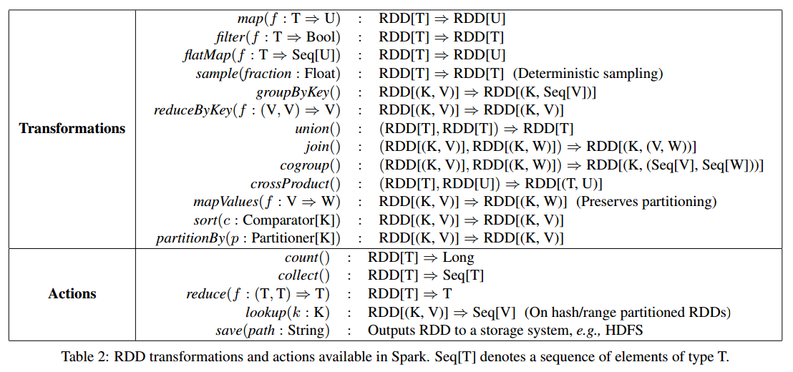
Spark Concepts
Formally, an RDD is a read-only, partitioned collection of records. RDDs can be only created through deterministic operations on either (1) a dataset in stable storage or (2) other existing RDDs.

Slide 7
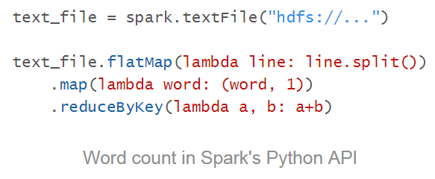
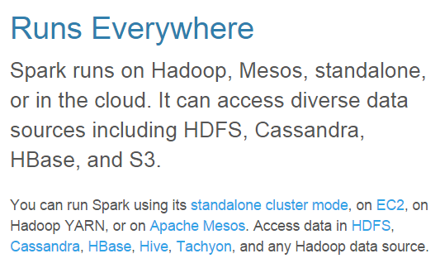

What’s Great about Spark
Refreshingly abstract
Supports Python
Typically runs in RAM
Has batteries included
?

Slide 8
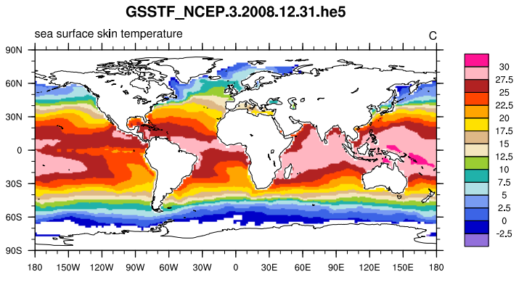
Experimental Setup
GSSTF_NCEP.3 collection 7/1/1987 to 12/31/2008
7,850 HDF-EOS5 files, 16 MB per file,
~120 GB total
4 variables on daily 1440x720 grid
  Sea level pressure (hPa)
  2m air temperature (C)
  Sea surface skin temperature (C)
  Sea surface saturation humidity (g/kg)
Lenovo ThinkPad X230T
  Intel Core i5-3320M (2 cores, 4 threads), 8GB of RAM, Samsung SSD 840 Pro
  Windows 8.1 (64-bit), Apache Spark 1.3.0

Slide 9
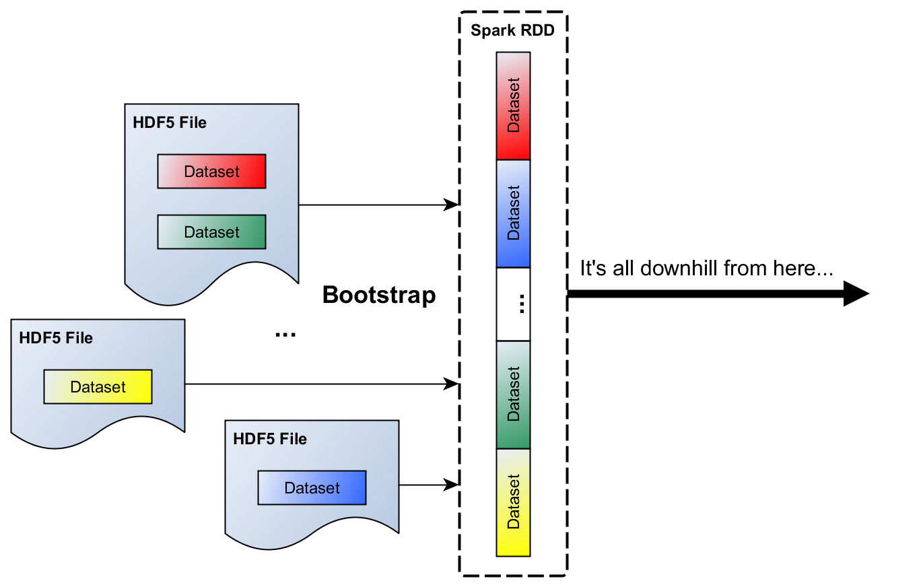
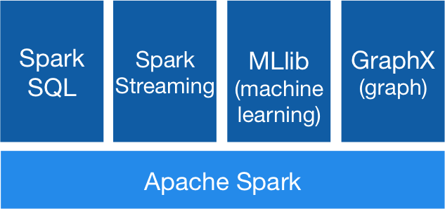
Getting off the Ground
Where do they dwell?

Slide 10

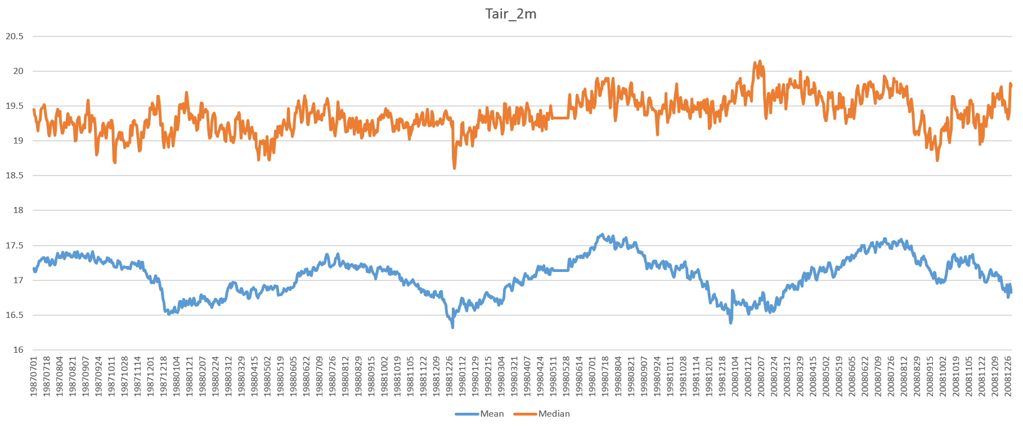
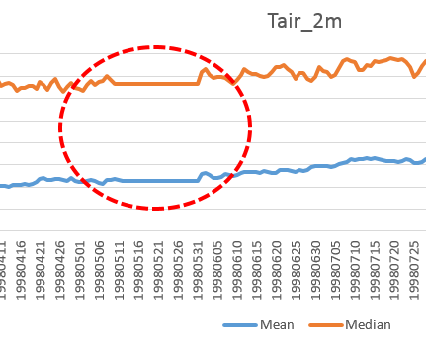
General Strategy
Create our first RDD – “list of file names/paths/...”
  Traverse base directory, compile list of HDF5 files
  Partition the list via SparkContext.parallelize()
Use the RDD’s flatMap method to calculate something interesting, e.g., summary statistics
RDD
Calculating Tair_2m mean and median for 3.5 years took about 10 seconds on my notebook.

Slide 11
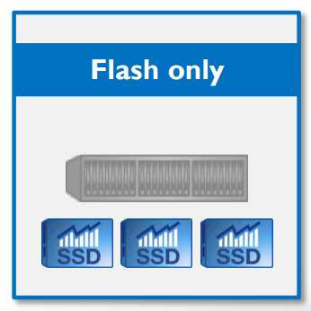



Variations
Instead of traversing directories, you can provide a CSV file of [HDF5 file names, path names, hyperslab selections, etc.] to partition
A fast SSD array goes a long way
If you have a distributed file system (e.g., GPFS, Lustre, Ceph), you should be able to feed large numbers of Spark workers (running on a cluster)
If you don’t have a parallel file system and use most of the data in a file, you can stage (copy) the files first on the cluster nodes

Slide 12
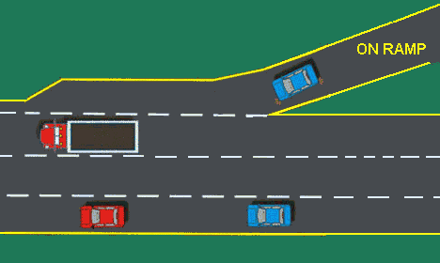

Conclusion
Forget MapReduce, stop worrying about HDFS
With Spark, exploiting data parallelism has never been more accessible (easier and cheaper)
Current HDF5 to Spark on-ramps can be effective under the right circumstances, but are kludgy
Work with us to build the right things right!

Slide 13
References
[BigHDF] | https://www.hdfgroup.org/pubs/papers/Big_HDF_FAQs.pdf
[Blog] | https://hdfgroup.org/wp/2015/04/putting-some-spark-into-hdf-eos/
[Report] | Zaharia et al., Resilient Distributed Datasets: A Fault-Tolerant Abstraction for In-Memory Cluster Computing, UCBerkeley 2011.
[Spark] | https://spark.apache.org/
[YouTube] | Mark Madsen: Big Data, Bad Analogies, 2014.

Slide 14
Thank You

Slide 15

This work was supported by NASA/GSFC under Raytheon Co. contract number NNG10HP02C

