Slide 1
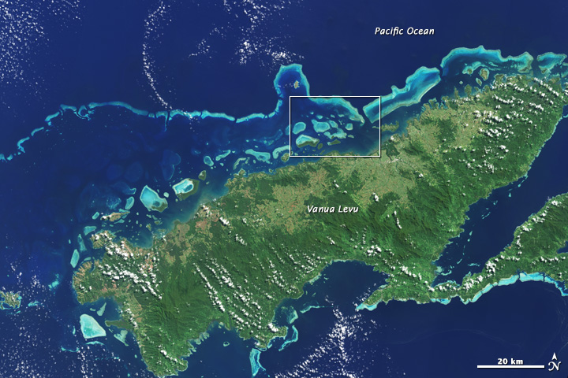
MATLAB and Scientific Data: New Features and Capabilities
Ellen Johnson
Senior Software Engineer
MathWorks
Landsat8 Image: Coral Reef, Vanua Levu, Fiji

Slide 2

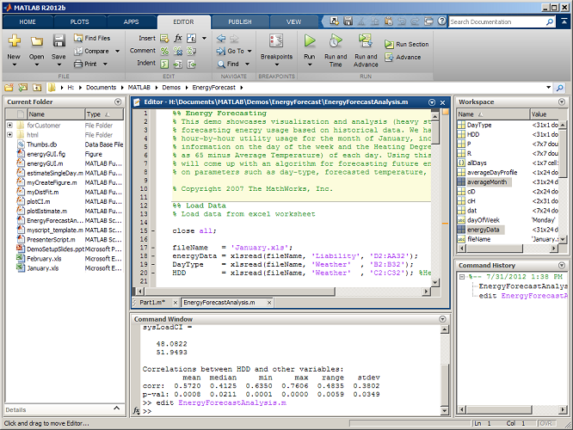
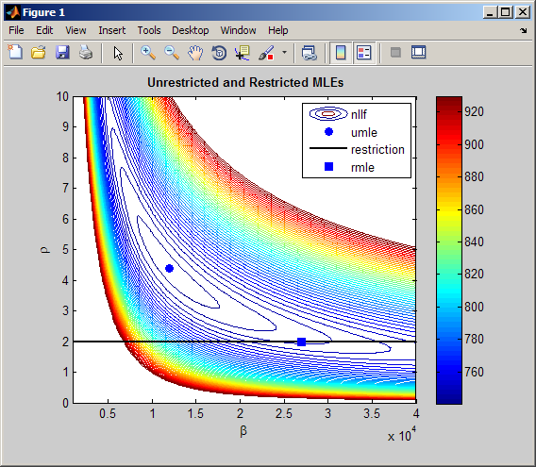
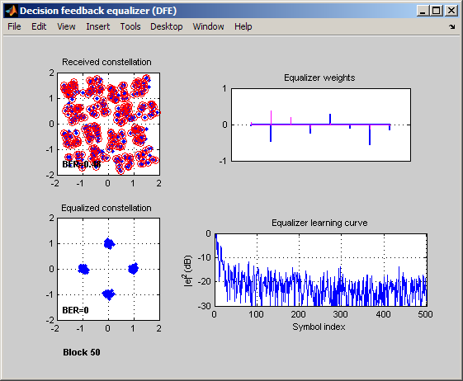
The Leading Environment for Technical Computing
Numeric computation
Parallel computing, with multicore and
multiprocessor support
Data analysis and visualization
Toolboxes for signal and image
processing, statistics, optimization,
symbolic math, and other areas
Tools for application development
and deployment
Notes:
MATLAB, our first core product, is the leading environment for technical computing. It is also the foundation of MathWorks products.
People apply MATLAB to a broad range of applications, including signal processing, control system analysis, image processing, and general data analysis. That’s one reason why MATLAB (is/can be) used so widely throughout (your organization/organizations like yours/your industry).
MATLAB addresses this range of applications by offering a core set of technical computing capabilities. These include:
* Fast and robust numeric computation, with over 1000 algorithms geared to engineering and science
* Engineering graphics and visualization tools
* A high-level programming language that has become an industry standard for developing and sharing algorithms
* Add-on toolboxes, providing additional functions for specific areas, such as signal and image processing, control system design, statistics, symbolic math, and other areas
Optional elaboration:
When people describe MATLAB, they generally talk about it as one of two things:
* An interactive, exploratory analysis and visualization environment
* A programming environment
In fact, it’s both. The math, graphics, and language can be applied in either way, and these two modes can be mixed. You can use MATLAB as an exploratory environment, iteratively trying out math functions and plotting results until you’re satisfied with the resulting analysis. And you can use that same MATLAB language to develop functions and applications that you can reuse and share with others. The mode you use really depends on your style and your end goal. The benefit of this is that you can do your thinking and your programming in a single environment.

Slide 3
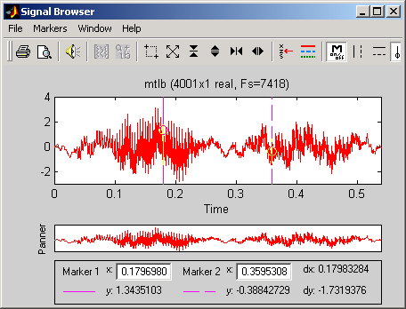
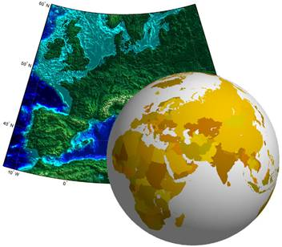
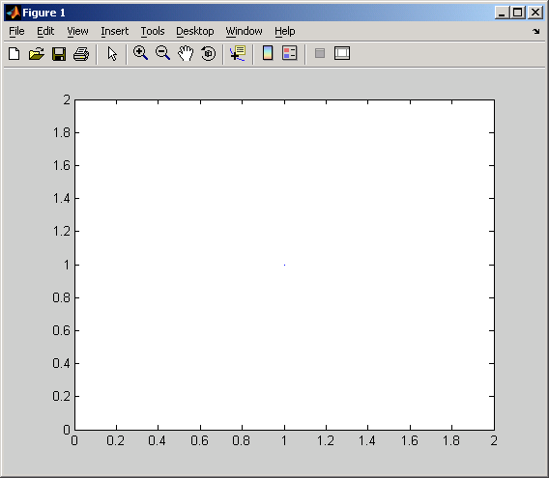
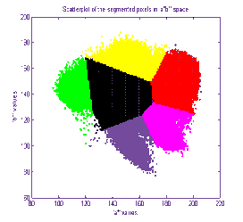
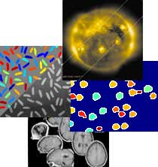


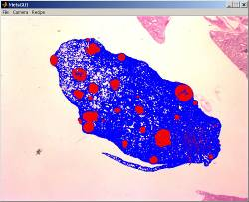

Go Farther with MATLAB and Toolboxes
_{Signal Processing Toolbox}
_{Mapping Toolbox}
Statistics and Machine Learning Toolbox
_{Image Processing Toolbox}
_{Database Toolbox}
_{Image Acquisition Toolbox}
_{MATLAB Compiler}
Notes:
Note to presenter: Use this slide to show that we have a number of toolboxes that extend the capabilities of MATLAB and a number of them are useful for Image Processing applications. You do not need to describe all of these toolboxes.
Image Acquisition Toolbox
Capture images and video from hardware, control devices within MATLAB
Database Toolbox
Exchange data with ODBC or JDBC-compliant relational databases
Statistics Toolbox
Perform statistical analysis, like Principle Components Analysis and K-means clustering
Signal Processing Toolbox
Tools for filtering, spectral analysis, and classical signal processing
Mapping Toolbox
Access, visualize, and analyze geospatial data
MATLAB Compiler
Deploy components for larger C/C++ projects or deploy stand-alone desktop applications. (Also available are Builders for JAVA and .NET)

Slide 4
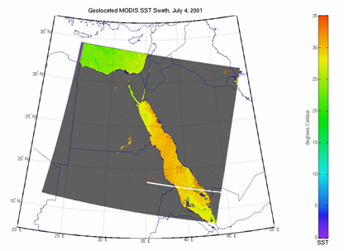
MATLAB and Scientific Data
Scientific data formats
  HDF5, HDF4, HDF-EOS2
  NetCDF (with OPeNDAP!)
  FITS, CDF, BIL, BIP, BSQ
Image file formats
  TIFF, JPEG, HDR, PNG, JPEG2000, and more
Vector data file formats
  ESRI Shapefiles, KML, GPS
  and more
Raster data file formats
  GeoTIFF, NITF, USGS and SDTS DEM, NIMA DTED, and more
Web Map Service (WMS)

Slide 5
Scientific Data Libraries
MATLAB R2015a
Developing formal upgrade cadence to stay current with vendors
Work closely with vendors on testing new versions
Library | Version in MATLAB | Vendor Version
HDF5 | 1.8.12 | 1.8.15
HDF4 | 4.2.5 | 4.2.11
HDF-EOS2 | 2.17 | 2.18
NetCDF with OPeNDAP | 4.1.3 | 4.3.3.1
CDF | 3.3.0 | 3.6.0
FITS | 3.27 | 3.37

Slide 6
HDF5
High Level Interface (h5read, h5write, h5disp, h5info)
  h5disp('example.h5','/g4/lat');
  data = h5read('example.h5','/g4/lat');
Low Level Interface (Wraps HDF5 C APIs)
  fid = H5F.open('example.h5');
  dset_id = H5D.open(fid,'/g4/lat');
  data = H5D.read(dset_id);
  H5D.close(dset_id);
  H5F.close(fid);
Notes:
h5disp maps to h5dump
try, catch
don’t have to recompile your code to play with the lower level interfaces
Run code as you type it

Slide 7
NetCDF
High Level Interface (ncdisp, ncread, ncwrite, ncinfo)
  url = 'http://oceanwatch.pifsc.noaa.gov/thredds/ dodsC/goes-poes/2day';
  ncdisp(url);
  data = ncread(url,'sst');
Low Level Interface (Wraps netCDF C APIs)
  ncid = netcdf.open(url);
  varid = netcdf.inqVarID(ncid,'sst');
  netcdf.getVar(ncid,varid,'double');
  netcdf.close(ncid);
Notes:
ncdisp maps to ncdump

Slide 8
New in R2014b/R2015a
HDF5 version 1.8.12!
  Read data with a third-party filter applied
  Both our high-level and low-level interfaces provide support
Dates and Times
  datetime, duration, and calendarDuration
  Support for math, sorting, comparisons, plotting, formatted display, timezones
Big Data
  mapreduce and datastore functions
  table and categorical powerful in conjunction with big data analysis
RESTful web server access
  webread, webwrite, and websave
  JSON objects represented as struct arrays

Slide 9
Reading HDF5 Data with Dynamically Loaded Filter
MATLAB can easily read datasets with dynamically loaded compression filters
Example using BZIP2 compressor
% Set the HDF5_PLUGIN_PATH environment variable
>> setenv('HDF5_PLUGIN_PATH','/test/BZIP2-plugin/plugins/lib');
% Read data with our high-level interface
>> myData = h5read('h5ex_d_bzip2.h5','/DS1');
% Read data with our low-level interface
>> fileId = H5F.open('h5ex_d_bzip2.h5','H5F_ACC_RDONLY','H5P_DEFAULT');
>> dset = H5D.open(fileId,'/DS1','H5P_DEFAULT');
>> myData = H5D.read(dset,'H5T_NATIVE_INT','H5S_ALL','H5S_ALL','H5P_DEFAULT');
>> H5D.close(dset);
>> H5F.close(fileId);

Slide 10
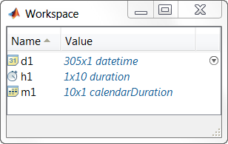
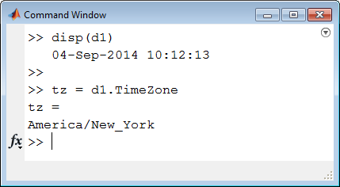
Date and Time Arrays
datetime for representing
a point in time
duration, calendarDuration
for representing elapsed time
Same data type for computation and display
  Add, subtract, sort, compare, and plot
  Customize display formats
  Nanosecond precision
Support for time zones
  Accounts for daylight saving time
Notes:
And now with R2014b, there are new datatypes for working with dates and time.
datetime is used to represent points in time, such as October 2nd 2014 at 2pm.
To represent elapsed time, you can use either a duration for a fixed length of time like 24 hours or a calendar duration for a variable length of time like 1 month which could be 28-31 days long.
These new types support arithmetic, comparisons, and plotting.
You can set and converting the time zone for datetimes accounting for daylight saving time, specify default display format for datetimes and durations while maintaining nanosecond precision for absolute times.

Slide 11
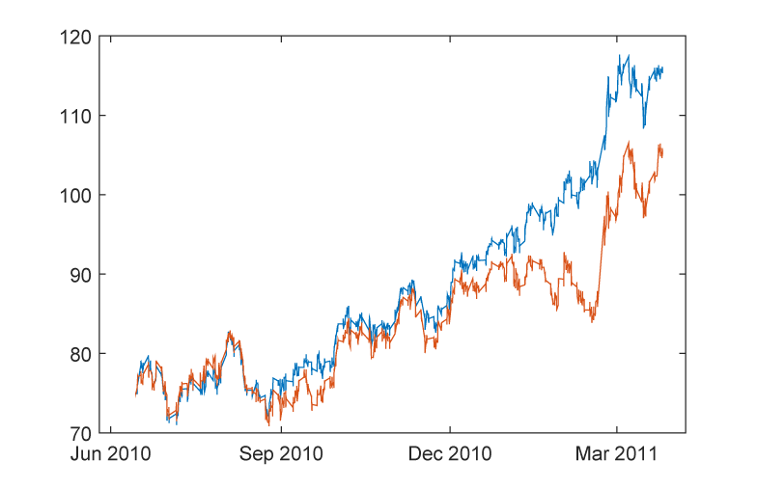
Automatic Updating of Datetime Tick Labels
Notes:
I encourage you to find out more about this latest release from MathWorks.
You can find the release announcement on our home page. From there you can navigate to the highlights for the entire release. And from there, you can navigate to the MATLAB new features page….

Slide 12

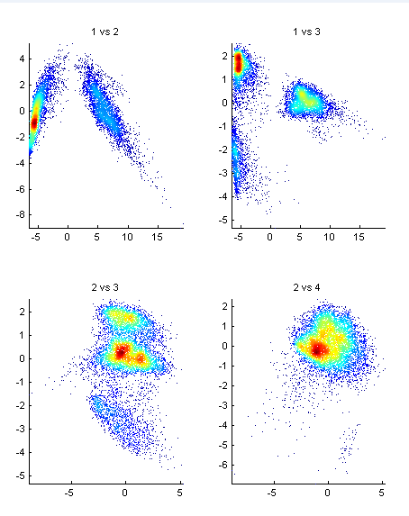
Big Data Capabilities in MATLAB
Memory and Data Access
64-bit processors
Memory Mapped Variables
Disk Variables
Databases
Datastores
Programming Constructs
Streaming
Block Processing
Parallel-for loops
GPU Arrays
SPMD and Distributed Arrays
MapReduce
Platforms
Desktop (Multicore, GPU)
Clusters
Cloud Computing (MDCS on EC2)
Hadoop
Notes:
There are three primary ways of categorizing ways to approach big data with MATLAB today.
You can extend memory usage and leverage disk space through features like 64 bit processors, memory mapped variables, and disk variables.
You can leverage programming constructs to process your data. These includes options for streaming data, block processing, and working with data in a distributed fashion with techniques such as parfor loops.
You can also take advantage of the hardware you have available to process and analyze big data, including clusters and clouds.
These are totally separate categories – and often you use aspect of them together to achieve the best way of tackling your big data problem.
We’ve added to these capabilities with R2014b, with datastores, and MapReduce functionality that scales for use with Hadoop.

Slide 13

Options for Handling Big Data
Platform | Desktop Only | Desktop + Cluster | Desktop + Hadoop
Data Size | 100’s MB -10’s GB | 100’s MB -100’s GB | 100’s GB – PBs
Techniques | parfor datastore mapreduce | parfor distributed data spmd | mapreduce
Cluster
Hadoop Cluster
MATLAB
Desktop (Client)
MATLAB
Desktop (Client)
MATLAB
Desktop (Client)
..…
..…
…
…
..…
..…
…
…
…
…
…
…
..…
..…
Scheduler
Hadoop Scheduler
Notes:
Silvina:
If they need to scle more, they will use similar resources in a cluster

Slide 14
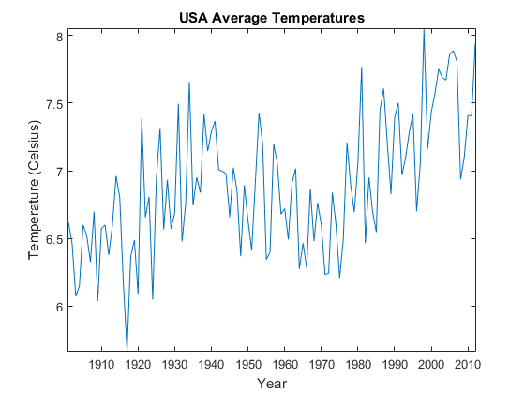
RESTful Web Service Access
Read historical temperature data from the World Bank Climate Data API
>> api = 'http://climatedataapi.worldbank.org/climateweb/rest/v1/';
>> url = [api 'country/cru/tas/year/USA'];
>> S = webread(url)
S =
112x1 struct array with fields:
year
data
>> S(1)
ans =
year: 1901
data: 6.6187

Slide 15
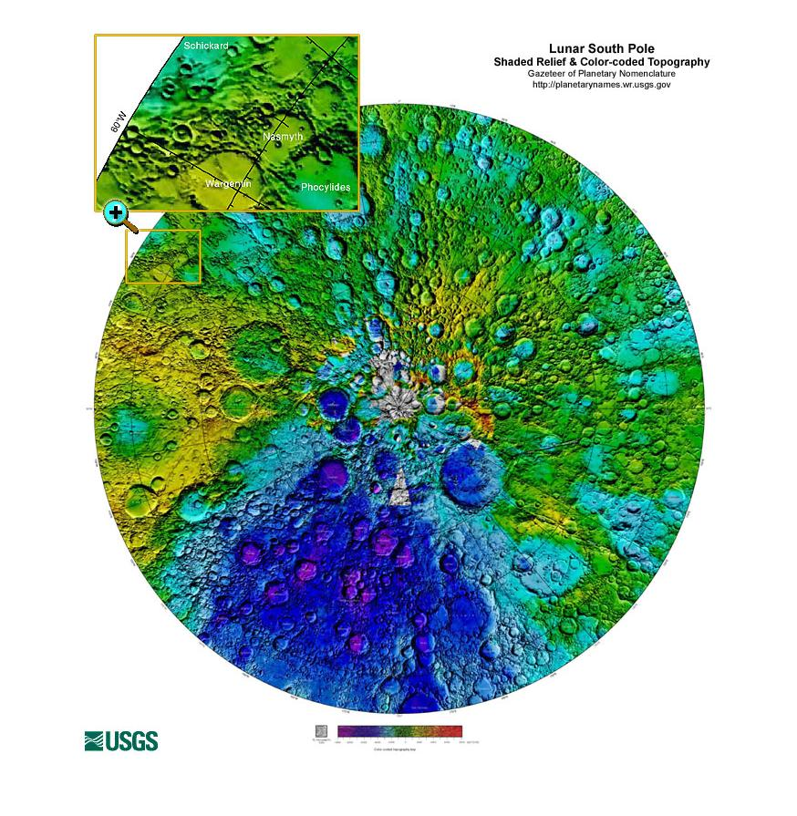
View and Save Lunar South Pole Color-coded Topography
>> url = 'http://planetarynames.wr.usgs.gov/images/moon_sp.jpg';
>> data = webread(url);
>> imshow(data)
>> filename = 'lunarSouthPole.jpg'
>> options = weboptions
>> options.Timeout = 10;
>> options.ContentType = 'image';
>> outFile = websave(filename,url,options)
outFile =
c:\Libraries\Documents\lunarSouthPole.jpg

Slide 16
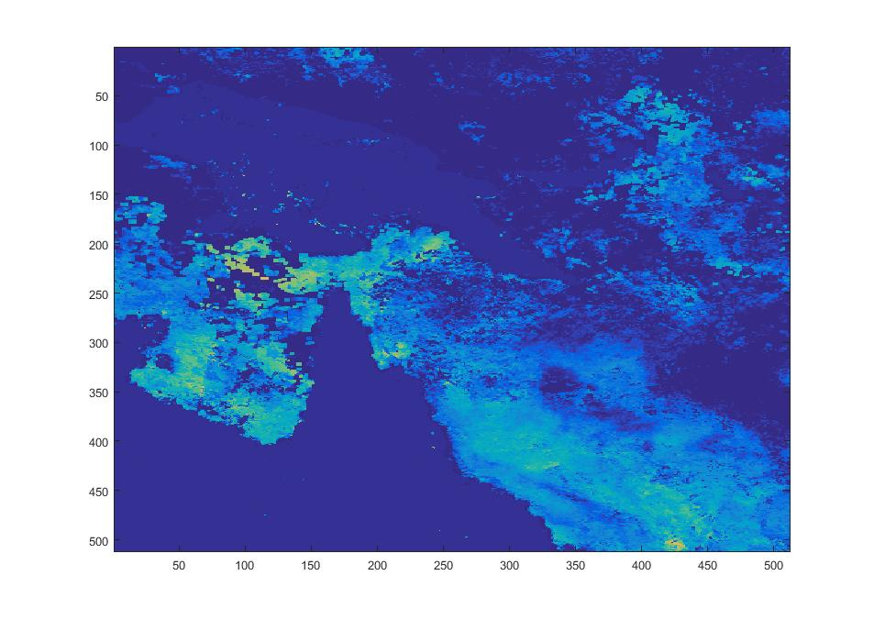
Demo: Webread meets HDF Server
HDF Server: A RESTful API providing remote access to HDF5 data
Responses are JSON formatted text
webread with weboptions provide data access
Example: Coral Reef Temperature Anomaly Database (CoRTAD)
Version 3 CoRTAD products in HDF5 format
1.8G dataset
Running h5serv locally
>> options = weboptions('RequestMethod','get','KeyName','host','KeyValue','cortadv3_row04_col14.hdfgroup.org')
>> data = webread('http://localhost:5000/',options)
data =
lastModified: '2015-07-10T00:41:43.681844Z'
hrefs: [5x1 struct]
root: '6f60d9c0-269c-11e5-aa56-005056c00008'
created: '2015-07-10T00:38:58.799031Z'

Slide 17
Questions?
www.mathworks.com
www.mathworks.com/matlabcentral
Examples:
    Using the high-level HDF5 Functions to Import Data
    Tackling Big Data with MATLAB
Performing Numerical Simulation of an Oil Spill
Reading Content from RESTful Web Service
Thank you!

Slide 18
References
www.hdfgroup.org
https://www.hdfgroup.org/HDF5/doc/Advanced/DynamicallyLoadedFilters/HDF5DynamicallyLoadedFilters.pdf
https://hdfgroup.org/wp/2015/04/hdf5-for-the-web-hdf-server/
http://data.worldbank.org/developers/climate-data-api
https://data.nasa.gov/data
http://visibleearth.nasa.gov/
http://www.nodc.noaa.gov/sog/cortad/
http://data.nodc.noaa.gov/cgi-bin/iso?id=gov.noaa.nodc:0068999

