Slide 1
ArcGIS and Multi-D: Tools & Roadmap
Esri Team: Christine White, Nawajish Noman,
Hong Xu, Dawn Wright
cwhite@esri.com

Slide 2


https://www.govloop.com/training/simple-ways-to-do-more-with-your-scientific-data

Slide 3
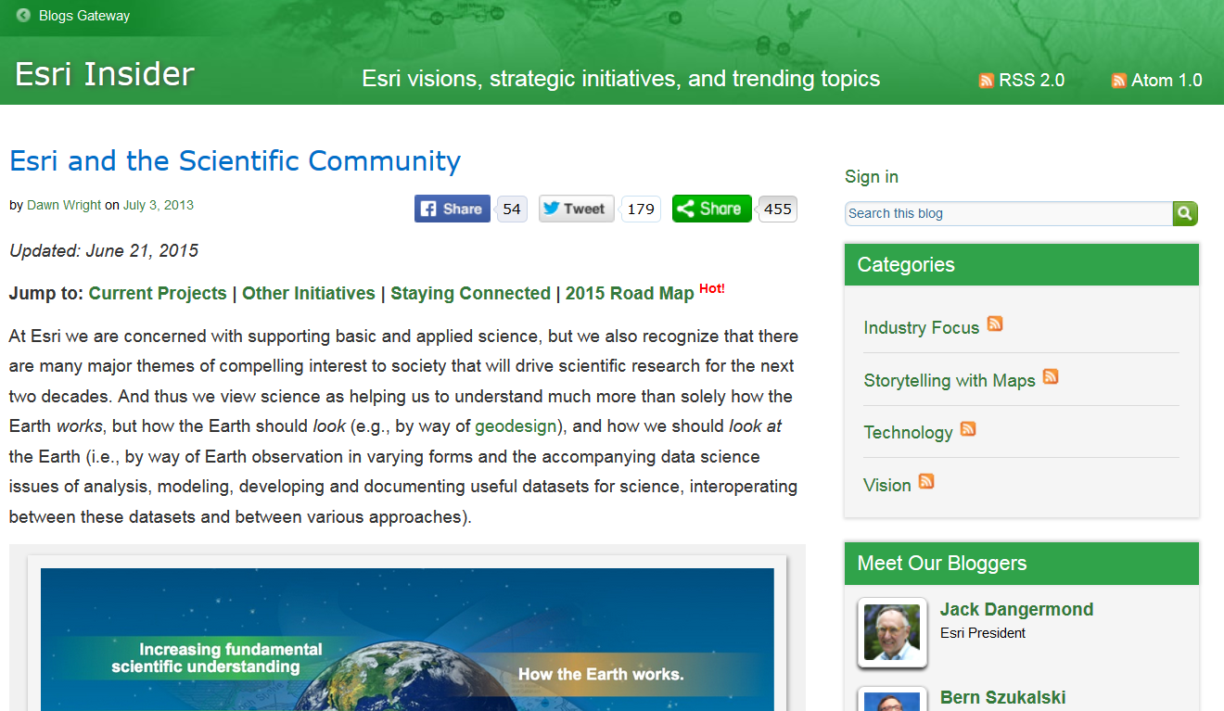

Notes:
http://www.esri.com/library/whitepapers/pdfs/esri-and-the-scientific-community.pdf

Slide 4
Esri Science Community Program
Serve Science Community
Esri CEO,
Chief Sci
NGO/Conservation/
Env Consulting
TNC
Conservation Intl
SCGIS
World Resources Institute
Audubon
Land Trust
exactEarth
Stone Environmental
CSA Ocean Sciences
Cal Academy of Sciences
etc.
Universities
• domain science depts
• geog/GIScience depts
• CS depts
• research facility
infrastructure
• platform for integration,
science strategy
• research offices
Natl Govt
Science
NOAA
NASA
USGS
BLM
BOEM
EPA
USDA Forest Service
US Fish & Wildlife
GEOSS, ESA
State/Local
Government
Cities & Counties
Flood Plain Managers
Coastal Planners
State GIS Offices
State Fish & Wildlife
State Forestry Programs
Water/Sanitation Districts
State Geological Surveys
Earth
Science
Social
Science
NSF
Esri Dev
CTOs
R&D
ArcGIS
Tech
relationships w/ professors, labs, science orgs, cooperative institutes
Energy Company
Research Units
RPS, Shell, Kisters, etc.
Sensor Tech
(Partners)
Big (Geo)Data
Program Components
Chief Scientist, National Government Science Team, Esri Education Team
Foster Innovation
Internships for students
Sabbaticals for faculty
Esri Development Centers at universities
Summits: Dev, Geodesign, Ocean, Health, etc.
(UC Science Symposium coming in 2016)
Informal MOUs with labs/orgs
Esri Press Research Monographs
Software stacks (e.g., MultiD, SciPy, R integration)
Data stacks (e.g., ArcGIS Online content, Living Atlas
Resource web sites (blogs, use cases, webinars)
Esri Press research monographs
App challenges/Design competitlons
Informal MOUs with labs/orgs

Slide 5
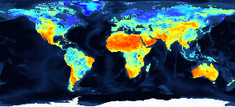
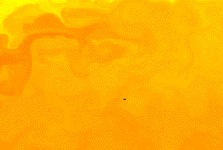
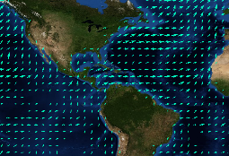
Scientific Data in ArcGIS - Vision
ArcGIS
direct ingest
data management
visualization
share
analysis

Slide 6
Accomplishments this past year
Multidimensional Data in ArcGIS Online
ArcGIS 10.3 directly reads HDF and GRIB data as raster
Scientific data support in Mosaic Dataset
  Ability to apply raster functions dynamically across visualization
Vector Field renderer for raster = Visualization of Raster as Vectors
Dimension Explorer
New raster functions

Slide 7
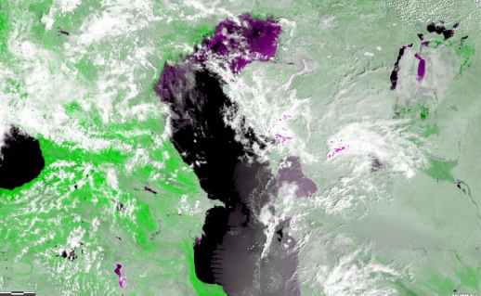
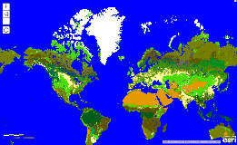
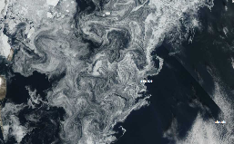
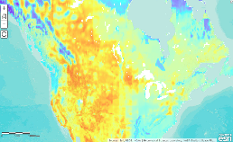
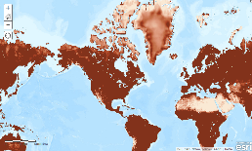
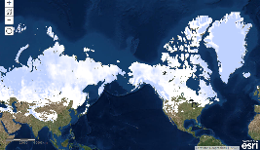
Scientific Data on ArcGIS Online
Online scientific content that can be directly used:
MODIS data
  MODIS land cover 2000-2011
  MODIS Vegetation Analysis
  MODIS Greenland Sea Ice
Live NOAA wind service
NASA Global Land Data Assimilation (GLDS)
  Soil moisture
  Evapotranspiration
  Snow pack
More

Slide 8
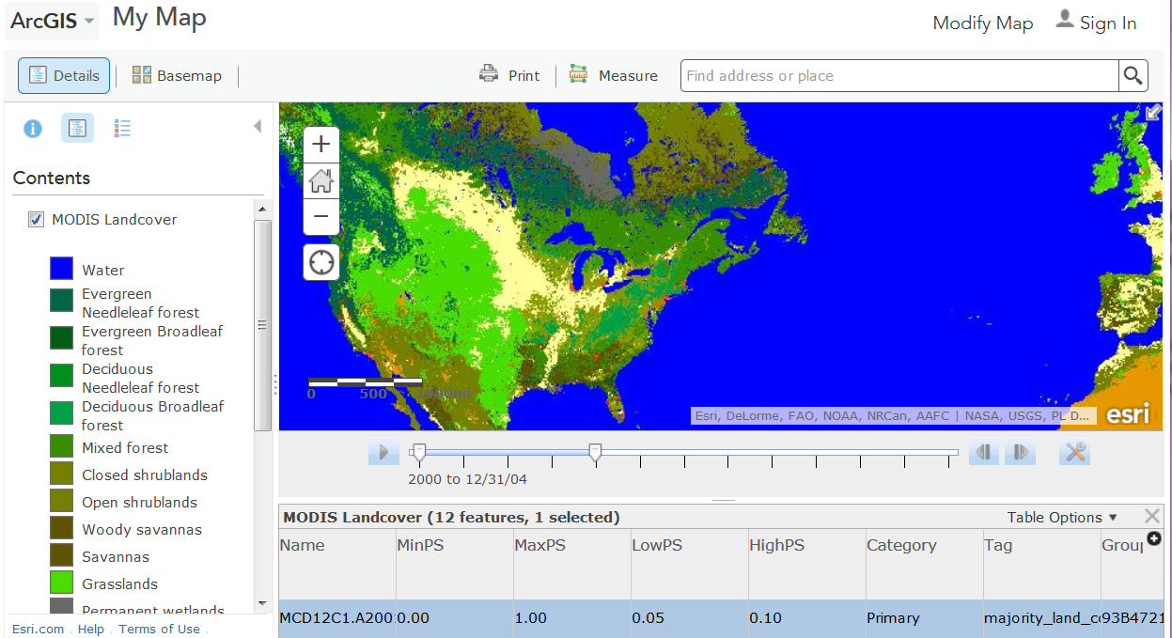
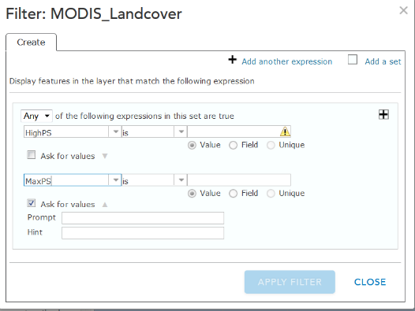
Notes:
http://sampleserver6.arcgisonline.com/arcgis/rest/services/ScientificData/MODIS_Landcover/ImageServer

Slide 9

ArcGIS Support for Multidimensional Data
The advanced multidimensional mosaic dataset model
Read netCDF as raster, feature point, table
  Make netCDF Raster Layer tool
  Make netCDF Feature Layer tool
  Make netCDF Table View
Directly read HDF and GRIB as raster layer
Mosaic dataset for all gridded multidimensional data (MDMD)
  Manage variables and dimensions
  Aggregate from multiple files
  On-the-fly scientific computation
  Serving scientific data through portal and web

Slide 10
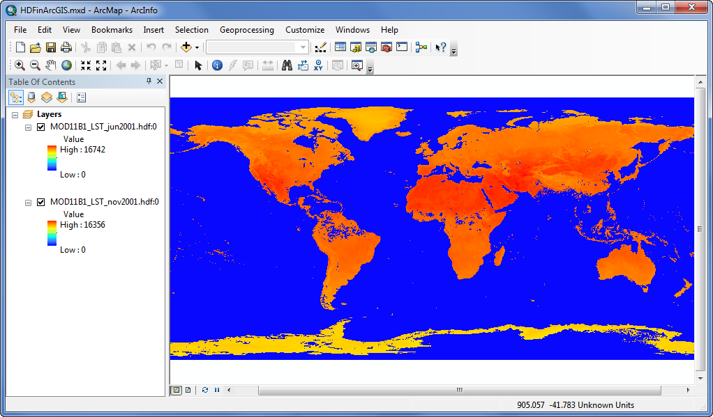
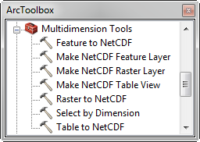
Directly reads HDF and GRIB data as raster

Slide 11
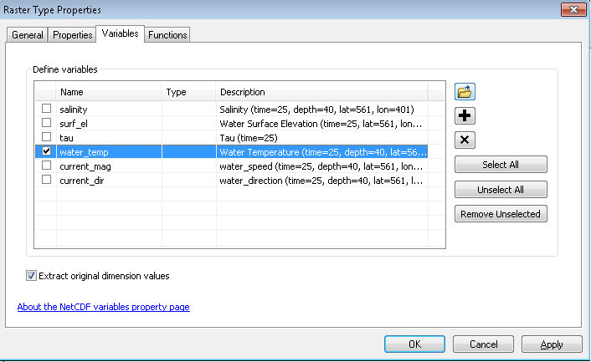



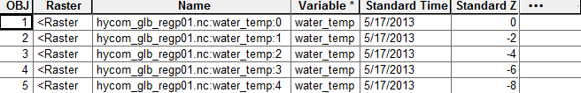
Multidimensional Mosaic Datasets
Manage netCDF, GRIB, and HDF
Created with netCDF, HDF & GRIB raster types
  Define variables when adding Rasters
  Each Row is a 2D Raster with variables and dimension values
Define On-the-fly processing
  Unit conversion
  Interpolate irregular gridded data

Slide 12
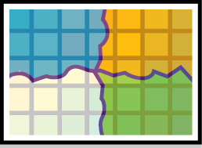






Multidimensional Mosaic Dataset- Aggregation
Aggregate data spatial, time and vertical dimension
Add multiple variables
Add from multiple files
Normalize time dimension
Normalize vertical dimensions

Slide 13
Multidimensional Data - Visualization
Query by dimension and variable
Temporal display using Time slider
Visualizing vertical dimension with Range slider
  ArcMap: esriurl.com/dimension
Visualize wind and current using vector symbols
  Arrows, Wind barbs, …
  Configurable sampling
Notes:
http://blogs.esri.com/esri/apl/2015/03/11/dimension-explorer/
esriurl.com/dimension

Slide 14
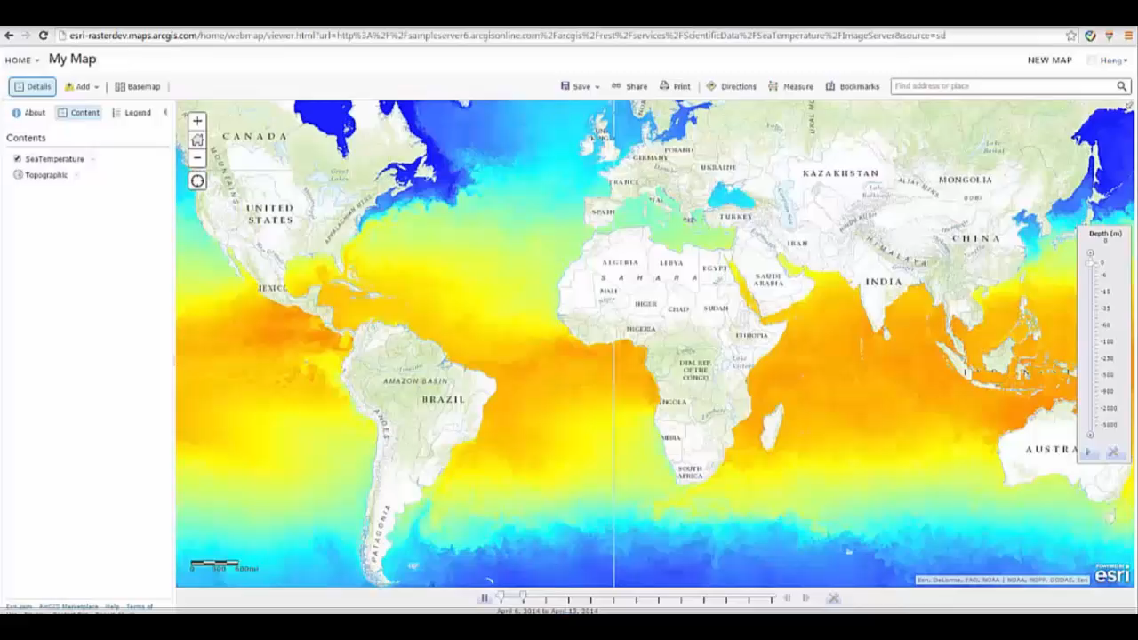
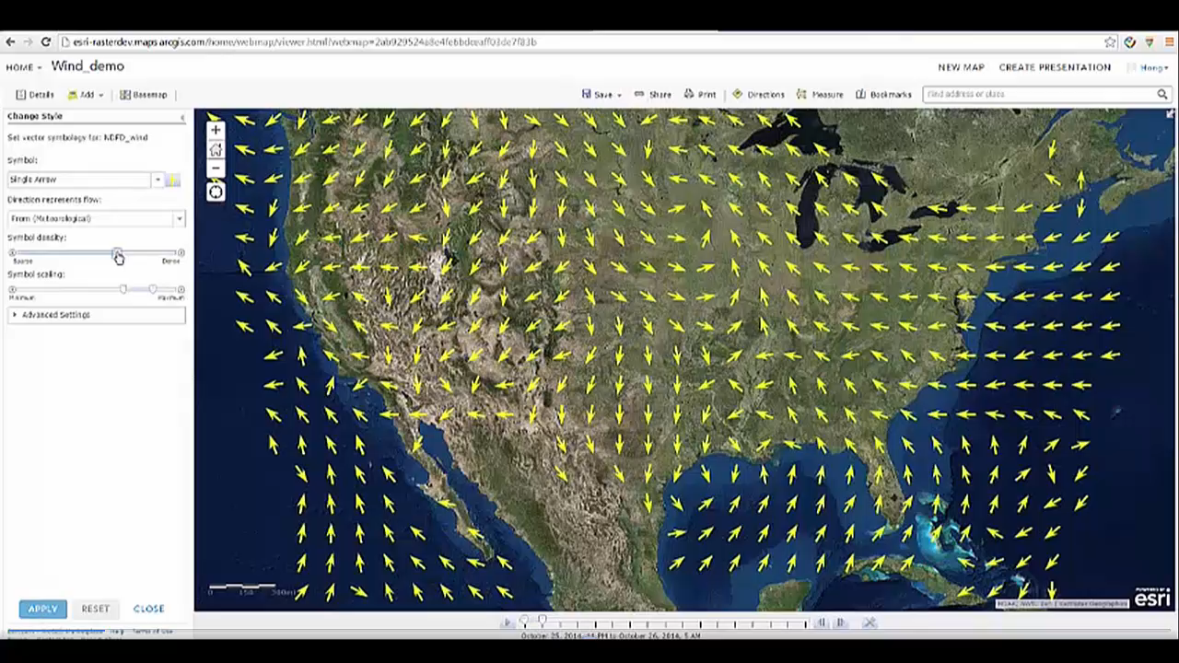
Web Viewer: Vertical Dimension Slider and Vector Symbol

Slide 15
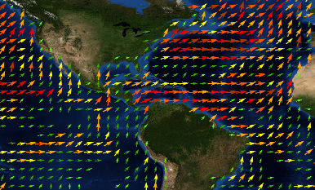
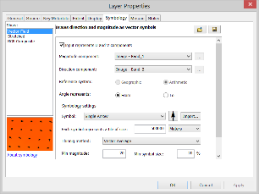
Visualization of Raster as Vectors
https://desktop.arcgis.com/en/desktop/latest/manage-data/raster-and-images/drawing-raster-data-using-vector-symbols.htm
New Vector Field renderer for raster
  Supports U-V and Magnitude-direction
  Dynamic thinning
  On-the-fly vector calculation
Eliminates raster to feature conversion
Eliminates data processing
Improves workflow performance
Notes:
Multidimensional and scientific data can now be rendered using a vector field renderer, and can also be stored as a mosaic dataset. The vector field renderer allows you to render either one variable as a scalar, or two variables with the vector field options. These multidimensional datasets can be stored in a mosaic dataset, using one of the three new supported raster types: GRIB, HDF, or netCDF. The mosaic dataset provides a great data structure to store multidimensional data, since it allows you to manage time and vertical dimensions.
The Vector Field renderer allows you to render multidimensional or scientific data. These data types have two variables to render, and require a special renderer. You can render magnitude and direction or a U and V variable set.

Slide 16
13 new raster functions
ArgStatistics Function, Classify function, Curvature Function, Elevation Void Fill Function, Python Raster Function, Recast Function, Resample Function, Segment Mean Shift Function, Statistics and Histogram Function, Transpose Bits Function, Unit Conversion Function, Vector Field Function, and Vector Field Renderer Function
The Python Raster function allows you to convert your Python syntax into a raster function. This allows you to perform a Python script on the fly, just like the other raster functions
  Create custom functions, and chain them within a raster function chain.
Raster Functions on Github - https://github.com/Esri/raster-functions
Notes:
Raster Functions
Raster functions are operations that process imagery and raster datasets by applying the processing directly to the pixels. You can use functions to create many different information layers which all use the same underlying dataset.
ArcGIS comes with dozens of out of the box functions that can be used for radiometric and geometric correction, data management, visualization, and analysis. Functions can be applied individually or combined to create function chains. There are several methods for applying functions depending on the structure of the dataset.

Slide 17
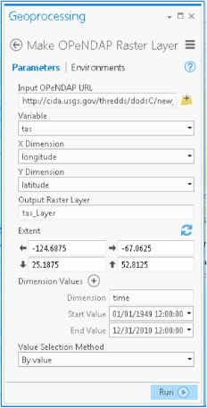
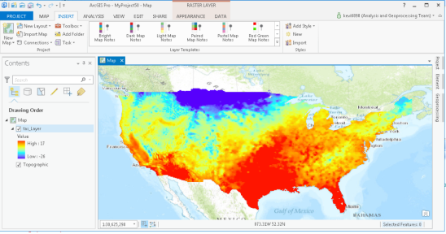
Support for OPeNDAP Data Sources
The OPeNDAP protocol has become the de facto standard for streaming scientific data
NOAA and NASA have extensive data collections available via OPeNDAP
New ArcGIS geoprocessing tool for reading OPeNDAP data
Makes a raster layer from data stored on a remote OPeNDAP server
http://pro.arcgis.com/en/pro-app/beta/tool-reference/multidimension/make-opendap-raster-layer.htm
Mean temperature (C) : 1950-2010
Notes:
OPeNDAP has become the standard for streaming scientific data.
70% of NOAA data holdings are available via OPeNDAP protocols.
New tool available in Pro 1.1, will be added to 10.4
This tool allows users to connect to any OPeNDAP server and convert the data directly to a raster layer.
Scientific community will now be able to access OPeNDAP data sources and be able to add the data directly to ArcGIS as a raster layer
In the past the user would have to access the OPeNDAP server directly and download the data, then bring into ArcGIS

Slide 18
Useful Links
http://sampleserver6.arcgisonline.com/arcgis/rest/services/ScientificData
https://github.com/Esri/raster-functions
Summary Blog Post: http://esriurl.com/scicomm
2015 Road Map: http://esriurl.com/sci2015
http://esriurl.com/workflows
Blog: “Accessing Multidimensional Scientific Data using Python” – http://blogs.esri.com/esri/arcgis/2015/06/10/accessing-multidimensional-scientific-data-using-python/

