Slide 1





Geospatial Data Abstraction Library (GDAL) Enhancement for ESDIS (GEE)
Increasing Accessibility and Interoperability of NASA Data Products with GIS Tools
NASA Atmospheric Science Data Center (ASDC)
Brian Tisdale, Booz Allen Hamilton (BAH), brian.e.tisdale@nasa.gov
Tiffany Matthews, Science Systems and Applications Inc, tiffany.j.matthews@nasa.gov
Matthew Tisdale, Booz Allen Hamilton (BAH), matthew.s.tisdale@nasa.gov
Funded by ESDIS in support of Big Earth Data Initiative (BEDI)

Slide 2
Improving the Accessibility and Use of NASA Earth Science Data in Geospatial Applications
Many of the NASA Langley Atmospheric Science Data Center (ASDC) Distributed Active Archive Center (DAAC) multidimensional tropospheric and atmospheric chemistry data products are stored in HDF4, HDF5 or NetCDF format, which traditionally have been difficult to analyze and visualize with geospatial tools.
With the rising demand from the diverse end-user communities for geospatial tools to handle multidimensional products, several applications, such as ArcGIS, have refined their software.
Many geospatial applications now have new functionalities that enable the end user to:
    Store, serve, and perform analysis on each individual variable, its time dimension, and vertical dimension.
    Use NetCDF, GRIB, and HDF raster data formats across applications directly
    Publish output within REST image services or WMS for time and space enabled web application development.

Slide 3
Approach
Construct a framework which can be incorporated into the GDAL library
Develop plugins to demonstrate the viability of this approach for three data products
Develop documentation and training materials to help the other DAACs to construct plug-ins consistent with the framework
Develop a certification process by which the plug-ins can be independently verified as properly converting the data to the format required for use in GIS tools

Slide 4

What is GDAL?
Geospatial Data Abstraction Library (GDAL) is a translator library for raster and vector geospatial data formats.
As a library, it presents a single raster abstract data model and vector abstract data model to the calling application for all supported formats
Leveraged by ArcGIS, GeoServer, MapServer, Quantum GIS (QGIS) and many other geospatial tools

Slide 5
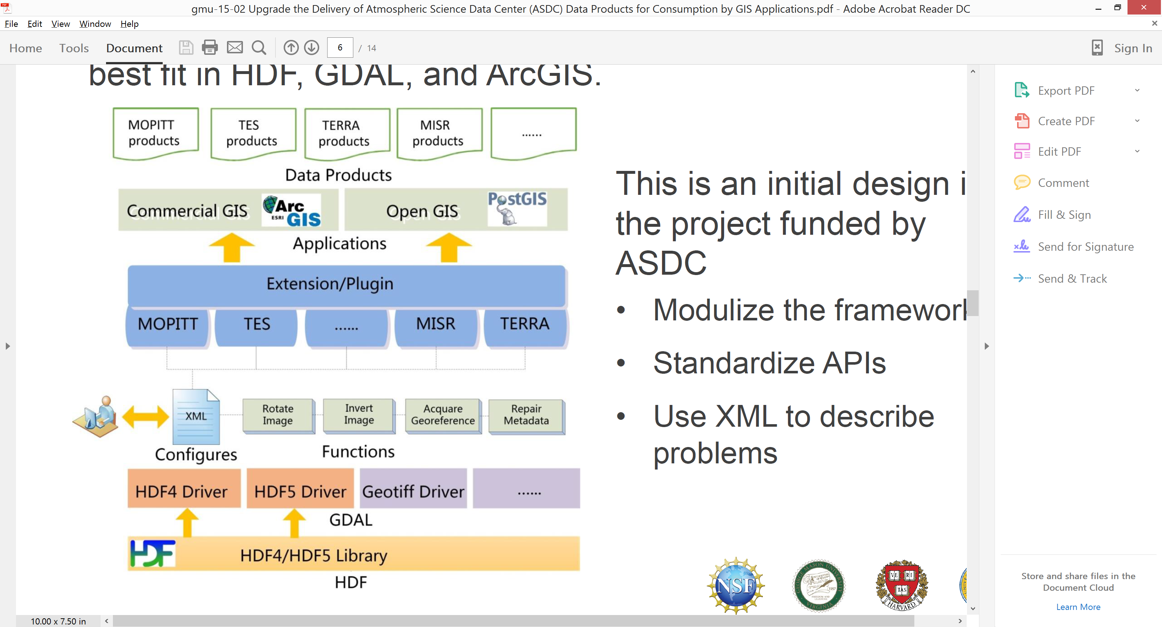
Initial Framework Design
Revised GDAL HDF Drivers to allow for extending and additional functionality.
  Added functions such as Image rotator, 3D subset reader, geo-reference interpreter, and metadata repairer to set up the generic algorithm framework.
Customized framework with Data product plugins that recognize file name patterns.
Enabled image rendering and user workflow with an ArcGIS plugin / extension for testing of effectiveness of the improved GDAL.

Slide 6
Plug-in Development
GDAL-metadata repairer
  Enabled reading image dimensions from metadata.
  Recognized and assigned correct value type of datasets.
  Automatically fixed ‘NoData’ value in metadata with values from data.
GDAL-image rotator
  Inverted the pixels of image which is upside down. The module rotates the image in memory and we may add more to this when other rotations are needed.
  Recognized latitude and longitude correctly.
GDAL 3D Subset Reader
  Converted the data structure that breaks the flow of program execution of the HDF driver into the correct organization (shown below).
GDAL Geo-Reference Interpreter
  Fixed the issue of missing ground control coordinates array.
  Enabled ability to read geo-reference information.
GIS software
plug-in
9
9
9
9
360
Before Improvement: Wrong data organization read by HDF driver
180
180
…
1
2
3
…
360
1
360
After Improvement
j = 0, line(0)
180
9
…
……
1
Height =180
Line(j) <-> Line(Height – j - 1)
j = Height -1, line(179)
Width = 360
Inverting raster dataset

Slide 7
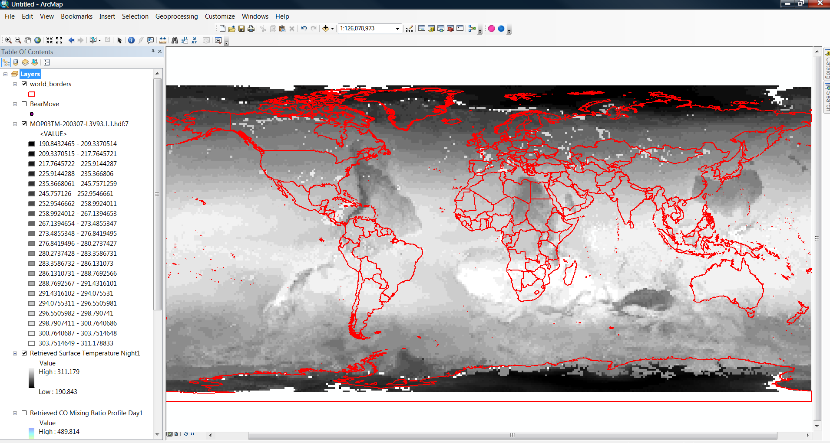
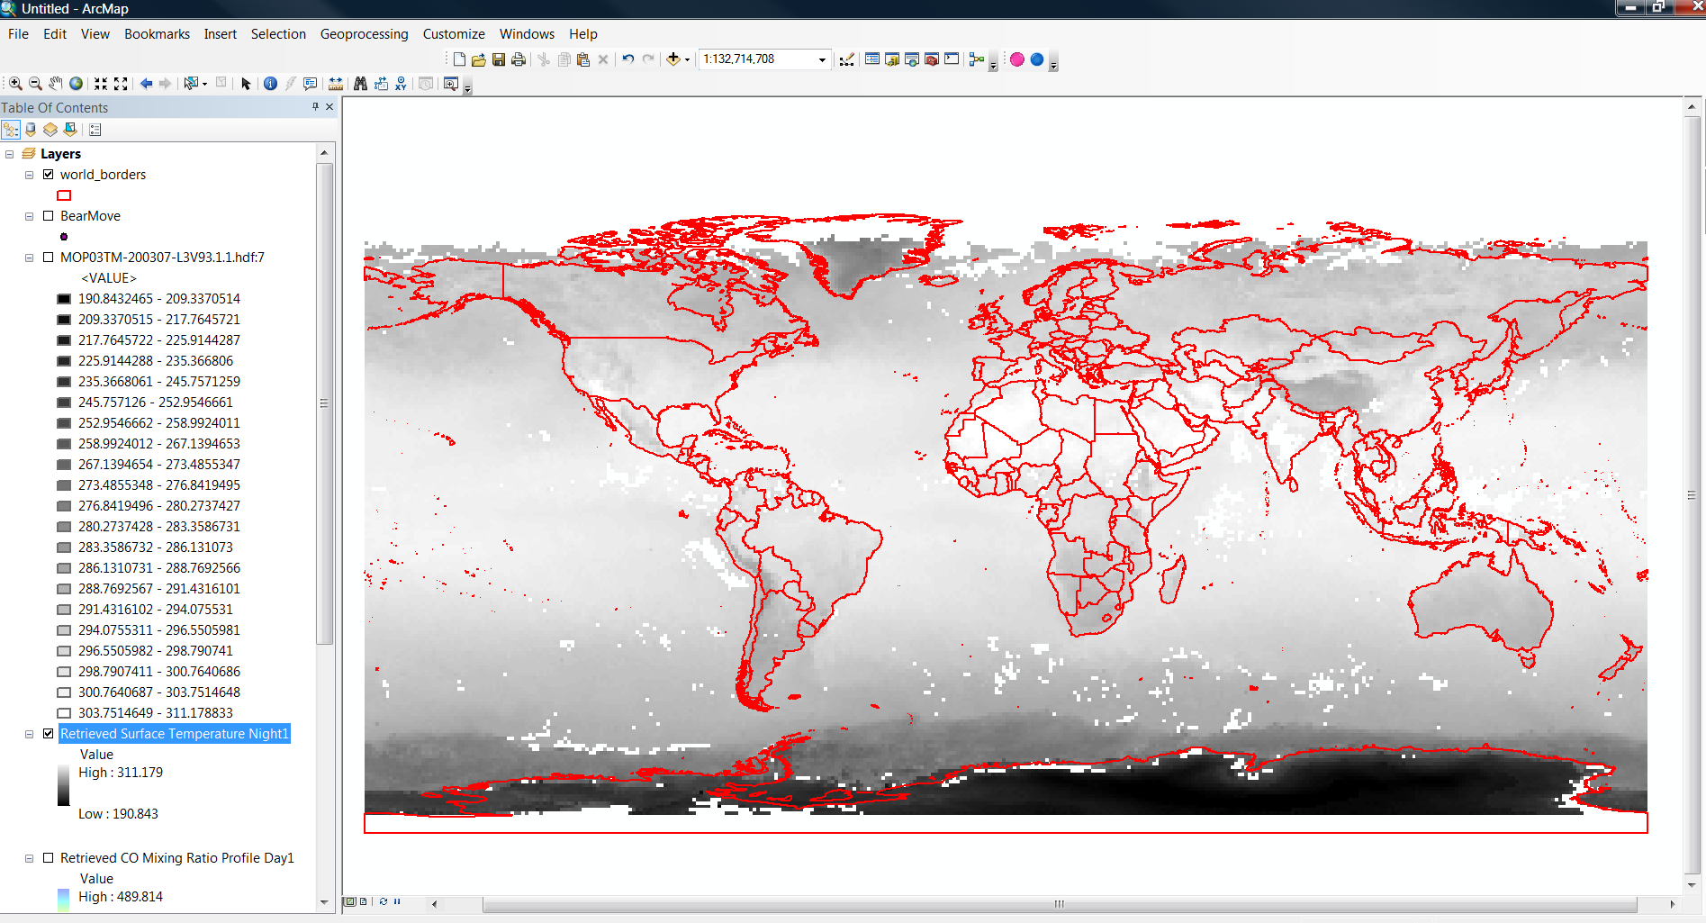
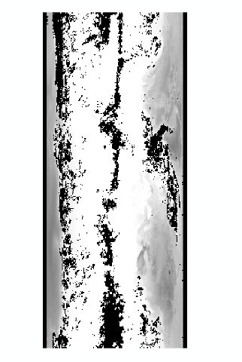
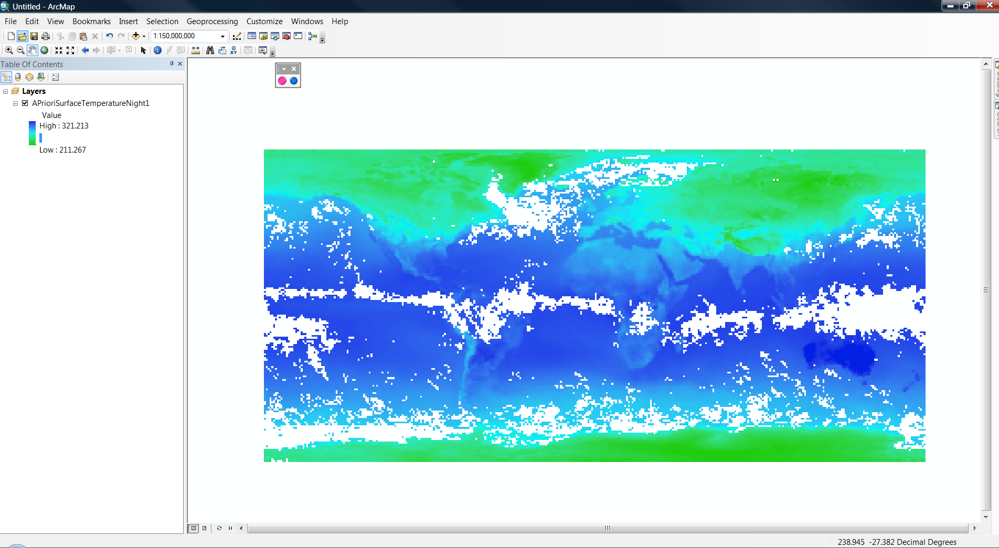
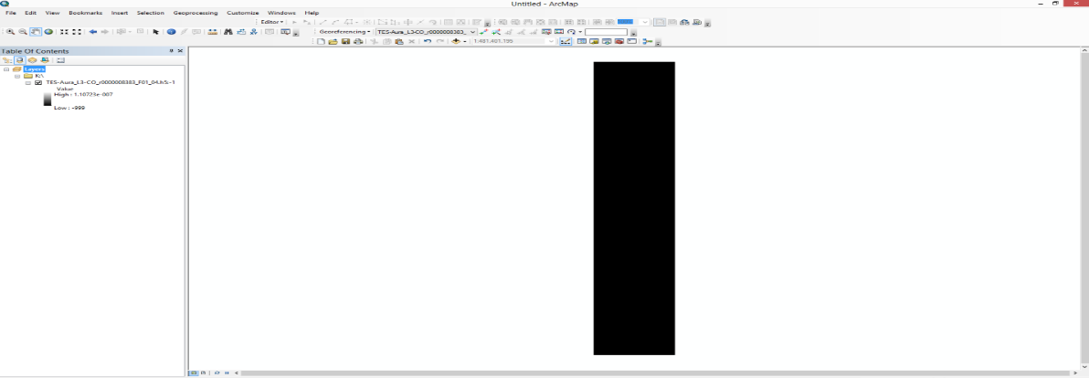
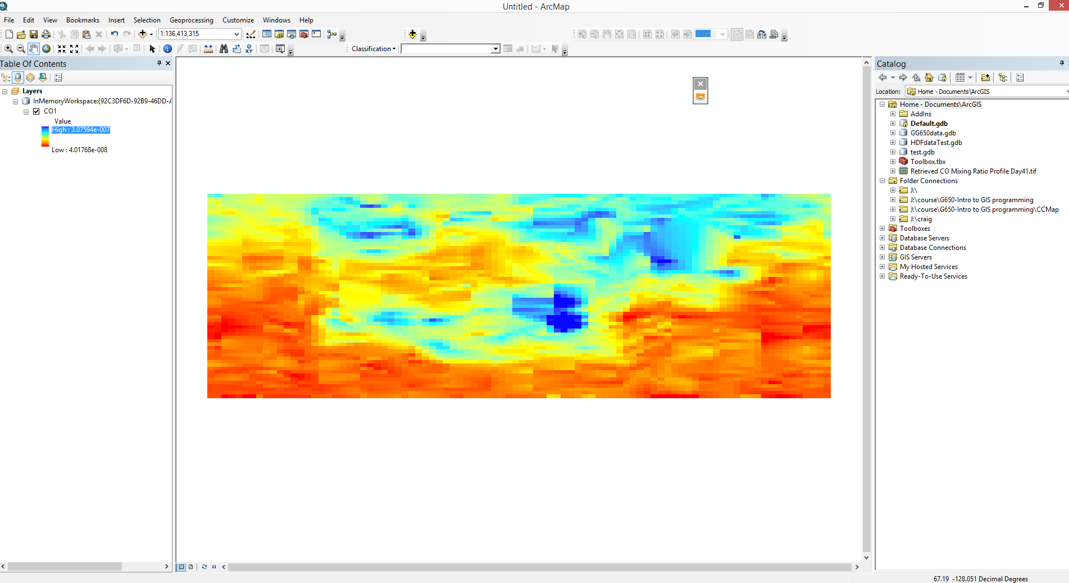
Results
In ArcMap 10.2.2
ASDC Improvement
Image Displayed Inverted
MOP03TM.005 (HDF4):
Retrieved Surface
Temperature Night
Missing Geo-Reference
& 90 Degree Rotated
MOP03TM.006 (HDF5):
A Priori Surface
Temperature Night
Missing Geo-Reference
& Cannot Display the 3D dataset
TL3COD.001 (HDF5):
CO
This is the layer of the 3D subset selected by users

Slide 8
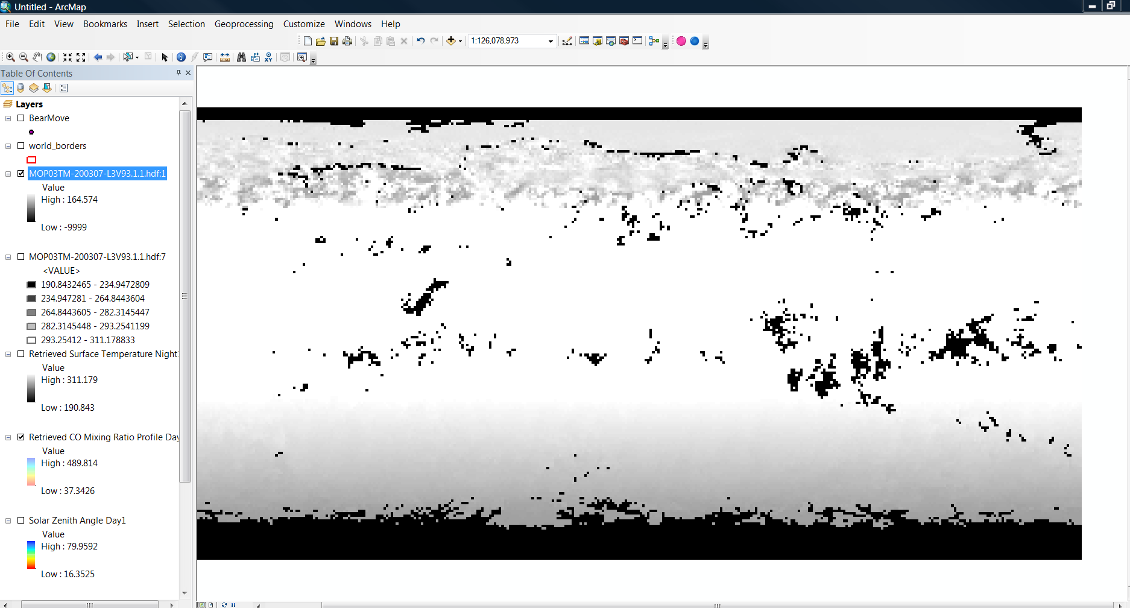
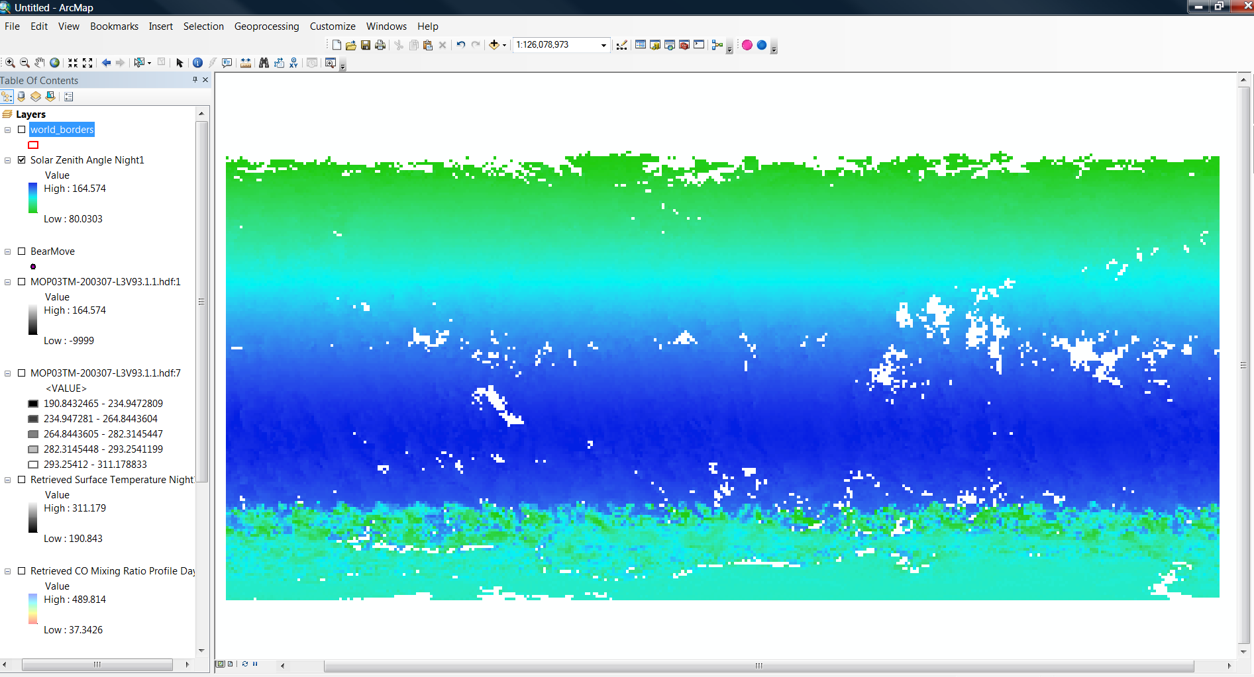
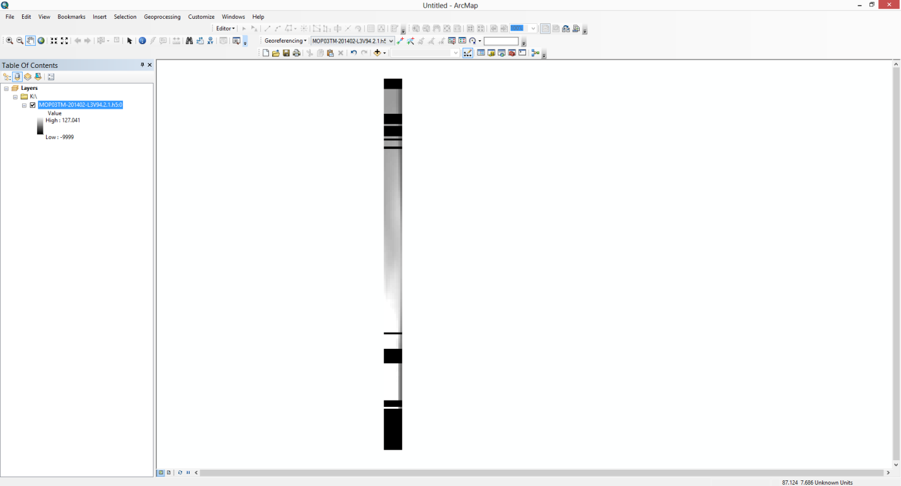
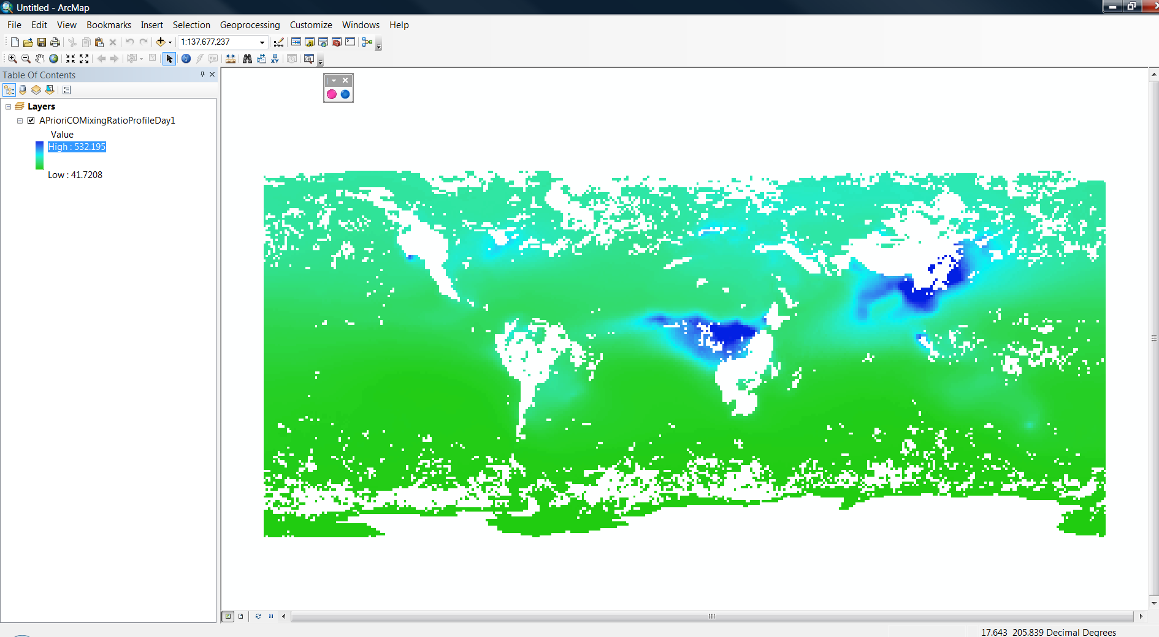
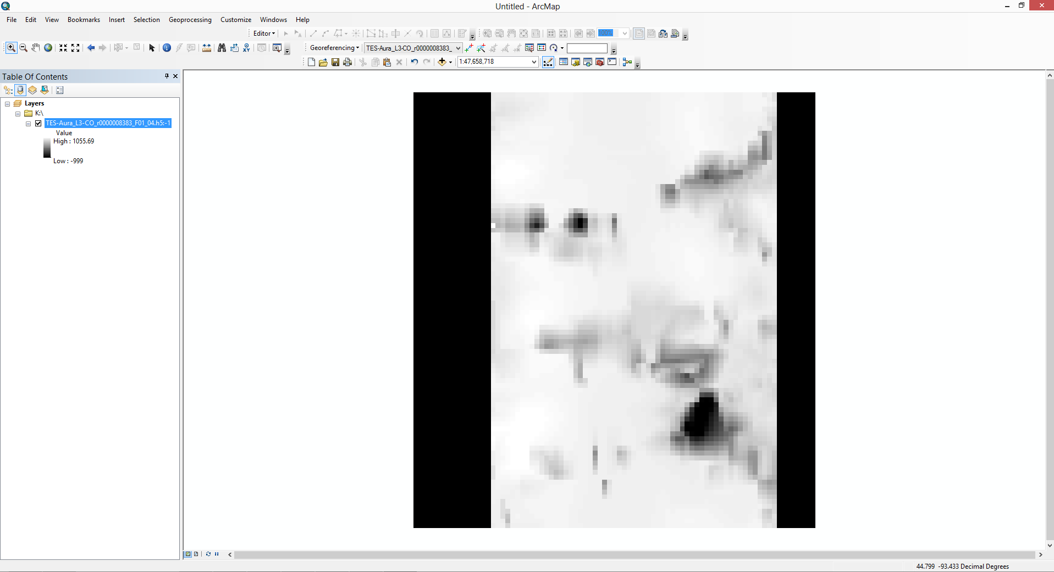
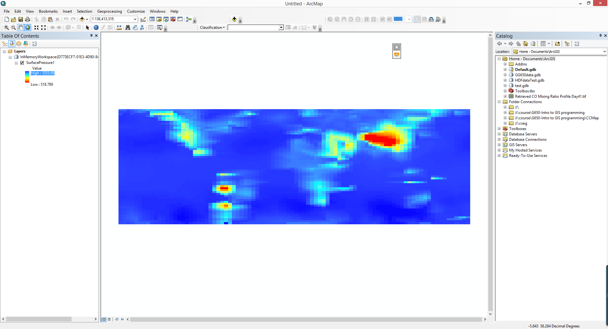
Results
In ArcMap 10.2.2
ASDC Improvement
Missing NoData Flag
MOP03TM.005 (HDF4):
Retrieved Surface
Temperature Night
Data range: -9999 to 164.574
Data range: 80.0303 to 164.574
Missing Geo-Reference
& Cannot Display the 3D dataset
MOP03TM.006 (HDF5):
A Priori CO Mixing
Ratio Profile Day
This is the layer of the 3D subset selected by users
Missing Geo-Reference
& 90 Degree Rotated
TL3COD.001 (HDF5):
Surface Pressure

Slide 9
Next Steps
Provide project outreach and awareness to the DAAC community to include overview and demonstration of Phase 1 results and Phase 2 plan.
Enhance the framework and plugins to move from alpha-quality code to early-production code to be more flexible and extensible.
  The framework should be agile, simple and XML driven (as the current “alpha-quality code” is tightly coupled to the GDAL HDF driver).
  “Early-production code” will be submitted as an enhancement to GDAL public branch.
Identify and document compliance certification requirements to include specifications on how to describe the data product problem set for the plugin.
Develop guides/tutorials, based up documented lessons learned and strategic processes, to aid DAAC’s in building GDAL plugins.
Conduct assessment of DAAC’s in-house geospatial knowledge and geospatial issues that they have identified.

Slide 10
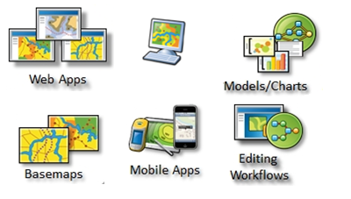
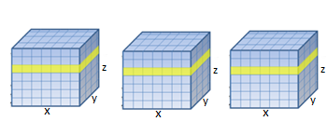
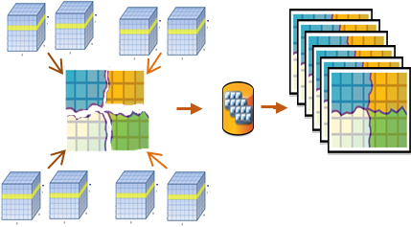
Utilizing the ArcGIS Platform as an End-to-End Solution for Processing, Analyzing, and Visualizing NASA’s Scientific Data
HDF/netCDF/GRIB Data Warehouses
ArcGIS Multidimensional Mosaic Dataset
Enable ArcGIS Platform
Aggregate (mosaic) spatial, time, and vertical dimensions
  Create a seamless multidimensional cube:
    from files representing different regions
    from files representing different time steps/slices
  Spatial Aggregation
  Temporal Aggregation
  On-the-fly analysis
Notes:
SSE is utilizing the ArcGIS Platform as an end-to-end (data to end-user analysis) solution for processing, analyzing, and visualizing NASA’s scientific data. Leveraging the ArcGIS Multidimensional Mosaic Dataset we can spatially and temporally aggregate our data from the source repositories into a s service compatible with the ArcGIS Platform. We focus on exposing the data and everything else just works! It’s all about aggregation!
Enable users to create, organize, and share geographic information and tools with anyone by using intelligent online maps and useful apps
Aps run virtually anywhere - on desktops, the web, smartphones, and tablets.
----- Meeting Notes (9/22/14 14:03) -----
Partnering with ASDC to help remove duplication from stored data.

Slide 11
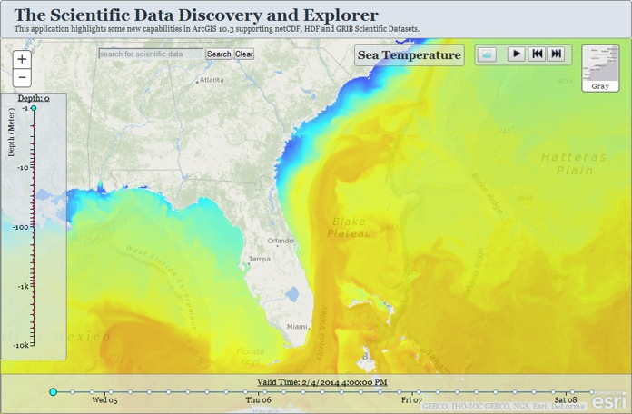
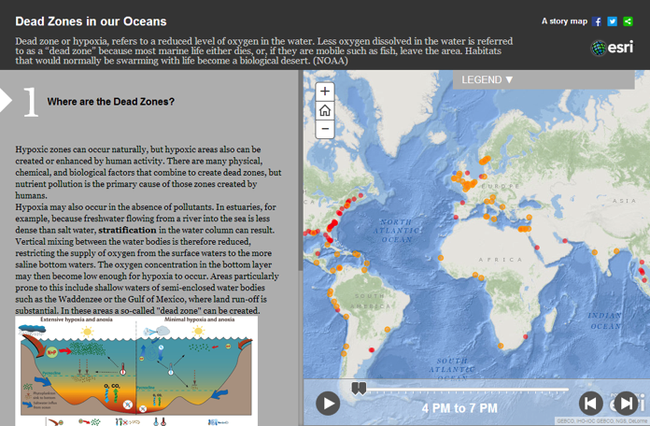
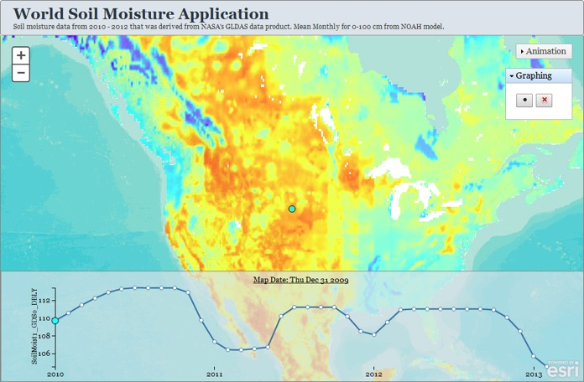
Multidimensional Data in Web Applications
Depth
Time
Create Story Maps to tell the
story of your scientific data
Temporal
Graph
Notes:
Want to quickly make a web map that shows change overtime? How about a map that shows changes at different pressure levels? We can make and share interesting maps like these quickly by selecting from a variety of configurable web mapping templates.

Slide 12
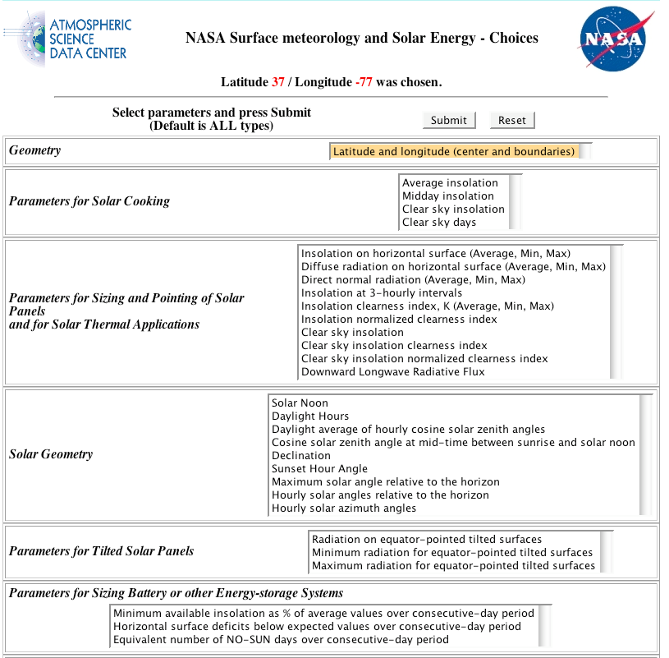
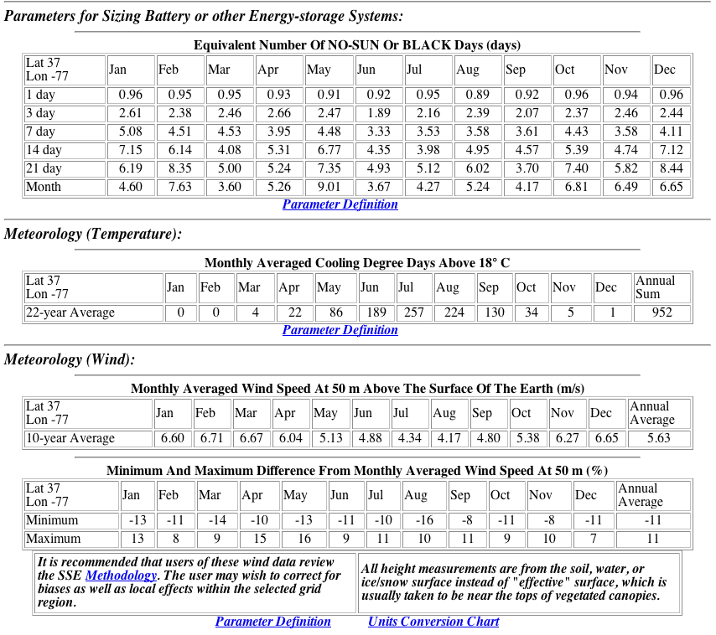
Use Case: POWER Surface meteorology and Solar Energy (SSE)
Objective: Integrate improved environmental data, analysis and modeling for enhanced management of energy production and energy efficiency systems.
Limited graphical capability
Requires improvement to better serve customers
Notes:
Objective: Improve the Nation’s public and private capability for integrating environmental data from NASA’s satellite-based analysis and modeling research into sound management of energy production and energy efficiency systems.

Slide 13
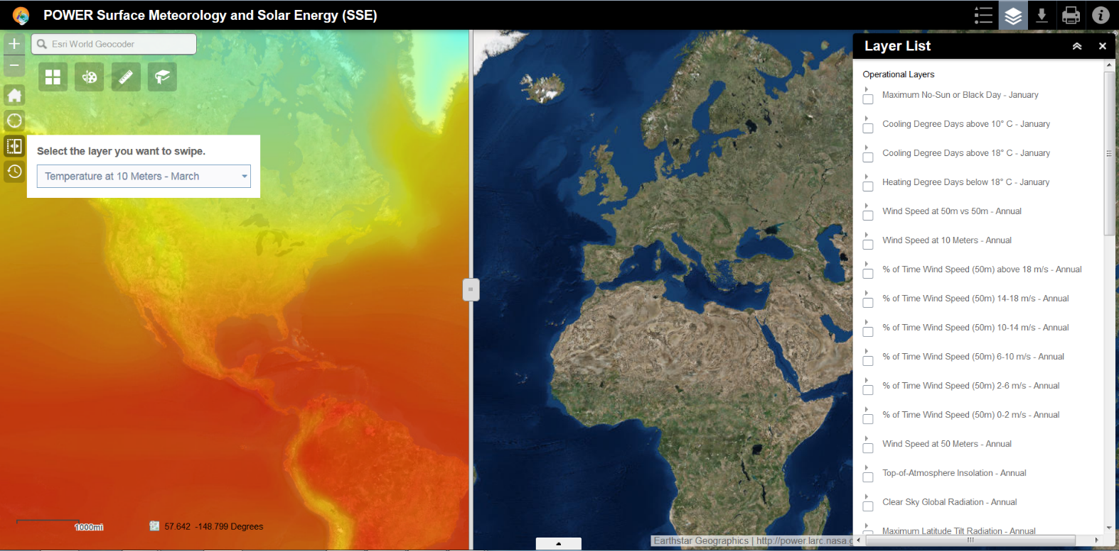

POWER SSE – GIS Web Application Enhancements
High quality viewing (Desktop/Mobile) and printing
Data Extraction and Subsetting
Simultaneous Dataset Visualization (Swiping)
Temporal Visualization
Custom Color Ramps
Pixel/Attribute Value Identification at Selected Location

Slide 14
Contact Us
NASA Atmospheric Science Data Center (ASDC)
Brian Tisdale, Booz Allen Hamilton (BAH), brian.e.tisdale@nasa.gov
Tiffany Matthews, Science Systems and Applications Inc, tiffany.j.matthews@nasa.gov
Matthew Tisdale, Booz Allen Hamilton (BAH), matthew.s.tisdale@nasa.gov

