Slide 1
HDF Project Update
Mike Folk
And the HDF Earth Science Project Team
The HDF Group
July 11, 2014

Slide 2
HDF Group Mission
To provide high quality software for managing large complex data,
to provide outstanding services for users of these technologies,
and
to insure effective management of data throughout the data life cycle.

Slide 3
The HDF Group
A not-for-profit company based in Champaign, IL.
Creators and stewards of HDF4 and HDF5
Develop and maintain the free, open-source HDF software
Notes:
“Develop … free…”: Explain open source model.
“Committed to…”: Talk about software development process, quality engineering, regular releases, etc.

Slide 4
The HDF Group Services
Core software maintenance and distribution
Helpdesk and Mailing Lists
Priority Support
Enterprise Support
Consulting
Training
Special Projects
Notes:
Helpdesk and Mailing Lists
Available to all users as a first level of support
Standard Support
Rapid issue resolution and advice
Consulting
Needs assessment, troubleshooting, design reviews, etc.
Training
Tutorials and hands-on practical experience
Enterprise Support
Supporting many HDF activities across organizations
Special Projects
Adapting customer applications to HDF
New features and tools
Research and Development

Slide 5





















Funding sources
Earth Science
High Performance Computing
High Speed Detectors
Various
Notes:
NASA – EOS
NOAA/NASA/Riverside Tech – NPOESS/JPSS
A leading U.S. aerospace company
DOE projects
Sandia National Laboratory
Lawrence Berkeley National Lab
Argonne
ITER – international project to build an experimental fusion reactor based on the tokamak concept
Paul Scherrer Institute – variety of projects
Projects in oil and gas industry, finance, others
“In kind” support

Slide 6
Revenues by source

Slide 7
Technical activities
Technical operations
Support
Core software
Library and tools
Applications
QA
Maintenance
HPC
Projects
Other products
Earth Science
ESDIS
JPSS
Others (ISO, GeoTIFF, etc.)
HDF SaaS/Studio

Slide 8
Earth Science activities
Notes:
For other work in earth science area, see later talk, “HDF Group Support for NPP/NPOESS/JPSS”

Slide 9
ESDIS
Notes:
HDF development work
OPeNDAP handler development
Code maintenance
HDF4, HDF5, HDFView, OPeNDAP handlers, etc.
H4H5 conversion library and utilities
Special tools, such as the HDF-EOS5 augmentation tool, the HDF-EOS2 dumper tool, the HDF-EOS5 to netCDF-4 converter tool and the HDF4/HDF-EOS2 to CF conversion library
HDF Support
Support to programmers and analysts and other EOS science software teams, tool vendors and other tool builders
Help EOS stakeholders (DAACs, SIPs, vendors, etc.)
Site visits to NASA data centers, SIPS and others
Communicating with the NASA User Service Working Group (USWG) and NASA ESDIS outreach managers
Helping NASA scientific applications to access and manage EOS data.
Participation in Earth Science conferences such as AGU, AMS, ESDSWG and ESIP Federation meetings
Helpdesk and newsletter
Tutorials and workshops
HDF and HDF-EOS websites
Studies, analyses, etc.
Investigate data catalog servers and integration with web service technologies
HDF4 content maps for archiving

Slide 10
HDF-EOS website
http://www.hdfeos.net/
HDF-EOS user support – forum, etc.
Demos and examples
HDF-EOS tools
Website Traffic: 3,500 visitors per month

Slide 11
Web services
Demo servers
  OPeNDAP – See Kent Yang’s Tues talk
  THREDDS – See Joe Lee’s Tues talk
  ENVI services engine – See Thomas Harris’ talk
What kinds of web services would you like to see at HDF-EOS.org?
Send us your favorite codes to demo.
Notes:
New products TRMM 7, GPM,

Slide 12
Examples
New Tool Examples
  NcML
  Google Earth
  ArcGIS
  Octave
  HDF-EOS plugin
  HEG (updated)
  GDAL (updated)
New IDL/MATLAB/NCL examples
  MOPITT v6
  OBPG VIIRS
  TRMM v7
  MASTER
Send us your requests and examples.

Slide 13
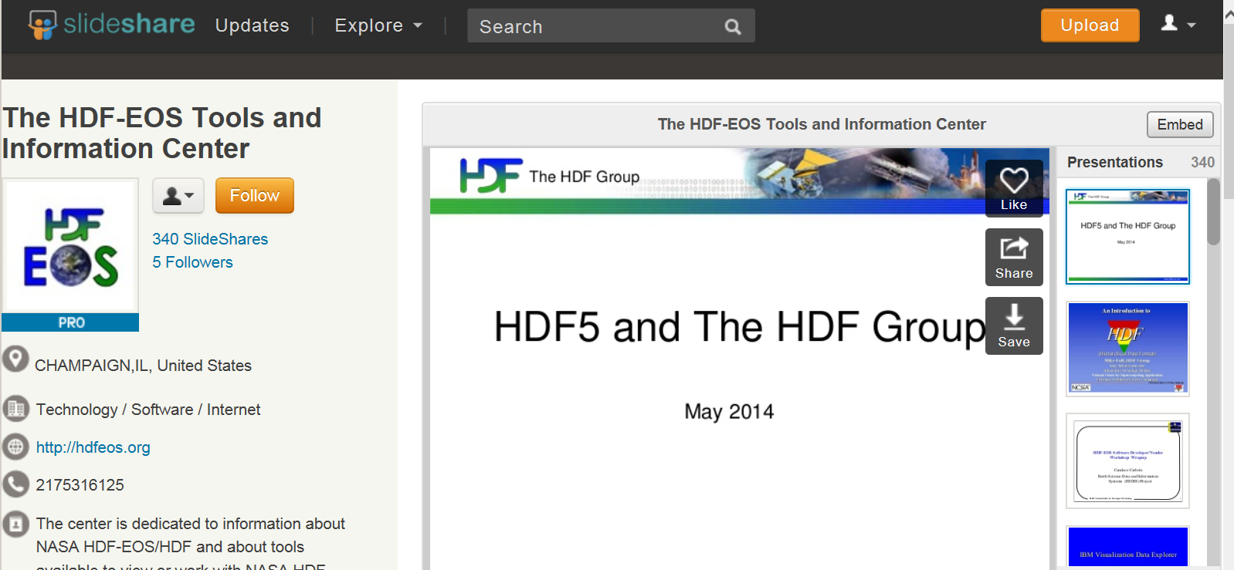
Slideshare
All workshop slides available through SlideShare
27,000 total Views in 2014

Slide 14
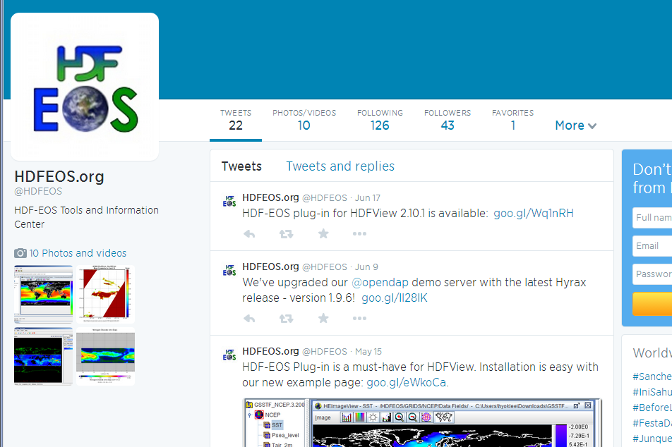
  Follow us on twitter: @HDFEOS

Slide 15
EOS-related Tools Maintained
H4CF Conversion Toolkit
HDF-EOS2 dumper
HDF-EOS5 augmentation
OPeNDAP Hdf4_handler
OPeNDAP Hdf5_handler
HDF-Java/HDFView

Slide 16
Other ESDIS
General maintenance, QA, and user support
HDF5 Product Designer
CERES HDF4 to HDF5 migration
HDF4-to-CF conventions spec
Assist with HDF-EOS software maintenance
ESDSWG Working Groups
  Geospatial
  HDF5 Conventions
  Dataset Interoperability (DIWG)

Slide 17

JPSS

Slide 18
JPSS activities
Tool development
  nagg (aggregation)
  h5augjpss (augmentation)
  h5edit (attribute editor)
Studies
  Compression for NPP products
  Web services for NPP (THREDDS, OPeNDAP)
  Assessing NPP metadata conventions, standards
Maintenance and testing on NASA AIX system
Direct user support
Notes:
Worked with JPSS personnel on compressing NPP products

Slide 19
Other earth science

Slide 20


GeoTIFF - standardization
ISO TC 211 – Geographic metadata standardization
Ocean Observatories Initiative - metadata
CH2MHill Polar Services - metadata
AZGS - EarthCube governance

Slide 21
General Maintenance,
Quality Assurance,
Support

Slide 22
hdf-forum
hdf-forum members help with
  Answering questions
  Release testing and configurations
  Issues identification and resolution
  Avenues to funding
hdf-forum@hdfgroup.org
Notes:
Configurations: Cmake build systems on non-windows platforms.
The HDF Group’s HelpDesk focuses on ESDIS and other paying customers while referring users to FORUM for difficult topics that require domain knowledge or very specific HDF5 usage

Slide 23
HDF product maintenance
Release Activities

Slide 24
Library and tool releases
New features
Performance enhancements
OS and compiler support added and deprecated
Configuration management improvements
Bug fixes
We need your input on priorities!

Slide 25
Release schedules
Releases at regular intervals, with occasional extra releases as needed.
HDF4
  Every February
HDF5
  Every May and November
Java
  Usually every November or December

Slide 26
Platform support

Slide 27
HDF4 Platforms Supported
OS | Compilers
Linux 2.6 PPC64 | GNU C and Fortran 4.4.6, IBM XL C/C++ V11.1 and Fortran V13.1
Linux 2.6 CentOS-5.10 | GNU C and Fortran 4.1.2 Intel C and Fortran v. 13.1.3 PGI C and Fortran v. 13.7
Linux 2.6 x86_64 CentOS-5.10 32 and 64-bit modes | GNU C and Fortran 4.1.2 Intel C and Fortran v. 13.1.3
Linux 2.6 x86_64 CentOS-6.5 32 and 64-bit modes | GNU C and Fortran 4.4.7 Intel C and Fortran v. 13.1.3 PGI C and Fortran v. 13.7
Linux Debian 7.2, Fedora20, SUSE13.1, Ubuntu 13.10 | GNU C and Fortran (system defaults)
SunOS 5.11 | Sun C 5.12 and Fortran 8.6
Windows 7 32 and 64-bit, Windows 8, Cygwin_ NT-6.1.1.7.25 | VS 2008, 2010, 2012 Intel 11.1, 12, 13, GNU C and Fortran 4.7.3
Mac OS X Intel 10.6.8, 10.7.5, 10.8.5, 10.9.1 32/64-bit | Apple clang v 5.0 and gfortran 4.6.2; Intel C and Fortran 13.0.3 and 14.0.1
http://www.hdfgroup.org/release4/platforms.html
Notes:
The slide outlines OSs and versions of the compilers used to test the latest public release HDF 4.2.10 in February 2014

Slide 28
HDF5 Platforms Supported
OS | Compilers
Same as for HDF4 | Same as for HDF4
AIX 5.3 | IBM XL C 10.1.0.5 and Fortran 12.1.0.6, gmake v3.82
Cray Linux Environment | PGI C, C++ and Fortran v.12.5.
FreeBSD 8.2-STABLE | GNU C, C++, Fortran 4.6.1
http://www.hdfgroup.org/HDF5/release/platforms5.html
Notes:
The slide outlines OSs and versions of the compilers used to test the latest public release HDF5 1.8.13 in May 2014. We support VS2008 on Windows for H5Py. Windows and Mac OS X have slightly updated versions of compilers

Slide 29
HDF4 and 5 Platforms to drop
OS | Last release
Mac OS X 10.7 | HDF 4.2.11 Feb 2015 HDF5 1.8.14 Nov 2014
What about Windows 7?
  Mainstream support ends Jan 2015
  Extended supports continues to 2020

Slide 30
HDF4 and 5 platforms and compilers to add
OS | Comment
Mac OS X 10.10 | For HDF4 and HDF5 releases in 2015
Compilers | Comment
GNU C/C++ 4.9 | For HDF4 and HDF5 releases in 2014 and 2015
We use virtualization.
Can add any Linux or Windows flavors.
Just let us know!

Slide 31
Recent and upcoming new HDF5 Capabilities

Slide 32
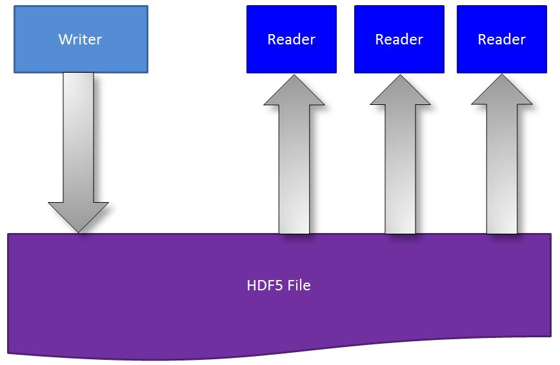
Concurrent Read/Write File Access
  Single Writer/Multiple Readers (SWMR)
  Simultaneous reading from the file while the file is being modified by another process

Slide 33
H5watch tool
Allows users to monitor when new records are appended to a dataset.
Uses SWMR

Slide 34
Virtual Object Layer (VOL)
Abstraction layer allows different plugins for accessing data
Use HDF5 Data Model without enforcing HDF5 file format
Notes:
34

Slide 35
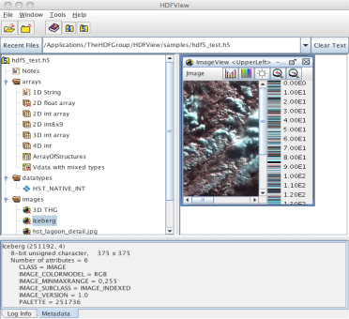


Virtual Object Layer (VOL)
HDF5 Application
HDF5 API
VOL
Plugin Layer
NetCDF
HDF5 Library
FS
Cloud
dimensions:
lon = 2 ;
lat = 2 ;
ref_time = UNLIMITED ; // (48 currently)
variables:
float lon(lon) ;
lon:long_name = "longitude" ;
lon:FORTRAN_format = "f6.1" ;
lon:units = "degrees_east" ;
float lat(lat) ;
lat:long_name = "latitude" ;
lat:FORTRAN_format = "f6.1" ;
lat:units = "degrees_north" ;
netCDF file
HDF5 file
Directories and files on FS
Objects in a cloud
Notes:
35

Slide 36
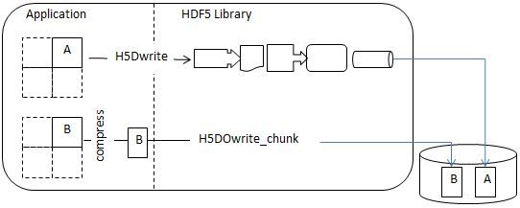
Direct chunk write
When writing chunked data, bypass hyperslab selection, data conversion, and the filter pipeline.

Slide 37
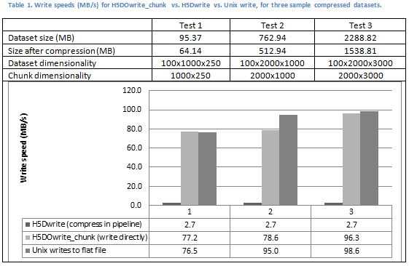
Direct chunk write performance

Slide 38
Other recent features of note
Fault tolerance through “journaling”
  Saving files when disaster strikes
  Journal metadata changes saved in a file
  H5recover tool to restore metadata in a file
Faster I/O with “metadata aggregation”
  Aggregate small pieces of HDF5 metadata
  Allocate metadata in page size blocks in a file, perform I/O in pages

Slide 39
Other recent features of note
Dynamically loadable filters
Persistent File Free Space tracking/recovery
Asynchronous I/O
  Allow application to proceed while the library performs I/O
h5repack and h5diff - performance improvements
Notes:
MD aggregation: MD blocks will be aligned, will know page address and can page in the whole block.
Notes about AIO:
As long as the file system is POSIX compliant
Other processes can be on other systems (as long as shared file system is POSIX compliant)

Slide 40
HDF5 1.10 Roadmap

Slide 41
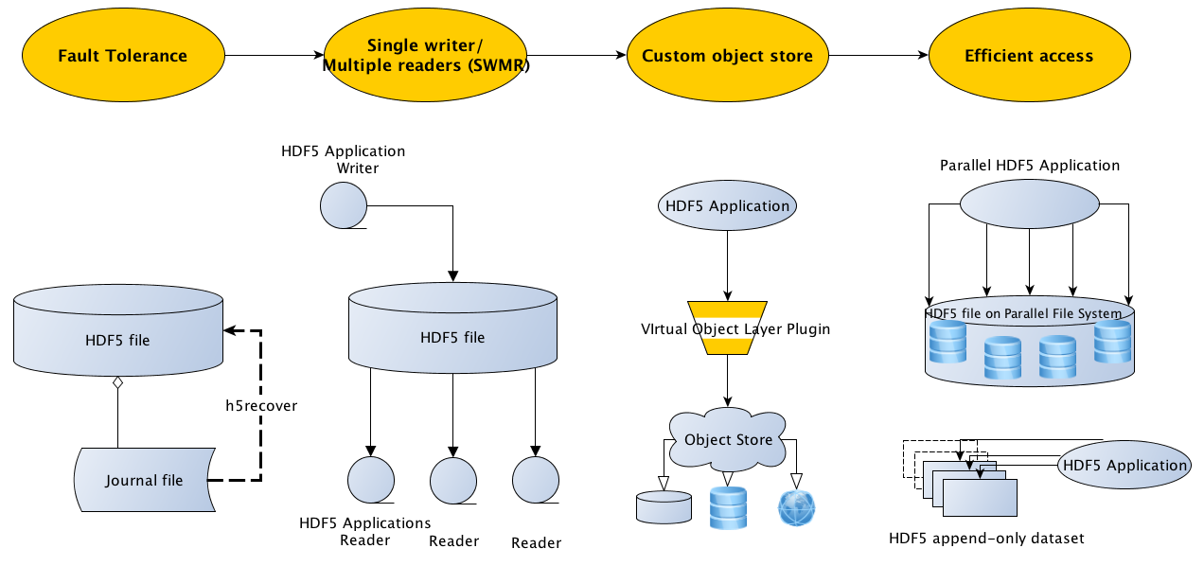
HDF5 1.10.0-beta Release Roadmap

Slide 42
A hero application

Slide 43
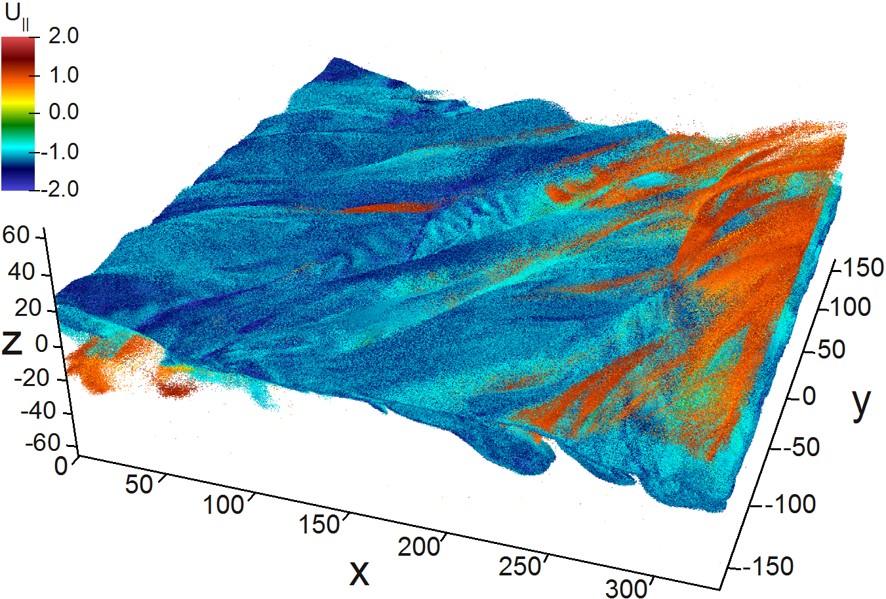
LBNL trillion particle simulation
“This is the first time that our science collaborators have been able to examine the trillion particle dataset.
They had largely ignored the particle data, or looked at a coarse grained version earlier”*
*http://www.sdav-scidac.org/highlights/data-management/28-highlights/data-management/55-scaling-trillion-particles.html

Slide 44
Challenges in trillion particle simulation
Problem: Support I/O and analysis needs for state-of-the-art plasma physics code
120,000 core machine (Hopper at LBNL)
350 TB dataset
Scalable writing & analyzing
  ~40TB files
  35GB/s peak I/O; 23GB/s sustained
  Novel indexing (Fastbit) for fast querying
  Index dataset in 10 minutes; query in 3 seconds
“Trillion Particles, 120,000 cores, and 350 TBs: Lessons Learned from a Hero I/O Run on Hopper”, https://sdm.lbl.gov/~sbyna/research/papers/2013-CUG_byna.pdf.
Notes:
The slide highlights recent accomplishments from the ExaHDF5 project funded by DOE/ASCR Exascale Scientific Data Management award.
1) Parallel I/O with HDF5
We ran a Trillion particle simulation on 120K cores on hopper. The code produced 30 TB of particle data per timestep, and produced over 350TB of data total
- To the best of our knowledge, this is the first time that anyone has demonstrated writes to a single, shared 30 TB HDF5 file
We hit peak I/O rates on hopper (~35GB/s) during the run, we sustained an average ~23GB/s, which is a new record for parallel HDF5 performance
2) FastBit based analysis-
We developed a novel hybrid parallel version of FastBit to do the indexing/querying on the dataset
This was the first time that we used FastBit and FastQuery to index and query a dataset with Trillion entries
We were able to index the dataset in 10 minutes and query the dataset in 3 seconds
DOE researchers: Prabhat (PI), Suren Byna, Oliver Rubel and John Wu (LBNL)
Scientific collaborators: Homa Karimabadi (UCSD), Vadim Roytershteyn (UCSD) and Bill Daughton (LANL)
Simulation code used in the study is VPIC, developed at LANL.
Please address any questions to Prabhat (prabhat@lbl.gov).

Slide 45
Thank You!

Slide 46
Surplus slides

Slide 47
Acknowledgement
This work was supported by Subcontract number 114820 under Raytheon Contract number NNG10HP02C, funded by the National Aeronautics and Space Administration (NASA). Any opinions, findings, conclusions, or recommendations expressed in this material are those of the authors and do not necessarily reflect the views of Raytheon or the National Aeronautics and Space Administration.

