Slide 1
HDF Workshop SlideShare Experiment
H. Joe Lee, Ted Habermann
The HDF Group

Slide 2
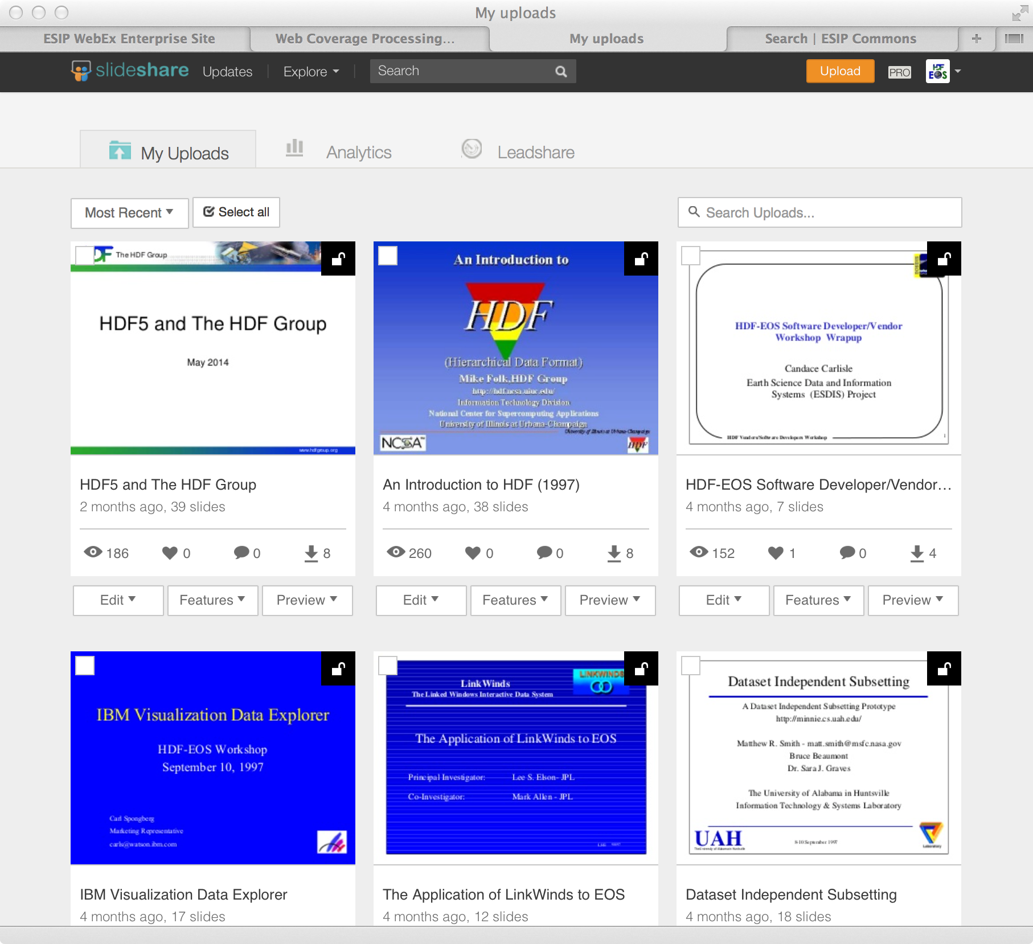
HDF Data Producer’s Conundrum
The entire history of the HDF Workshops (340
presentations) (340) are now available on slideshare.net.

Slide 3
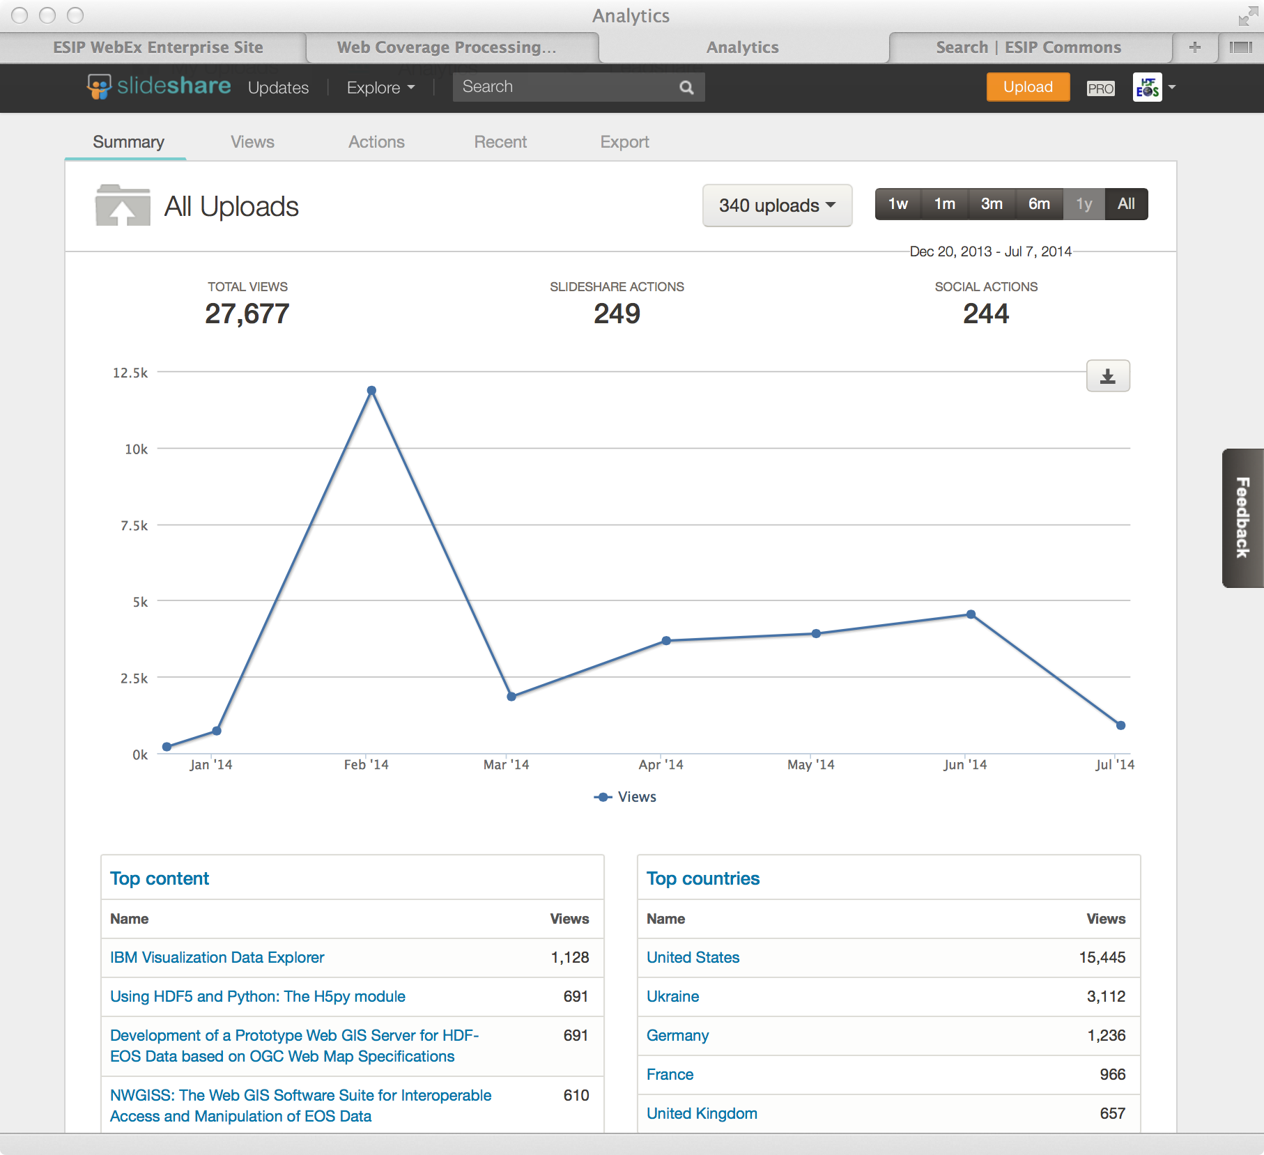
Increased information access and use
These presentations have been viewed over 27,000 times since December.

