Slide 1

Advancing Scientific Data Support in
ArcGIS
2014 ESIP Summer Meeting
July 8–11, 2014 | Frisco, Colorado
Nawajish Noman

Slide 2
Outline
ArcGIS and Scientific Data
Ingest and aggregation
Visualization and Analysis
Service, Ready-to-Use Maps, Web Applications
Extending Analytical Capabilities using Python
OPeNDAP and Future Direction

Slide 3
ArcGIS Platform
Desktop
Web
Device
ArcGIS
Server
Online Content
and Services
Notes:
ArcGIS is the geography platform for your organization, enabling you to create, organize, and share geographic information and tools with anyone by using intelligent online maps and useful apps. These apps run virtually anywhere - on desktops, the web, smartphones, and tablets.

Slide 4
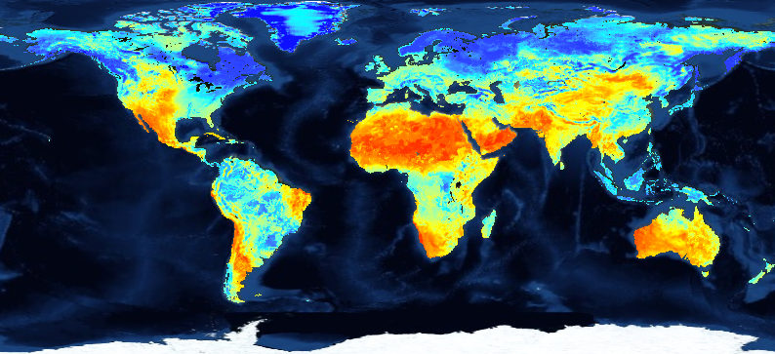
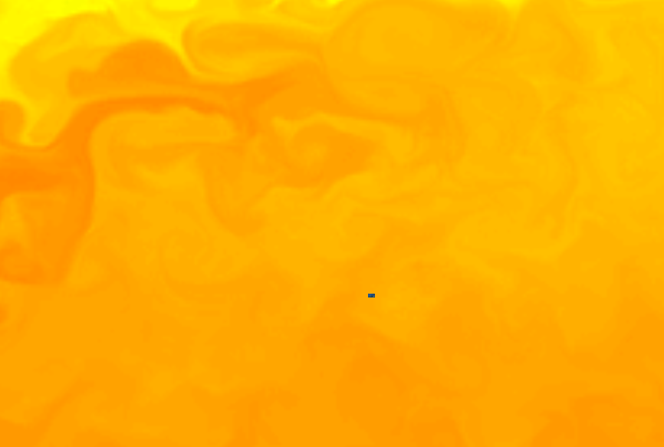
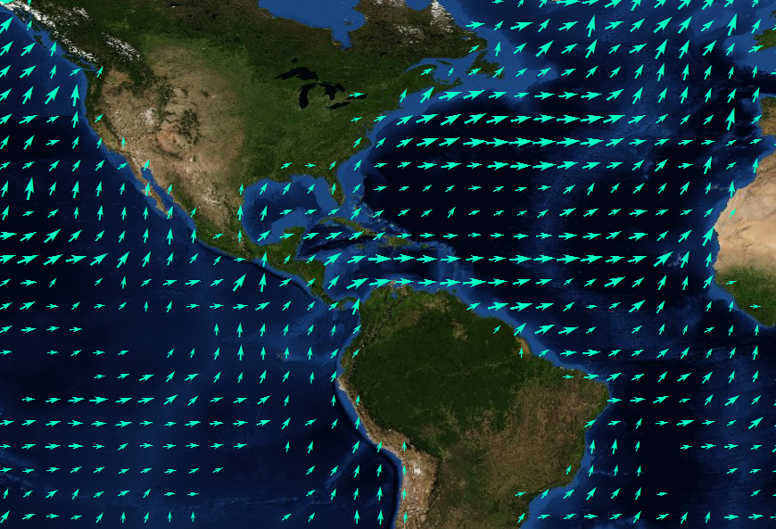
Scientific Data
Stored in netCDF, GRIB, and HDF formats
Multidimensional
  Ocean data
    Sea temperature, salinity, ocean current
  Weather data
    Temperature, humidity, wind
  Land
    Soil moisture, NDVI, land cover

Slide 5
Scientific Data in ArcGIS - Vision
ArcGIS
direct ingest
data management
visualization
share
analysis

Slide 6
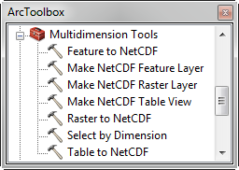
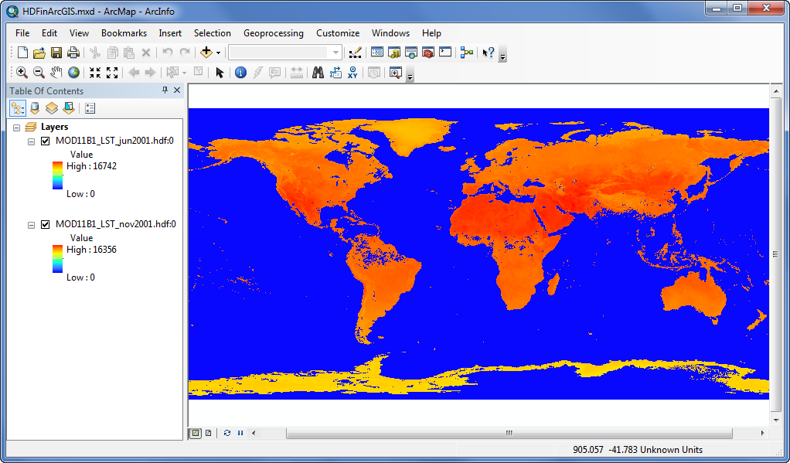
Ingesting Scientific data in ArcGIS
Directly reads netCDF file using
  Make NetCDF Raster Layer
  Make NetCDF Feature Layer
  Make NetCDF Table View
Directly reads HDF and GRIB data as raster

Slide 7
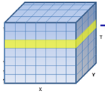
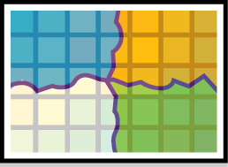






What about Aggregation?
Create a seamless multi-dimensional cube from
  files representing different regions
  files representing different time steps/slices

Slide 8
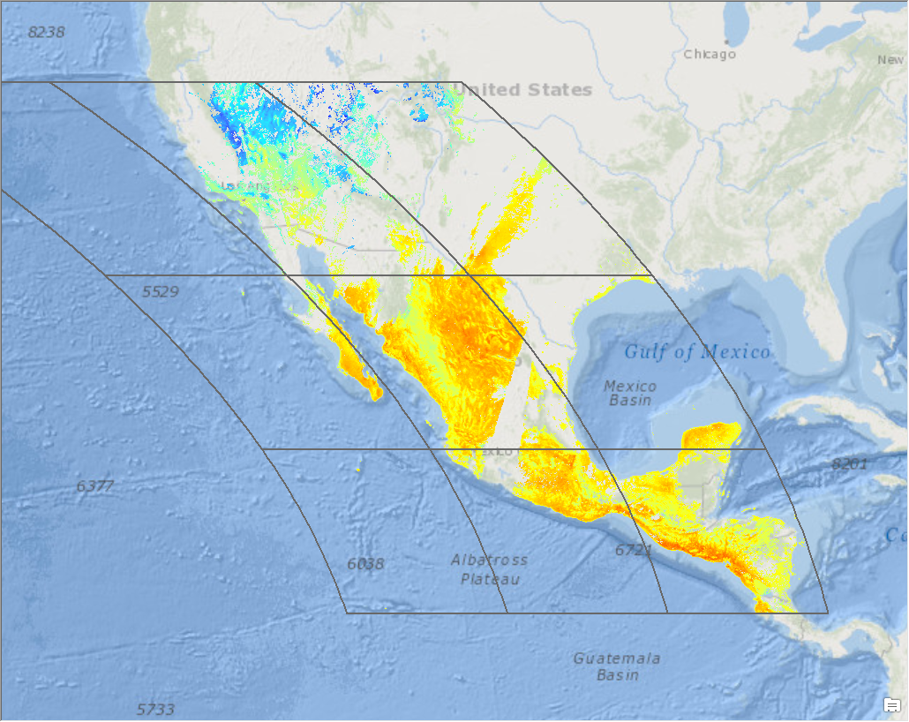
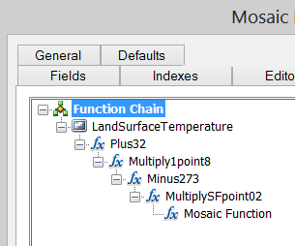
Scientific data support in Mosaic Dataset
Supports netCDF, HDF and GRIB
  Spatial Aggregation
  Temporal Aggregation
  On-the-fly analysis
Accessible as Map Service
Accessible as Image Service
Supports direct ingest
Eliminates data conversion
Eliminates data processing
Improves workflow performance
Integrates with service oriented architecture
Notes:
Will be available in 10.3 or later.

Slide 9
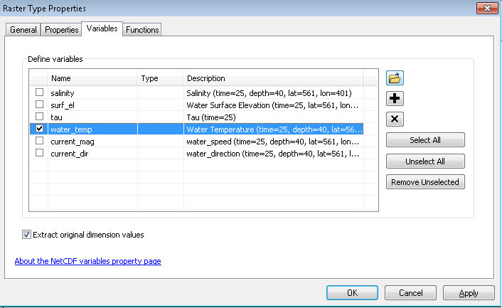
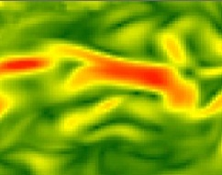
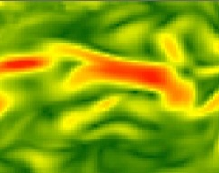
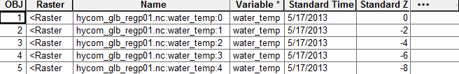
Multidimensional Mosaic Datasets
Aggregate (mosaic) spatial, time, and vertical dimensions
Raster Types for netCDF, HDF & GRIB
Define variables when adding Rasters
Each Row is a 2D Raster with variables and dimension values
Define on-the-fly processing
Serve as Multidimensional
  Image Service
  Map Service
  WMS
Notes:
From a set of source netCDF, HDF & GRIB files one can create a mosaic dataset using different dimensions and variables.

Slide 10
Using Scientific Data in ArcGIS
Behaves the same as any layer or table
Display
  Same display tools for raster and feature layers will work on multi-dimensional netCDF raster and netCDF feature layers.
Graphing
  Driven by the table just like any other chart.
Animation
  Multi-dimensional data can be animated through time dimension
Analysis Tools
  Will work just like any other raster layer, feature layer, or table. (e.g. create buffers around netCDF points, reproject rasters, query tables, etc.)

Slide 11
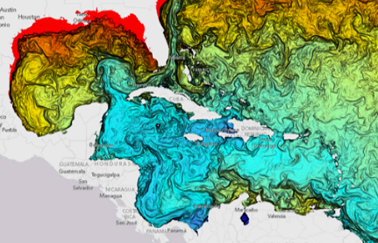
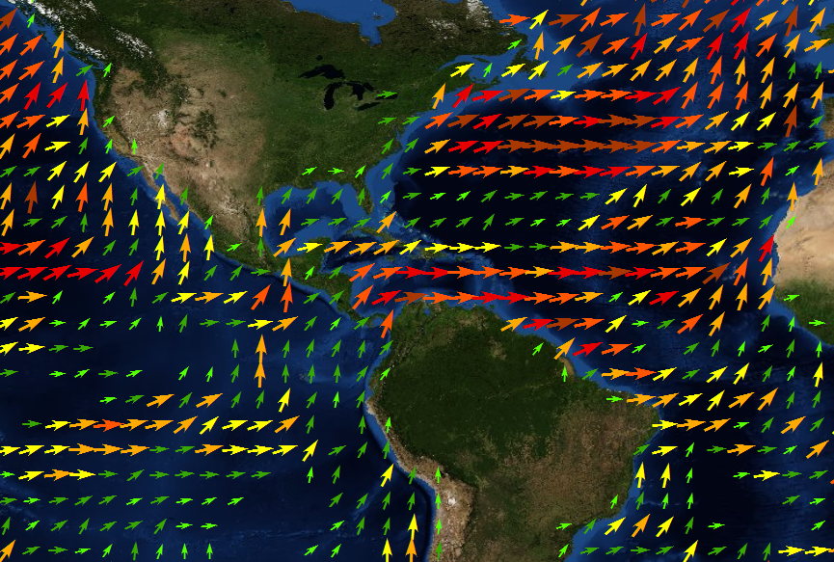
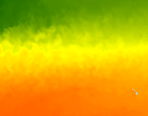
Multidimensional Mosaic Dataset - Visualization
Visualize temporal change of a variable
Visualize a variable at any vertical dimension
Visualize flow direction and magnitude variables

Slide 12
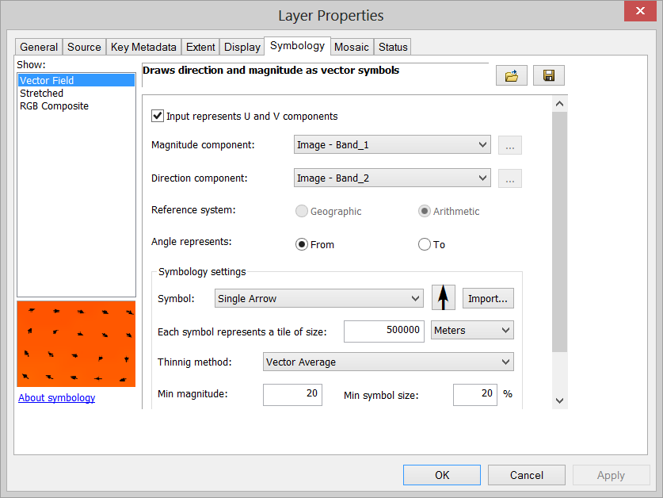
Visualization of Raster as Vectors
New Vector Field renderer for raster
  Supports U-V and Magnitude-direction
  Dynamic thinning
  On-the-fly vector calculation
Eliminates raster to feature conversion
Eliminates data processing
Improves workflow performance
Notes:
Will be available in 10.3 or later.

Slide 13
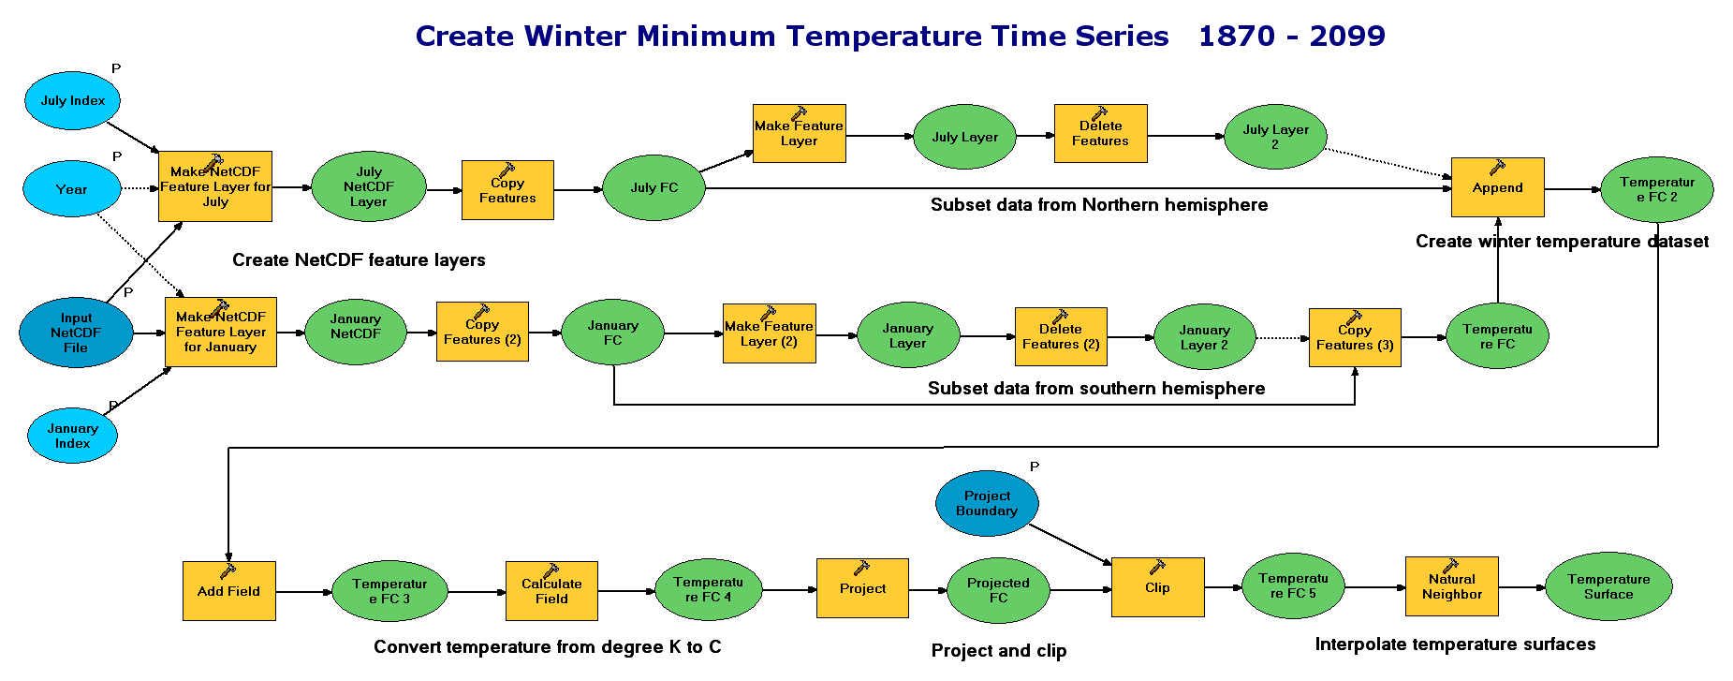
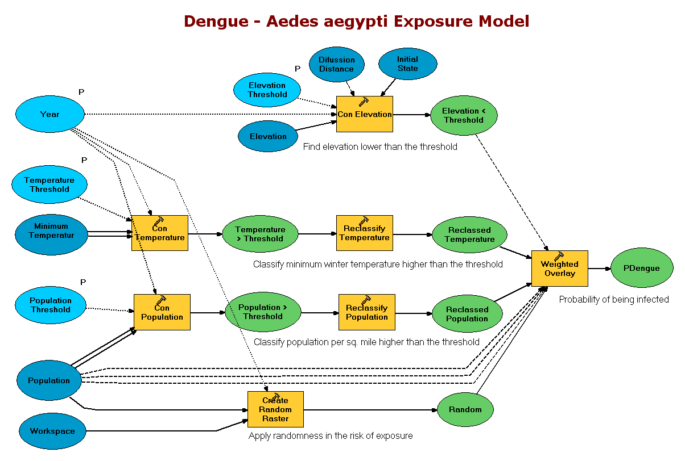
Spatial and Temporal Analysis
Several hundreds analytical tools available for raster, features, and table
Temporal Modeling
  Looping and iteration in ModelBuilder and Python

Slide 14
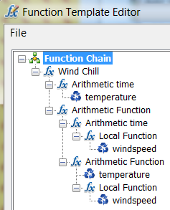
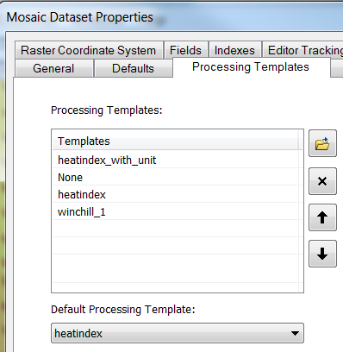
Modeling with Raster function template (RFT)
A scientific model = a raster function template
  Windchill = 35.74 + 0.6215T - 35.75(V^0.16) + 0.4275T(V^0.16)
RFT
  Created using
  Contains Query, GroupName, Variables
  Set Mosaic dataset properties
  Used during adding raster data
Notes:
Use mosaic dataset and RFT to model scientific phenomena

Slide 15
Sharing / WMS Support (for multi-dimensions)
Map Service (supports WMS)
  Makes maps available to the web.
Image Service (supports WMS)
  Provides access to raster data through a web service.
Geoprocessing Service
  Exposes the analytic capability of ArcGIS to the web.
Map Package
  To share complete map documents and the data referenced by the layer it contains.
Geoprocessing Package
  To share your geoprocessing workflow.

Slide 16
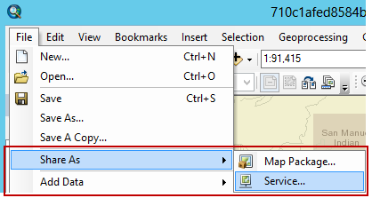
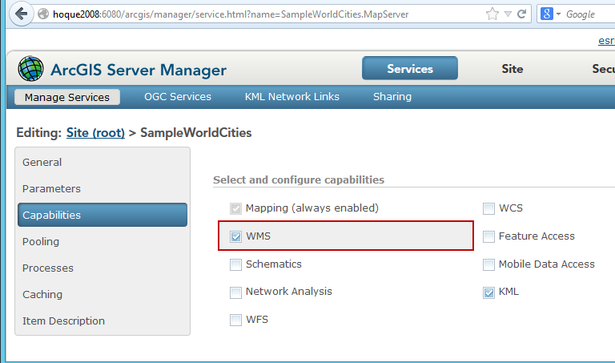
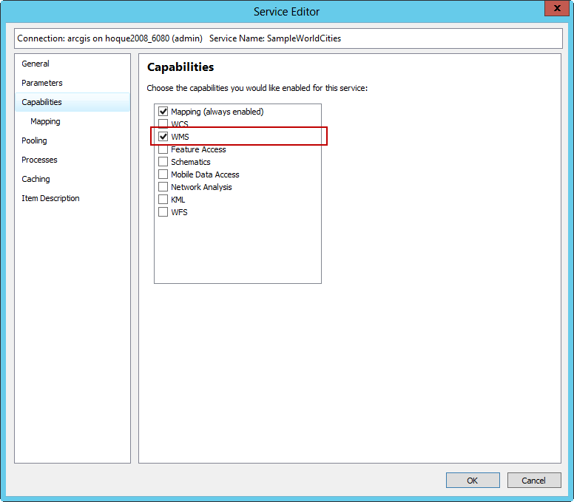
Publishing a WMS on ArcGIS Server
Enable WMS capabilities on Service Editor or Manager

Slide 17
Multi-dimensional data support in WMS
getCapabilities
  Supports time, elevation and other dimensions (e.g. depth)
getMap
  Returns map for any dimension value
  &DIM_<dimensionName>=<value>&
  Supports CURRENT for time dimension
  &TIME=CURRENT&
getFeatureInfo
  Returns information about feature for any dimension value

Slide 18
Multi-dimensional WMS in ArcMap
Supports WMS layer like any other layer
Animates a time enabled WMS layer using time-slider
Slices for any dimension value are accessible with ArcObjects
Public Sub UpdateWMSServiceLayerDimensionValue()
'UID for wms service layer type
Dim pUid As New uid
pUid = "{27ABB9EC-7A26-4cf8-8BD4-70EC1D274E17}"
Dim pWMSMapLayer2 As IWMSMapLayer2
'calling a function to find the layer from active dataframe
Set pWMSMapLayer2 = GetLayer(pUid, "myWMSLayer")
'setting values to dimensions
Dim pDimNameValues As IPropertySet
Set pDimNameValues = New PropertySet
pDimNameValues.SetProperty "Depth", "500" 'dimension#1
pDimNameValues.SetProperty "T1", "500" 'dimension#2
Set pWMSMapLayer2.DimensionValues = pDimNameValues
'calling a function to redraw the layer
RefreshActiveDataFrame
End Sub

Slide 19
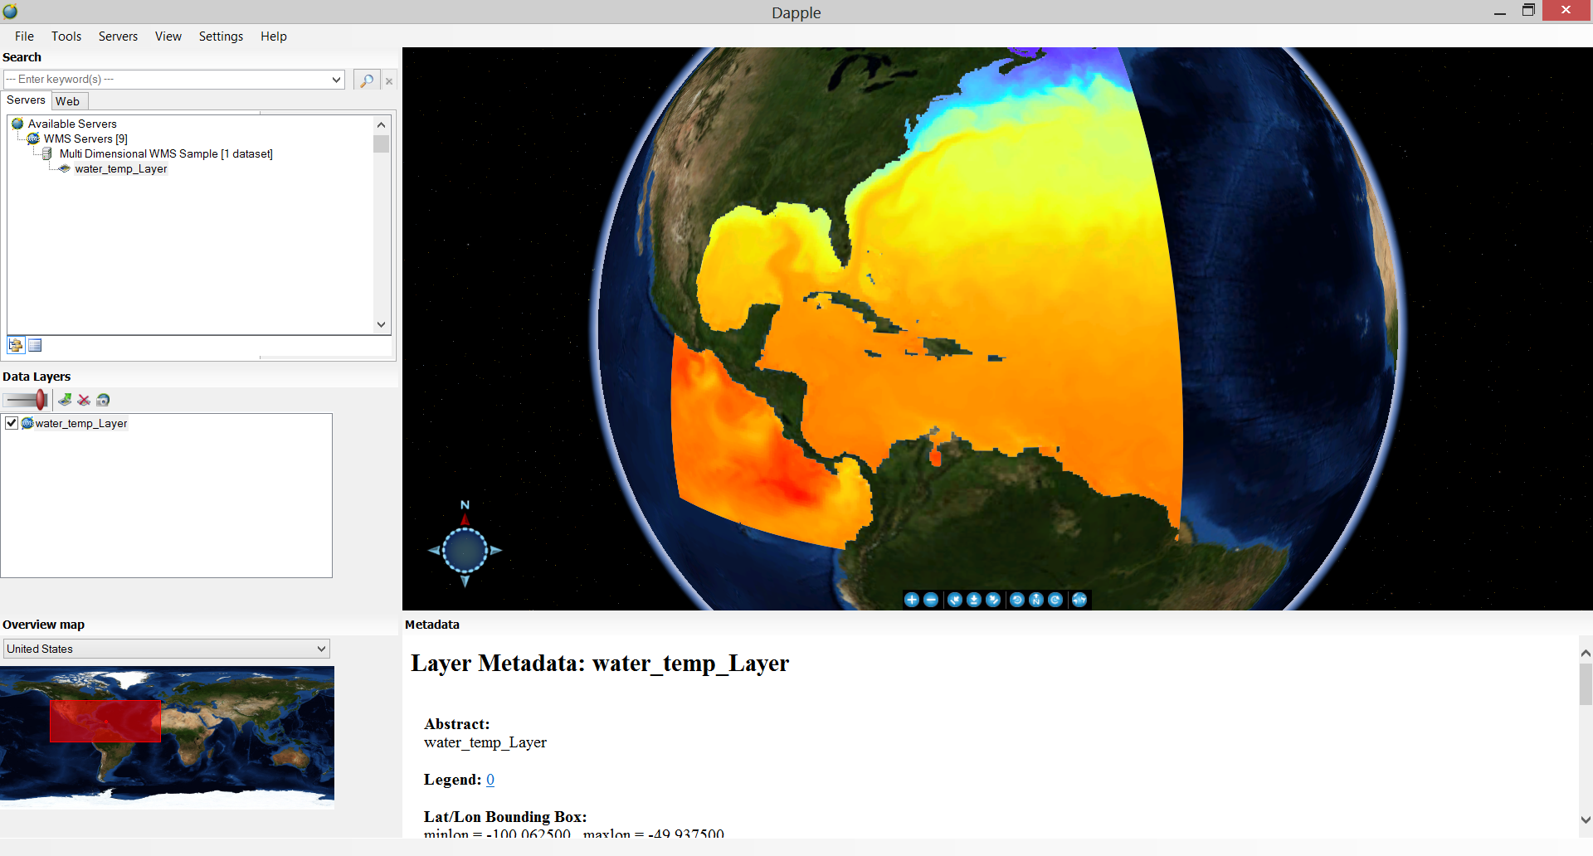
WMS in Dapple Earth Explorer

Slide 20
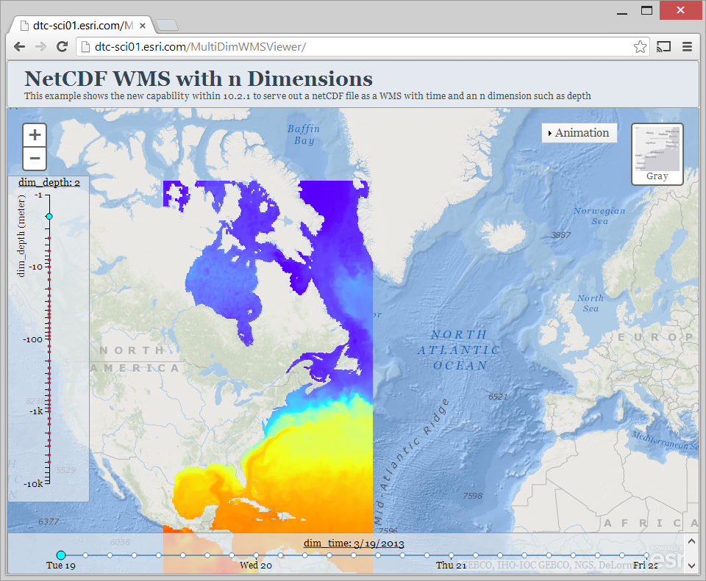
Multi-dimensional WMS in a Web Application
Depth
Time
http://dtc-sci01.esri.com/MultiDimWMSViewer/

Slide 21

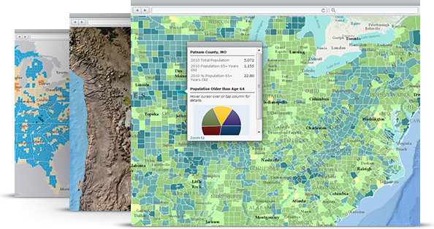
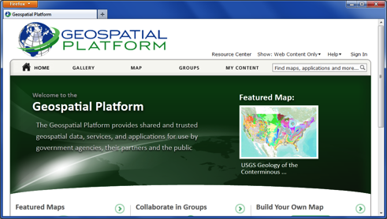
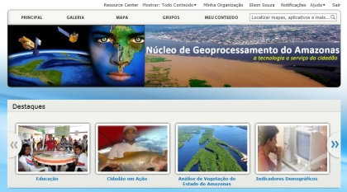
ArcGIS Online
Curated, authoritative content provided by Esri
  Ready To Use
  Highly scalable
  Global to National
Authoritative content provided by the community
  Hosted in your ArcGIS Online Organization account
  Hosted on your hardware and shared to ArcGIS Online
> 100 Tb of data
> 150 millions maps per day

Slide 22



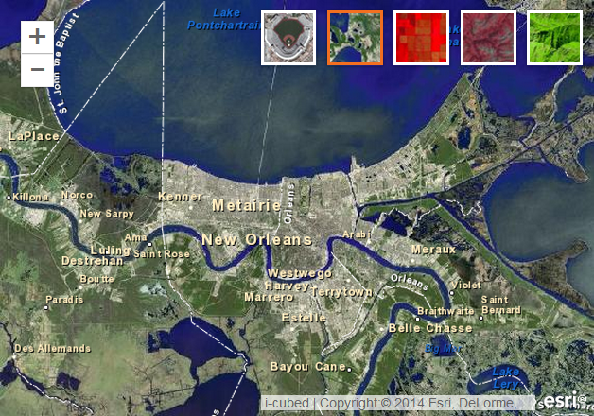
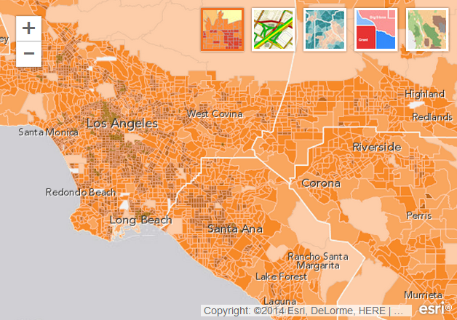


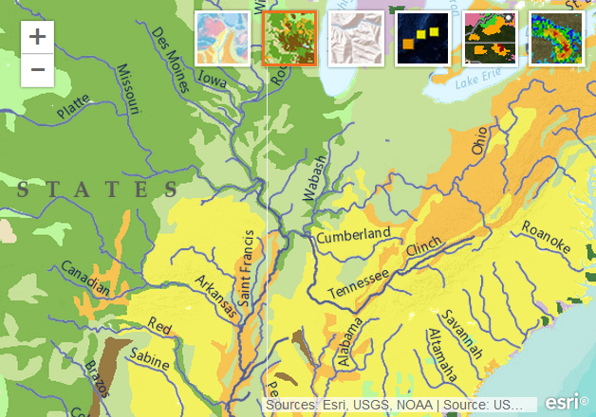
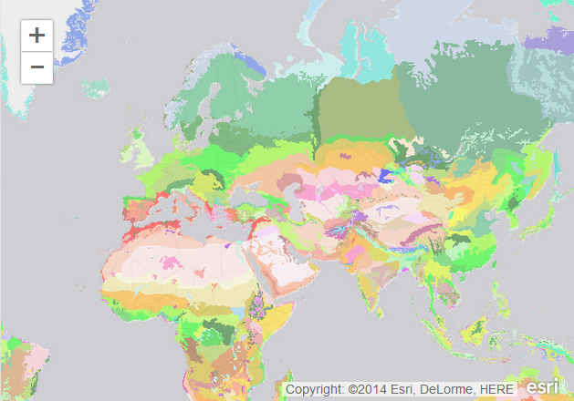
Ready-to-Use Maps
http://www.arcgis.com/features/maps/index.html

Slide 23
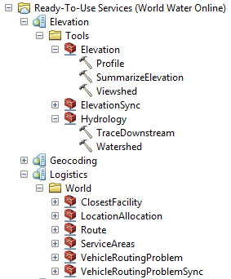
Ready-To-Use Analysis Services
Esri hosted analysis on Esri hosted data
  Simplify job of GIS Professionals
  Can be used in models and scripts
  just like any other tool
  Extend spatial analysis to a
  much broader audience
  Available in Desktop or as REST service
Best practices published to the Resource Center
Notes:
There is another class of common spatial problems which rely upon data that is particularly large, or difficult to build, or to maintain.
For these problems we have developed very efficient, task specific, hosted services, we are calling these Ready To Use services
In this case Esri compiles, hosts, and maintains the foundational data and users of the service provide relatively small spatial inputs (normally points or a small set of polygons, maybe with a few attributes), and we provide back to them some new attributes or features. It’s a very small network load against large hosted data.
Jeff showed a few of these yesterday with the geocoding and network services.
There are some new services that will be released in June in conjunction with the landscape project working against elevation data, to create viewsheds, profiles, to summarize elevation under a feature, and to create watersheds.
These kinds of services are important for Desktop users because they will simplify the work of GIS professionals. If you want to do a viewshed study of an area, you don’t need to go to geodata.gov and download the DEM, or pull a big chunk of elevation data from a landscape image service to your local desktop to do the analysis, just give a location to the service and get back a polygon in a few seconds. Done.
And now Scott is going to show us a few examples of these…

Slide 24
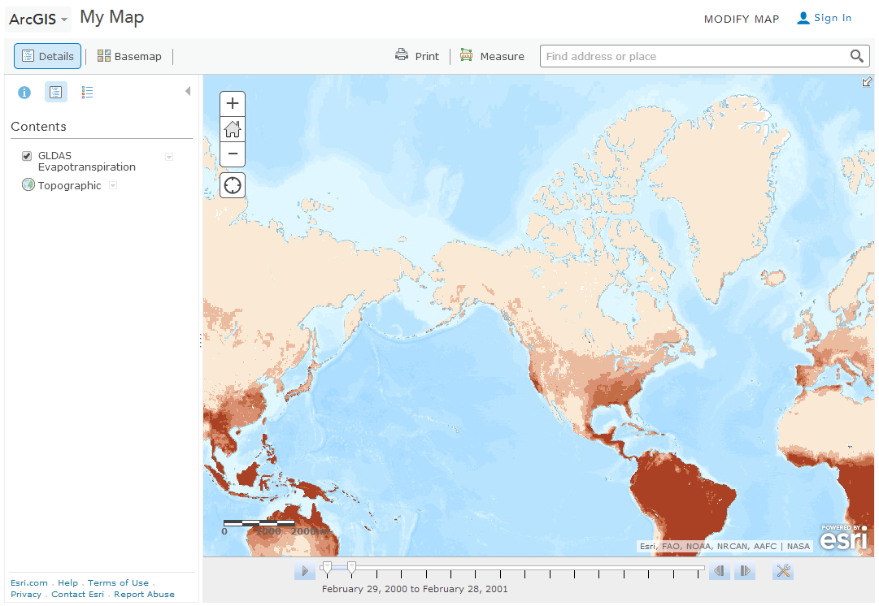
Ready-to-Use Scientific Data Maps
GLDAS Noah Land Surface Model Outputs
  Evapotranspiration
  Soil Moisture
  Snow Pack
  Other

Slide 25
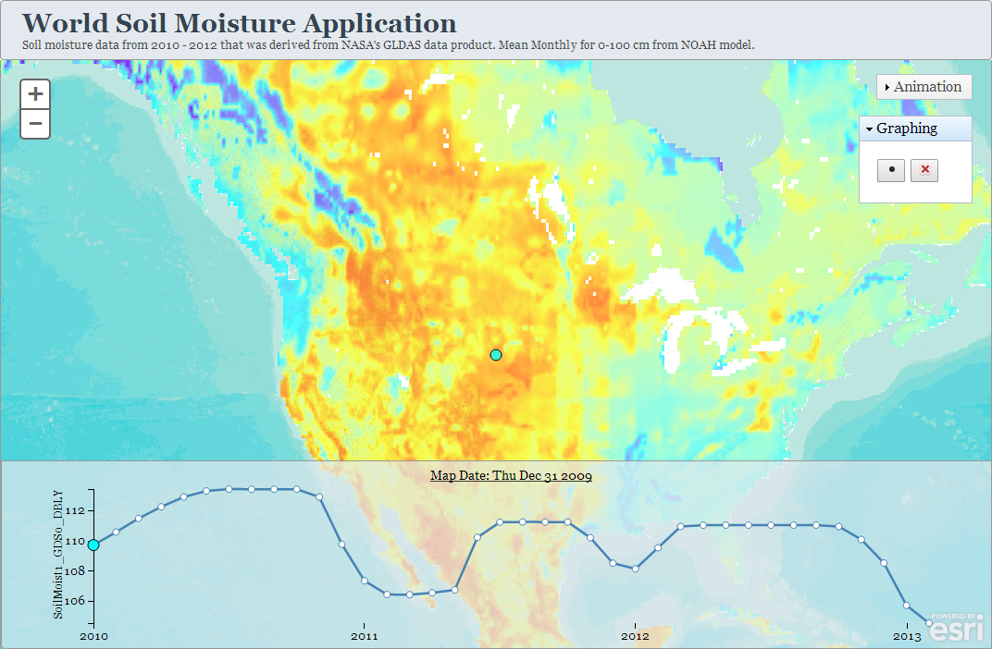
Web Application

Slide 26
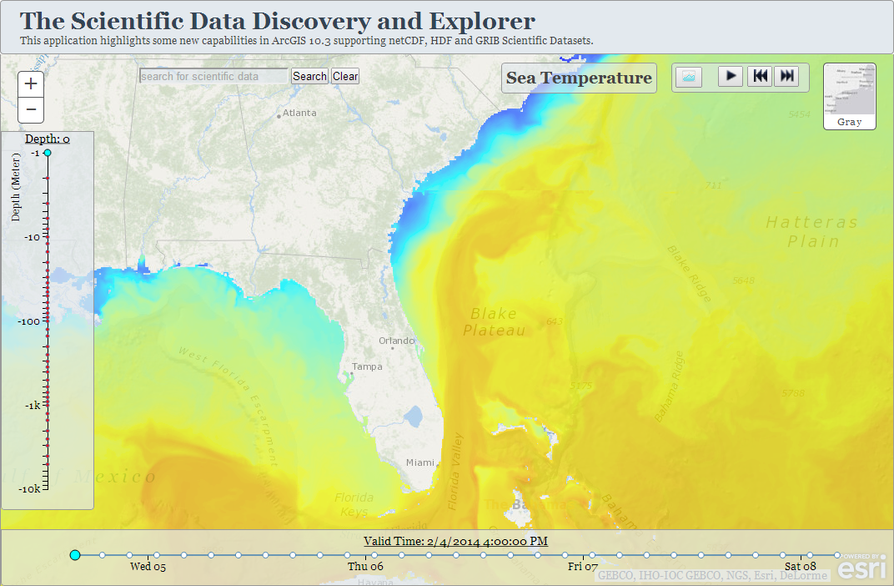
Web Application

Slide 27
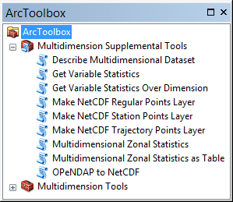
Python and Geoprocessing Tools
netCDF4-python and SciPy are included in 10.3/Pro
Supplemental tools
OPeNDAP to NetCDF
Make NetCDF Regular Point Layer
Make NetCDF Station Point Layer
Make NetCDF Trajectory Point Layer
Describe Multidimensional Dataset
Get Variable Statistics
Get Variable Statistics Over Dimension
Multidimensional Zonal Statistics
Multidimensional Zonal Statistics As Table
http://blogs.esri.com/esri/arcgis/2013/05/24/introducing-the-multidimension-supplemental-tools-2/

Slide 28
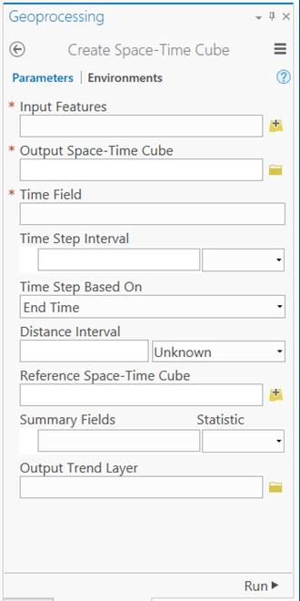
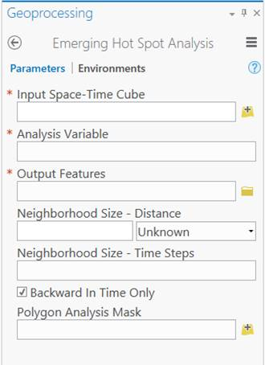
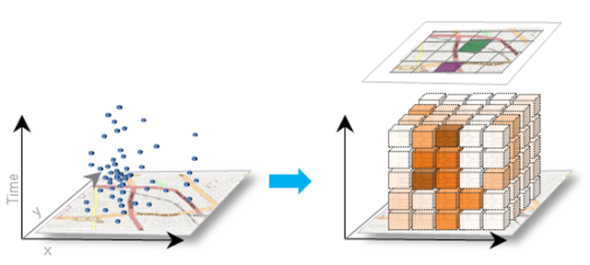
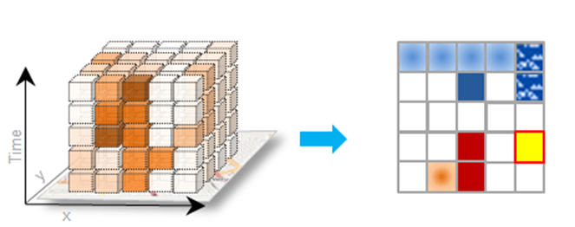
Create Space-Time Cube & Emerging Hot Spot Analysis
Notes:
Aggregates a set of points (either weighted or unweighted) into a NetCDF cube structure, using both a spatial and temporal scale for aggregation. Within each cube element, points are counted and statistics are calculated for any associated attributes that the user specifies. A map is returned with the temporal trend of the count of points over time, or if the user specifies a summary field, then the temporal trend of the first summary field is mapped.
Identifies trends in the clustering of space-time event data including new, growing, shrinking and sporadic hot and cold spots. Runs a space-time hot spot analysis on a user-specified analysis field from an input space-time cube and returns a polygon feature class of emerging hot spot types and cold spot types, as well as a 3D visualization of the space-time hot spot analysis in the form of several views of the NetCDF data in the form of multiple NetCDF Feature Layers.

Slide 29
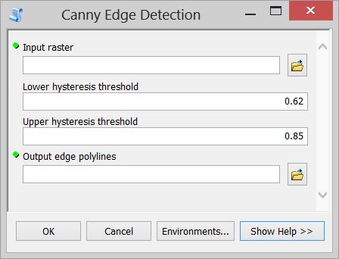
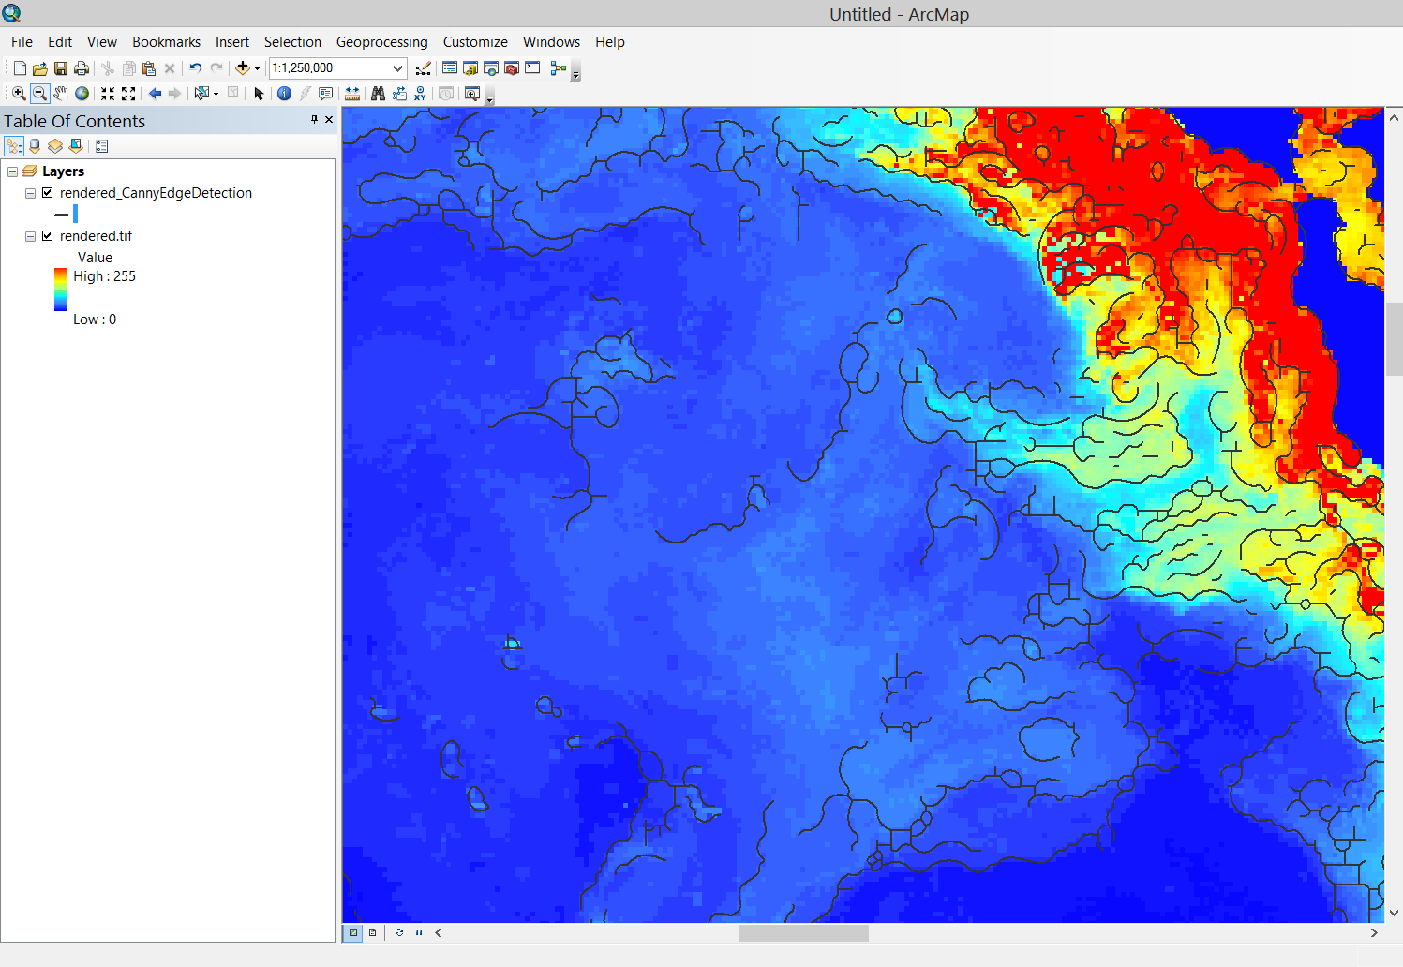
Creating your own tool
Notes:
Satellite based remote sensing provide a spatially extensive, almost real-time view of the surface of the Earth’s oceans. For example, there are a wide variety of satellite based measurements of sea surface temperature, surface wind speed and direction and geostrophic ocean current. (define geostrophic: the component of a wind or current that arises from a balance between pressure gradients and Coriolis forces). Another remotely-sensed measurement that is important to oceans and fishery scientists is chlorophyll-a concentration. Chlorophyll-a concentrations – along with sea surface temperature -- are known to play a role in the distribution and variability in fish abundance. We can measure this important ecological variable from space because the chlorophyll pigments in ocean waters absorb blue and red light and strongly reflect green light thus affecting ocean color. This is apparent in this 2007 Aqua MODIS image of the Barents Sea showing a large, dense phytoplankton bloom in the aquamarine here.
However, the visual detection of zones of increased chlorophyll concentration is tedious and time consuming. To identify, map, quantify and study these important zones requires an automated method for their delineation. A common method used to delineate these zone is to identify their fronts. ”Ocean fronts are relatively narrow zones of enhanced horizontal gradients of physical, chemical, optical and/or biological parameters which may have an expression at the ocean’s surface.” (Wall et al., 2008). They mark the boundary between waters of different physical and chemical characteristics.
Several methods are available for the automated delineation of ocean fronts. Two of the most popular single-image methods are the Cayula-Cornillion methods and the Canny method. The Cayula-Cornillion method has been implemented in the popular Marine Geospatial Ecology Tools developed by the Marine Geospatial Ecology Lab at Duke University. So today, I’d like to demonstrate the alternative Canny edge detection algorithm.
This demonstration uses a custom Python toolbox which combines some open-source code for the Canny algorithm, elements of the SciPy Python package for scientific computing and tools from the Spatial Analyst toolbox. This demonstration shows how the ArcGIS platform can be extended for scientific analysis.

Slide 30
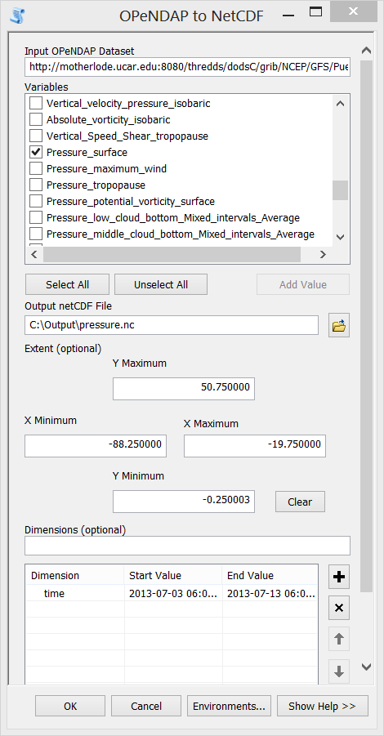
OPeNDAP to NetCDF

Slide 31
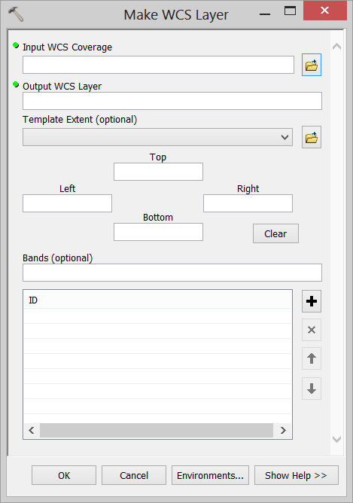
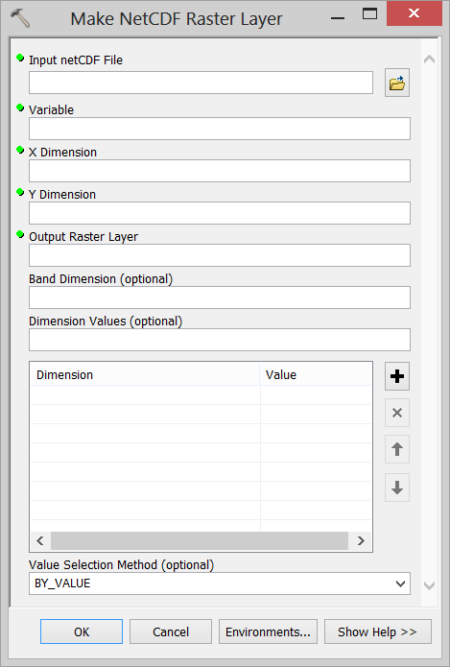
Next: Make OPeNDAP Layer
Ingest OPeNDAP Service
Output dynamic multidimensional raster
Support Sub-setting

Slide 32
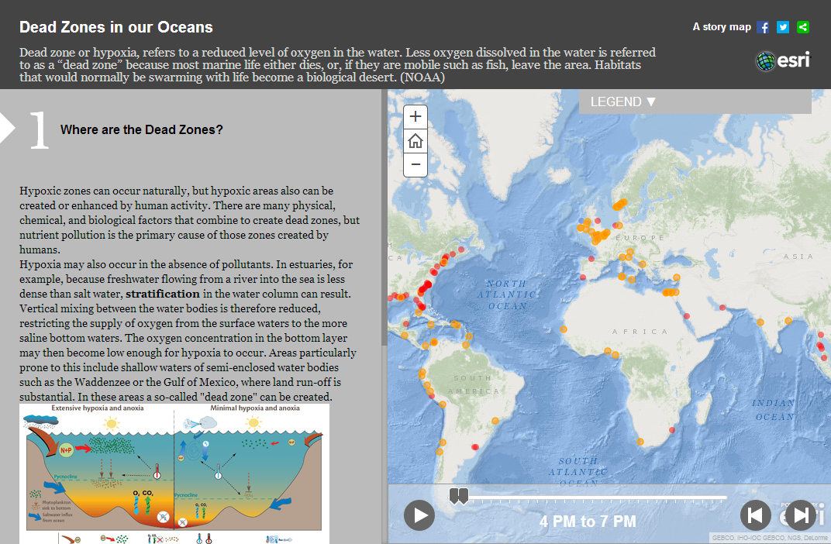
Tell the story of your scientific data – Create Story Maps
http://dtc-sci01.esri.com/DeadZoneStoryMap/

