Slide 1
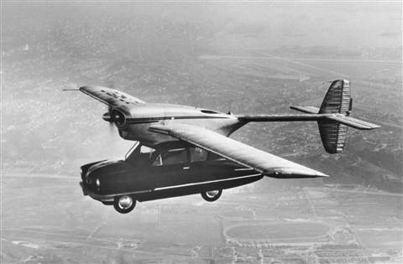
HDF and Augmentation
Mike Folk
The HDF Group
ESIP 2014

Slide 2

*
*shoes that remove ice and snow
Notes:
http://www.bing.com/images/search?q=shindogu&qs=n&form=QBIR&pq=shindogu&sc=8-8&sp=-1&sk=#view=detail&id=A47D419AE4C8487B26441D6D3B67B58D60F66046&selectedIndex=26

Slide 3
Augment:
Add to, amplify, extend, enhance.
thesaurus.com
*
*shoes that remove ice and snow
Notes:
http://www.bing.com/images/search?q=shindogu&qs=n&form=QBIR&pq=shindogu&sc=8-8&sp=-1&sk=#view=detail&id=A47D419AE4C8487B26441D6D3B67B58D60F66046&selectedIndex=26

Slide 4
Augmentation
An HDF design philosophy

Slide 5
Why we augment
Serve intended purpose better.
Whole new purpose.
Available to new tools and applications
More “standard,” hence more widely accessible.
Preservation
Notes:
These are not mutually exclusive.
To make something serve its intended purpose better.
To make something serve its intended purpose, but in a new context.
To make something more “standard” and hence more widely accessible.
To give something a whole new purpose.
To make something more like some other thing, so that the two can be combined in some way.

Slide 6
HDF augmentation
Preserve the original use
Add needed extra information
  Rename things
  Move things around
  Reduce complexity
  Hide things

Slide 7
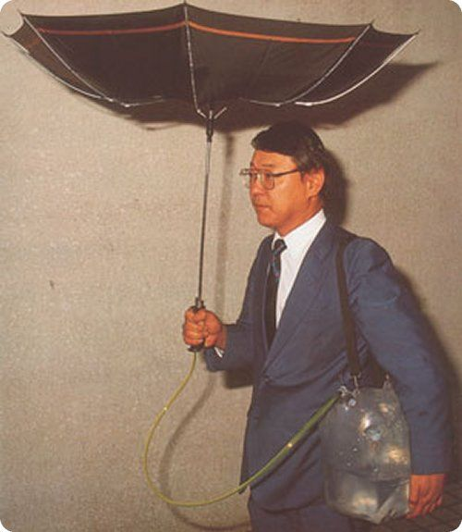
Augmenting HDF-EOS5 files for netCDF-4 access

Slide 8
netCDF4 to access HDF-EOS5 files
HDF-EOS5 uses HDF5 as its storage layer
Adds EOS structural and content metadata
HDF-EOS5
HDF-EOS5
file
HDF5

Slide 9
netCDF4 to access HDF-EOS5 files
netCDF-4 uses HDF5 as its storage layer
Adds netCDF-4 structural and content metadata
HDF-EOS5
HDF-EOS5
file
NetCDF-4
file
NetCDF4
HDF5
HDF5

Slide 10
netCDF4 to access HDF-EOS5 files
netCDF-4 metadata added to HDF-EOS5 file
EOS5 use not affected.
HDF-EOS5
HDF-EOS5
file
Augmented
HDF-EOS5
file
NetCDF-4
file
NetCDF4
HDF5
HDF5

Slide 11

H5augjpss

Slide 12
IDV
IDV
  Based on netCDF classic model (no groups)
IDV required attributes and variables
  Scale factors, offsets
  Geolocation metadata
  “Radiance” variable

Slide 13
H5augjpss will …
Make a JPSS HDF5 file look like netCDF-4
  Hide HDF5 elements not supported by netCDF
  Add coordinate variables
  Remove groups from view to conform to netCDF classic
Add information needed by tools such as IDV
    Geolocation metadata
    “Radiance” variable

Slide 14
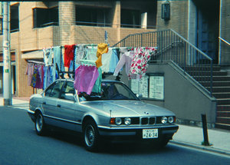
HDF4 file Content Maps

Slide 15
HDF4 File Contents – User View
Notes:
Look a bit more closely at the types of information that are in an HDF4 file…
all of these are important and need to be accessible far into the future.
The object data typically takes up most of the space in an HDF4 file and
is the most difficult to represent in Text format.

Slide 16
HDF4 File Contents – User View
Objects & Relationships
Notes:
Look a bit more closely at the types of information that are in an HDF4 file…
all of these are important and need to be accessible far into the future.
The object data typically takes up most of the space in an HDF4 file and
is the most difficult to represent in Text format.

Slide 17
HDF4 File Contents – User View
User Metadata
Notes:
Look a bit more closely at the types of information that are in an HDF4 file…
all of these are important and need to be accessible far into the future.
The object data typically takes up most of the space in an HDF4 file and
is the most difficult to represent in Text format.

Slide 18
HDF4 File Contents – User View
Object Data
Notes:
Look a bit more closely at the types of information that are in an HDF4 file…
all of these are important and need to be accessible far into the future.
The object data typically takes up most of the space in an HDF4 file and
is the most difficult to represent in Text format.

Slide 19
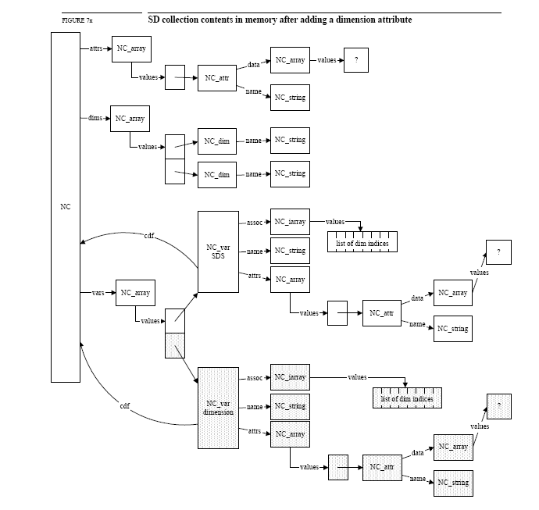
HDF4 files are complex

Slide 20
Project Motivation
HDF4 file
HDFView
HDF4 Library
Notes:
An HDF4 file without the HDF4 library is like a DVD without the player
(hardware and software) to read it.
You can’t tell what the content is (pictures/movies, …) , let alone get at the “data”.
From a preservation perspective, the player and the library are areas of caution.

Slide 21
Project Motivation
HDF4 file
X
HDFView
HDF4 Library
Notes:
An HDF4 file without the HDF4 library is like a DVD without the player
(hardware and software) to read it.
You can’t tell what the content is (pictures/movies, …) , let alone get at the “data”.
From a preservation perspective, the player and the library are areas of caution.

Slide 22
HDF4 mapping workflow
HDF4 File
HDF4 Mapping File
(XML document)
hmap
linked with
HDF4 library

Slide 23
HDF4 mapping workflow
HDF4 File
HDF4 Mapping File
(XML document)
hmap
linked with
HDF4 library
Object Data
Groups, Data Objects,
Structural and Application
Metadata;
Locations of Object Data
Reader
program

