Slide 1
HDF OPeNDAP update
Kent Yang
The HDF Group

Slide 2
Why OPeNDAP?
Check metadata remotely (in various forms)
Obtain the subset of data easily and efficiently
Hide the original data sources
  netCDF, HDF4, HDF5 or GeoTiFF, GRIB
Many popular earth science tools can visualize and analyze the data via OPeNDAP
OPeNDAP output(including subsets) can be downloaded as other formats

Slide 3
What makes HDF OPeNDAP support special?
The visualization of HDF(5) data by OPeNDAP
  What users request the most

Slide 4

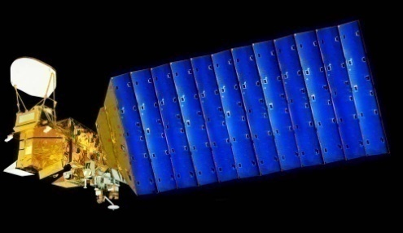
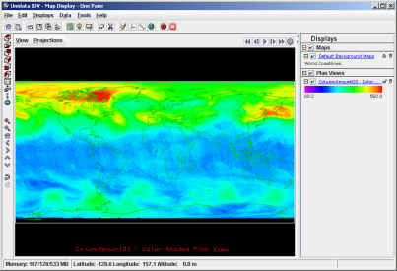



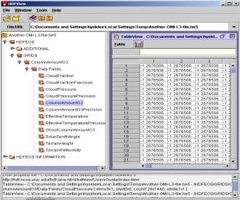
Access HDF via OPeNDAP
Aqua/Aura
Users
HDF Handlers(CF)
HDF Handlers
AIRS/OMI
DAP
Clients
Servers
HDF Files

Slide 5
HDF4 handler update
Add TRMM 7 support
  level 1 and level 2 swath
  Level 3 grid
Improve the performance to handle AIRS version 6 grid and MOD08_M3 products
Improve the performance to handle MODIS products with no-CF scale and offset rules
Reduce the number of file open/close calls when using file netCDF module to access HDF data
Map HDF4 char array to DAP String
Notes:
MOD08_M3, AIRS version 6 grid

Slide 6
MOD08_M3 and AIRS version 6 Performance
Disable the generation of StructMetadata as a DAP attribute for the CF option
Use the special features in these products to efficiently build DDS and DAS

Slide 7
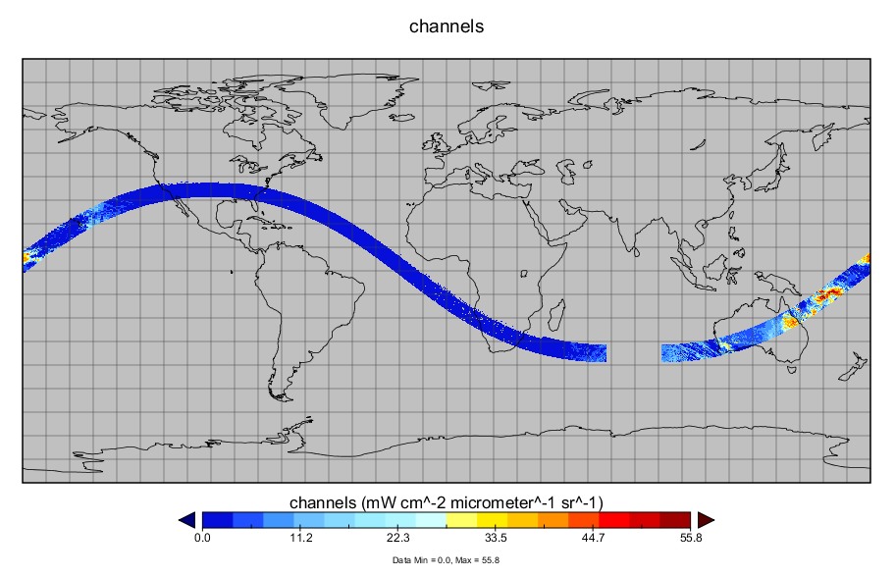
TRMM 7 Demo – swath(level 1B)

Slide 8
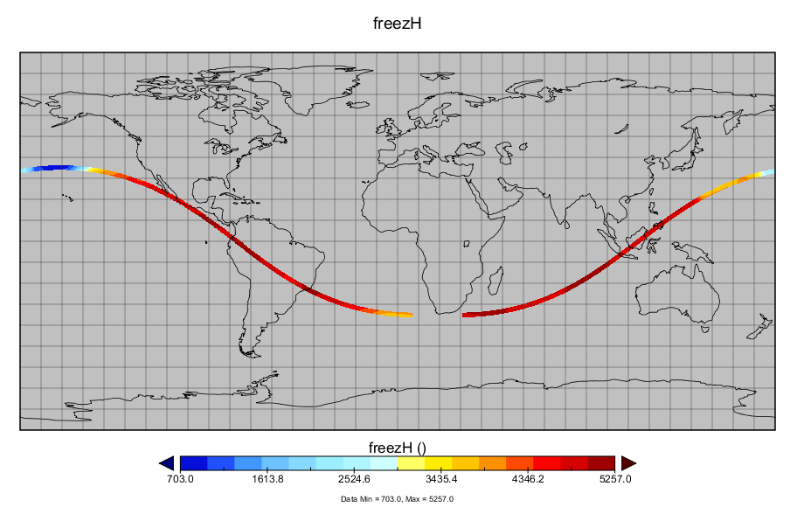
TRMM 7 Demo – swath(level 2A25)

Slide 9
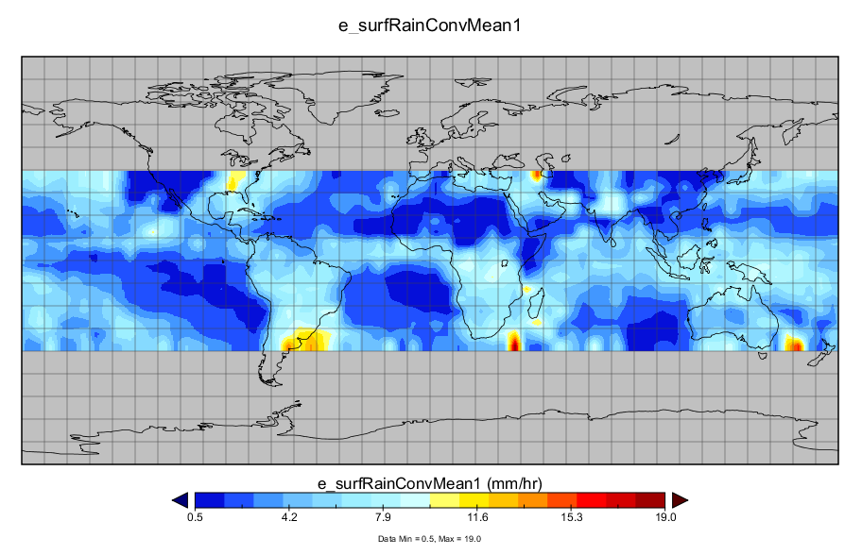
TRMM 7 Demo multi-grid(level 3A25)

Slide 10
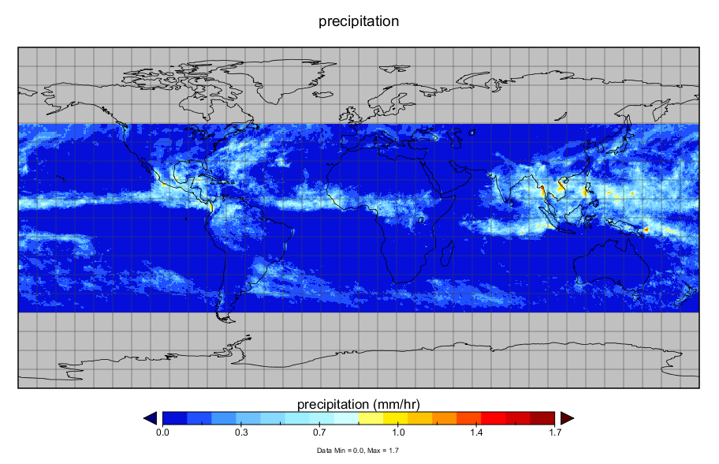
TRMM 7 Demo grid(level 3B43)

Slide 11
HDF5 handler update
Support GPM level-1 products
  Make the products follow CF
Reduce the number of file open/close calls when using file netCDF module to access HDF data

Slide 12
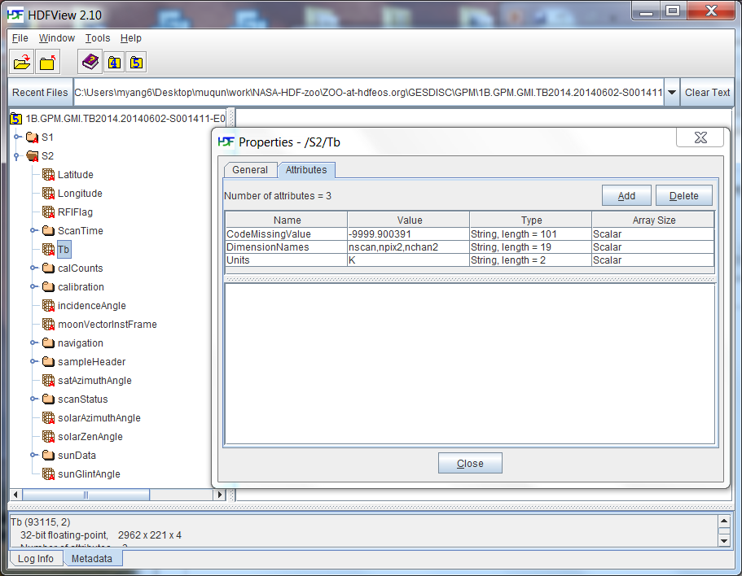
GPM HDF5 structure

Slide 13
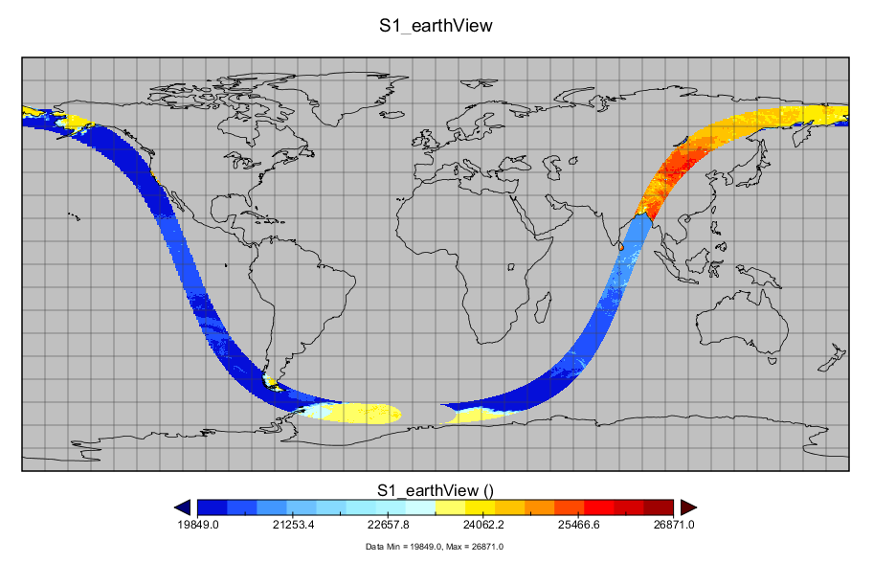
HDF5 handler demo: GPM level 1A

Slide 14
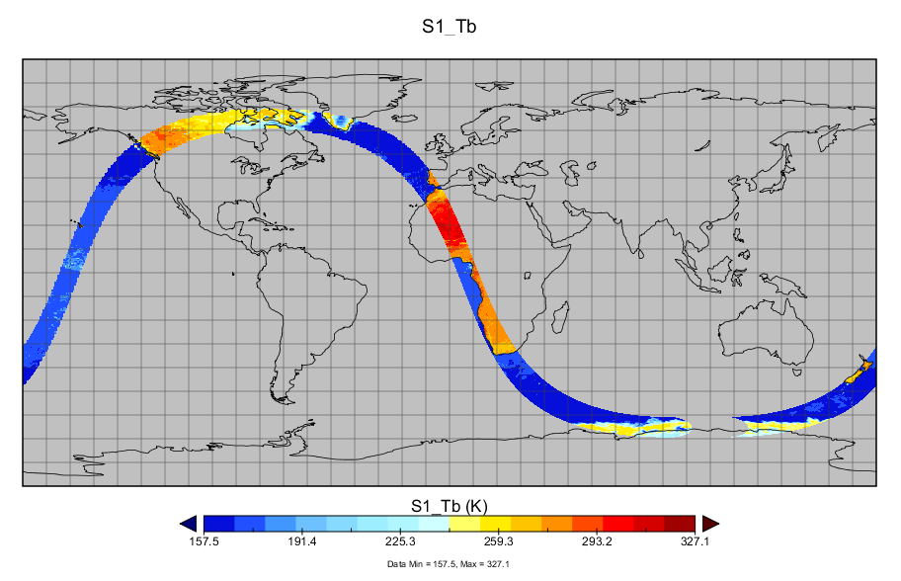
HDF5 handler demo: GPM level 1B

Slide 15
Hyrax file-netCDF module
Can work with HDF handlers to convert HDF files to netCDF-3 or netCDF-4 classic files that follow the CF conventions
We also help debug and provide fixes for this module to help NASA

Slide 16
File netCDF module demo
Can use besstandalone program
End users can install Hyrax and use this program to convert HDF4 and HDF5 files to netCDF3 or netCDF4
Notes:
Ncdump to dump the file

Slide 17
More challenges
CF conventions evolve and tools evolve
New versions of existing HDF products and new HDF products may require significant updates
The data aggregation service requires decent performance of the data service per file

Slide 18
Future - Performance
Reduce the DDS and DAS access time
Provide a caching mechanism in the handler level

Slide 19
Earth Science Group
Ted Habermann
Aleksandar Jelenak
H. Joe Lee
Joel Plutchak
John Readey
Kent Yang
Notes:
The Earth Science Group is a subgroup within The HDF Group formed to concentrate on issues like these. We’re excited by the opportunity to join in the conversation and help form the emerging landscape in Earth Sciences software, data and metadata conventions and their uses in current and upcoming missions.

