Slide 1
Make CERES products user-friendly
Kent Yang
The HDF Group

Slide 2
Background
CERES team upgrades their HDF4 products
The HDF Group provides suggestions to make the new products user-friendly
  Make the HDF4 products follow CF conventions
  Also update the HDF4 to HDF5 conversion tool to help CERES team migrate HDF4 to HDF5

Slide 3
A good model to work with science teams
Use HDF Group’s expertise on how to best use HDF’s features and make the HDF products user-friendly
Help HDF Group to update tools to help the NASA data centers
The HDF Group also provides similar suggestions to SMAP, ICESAT-2 and some MEaSUREs teams

Slide 4
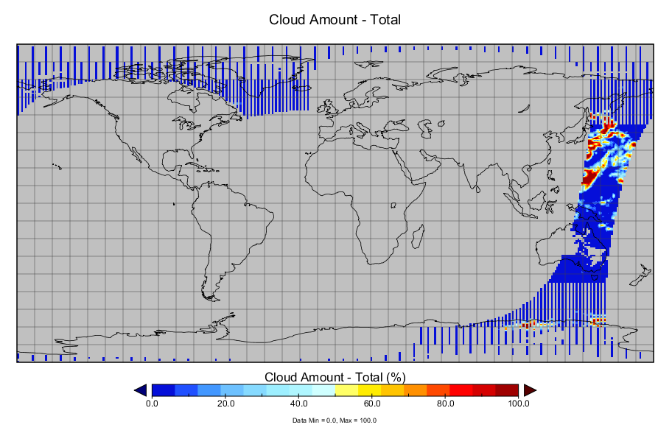
A demo on new CERES product

Slide 5
Earth Science Group
Ted Habermann
Aleksandar Jelenak
H. Joe Lee
Joel Plutchak
John Readey
Kent Yang
Notes:
The Earth Science Group is a subgroup within The HDF Group formed to concentrate on issues like these. We’re excited by the opportunity to join in the conversation and help form the emerging landscape in Earth Sciences software, data and metadata conventions and their uses in current and upcoming missions.

