Slide 1
HDF Studio
John Readey
The HDF Group

Slide 2
About Me (briefly)
IBM/Portable Graphics: 1990-1997
  3D graphics – OpenGL, Open Inventor
DEC/Intel: 1997 – 2006
  Developed Intel Array Visualizer (first exposure to HDF!)
Amazon.com: 2006-2014
  FBA – Fulfillment for 3rd party sellers
  AWS – Diagnostic Tools
The HDF Group: 2014 - ?
  Tools & Cloud Technology

Slide 3
What is HDF Studio?
A set of server and client side software components that enables people to visualize and understand their data and to share that knowledge with others
Details:
  Focus on large structured datasets (HDF5)
  Share not only the data, but representations of data
  Utilize Web Standards (REST, JSON, Oauth)
  Highly scalable (by collection size and number of users)

Slide 4
Limitations of HDFView as a Platform
Data is shared by copying files (e.g. through FTP)
Views (graphs) are not persisted
Limited ability to handle large data sets
Does not address collections (related sets of files)
Extending (i.e. plugin architecture) is hard
Notes:
Limitations of HDFView as a data sharing platform

Slide 5
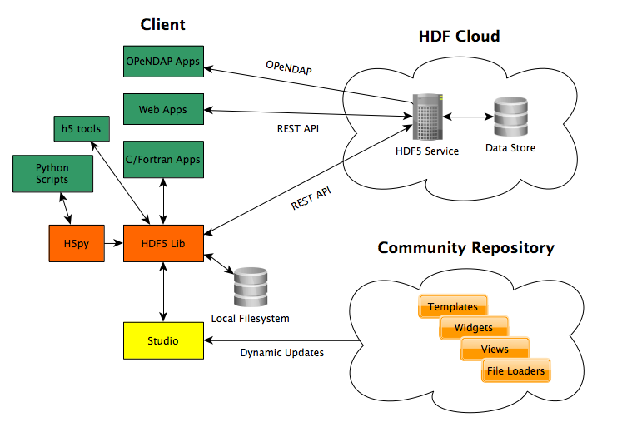
HDF Studio Architecture

Slide 6
HDF Studio Components
Cloud based repository for data
REST API for reading and writing data
OPeNDAP support
HDF5 library modified to use REST API
Studio Desktop App – view and edit data local or remote
Plugin model – extensions to Studio can be pulled in dynamically from common repository

Slide 7
Challenges…
Authentication and permission model
  Let people keep data private or share with others
Performance
  Goal – comparable to local file system performance
Scalability
  Support arbitrary numbers of users accessing service
  Arbitrary large data collection size
Reliability
  Service should work almost always (99.99% uptime)

Slide 8
Where we are now…
Just getting started!
Welcome:
  Comments
  Cool ideas
  Areas for collaboration
Intent is to release updates incrementally

Slide 9
Questions?

