Slide 1
HDF-Java Overview
Joel Plutchak
The HDF Group
Notes:
Providing a brief roadmap of Java development at The HDF Group. History, current status, possible future direction.

Slide 2
An HDF-Java Timeline
Jan 1996
Java 1.0
JHV & JHI
1996
HDF5 Object Layer
Spring 1999
Editing
Spring 2003
Summer 2003
Abstract Interfaces & plug-in framework
NPOESS: regions references & bitfields
Summer 2009
Summer 2013
CF Conven-tions
Fall 1997
Java Proposal
Summer 2002
Common Object Model
Notes:
mention HDF-EOS plug-in, FITS I/O module, netCDF (native Java)
The JHV and JHI grew out of (was influenced by?) work on the NASA-funded Project Horizon, in conjunction with the Univ of Illinois departments of Astronomy and Atmospheric Sciences. They led to the proposal for what is now collectively known as HDF-Java.
The original work was based on the original Hierarchical File Format, now known as HDF4. The first version of HDF5 was released in 1998; support for HDF5 followed in 1999 with a separate object model parallel to that of HDF4.
By summer of 2002 the two models were abstracted into a single object model with different implementations, adding to the sustainability of the software by bridging the gap between HDF4 and HDF5, and allowing support for additional file formats
A bit later editing capabilities were added to the main functionality.
Building on the abstraction of the underlying object model and I/O, GUI components of the HDFView application were abstracted and redesigned as interfaces, allowing overriding of those components (tree, image, table, palette, ??????).
A lot of small enhancements and fixes took place after 2003; a couple of note were additions to support the NPOESS (now JPSS) project, and the ESDIS project.
In August of 2013 the Java task lead and programmer left the company.

Slide 3
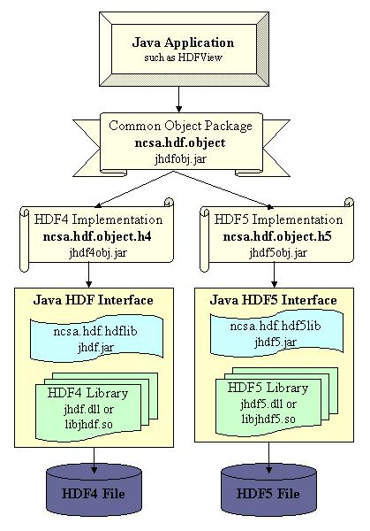
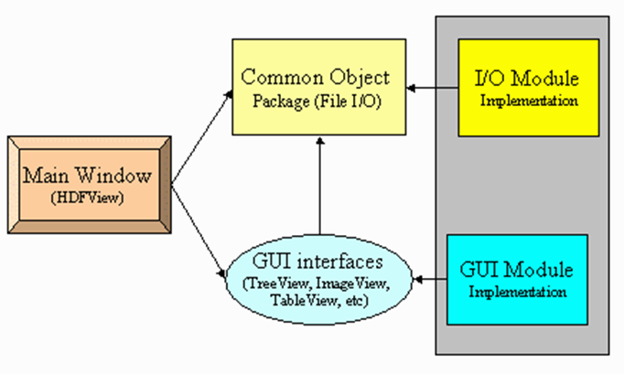
HDF-Java Architecture
High-level architecture:
  Java Application
  Java Object Layer API
  Format-specific / Java Native Interface (JNI) implementations
  HDFView
Notes:
A Java application that accesses HDF (or other) format files is built on top of an Object Layer interface (aka Common Object Package) that encapsulates data format objects; plus a lower layer that includes:
An implementation for each file format supported
A JNI interface to each native library (if necessary) for each file format
Additional file formats include a netCDF (pure Java) interface, a FITS interface, HDF-EOS2, HDF-EOS5 (Raytheon/ESDIS)
The plug-in architecture for HDFView also includes the GUI interfaces, in order to add capabilities that extend or differ from the default implementations (Tree, Image, Table, Text, Palette)
Combined HDF-EOS2/5 implementations for Tree, Image, Table

Slide 4
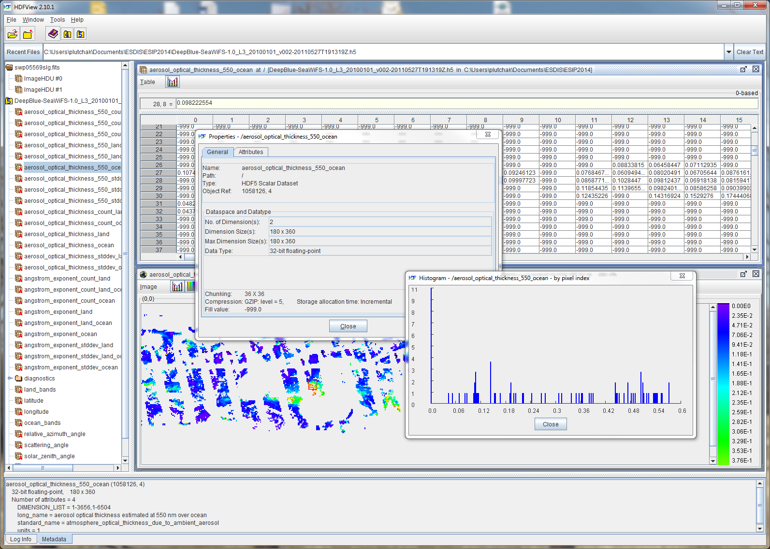
HDFView
Notes:
Add from 1 to 3 screen captures: image view (with graph?), table view, HDF-EOS plug-in?
Animate?

Slide 5
Current Status
Basic capabilities & limitations
HDFView:
Image & table views, editing, animation, some metadata convention support
Plug-in architecture for I/O and GUI (netCDF, FITS, HDF-EOS2/5)
Outdated graphical interface; scope creep
Java Object Layer:
Abstraction of HDF & generic dataset concepts
Data type mapping issues from HDF representation to Java
Memory model: monolithic
HDF4/HDF5 JNI Layer:
Most HDF functionality and data types supported
Some missing: e.g., variable length types, compound compound
http://www.hdfgroup.org/products/java/
Notes:
Views for image, table, palette, attributes, and text; editing of everything (attribute and dataset values, group and dataset names, etc.)
Scope creep without considering redesign/rescope has led to some delicate code interconnections
Data type: Java supports more restricted set of data types, so mapping necessary; e.g., Extended ASCII → Unicode/ASCII
Abstraction and plug-in architecture promotes sustainability by allowing to keep up with changing and new formats and display options
Data type mapping in some cases one-way; can’t save changes, etc.
Monolithic memory model, so limited by system and/or Java VM memory.

Slide 6
Future Direction
Near-term work
Data types & functionality: fully realize in HDF Object and JNI Layers
Decouple layers: easier packaging and distribution
Memory model: redesign to support large(r) datasets
Prepare to support new HDF5 features: HDF5 1.10
The Future
?
Notes:
- Decouple layers: easier to use for Java programming; more nimble with releases (currently once per year, all components simultaneously)

Slide 7



Questions?
Thank you!
Joel Plutchak
plutchak@hdfgroup.org
This work was supported by subcontract 114820 under prime contract NNG10HP02C, funded by the National Aeronautics and Space Administration (NASA). Any opinions, findings, or conclusions expressed in this material are those of the author and do not necessarily reflect the views of NASA.
Notes:
Flashback to 1995 with the original Java mascot, “Duke”

Slide 8
Supplemental Slides

Slide 9
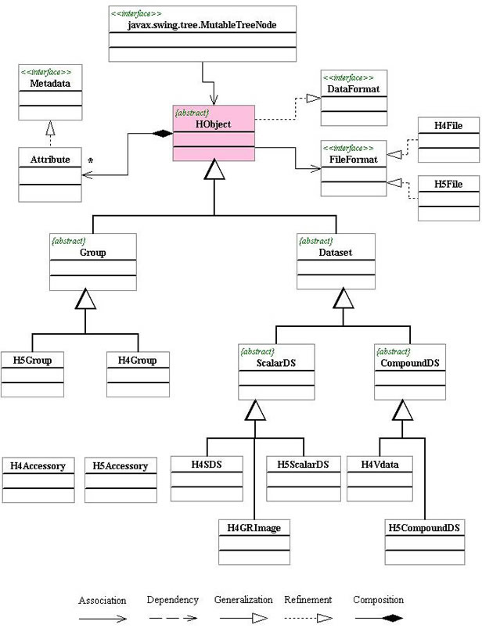
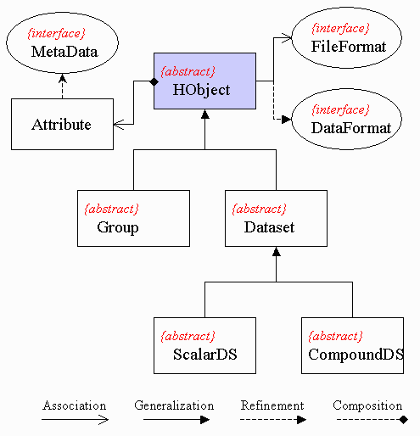
HDF-Java Object Classes

Slide 10
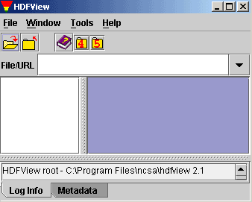
HDFView
Notes:
Add from 1 to 3 screen captures: image view (with graph?), table view, HDF-EOS plug-in?
Animate?

Slide 11
Earth Science Group
Ted Habermann
Aleksandar Jelenak
H. Joe Lee
Joel Plutchak
Kent Yang
Notes:
The Earth Science Group is a subgroup within The HDF Group formed to concentrate on issues like these. We’re excited by the opportunity to join in the conversation and help form the emerging landscape in Earth Sciences software, data and metadata conventions and their uses in current and upcoming missions.

