Slide 1

The National Oceanographic Data Center’s NetCDF Templates
ESIP Summer Meeting 2014
Ajay Krishnan
Ajay.Krishnan@noaa.gov

Slide 2
Outline
CF and ACDD inclusion into the NODC netCDF templates
Overview of NODC netCDF templates
Unidata ACDD Reports
Benefits
Notes:
Here is what I will be discussing throughout this presentation…
I will be discussing netCDF data files which are structured data files…
Network Common Data Form (netCDF)
• Developed by Unidata program at the University
Corporation for Atmospheric Research (UCAR)
• In different contexts: data model, file format, or
API
• NODC started receiving data in netCDF – 1990s
• Two Data Models
– Classic
– Enhanced

Slide 3
  Conventions
Attribute Conventions for Dataset Discovery (ACDD) conventions used in NODC templates:
  All Highly Recommended, Recommended, and Suggested Global Attributes.
  All Highly Recommended Variable Attributes.
Climate and Forecast (CF) Standards used in NODC netCDF templates:
  All CF Attributes
  Follows CF Feature Types
Notes:
Our netCDF templates follow all of the ACDD conventions for both Global and Variable Attributes.
NODC templates follow all of the CF Attribute recommendations and align along the CF Feature Types for storing environmental data.
This could be included somewhere else
I don’t know if it’s acceptable to do this….. Once you say it’s CF then is this implied?

Slide 4
CF Feature Types
point - single data point (having no implied coordinate relationship to other points).
  e.g., Single observation of a whale’s location.
timeSeries - series of data points at the same spatial location with monotonically increasing times.
  e.g., Single buoy.
trajectory - series of data points along a path through space with monotonically increasing times.
  e.g., Underway platform thermosalinograph data.
profile - ordered set of data points along a vertical line at a fixed horizontal position and fixed time.
  e.g., Conductivity Temperature Depth (CTD) or Expendable Bathythermograph (XBT) casts
timeSeriesProfile - series of profile features at the same horizontal position with monotonically increasing times.
  e.g., Mooring line with stationary instruments at the same or various depths.
trajectoryProfile - series of profile features located at points ordered along a trajectory.
  e.g., Undulating gliders, Argo floats
swath - array of data in "sensor coordinates“.
e.g., Level 2 polar-orbiting satellite data
grid - Data represented or projected on a regular or irregular grid.
e.g., 1-degree resolution salinity analysis product
Notes:
The definitions of each of the CF feature types followed by oceanographic examples of data which fits that feature type.

Slide 5
Combining both CF and ACDD conventions into the NODC netCDF templates, serves as a starting point for applying the CF and ACDD conventions to any oceanographic data set.
A supporting decision tree assists in selecting the right template for any given dataset, and a table provides guidance on how to populate the netCDF attributes…
… and a set of real world examples help illustrate the most effective use of the conventions
http://www.nodc.noaa.gov/data/formats/netcdf/

Slide 6
http://www.nodc.noaa.gov/data/formats/netcdf/decision_tree_high_res.pdf
Notes:
Here is the NODC flow chart for determining what CF feature type and, in turn, what NODC template you would use for your data. This is not intended to be readable, the link is provided at the bottom for audience members to view in full resolution.
Basically you answer the questions accordingly and based on your responses you will be directed to the appropriate template.

Slide 7
NODC added attributes:
variable
global
nodc_name
uuid
sea_name
nodc_template_version
platform
instrument
Notes:
Venn diagram showing the nodc added attributes, both global and variable level attributes.
Nodc_name - The NODC controlled vocabulary name for the variable if different from the standard name attribute or the standard name attribute does not exist.
Platform - This attribute can be used with a geophysical variable to identify the platform that was used in the collection of the data. The value of the attribute should be set to another variable which contains the details of the platform. There can be multiple platforms involved depending on if all the instances of the featureType in the collection share the same platform or not. If multiple platforms are involved, a variable should be defined for each platform and referenced from the geophysical variable in a comma separated string. NODC recommends the use of the following attributes for those platform variables: call_sign, ices_code, wmo_code, and imo_code
Instrument - This attribute can be used with a geophysical variable to identify the instrument that collected the data. The value of the attribute should be set to another variable which contains the details of the instrument. There can be multiple instruments involved depending on if all the instances of the featureType in the collection come from the same instrument or not. If multiple instruments are involved, a variable should be defined for each instrument and referenced from the geophysical variable in a comma seperated string. NODC recommends the use of the following attributes for those instrument variables: make_model, serial_number, calibration_date, factory_calibrated, user_calibrated, calibration_report, accuracy, valid_range, and precision.
Uuid - Machine readable unique identifier for each netCDF file. A new uuid should be created whenever the netCDF file is changed. Review the history attribute listed below for further information about tracking older versions of the data file. From wikipedia: A UUID is a 16-octet (128-bit) number. The number of theoretically possible UUIDs is therefore about 3.4 × 10^38. In its canonical form, a UUID consists of 32 hexadecimal digits, displayed in 5 groups separated by hyphens, in the form 8-4-4-4-12 for a total of 36 characters (32 digits and 4 hyphens). (ex., 550e8400-e29b-41d4-a716-446655440000)
Sea_name - The names of the sea in which the data were collected.
Nodc_template_version - This attribute tracks the version of the feature type created by NODC. (for example: nodc_template_version = "netCDF_single_trajectory_v1.0")
Below here is where I can add in cdl examples from NODC.

Slide 8
Ocean Archive System Authority Tables
  People - NODC managed table
  Projects - NODC managed table
  Institutions - NODC managed table
  Platforms - NODC currently is syncing table with the International Council for the Exploration of the Sea (ICES)
  Sea names - IHO's Limits of Oceans and Seas circa 1953, the National Marine Sanctuaries, and NODC named regions
  Data types - Climate and Forecast standard names, Global Change Master Directory science keywords, NODC names, and others?
  Instruments - Global Change Master Directory instrument keywords and NODC generated instrument names
  Observations - NODC managed table
  Countries - NODC uses ISO3166 for current and obsolete countries
Notes:
NODC itself manages several authority tables which have been integrated in conjunction with ACDD and CF standards to provide robust documentation about each data file.

Slide 9
NODC using CF to establish relationships between attributes and variables
station_name and inclusion of cf_role:
char station_name(name_strlen) ;
station_name:long_name = "Cordell Bank National Marine Sanctuary (CBNMS) Bodega Marine Lab (BML) Buoy" ;
station_name:cf_role = "timeseries_id" ;
station_name = "Cordell Bank Buoy" ;
instrument:
double conductivity(time) ;
…
conductivity:instrument = "instrument2" ;
…
int instrument2 ;
instrument2:long_name = "Seabird 37 Microcat" ;
instrument2:nodc_name = "CTD" ;
instrument2:make_model = "SBE-37" ;
instrument2:serial_number = "" ;
instrument2:calibration_date = "" ;
instrument2:comment = "" ;
instrument2 = _ ;
ancillary_variables:
double conductivity(time) ;
…
conductivity:ancillary_variables = "conductivity_qc" ;
…
int conductivity_qc(time) ;
conductivity_qc:standard_name = "sea_water_electrical_conductivity status_flag" ;
conductivity_qc:long_name = "Conductivity QC Flag" ;
conductivity_qc:flag_values = 0, 1, 2, 9 ;
conductivity_qc:flag_meanings = "no_known_bad_data known_bad_data suspicous_data missing_data" ;
conductivity_qc:data_min = 0. ;
conductivity_qc:data_max = 0. ;
conductivity_qc:valid_range = 0., 9. ;
conductivity_qc:coordinates = "time lat lon alt" ;
conductivity_qc:_FillValue = 0 ;
conductivity_qc:comment = "" ;
Notes:
Show examples of how we use these features (screen shots?).

Slide 10
Comparing data sets which have been converted into NODC netCDF templates…
Notes:
The following are examples of data set’s which have been converted into NODC’s netCDF template and their corresponding NetCDF Attribute Convention for Dataset Discovery Report.

Slide 11
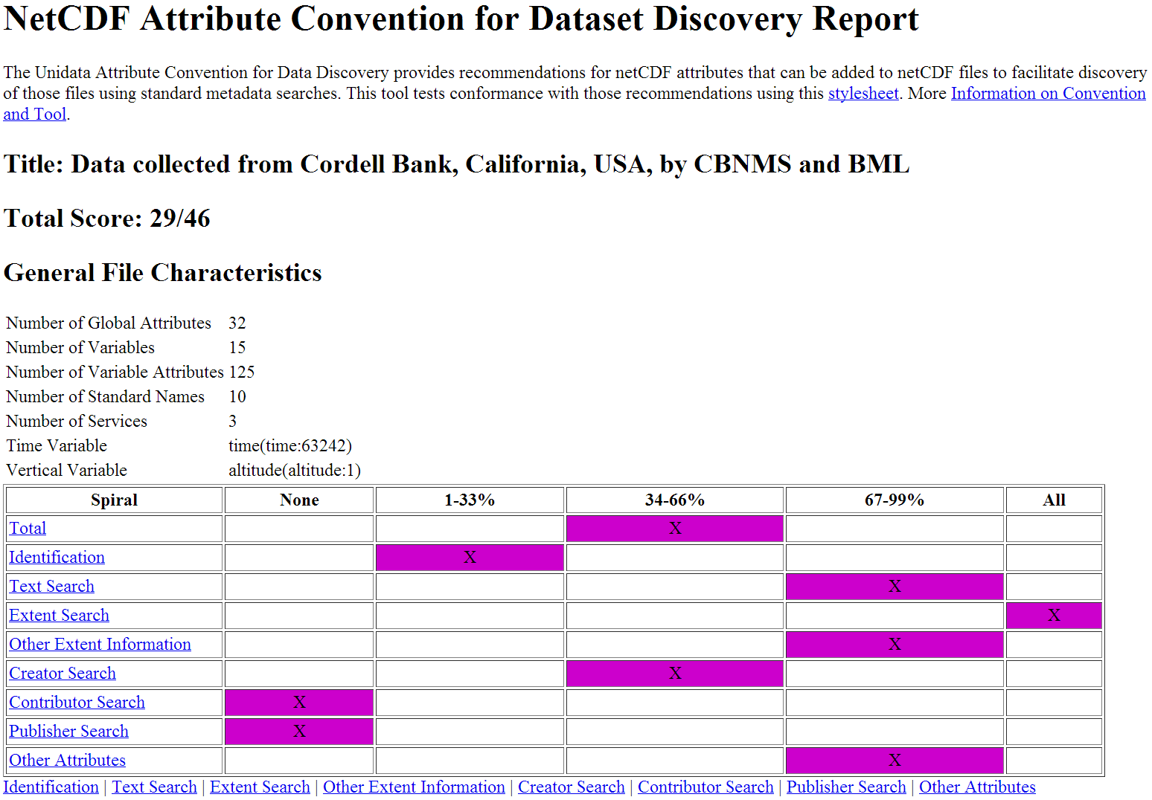
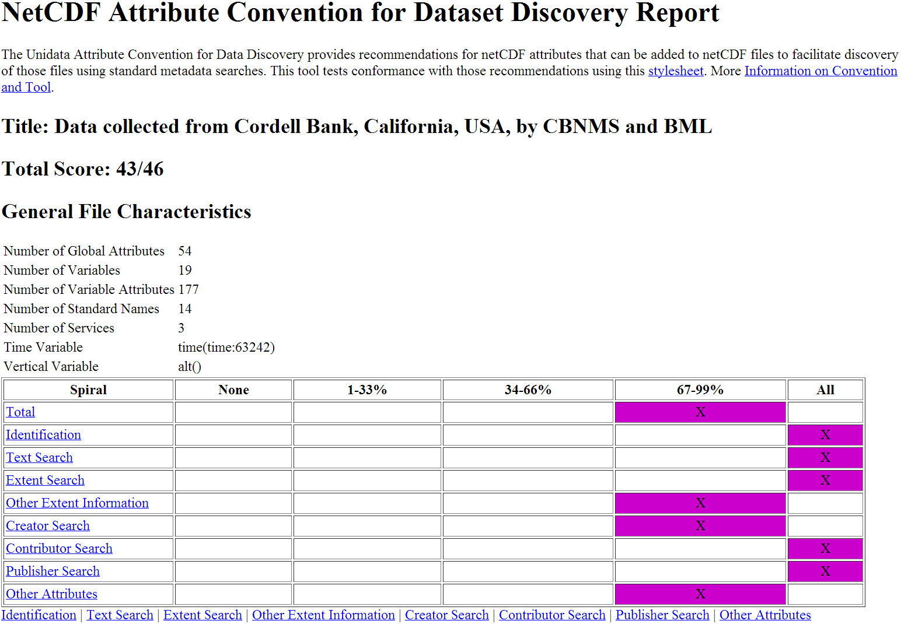
Unidata Attribute Convention for Data Discovery Reports
Bodega Marine Lab timeSeries Pre-NODC template
Bodega Marine Lab timeSeries Post-NODC template
http://data.nodc.noaa.gov/thredds/uddc/testdata/NMS_CBM_CTD_2008.nc?catalog=http%3A%2F%2Fdata.nodc.noaa.gov%2Fthredds%2Fcatalog%2Ftestdata%2Fcatalog.html&dataset=testdata%2FNMS_CBM_CTD_2008.nc
http://data.nodc.noaa.gov/thredds/uddc/testdata/netCDFTemplateExamples/timeSeries/BodegaMarineLabBuoy.nc?catalog=http%3A%2F%2Fdata.nodc.noaa.gov%2Fthredds%2Fcatalog%2Ftestdata%2FnetCDFTemplateExamples%2FtimeSeries%2Fcatalog.html&dataset=testdata%2FnetCDFTemplateExamples%2FtimeSeries%2FBodegaMarineLabBuoy.nc

Slide 12
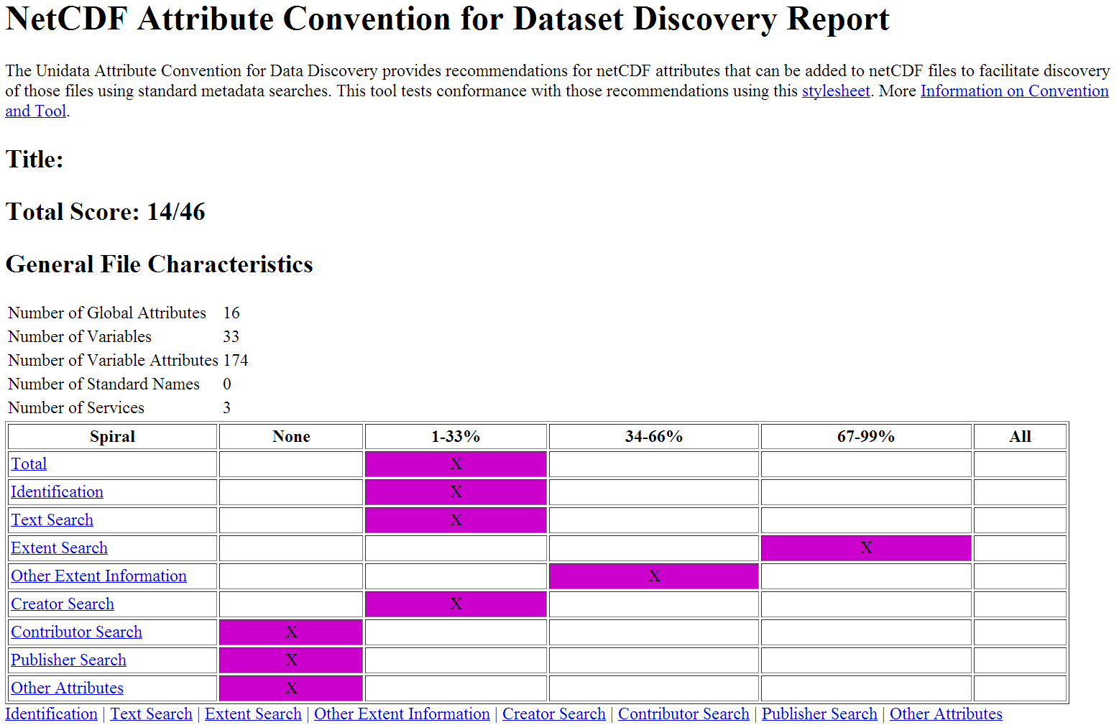
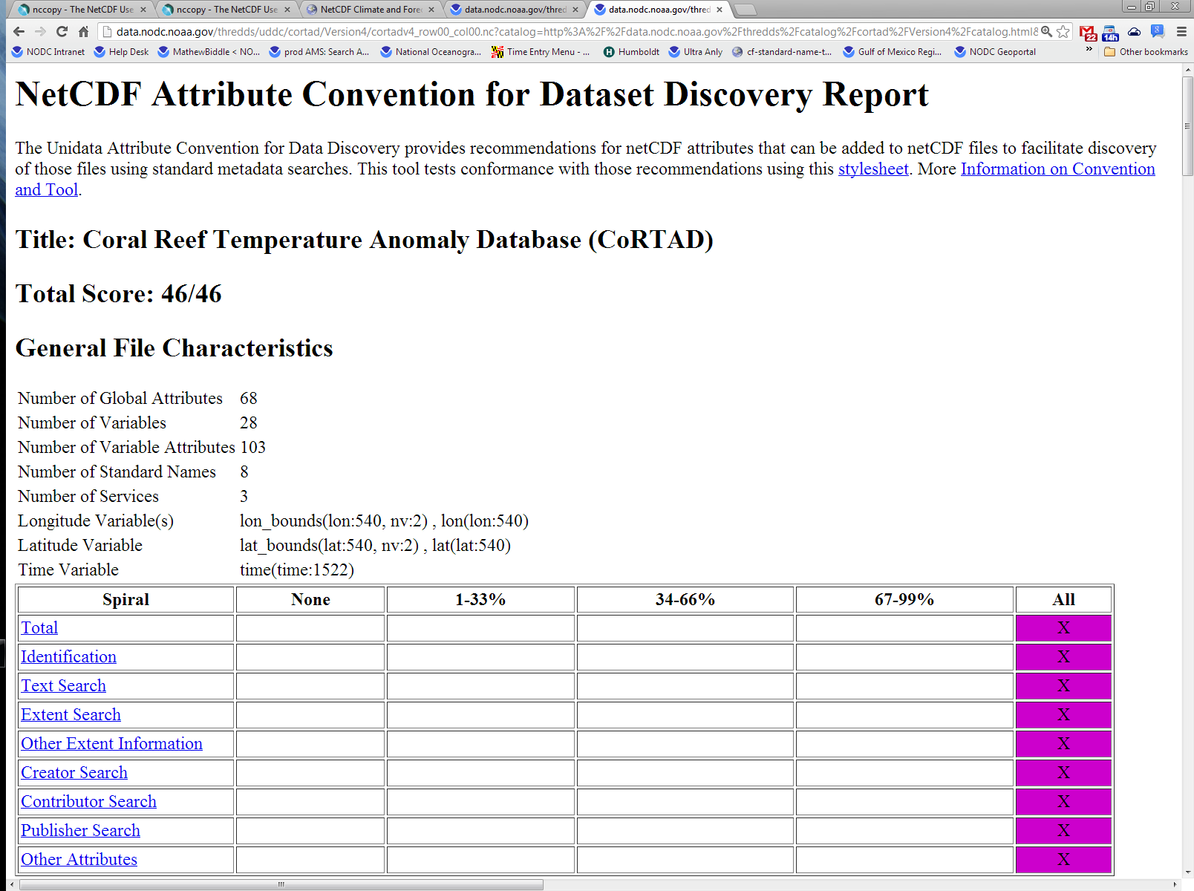
Unidata Attribute Convention for Data Discovery Reports
CORTAD V1.1 Gridded
Pre-NODC Template
CORTAD V4.4 Gridded
Post-NODC Template
http://data.nodc.noaa.gov/thredds/uddc/cortad/Version1/cortad_row00_col00.hdf?catalog=http%3A%2F%2Fdata.nodc.noaa.gov%2Fthredds%2Fcatalog%2Fcortad%2FVersion1%2Fcatalog.html&dataset=cortad%2FVersion1%2Fcortad_row00_col00.hdf
http://data.nodc.noaa.gov/thredds/uddc/cortad/Version4/cortadv4_row00_col00.nc?catalog=http%3A%2F%2Fdata.nodc.noaa.gov%2Fthredds%2Fcatalog%2Fcortad%2FVersion4%2Fcatalog.html&dataset=cortad%2FVersion4%2Fcortadv4_row00_col00.nc
Notes:
The Unidata Attribute Convention for Data Discovery provides recommendations for netCDF attributes that can be added to netCDF files to facilitate discovery of those files using standard metadata searches.
CoRTAD 4 is a gridded data set.
CoRTAD 4 is derived from Pathfinder 5.2 Sea Surface Temperatue, while CoRTAD 3 utilized Pathfinder 5.1 and 5.0. CoRTAD 4 has 14 extra months of data, 11 percent more pixels and is produced in NetCDF-Classic format compared to CoRTAD 3. CoRTAD 4 has slightly improved harmonics and contains additional metadata. CoRTAD 4 is compliant with version 1.0 of NODC's NetCDF templates

Slide 13
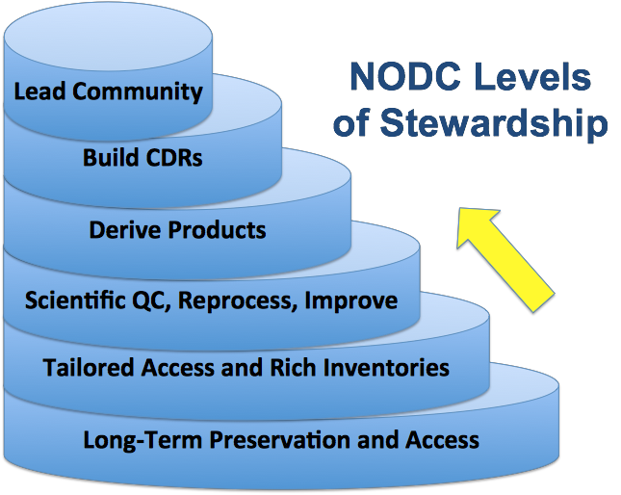
Goals/Benefits
Providing long-term preservation
Scientific quality control
Product development
Multiple data re-use beyond its original intent
Notes:
How the use of the templates aligns with NODC’s Levels of Stewardship

Slide 14
Key Principles
Be explicit and provide accurate values for the attributes
File specific attributes and not the overall collection
For richer metadata look at ISO metadata transfer standard
Covers “most” situations
Not enforcing a new convention
Notes:
Do your best to provide accurate values for the attributes, and if you don't know them, state that clearly. Avoid "NA" or "N/A" as they can have multiple meanings.

Slide 15
Thank you.
Questions/Comments?

Slide 16
netcdf BodegaMarineLabBuoy {
dimensions:
name_strlen = 17 ;
time = 63242 ;
variables:
double time(time) ;
time:standard_name = "time" ;
time:long_name = "Time" ;
time:units = "hours since 1970-01-01 00:00:00 UTC" ;
time:axis = "T" ;
time:ancillary_variables = "" ;
time:comment = "" ;
time:ioos_category = "Time" ;
time:calendar = "standard" ;
float lat ;
lat:long_name = "latitude in decimal degree north" ;
lat:standard_name = "latitude" ;
lat:units = "degree_north" ;
lat:data_min = 38.0488 ;
lat:data_max = 38.0488 ;
lat:instrument = "instrument1" ;
lat:ancillary_variables = "" ;
lat:comment = "" ;
lat:ioos_category = "Location" ;
float lon ;
lon:long_name = "longitude in decimal degree east" ;
lon:standard_name = "longitude" ;
lon:units = "degree_east" ;
lon:data_min = -123.458 ;
lon:data_max = -123.458 ;
lon:instrument = "instrument1" ;
lon:ancillary_variables = "" ;
lon:comment = "" ;
lon:ioos_category = "Location" ;
double alt ;
alt:long_name = "Height above mean sea level" ;
alt:standard_name = "altitude" ;
alt:units = "m" ;
alt:positive = "up" ;
alt:data_min = -1.5 ;
alt:data_max = -1.5 ;
alt:ancillary_variables = "" ;
alt:comment = "" ;
alt:ioos_category = "Location" ;
char station_name(name_strlen) ;
station_name:long_name = "Cordell Bank National Marine Sanctuary (CBNMS) Bodega Marine Lab (BML) Buoy" ;
station_name:cf_role = "timeseries_id" ;
double temperature(time) ;
temperature:long_name = "Water temperature, IPTS-90" ;
temperature:standard_name = "sea_water_temperature" ;
temperature:nodc_name = "TEMPERATURE" ;
temperature:units = "degree_Celsius" ;
temperature:scale_factor = 1. ;
temperature:add_offset = 0. ;
temperature:_FillValue = -99999. ;
temperature:data_min = 9.8552 ;
temperature:data_max = 15.8311 ;
temperature:instrument = "instrument2" ;
temperature:coordinates = "time lat lon alt" ;
temperature:source = " " ;
temperature:references = " " ;
temperature:ioos_category = "Temperature" ;
temperature:grid_mapping = "crs" ;
temperature:ancillary_variables = "temperature_qc" ;
double salinity(time) ;
salinity:long_name = "Salinity, IPSS-78" ;
salinity:standard_name = "sea_water_salinity" ;
salinity:nodc_name = "SALINITY" ;
salinity:units = "0.001" ;
salinity:scale_factor = 1. ;
salinity:add_offset = 0. ;
salinity:_FillValue = -99999. ;
salinity:data_min = 33.0771 ;
salinity:data_max = 33.9761 ;
salinity:instrument = "instrument2" ;
salinity:coordinates = "time lat lon alt" ;
salinity:source = " " ;
salinity:references = " " ;
salinity:ioos_category = "Salinity" ;
salinity:grid_mapping = "crs" ;
salinity:ancillary_variables = "salinity_qc" ;
double density(time) ;
density:long_name = "Density" ;
density:standard_name = "sea_water_density" ;
density:nodc_name = "DENSITY" ;
density:units = "kg m-3" ;
density:scale_factor = 1. ;
density:add_offset = 0. ;
density:_FillValue = -99999. ;
density:data_min = 24.4722 ;
density:data_max = 26.1079 ;
density:instrument = "instrument2" ;
density:coordinates = "time lat lon alt" ;
density:source = " " ;
density:references = " " ;
density:ioos_category = "Salinity" ;
density:grid_mapping = "crs" ;
density:ancillary_variables = "density_qc" ;
double conductivity(time) ;
conductivity:long_name = "Conductivity" ;
conductivity:standard_name = "sea_water_electrical_conductivity" ;
conductivity:nodc_name = "CONDUCTIVITY" ;
conductivity:units = "S m-1" ;
conductivity:scale_factor = 1. ;
conductivity:add_offset = 0. ;
conductivity:_FillValue = -99999. ;
conductivity:data_min = 3.6799 ;
conductivity:data_max = 4.18236 ;
conductivity:instrument = "instrument2" ;
conductivity:coordinates = "time lat lon alt" ;
conductivity:source = " " ;
conductivity:references = " " ;
conductivity:ioos_category = "Salinity" ;
conductivity:grid_mapping = "crs" ;
conductivity:ancillary_variables = "conductivity_qc" ;
int platform1 ;
platform1:long_name = "Station 46095. Cordell Bank Buoy" ;
platform1:nodc_name = "FIXED PLATFORM, MOORINGS" ;
platform1:call_sign = "" ;
platform1:ices_code = "" ;
platform1:imo_code = "" ;
platform1:wmo_code = "46095" ;
platform1:comment = "" ;
int temperature_qc(time) ;
temperature_qc:standard_name = "sea_water_temperature status_flag" ;
temperature_qc:long_name = "Temperature QC Flag" ;
temperature_qc:flag_values = 0, 1, 2, 9 ;
temperature_qc:flag_meanings = "no_known_bad_data known_bad_data suspicous_data missing_data" ;
temperature_qc:data_min = 0. ;
temperature_qc:data_max = 1. ;
temperature_qc:valid_range = 0., 9. ;
temperature_qc:coordinates = "time lat lon alt" ;
temperature_qc:_FillValue = 0 ;
temperature_qc:comment = "" ;
int salinity_qc(time) ;
salinity_qc:standard_name = "sea_water_salinity status_flag" ;
salinity_qc:long_name = "Salinity QC Flag" ;
salinity_qc:flag_values = 0, 1, 2, 9 ;
salinity_qc:flag_meanings = "no_known_bad_data known_bad_data suspicous_data missing_data" ;
salinity_qc:data_min = 0. ;
salinity_qc:data_max = 0. ;
salinity_qc:valid_range = 0., 9. ;
salinity_qc:coordinates = "time lat lon alt" ;
salinity_qc:_FillValue = 0 ;
salinity_qc:comment = "" ;
int density_qc(time) ;
density_qc:standard_name = "sea_water_density status_flag" ;
density_qc:long_name = "Density QC Flag" ;
density_qc:flag_values = 0, 1, 2, 9 ;
density_qc:flag_meanings = "no_known_bad_data known_bad_data suspicous_data missing_data" ;
density_qc:data_min = 0. ;
density_qc:data_max = 0. ;
density_qc:valid_range = 0., 9. ;
density_qc:coordinates = "time lat lon alt" ;
density_qc:_FillValue = 0 ;
density_qc:comment = "" ;
int conductivity_qc(time) ;
conductivity_qc:standard_name = "sea_water_electrical_conductivity status_flag" ;
conductivity_qc:long_name = "Conductivity QC Flag" ;
conductivity_qc:flag_values = 0, 1, 2, 9 ;
conductivity_qc:flag_meanings = "no_known_bad_data known_bad_data suspicous_data missing_data" ;
conductivity_qc:data_min = 0. ;
conductivity_qc:data_max = 0. ;
conductivity_qc:valid_range = 0., 9. ;
conductivity_qc:coordinates = "time lat lon alt" ;
conductivity_qc:_FillValue = 0 ;
conductivity_qc:comment = "" ;
int instrument1 ;
instrument1:long_name = "Worldwide GPS Satellite Tracker" ;
instrument1:nodc_name = "GPS" ;
instrument1:make_model = "SX1" ;
instrument1:serial_number = "" ;
instrument1:calibration_date = "" ;
instrument1:comment = "" ;
int instrument2 ;
instrument2:long_name = "Seabird 37 Microcat" ;
instrument2:nodc_name = "CTD" ;
instrument2:make_model = "SBE-37" ;
instrument2:serial_number = "" ;
instrument2:calibration_date = "" ;
instrument2:comment = "" ;
double ht_wgs84 ;
ht_wgs84:long_name = "Height above WGS 84" ;
ht_wgs84:standard_name = "height_above_reference_ellipsoid" ;
ht_wgs84:units = "m" ;
ht_wgs84:data_min = -34.023998260498 ;
ht_wgs84:data_max = -34.023998260498 ;
ht_wgs84:ioos_category = "" ;
ht_wgs84:ellipsoid_name = "WGS 84" ;
ht_wgs84:_FillValue = -99999. ;
ht_wgs84:comment = "" ;
double ht_mllw ;
ht_mllw:long_name = "Height above mean lower low water" ;
ht_mllw:standard_name = "water_surface_height_above_reference_datum" ;
ht_mllw:data_min = -0.549000024795532 ;
ht_mllw:data_max = -0.549000024795532 ;
ht_mllw:ioos_category = "" ;
ht_mllw:water_surface_reference_datum_altitude = "lower low water datum" ;
ht_mllw:_FillValue = -99999. ;
ht_mllw:comment = "Mean Lower Low Water - The average of the lower low water height of each tidal day observed over the National Tidal Datum Epoch. As defined by NOAA Tides and Currents (http://tidesandcurrents.noaa.gov/datum_options.html)" ;
int crs ;
crs:grid_mapping_name = "latitude_longitude" ;
crs:longitude_of_prime_meridian = 0. ;
crs:semi_major_axis = 6378137. ;
crs:inverse_flattening = 298.257223563 ;
crs:epsg_code = "EPSG:4326" ;
http://data.nodc.noaa.gov/thredds/catalog/testdata/netCDFTemplateExamples/timeSeries/catalog.html?dataset=testdata/netCDFTemplateExamples/timeSeries/BodegaMarineLabBuoy.nc
Notes:
Bodega Marine Lab timeSeries variable attributes

Slide 17
// global attributes:
:title = "Data collected from Cordell Bank, California, USA, by CBNMS and BML" ;
:summary = "These seawater data are collected by a moored fluorescence and turbidity instrument operated at Cordell Bank, California, USA, by CBNMS and BML. Beginning on 2008-04-23, fluorescence and turbidity measurements were collected using a Wetlabs ECO Fluorescence and Turbidity Sensor (ECO-FLNT USB). The instrument depth of the water quality sensors was 01.0 meter, in an overall water depth of 85 meters (both relative to Mean Sea Level, MSL). The measurements reflect a 10 minute sampling interval.";
:id = "" ;
:uuid = "" ;
:naming_authority = "" ;
:time_coverage_start = "2008-07-28 17:30:00 UTC" ;
:time_coverage_end = "2008-09-10 15:31:00 UTC" ;
:time_coverage_resolution = "" ;
:platform = "platform1" ;
:geospatial_lon_max = -123.458000183105 ;
:geospatial_lon_min = -123.458000183105 ;
:geospatial_lon_units = "degree_east" ;
:geospatial_lon_resolution = "" ;
:geospatial_lat_max = 38.0488014221191 ;
:geospatial_lat_min = 38.0488014221191 ;
:geospatial_lat_units = "degree_north" ;
:geospatial_lat_resolution = "" ;
:geospatial_vertical_min = -1.5 ;
:geospatial_vertical_max = -1.5 ;
:geospatial_vertical_positive = "up" ;
:geospatial_vertical_units = "m" ;
:geospatial_vertical_reference = "mean_sea_level" ;
:area = "Cordell Bank National Marine Sanctuary, CA, USA" ;
:creator_name = "Data Manager (bmldata@ucdavis.edu)" ;
:infoURL = "http://portal.ncddc.noaa.gov" ;
:institution = "National Marine Sanctuary Program (NMS), Cordell Bank National Marine Sanctuary (CBNMS) and Bodega Marine Laboratory, University of California Davis" ;
:institution_url = "http://bml.ucdavis.edu" ;
:institution_dods_url = "http://bml.ucdavis.edu" ;
:creator_email = "Data Manager (bmldata@ucdavis.edu)" ;
:creator_url = "http://bml.ucdavis.edu" ;
:project = "CBNMS" ;
:source = "moored platform observation - fixed altitude" ;
:acknowledgment = "" ;
:processing_level = "" ;
:keywords = "EARTH SCIENCE > Oceans > Ocean Pressure > Water Pressure, EARTH SCIENCE > Oceans > Salinity/Density > Density, EARTH SCIENCE > Oceans > Ocean Temperature > Water Temperature, EARTH SCIENCE > Oceans > Salinity/Density > Conductivity, EARTH SCIENCE > Oceans > Salinity/Density > Salinity";
:keywords_vocabulary = "GCMD Earth Science Keywords. Version 5.3.3" ;
:standard_name_vocabulary = "CF Standard Names" ;
:comment = "" ;
:contributor_name = "" ;
:contributor_role = "" ;
:originator_files = "" ;
:cdm_data_type = "Station" ;
:date_created = "24-Apr-2012" ;
:date_modified = "24-Apr-2012" ;
:publisher_name = "US NATIONAL OCEANOGRAPHIC DATA CENTER " ;
:publisher_url = "http://www.nodc.noaa.gov/" ;
:publisher_email = "NODC.Services@noaa.gov" ;
:featureType = "timeSeries" ;
:history = "2011-03-17 23:17:49 UTC: File created at 2011-03-17 23:17:49 UTC edited on 24-Apr-2012" ;
:Conventions = "CF-1.5" ;
:Metadata_Conventions = "" ;
:nodc_template_version = "NODC_NetCDF_TimeSeries_Orthogonal_Template_v1.0" ;
:metadata_link = "" ;
http://data.nodc.noaa.gov/thredds/catalog/testdata/netCDFTemplateExamples/timeSeries/catalog.html?dataset=testdata/netCDFTemplateExamples/timeSeries/BodegaMarineLabBuoy.nc
Notes:
Bodega Marine Lab timeSeries global attributes

Slide 18
netcdf cortadv4_row00_col00 {
dimensions:
harm_num = 5 ;
lat = 540 ;
lon = 540 ;
max_sd_mean_stats = 3 ;
nodim = 1 ;
nv = 2 ;
sst_stats_num = 4 ;
ssta_stats_num = 5 ;
time = 1522 ;
yr_week = 53 ;
variables:
int time(time) ;
time:standard_name = "time" ;
time:long_name = "reference time" ;
time:units = "days since 1980-12-31 12:00:00 0:00" ;
time:axis = "T" ;
time:calendar = "Gregorian" ;
time:bounds = "time_bounds" ;
time:comment = "The week runs from Saturday through Friday. Time is the middle of the week (Tuesday)." ;
double time_bounds(time, nv) ;
time_bounds:units = "days since 1980-12-31 12:00:00 0:00" ;
time_bounds:comment = "time bounds for each time value" ;
double lat(lat) ;
lat:standard_name = "latitude" ;
lat:units = "degrees_north" ;
lat:reference_datum = "geographical coordinates, WGS84 projection" ;
lat:grid_mapping = "crs" ;
lat:axis = "Y" ;
lat:valid_min = 67.52084f ;
lat:valid_max = 89.97918f ;
lat:bounds = "lat_bounds" ;
double lat_bounds(lat, nv) ;
lat_bounds:units = "degrees_north" ;
lat_bounds:comment = "latitude values at the north and south bounds of each pixel." ;
double lon(lon) ;
lon:standard_name = "longitude" ;
lon:units = "degrees_east" ;
lon:reference_datum = "geographical coordinates, WGS84 projection" ;
lon:grid_mapping = "crs" ;
lon:axis = "X" ;
lon:valid_min = -179.9792f ;
lon:valid_max = -157.5208f ;
lon:bounds = "lon_bounds" ;
double lon_bounds(lon, nv) ;
lon_bounds:units = "degrees_east" ;
lon_bounds:comment = "longitude values at the west and east bounds of each pixel." ;
int crs(nodim) ;
crs:grid_mapping_name = "latitude_longitude" ;
crs:epsg_code = "EPSG:4326" ;
crs:semi_major_axis = "6378137.0" ;
crs:inverse_flattening = "298.257223563" ;
double ClimSST(yr_week, lat, lon) ;
ClimSST:standard_name = "sea_surface_skin_temperature" ;
ClimSST:scale_factor = 0.01 ;
ClimSST:add_offset = 273.15 ;
ClimSST:long_name = "Climatological SST based on weekly SSTs for 1981-2010, created using harmonics approach." ;
ClimSST:units = "Kelvin" ;
double Harmonics(harm_num, lat, lon) ;
Harmonics:scale_factor = 0.01 ;
Harmonics:add_offset = 273.15 ;
Harmonics:long_name = "The five coefficients determined using the fit harmonics approach, from which ClimSST is evaluated. To convert the amplitudes (layers 1 and 3) or the long term mean (layer 5) to Kelvin, use a scale of scale and an offset of offset. To convert to deg C omit the offset." ;
Harmonics:units = "Kelvin" ;
double SST_Stats(sst_stats_num, lat, lon) ;
SST_Stats:scale_factor = 1. ;
SST_Stats:add_offset = 273.15 ;
SST_Stats:long_name = "Minimum, Maximum, Standard Deviation, and Mean of SST time series" ;
SST_Stats:units = "Kelvin" ;
double SSTA_Stats(ssta_stats_num, lat, lon) ;
SSTA_Stats:scale_factor = 1. ;
SSTA_Stats:add_offset = 0.f ;
SSTA_Stats:long_name = "Minimum, Maximum, Standard Deviation, Mean, and Mean of absolute values of SST Anomaly (SSTA) time series" ;
SSTA_Stats:units = "Kelvin" ;
double TSA_Stats(max_sd_mean_stats, lat, lon) ;
TSA_Stats:scale_factor = 1. ;
TSA_Stats:add_offset = 0.f ;
TSA_Stats:long_name = "Maximum, Standard Deviation, and Mean of Thermal Stress Anomaly (TSA) time series." ;
TSA_Stats:units = "Kelvin" ;
short SSTA_Frequency_Stats(max_sd_mean_stats, lat, lon) ;
SSTA_Frequency_Stats:scale_factor = 1. ;
SSTA_Frequency_Stats:add_offset = 0. ;
SSTA_Frequency_Stats:long_name = "Maximum, Standard Deviation, and Mean of SST Anomaly Frequency (SSTA_Frequency) time series" ;
SSTA_Frequency_Stats:units = "weeks" ;
double SSTA_DHW_Stats(max_sd_mean_stats, lat, lon) ;
SSTA_DHW_Stats:scale_factor = 1. ;
SSTA_DHW_Stats:add_offset = 0.f ;
SSTA_DHW_Stats:long_name = "Maximum, Standard Deviation, and Mean of SST Anomaly Degree Heating Week (SSTA_DHW) time series" ;
SSTA_DHW_Stats:units = "Kelvin" ;
double TSA_Frequency_Stats(max_sd_mean_stats, lat, lon) ;
TSA_Frequency_Stats:scale_factor = 1. ;
TSA_Frequency_Stats:add_offset = 0. ;
TSA_Frequency_Stats:long_name = "Maximum, Standard Deviation, and Mean of Thermal Stress Anomaly Frequency (TSA_Frequency) time series" ;
TSA_Frequency_Stats:units = "weeks" ;
double TSA_DHW_Stats(max_sd_mean_stats, lat, lon) ;
TSA_DHW_Stats:scale_factor = 1. ;
TSA_DHW_Stats:add_offset = 0.f ;
TSA_DHW_Stats:long_name = "Maximum, Standard Deviation, and Mean of Thermal Stress Anomaly Degree Heating Week (TSA_DHW) time series" ;
TSA_DHW_Stats:units = "Kelvin" ;
byte Land(lat, lon) ;
Land:scale_factor = 1. ;
Land:add_offset = 0. ;
Land:coordinates = "lon lat" ;
Land:standard_name = "land_binary_mask" ;
Land:long_name = "A matrix showing which pixels are on land. No analyses take place at those locations." ;
byte AllBad(lat, lon) ;
AllBad:scale_factor = 1. ;
AllBad:add_offset = 0. ;
AllBad:coordinates = "lon lat" ;
AllBad:long_name = "A matrix showing which pixels are always missing. These missing pixels are not gap-filled and no analysis takes place at those locations." ;
short NumberGood(lat, lon) ;
NumberGood:scale_factor = 1. ;
NumberGood:add_offset = 0. ;
NumberGood:coordinates = "lon lat" ;
NumberGood:long_name = "A matrix showing how many of the original SST observations are valid prior to any gap-filling." ;
short WeeklySST(time, lat, lon) ;
WeeklySST:scale_factor = 0.01 ;
WeeklySST:add_offset = 273.15 ;
WeeklySST:coordinates = "lon lat time" ;
WeeklySST:standard_name = "sea_surface_skin_temperature" ;
WeeklySST:long_name = "Gappy weekly SST time series for 1981-2010" ;
WeeklySST:units = "Kelvin" ;
WeeklySST:source = "The weekly sea surface temperature is derived from Pathfiner 5.2 SST with the exception of 1994 day 256 through 1995 day 17. For this period Pathfinder 5.0 data was employed. This is due to the fact that as of the 5.2 prodution date the low level AVHRR data for this time period was of low quality or unavailable. NODC will fill in this gap in the V5.2 SST if and when it becomes available and subsequently reprocess these CorTAD data." ;
WeeklySST:missing_pixel_value = "-1110" ;
WeeklySST:land_value = "-1100" ;
WeeklySST:_FillValue = -1100s ;
short MedfillSST(time, lat, lon) ;
MedfillSST:scale_factor = 0.01 ;
MedfillSST:add_offset = 273.15 ;
MedfillSST:coordinates = "lon lat time" ;
MedfillSST:standard_name = "sea_surface_skin_temperature" ;
MedfillSST:long_name = "Partially gap-filled weekly SST time series after median fill for 1981-2010" ;
MedfillSST:units = "Kelvin" ;
MedfillSST:source = "The weekly sea surface temperature is derived from Pathfiner 5.2 SST with the exception of 1994 day 256 through 1995 day17. For this period Pathfinder 5.0 data was employed. This is due to the fact that as of the 5.2 prodution date the low level AVHRR data for this time period was of low quality or unavailable. NODC will fill in this gap in the V5.2 SST if and when it becomes available and subsequently reprocess these CorTAD data." ;
MedfillSST:missing_pixel_value = "-1110" ;
MedfillSST:land_value = "-1100" ;
MedfillSST:_FillValue = -1100s ;
short FilledSST(time, lat, lon) ;
FilledSST:scale_factor = 0.01 ;
FilledSST:add_offset = 273.15 ;
FilledSST:coordinates = "lon lat time" ;
FilledSST:standard_name = "sea_surface_skin_temperature" ;
FilledSST:long_name = "Gap-free weekly SST time series for 1982-2009 after median spatial and temporal pchip interpolation" ;
FilledSST:units = "Kelvin" ;
FilledSST:source = "The weekly sea surface temperature is derived from Pathfiner 5.2 SST with the exception of 1994 day 256 through 1995 day 17. For this period Pathfinder 5.0 data was employed. This is due to the fact that as of the 5.2 prodution date the low level AVHRR data for this time period was of low quality or unavailable. NODC will fill in this gap in the V5.2 SST if and when it becomes available and subsequently reprocess these CorTAD data." ;
FilledSST:missing_pixel_value = "-1110" ;
FilledSST:land_value = "-1100" ;
FilledSST:_FillValue = -1100s ;
short SSTA(time, lat, lon) ;
SSTA:add_offset = 0.f ;
SSTA:coordinates = "lon lat time" ;
SSTA:long_name = "Weekly SST Anomalies" ;
SSTA:units = "Kelvin" ;
SSTA:scale_factor = 0.001 ;
short TSA(time, lat, lon) ;
TSA:scale_factor = 0.01 ;
TSA:add_offset = 0.f ;
TSA:coordinates = "lon lat time" ;
TSA:long_name = "Thermal Stress Anomalies (defined as SST minus Maximum Weekly Mean Climatological SST)" ;
TSA:units = "Kelvin" ;
short SSTA_Frequency(time, lat, lon) ;
SSTA_Frequency:scale_factor = 1. ;
SSTA_Frequency:add_offset = 0. ;
SSTA_Frequency:coordinates = "lon lat time" ;
SSTA_Frequency:long_name = "Frequency of SST Anomalies >= 1 deg C over previous 52 weeks" ;
SSTA_Frequency:units = "weeks" ;
short SSTA_DHW(time, lat, lon) ;
SSTA_DHW:scale_factor = 0.01 ;
SSTA_DHW:add_offset = 0.f ;
SSTA_DHW:coordinates = "lon lat time" ;
SSTA_DHW:long_name = "Sum of SST Anomalies >= 1 deg C over previous 12 weeks (SSTA Degree Heating Week)" ;
SSTA_DHW:units = "Kelvin" ;
short TSA_Frequency(time, lat, lon) ;
TSA_Frequency:scale_factor = 1. ;
TSA_Frequency:add_offset = 0. ;
TSA_Frequency:coordinates = "lon lat time" ;
TSA_Frequency:long_name = "Frequency of Thermal Stress Anomalies >= 1 deg C over previous 52 weeks" ;
TSA_Frequency:units = "weeks" ;
short TSA_DHW(time, lat, lon) ;
TSA_DHW:add_offset = 0.f ;
TSA_DHW:coordinates = "lon lat time" ;
TSA_DHW:long_name = "Sum of SST Anomalies >= 1 deg C over previous 12 weeks (TSA Degree Heating Week)" ;
TSA_DHW:units = "Kelvin" ;
TSA_DHW:scale_factor = 0.01 ;
http://data.nodc.noaa.gov/thredds/catalog/cortad/Version4/catalog.html?dataset=cortad/Version4/cortadv4_row00_col00.nc
Notes:
Cortad version 4 gridded variable attributes

Slide 19
// global attributes:
:title = "Coral Reef Temperature Anomaly Database (CoRTAD)" ;
:Conventions = "CF-1.6" ;
:Metadata_Conventions = "Unidata Dataset Discovery v1.0" ;
:featureType = "grid" ;
:cdm_data_type = "grid" ;
:nodc_template_version = "NODC_NetCDF_Grid_Template_v0.9" ;
:standard_name_vocabulary = "CF-1.6" ;
:acknowledgment = "Please acknowledge the use of these data with the following statement: These data were provided by GHRSST and the US Nation
al Oceanographic Data Center. This project was supported in part by a grant from the NOAA Climate Data Record (CDR) Program for satellites" ;
:platform = "NOAA-7, NOAA-9, NOAA-11, NOAA-9, NOAA-14, NOAA-16, NOAA-17, NOAA-18" ;
:platform_dates = "NOAA-7 1981236-1985003, NOAA-9 1985004-1988312, NOAA-11 1988313-1994256, NOAA-9 1994257-1995021, NOAA-14 1995022-2000285, NOAA-16 2000286-2002365, NOAA-17 2003001-2005155, NOAA-18 2005156-2010365" ;
:sensor = "AVHRR_GAC" ;
:instrument = "AVHRR_GAC" ;
:processing_level = "Level 4" ;
:product_version = "V4" ;
:creator_name = "Kenneth S. Casey" ;
:creator_email = "Kenneth.Casey@noaa.gov" ;
:creator_url = "http://www.nodc.noaa.gov/SatelliteData/Cortad/" ;
:project = "Coral Reef Temperature Anomaly Database" ;
:project_acronym = "CoRTAD" ;
:project_support = "National Oceanographic Data Center (NODC), NOAA Coral Reef Conservation Program (CRCP)" ;
:contributor_name = "Elizabeth R. Selig" ;
:contributor_role = "Principal Investigator" ;
:publisher_name = "National Oceanographic Data Center (NODC)" ;
:publisher_email = "NODC.Services@noaa.gov" ;
:publisher_url = "http://www.nodc.noaa.gov/" ;
:date_issued = "20120101T000000Z" ;
:references = "http://pathfinder.nodc.noaa.gov and Casey, K.S., T.B. Brandon, P. Cornillon, and R. Evans: The Past, Present and Future of the
AVHRR Pathfinder SST Program, in Oceanography from Space: Revisited, eds. V. Barale, J.F.R. Gower,and L. Alberotanza, Springer, 2010. DOI: 10.1007/978-90-481-
8681-5_16." ;
:institution = "US DOC; NOAA; National Environmental Satellite Data and Information Service; National Oceanographic Data Center" ;
:spatial_resolution = "0.0417 degree" ;
:geospatial_lat_units = "degrees north" ;
:geospatial_lat_resolution = "0.0417 degree" ;
:geospatial_lon_units = "degrees east" ;
:geospatial_lon_resolution = "0.0417 degree" ;
:northernmost_latitude = 89.97918f ;
:southernmost_latitude = 67.52084f ;
:easternmost_longitude = -157.5208f ;
:westernmost_longitude = -179.9792f ;
:geospatial_lat_max = 89.97918f ;
:geospatial_lat_min = 67.52084f ;
:geospatial_lon_max = -157.5208f ;
:geospatial_lon_min = -179.9792f ;
:geospatial_vertical_min = 0. ;
:geospatial_vertical_max = 0. ;
:geospatial_vertical_units = "m" ;
:geospatial_vertical_resolution = "point" ;
:geospatial_vertical_positive = "down" ;
:comment = "The global grid is divided into 16 longitude ranges and 8 latitude ranges to create 128 tiles. This file contains the data for one
of those tiles." ;
:keywords = "Oceans > Ocean Temperature > Sea Surface Temperature" ;
:keywords_vocabulary = "NASA Global Change Master Directory (GCMD) Science Keywords Sea Surface Temperature" ;
:summary = "This netCDF-4 file contains a collection of sea surface temperature (SST) and related thermal stress metrics, developed specifically for coral reef ecosystem applications but relevant to other ecosystems as well. The CoRTAD contains global, approximately 4 km resolution SST data on a weekly time scale from 1981 through 2010 (Version 4). In addition to SST, it contains SST anomaly (SSTA, weekly SST minus weekly climatological SST), thermal stress anomaly (TSA, weekly SST minus the maximum weekly climatological SST), SSTA Degree Heating Week (SSTA_DHW, sum of previous 12 weeks when SSTA is greater than or equal to 1 degree C), SSTA Frequency (number of times over previous 52 weeks that SSTA is greater than or equal to 1 degree C), TSA DHW (TSA_DHW, also known as a Degree Heating Week, sum of previous 12 weeks when TSA is greater than or equal to 1 degree C),and TSA Frequency (number of times over previous 52 weeks that TSA is greater than or equal to 1 degree C)." ;
:license = "These data are available for use without restriction." ;
:naming_authority = "gov.noaa.nodc" ;
:uuid = "7237B0D7-0F42-4587-B0A9-DBB498C9DCD9" ;
:time_coverage_start = "19811031T000000Z" ;
:time_coverage_end = "20101231T000000Z" ;
:grid_mapping = "Equidistant Cylindrical" ;
:rows = 540. ;
:cols = 540. ;
:MATLAB_map_legend = 1.5f, 90.00002f, -180.f ;
:timesteps = 1522. ;
:date_created = "2012-04-27" ;
:id = "0087989" ;
:Time_Period_Covered = "1981-10-31 - 2010-12-31" ;
:metadata_link = "accession.nodc.noaa.gov/0087989" ;
:nco_openmp_thread_number = 1 ;
:source = "The weekly sea surface temperature is derived from Pathfinder 5.2 SST with the exception of 1994 day 256 through 1995 day 17. For
this period Pathfinder 5.0 data was employed. This is due to the fact that as of the 5.2 prodution date the low level AVHRR data for this time period was of
low quality or unavailable. NODC will fill in this gap in the V5.2 SST if and when it becomes available and subsequently reprocess these CorTAD data." ;
:NCO = "4.1.0" ;
:history = "Wed Jun 13 21:21:29 2012: ncks -A climsst/ClimSSTcrtv4_row00_col00.nc cortadv4_row00_col00.nc\n",
"Fri Jun 8 14:55:55 2012: ncatted -a source,global,o,c,The weekly sea surface temperature is derived from Pathfinder 5.2 SST with the
exception of 1994 day 256 through 1995 day 17. For this period Pathfinder 5.0 data was employed. This is due to the fact that as of the 5.2 prodution date
the low level AVHRR data for this time period was of low quality or unavailable. NODC will fill in this gap in the V5.2 SST if and when it becomes available and subsequently reprocess these CorTAD data. cortadv4_row00_col00.nc\n",
"Fri Jun 8 13:29:37 2012: ncks -A /nodc/users/udadi/junk/cortad/bounds/bounds_row00_col00.nc cortadv4_row00_col00.nc\n",
"Fri Jun 8 13:27:45 2012: ncatted -O -a _FillValue,WeeklySST|MedfillSST|FilledSST,c,s,-1100 cortadv4_row00_col00.nc\n",
"Fri Jun 8 13:27:26 2012: ncatted -a comment,time,o,c,The week runs from Saturday through Friday. Time is the middle of the week (Tuesday). cortadv4_row00_col00.nc\n",
"Fri Jun 8 13:27:04 2012: ncatted -a land_value,,m,c,-1100 cortadv4_row00_col00.nc\n",
"Fri Jun 8 13:26:11 2012: ncatted -a missing_pixel_value,,m,c,-1110 cortadv4_row00_col00.nc\n",
"Wed Jun 6 18:26:08 2012: ncpdq -O -a max_sd_mean_stats,ssta_stats_num,sst_stats_num,harm_num,yr_week,time,lat,lon cortadv4_row00_col
00.nc cortadv4_row00_col00.nc\n",
"MATLAB: tsmaster_v4.m" ;
}
http://data.nodc.noaa.gov/thredds/catalog/cortad/Version4/catalog.html?dataset=cortad/Version4/cortadv4_row00_col00.nc
Notes:
Cortad version 4 gridded global attributes

