Slide 1
Aggregation
–
What’s it to The HDF Group?
ESIP Summer Meeting 2013
Mike Folk & Larry Knox
The HDF Group

Slide 2
Why do we aggregate?
Aggregation and HDF
Types of aggregation in remote sensing
nagg
Aggregations needs and solutions we would like to see

Slide 3
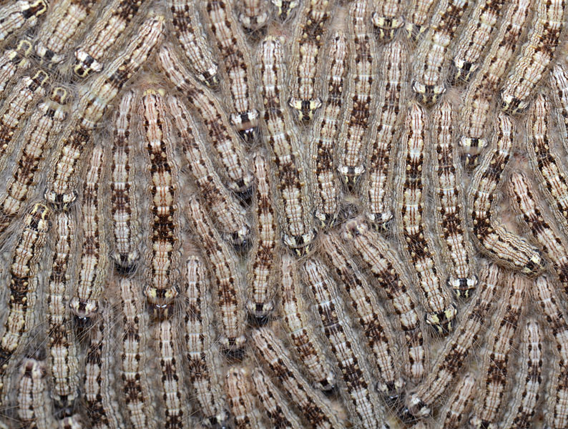
caterpillar

Slide 4
To see a bigger picture

Slide 5
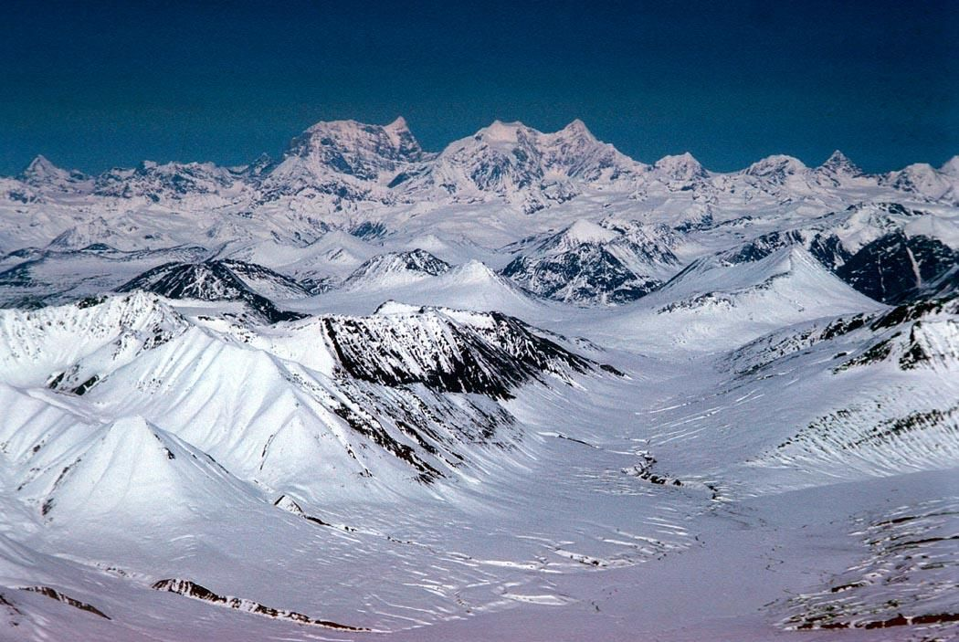

Slide 7
“The whole is more than the sum of its parts.”

Slide 8
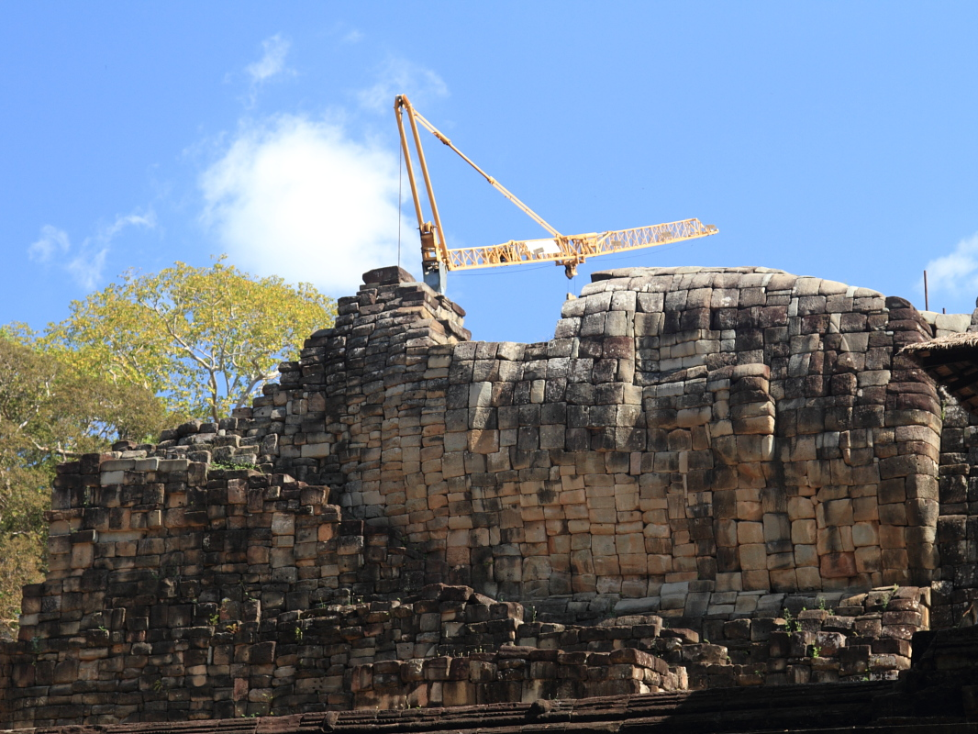
Baphuon Temple, Angkor Thom, Cambodia

Slide 9
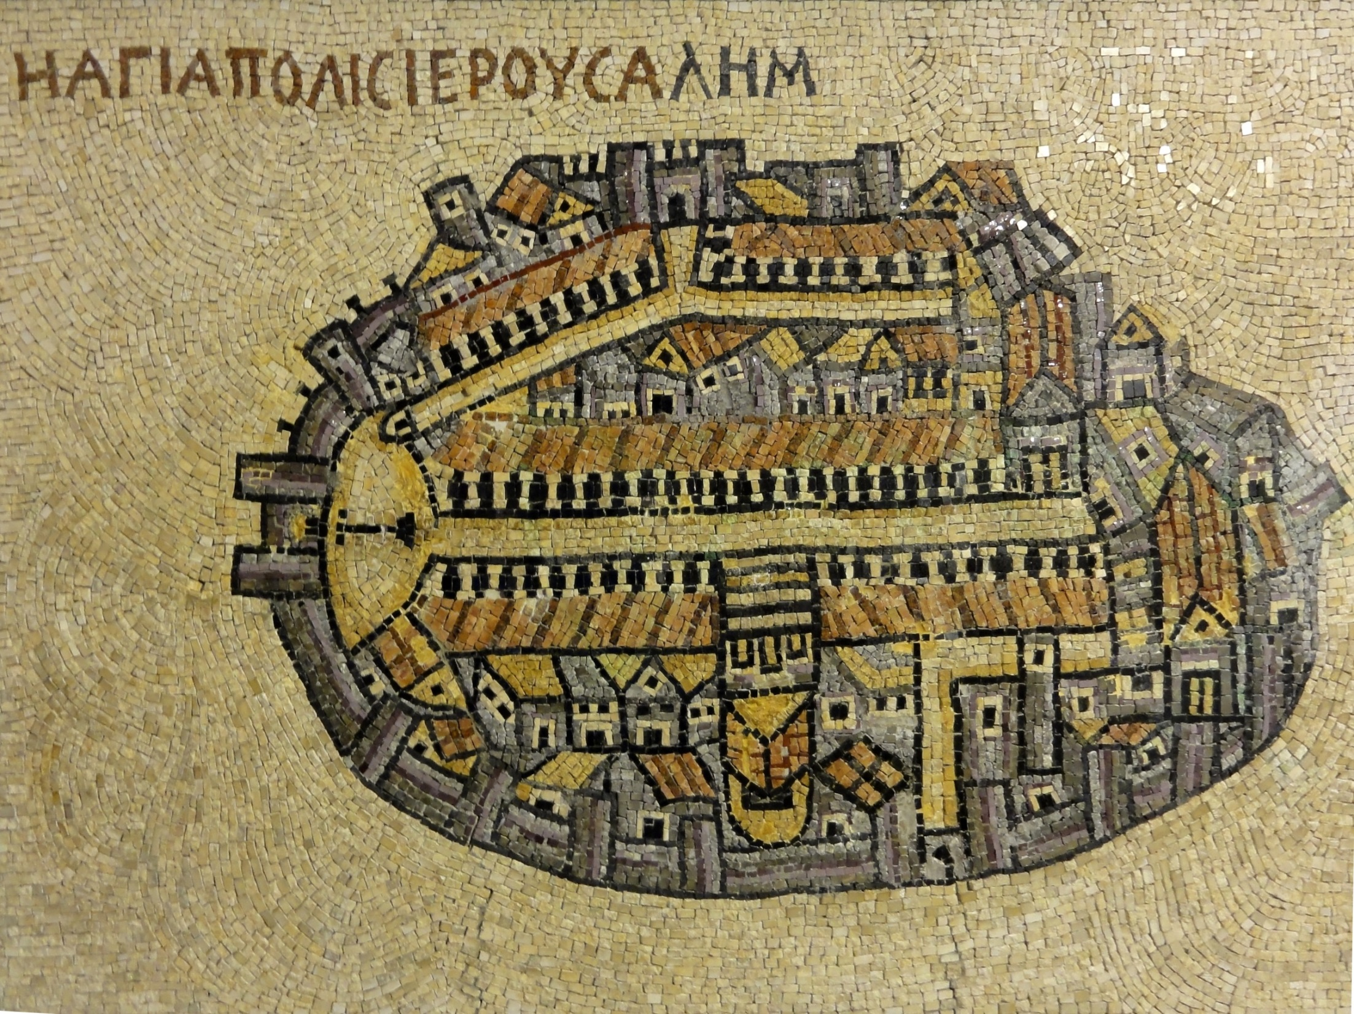
Jerusalem

Slide 10
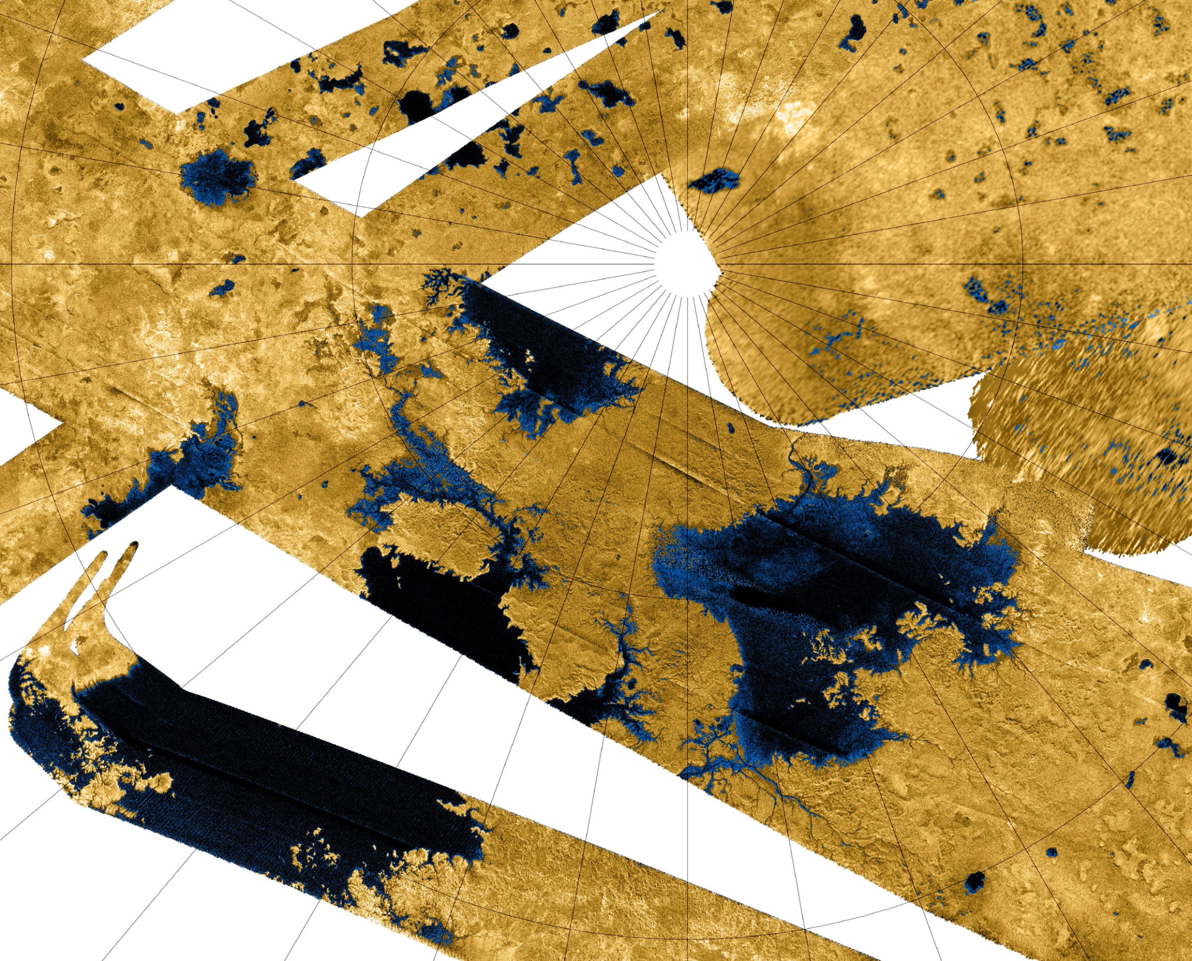
Seas and lakes of Titan, from Cassini mosaic

Slide 11
Greater efficiency in storage and transport.

Slide 12
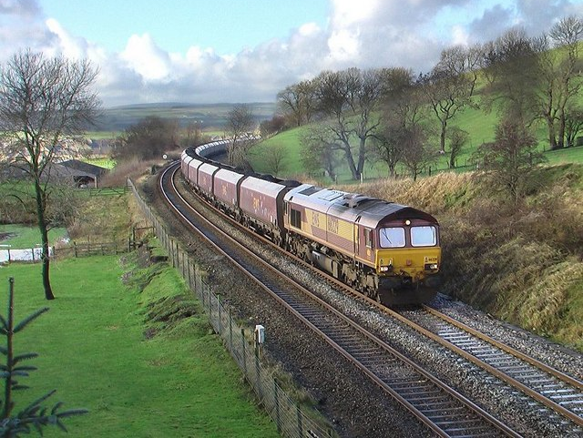
Greater efficiency in storage and transport.

Slide 13
If a tool can only work with a single object, aggregation can combine together into a single object all the information we want the tool to use.

Slide 14
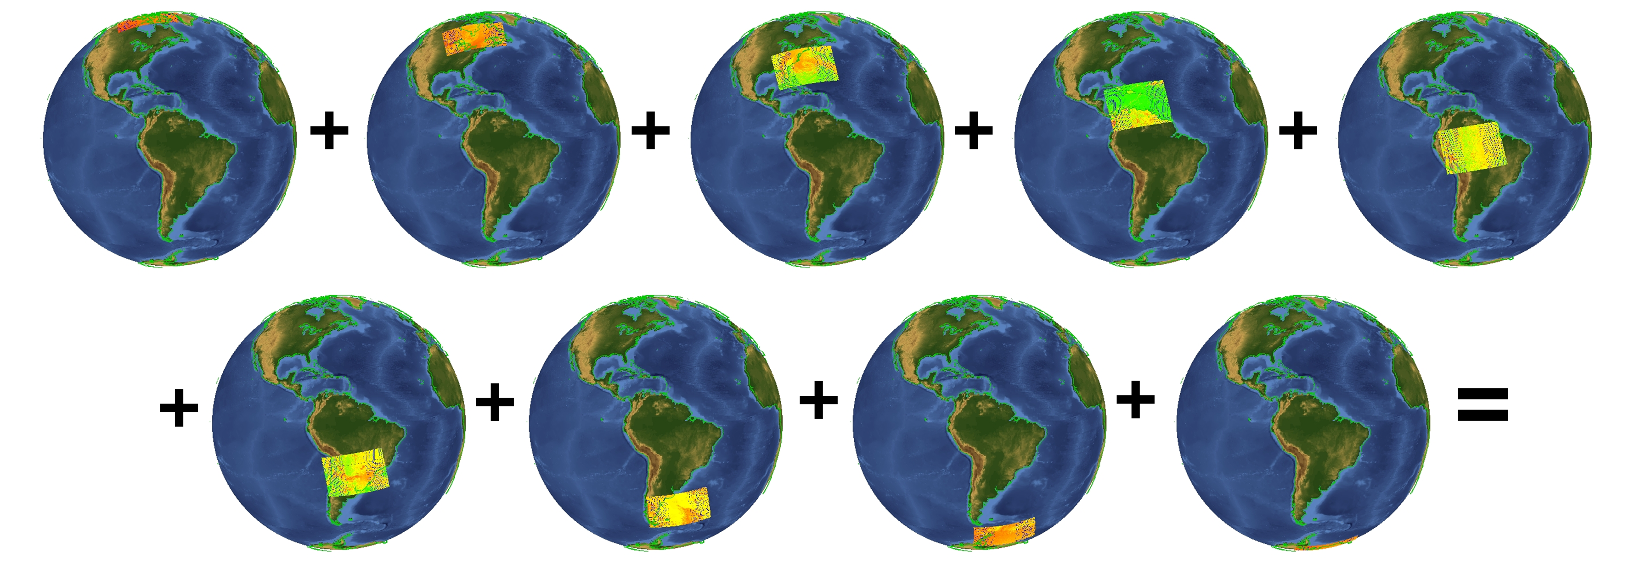

Slide 15
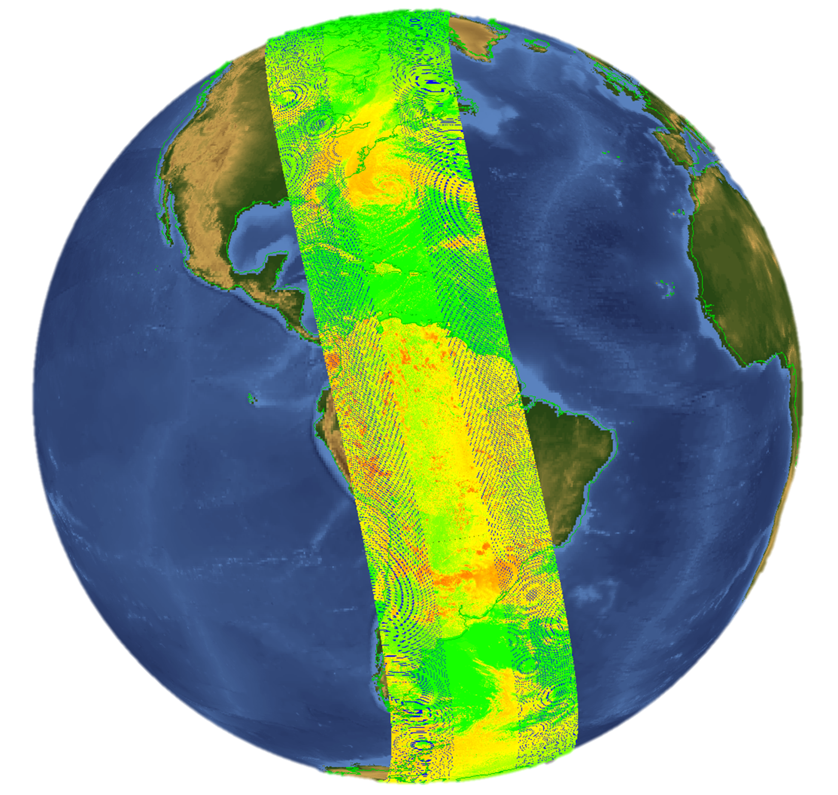

Slide 16
The LEGO effect
If we store items in smaller and simpler packages, this can enable use to aggregate objects in a greater variety of ways.

Slide 17
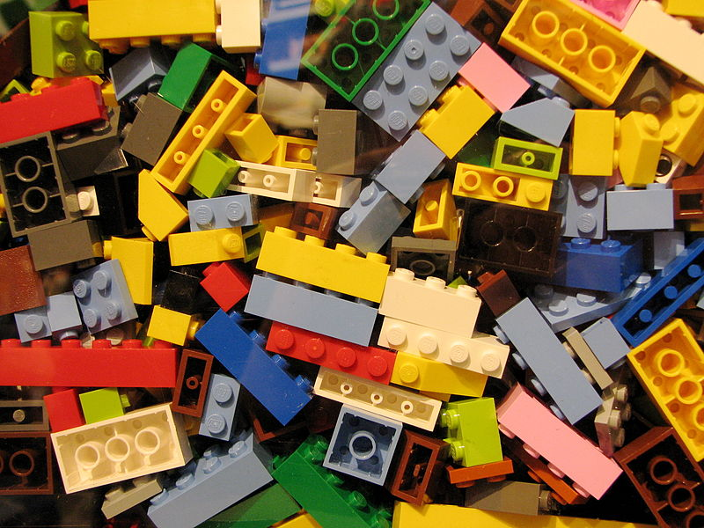

Slide 18
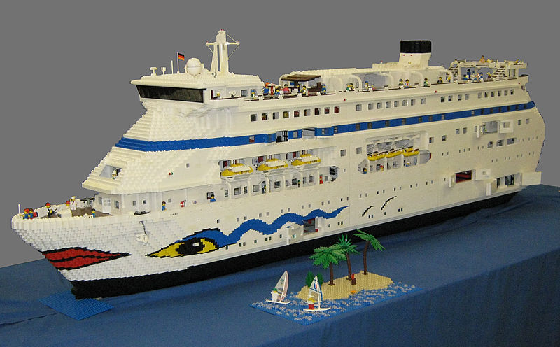

Slide 19
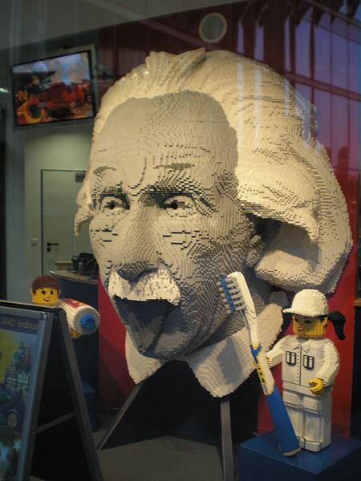

Slide 20
2. Aggregation and HDF

Slide 21
Aggregation in HDF
The H in HDF means hierarchy, which in practice is an aggregation.
A raster image is an aggregation
  Raster image groups were the first aggregation in HDF.
  A raster is an aggregation of scan lines, which are aggregations of pixels.
Grouping:
  Vgroups were the next logical step - a general grouping structure.
  Vdatas aggregating different datatypes together in a single datatype.
  HDF groups enable us to express more than one aggregation, or views, of the same set of objects in a file.
chunking
external storage

Slide 22


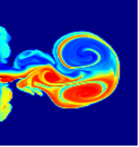
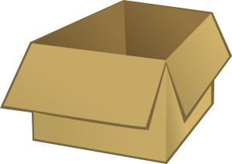

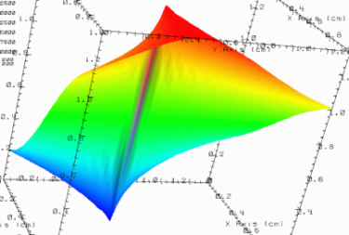
HDF5 groups, datasets and attributes
/
Parameters
10;100;1000
Viz
SimOut
lat | lon | temp
----|-----|-----
12 | 23 | 3.1
15 | 24 | 4.2
17 | 21 | 3.6
Timestep
36,000
Notes:
Aggregation in HDF
The H in HDF means hierarchy, which in practice is an aggregation.
A raster image is an aggregation
Raster image groups were the first aggregation in HDF.
A raster is an aggregation of scan lines, which are aggregations of pixels.
Grouping:
Vgroups were the next logical step - a general grouping structure.
Vdatas aggregating different datatypes together in a single datatype.
HDF groups enable us to express more than one aggregation, or views, of the same set of objects in a file.
chunking
external storage
HDF5 groups, datasets and attributes

Slide 23
Using HDF for aggregation
It's everywhere
Perhaps the most common reason for using HDF is its ability to support aggregation in a very flexible way.

Slide 24
Swath Structure
SWATHS
SwathName:
<name>
Swath_1
…
Swath_2
DataFields:
<name>
Data
fields
Profile
fields
Geolocation
fields
FieldName:
<name>
Longitude
Latitude
Data
field.1
…
Data
field.n
Profile
field.1
…
Profile
field.n
Time
Notes:
Profile: Another type of data that the Swath is equally well suited to arises from a sensor that measures a vertical profile, instead of scanning across the ground track. The resulting data resembles a standard Swath tipped up on its edge.

Slide 25
3. Types of aggregation for remote sensing

Slide 26
Types of aggregation for remote sensing
Temporal: Arranging according to time.
Spatial: Arranging according to space.
Packaging: Grouping a variety of related objects.
An aggregation may consist all instances of an object over the dimensional extent.
Or it may be a sampling of instances of an object over the dimensional extent.

Slide 27
4. nagg

Slide 28
What is nagg?
Nagg is a tool for rearranging NPP data granules from existing files to create new files with a different aggregation number or a different packaging arrangement.

Slide 29
Definitions
Granule
  A grouping of measurements or derived data spanning a defined period (e.g., 28.6 seconds) and integer number of sensor scans.
Geolocation products
  Geolocation information is stored in the same manner as other data.
  Geolocation products may be packaged with data files, or they may be in separate files.
Aggregation¹
  A collection of temporally ordered granules within a JPSS HDF5 file.
  Compatible NPP data products together or with corresponding geolocation product in common files.
  ¹ JPSS Common Data Format Control Book – External Volume I, p 76

Slide 30
Nagg operations
Aggregation
Aggregate data granules
De-aggregate data granules
Re-aggregate data granules
Packaging
Package granules of multiple compatible products in common files
Un-package products into separate files for each product
-g no or –g <product>
Notes:
Two independent operations which can be combined

Slide 31
Nagg operations
Aggregation
Aggregate data granules
De-aggregate data granules
Re-aggregate data granules
Packaging
Package granules of multiple compatible products in common files
Un-package products into separate files for each product
-g no or –g <product>
Notes:
Two independent operations which can be combined

Slide 32
Aggregation
Increase number of granules per aggregation from 1 to 4
Input files (8 + 8 geo)
0:31:12
0:31:44
0:32:16
0:32:48
0:33:20
0:33:52
0:34:24
0:34:56
Geolocation product is processed automatically and packaged with sensor data product by default.
Command:
nagg –n4 –t SATMS SATMS*.h5
Input files:
8 SATMS*.h5 files & 8 GATMO*.h5 files
Output:
Produced 4 granules in GATMO-SATMS_npp_d20120404_t0031123_e0033199_b02251_c20120920193004057328_XXXX_XXX.h5
Produced 4 granules in GATMO-SATMS_npp_d20120404_t0033203_e0035279_b02251_c20120920193004110634_XXXX_XXX.h5
0
0
0
0
0
0
0
0
0
0
0
0
0
0
0
0
SATMS GATMO

Slide 33
Aggregation
Increase number of granules per aggregation from 1 to 4
Input files (16)
0:31:12
0:31:44
0:32:16
0:32:48
0:33:20
0:33:52
0:34:24
0:34:56
Output files (2)
0:31:12
0:31:44
0:32:16
0:32:48
0:33:20
0:33:52
0:34:24
0:34:56
0
0
0
1
2
3
0
1
2
3
0
0
0
0
0
0
0
0
0
1
2
3
0
1
2
3
0
0
0
0
0
0
SATMS GATMO

Slide 34
Nagg operations
Aggregation
Aggregate data granules
De-aggregate data granules
Re-aggregate data granules
Packaging
Package granules of multiple compatible products in common files
Un-package products into separate files for each product
-g no or –g <product>
Notes:
Two independent operations which can be combined

Slide 35
Packaging
Package SATMS,TATMS,GATMO products
Fill granules will be created for missing granules from missing files.
Command:
../nagg –t SATMS,TATMS ../testfiles/SATMS*.h5 ../testfiles/TATMS*.h5
Output (8 files):
Produced 1 granules in GATMO-SATMS-TATMS_npp_d20120404_t0031123_e0031370_b02251_c20120921043859559810_XXXX_XXX.h5
Produced 1 granules in GATMO-SATMS-TATMS_npp_d20120404_t0031443_e0032159_b02251_c20120921043859591107_XXXX_XXX.h5
…
Produced 1 granules in GATMO-SATMS-TATMS_npp_d20120404_t0034563_e0035279_b02251_c20120921043859765891_XXXX_XXX.h5
Input files (22)
0:31:12
0:31:44
0:32:16
0:32:48
0:33:20
0:33:52
0:34:24
0:34:56
0
0
0
0
0
0
0
0
0
0
0
0
0
0
0
0
0
0
0
0
0
0
SATMS TATMS GATMO

Slide 36
Packaging
Package SATMS,TATMS,GATMO products
Input files (22)
0:31:12
0:31:44
0:32:16
0:32:48
0:33:20
0:33:52
0:34:24
0:34:56
Output files (8)
0:31:12
0:31:44
0:32:16
0:32:48
0:33:20
0:33:52
0:34:24
0:34:56
0
0
0
0
0
0
0
0
0
0
0
0
0
0
0
0
0
0
0
0
0
0
0
0
0
0
0
0
0
0
0
0
0
0
0
0
0
0
0
0
0
0
0
0
0
0
SATMS TATMS GATMO

Slide 37
5. Aggregation needs and solutions we would like to see

Slide 38
Types of aggregation for remote sensing
Temporal: Arranging according to time.
Spatial: Arranging according to space.
Packaging: Grouping a variety of related objects.
What else?
What is a granule?
Could there be common vocabulary and model that spans the wide variety of products and types of aggregation?

Slide 39
An aggregation/de-aggregation reference model?

Slide 40
Questions/comments?

Slide 41
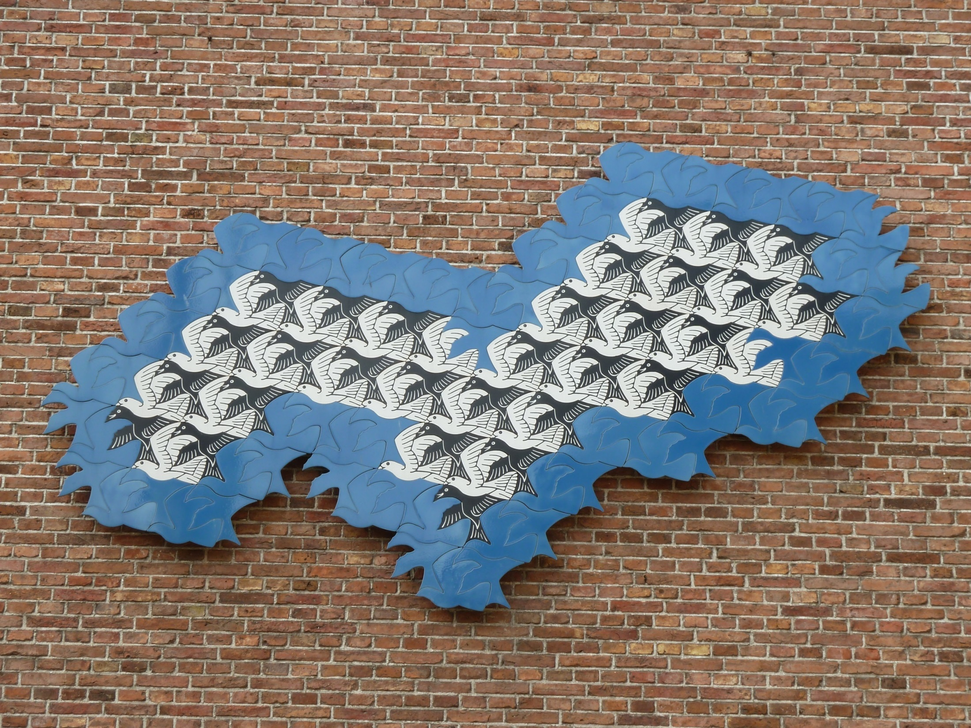
M.C. Escher

