Slide 1
Aggregation/Subsetting
Use Case: Unidata IDD/LDM Data
Ethan Davis
UCAR Unidata

Slide 2
Unidata Use Case
Serving data from IDD/LDM data streams
Real-time data: model, satellite, radar, station, profiles, etc.
  A lot of data, e.g., several radar data records per second
  delete after 7, 30, 45 days depending on data and server

Slide 3
Starting from netCDF data model (array index space)
netCDF and OPeNDAP data models don't understand coordinate systems
  Arrays and index space
  Sequences with constraints
    Lots of limitations when dealing with array index space
  Types of aggregation
    Join on an Existing dimension
    Join on a New Dimension
    Union

Slide 4
Problems with Array Index based Aggregation
Data access/subsetting:
  Client WANTS to deal with coordinate systems
  Client must do some heavy lifting
  rolling archive means the mapping between index space and coordinate space is potentially time dependent
Aggregation:
  Brittle: Data must be VERY homogeneous (any variation breaks things … and there's always variation in real-time data)

Slide 5
Coordinate System and Data Type Aggregation/Subsetting
Aggregation
  Higher-level understanding of datasets allows for improved aggregation.
    Not as brittle.
    Better understanding of needed metadata changes
Subsetting
  Higher-level understanding of datasets allows for services that don't require as much work by client
    Grid: OGC WCS and WMS
    Point, station, profile:
      TDS NCSS, etc.
      OGC SOS and WFS (* Outside implementations)
  Advantages:
    Easier for users/clients
    Can better handle real-time/changing datasets

Slide 6

GRIB storage

Slide 7
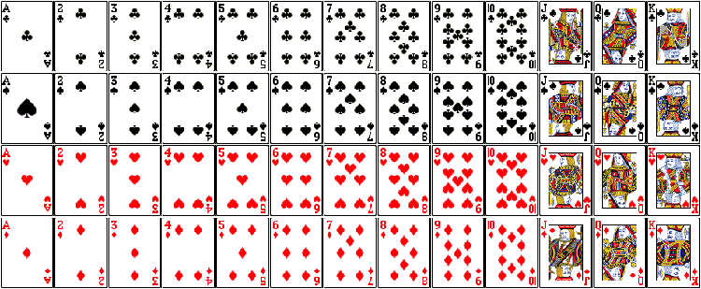
netCDF storage

Slide 8
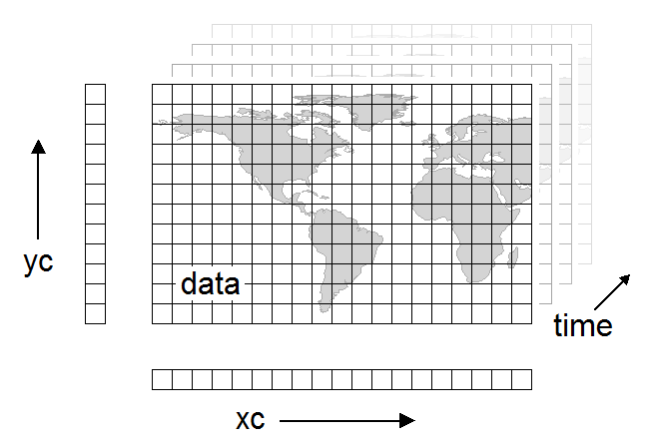
GRIB Rectilyzationologicment
Turn unordered collection of 2D slices into 3-6D multidimensional array
Each GRIB record (2D slice) is independent
There is no overall schema to describe what its supposed to be
  there is, but not able to be encoded in GRIB

