Slide 1
HDF Town Hall
Ted Habermann, The HDF Group
ESIP Summer 2013

Slide 2












Community

Slide 3
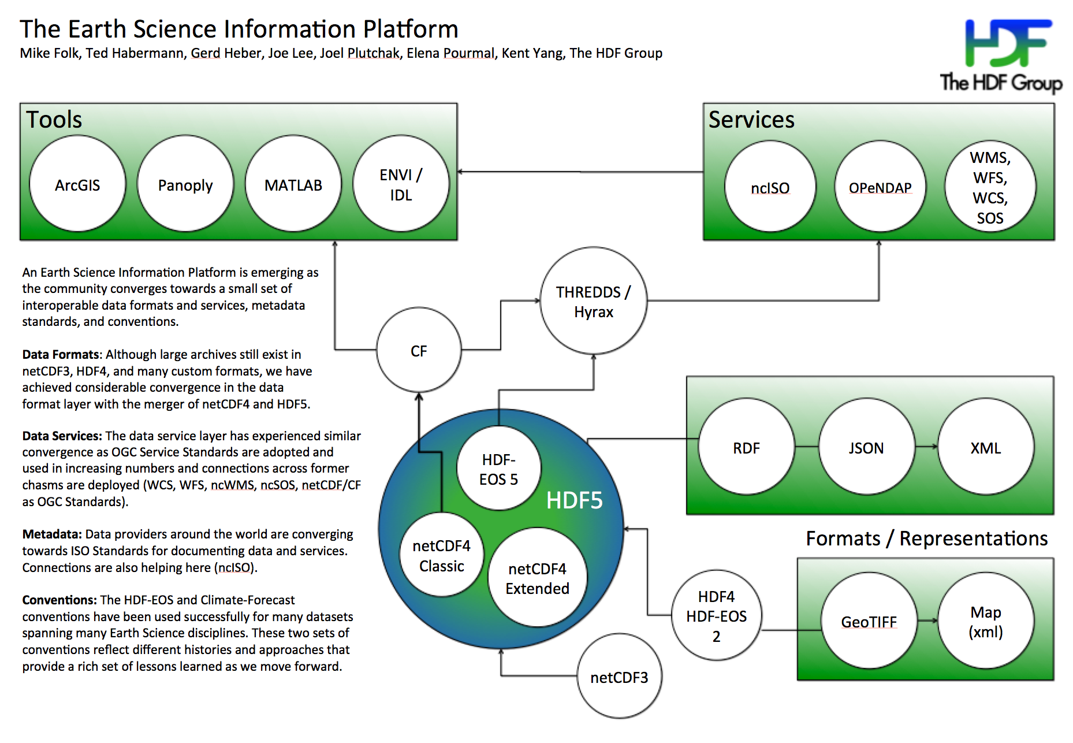
The Earth Science Platform

Slide 4
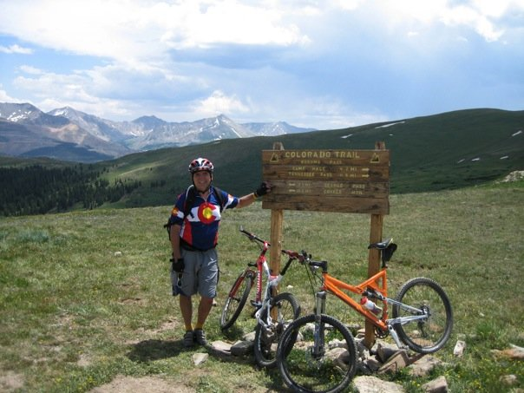
Questions/comments?

