Slide 1
ENVI & IDL Services Engine
For Web-Accessible
Earth Science Applications
ESIP Summer Meeting 2013 – Cool Tools!
Chapel Hill, NC
July 9, 2013
Notes:
This presentation is an overview of Exelis VIS, the business groups we are associated with, how Geospatial Systems fits in the corporate model, and the products we provide and how they can work for you.

Slide 2
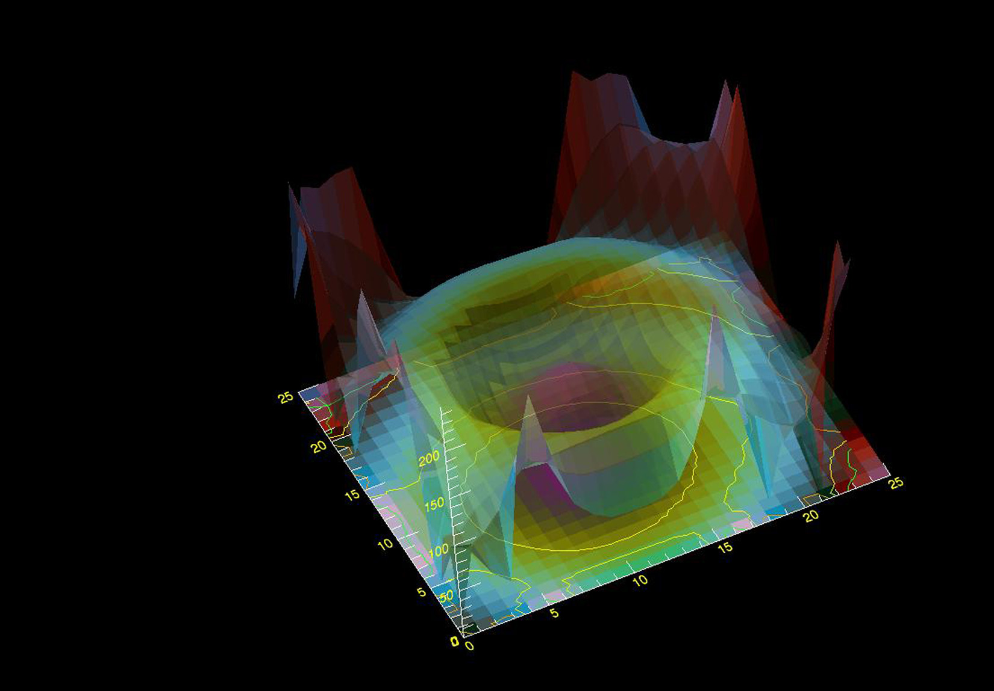

IDL
DISCOVER WHAT’S IN YOUR DATA
Language for Analysis,
Rules, and Conventions
Interactive Graphics
System
Development
Environment
Customize ENVI
Products with IDL
Output File Formats
Notes:
IDL is the trusted scientific programming language used across disciplines to create meaningful visualizations out of complex numerical data. From small scale analysis programs to widely deployed applications, IDL provides the comprehensive computing environment you need to effectively get information from your data.
(Change Slide)

Slide 3
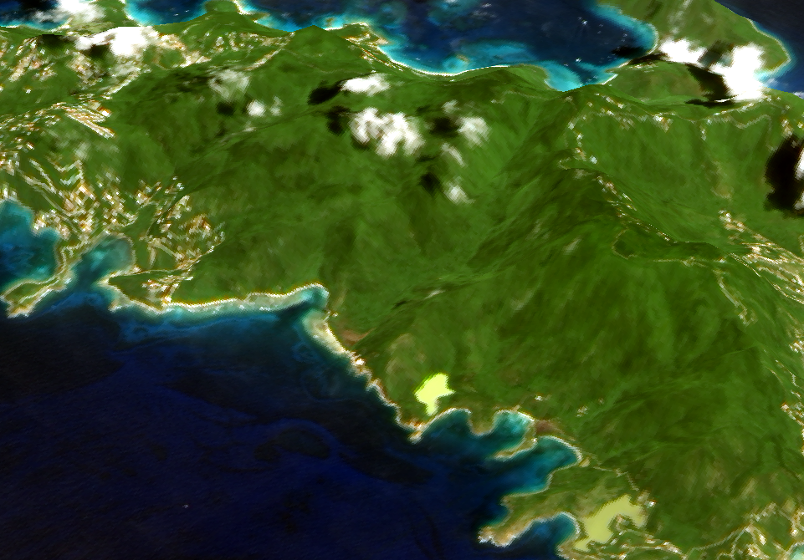
ENVI Platform
IMAGERY AND DATA
BECOME KNOWLEDGE
ENVI
ENVI | LiDAR
ENVI | SARscape
ENVI | Services Engine
Notes:
3D view of Saint John US Virgin Islands - data fusion - ALI image fused with E3De DEM from LiDAR point cloud

Slide 4
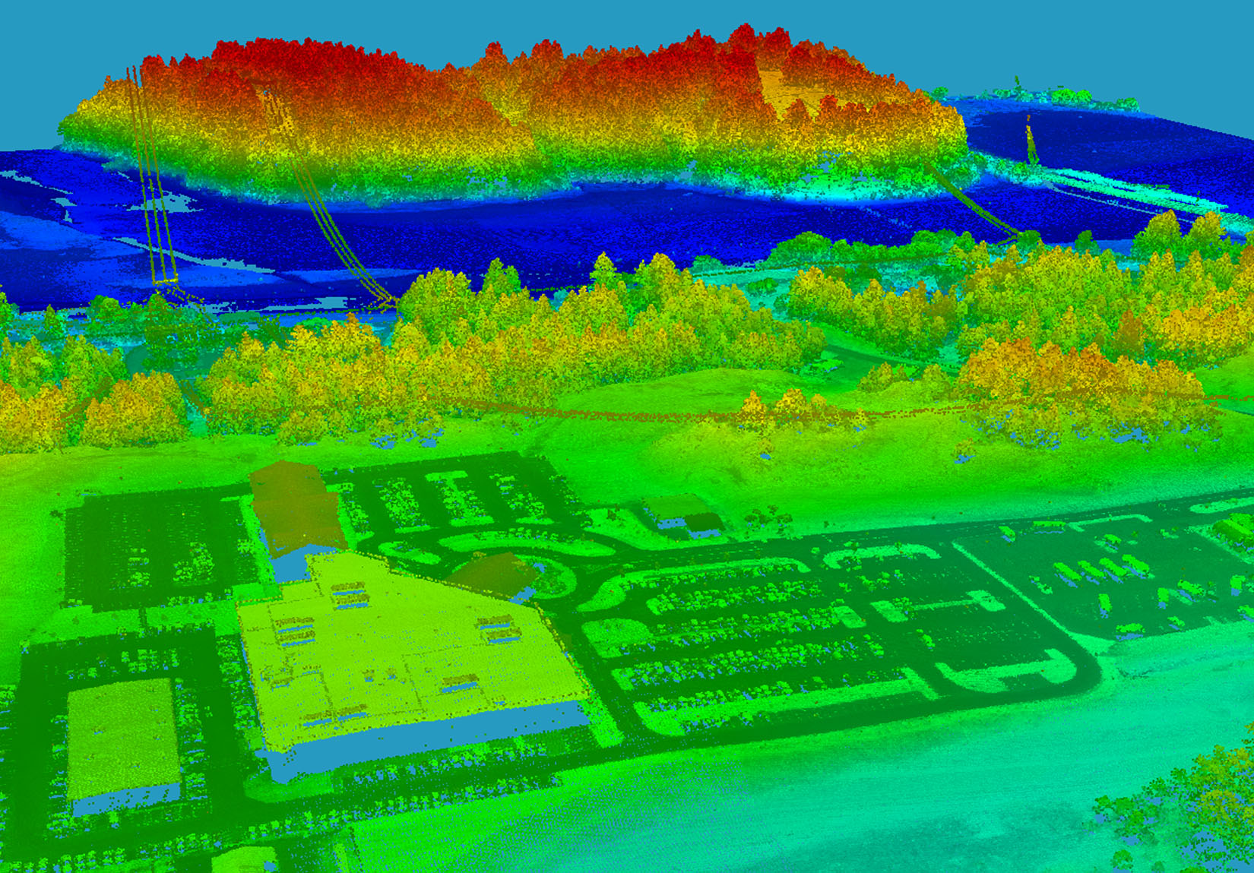
ENVI LiDAR
IMAGERY AND DATA
BECOME KNOWLEDGE
Prepare LiDAR Data for
Geospatial Analysis
Identify & Extract 3D
Features
Export Results to ENVI
and ArcGIS
Notes:
ENVI | LiDAR is an interactive geospatial software environment that allows you use LiDAR data to create powerful, realistic 3D visualizations and easily extract important features and products from your raw LiDAR point cloud data.
(Change Slide)

Slide 5
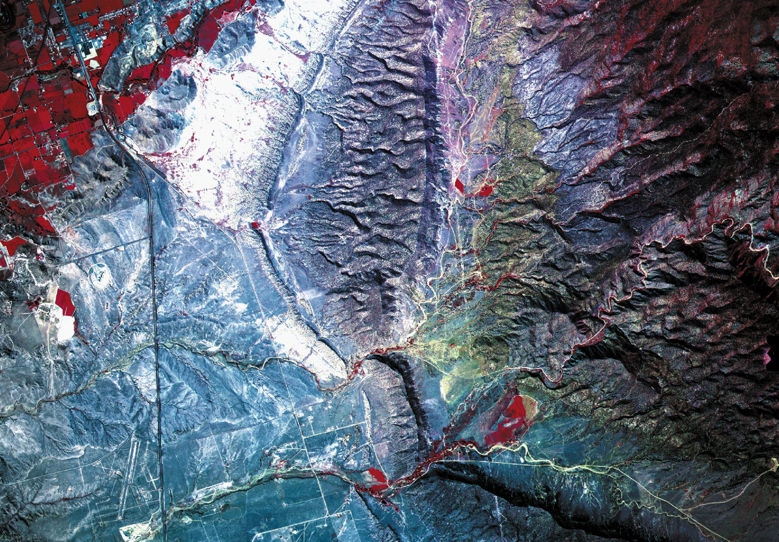
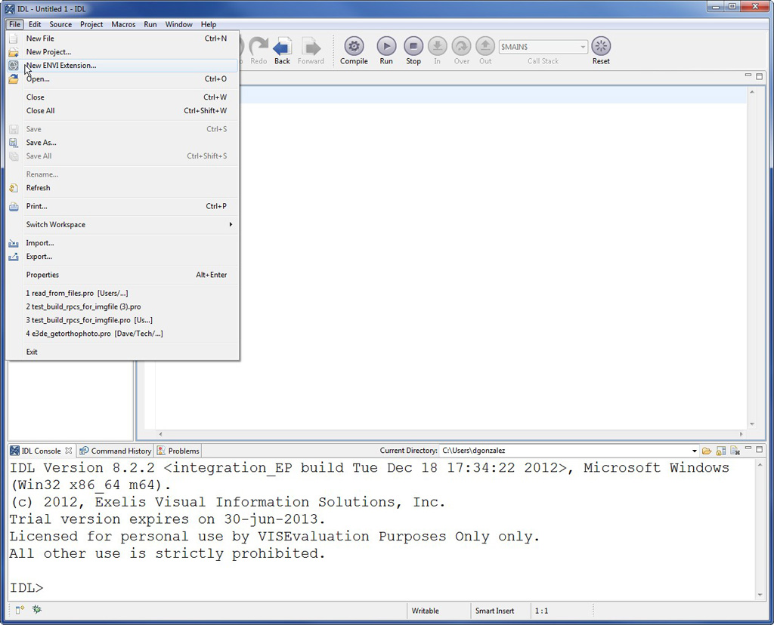
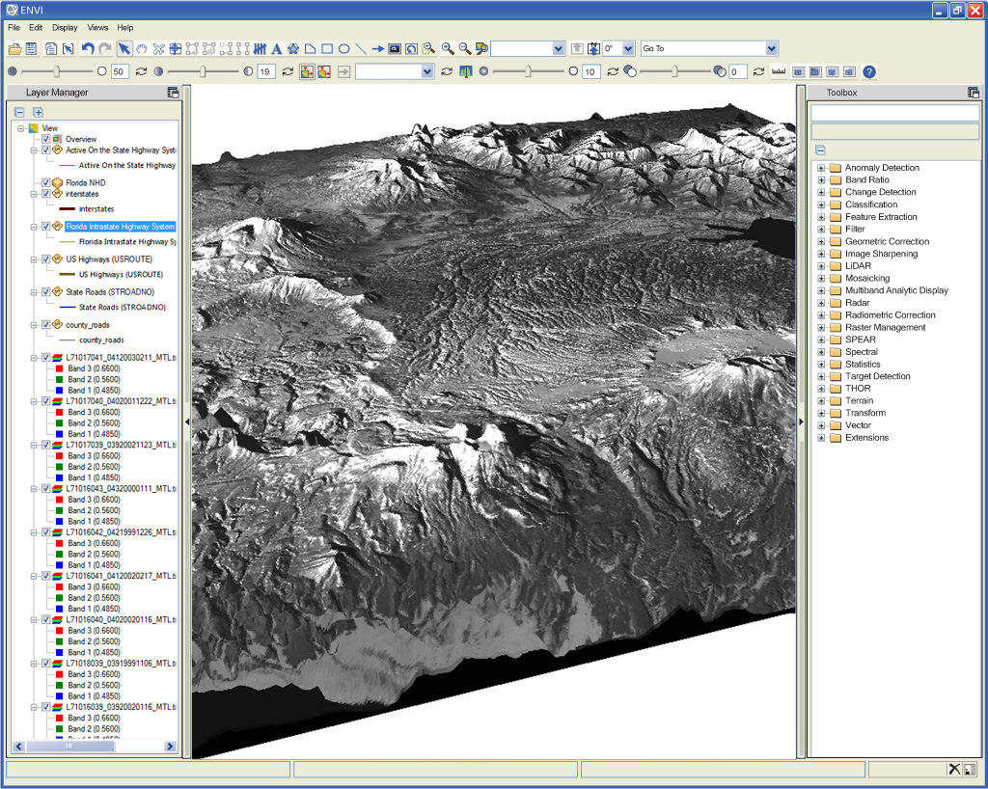
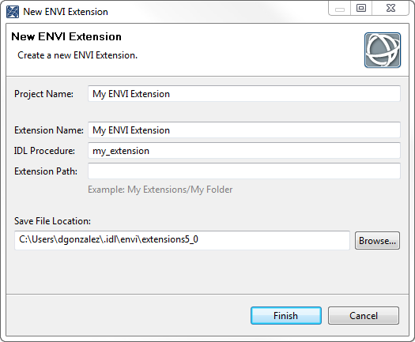
Extending ENVI with IDL
- Custom algorithms
- Batch Processing in IDL using the ENVI API
IDL
DISCOVER WHAT’S IN YOUR DATA
Language for Analysis,
Rules, and Conventions
Interactive Graphics
System
Development
Environment
Customize ENVI
Products with IDL
Output File Formats
Notes:
One of the greatest advantages of using ENVI is the ability to easily extend and customize ENVI functionality with IDL. Use IDL to add your own algorithms, create batch processes, add custom tools, and more.
Image example: IDL tools for easily generating an ENVI extension.

Slide 6
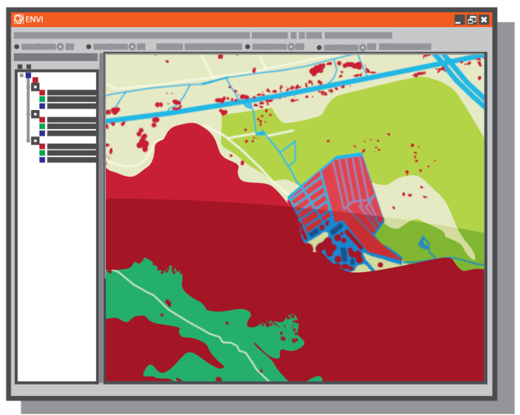

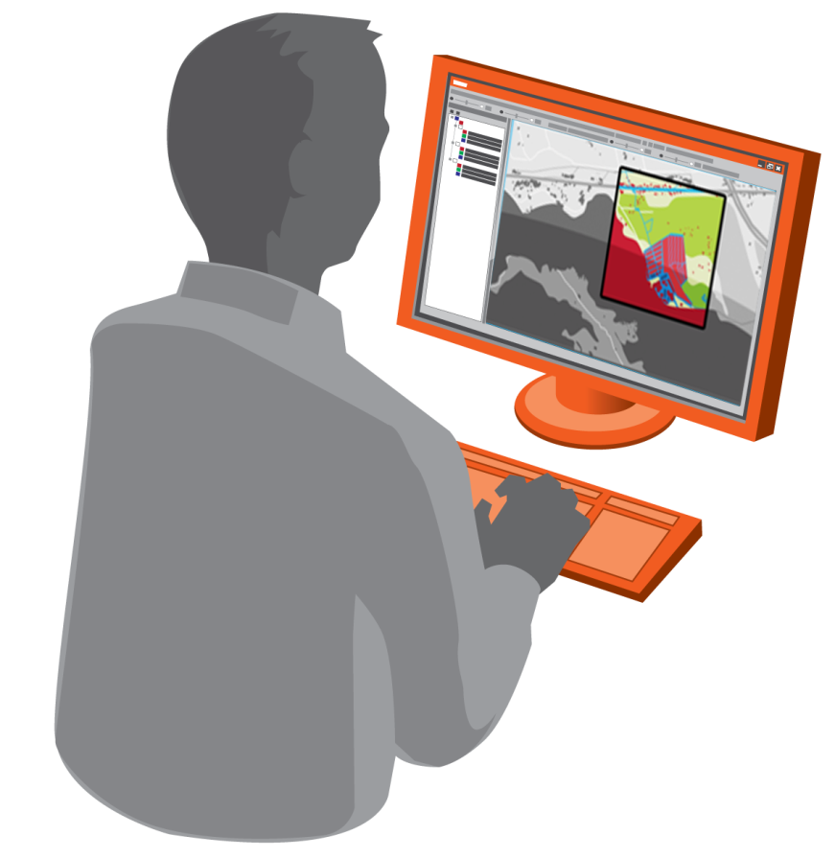



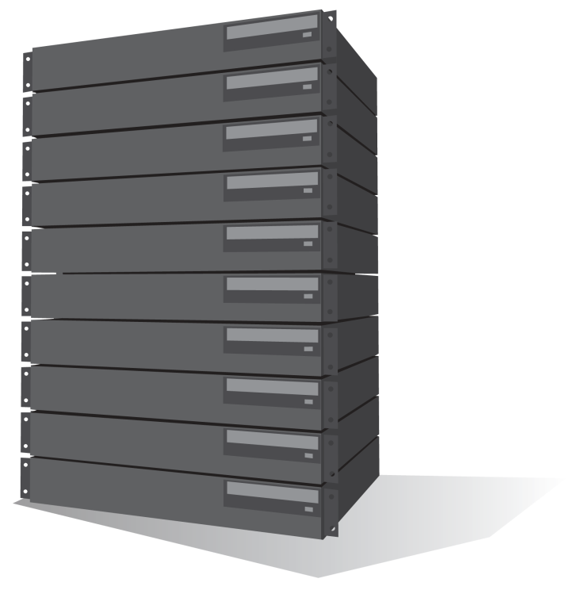



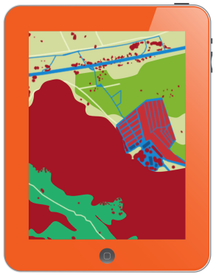


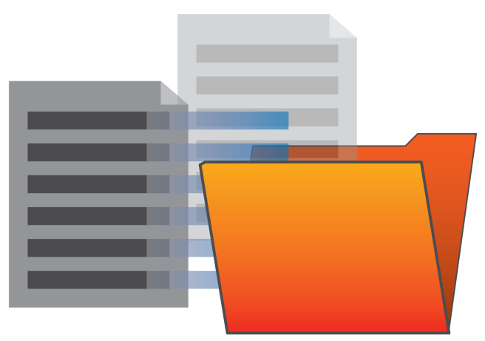

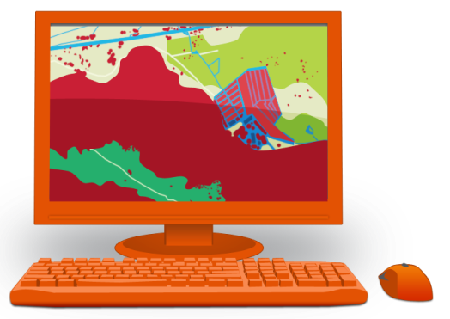
ENVI Services Engine
ENVI Services
ONLINE, ON-DEMAND, GEOSPATIAL AWARENESS
Create
Deploy
Access
Configure seamlessly
with your existing
infrastructure
Create and publish web
deployed image analysis
tools
Consume ENVI from
mobile, web, and thin
clients
Get geospatial imagery
where and when you
need it
Notes:
As the demand for access to geospatial information grows, the need for new and more efficient ways to deliver information to those who need it most becomes more important. That's why Exelis Visual Information Solutions created ENVI Services Engine, a cloud-based image analysis solutions that allows your organization to create, publish, and deploy advanced ENVI image and data analytics to any existing enterprise infrastructure.

Slide 7

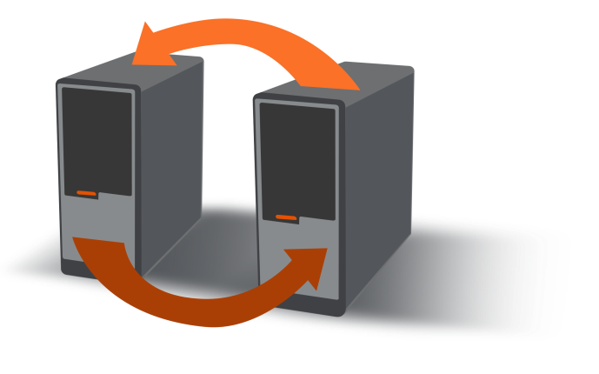
Configure seamlessly with your existing infrastructure
ENVI Services
ONLINE, ON-DEMAND, GEOSPATIAL AWARENESS
EXISTING INFASTRUCTURE
Configure seamlessly
with your existing
infrastructure
Create and publish web
deployed image analysis
tools
Consume ENVI from
mobile, web, and thin
clients
Get geospatial imagery
where and when you
need it
Notes:
Configure seamlessly with your existing infrastructure
ENVI’s cloud based solutions are middleware independent, meaning you can integrate enterprise level image analysis capabilities without having to re-configure your existing architecture. Based on HTTP REST, ENVI Services can be called by any middleware component via a RESTful call, and return derived products such as shapefiles or rasters direct to a directory of your choosing for further analysis or for dissemination as a web service.
(Change Slide)

Slide 8
Create and publish web deployed image analysis tools
ENVI Services
ONLINE, ON-DEMAND, GEOSPATIAL AWARENESS
Create
Deploy
Configure seamlessly
with your existing
infrastructure
Create and publish web
deployed image analysis
tools
Consume ENVI from
mobile, web, and thin
clients
Get geospatial imagery
where and when you
need it
IMAGE ANALYSIS SERVICES
ENVI
IDL
Python
Java
C++
Others
OTHER SERVICES
STORAGE / SERVER
DATA
APPS
MIDDLEWARE
BUSINESS LOGIC
App Developer
Notes:
Create and publish web deployed image analysis tools
One of the main benefits of deploying image analytics in the cloud is the ability to run complex, resource intensive analysis on extremely large datasets from thin or mobile clients. By moving the analysis to the data, the need for high-powered, localized clients is eliminated in favor of lightweight applications that can call analysis functions via the web.
Another benefit to deploying image analytics in the cloud is collaboration among disconnected users with the use of a centralized repository for data and analysis functionality. In many instances, users from different parts of the same organization may use different software packages to conduct similar work. This can result in inconsistent workflows, erroneous results, and even incompatible outputs. A single deployment of a vetted analysis software package provide your organization with consistent and repeatable processes.
(Change Slide)

Slide 9
Consume ENVI from mobile, web, and thin clients
ENVI Services
ONLINE, ON-DEMAND, GEOSPATIAL AWARENESS
Access
Deploy
Configure seamlessly
with your existing
infrastructure
Create and publish web
deployed image analysis
tools
Consume ENVI from
mobile, web, and thin
clients
Get geospatial imagery
where and when you
need it
IMAGE ANALYSIS SERVICES
Web
OTHER SERVICES
STORAGE / SERVER
DATA
Mobile
MIDDLEWARE
BUSINESS LOGIC
Desktop
Notes:
Consume ENVI from mobile, web, and thin clients
Once you have configured your architecture and created image analysis services to be served via the web, you can then embed the ability to call your server’s functionality from your mobile app, web based viewer, or thin client. Functional calls can be made direct to ENVI Services via HTTP REST, or routed through your middleware via standards based specifications such as Open GeoSpatial Consortium OGC Web Services or Esri’s Open GeoServices REST Specification.
(Change Slide)

Slide 10
ENVI & IDL Services Engine Applications
IDL and ENVI Processing Close to Data Archives
Format conversion
Image stretching
RGB Band Combination
Data subset
On-demand scientific processing

Slide 11





  On-demand Processing within the EOSDIS Architecture Framework
Science Data System Functions
Level Zero Processing
Science Processing
Archive
Discovery
& On-demand Processing
Users
Commercial
MEaSUREs
S4PA
Data Center Unique
Browser
EDOS
SIPSs
DMAS
OPENDaP
SCFs
ANGe
GCMD
Mobile
Cutom PI
ECS
Echo
ENVI & IDL Services Engine
On-Demand Processing for Scientific Discovery
Workstation
Applications
ENVI/IDL Processors
HTTP
REST
Native Processors
ENVI
IDL
Java
C++
Other
Application
Publishing
Adapted from: Behnke, 2010, ESIP Federation Meeting

Slide 12




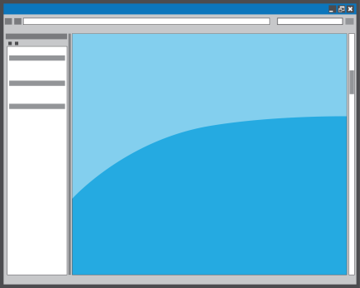




Integrating ENVI & IDL Services with GeoServer
Deployment in the Enterprise
App Developer
Service Interface
Apps
Browser
ENVI & IDL Services Engine Processors
HTTP
REST
WMS
WPS
WCS
WFS
C-WS
ENVI
IDL
Python
Java
C++
Others
Mobile
Middleware
Implements Services
Calls underlying functionality
Java Enterprise/
ArcGIS Server/GeoServer
Services
Data Store
Workstation
Applications
  Developers create apps with ENVI+IDL, Python, or other development tools and publish them to the engine
  Middleware agnostic design integrates through HTTP
  ENVI Services Engine manages ENVI+IDL processes
  End users interact via their interface of choice
  Discrete online apps simplify updates to users
Notes:
The ENVI Services Engine (ESE) provides rich Analytics from imagery to support geospatial data processing and visualization in ArcGIS by working with ArcGIS Server to support server based processing of imagery, LIDAR, terrain and GIS data and then serve the data to desktop and mobile clients using the power of ArcGIS for Server.
ESE is OGC compliant and supports WMS, WPS, WCS and WFS, allowing users to chain together algorithms for robust workflows and then stream the results to clients.

Slide 13
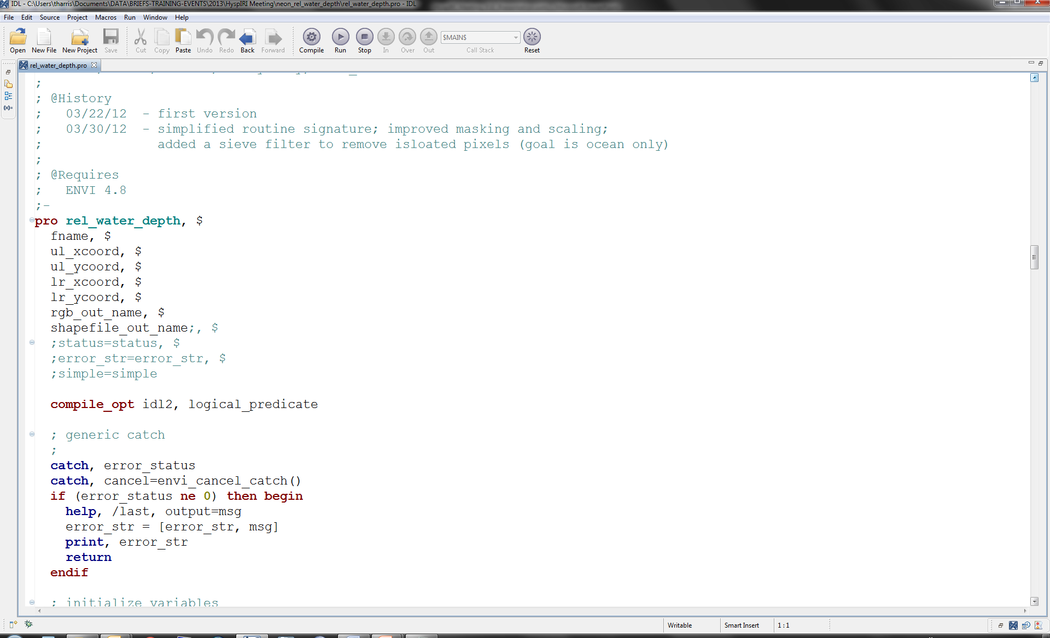
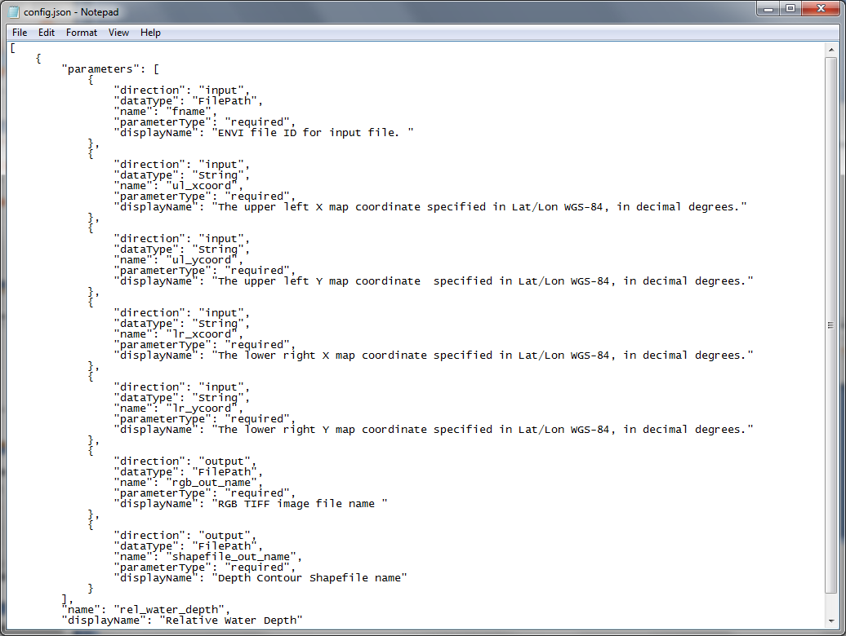
ENVI & IDL Services Engine
IDL Application Deployment Model

Slide 14
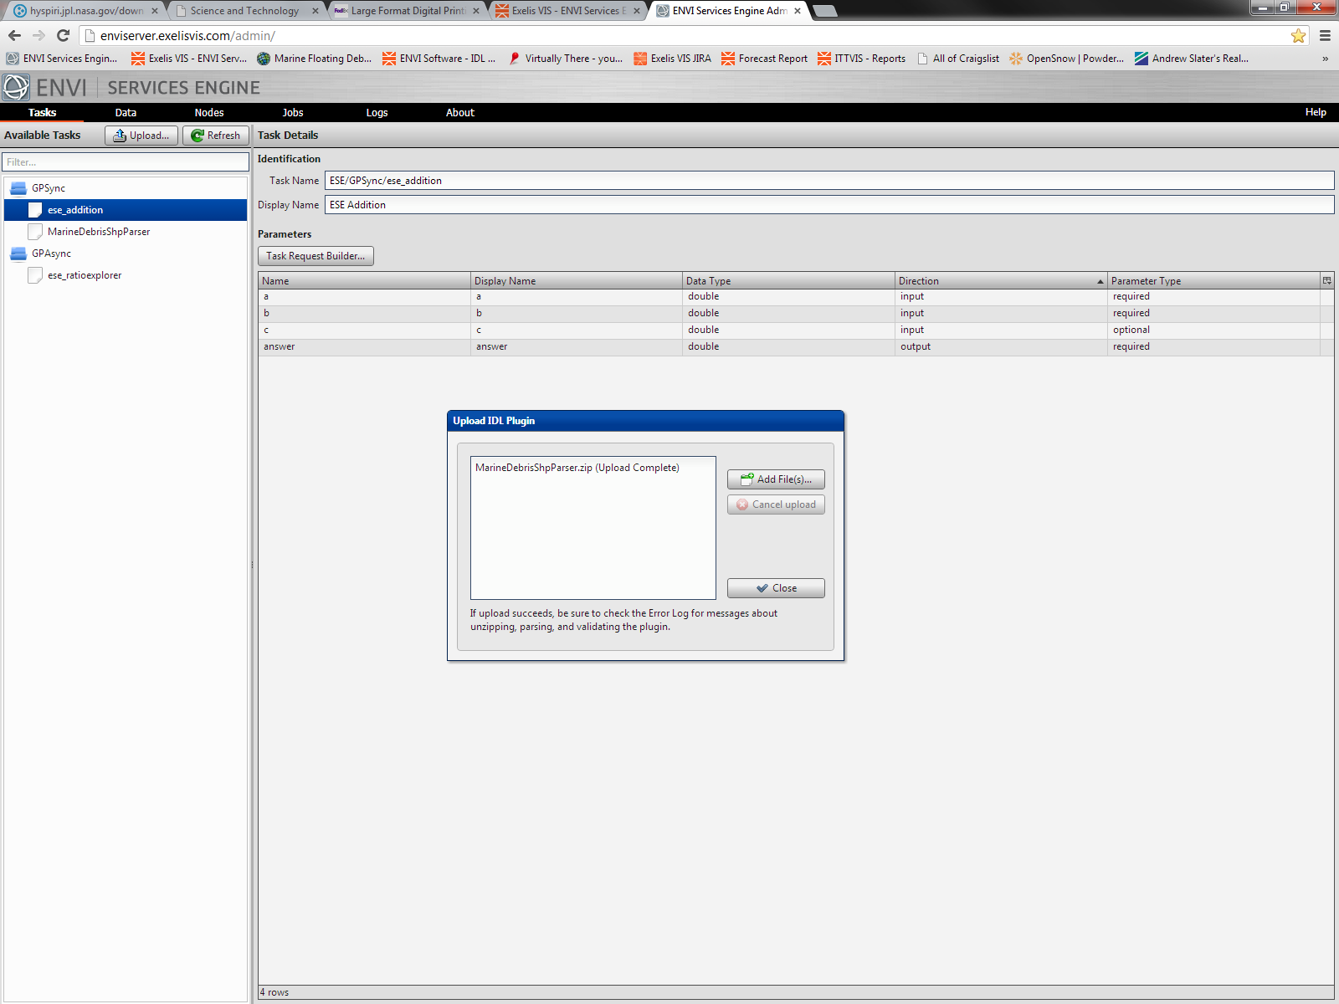
RelativeH2O.zip (Upload Complete)

Slide 15
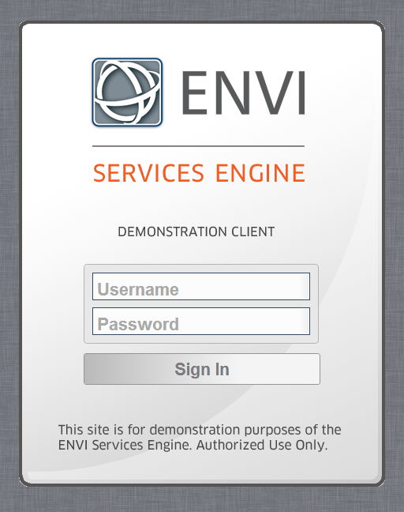

Slide 16
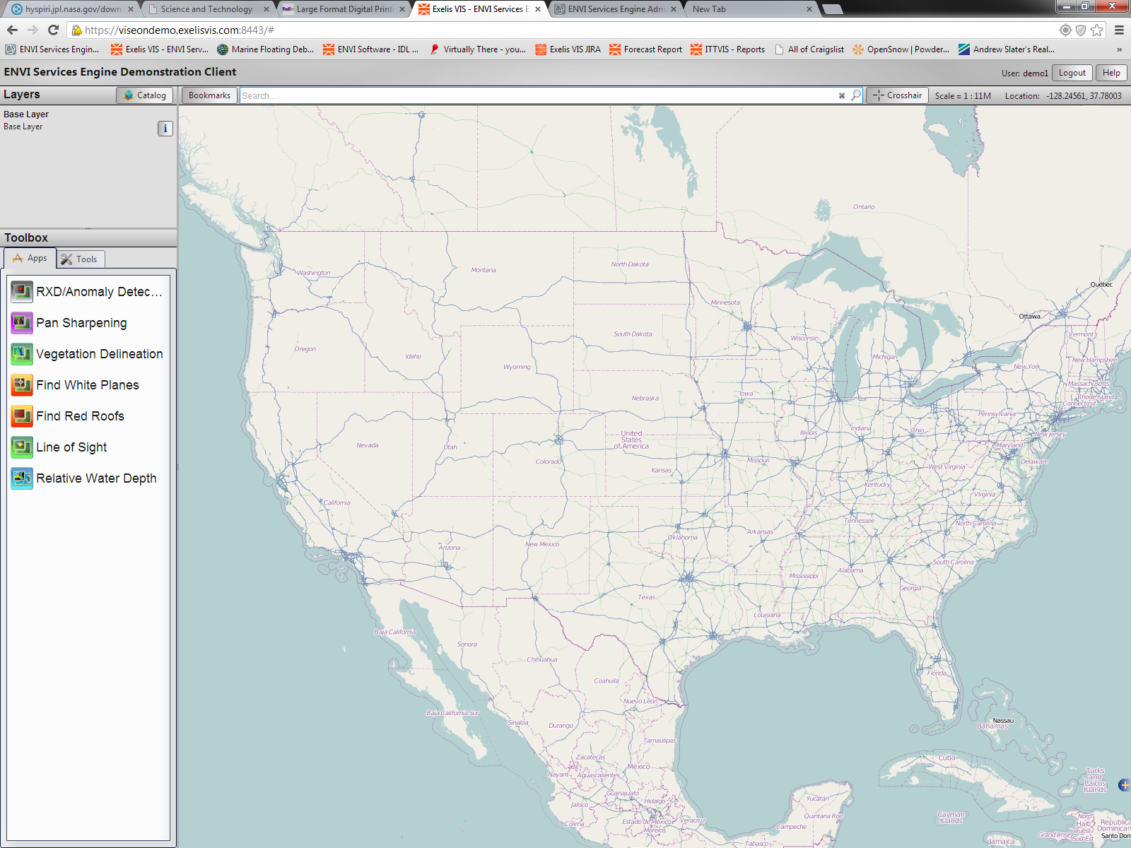

Slide 17
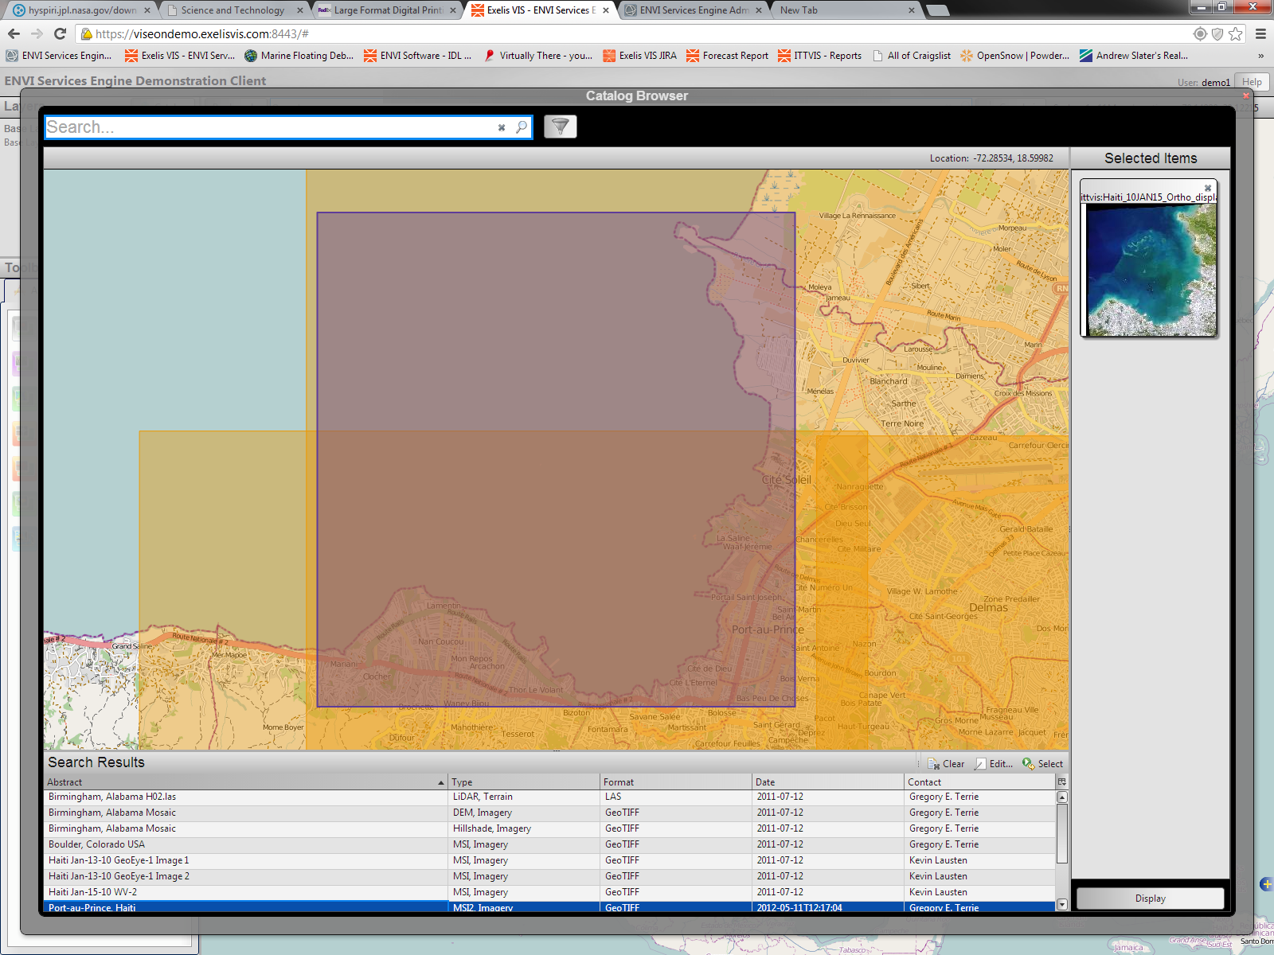

Slide 18
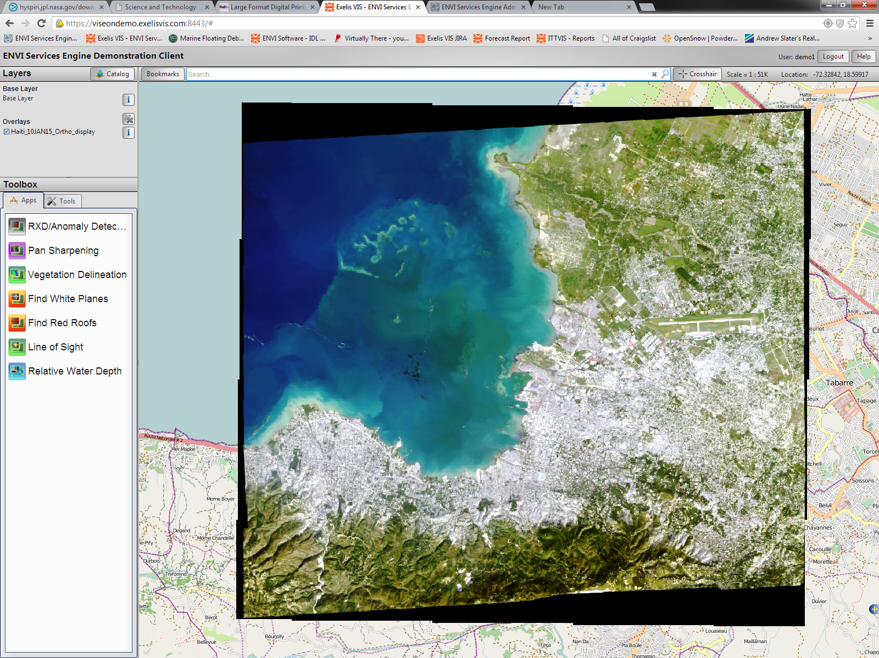

Slide 19
